Slide 1
GPU applications for supermassive computing: status and perspectives
Piero Vicini - INFN
(piero.vicini@roma1.infn.it)

Slide 2
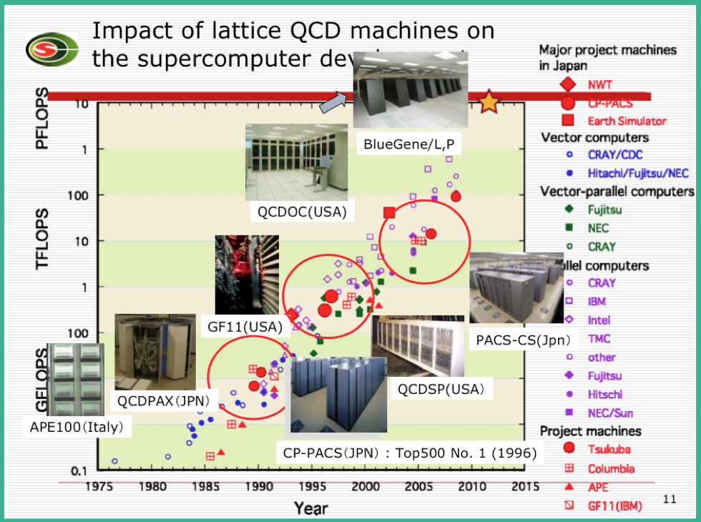
LQCD (Lattice Quantum Chromo Dynamics)
The physical problem: QCD phase diagram and confinement
  Low energy QCD and confinement are intrinsically nonperturbative phenomena.
  In Lattice QCD a finite lattice is introduced as a nonperturbative gauge invariant regulator and observables are calculated by using Monte Carlo simulations.
The numerical problem
  In a LQCD simulation a lot of L × L linear systems have to be solved, with L ∼ 10⁵ ÷ 10⁶ (!)
    Need for dedicated high performances supercomputer (APE, Blue-Gene,…)
Alghorithmic peculiarities
  Homogeneity
    Ideally suited for SIMD parallelization on many core architectures
  Locality
    Parallel machine efficent scaling through the adoption of low latency 3D Torus network
4x3 complex
elements spinor
3x3 complex
elements SU3 matrix

Slide 3
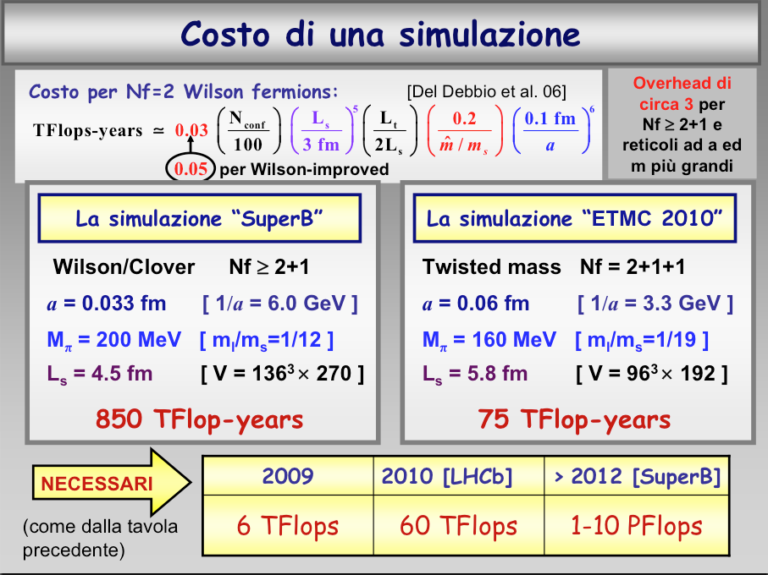
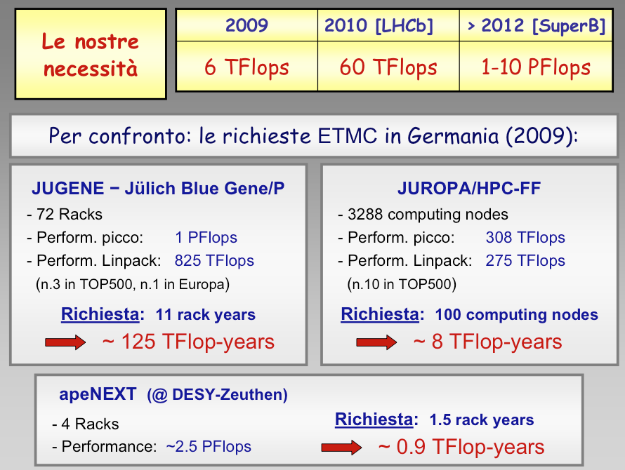
INFN computing requirements for the next years
V. Lubicz – CSN4 talk, settembre 2009
Compute intensive physics
  ~ 0.01-1 Pflops for single research group
  ~ 0.1-10 Pflops nationwide
and beyond LQCD…
  2D Spin models, Bio-Computing, Gravitational wave analysis, Complex systems, 2D/3D Fluid Dynamics, Montecarlo for medical and space sciences, …

Slide 4
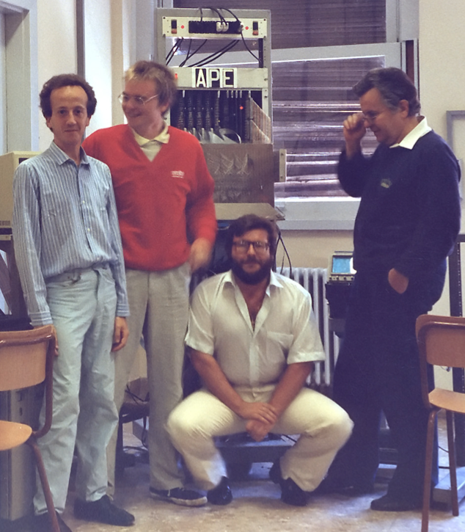
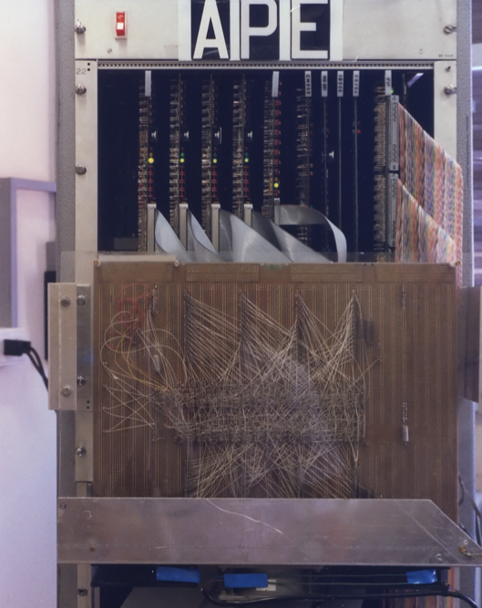
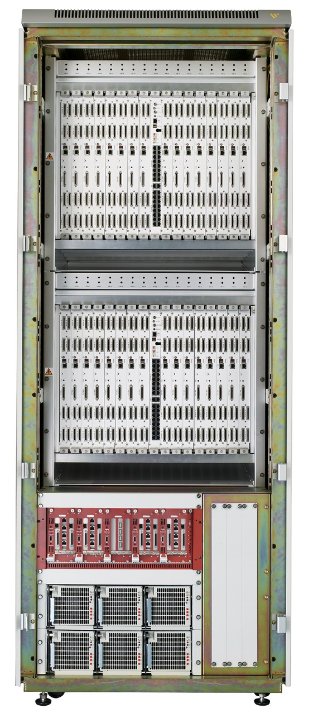
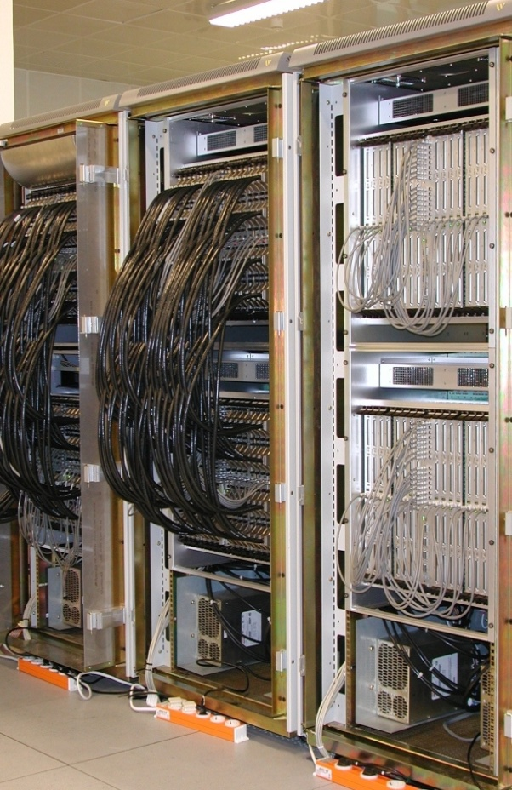
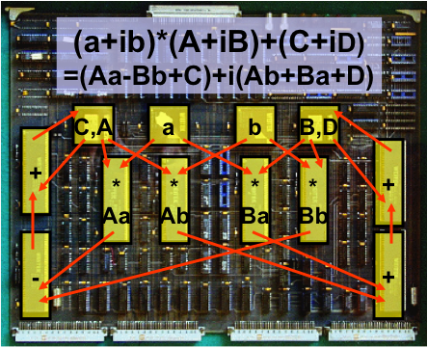
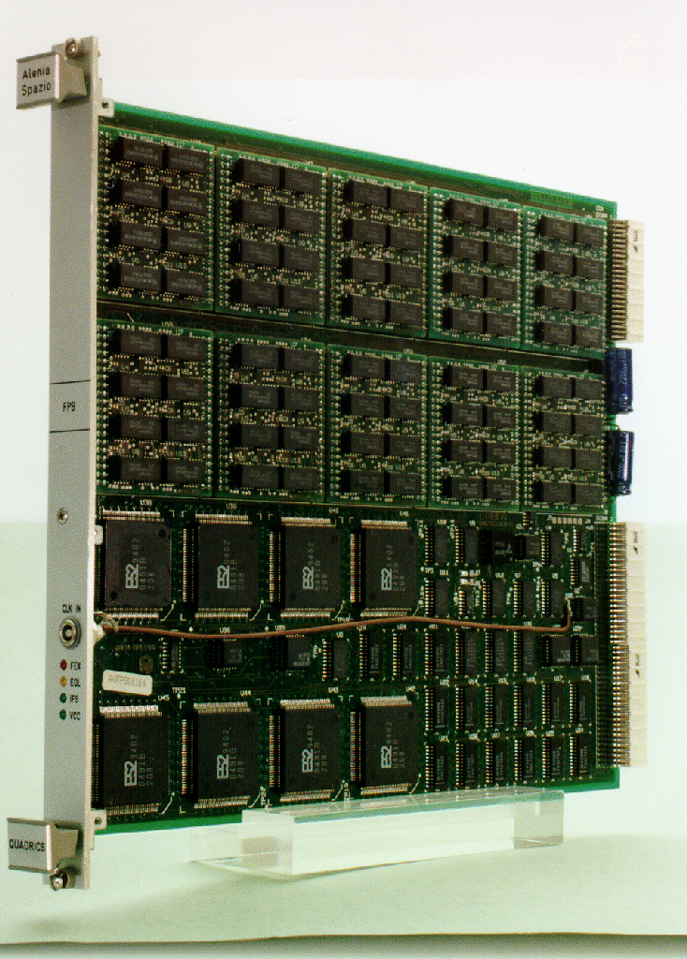
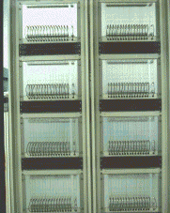
A little bit of history: from APE1 to apeNEXT
APE1 (1988) 1GF, chipset Weitek
APEmille (1999) 128GF, SP, Complex
Italy+France+Germany collaboration
apeNEXT (2004)
800GF, DP, Complex
APE100 (1992) 25GF, SP, REAL
“Home made” VLSI processors

Slide 5
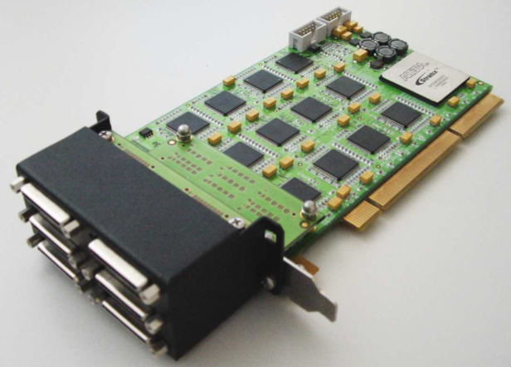
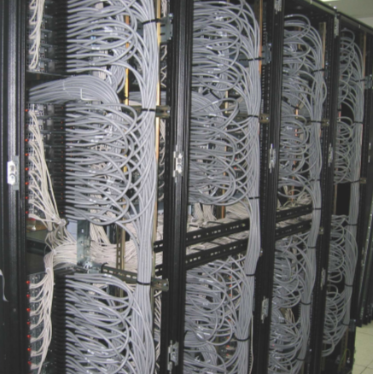
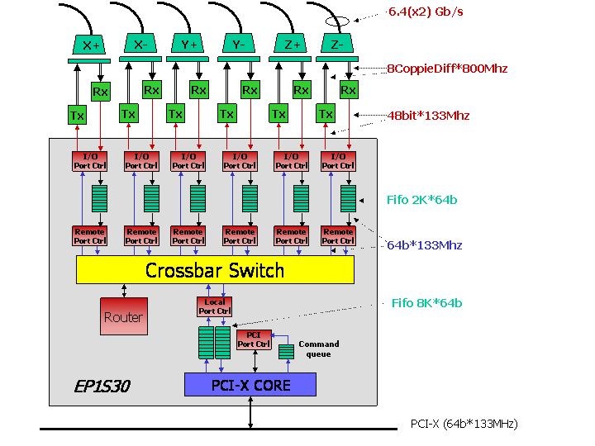
A little bit of history: apeNET
APEnet: PC Cluster 3-d torus network
  Integrated routing and switching capabilities
  High throughput, low latency, “light-weight” protocol
  PCI Interface, 6 Links full-bidir on torus side
History
  2003-2004: APEnet V3 (PCI-X)
  2005: APEnet V3+
    same HW with RDMA API
  2006-2009: APEnet goes embedded
    DNP, D(istributed) N(etwork) Processor
    EU SHAPES project co-development
  2011: APEnet+
    PCI Express, enhanced torus links

Slide 6
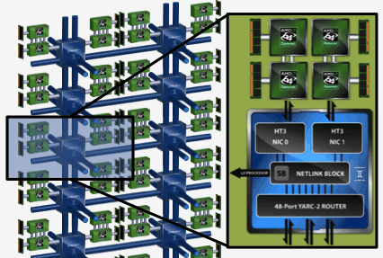
The (many) millions dollar question….
Time changes but some facts are still true..
The hunger for floating point computing power remains unchanged
Towards the ExaFlops, main keywords remain unchanged
  Floating Point Engine allowing efficient execution of scientific applications
  Smart and efficent specialized interconnection system to scale up to systems made of huge number of computing nodes (100-10000-100000-….)
  Dense and robust low power system assembly required
NRE costs for custom developments of ASICS, systems, networks reached absurd high levels….
So the question is:
can we use commodities technologies to meet
the demands of computing power of modern scientific applications?
i.e. 3D Torus
Cray Gemini is a 3D Torus network quite similar to APE (sigh…)

Slide 7
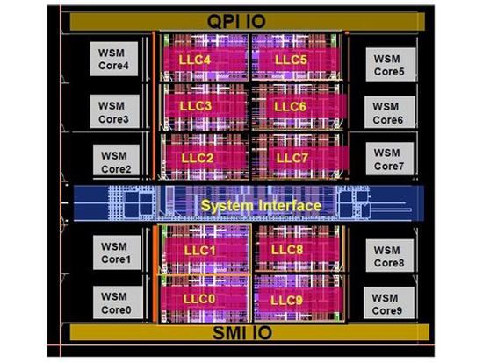
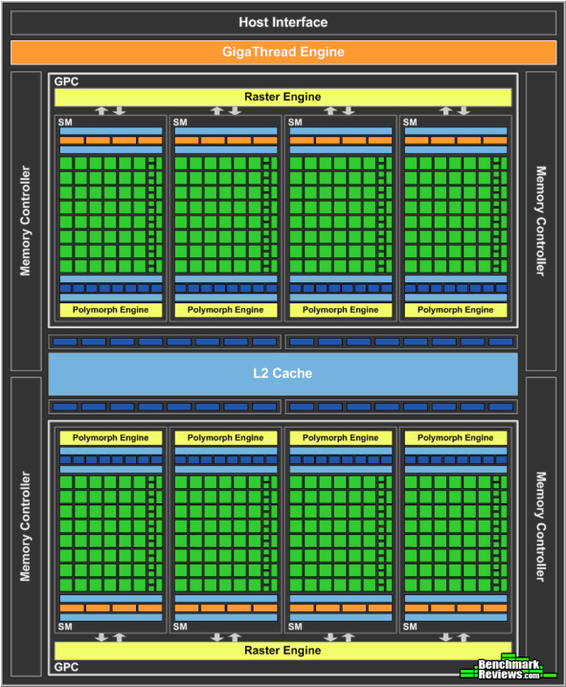
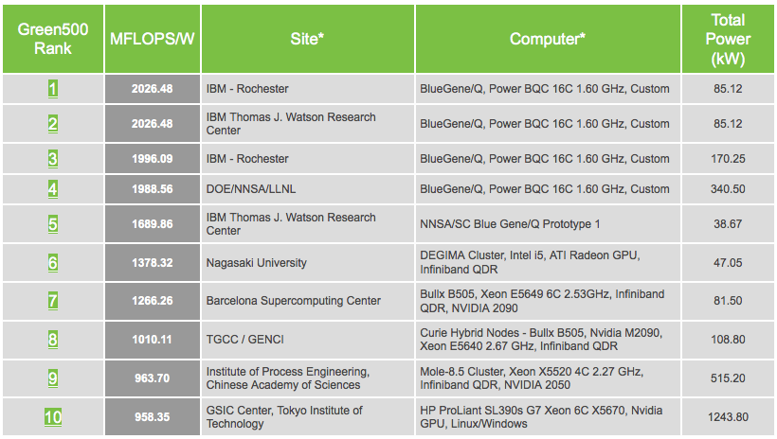
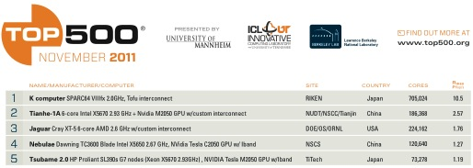
Peta (Exa?)Flops scale enabling technologies: GPGPU
General Purpose Graphic Processing Unit: impressive peak performance (N*TFlops per chip)
Videogames market i.e. 10 G$/yr unified gaming and HPC chip architectures
Architecture and characteristics fit with HPC scientific application (LQCD as an example…) requirements
  Many-Core (>>100) SIMD-like architecture
  High local memory bandwidth
    140 GB/s -> 500 GB/s
  Good for data parallelism (more than task parallelism…)
  “Green” and cost effective
INTEL Westmere
+many caches - few processing
NVidia Fermi GPU
many computing units!!!

Slide 8
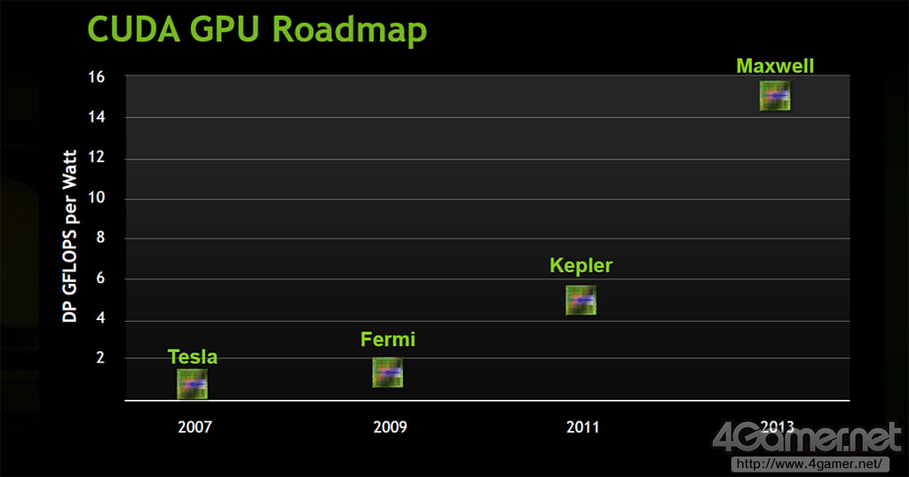
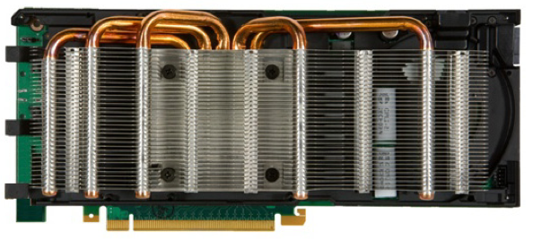
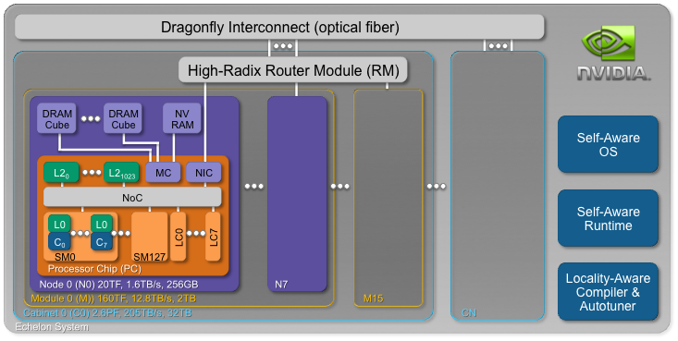
Peta (Exa?)Flops scale enabling technologies: GPGPU (2)
  Aggressive but (really!) feasible roadmap: much room for performance scaling
x4
x4
Nvidia Fermi (Tesla 20xx)
  (3 *10⁹ transistors)
  ~500 core, 1 TF SP, 0.5 TF DP
  6 GB external memory (150 GB/s)
  ~250W, <2K Euro
ECHELON: NVIDIA’s Extreme-Scale Computing Project
  128 SM (1024 core) 160 GFlops each, 20 TFlops aggregated
  Network: 150 GB/s; DRAM: 1.6TB/s
  300 W

Slide 9
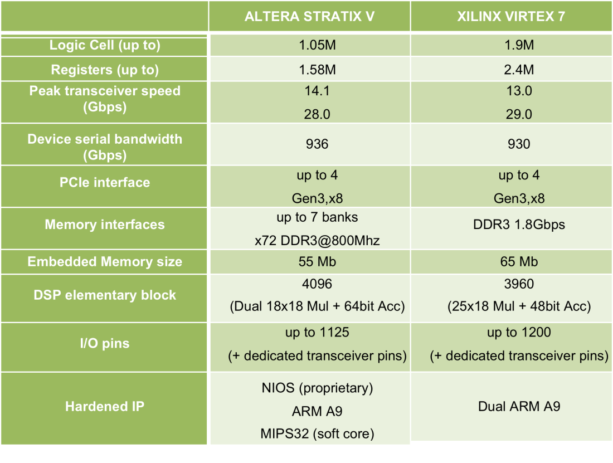

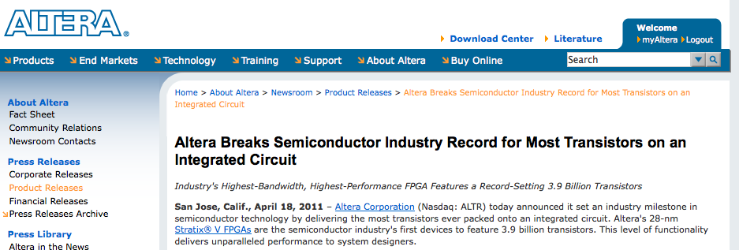

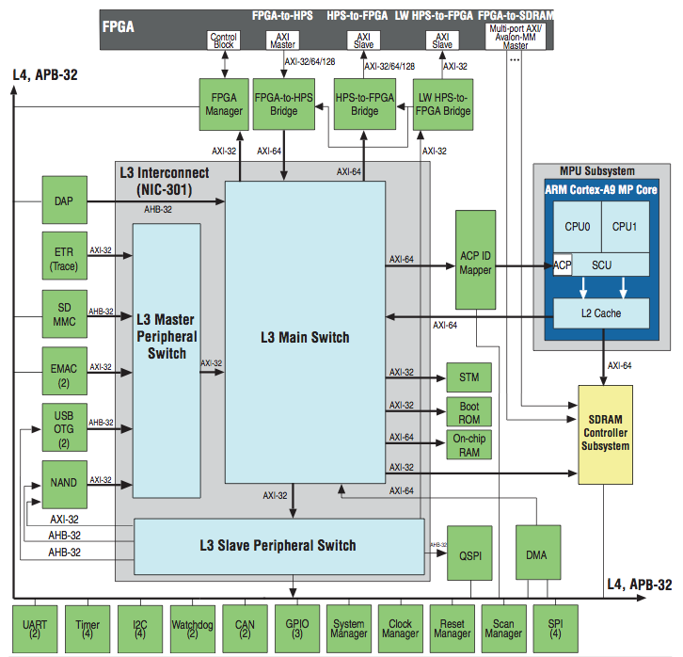
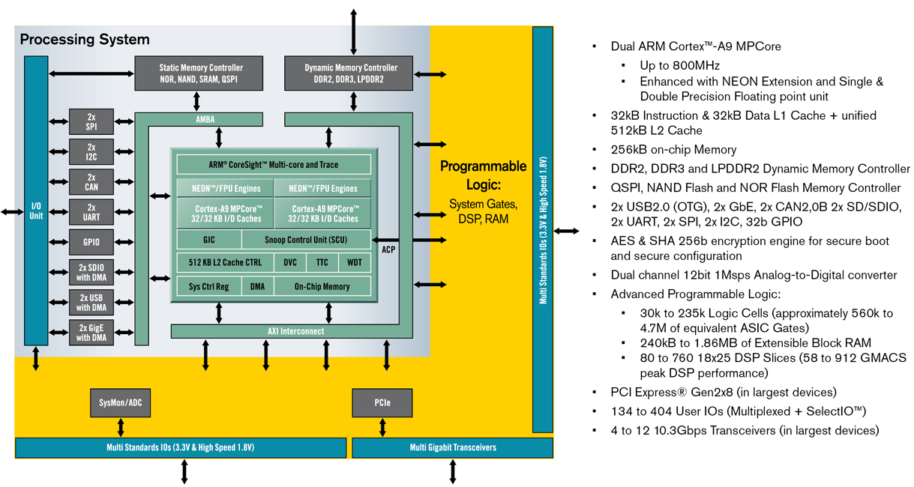
PetaFlops scale enabling technologies: FPGA
High–end FPGA-based systems are the ideal hardware to build custom network
Two main FPGA families: ALTERA STRATIX V – XILINX VIRTEX 7,
    28nm, introduction during 2011
    Tflops, (multi)Terabits I/O bandwidth, hardIP uP cores
Altera Embedded
Initiative:
Dual ARM9 on
28nm Altera FPGA
Xilinx Extensible Processing Platform: Zynq

Slide 10
QUOnG: GPU+3D Network
QUonG (QUantum chromodynamics ON Gpu) is a comprehensive initiative aiming to deploy an GPU-accelerated HPC hardware platform mainly devoted to theoretical physics computations (LQCD).
  Heterogeneous cluster: PC mesh accelerated with high-end GPU and interconnected via 3-D Torus network
  Added value: tight integration between accelerators (GPU) and custom/reconfigurable network (DNP on FPGA) allows latency reduction and computing efficiency gain
  Communicating with optimized custom interconnect (APEnet+), with a standard software stack (MPI, OpenMP, …)
  Optionally an augmented programming model (cuOS)
  Community of researchers sharing codes and expertise (LQCD, GWA, Laser-plasma interactions, BioComputing, Complex systems,…)
  GPU by Nvidia:
    solid HW and good SW
    fruitful collaboration with NVidia US development team to “integrate” GPU with our network
Notes:
The goal of the project is to deliver a complete reference HW platform tailored for scientific computations leveraging on commodity devices and on a dedicated custom interconnection system (APEnet+) for inter-node communication network

Slide 11
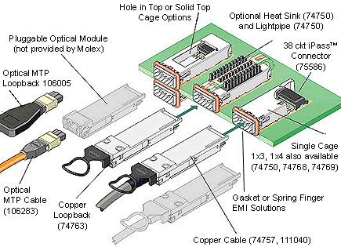
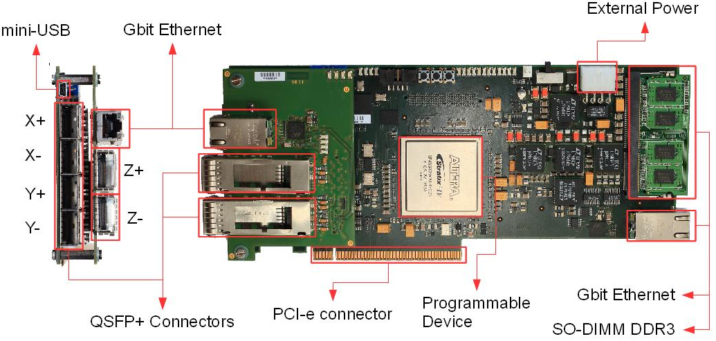
APEnet+ at a glance
DNP
X⁺
X⁻
Y⁺
Y⁻
Z⁺
Z⁻
3D Torus network
    ideal for large-scale scientific simulations (domain decomposition, stencil computation, …)
    scalable (APENEt+ today up to 32K nodes)
    Cost effective: no external switches! 1 card+3 cables
  APEnet based on INFN DNP
  RDMA: Zero-copy RX & TX !
  Small latency & high bandwidth
  GPU clusters features (APEnet+):
    RDMA support for GPUs! -> no buffer copies between GPU and host.
    Very good GPU to GPU latency
Torus
Links
torus
link
torus
link
torus
link
torus
link
torus
link
torus
link
Router
7x7 ports switch
routing logic
arbiter
Network Interface
TX/RX Block
32bit Micro Controller
Collective comm block
1Gb Eth port
GPU I/O accelerator
Memory controller
On Board Memory
PCIe X8 Gen2 core
APEnet+ card:
  FPGA based (ALTERA St.IV EP4SGX290)
  6 full-bidirectional links up to 68 Gbps raw (~400 Gbps)
  PCIe X8 Gen2 in X16 slot
    peak BW 4+4 GB/s
  Network Processor, off-loading engine integrated in the FPGA
  Zero-copy RDMA host interface
  Direct GPU interface
  Industry standard QSFP+ cabling
  Copper (passive/active), optical
PCIe X8 Gen2 8@5 Gbps
Notes:
The goal of the project is to deliver a complete reference HW platform tailored for scientific computations leveraging on commodity devices and on a dedicated custom interconnection system (APEnet+) for inter-node communication network

Slide 12
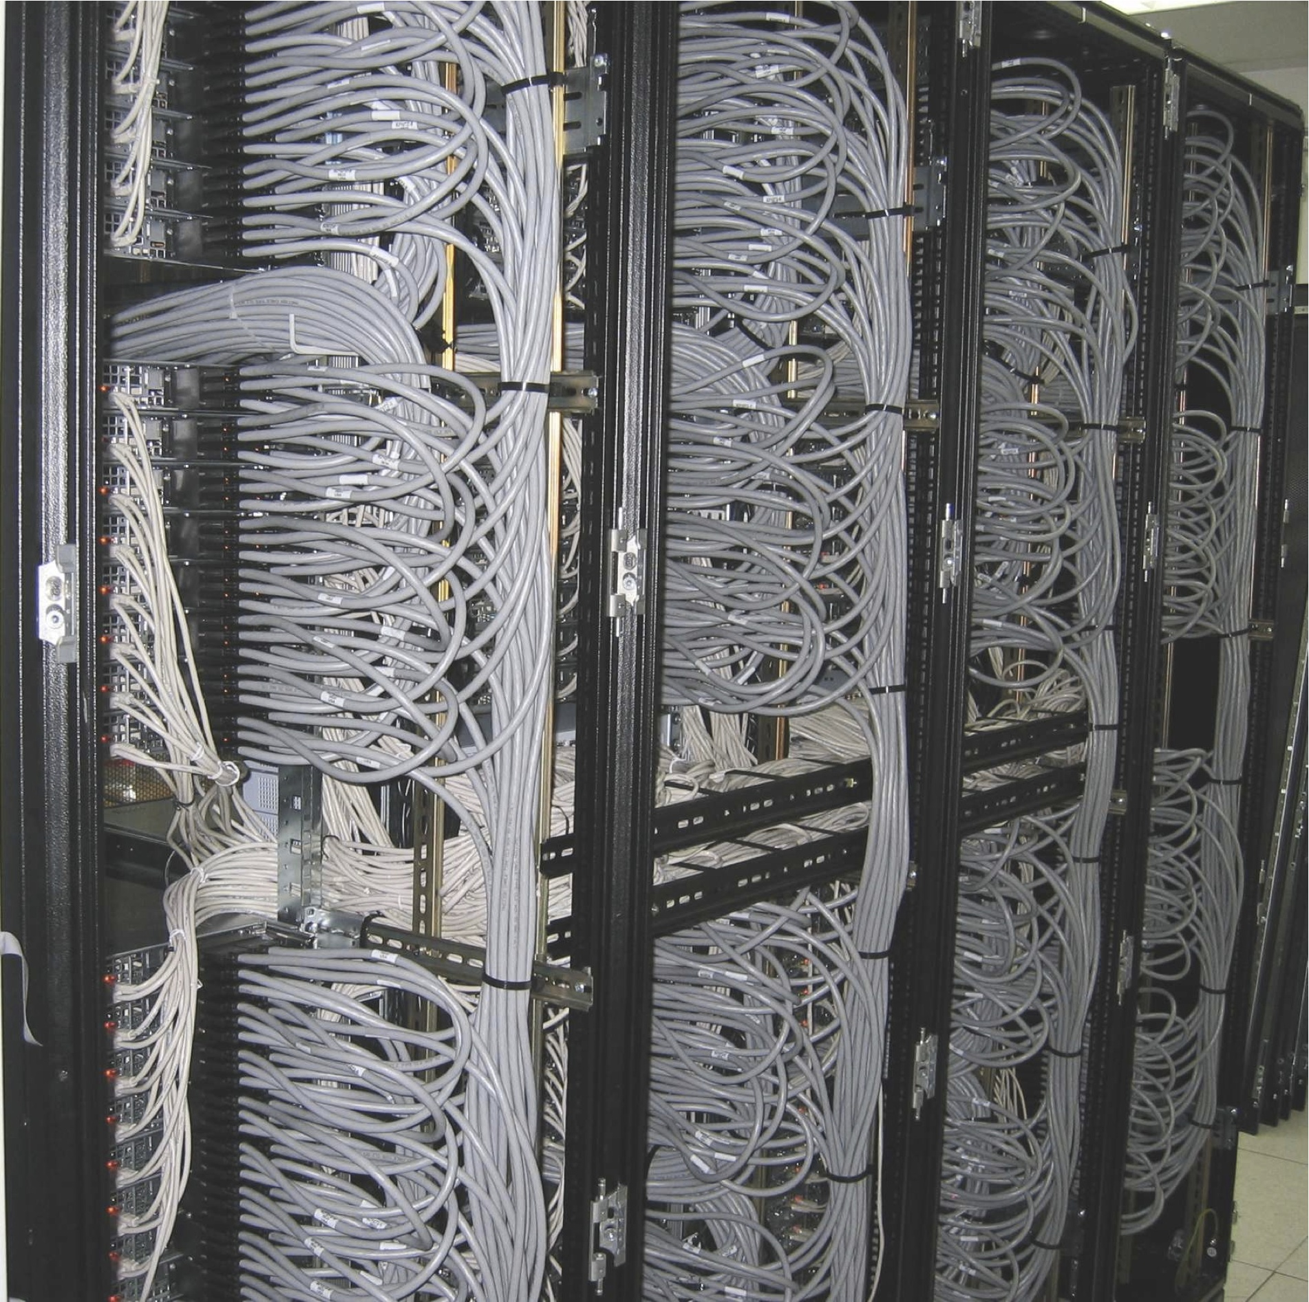

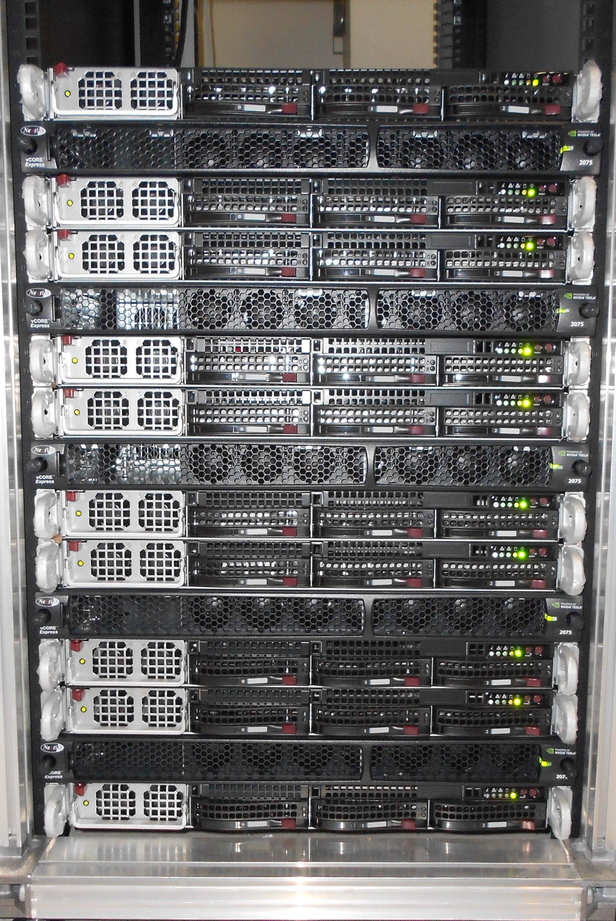
QUonG assembly
QUonG quick recipe:
1) Take N PC cluster nodes and plug 1 APEnet+ card per node
2) Plug M GPUs per node
3) Connect 6 cables for APEnet+ first neigh. connections
Add service networks (IB,Eth,..) as you like and
serve it to the computational physicists….
QUonG Deployment status (2011/12)
42U “Full rack” system:
        ~60 TFlops/rack peak
        25 kW/rack (i.e. 0.4 kW/TFlops)
        300 k€/rack (i.e. <5 K€/TFlops)
  Full rack prototype construction (fully funded…)
      25 TFlops proto ready at 1Q/12
      Full rack ready at 3Q/2012
      …waiting for Kepler GPUs
1U S20xx NVIDIA system packing 4 Fermi-class GPUs (~5 Tflops)
1U multi-core INTEL server
equipped with APEnet+ board
Notes:
quick recipe:take N cluster nodes
for each node:
plug M GPUs
and 1 APEnet+ card
plug and connect 6 cables to first-neighbor nodes
e.g. 128 nodes, arranged in a XYZ=8x4x4 grid with periodic boundary conditions.

Slide 13
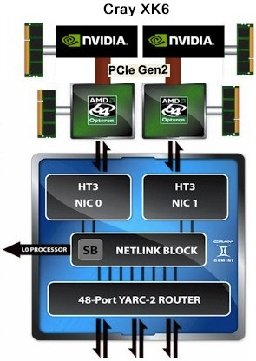
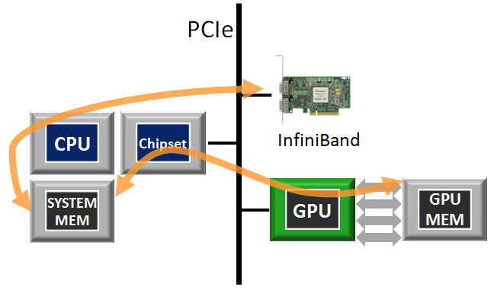
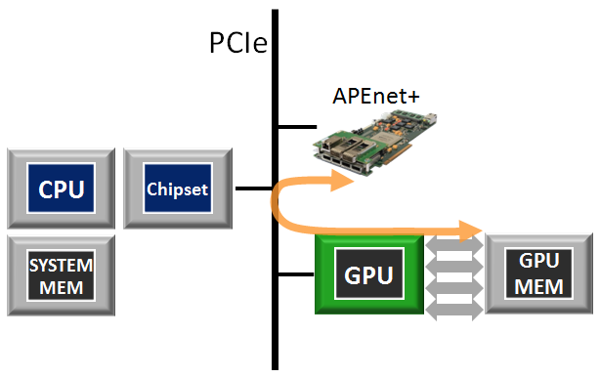
GPU-P2P in APEnet+
TRADITIONAL DATA FLOW
Peer-to-Peer means:
Data exchange on the PCIe bus
No bounce buffers on host
APEnet+ P2P support
  cutting-edge HW/SW technologies developed jointly with Nvidia
    APEnet+ board acts as a peer
    APEnet+ board can read/write “directly” GPU memory
Direct GPU access
  Specialized APEnet+ HW block
  GPU initiated TX
  Latency saver for small size messages
APENET+ ENHANCED DATA FLOW
Notes:
The goal of the project is to deliver a complete reference HW platform tailored for scientific computations leveraging on commodity devices and on a dedicated custom interconnection system (APEnet+) for inter-node communication network

Slide 14
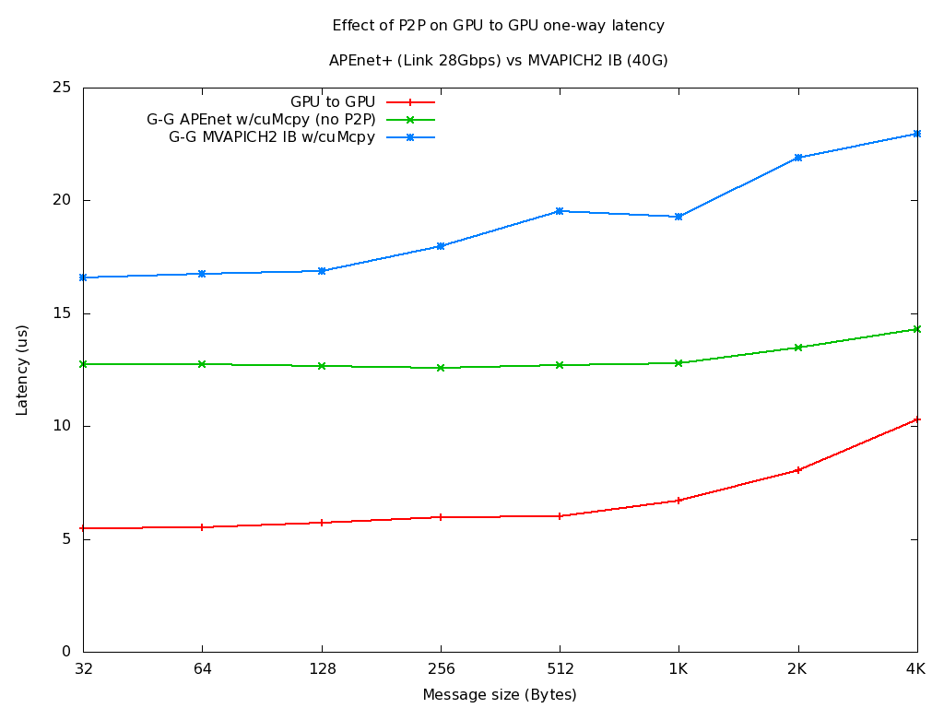
Effect of P2P introduction: preliminary results
MVAPICH2 points from the Ohio State U. web site*
No P2p = 2x cuMemcpy()
on host bounce buffers (~7us)
Notes:
The goal of the project is to deliver a complete reference HW platform tailored for scientific computations leveraging on commodity devices and on a dedicated custom interconnection system (APEnet+) for inter-node communication network

Slide 15
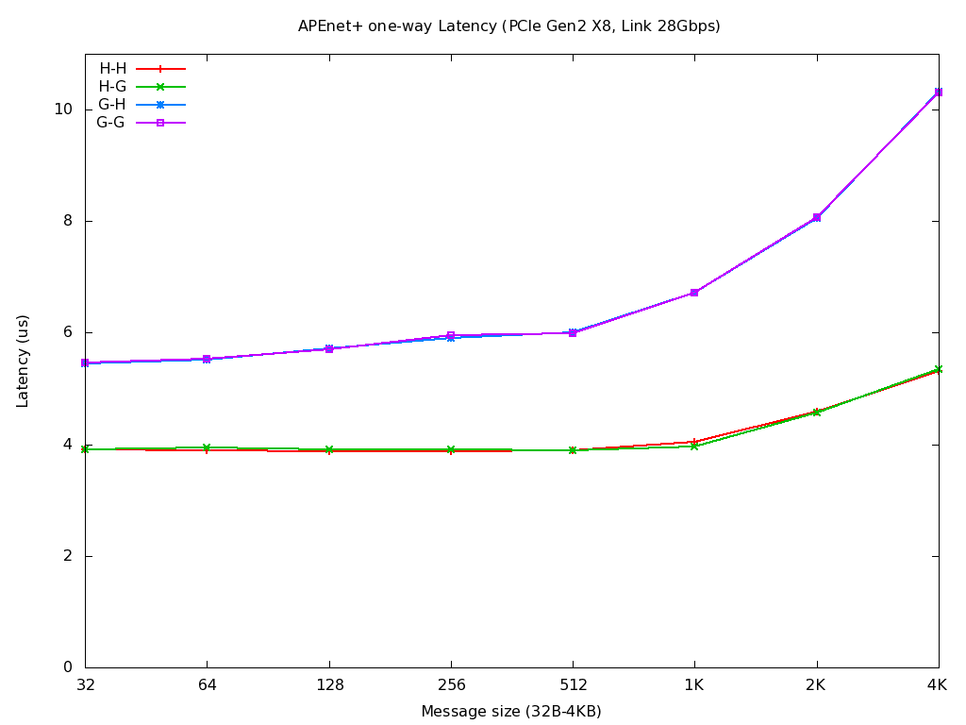
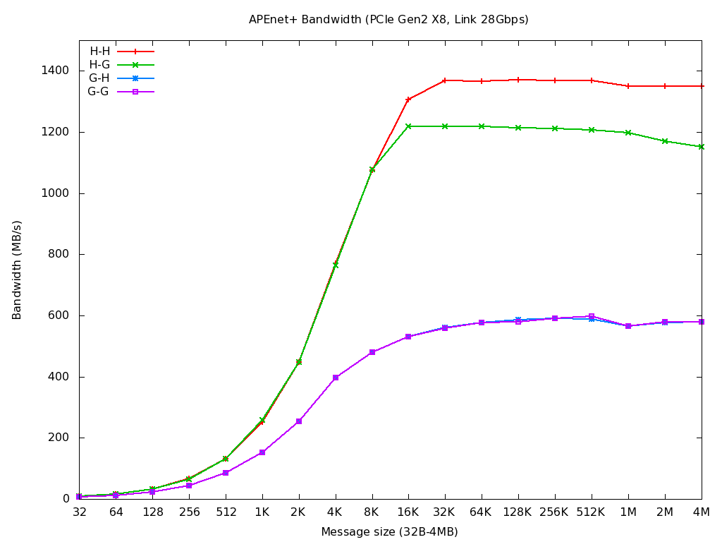
APEnet+ preliminary results
  Coded with APEnet+ RDMA API + CUDA 4.1.
  One-way point-to-point test involving two nodes
  Reduced bandwidth on 3D Torus links
  OSU-like one-way latency test for small msg sizes
  No small message optimizations
  Copying of data in temporary buffers.
  Reduced pipelining capability of the APEnet+ HW
  ~ 5-6 μs on GPU-GPU test: record!
  1.5x for GPU TX, working for improvements
  Work in progress
  Plateau at 16KB
    accelerate the receiving tasks performed by the μC
  low asymptotic bw of 600MB/s for GPU TX
    P2P read protocol fully implemented, working on pipeling and overlapping of subsequent packets (target x4)
Notes:
The goal of the project is to deliver a complete reference HW platform tailored for scientific computations leveraging on commodity devices and on a dedicated custom interconnection system (APEnet+) for inter-node communication network

Slide 16
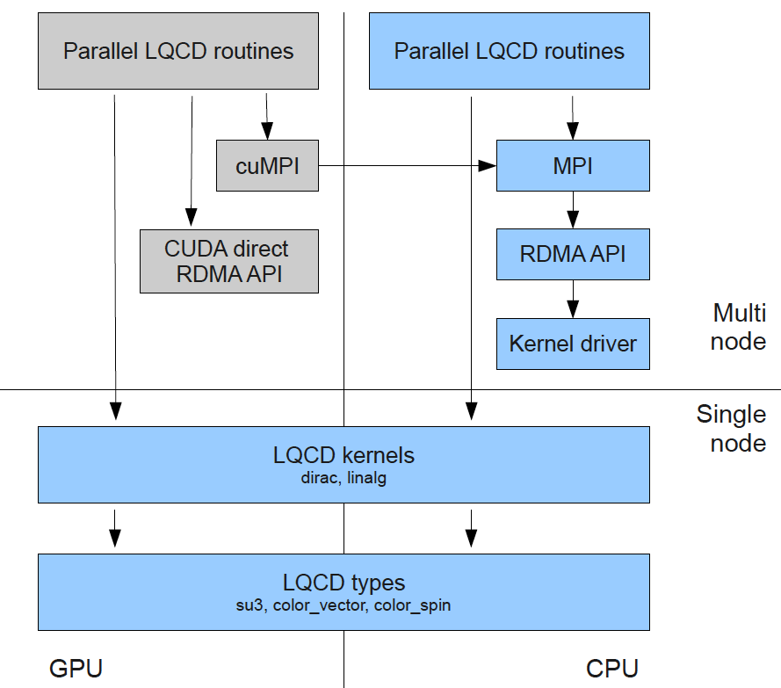
SW stack and GPU optimizations
APEnet programming model
native RDMA API:
  RDMA buffer registration: pinning and posting combined
  single message transmission async queue
  async delivery of completion events (both TX and RX)
MPI:
  early prototype
  APEnet BTL module for OpenMPI
  tentatively using GPU-aware feature in openmpi svn trunk
GPU centric programming model
CUDA direct RDMA API:
  Subset of APEnet+ RDMA API, available from within running GPU kernels
  a running GPU kernel can emit requests for services to the host.
Notes:
The goal of the project is to deliver a complete reference HW platform tailored for scientific computations leveraging on commodity devices and on a dedicated custom interconnection system (APEnet+) for inter-node communication network

Slide 17
LQCD on GPU (1)
C. Bonati (Pisa), G. Cossu (KEK), M. D’Elia (Pisa), A. Di Giacomo (Pisa) P. Incardona (Pisa)
Notes:
The goal of the project is to deliver a complete reference HW platform tailored for scientific computations leveraging on commodity devices and on a dedicated custom interconnection system (APEnet+) for inter-node communication network

Slide 18
LQCD on GPU (2)
C. Bonati (Pisa), G. Cossu (KEK), M. D’Elia (Pisa), A. Di Giacomo (Pisa) P. Incardona (Pisa)
Notes:
The goal of the project is to deliver a complete reference HW platform tailored for scientific computations leveraging on commodity devices and on a dedicated custom interconnection system (APEnet+) for inter-node communication network

Slide 19
LQCD on QUonG
  Preliminary LQCD computation using QUDA DSlash Wilson code on 48³*96 lattice site (QUDA collaboration) on QUonG without APEnet+ (Infiniband only)
  Test for strong and weak scaling
Notes:
The goal of the project is to deliver a complete reference HW platform tailored for scientific computations leveraging on commodity devices and on a dedicated custom interconnection system (APEnet+) for inter-node communication network

Slide 20
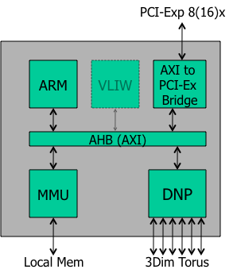
What’s next: 2012 (and beyond…) R&D
  APEnet+ update based on next gen 28nm FPGA i.e. more bandwidth, less latency
  Architectural enhancements
    Larger buffers (bigger packets handling)
    Optimized HW (low latency, direct access) interface to next-gen GPUs
    Fault handling tolerant capabilities to safely scale at multi-Pflops
  Introduction of Dual PCI Gen3 -> bandwidth 4x
    8Gbps vs 5Gbps (Gen2), better encoding (128b/130b) vs 8b/10b -> bandwidth 2x
    increased number of transceivers allow for integration of 2nd PCI Express Gen3 x8 -> bandwidth 2x
  Transceiver switching frequency rising
    14 Gbps vs current 8 Gbps ->~2x on torus link
  Experiment with Dual Hard IP ARM A9 @ 800 MHz
  Specific task acceleration through ASIP design
  collective operations, e.g. MPI global sums
  DMA gather-scatter engine to autonomously gather data into pkts.
  LQCD/PSNN acceleration tasks preliminary implementation
Porting of scientific codes on QUonG (LQCD e PSNN but also BioComputing, Complex systems,…)
Thinking about Tegra3/Kepler - APEnet+ integration
  Using NVidia CARMA KIT(?)
  …towards a “networked GPU”….
QSFP+
14 Gbps x4
ALTERA
Stratix V
14 Gbps x4
SO-DIMM
Gen3 x8
Gen3 x8
QSFP+
PCI Ex
Switch
Gen3 x16
PCI Exp Gen3 x16
ASIP
Notes:
The goal of the project is to deliver a complete reference HW platform tailored for scientific computations leveraging on commodity devices and on a dedicated custom interconnection system (APEnet+) for inter-node communication network

Slide 21
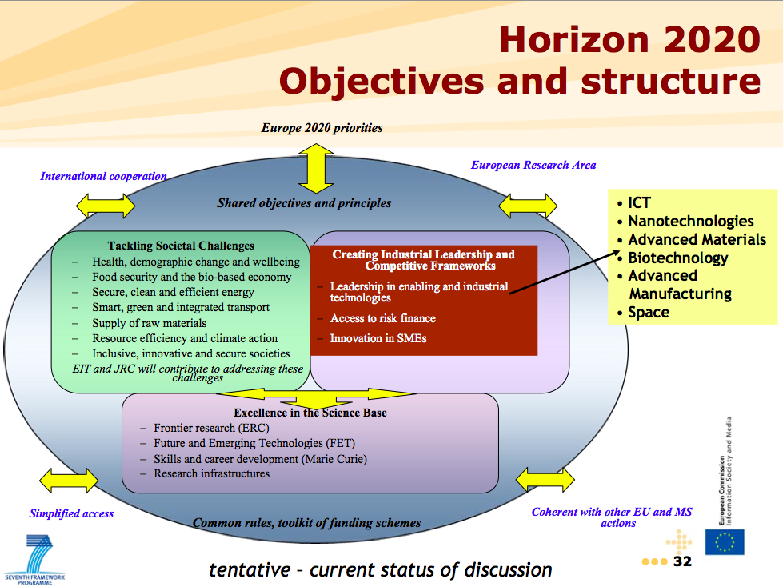

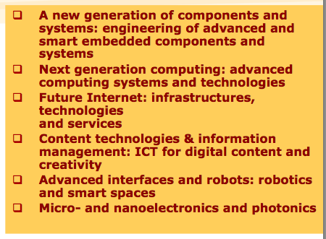
APE vs Horizon2020 keywords
Dr. Max Lemke, Deputy Head of Unit G3
ICT Programme
European Commission
Hipeac Conf. Jan. 2012
“This Communication highlights the strategic nature of High-Performance Computing (HPC) as a crucial asset for the EU's innovation capacity, and calls on Member States, industry and the scientific communities, in cooperation with the Commission, to step up joint efforts to ensure European leadership in the supply and use of HPC systems and services by 2020.”
“Excellence in the Science Base: Frontier Research ”:
  LQCD simulation and HEP computing
“Leadership in enabling and industrial technologies”
  QUonG/Apenet+
“Future and Emerging Technology (FET)”
  enhancements of APE network (fault tolerance, Brain Inspired,…)
“Innovations in SMEs”:
  TT to strengthen the role of EU industry
Notes:
The goal of the project is to deliver a complete reference HW platform tailored for scientific computations leveraging on commodity devices and on a dedicated custom interconnection system (APEnet+) for inter-node communication network

Slide 22
Conclusions
LQCD hunger for computing power is reaching the multi PetaFlops
QUonG (i.e system based on GPU) shows excellent and promising preliminary results for scientific computing
  Today a reduced QUonG 25 Tflops prototype to be scaled up to 60 Tflops at the end of 2012
  Much room for performance improvements either on HW side as well as on algorithmic side
  The GPU roadmap provides a medium / long term interesting and appealing perspective to allow QUonG systems to scale at 10-100 PetaFlops
HPC international competition is going to focus on “our interest” topics
  GPU + 3D Torus: from technology perceived as “exotic” to the today mainstream
  The APE community has 20 years of experience on building and programming of similar MPPs
    we started before (!)
    we still have some significant advantages to exploit (3D Torus, P2P, algorithmic coding)
The HPC “a la APE” can be a driver for the INFN participation in Horizon 2020 Framework program
  Excellence Science, ICT, FET, Technology Transfer to SMEs
Notes:
The goal of the project is to deliver a complete reference HW platform tailored for scientific computations leveraging on commodity devices and on a dedicated custom interconnection system (APEnet+) for inter-node communication network

Slide 23
Thank you!
Any question or comment?
Notes:
The goal of the project is to deliver a complete reference HW platform tailored for scientific computations leveraging on commodity devices and on a dedicated custom interconnection system (APEnet+) for inter-node communication network

Slide 24
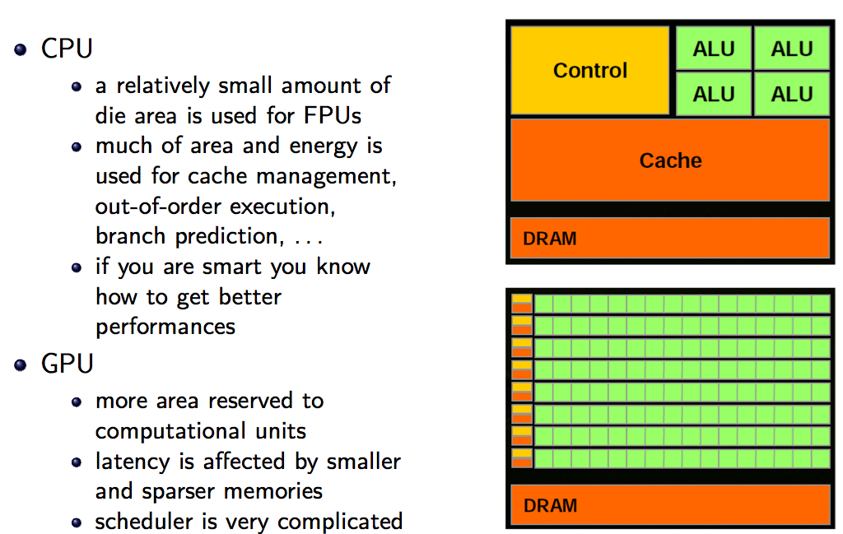
GPGPU vs CPU
Notes:
GPU application choices
should have...
•Data parallelism
•Large datasets, suitable for streaming (stream == collection of items requiring similar computation. I.e., grid cells in a simulation
Independence among data elements
•Arithmetic/logic-heavy

Slide 25
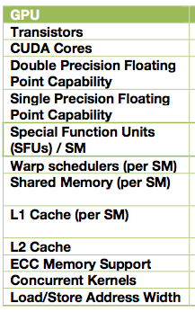
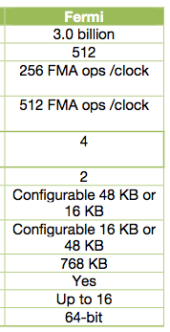
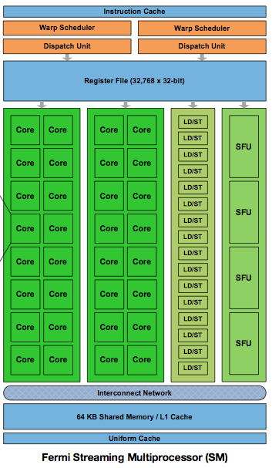
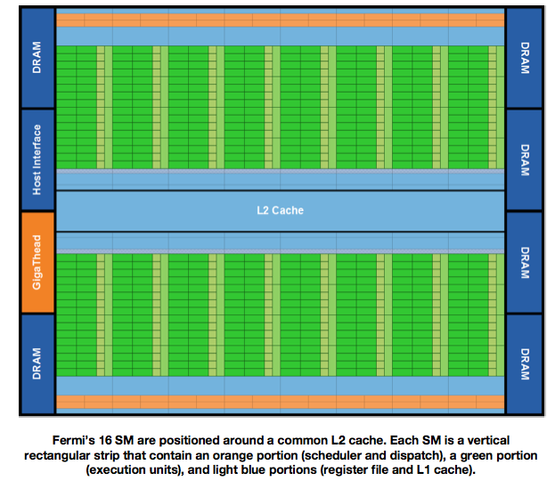
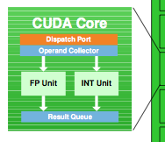
GPGPU: Nvidia Fermi architecture
Notes:
As an exaple we need at least to use 64 bit machine to take into account errors, dynamic,

Slide 26
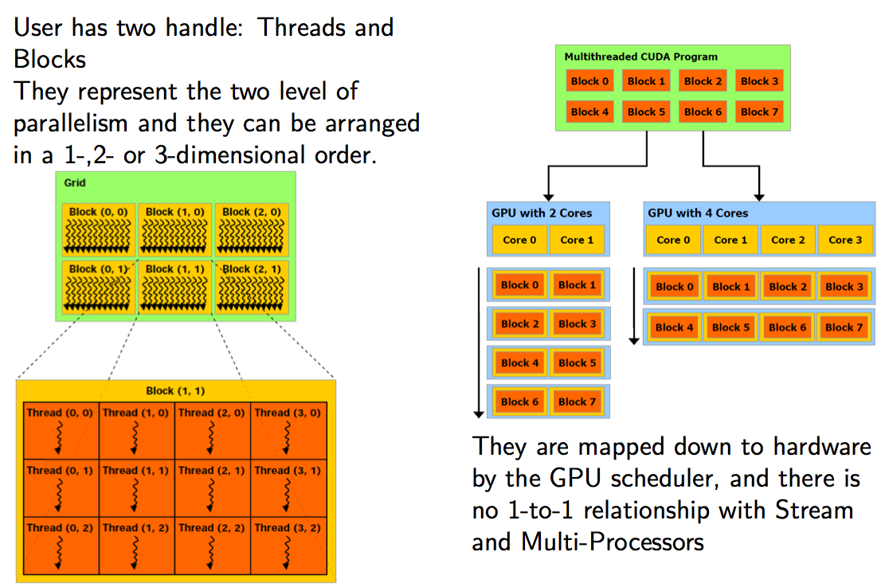
GPGPU: programming model
Notes:
As an exaple we need at least to use 64 bit machine to take into account errors, dynamic,

Slide 27
DNP, Distributed Network Processor
DNP: 3D Torus network controller
  packet-based direct network with 2-d/3-d torus topology.
  fixed size header/footer envelope (header+ footer)
  auto-routing using dimension-order static routing, with dead-lock avoidance.
  Error detection via EDAC/CRC at packet level.
  RDMA (Remote Direct Memory Access) capabilities, PUT and GET, are implemented at the firmware level.
  SystemC models, VHDL (synthesizable) code, AMBA Interface (SHAPES), PCI Express Interface
    Implementation on FPGA and “almost” tape-out on ASIC
X⁺
X⁻
Y⁺
Y⁻
Z⁺
Z⁻
torus
link
torus
link
torus
link
torus
link
torus
link
torus
link
Altera Stratix IV
router
7x7 ports switch
routing logic
arbiter
TX/RX FIFOs & Logic
collective communication block
100/1000 Eth port
128@250MHz bus
PCIe X8 Gen2 core
NIOS II processor
memory controller
DDR3
Module
PCIe X8 Gen2 8@5 Gbps

Slide 28
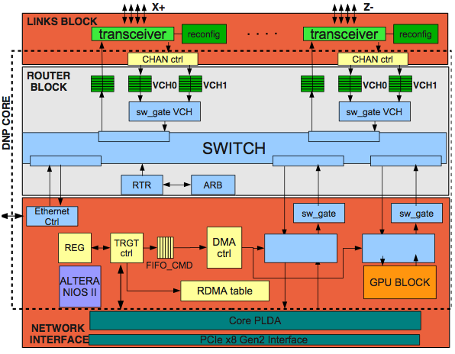
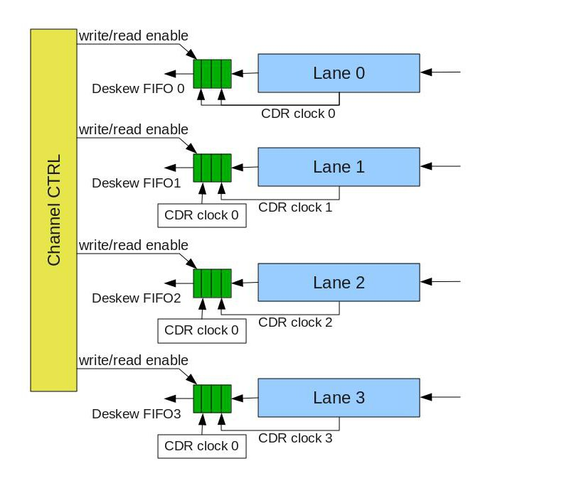
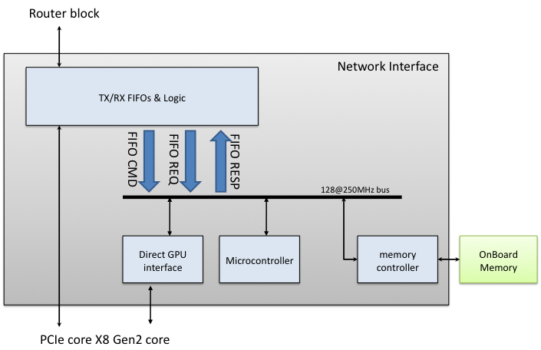
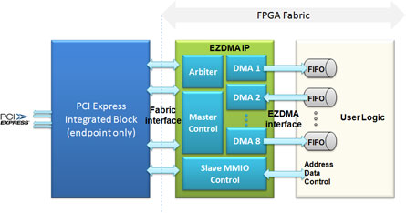
DNP technical details
PCI Express Interface
  Built on ALTERA PCI HardIP + commercial wrapper/multi-dma engine (PLDA EZDMA2) with (up to) 8 independent and concurrent DMA engines
High speed serial link interface to DNP core
  Multiple virtual channel to avoid deadlock and enhance fault tolerance
  4 bounded independent serial links each lane running at 8.5 Gb/s
  Each lane providing CDR, 8b10b encoder, de-skewing logic,…
Design of hardware/firmware RDMA supporting sub-system based on ALTERA native uP (NIOS II)
Experimental direct interface for custom integrated accelerator e/o GPU
Notes:
Remote Direct Memory Access (RDMA) allows to read/write data from/to a remote node’s memory, with minimal demand of memory bandwith and CPU overhead
PCI Express x8 is the maximum lanes configuration for current FPGA familyconfiguration

Slide 29

SW stack
Notes:
The APElink+ device is not integrated in the Linux kernel as a network device but rather as a special-purpose stream device, supported by its own kernel device driver (see Fig. 6).
The APEnet+ native programming interface is the APEnet RDMA API, a set of low-level custom data structures and functions, which is available as a small C language library:•
Memory buffer registration primitives are used to expose memory buffers to RDMA primitives: register_buffer(), unregister_buffer().•
Communication primitives available to applications are: rmda_put(), rdma_get(), rdma_send().•
Events are routed to applications whenever RDMA primitives are executed or registered memory buffers are accessed: wait_event().

Slide 30

SW stack

Slide 31

SW stack
Notes:
A subset of the APEnet+ RDMA API, the CUDA direct RDMA API, will also be available from within running GPU kernels.
It is implemented using cuOS [31], Offloaded System services for CUDA, a general purpose framework by which a running GPU kernel can emit requests for services to the host.
This approach has multiple advantages. The first is user- friendliness, in that it allows to quickly spawn lenghty net- work operations avoiding the standard procedure: splitting the CUDA kernel into multiple chunks, synchronizing for kernel completion, copying of data, starting of network operations, submission on the next kernel, etc.. The second is that it creates a nice opportunity for optimizations, as in certain occasions, e.g. small message size, and using dedicated APElink+ HW resources, the CUDA kernel can both emit RDMA communication primitives and receive RDMA events without help from the host, cutting latency and providing more computation overlap.
For easy porting of legacy MPI applications, we are developing cuMPI, or MPI for CUDA, which is a subset of the MPI APIs directly invokable from within CUDA kernels.
With it, MPI communication primitives are generated on the GPU and passed to the host for execution, using cuOS. As cuMPI is of broader use and is not directly connected to APEnet+, it is available as open source and is being developed within the cuOS code repository [32].

Slide 32

SW stack

Slide 33

SW stack

Slide 34

AURORA LQCD results

Slide 35

Requirements from LQCD*
GPU lattice size = L³xT
N_{GPU} per computing node (i/e 1 APEnet+) ->
computing node lattice size = L³xN_{GPU}T
even/odd + γ projection trick Dslash:
  f(L, N_{GPU}) = 1320/2 × N_{GPU} × L³T flops
  r(L, N_{GPU}) = 24/2 × 4 × (6/2 N_{GPU} L²T + x/2 L³) bytes
  with x=2,2,0 for N_{GPU}=1,2,4
Balance condition*: perfect overlap between computing time and communication time
  f(L, N_{GPU})/perf(N_{GPU}) = r(L, N_{GPU})/BW ➔
  BW(L, N_{GPU}) = perf(N_{GPU}) × r(L, N_{GPU}) / f(L, N_{GPU})
* Slightly modified performance model taken from Babich (STRONGnet 2010), from Gottlieb via Holmgren

Slide 36
Requirements from LQCD (2)
For L=T, N_{GPU}=2, perf 1 GPU=135 GFlops sustained:
  BW(L, 2) = 2×135×10⁹ × 24 (6×2+2)L³ / (1320× L⁴) = 68.7/L GB/s
  14 messages of size m(L) = 24 L³ bytes
2 GPUs per node, at L=32:
  E/O prec. Dslash compute-time is 5.1ms -> minimum required BW(L=32) is 2.1 GB/s
  Transmit 14 buffers of 780KB, 360us each or 4 KB pkt in 1.85us
apeNET+ bandwidth (PCI Gen2 x8 / 34 Gbps per link) allows “strong scaling” up to few tens of GPU -> enhance bandwidth especially on PCI Express side (next board release)
tight time budget -> reduce transfer latency, specific GPU-APEnet+ optimizations
GPU lattice | GPUs per node | Node lattice | Global lattice | # of nodes | # of GPUs | Req BW GB/2
16ˆ3*16 | 2 | 16ˆ3*32 | 64ˆ3*128 | 256 | 512 | 4.3
16ˆ3*32 | 2 | 16ˆ3*64 | 64ˆ3*128 | 128 | 256 | 4.0
32ˆ3*32 | 2 | 32ˆ3*64 | 64ˆ3*128 | 16 | 32 | 2.1
16ˆ3*32 | 4 | 16ˆ3*128 | 64^3*128 | 64 | 256 | 7.4
32ˆ3*32 | 4 | 32ˆ3*128 | 64^3*128 | 8 | 32 | 3.7
Notes:
PCIe *:
One 32bit reg posted write: 130ns
One regs read: 600ns
8 regs write: 1.7us
PCIe is a complex beast!
Far away from processor and memory (on-chip mem ctrl)
Mem reached through another network (HT or QPI)
Multiple devices (bridges, bufs, mem ctrl) in between
Round-trip req (req + reply) ~ 500ns !!!

