Slide 1
Density Dependence of the Symmetry Energy with Light Clusters
Mike Youngs
Michigan State University
NSCL
September 4, 2012

Slide 2
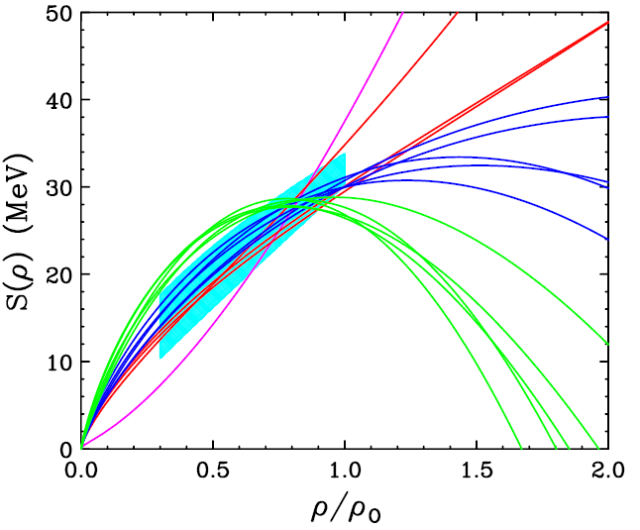
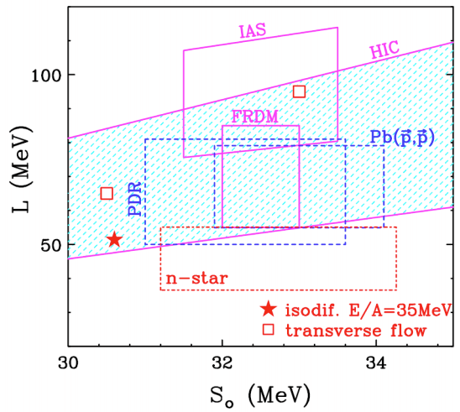
The Symmetry Energy
adapted from
M.B. Tsang, Prog. Part.Nucl.Phys. 66, 400 (2011)
Brown, Phys. Rev. Lett. 85, 5296 (2001)
B. Tsang et al., arXiv:1204.0466

Slide 3
Experimental Details
Sought to measure emitted neutrons, protons and light clusters from central collisions.
and
at 50 and
120 MeV/A
M. A. Famiano et al., PRL 97, 052701 (2006)

Slide 4
Observables
Effective mass
Transverse and Elliptical Flow
Single Particle Spectra
DR(n/p)
DR(t/3He)

Slide 5
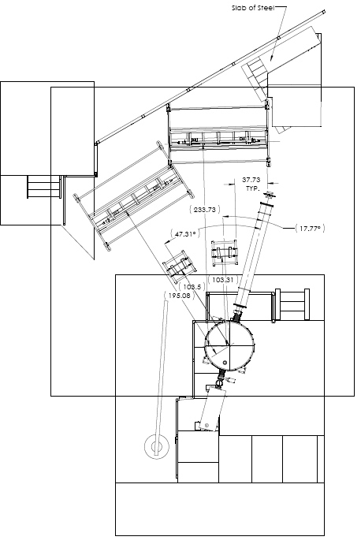

Slide 6
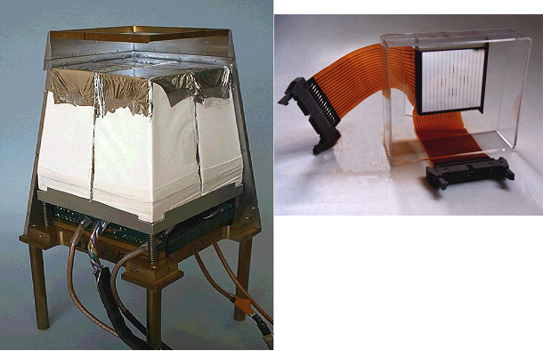
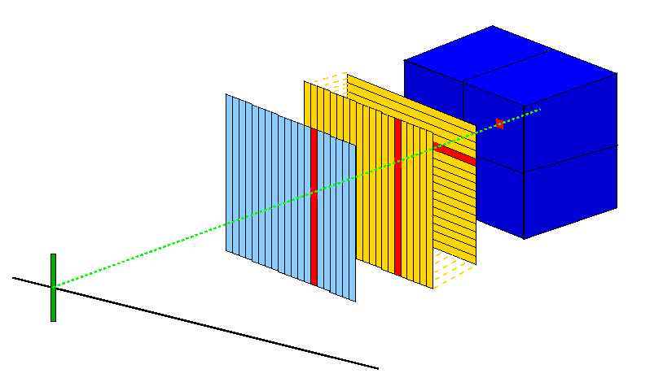
LASSA
Si-E 500 μm
4x CsI(Tl) 6cm
Si-ΔE 65 μm
16 strips v (front)
Pixel
Large Area Silicon Strip Array was built in 2000 and consists of a 65 μm dE single sided Si, a 0.5 mm double sided Si, and 4 6cm CsI(Tl) detectors.
16 strips h. (back)
16 strips v. (front)

Slide 7
LASSA part 2

Slide 8
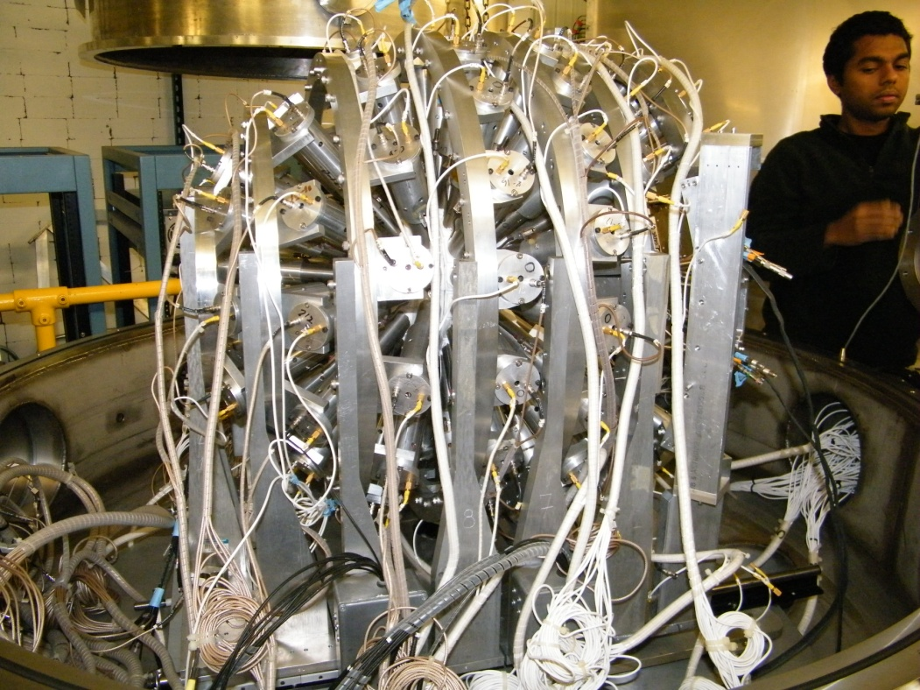
Miniball Array
4π phoswich detector using a thin fast plastic and a CsI(Tl) crystal
Full complement has 11 rings and covers 89% of full solid angle
Our setup uses ~73% of the full solid angle

Slide 9
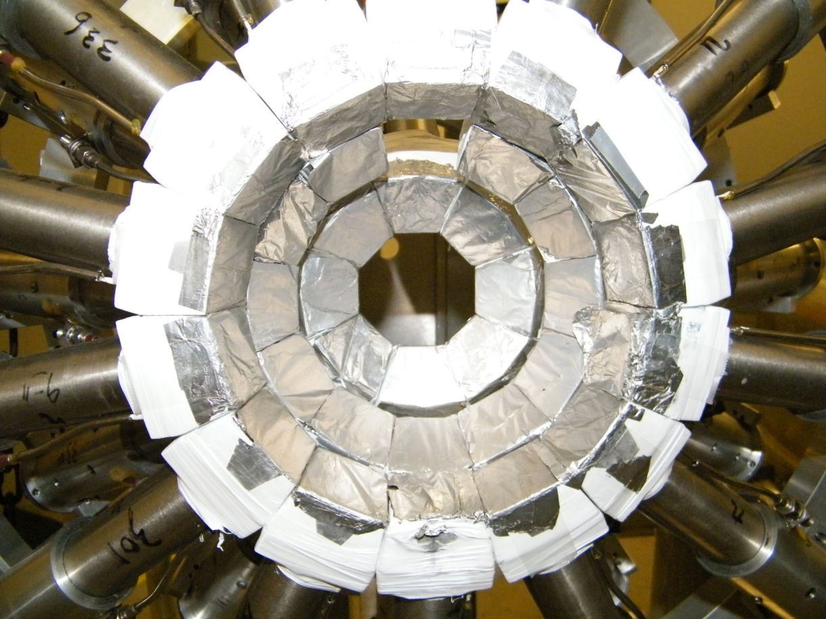
Miniball part 2

Slide 10
Neutron Walls
2 large area walls
Each wall has 25 tubes stacked vertically filled with liquid organic scintillator
~8 cm position resolution
~1 ns timing resolution

Slide 11
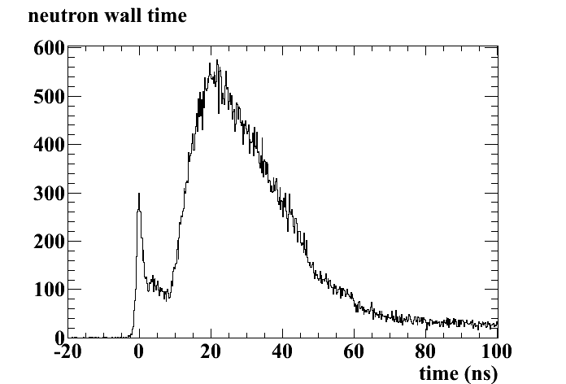
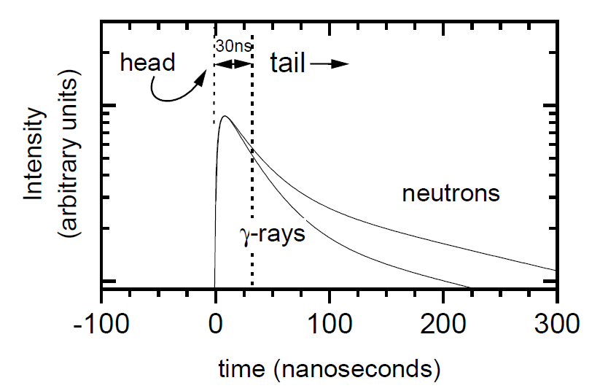
PSD
γ, cosmics
Prompt γ
n, p

Slide 12
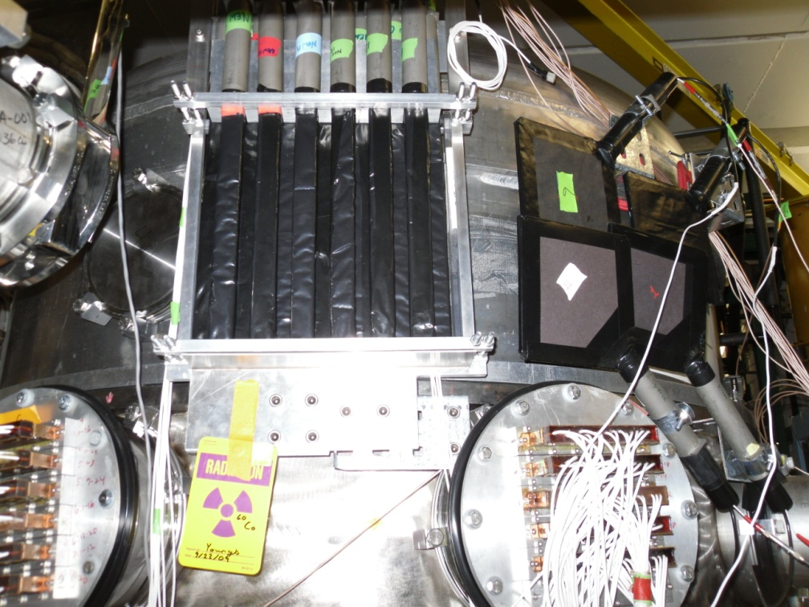
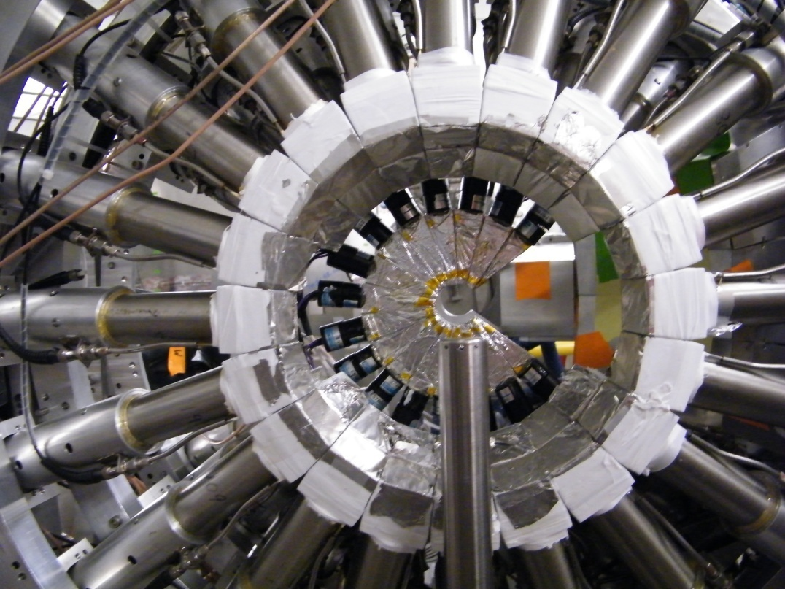
The Supporting Cast
Proton Veto Detectors
Forward Array (Start Timer)

Slide 13
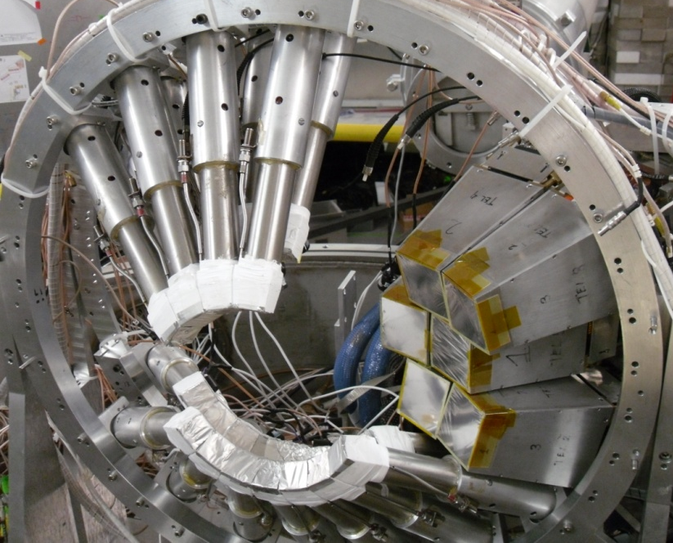
Experimental Set Up

Slide 14
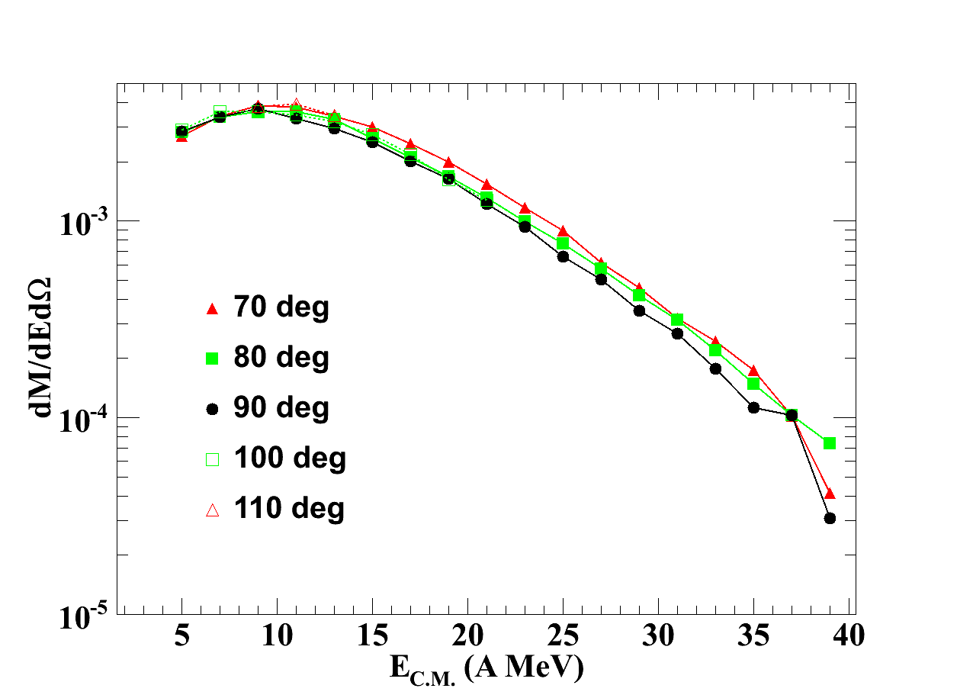
Data Selection

Slide 15
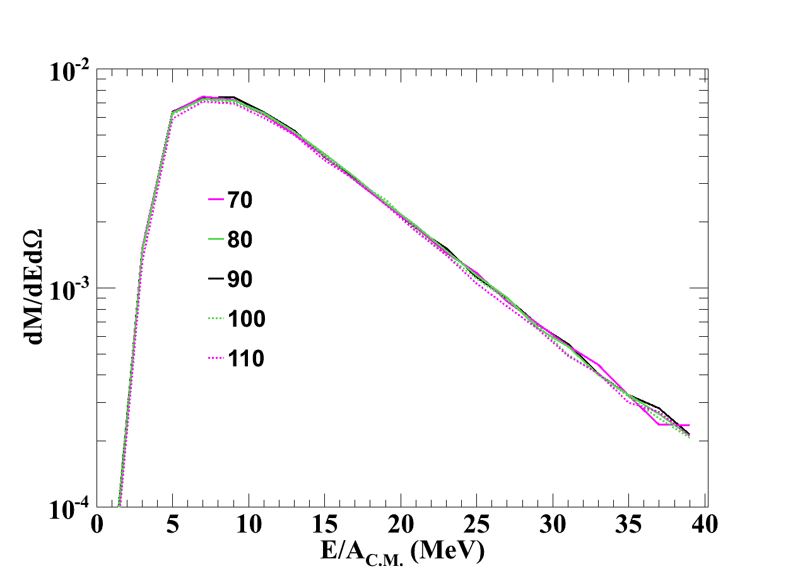
Simulation Comparison
1 fm
4 fm

Slide 16
Simulation Comparison
1 fm
4 fm

Slide 17
Impact Parameter Dependence
50 MeV
Closed – b<2 fm
Open – 2<b<4 fm
120 MeV

Slide 18
Impact Simulations

Slide 19
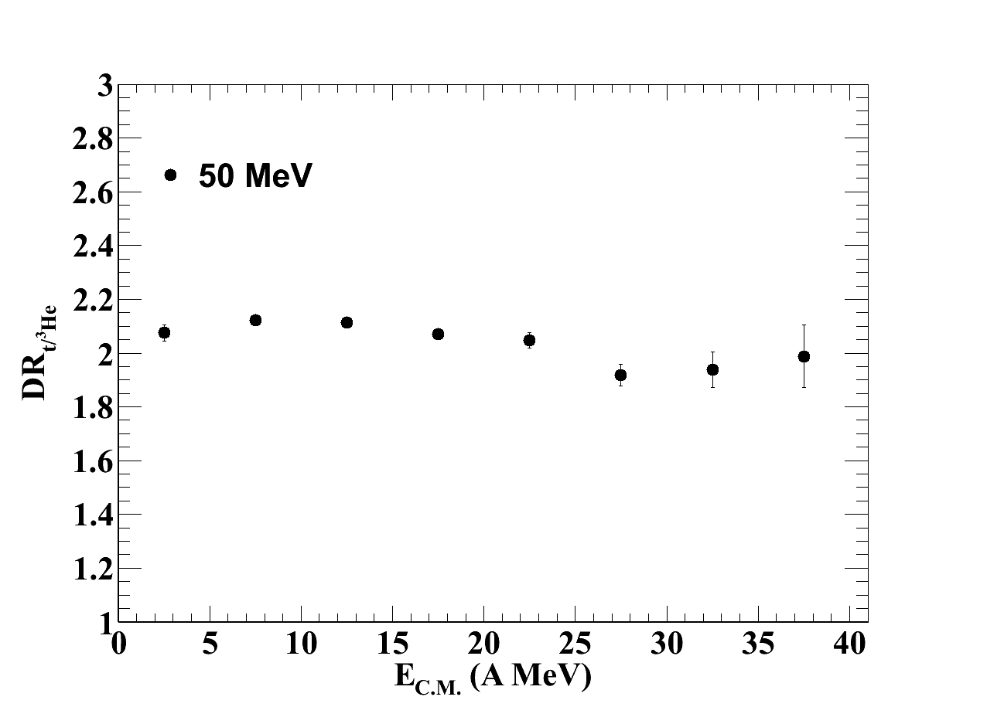
Preliminary Results for t/3He

Slide 20
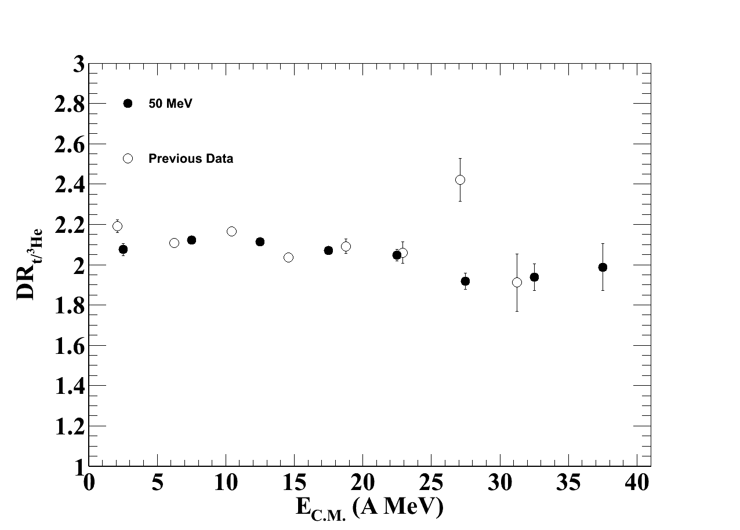
Preliminary Results for t/3He

Slide 21
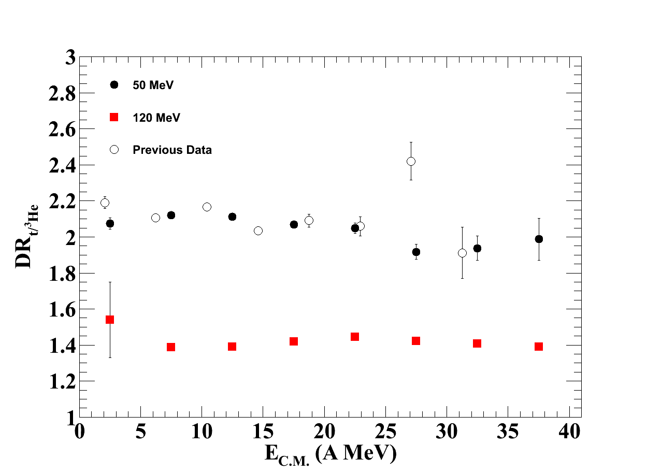
Preliminary Results for t/3He

Slide 22
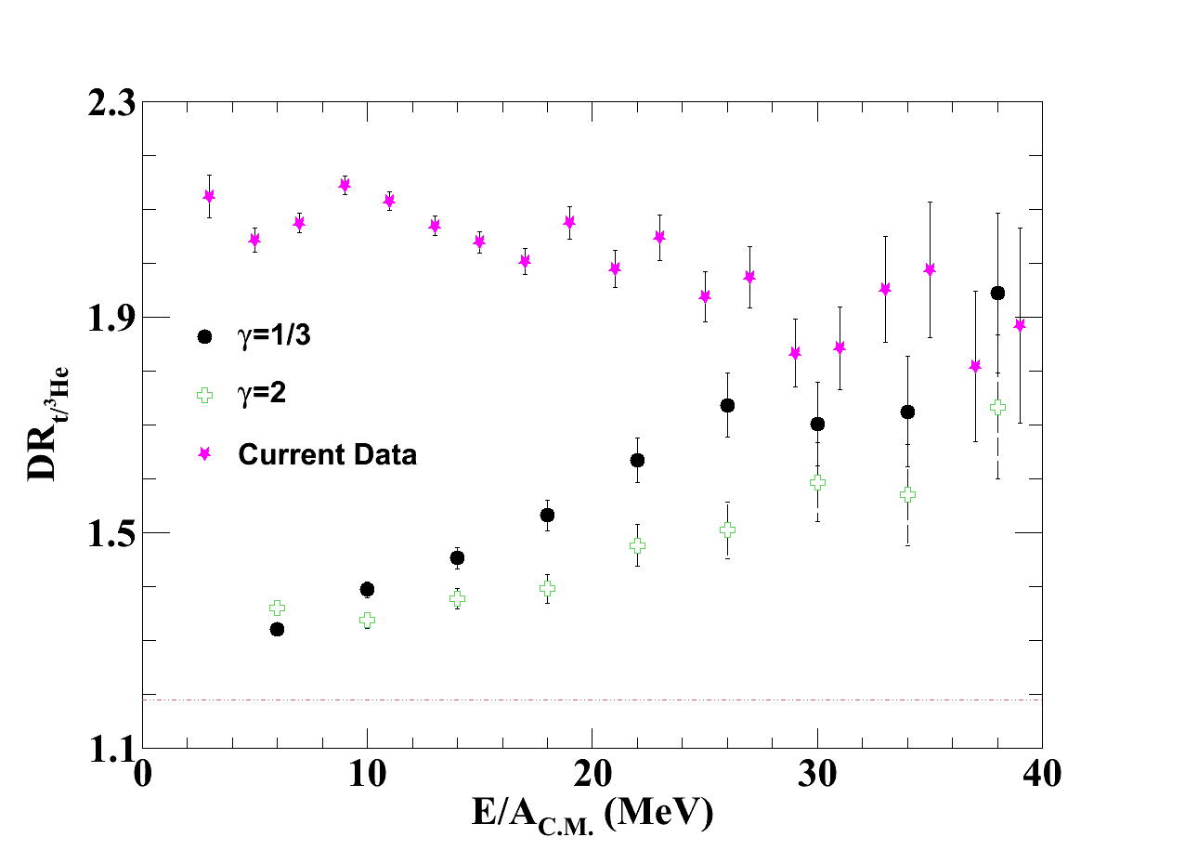
Comparisons
50 MeV/A
120 MeV/A

Slide 23
Limiting Factor

Slide 24
Thank you collaborators!
Dan Coupland
William Lynch
Betty Tsang
Zibi Chajecki
Michael Famiano
Brenna Giacherio
Tilak Ghosh
Rachel Hodges
Micha Kilburn
Jenny Lee
Fei Lu
John Novak
Paulo Russotto
Alisher Sanetullaev
Concettina Sfienti
Giuseppe Verde
Jack Winkelbauer

Slide 25
THE END (of the beam line)

