Slide 1


Global analysis of neutrino data
Laboratori Nazionali del Gran Sasso
Assergi, Italy – May 8-10, 2012
(in the standard 3ν framework)
Gianluigi Fogli

Slide 2
Outline
Why global analyses?
From first hints to evidence for θ₁₃ ≠ 0
Status of 3ν oscillation parameters, one year ago (2011)
3ν analysis: metodological issues
2012 3ν results
Conclusions
5.1 (θ₁₃, θ₂₃) correlations
5.2 (θ₁₃, δ_{CP}) correlations
Mainly based on earlier work and work in progress done in collaboration with:
E. Lisi, A. Marrone, D. Montanino, A. Palazzo, A.M. Rotunno

Slide 3
1. Why global analyses?
In general, global analyses of data from different experiments are necessary when some physical parameters are not (precisely) measured by any single experiment.
In this case, the parameters may be at least constrained by joint, careful fits of various datasets.
Even when measurements become available, global analyses often remain useful to perform consistency tests of theoretical scenarios, where possible “tensions” may eventually emerge from the comparison of different datasets.
Of course, such analyses have obvious limitations: they cannot replace the experimental measurements!

Slide 4
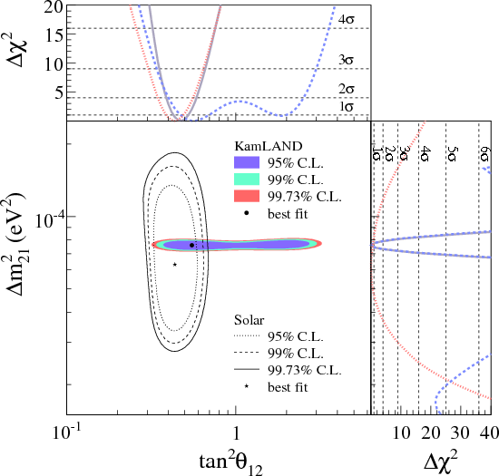
2. From first hints to evidence for θ₁₃ ≠ 0
A few years ago (2008), after the presentation of the KamLAND spectral data: impressive agreement of solar and KamLAND constraints in 2ν analyses.
Agreement obtained assuming
ν_{e} = cosθ₁₂ ν₁ + sinθ₁₂ ν₂
with a small, but acceptable, disagreement between the two best-fit points …
But one can learn more going
beyond the 2ν approximation …
[figure taken from the official KamLAND site (2008)]

Slide 5
for three neutrinos:
3ν: ν_{e} = U_{e1} ν₁ + U_{e2} ν₂ + U_{e3} ν₃
possible CP phase δ_{CP}
ν_{e} = cosθ₁₃ (cosθ₁₂ ν₁ + sinθ₁₂ ν₂) +e^{-iδ} sinθ₁₃ ν₃
mixing angle θ₁₃
However, the CP phase is unobservable via ν_{e} disappearance
So, averaging Δm²–driven oscillations (i.e. solar & KamLAND):
P_{ee} (3ν) = cos⁴θ₁₃ P_{ee}(2ν) + sin⁴θ₁₃

Slide 6
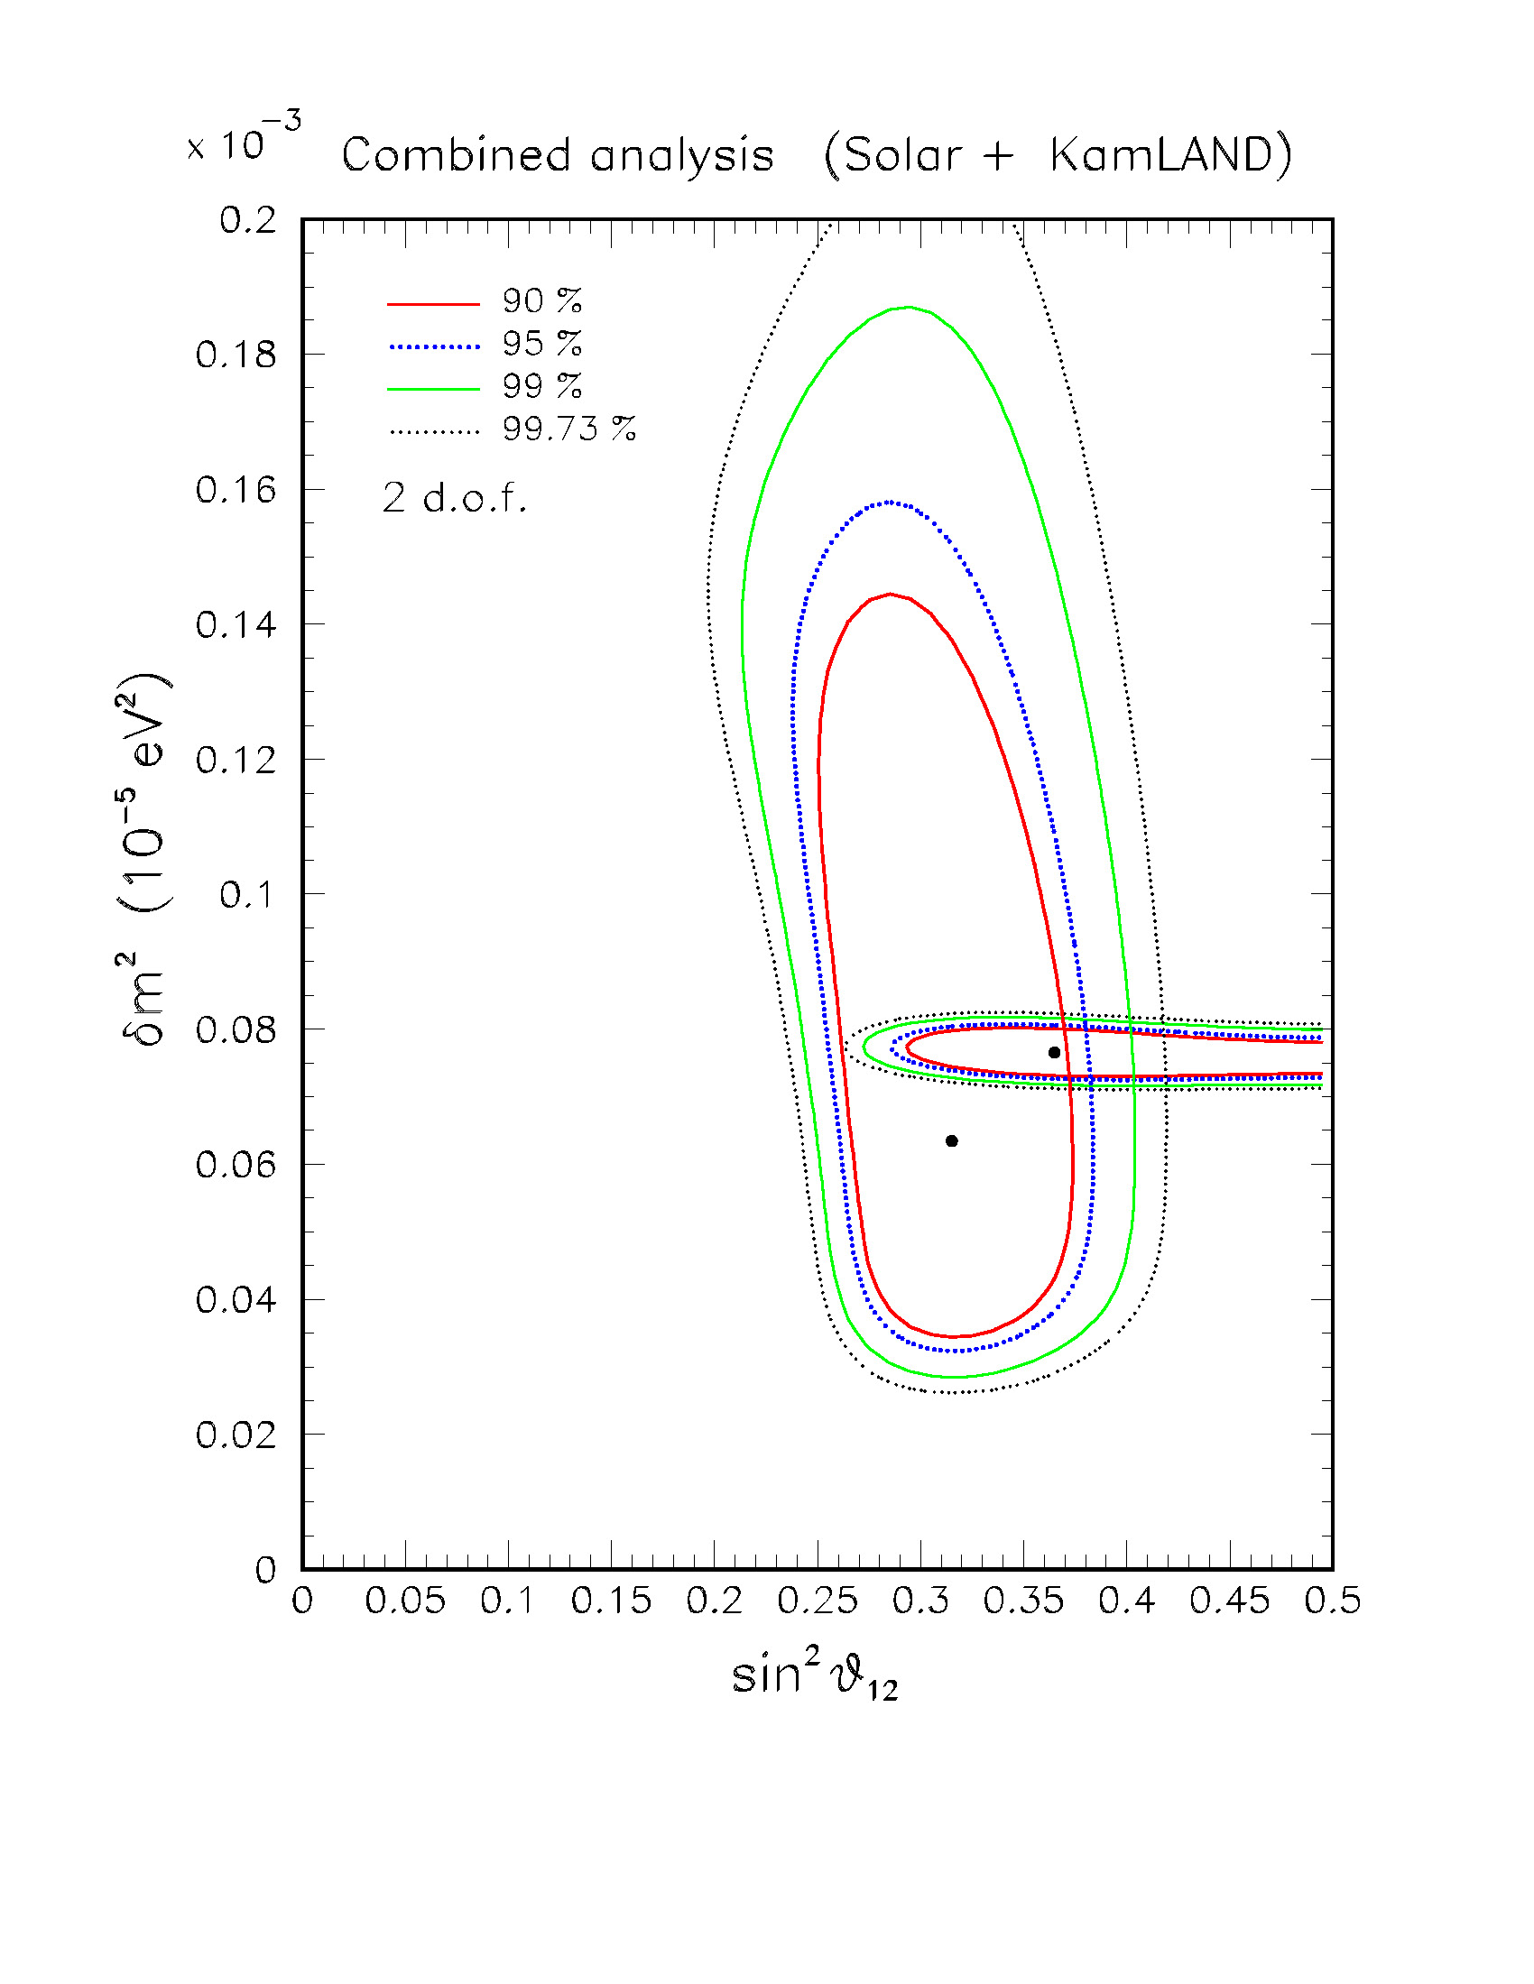
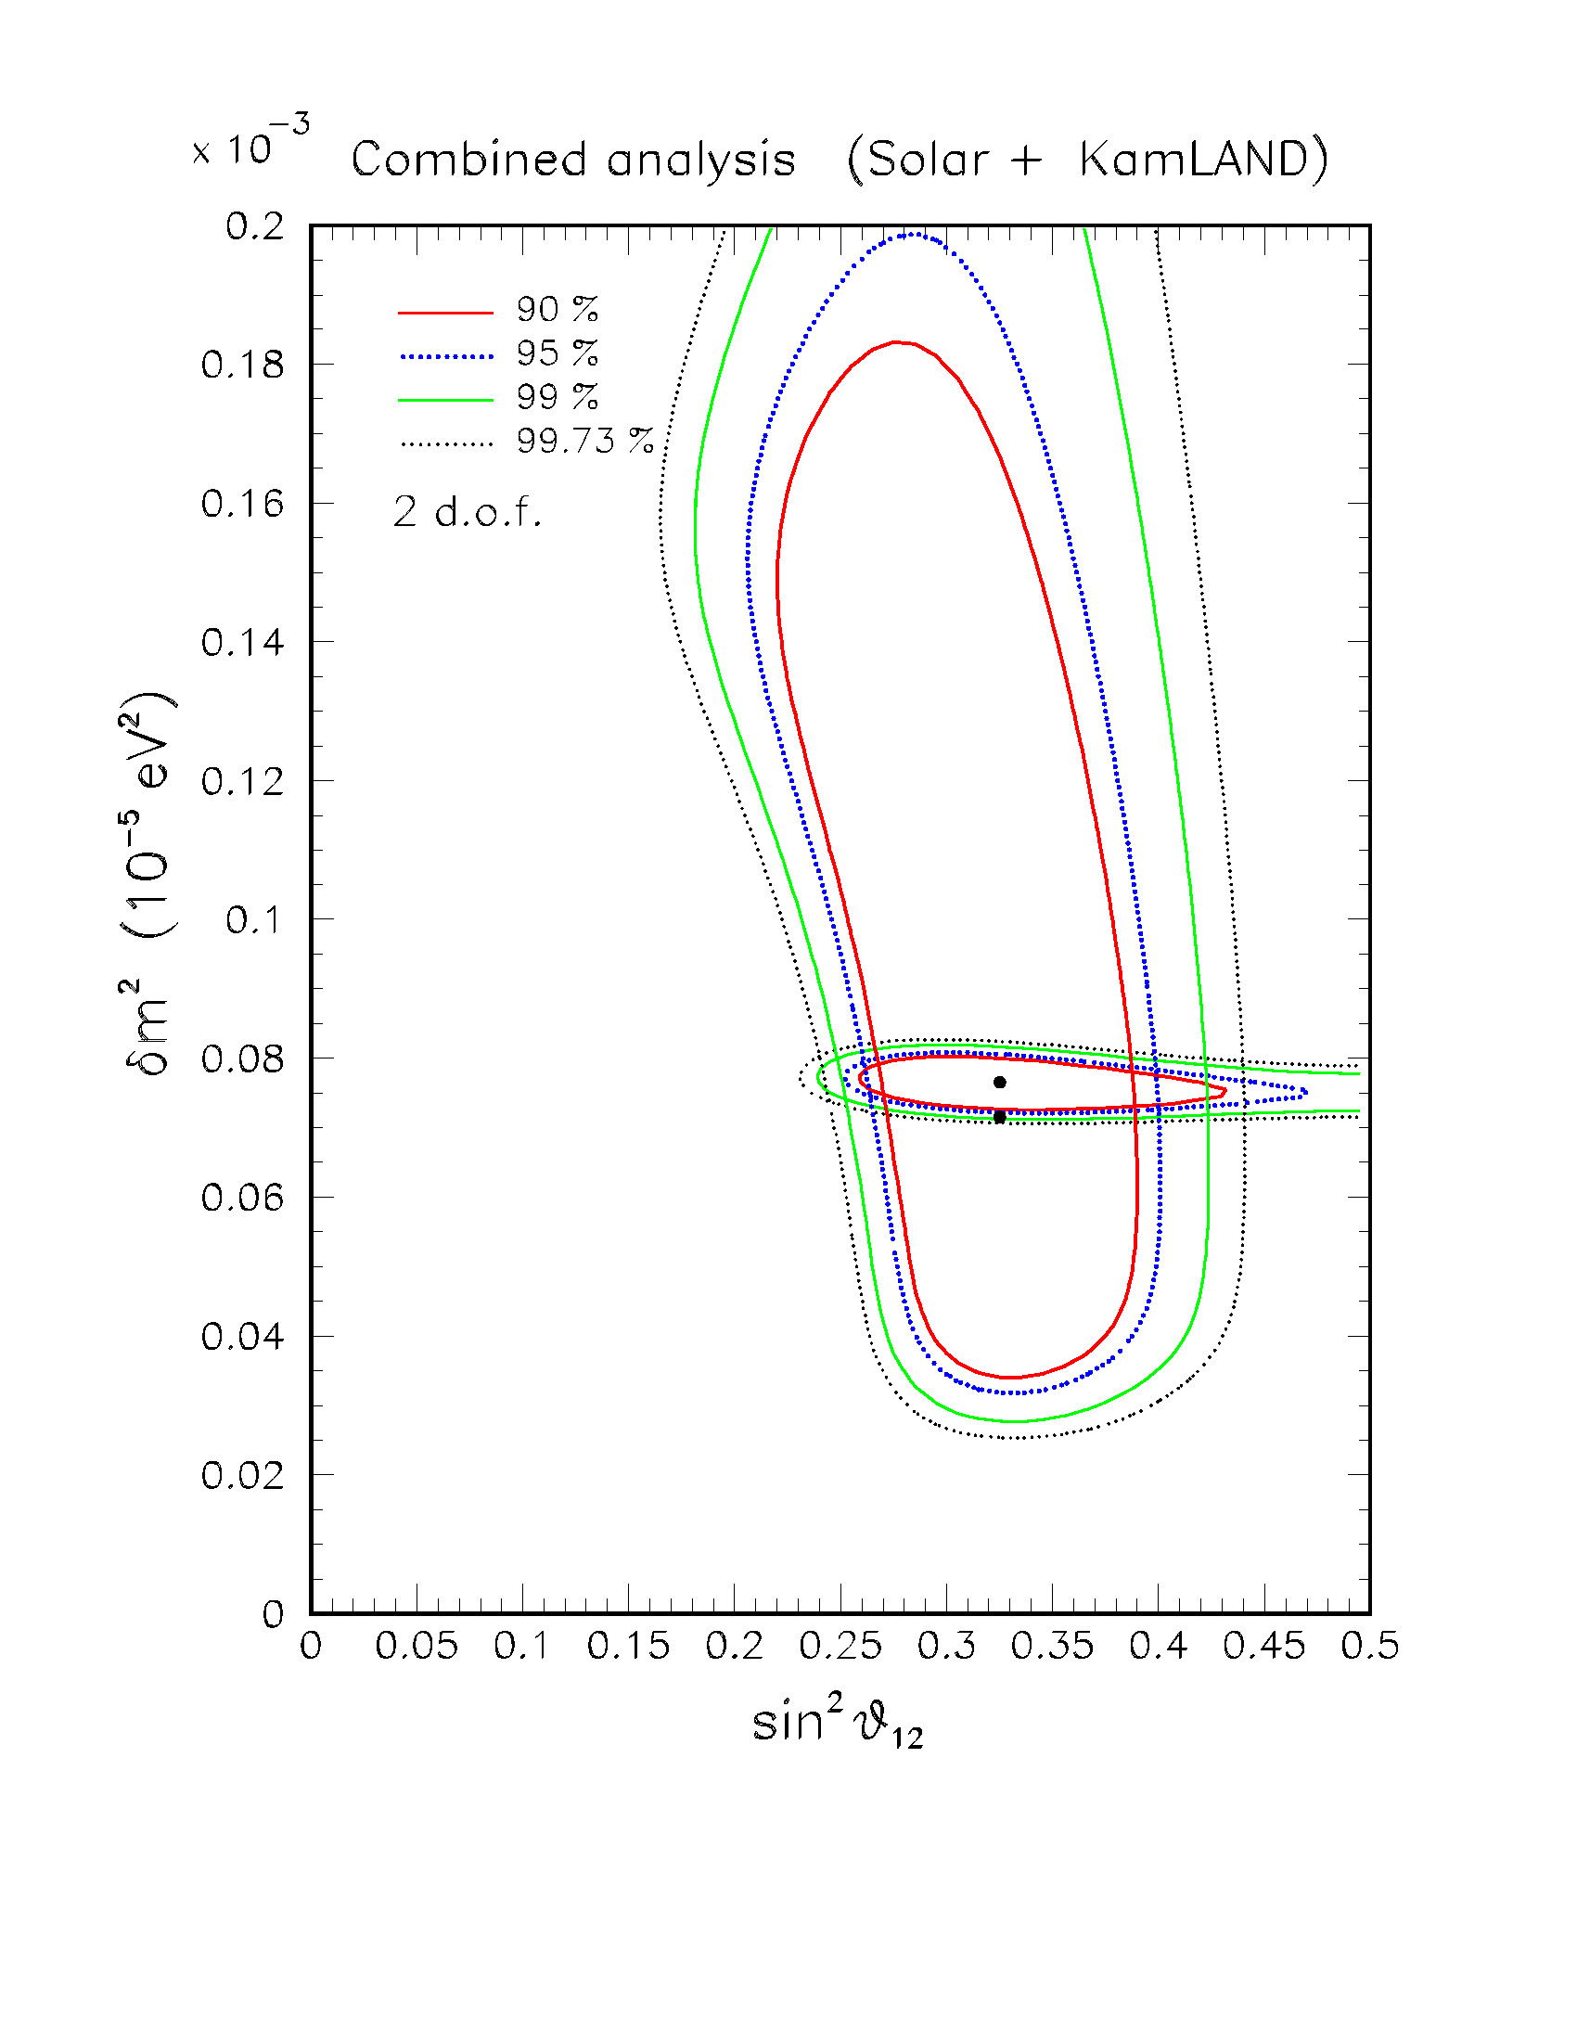
2008 data:
nonzero θ₁₃ improves the convergence of the two data sets
sin²θ₁₃ = 0
sin²θ₁₃ = 0.03
[GLF, Lisi, Marrone, Palazzo, Rotunno, Proc. of “NO-VE 2008”]
[Balantekin & Yilmaz, J.Phys. G 35, 075007 (2008), arXiv:0804.3345,]

Slide 7
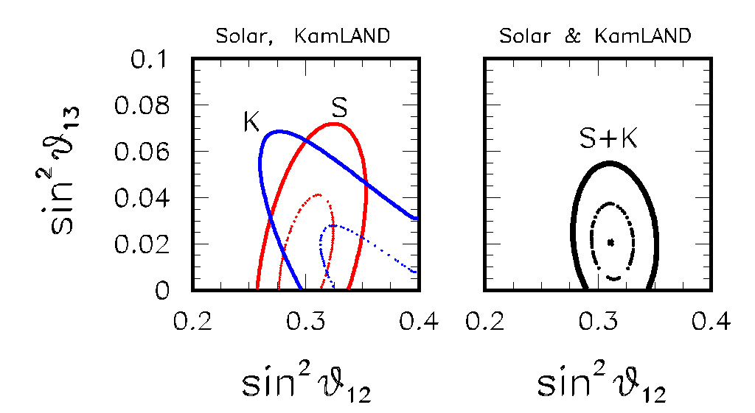
The solar+KamLAND hint for θ₁₃ > 0 can be plotted in the plane of the two mixing angles, where the different correlations of the two datasets are more evident:
Best fit more than 1 sigma away from zero
sin²θ₁₃ = 0.021 ± 0.017
(Solar + KamLAND)
2008: Hint of ν_{e} as a superposition of three states ?
[GLF, Lisi, Marrone, Palazzo, Rotunno, PRL 101, 141801 (2008), hep-ph/0806.2649]
Note: even though statistically weak (~1.5 σ), this hint is quite “clean”, as it involves very simple oscillation physics.

Slide 8
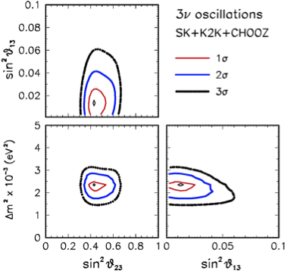
In addition, the solar + KL hint was consistent with a previous preference for θ₁₃ > 0, found from our 3ν analysis of atmospheric + LBL + Chooz data …
[GLF, Lisi, Marrone, Palazzo, Progr. Part. Nucl. Phys. 57, 742 (2006), hep-ph/0506083]
… mainly due to subleading “solar term” effects which help fitting atmospheric electron event data (especially sub-GeV).
best fit ~ 1 sigma away from zero
[However, atmospheric ν physics and data analysis are admittedly more involved; statistical significance of the atmospheric hint somewhat debated in the literature.]

Slide 9
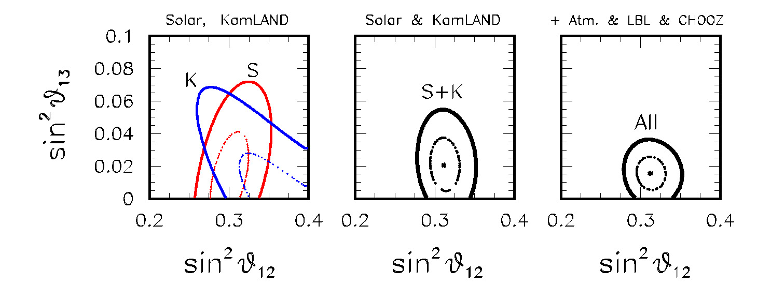
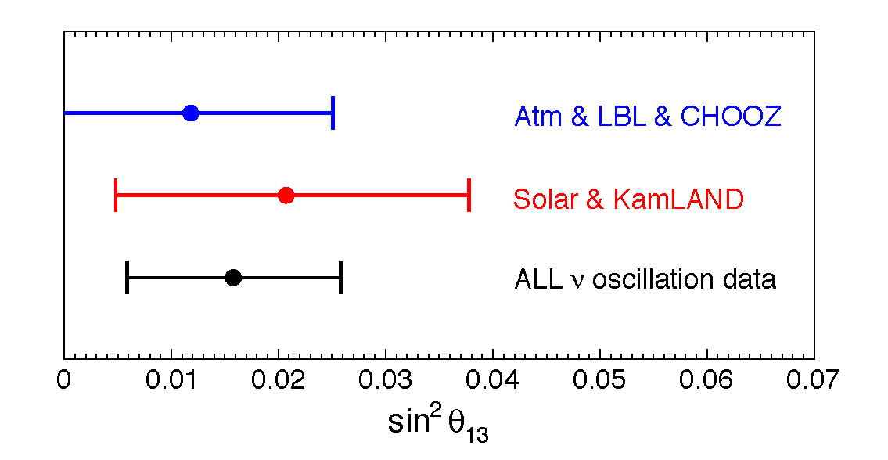
Our summary in 2008 …
“Hints of θ₁₃ > 0 from global neutrino data analysis”
[GLF, Lisi, Marrone, Palazzo, Rotunno, PRL 101, 141801 (2008), hep-ph/0806.2649]
Hint significance: 90% C.L.
sin²θ₁₃ = 0.016 ± 0.010
Large literature and debate 2008-2011!

Slide 10
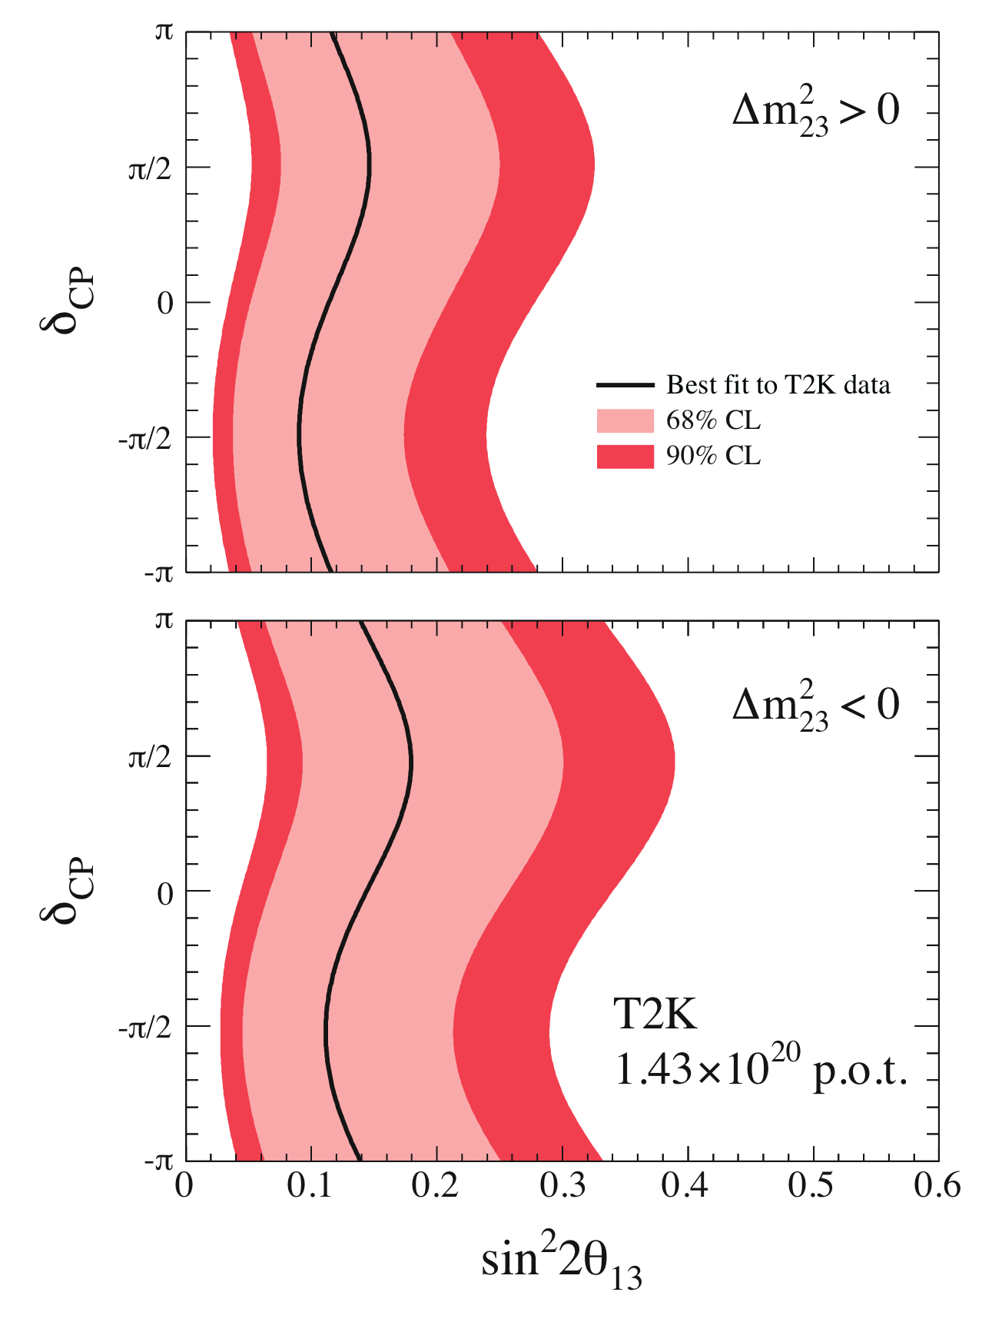
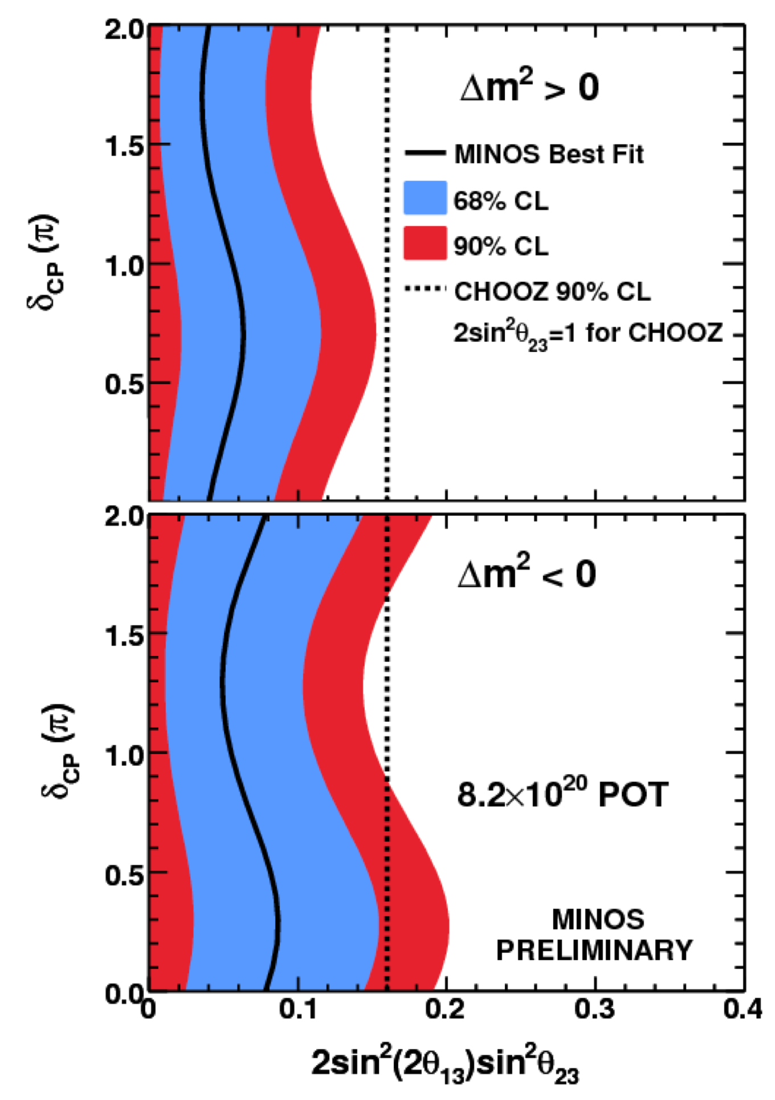
June 2011 breakthrough: new T2K and MINOS appearance results
Both experiments favor sin²θ₁₃ ~ few % !
T2K
MINOS
P_{μe} = sin²θ₂₃sin²(2θ₁₃)sin²(Δm²L/4E_{ν}) + subleading solar & CP terms
(wiggles in the plots)
So, it makes sense to combine these with all the other oscillation data …

Slide 11
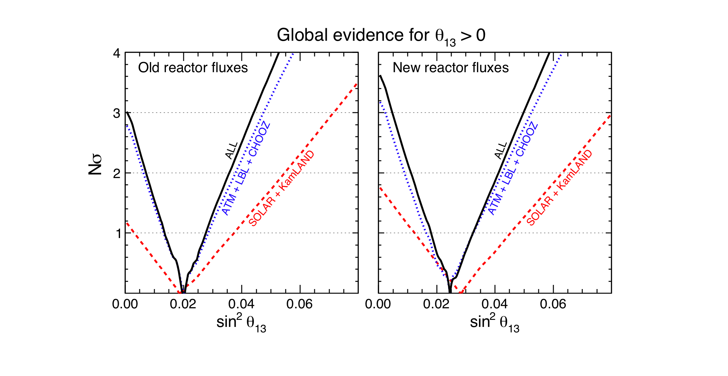
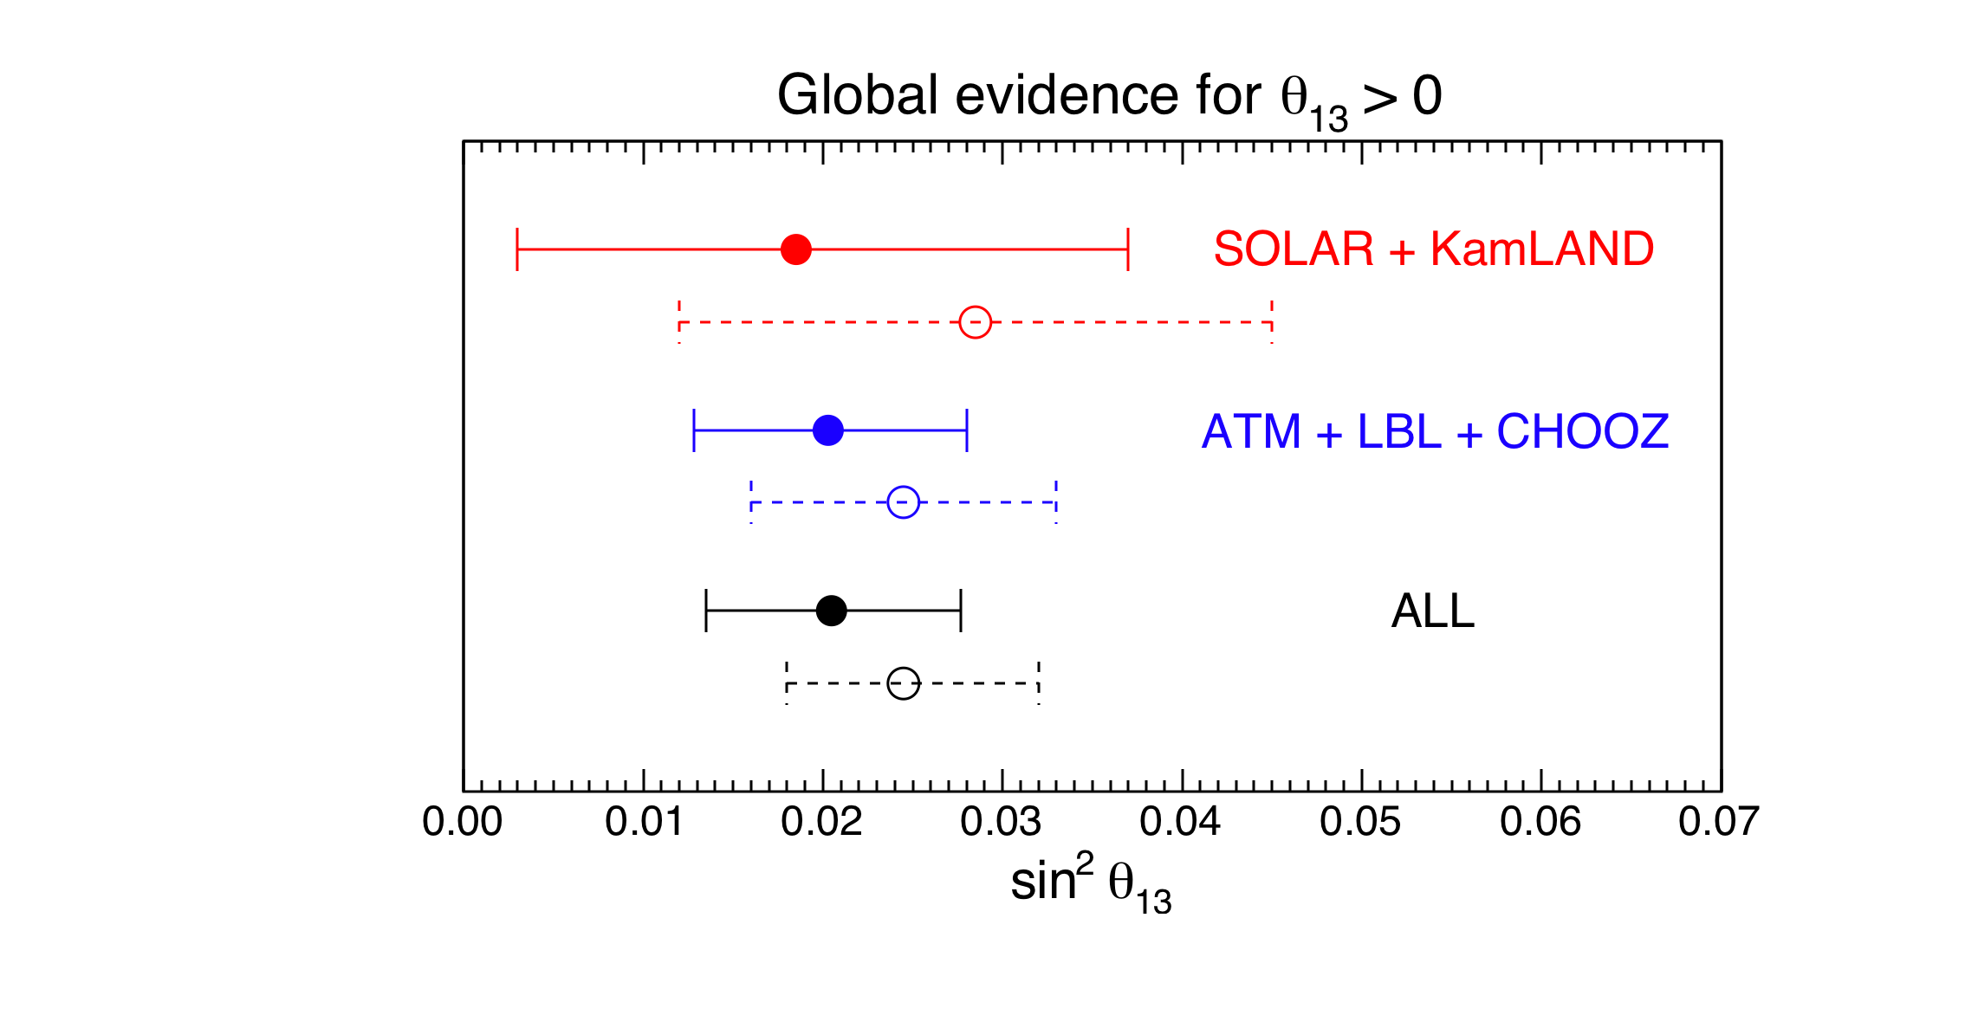
2011 data:
“Evidence of θ₁₃ > 0 from global neutrino data analysis”
[GLF, Lisi, Marrone, Palazzo, Rotunno, arXiv:1106.6028]
Note:
ATM + LBL + CHOOZ
now more significant that
Solar + KamLAND
Very good agreement of two totally independent sets of data on sin²θ₁₃
sin²θ₁₃ = 0.021 ± 0.007 (“old” reactor fluxes)
sin²θ₁₃ = 0.025 ± 0.007 (“new” reactor fluxes)
In conclusion, evidence for sin²θ₁₃ > 0 at > 3σ (with small changes for new/old reactor fluxes assumed in the fit)

Slide 12
Comparing 2011 evidence for sin²θ₁₃ > 0 …
sin²θ₁₃ = 0.021 ± 0.007 (old reactor fluxes)
sin²θ₁₃ = 0.025 ± 0.007 (new reactor fluxes)
… with new (2012) SBL reactor data:
Double Chooz (far detector):
Daya Bay (near + far detectors):
RENO (near + far detectors):
sin²θ₁₃ = 0.022 ± 0.013
sin²θ₁₃ = 0.024 ± 0.004
sin²θ₁₃ = 0.029 ± 0.006
we find a spectacular agreement!

Slide 13
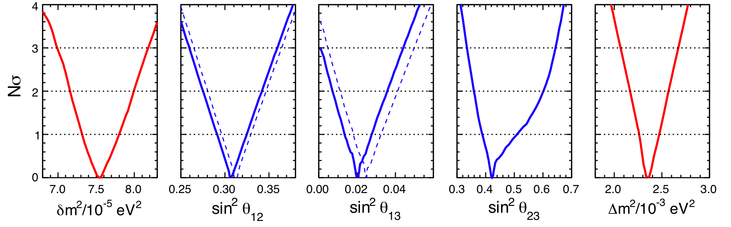
3. Status of 3ν oscillation parameters, one year ago (2011)
Global data analysis in terms of Nσ = √Δχ²
(the more linear and symmetric, the more gaussian errors)
“small” δm²
(“solar” ν)
mixing angles θ₁₂, θ₁₃, θ₂₃
“large” Δm²
(“atmospheric” ν)
[G.L.F., E. Lisi, A. Marrone, A. Rotunno, A. Palazzo, “Evidence of θ₁₃ > 0 from global neutrino data analysis”, Phys. Rev. D84 (2011) 053007, arXiv:1106.6028v2]

Slide 14
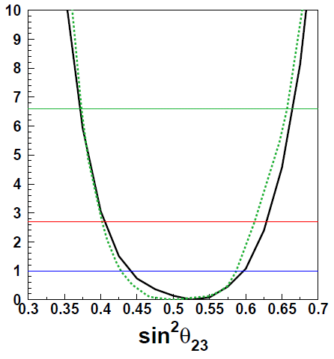
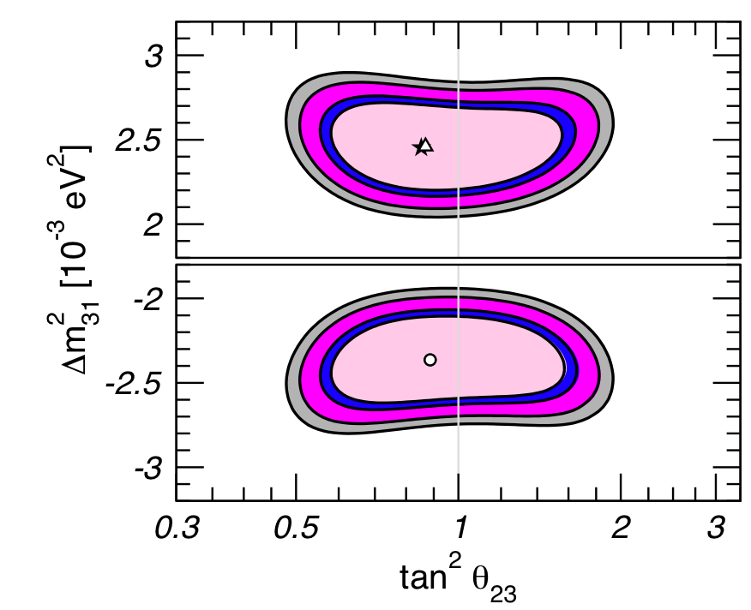
Still open problems (2011), apart from δ_{CP} …
1
3ν mass-mixing hierarchy
no hints so far
2
sin²θ₂₃: ν_{μ}-ν_{τ} mixing, maximal or not ?
SK@Neutrino2010
Gonzalez-Garcia et al. 2010
Our analysis, 2011
Nearly maximal…
Slightly nonmaximal…
Slightly more nonmaximal…
It includes now SK I+II+III
data with both θ₁₃ ≠ 0 and δm² ≠ 0

Slide 15
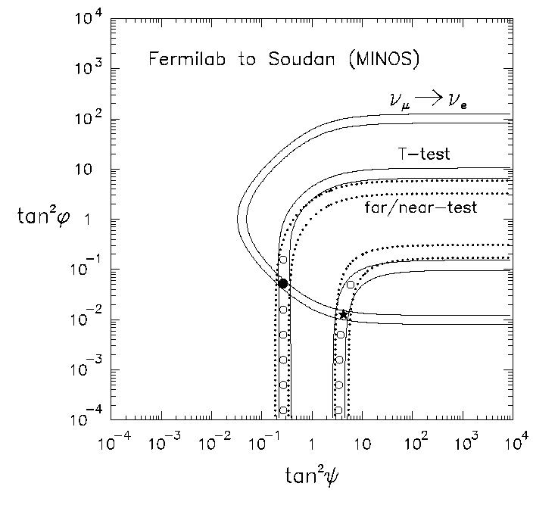
4. 3ν analysis: methodological issues
There is an interesting interplay between LBL appearance + disappearance data, SBL reactor data, and octant degeneracy, as pointed out long ago
[GLF & Lisi, Phys. Rev. D54 (1996) 3667, hep-ph/9604415]
1
For (slightly) non-maximal mixing, LBL app. + disapp. data give rise to two quasi-degenerate solutions with a (slight) anticorrelation between θ₁₃ and θ₂₃.
appear.
disappear.
[In our 1996 notation: ϕ = θ₁₃, ψ = θ₂₃]

Slide 16
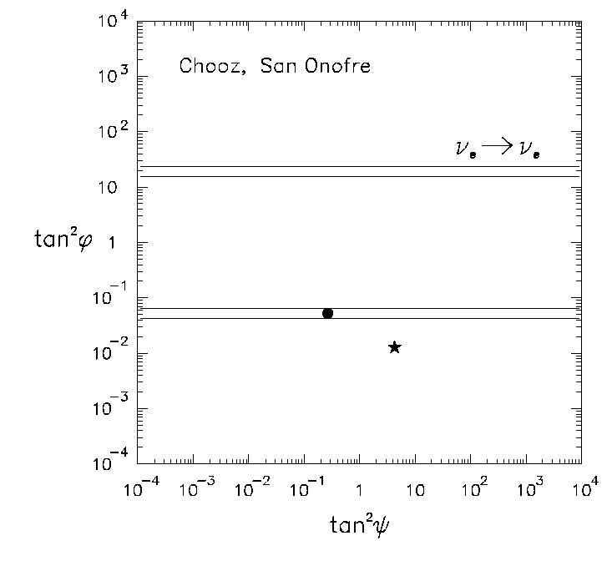
2
On the other hand, SBL reactor data, or any other constraint on θ₁₃ (eg, solar + KamLAND), may “select” or at least “prefer” one of the two solutions, lifting (part of) the degeneracy.
As we shall see in a moment, this hypothetical 1996 scenario seems to emerge from 2012 data …
… even though only at the level of hints!

Slide 17
This interplay is simply an effect of 3ν oscillation physics: in first approximation,
Δm²-driven vacuum oscillation probabilities are generalized as (2ν → 3ν):
LBL appearance: P_{μe}= sin²θ₂₃sin²(2θ₁₃)sin²(Δm²L/4E_{ν}) + corrections
NOT octant symmetric, anticorrelates θ₂₃ and θ₁₃: the lower θ₂₃, the higher θ₁₃
SBL reactors: P_{ee} = 1–sin²(2θ₁₃)sin²(Δm²L/4E_{ν}) + corrections
So, they may distinguish “high” from “low” θ₁₃
3ν combination of LBL accelerator and SBL reactor data may already
provide some slight preference for one θ₂₃ octant versus the other.

Slide 18
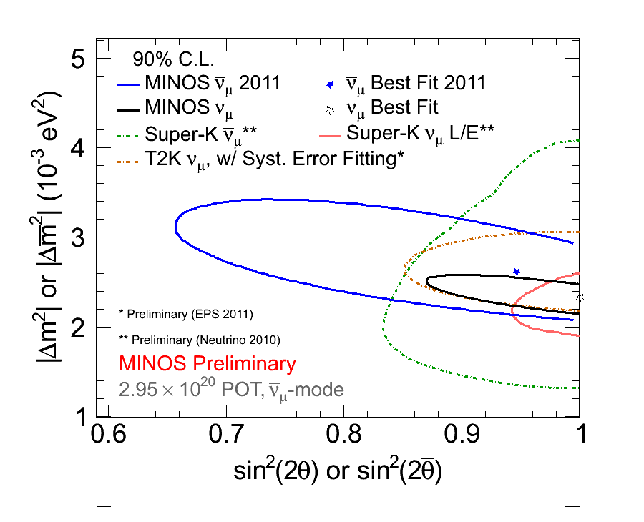
In order to reveal a similar effect, one needs a full 3ν analysis of LBL accelerator data (appearance + disappearance).
In particular it is important that T2K & MINOS abandon their (no longer defensible) 2ν approximation in disappearance mode:
OBSOLETE!
We suggest:
On the x-axis, put sin²θ₂₃, NOT sin²2θ₂₃
On the y-axis, put some 3ν (NOT 2ν) definition of Δm²
We use:
in both normal and inverted hierarchy (the sign just flips)
1
Δm² = (Δm² + Δm² )
2
31
32

Slide 19
… it is also important that T2K and MINOS combine their own disappearance + appearance data in a “full-fledged” 3ν analysis without approximation or assumption a priori.
T2K
These LBL contours may be shifted to the left (right) for higher (lower) θ₂₃, due to the anti-correlation effect seen before …
… this introduces obvious consequences for the comparison with θ₂₃–independent SBL reactor data
Suggestion: never assume maximal mixing a
priori, let the data decide!

Slide 20
A final “methodological note” before presenting our updated 2012 analysis:
1
We prefer to group LBL accelerator data with solar + KamLAND data, since the latter provide the “solar parameters” needed to calculate the
full 3ν LBL probabilities in matter
So, the sequence of contraints will be shown as:
(LBL + Solar + KamLAND)
(LBL + Solar + KamLAND) + (SBL reactor)
(LBL + Solar + KamLAND) + (SBL reactor) + (SK atm)
Moreover:
2
We have extended to any δ_{CP} our 3ν analysis of the atmospheric neutrinos, previously limited in our papers to the CP-conserving cases δ = 0 and δ = π.
3
In the following: Nσ contours Δχ² = (Nσ)²
(our usual and PDG convention)

Slide 21
5. 2012 3ν results (work in progress)
5.1 (θ₁₃, θ₂₃) correlations
Let us remind the 1996 hypothetical example [hep-ph/9604415], in which …
… two quasi-degenerate
solutions from LBL
app + disapp. data…
… are solved in favor of
higher θ₁₃ and 1st θ₂₃ octant
by SBL reactor data …

Slide 22
From 2012 LBL appearance + disappearance data plus solar + KamLAND data:
we obtain for both hierarchies, NH & IH:
normal
hierarchy
two quasi-degenerate and anticorrelated solutions (merging above 1σ)
with a marginal preference for the first octant (< 1σ)
inverted
hierarchy
Moreover:
weaker constraint on θ₁₃
for inverted hierarchy
(as already known from T2K, MINOS)

Slide 23
Adding SBL reactor data (Chooz, Double Chooz, Daya Bay, RENO):
large θ₁₃ preferred !
for both NH & IH
normal
hierarchy
NH
further preference for the solution with
higher θ₁₃
lower θ₂₃
(1st octant)
inverted
hierarchy
IH
marginal preference for 1st octant

Slide 24
Adding SK atm data:
the preference for θ₂₃ in the 1st octant is corroborated
normal
hierarchy
inverted
hierarchy
Note: overall goodness of fit very similar in NH and IH. No hint about hierarchy yet…

Slide 25
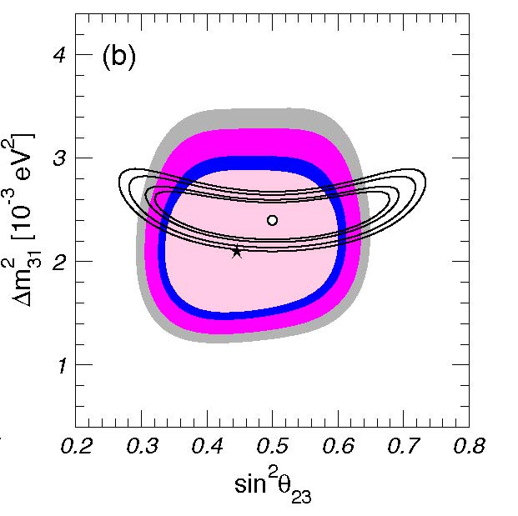
We find a significant role of SK atm data in favoring θ₂₃ in the 1st octant.
To this regards let us note that:
So far, the SK collaboration has found no significant “hint” of non-maximal mixing in their official 3ν data analysis.
However, another recent, full 3ν data analysis does find some preference for the 1st octant in atm. data:
M. Maltoni @ EPS-HEP 2011
A final message is in order:
These are still “fragile” features, but worth of
further studies in both LBL and ATM data analyses!

Slide 26
5.2 (θ₁₃, δ_{CP}) correlations
We reproduce well the T2K and MINOS contours under their same assumptions:
T2K
MINOS
Let us note that an analysis of (θ₁₃, δ_{CP}) has been performed by Minakata et al. using the recent LBL + SBL reactor data (Machado, Minakata, Nunokawa, Zukanovich Funchal, arxiv 1111.3330 and next talk). [We agree under the same inputs and priors.]
Our analysis, however, includes all data and treats all parameters as free
(no prior assumptions).

Slide 27
With only LBL + solar + KamLAND data:
normal
hierarchy
no significant sensitivity to δ_{CP} yet,
all values allowed at < 1σ
inverted
hierarchy

Slide 28
Adding SBL reactor data:
NH
normal
hierarchy
at most ~ 1σ
sensitivity
inverted
hierarchy
IH
not yet
sensitivity
at ~1σ

Slide 29
Adding SK atmospheric data:
normal
hierarchy
inverted
hierarchy
We find a ~ 1σ preference for θ ∼ π as in the early analysis of hep-ph/0506083.

Slide 30
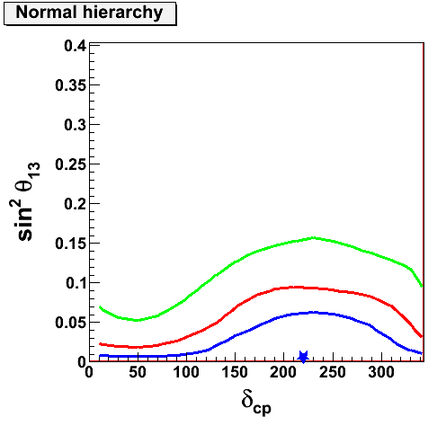
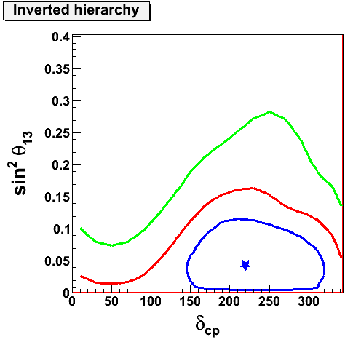
We note that δ ∼ π is compatible with SK atm. official results presented at “Neutrino 2010” by Y. Takeuchi, which favor δ ∼ 1.2 π in both hierarchies
Let us remind you our interpretation, proposed in hep-ph/0506083:
δ ∼ π enhances the interference oscillation term and gives extra electron appearance for O(GeV) atmosph. events, “explaining” part of the persisting SK electron excess.
Once more: this is a “fragile” feature, but worth further studies with current data.

Slide 31
6. CONCLUSIONS: Summary of our 2012 analysis
Previous hints of θ₁₃ > 0
are now measurements!
(and basically independent
of old/new reactor fluxes)
Some hints of θ₂₃ < π/4
are emerging at ~ 2σ ,
worth exploring by means
of atm. and LBL+reac. data
A possible hint of δ_{CP} ∼ π
emerging from atm. data
[Is the PMNS matrix real?]
So far, no hints for
NH IH

Slide 32

You are cordially invited to discuss the current oscillation picture,
from “hints” to “measurements” and beyond, at NOW 2012 (9-16 Sept)
in Conca Specchiulla, Otranto, Lecce, Italy - www.ba.infn.it/now
Thank you for your attention!

