Slide 1

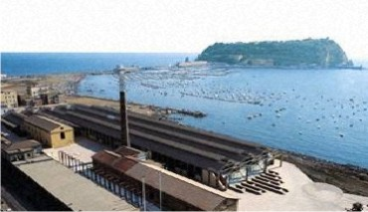
Controversial issues in S&T enter Science Centres and Museum
Guglielmo Maglio – Fondazione IDIS Erice International School of Journalism 02/08/12

Slide 2
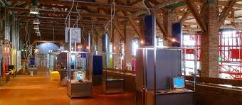
Controversial issues in S&T enter Science Centres and Museum
Guglielmo Maglio – Fondazione IDIS Erice International School of Journalism 02/08/12

Slide 3
Controversial issues in S&T enter Science Centres and Museum
summary:
What is controversial?
How museums deal with controversial issues?
Factors helping dialogue
Some experiences
Collecting visitors’ opinions
Controversial in Nano
Consensus game

Slide 4
Controversial issues in S&T enter Science Centres and Museum
controversy - defining its meaning
“An idea or a viewpoint may be considered an issue if a number of
people disagree about the statements and assertions made…
Issues that deeply divide a society, that generate conflicting
explanations and solution based on alternative value systems are
considered controversial”
(Robert Stradling 1984, Controversial Issues in Classroom)
'In general, a controversy is not a dispute involving one person, nor one
that is over rapidly. A controversy exists over a longer period of time
and divides groups of people.'
(Thomas Brante 1993, Controversial Science From Content to Contention)

Slide 5
Controversial issues in S&T enter Science Centres and Museum
controversy - defining its meaning
A controversial issue discussion is also defined as a reflective dialogue
among people about an issue on which there is a disagreement.
Controversy provokes the dialogue pushing people to access a topic
through their own opinion.
But to stimulate dialogue we should provide:
Supportive evidences (including destabilising knowledge),
Comments and expressions of different points of view (experts included)
An adequate space and time
Good management of the dialogue

Slide 6
Controversial issues in S&T enter Science Centres and Museum
The public controversy over science and society is one of the most important ways of communication between the public and the experts
Martin Bauer assertion that the public controversy over and resistance to new technology may function as unofficial technology assessment
In interviews many scientists confess that due to the public controversy over and resistance to GMO they started to look over the potential adversarial effects of their research for the first time.

Slide 7
Controversial issues in S&T enter Science Centres and Museum
Dialogue on controversial issues in S&T – Why?
Policy decisions on S&T are seen by people as either risk or safe
Risk decisions are better when public shares the power
People cannot express their opinion if they’re not informed
Explaining “risk” information is difficult but not impossible

Slide 8
Controversial issues in S&T enter Science Centres and Museum
Are museums and science centres a place for dialogue?
can popularize technical contents
know how to create the “right” environment
can be neutral arenas
have the trust of visitors
have contacts with scientists/industries and stakeholders
know their visitors

Slide 9
Controversial issues in S&T enter Science Centres and Museum
How science museums and centres deal with controversial issues on S&T?
According to Brante (1993), there are two types of science controversy:
Scientific Fact Controversy
Primarily concerns debates where the parties have scientific status
Science-based Controversy
Debates with a heavy ethical, social, political overlay

Slide 10
Controversial issues in S&T enter Science Centres and Museum
Scientific Fact Controversy
Primarily concerns debates where the parties have scientific status
The topics chosen can raise interest in visitors, but they usually play the role of passive audience, since they have not the knowledge to join the debate
Visitors should build their knowledge from the experts and mediators they meet. It’s a classical sample of Public Understanding of Science
Some topics may even not interest large public at all
(ex: Neanderthals and Sapiens are just the same species?..
Do Higgs-Bosons particles really exists?…)

Slide 11
Controversial issues in S&T enter Science Centres and Museum
Science-based Controversy
Debates with a heavy ethical, social, political overlay
These controversies needs the involvement of scientific experts, but also other experts who have parity in knowledge (philosophers, social scientists, politicians).
The understanding of science is not the only knowledge that visitors need to join the debate.
(ex.: nanotechnologies, Stem cell research, Brainsciences, Nuclear and alternative energies, GMO foods….)

Slide 12
Controversial issues in S&T enter Science Centres and Museum
A debate on controversial topics should include:
Issues often centered on risk
Issues that are “hot”, relevant and interesting for the audience
Ethical issues affecting the visitor’s experiences and feelings
Moral issues affecting the visitor’s sense of social consciousness
If we take in consideration the parameters above, we can make a debate not only controversial for scientific istitution, but also controversial for the large public.

Slide 13
Controversial issues in S&T enter Science Centres and Museum
some human/physical factors helping debate
according to the Città della Scienza experience
exhibition | Factors | human
● ● ● | Supportive evidences | ● ●
● ● ● | Comments from different points of view (experts included) | ● ● ●
● ● | An adequate space and time | ●
● | Management of the dialogue | ● ● ●

Slide 14
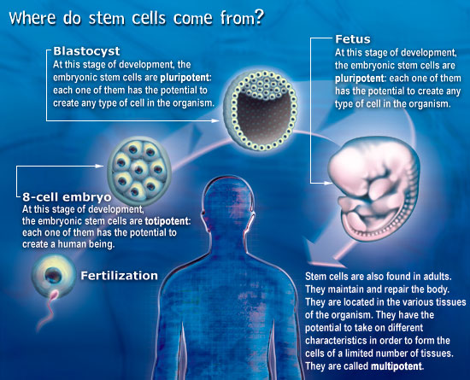
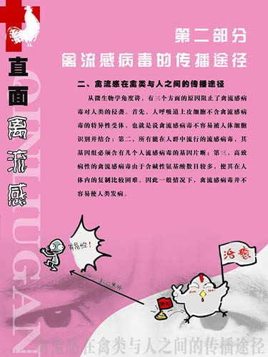
Controversial issues in S&T enter Science Centres and Museum
Exhibition: Supportive evidences:

Slide 15
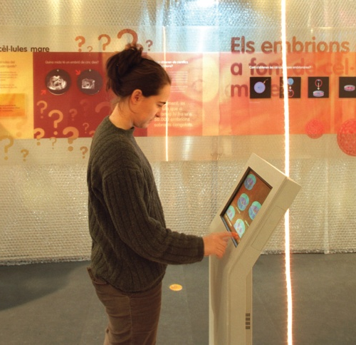
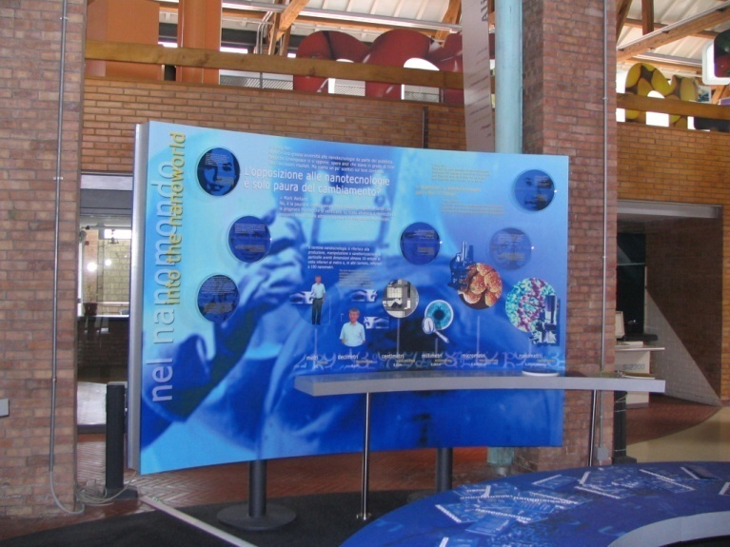

Controversial issues in S&T enter Science Centres and Museum
Exhibition: collecting opinions

Slide 16
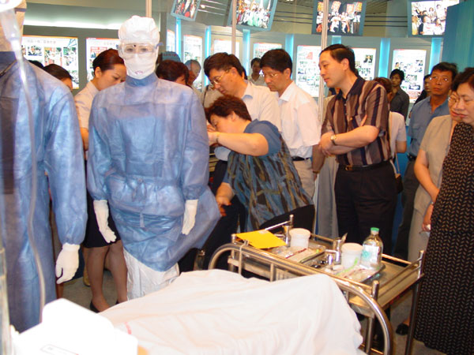
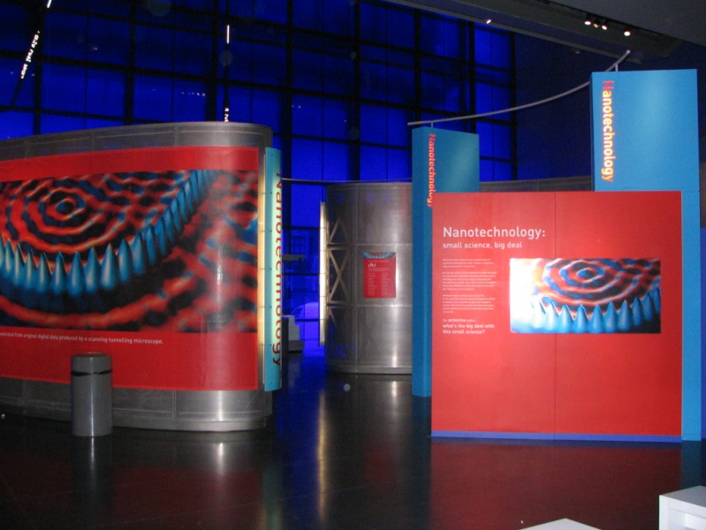
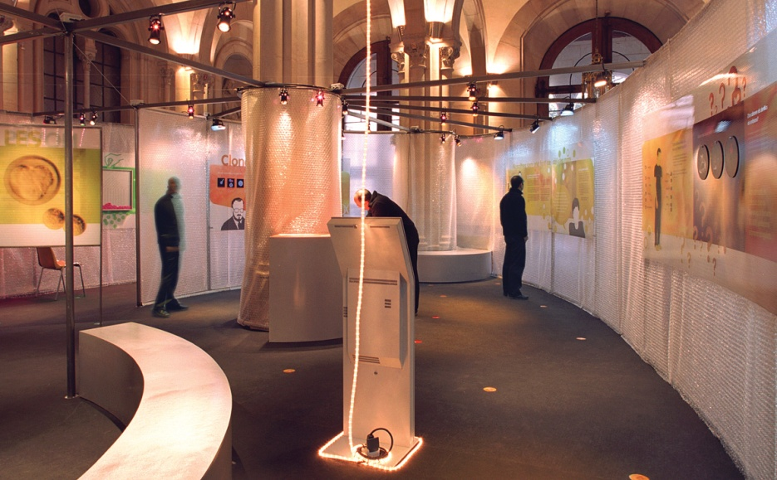
Controversial issues in S&T enter Science Centres and Museum
Exhibition: providing stimulating space

Slide 17
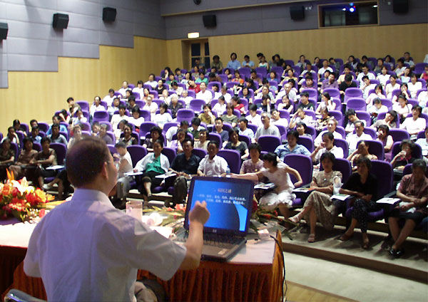
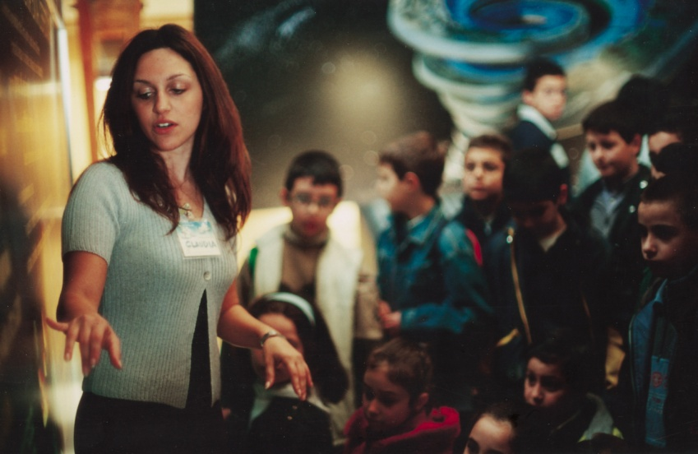
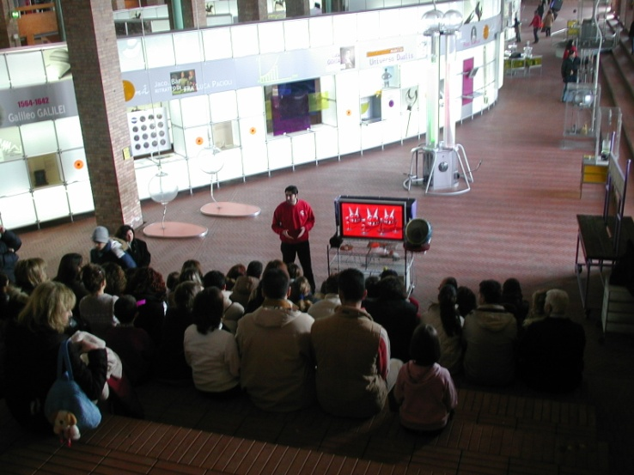
Controversial issues in S&T enter Science Centres and Museum
human: Supportive evidences

Slide 18
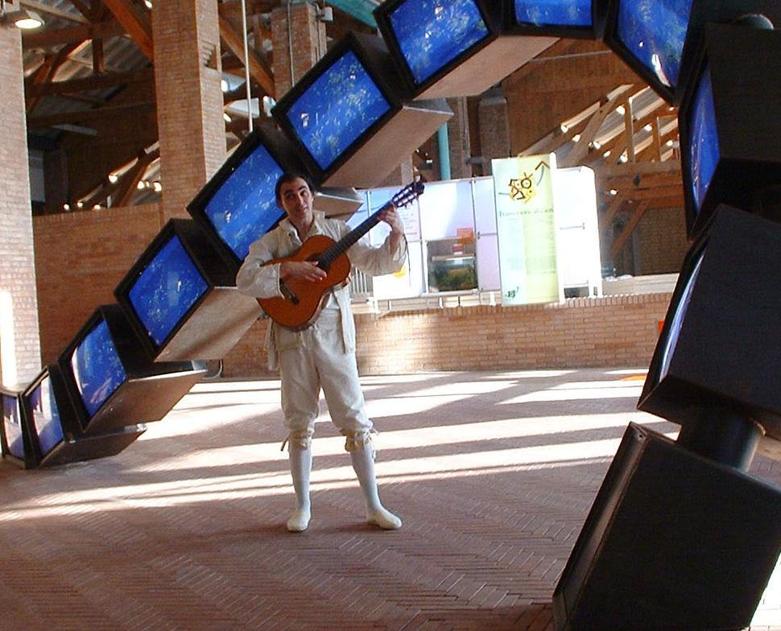
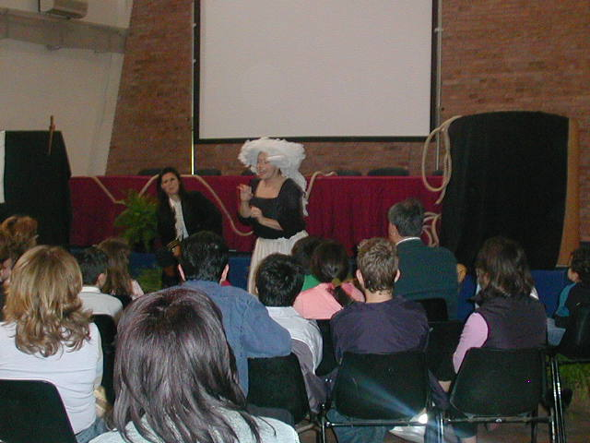
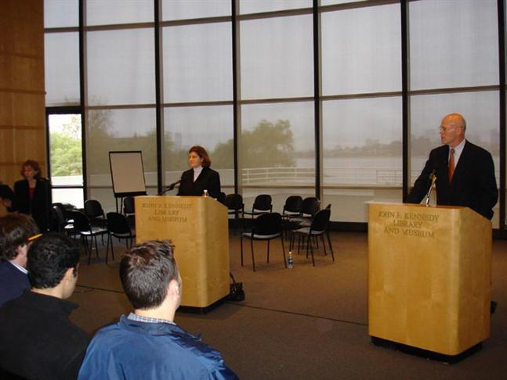
Controversial issues in S&T enter Science Centres and Museum
human: stimulating opinions

Slide 19
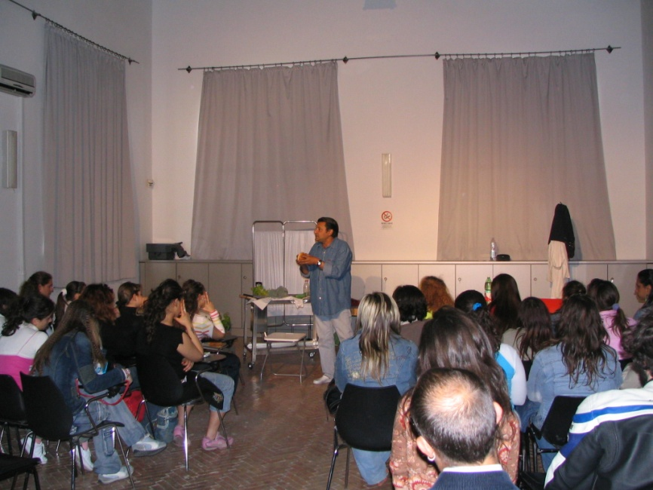
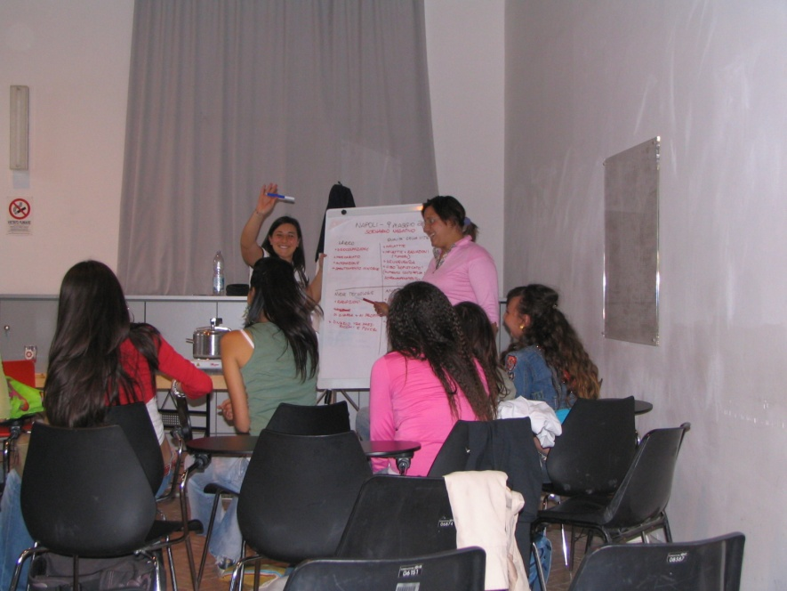
Controversial issues in S&T enter Science Centres and Museum
human: management of the dialogue

Slide 20
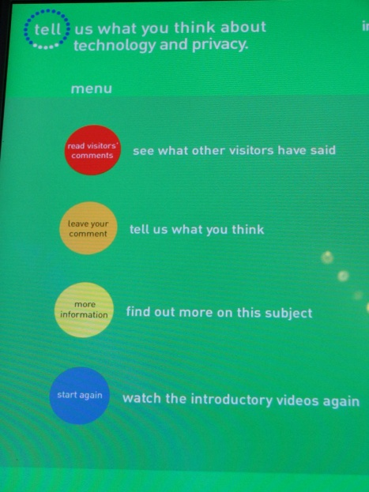
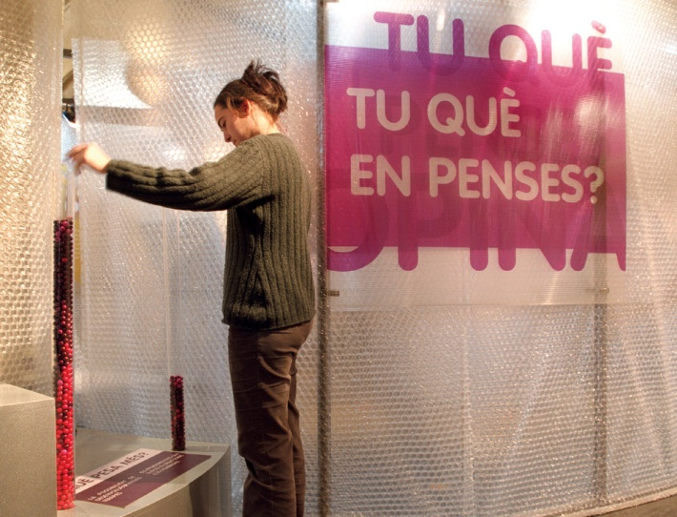
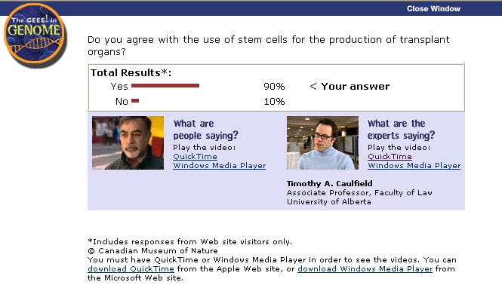
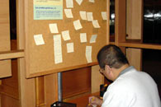
Controversial issues in S&T enter Science Centres and Museum
When visitors have their say!

Slide 21

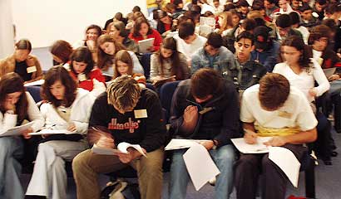
Controversial issues in S&T enter Science Centres and Museum
When visitors have their say!

Slide 22
Science centres and public debates: involving the public in decisions on science and technology
Talking Nano!
Notes:
When it comes to unequal access to technology, information insecurity and inadequate biodefense research it is clear that it is not too early to identify the factors and begin to respond to
This comes from the consideration that technology result in comfort, security, health and longevity of people’s lives in industrialized nations. A more encompassing historical, global and ecological view od technology’s development and impacts, shows that emerging technologies are not inevitably good. Science creates, industry applies and society adapts
It is thought that public opposition is the result of misunderstandings or baseless concerns regarding them, and this is not always true. Ethical aspects depends on value judgements and conceptions of the good – areas in which business acumen and scientists knowledge afford no special privilege.

Slide 23
Science centres and public debates: involving the public in decisions on science and technology
Talking Nano!
Three Misconceptions about Emerging Nanotechnologies
It is too soon to tell what the social and ethical issues are.
(ex: unequal access to technology)
The nanotechnology revolution is inevitably good.
(ex: difference between industralized nations, sustainability)
The point of the social and ethical issues is to secure public acceptance.
(ex: opposition is not always the result of misunderstanding)
Notes:
When it comes to unequal access to technology, information insecurity and inadequate biodefense research it is clear that it is not too early to identify the factors and begin to respond to
This comes from the consideration that technology result in comfort, security, health and longevity of people’s lives in industrialized nations. A more encompassing historical, global and ecological view od technology’s development and impacts, shows that emerging technologies are not inevitably good. Science creates, industry applies and society adapts
It is thought that public opposition is the result of misunderstandings or baseless concerns regarding them, and this is not always true. Ethical aspects depends on value judgements and conceptions of the good – areas in which business acumen and scientists knowledge afford no special privilege.

Slide 24
Science centres and public debates: involving the public in decisions on science and technology
Social and Ethical Issues about Nanotechnologies
Social context Issues
Contested Moral Issues
Technoculture Issues
Form of life Issues
Transformational Issues
Source: Ronald Sandler, 2009. Nanotechnology: the Social and Ethical Issues.
Notes:
Unequal access to technology, inadequate information security/privacy protection, inefficiences in intellectual prperty systems, unequal exposure to environmental hazards and inadequate consumersafety protection
Syntethic biology, construction of artificial organisms, biological weapons development, stem cell research and genetic modification of human beings
Technoculture means overreliance on technological fixes to manage problematic effects (rather than addressing the cause of the effects) overestimating our capacity to predict and control technology
If nanomedicine helps to extend the average human life span even five or ten healthful years, it will have impact on family norms and structures , life plans and trajectories , social and poltical istitutions
These issues arise from nanotechnlogy potential (in combination with biotechnology, infomation technology, robotics) to transform aspects of human situation, by altering the kind of creature that we are or creating autonomous artificial life.

Slide 25
Science centres and public debates: involving the public in decisions on science and technology
Social context Issues about Nanotechnologies
• differential access to medical care andmedical technologies;
• educational inequalities;
• inadequate information security/privacy protections;
• inefficiencies in intellectual property systems;
• inadequate individual autonomy protections;
• under-representation of women and minority groups in engineering and academia;
• unsustainable agricultural policies and practices;
• unfair tariffs, subsidies and tradeagreements;
• inadequate consumer safety protection;
• conflicts of interests for regulators or researchers;
• externalization of pollution and health costs;
• inadequate biodefense/military research oversight; and
• inadequate governmental capacity (e.g., resources, expertise, commitment, institutional design, legal authority, public trust, communication, access to information).
Notes:
Unequal access to technology, inadequate information security/privacy protection, inefficiences in intellectual prperty systems, unequal exposure to environmental hazards and inadequate consumersafety protection
Syntethic biology, construction of artificial organisms, biological weapons development, stem cell research and genetic modification of human beings
Technoculture means overreliance on technological fixes to manage problematic effects (rather than addressing the cause of the effects) overestimating our capacity to predict and control technology
If nanomedicine helps to extend the average human life span even five or ten healthful years, it will have impact on family norms and structures , life plans and trajectories , social and poltical istitutions
These issues arise from nanotechnlogy potential (in combination with biotechnology, infomation technology, robotics) to transform aspects of human situation, by altering the kind of creature that we are or creating autonomous artificial life.

Slide 26
Science centres and public debates: involving the public in decisions on science and technology
Contested Moral Issues about Nanotechnologies
• biological and chemical weapons;
• human embryonic stem cell research (and associated therapeutics);
• human enhancement; and
• gene patenting and bio-prospecting.
Notes:
Unequal access to technology, inadequate information security/privacy protection, inefficiences in intellectual prperty systems, unequal exposure to environmental hazards and inadequate consumersafety protection
Syntethic biology, construction of artificial organisms, biological weapons development, stem cell research and genetic modification of human beings
Technoculture means overreliance on technological fixes to manage problematic effects (rather than addressing the cause of the effects) overestimating our capacity to predict and control technology
If nanomedicine helps to extend the average human life span even five or ten healthful years, it will have impact on family norms and structures , life plans and trajectories , social and poltical istitutions
These issues arise from nanotechnlogy potential (in combination with biotechnology, infomation technology, robotics) to transform aspects of human situation, by altering the kind of creature that we are or creating autonomous artificial life.

Slide 27
Science centres and public debates: involving the public in decisions on science and technology
Technoculture Issues about Nanotechnologies
• tendency to favor technological fixes over comprehensive solutions;
• tendency to treat problematic effects rather than address their underlying causes;
• techno-hubris, or overestimation of our ability to predict and control technology
(particularly within complex systems);
• techno-determinism, or overstatement of the extent to which technology drives history;
• techno-optimism, or overconfidence in the inevitable goodness of technology
and its capacity to solve social and environmental problems;
• alienation from nature—i.e., detrimental technological mediation of interactions
and relationships between people and nature;
• commodification of nature and marginalization of non-economic values; and
• privileging elite-controlled risk assessment (rather than inclusive or precautionary
approaches) to determining responsiveness to uncertainties associated with technology.
Notes:
Unequal access to technology, inadequate information security/privacy protection, inefficiences in intellectual prperty systems, unequal exposure to environmental hazards and inadequate consumersafety protection
Syntethic biology, construction of artificial organisms, biological weapons development, stem cell research and genetic modification of human beings
Technoculture means overreliance on technological fixes to manage problematic effects (rather than addressing the cause of the effects) overestimating our capacity to predict and control technology
If nanomedicine helps to extend the average human life span even five or ten healthful years, it will have impact on family norms and structures , life plans and trajectories , social and poltical istitutions
These issues arise from nanotechnlogy potential (in combination with biotechnology, infomation technology, robotics) to transform aspects of human situation, by altering the kind of creature that we are or creating autonomous artificial life.

Slide 28
Science centres and public debates: involving the public in decisions on science and technology
Transformational Issues about Nanotechnologies
• For the person undergoing an enhancement, what are the risks associated with the process?
• Would it be beneficial or detrimental to become radically enhanced?
• Is there something problematic about the desire to become radically enhanced?
• Should parents have the legal right to radically enhance their children?
• Is it morally permissible for parents to radically enhance their children (and, if
so, should they do so)?
• Should parents ever be required to radically enhance their children?
• How would radical human enhancement affect obtaining familial relationships,
institutions and norms?
• How would radical human enhancement impact obtaining social norms, practices,
organizations and institutions beyond the family?
• Overall, would widespread radical human enhancement have good or bad
social consequences?
• Would radical human enhancement impair or promote justice?
• How would radical human enhancement alter our relationship to the environment and non-human organisms?
Notes:
Unequal access to technology, inadequate information security/privacy protection, inefficiences in intellectual prperty systems, unequal exposure to environmental hazards and inadequate consumersafety protection
Syntethic biology, construction of artificial organisms, biological weapons development, stem cell research and genetic modification of human beings
Technoculture means overreliance on technological fixes to manage problematic effects (rather than addressing the cause of the effects) overestimating our capacity to predict and control technology
If nanomedicine helps to extend the average human life span even five or ten healthful years, it will have impact on family norms and structures , life plans and trajectories , social and poltical istitutions
These issues arise from nanotechnlogy potential (in combination with biotechnology, infomation technology, robotics) to transform aspects of human situation, by altering the kind of creature that we are or creating autonomous artificial life.

Slide 29
Science centres and public debates: involving the public in decisions on science and technology
How to introduce topics
Tell visitors what they should know
Make visitors understand (or having the perception that they can understand)
Prepare visitors to what you are not telling them
Help them to express their opinion

Slide 30
Science centres and public debates: involving the public in decisions on science and technology
Hot-topics in Science centres
Nanotechnology
Stem cell research
Brainsciences
Nuclear and alternative energies
GMO foods

Slide 31
Science centres and public debates: involving the public in decisions on science and technology
What we should know before
We can’t give visitors “scary” information without scarying them
When we communicate risk there is always an emotional component
Reaction of visitors can be emotional and rational at the same time
That there are risk-communication professionals who can help
That people can find their preferred information sources (not always the more reliable ones)
That not all the scientists know how to communicate

Slide 32
Science centres and public debates: involving the public in decisions on science and technology
Sharing the power
When visitors are informed and able to decide, they
don’t feel excluded
understand things better
can evaluate (and eventually tolerate) risk much better

Slide 33
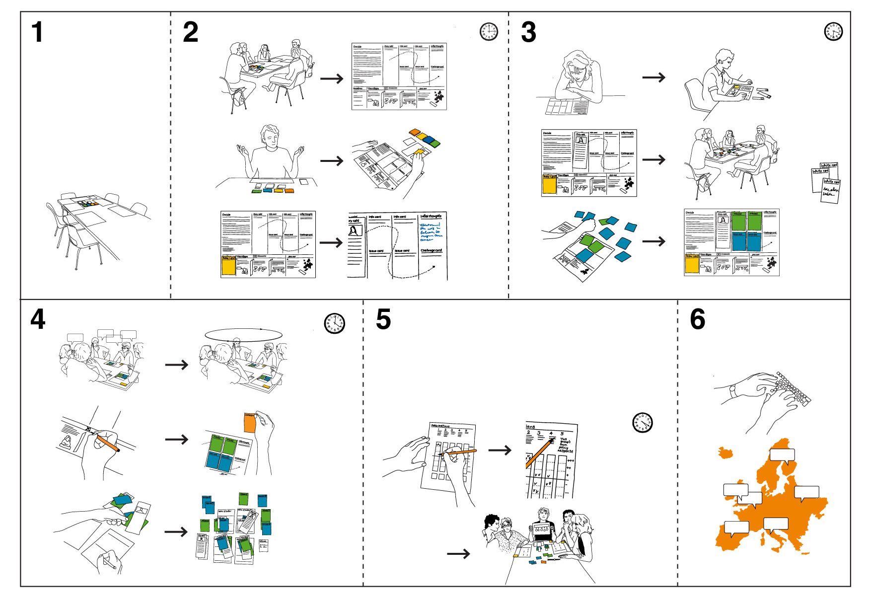
Controversial issues in S&T enter Science Centres and Museum
Decide game

Slide 34
Controversial issues in S&T enter Science Centres and Museum
time for your questions….
Thank you!
Guglielmo Maglio
maglio@cittadellascienza.it

Slide 35
Science centres and public debates: involving the public in decisions on science and technology

Slide 36
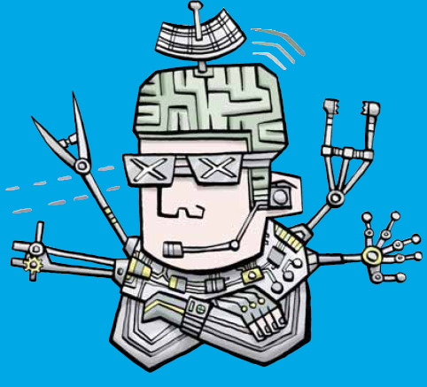
Science centres and public debates: involving the public in decisions on science and technology

