Slide 1
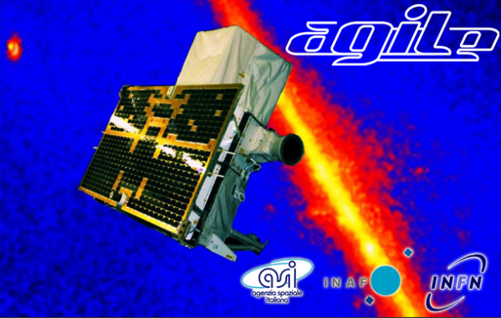
Young Researchers Meeting in Rome
January 20, 2012
Direct proof of CR
acceleration by SNR W44
Martina Cardillo
Andrea Giuliani
Marco Tavani
Università di Roma Tor Vergata & INAF-IASF Roma
martina.cardillo@iasf-roma.inaf.it

Slide 2
The AGILE team and the
PI Marco Tavani has won the “Bruno Rossi Prize”
2012

Slide 3
Table of Contents
Brief introduction on Cosmic-Ray and SNRs:
Why SNRs?
The importance of a low energy analysis
The Supernova Remnant W44:
An overview
AGILE results
Possible developments
Conclusions

Slide 4
Cosmic Ray problem: acceleration
Supernova Remnants(for E<${10}^{15}$eV)
1
2
High magnetic field and X variation
3
The only quantitative approach

Slide 5
Cosmic Ray problem: acceleration
Protons need high density
Molecular Clouds
INDIRECT PROOFS
Ambiguity Inverse Compton peak and pion bump
Multiwavelength
analysis
Low energy
analysis

Slide 6
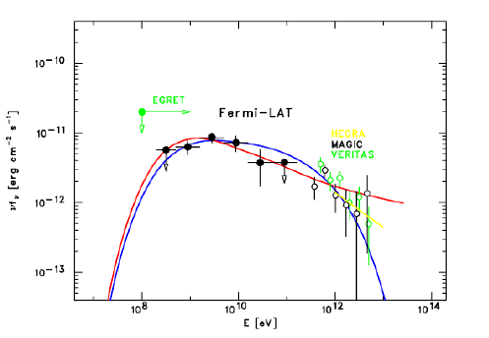
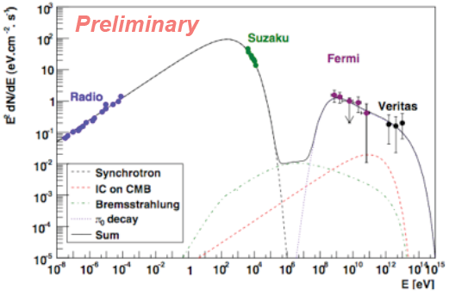
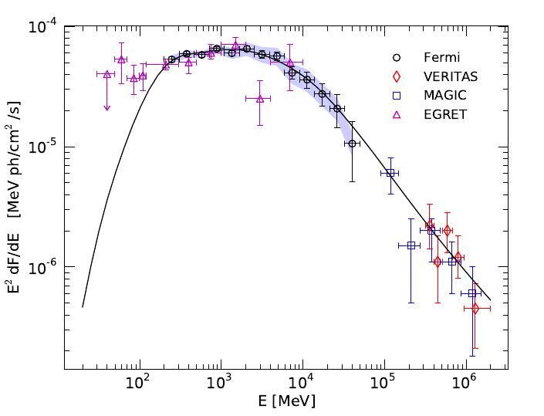
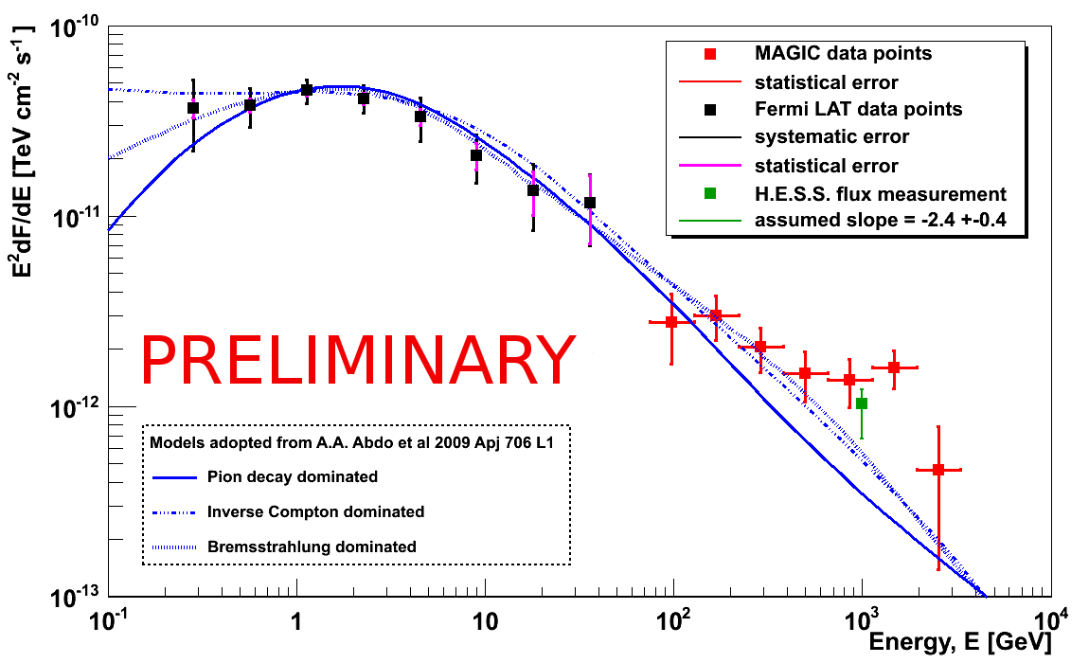
CAS A
W51c
IC443
Cosmic Ray problem: acceleration
Tycho
Giordano et al. 2012
CAS A
Abdo et al. 2010
Abdo et al. 2010
Krause et al. 2011
Abdo et al. 2010
Tavani et al. 2010

Slide 7
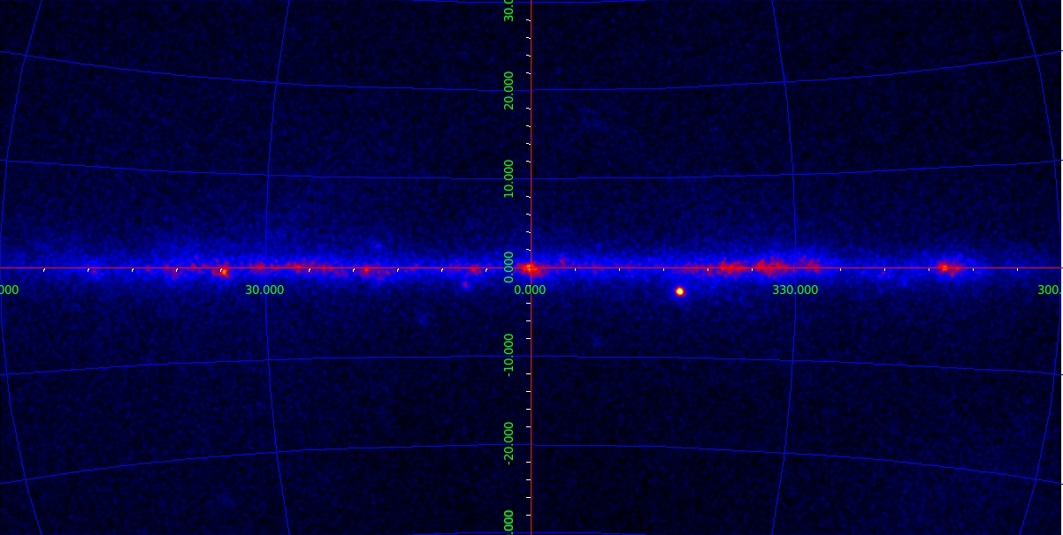
The SNRW44
Galactic Plane
W44 (G34.7-0.4)
Distance:
3.1 kpc
(1pc=$3×{10}^{18}$ cm)
Middle Age:
$2×{10}^{4}$ yrs
Mixed morphology
AGILE sky E>400 MeV

Slide 8
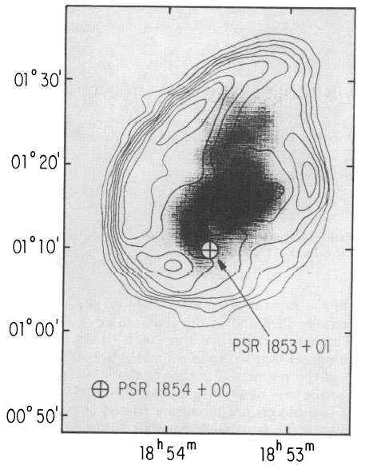
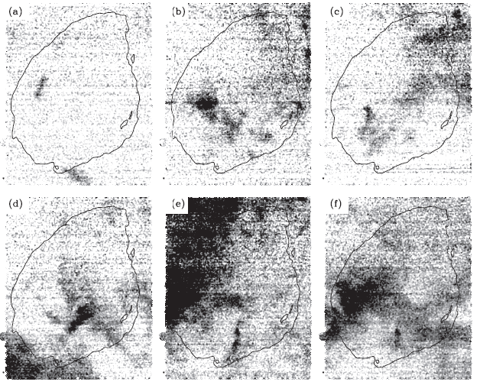
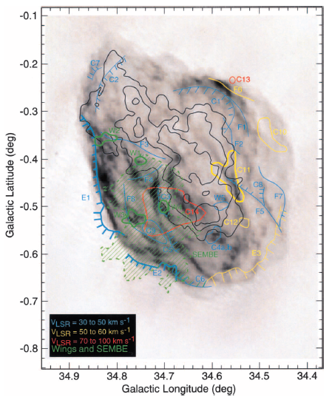
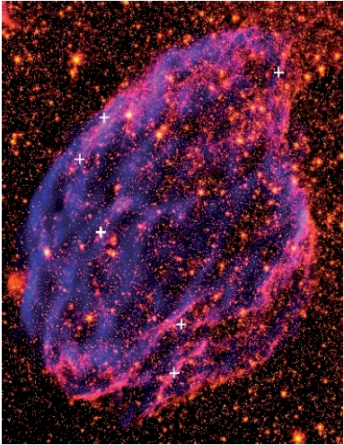
The SNRW44: low-energy
Wolszczan et al. (1991)
Reach et al. (2005)
CO integrated
emission
over a different
velocity range.
94,9-97,5
80,6-88,4
72,8-79,3
Discovery of a Radio pulsar → same age and same distance.
54,6-59,8
45,4-52
38,6-42,8
Seta et al. (2004)
Castelletti et al. (2007)
Wings →interaction with a MC
SEMBE: due to the shocked gas
Eastern limb spectrum consistent with a diffusive shock acceleration model

Slide 9
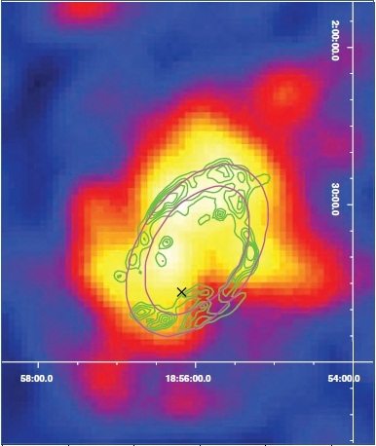
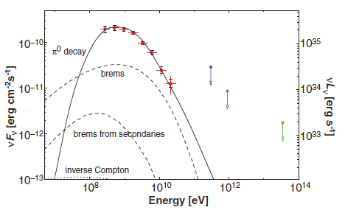
The SNRW44: high energy
Fermi-LAT
$π^{0} decay$ most plausible model.
GeV emission extended → gamma-ray no attributed to radio pulsar.
Spectral break → no linear DSA (Malkov et al. 2010).
Abdo et al. (2010)

Slide 10
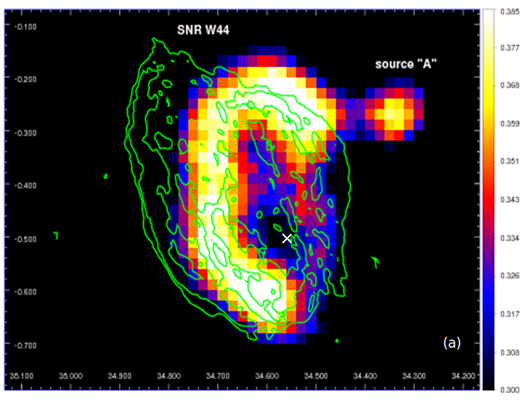
The SNRW44: high energy
AGILE
Giuliani, Cardillo,Tavani et al .(2011)
AGILE map
E>400 MeV
VLA contours
(Dubner, Castelletti et al.)

Slide 11
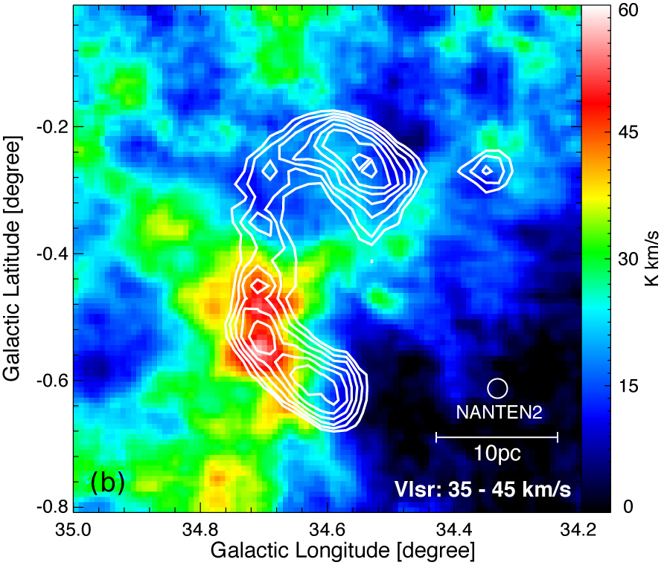
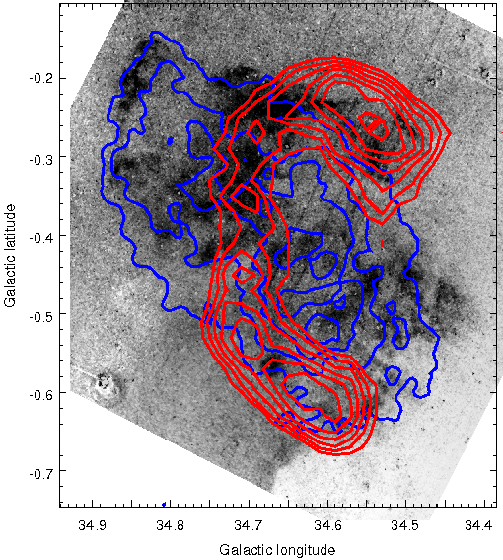
The SNRW44: high energy
AGILE
AGILE contours
S[II] Burrell Smith telescop image with ROSAT contours (Castelletti &Dubner, adapted from Giacani et al. 1997)
CO NANTEN image (Fukui )
Giuliani, Cardillo, Tavani et al .(2011)

Slide 12
The SNRW44: high energy
Fermi-LAT
In Abdo et al (2010)
Bremsstrahlung is exlcluded as dominant contribution assuming n$\sim {10}^{2}$ and $K_{ep}\sim {10}^{−2}$→ B$\sim 70μG$
Parameter
combinations

Slide 13
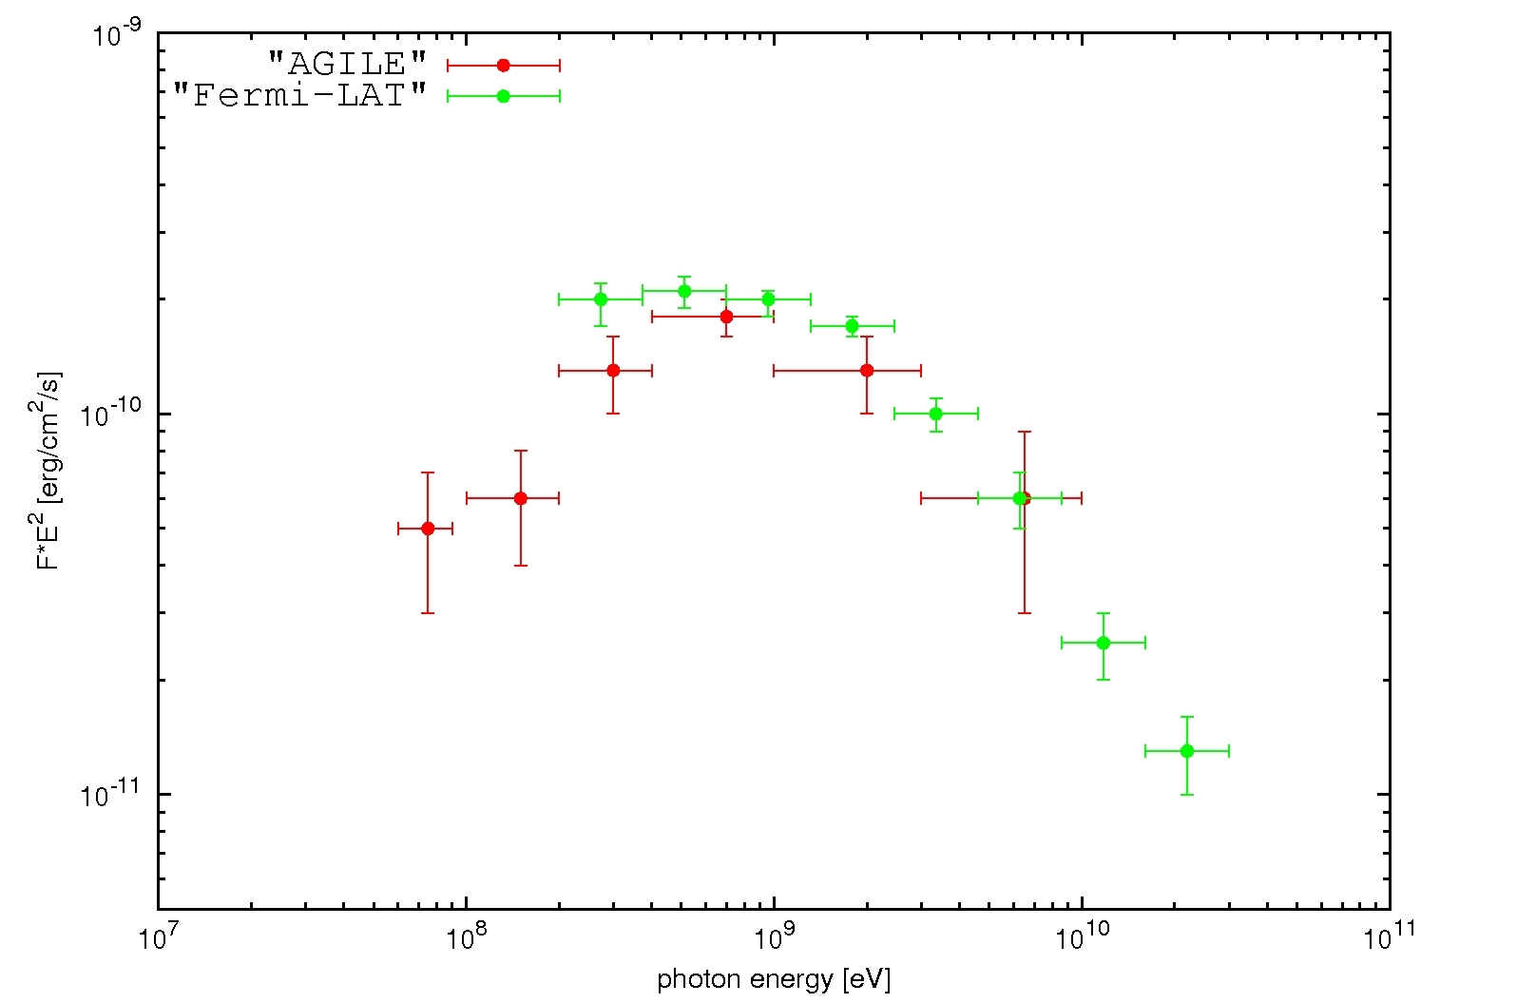
The SNRW44: high energy
AGILE
DIRECT PROOF
The clearest low-energy decay
excludes all possible leptonic
contributions
Giuliani, Cardillo, Tavani et al .(2011)

Slide 14
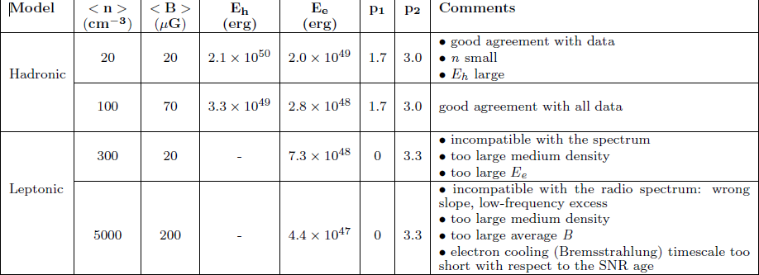
The SNRW44: high energy
AGILE
In all leptonic models, the only particle distribution that can fit radio and gamma-ray data is a broken power-law (Zirakashvili et al. 2007):
$$F_{e}\left(E\right)=K{\left(\frac{E}{E_{c}}\right)}^{p_{1}}{\left(\frac{1}{2}\left(1+\frac{E}{E_{c}}\right)\right)}^{{p_{1}−p}_{2}}$$
Giuliani, Cardillo, Tavani et al .(2011)

Slide 15
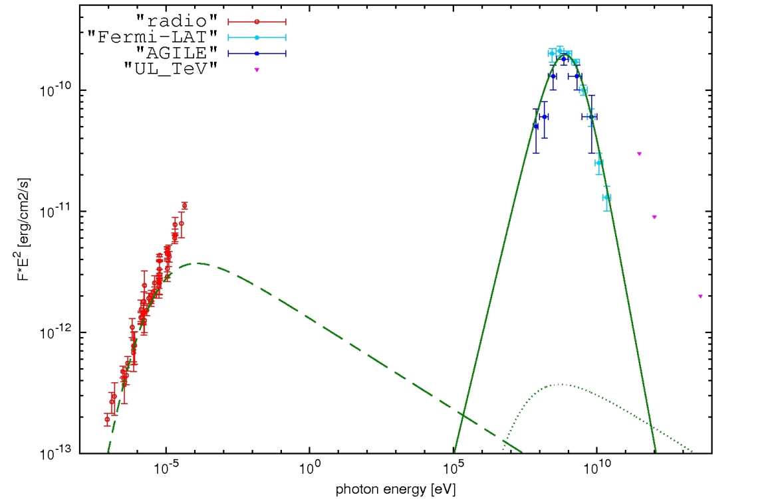
The SNRW44: high energy
AGILE
THE BEST LEPTONIC MODEL
No-thermal Bremsstrahlung dominated
Giuliani, Cardillo, Tavani et al .(2011)

Slide 16
The SNRW44: high energy
AGILE
In the case of hadronic models, particle distributions that can fit radio and gamma-ray data are power-law with a low-energy cut-off for hadrons and with a high energy cut-off for leptons:
$$F_{p}\left(E\right)=K{\left(\frac{E}{1GeV}\right)}^{−p_{2}}exp\left(−\frac{E_{c}}{E}\right)$$
$$F_{e}\left(E\right)=K{\left(\frac{E}{1GeV}\right)}^{−p_{1}}exp\left(−\frac{E}{E_{c}}\right)$$
Giuliani, Cardillo, Tavani et al .(2011)

Slide 17
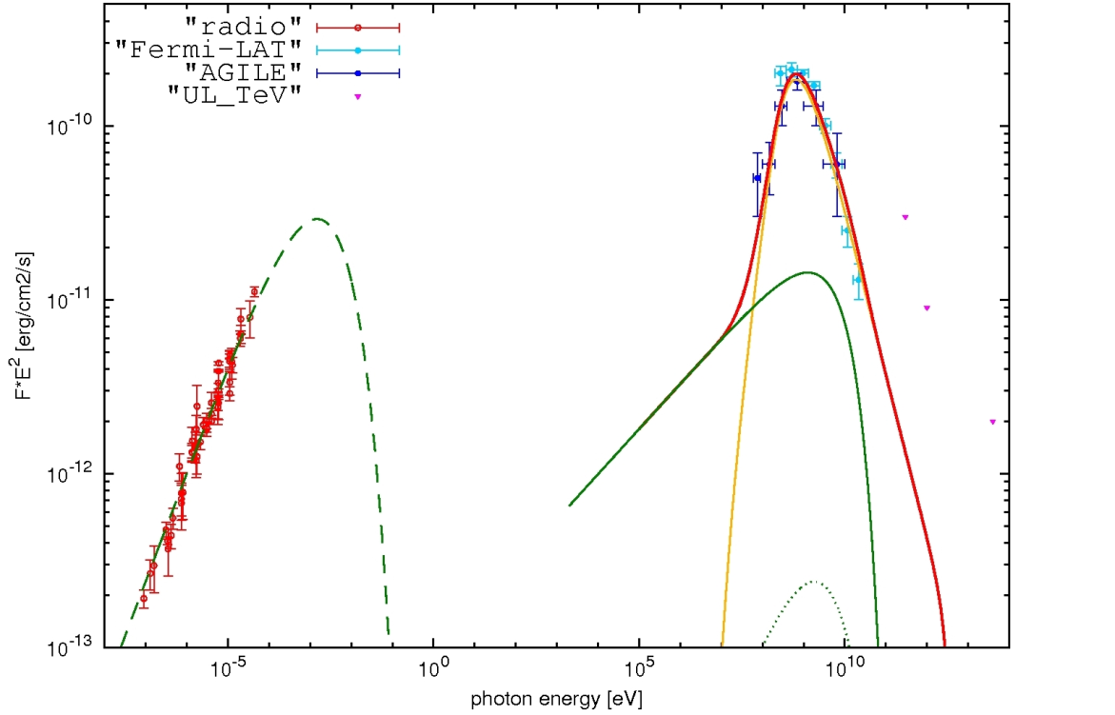
The SNRW44: high energy
AGILE
THE BEST HADRONIC MODEL
Giuliani, Cardillo, Tavani et al .(2011)

Slide 18
AGILE RESOLVES THE MYSTERY
OF THE ORIGIN OF COSMIC RAYS

Slide 19
Possible
Developments

Slide 20
Cosmic Ray problem: propagation
LINEAR
NO
LINEAR
Particle spectrum modified by shock but no viceversa
Particle spectrum modified by shock but also the shock modified by particles.
One possible mechanism:
Dumping of the Alfvèn waves in a determined wavelength range

Slide 21
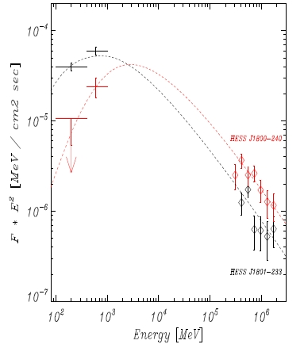
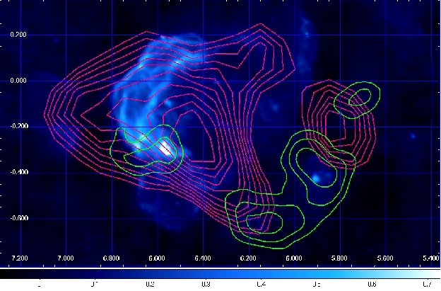
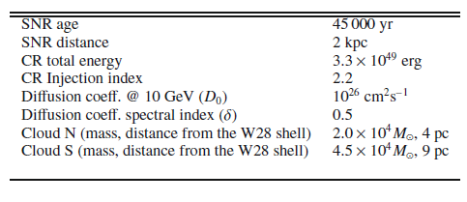
Cosmic Ray problem: propagation
Linear
Giuliani et al., 2010
W28
GeV (AGILE, Giuliani et al 2010)
TeV (HESS, Aharonian et al. 2008)
Radio (VLA, Brogan et al. 2006)

Slide 22
Cosmic Ray problem: propagation
Linear
E² J(E)
(Erg cm²s⁻¹sr⁻¹)
E² J(E)
(Erg cm²s⁻¹sr⁻¹)
100 MeV
10TeV
10TeV
Nearby
Distant

Slide 23
Cosmic Ray problem: propagation
Linear
W28
$$f_{out}\left(t,d,E\right)=\frac{ηE_{SN}}{π^{\frac{3}{2}} ln⁡(\frac{E_{MAX}}{E_{min}})}\frac{e^{−{(\frac{d}{R_{d}^{3}})}^{2}}}{R_{d}^{3}}{(\frac{E}{10GeV})}^{−p}$$
Gabici et al., 2009
AGILE-HESS-PE model
η=0.03
p=2.2
$$D_{0}=1.6×{10}^{26}$$
$$δ=0.53$$
GeV (AGILE, Giuliani et al., 2010)
$$d_{N}=4$$
TeV (HESS, Aharonian et al.,2008)
$$d_{S}=12,7$$
Radio (VLA, Brogan et al., 2006)
Cardillo master thesis

Slide 24
Cosmic Ray problem: propagation
No Linear
W44
$p$=3
Uchiyama et al. 2010; Malkov et al. 2011

Slide 25
Conclusions
Direct evidence for pion emission is then established
in a SNR for the first time thanks to AGILE satellite;
AGILE find that W44 has the clearest low-energy
decay → exclusion of Bremsstrahlung (and all leptonic)
contribution;
We want to extend the same kind of analysis to
other SNRs because only low-energy spectral points,
together a multiwavelength analysis, can discriminate
hadronic to leptonic model;
The SNR W44 is one of the cases where the simple
DSA linear theory is not sufficient to explain the CR
spectrum →investigation of no-linear mechanisms.

Slide 26
THANKS TO ALL!

