Slide 1
Front End Electronic Design
For outer Layers of SuperB (L.4 & L.5)
Team: Luca Bombelli, Bayan Nasri, Carlo Fiorini, Paolo Trigilio

Slide 2
Table of Contents
FE architecture and Noise evaluation
Analog Efficiency
Timing accuracy
Noise jitter
Time walk

Slide 3
Remind of chosen architecture
FE-Block Diagram
Third order complex-pole shaping

Slide 4
FE-Model (2)
Detector Model used in simulation
(including ganging)
Parameters (from Luciano Bosisio):
Assumption on missing data
C_{AC} = 20× C_{D}
C_{Fanout} = 10 / 25 pF
Strip | Layer | Type | C_{D}(pF) | R_{B}(MΩ) | R_{S}(Ω) | I leakage(nA) | C_{AC}(pF) | C_{Fanout}(pF)
Phi | 4 | p | 45.5 | 2.7 | 121.3 | 7.4 | 910 | 10
Phi | 5 | P | 57.1 | 2.5 | 152.1 | 8.4 | 1142 | 10
Z | 4 | n | 23.1 | 2.7 | 46.3 | 4.5 | 462 | 25
Z | 5 | n | 23.1 | 3.3 | 46.3 | 3.8 | 462 | 25

Slide 5
FE-circuit
Preamplifier
Shaper
Digital control:
4 selectable peaking time (1000, 750, 500, 375 ns)
2 polarity (n-strip, p-strip)
2 gain setting (nominal gain, +30%)

Slide 6
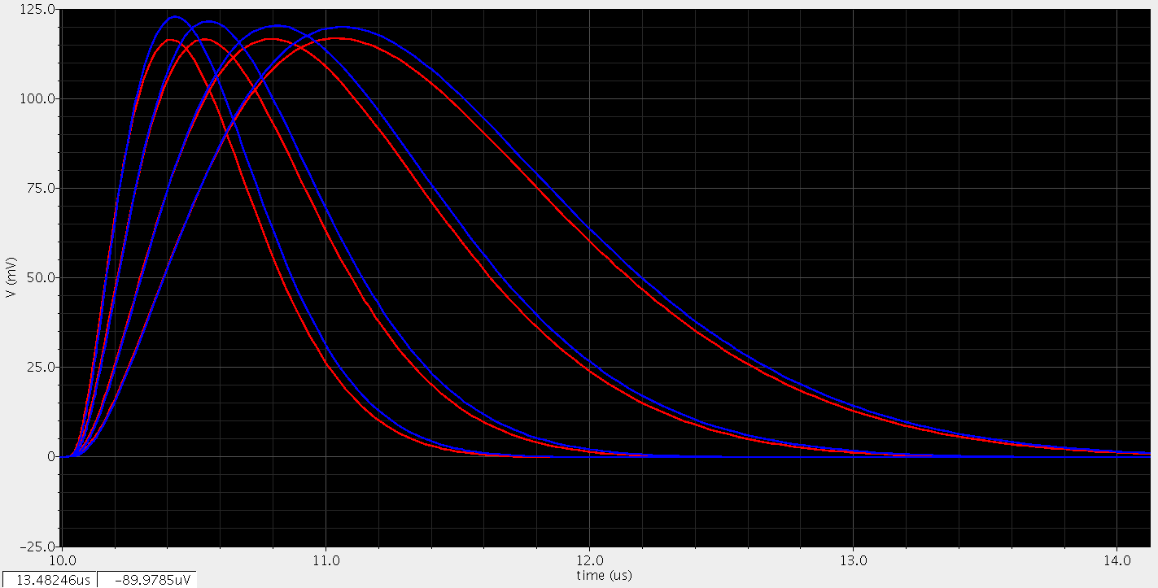
Shaper output in different Peaking times and in both n-strip and n-strip
N-strip
P-strip

Slide 7
ENC Estimation (1)
Layer 5: p-strip
Tp(ns) | 375 | 500 | 750 | 1000
ENC_FET | 600 | 529 | 444 | 395
ENC_Rs | 468 | 407 | 333 | 290
ENC_RB | 234 | 270 | 329 | 379
ENC_Rf | 579 | 583 | 589 | 590
ENC_Leakage | 149 | 172 | 210 | 241
ENC_others | 539 | 498 | 434 | 408
ENC_Total | 1132 | 1066 | 998 | 978
Rbias = 10Mohm per sensor
Can be reduced to 276 with Rbias = 20 Mohm

Slide 8
ENC Estimation (2)
Phi-Strip
Layer 4
Layer 5
Z-Strip
Layer 4
Layer 5
Tp(ns) | 250 | 375 | 500 | 750
ENC_FET | 698 | 512 | 451 | 379
ENC_Rs | 463 | 333 | 290 | 237
ENC_RB | 165 | 226 | 260 | 317
ENC_Rf | 705 | 580 | 583 | 588
ENC_Leakage | 104 | 140 | 161 | 197
ENC_others | 614 | 526 | 490 | 427
ENC_Total | 1270 | 1028 | 980 | 931
Tp(ns) | 250 | 375 | 500 | 750
ENC_FET | 668 | 479 | 421 | 353
ENC_Rs | 154 | 109 | 94 | 77
ENC_RB | 168 | 229 | 264 | 323
ENC_Rf | 525 | 394 | 393 | 394
ENC_Leakage | 82 | 111 | 128 | 157
ENC_others | 674 | 587 | 538 | 463
ENC_Total | 1111 | 898 | 846 | 793
Tp(ns) | 375 | 500 | 750 | 1000
ENC_FET | 600 | 529 | 444 | 395
ENC_Rs | 468 | 407 | 333 | 290
ENC_RB | 234 | 270 | 329 | 379
ENC_Rf | 579 | 583 | 589 | 590
ENC_Leakage | 149 | 172 | 210 | 241
ENC_others | 539 | 498 | 434 | 408
ENC_Total | 1132 | 1066 | 998 | 978
Tp(ns) | 375 | 500 | 750 | 1000
ENC_FET | 479 | 421 | 353 | 314
ENC_Rs | 109 | 94 | 77 | 67
ENC_RB | 207 | 239 | 292 | 337
ENC_Rf | 394 | 393 | 394 | 394
ENC_Leakage | 102 | 118 | 144 | 166
ENC_others | 587 | 538 | 464 | 429
ENC_Total | 891 | 837 | 779 | 764

Slide 9
Table of Contents
FE architecture and Noise evaluation
Analog Efficiency
Timing accuracy
Noise jitter
Time walk

Slide 10
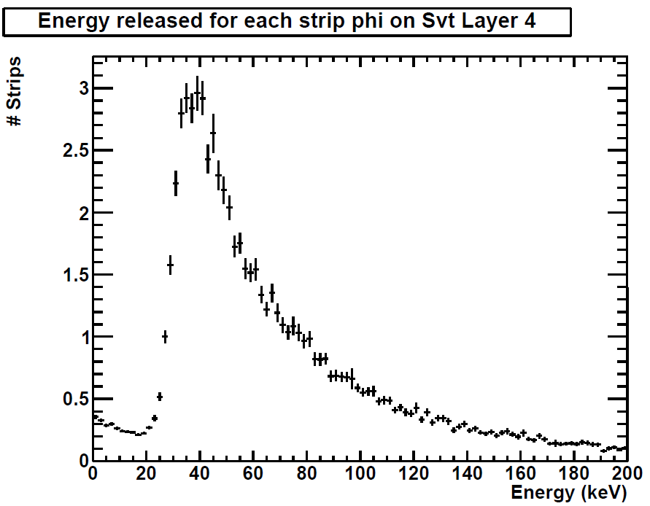
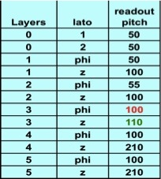
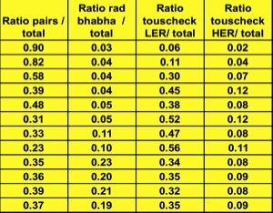
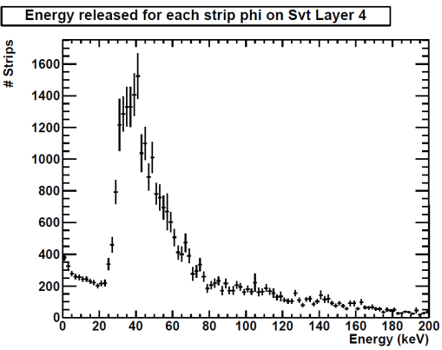
Efficiency simulation: background data used
Input Data:
Energy distribution for different background sources
Relative weights
Average hit-rate
Rad babha
Touscheck LER/HER
Pairs

Slide 11
Efficiency simulation: Pulse shape and calculation
Generation of random sequences
of pulses with given energy distribution.
3° order complex shaper, 500ns peaking time
Efficiency:
$η=1− \frac{T.O.T}{T_{total}}$
Threshold: 0.25 MIP

Slide 12
Efficiency simulation for the different peaking time
Strip | Strip rate [KHz] | Peaking time [ns] | Efficiency | Efficiency (x5 safety margin )
L4 phi | 18 | 250 | 99.2% | 96.1%
L4 phi | 18 | 375 | 98.8% | 94.2%
L4 phi | 18 | 500 | 98.4% | 92.3%
L4 phi | 18 | 500 (real poles) | 98.2% | 91.4%
L4 phi | 18 | 750 | 97.6% | 88.6%
Available peaking-times
Available peaking-times
Strip | Strip rate [KHz] | Peaking time [ns] | Efficiency | Efficiency (x5 safety margin )
L5 phi | 10.9 | 375 | 99.3% | 96.4%
L5 phi | 10.9 | 500 | 99.0% | 95.2%
L5 phi | 10.9 | 750 | 98.5% | 93.0%
L5 phi | 10.9 | 1000 | 98.1% | 90.7%
L5 phi | 10.9 | 1000 (real poles) | 97.8% | 89.6%

Slide 13
Efficiency simulation for the different peaking time
Available peaking-times
Strip | Strip rate [KHz] | Peaking time [ns] | Efficiency | Efficiency (x5 safety margin )
L4 z | 9.4 | 250 | 99.5% | 97.4%
L4 z | 9.4 | 375 | 99.2% | 96.1%
L4 z | 9.4 | 500 | 98.9% | 94.8%
L4 z | 9.4 | 500 (real poles) | 98.8% | 94.1%
L4 z | 9.4 | 750 | 98.4% | 92.4%
Available peaking-times
Strip | Strip rate [KHz] | Peaking time [ns] | Efficiency | Efficiency (x5 safety margin )
L5 z | 6.2 | 375 | 99.5% | 97.5%
L5 z | 6.2 | 500 | 99.3% | 96.7%
L5 z | 6.2 | 750 | 99.0% | 95.1%
L5 z | 6.2 | 1000 | 98.7% | 93.4%
L5 z | 6.2 | 1000 (real poles) | 98.5% | 92.5%

Slide 14
Table of Contents
FE architecture and Noise evaluation
Analog Efficiency
Timing accuracy
Noise jitter
Time walk

Slide 15
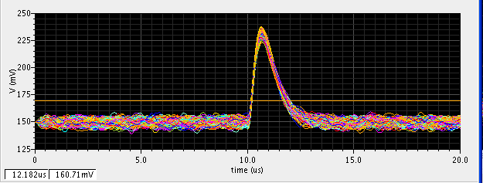
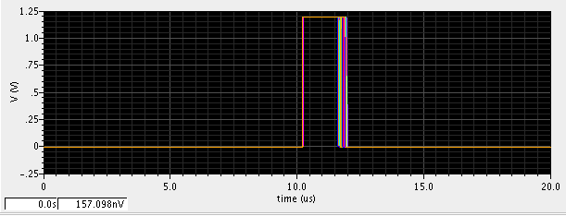
Timing Resolution with TOT – Noise jitter
Transient noise simulation
Peaking Time = 1us
Preliminary result
Signal = 52.8mV (1 MIP)
Noise = 1.58mV (822 el)
Threshold = 0.25 MIP
Jitter TOT = 18ns rms

Slide 16
Timing Resolution with TOT – Noise jitter
Peaking Time = 500ns
Signal = 80mV (1 MIP)
Noise = 2.6mV (888 el)
Threshold = 0.25 MIP
Jitter TOT = 12ns rms

Slide 17
Timing Resolution with TOT – Time walk
Peaking Time = 1us
Threshold = 0.25 MIP
Dynamic Range = 0.25-15 MIP
Signal applied at time 0s
Analog TOT
Energy information
Time walk = 936ns
“Analog” TS

Slide 18
Timing Resolution with TOT – “Digital” outputs
Peaking Time = 1us
Digital TOT
TS
TOT clock = 2 MHz
(3 bit TOT)
TS clock = 30 MHz

Slide 19
Timing Resolution with TOT – Energy reconstruction
With only this information, reconstruct what was the time walk.
“Analog” TS

Slide 20
Timing Resolution with TOT – Time correction
Peaking Time = 1us
TS
Time walk correction
Reconstructed time

Slide 21
Timing Resolution with TOT – Time correction with phase error
Peaking Time = 1us
TOT = 3 bits
TOT clock = 2 MHz
Random time relation between hit and TS clock
Max error = 80ns
Some residual structure in the reconstructed time

Slide 22
Timing Resolution with TOT – Time correction with phase error
Peaking Time = 1us
TOT = 4 bits
TOT clock = 4.2 MHz
Max error = 50ns
Some residual structure in the reconstructed time

Slide 23
Timing Resolution with TOT – Time correction with phase error
Peaking Time = 1us
TOT = 5 bits
TOT clock = 8.8 MHz
Max error = 35ns

Slide 24
Timing Resolution with TOT – Time correction with phase error
Peaking Time = 1us
TOT = 6 bits
TOT clock = 18 MHz
Max error = 25ns
Constant and uniform time error!

Slide 25
Conclusion and next activities
Noise level adequate of a S/N > 20
Foreseen efficiency > 98% at nominal background rate
Time resolution can be increased in the outer layer with more precise TOT information.
Design of TOT comparator and of BLR undergoing

Slide 26
Backup Slide

Slide 27
Efficiency simulation for all layers shaper (RC)²-CR at nominal rates
Strip | Strip rate [kHz] | Peaking time [ns] | Efficiency | Efficiency (x5 safety margin )
L0 (side 1) | 242 | 25 (real poles) | 99.1 % | 95.7 %
L1 Phi | 145 | 100 (real poles) | 98.3% | 91.0%
L2 Phi | 105 | 100 (real poles) | 98.5% | 92.6%
L3 phi | 83.8 | 200 (real poles) | 96.2% | 82.4%
L4 phi | 18 | 500 (real poles) | 98.2 % | 91.4 %
L5 phi | 10.9 | 1000 (real poles) | 97.8 % | 89.6 %
Foreseen peaking-times
Strip | Strip rate [kHz] | Peaking time [ns] | Efficiency | Efficiency (x5 safety margin )
L0 (side 2) | 242 | 25 (real poles) | 99.5% | 97.4%
L1 z | 94.6 | 100 (real poles) | 98.2% | 90.8%
L2 z | 90.8 | 100 (real poles) | 98.2% | 91.4%
L3 z | 54 | 200 (real poles) | 97.9% | 89.3%
L4 z | 9.4 | 500 (real poles) | 98.8 % | 94.1 %
L5 z | 6.2 | 1000 (real poles) | 98.5 % | 92.5 %
Foreseen peaking-times

