Slide 1


SuperB SVT
Strip Pairing: impact on the capacitance value
Irina Rashevskaya, Luciano Bosisio, Livio Lanceri, Lorenzo Vitale
Erik Vallazza, Michela Prest
INFN-Trieste e Università di Trieste

Slide 2
Update on activities in Trieste
Microstrip Sensor for Layers 0 - 5
  Definition of ladder composition, sensor models and dimensions, strip pitches
  Accurate strip capacitance measurements
  6’’ Silicon wafer for mechanical assembly tests:
  300 µm thick received, waiting for 200µm thick
Fanout design for Layers 1 - 5
  Evaluation of strip connection schemes (ganging/pairing)
  Prototypes L1phi, L3z ganging, L3z pairing are now in production
  Prototypes L5z ganging+pairing are being designed
Not covered here:
  Analysis of 2011 Beam-Test data
  Evaluation of background from e⁺e⁻ pairs (Carlo Stella)

Slide 3
Ganging vs. Pairing Layer3
“ganged” strips
fanout trace
(X2 ganging)
l1
C(l1) + 2Cstrip
fanout trace
l2
C(l2) + Cstrip
l3
fanout trace
(X2 pairing)
C(l3) + C paired strip
“not-paired” strip
“paired x2” strips

Slide 4
Inner Layers: Pairing only
Proposed z-side strip connection for Layers 1, 2, 3.
Layer | # of channels with NO pairing | # of channels with pairing x 2 | # of channels with pairing x 3 | Total # of readout channels
1 | 688 | 208 | 0 | 896
2 | 627 | 132 | 137 | 896
3 | 957 | 196 | 127 | 1280
Layer 1, 2 p side 100um readout pitch
Layer 3 n side 110um readout pitch

Slide 5
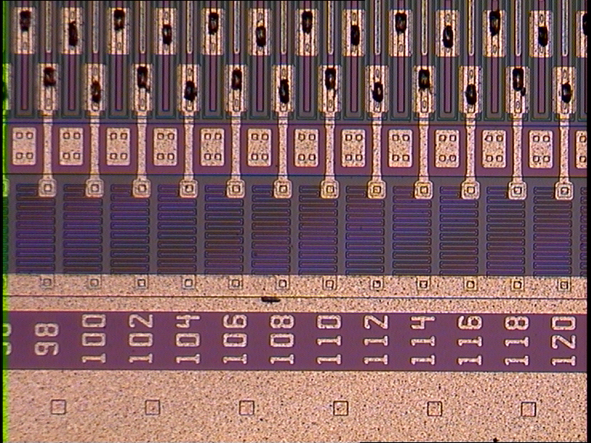
Setup for Strip Capacitance Measurements
We measured the capacitance of
different pairing configurations
on BaBar-like FBK-irst sensors
  Double-sided with parallel strips on p and n sides at 50 um pitch
  Two sensors glued and bonded on fiberglass boards, for measurements on p-side and n-side, respectively. On opposite (back) side all strips bonded to a common line.
  On front side four groups of strips have been bonded in such a way to facilitate capacitance measurements on four pairing configurations (x1, x2, x3, x4).
  The same setup will be used for noise measurements

Slide 6
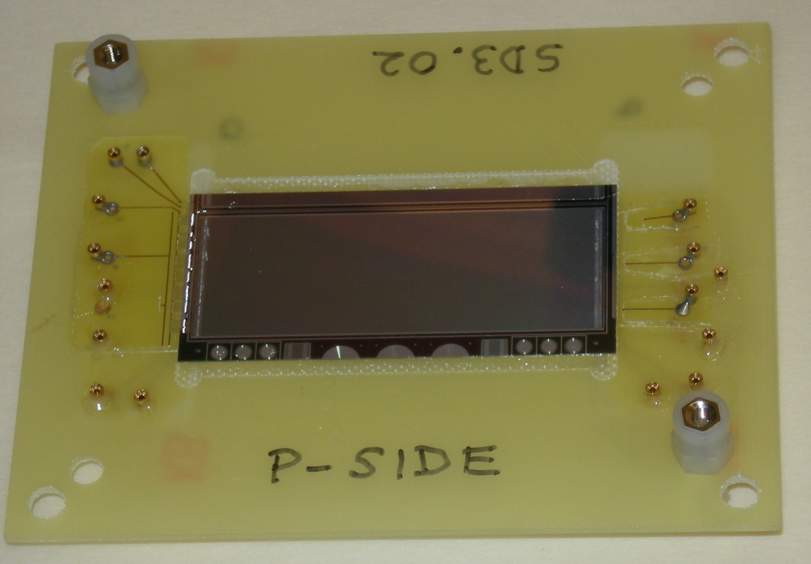
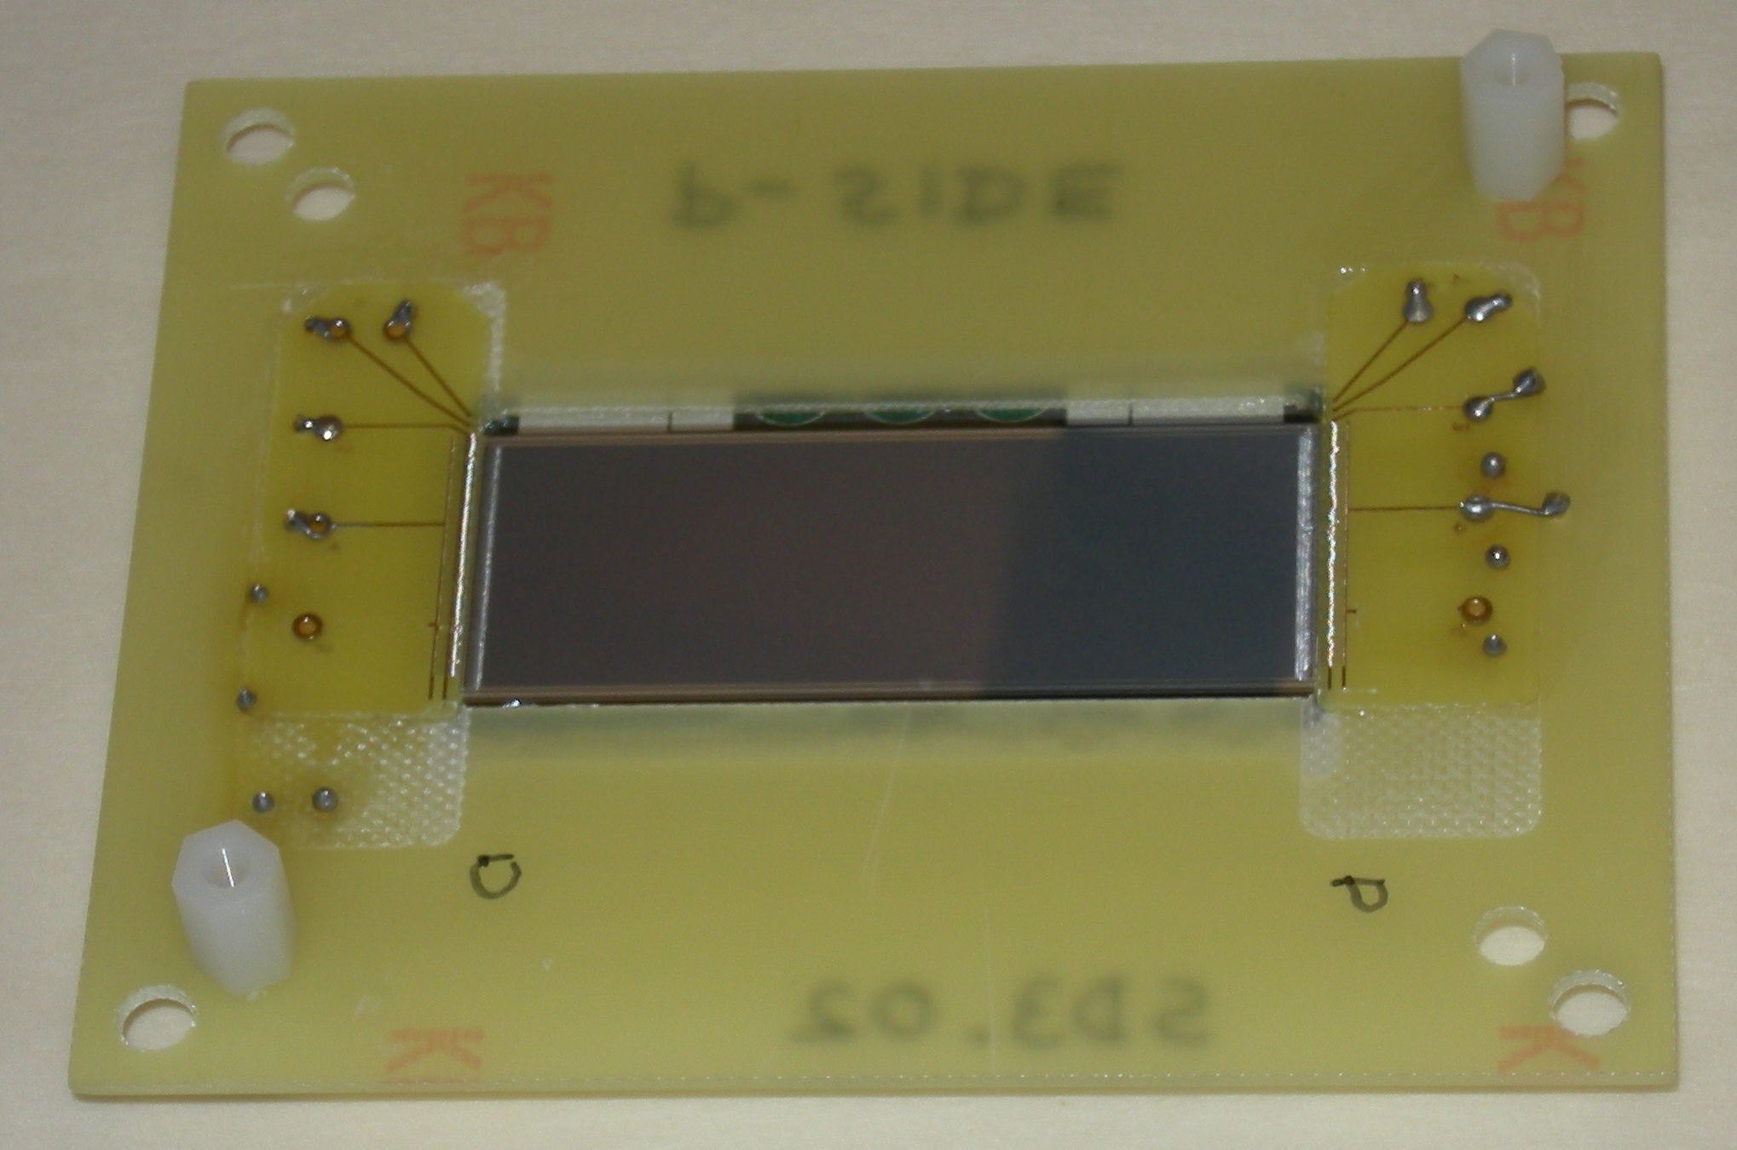
Sample mounting
Front side
Back side

Slide 7
Bonding Scheme
ADJ
Strip
ADJ
Readout strip
Non Readout
No Pairing
Pairing x2
Pairing x3
Similar arrangement for Pairing x4
On left and right sides > 10 readout strips bonded to Common line

Slide 8
Bonding Scheme with intermediate strips connected
ADJ
Strip
ADJ
Readout strip
Non Readout
No Pairing
Pairing x2
Pairing x3
Similar arrangement for Pairing x4
On left and right sides > 10 readout strips bonded to Common line

Slide 9
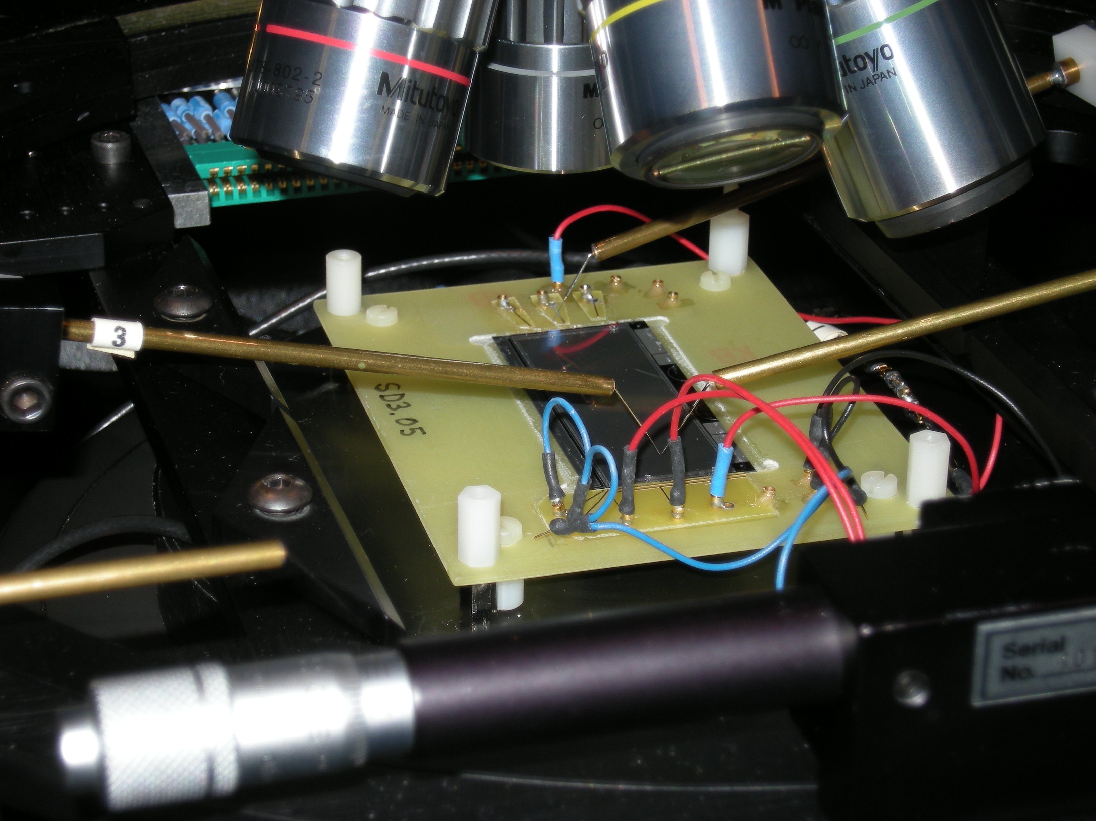
Measurement
For every configuration three C-V measurements were performed (at 100kHz and 1MHz):
  Capacitance to First neighbouring strips
  Capacitance to All strips on the same side
  Total strip Capacitance to front and back sides
(The strip under test and its first neighbours are contacted by probe needles: this minimizes stray capacitance)

Slide 10
Measured Capacitances on P-side
p+ Strip Pitch = 50 um Readout Pitch = 100um
RED figures: Values with intermediate strips connected
black % = Capacitance increase for
“pairing” vs. “non pairing”
red % = Capacitance increase for
intermediate strips connected vs. floating

Slide 11
Measured Capacitances on N-side
n+ Strip Pitch = 50 um Readout Pitch = 100um
RED figures: Values with intermediate strips connected
black % = Capacitance increase for
“pairing” vs. “non pairing”
red % = Capacitance increase for
intermediate strips connected vs. floating

Slide 12
Comments
Pairing gives significantly lower capacitance with respect to ganging the same number of strips.
The advantage in capacitance of pairing with respect to ganging increases with the pairing/ganging multiplicity.
A further gain in capacitance comes from the fanout circuit: pairing requires shorter traces at a wider pitch.
The additional capacitance increase when connecting also the intermediate strips is ~ 4 – 6 % for p-side, ~ 6 – 9 % for n-side.

Slide 13
Outer Layers: Pairing + Ganging
Proposed z-side strip connection for Layers 4, 5.
Pairing alone (2 strips at most, due to limited dip angles) is not enough: we must in addition gang together 2 and 3 strips.
Layer | Total number of strips | Number of channels with the indicated pairing multiplicity |  | Number of channels needed with pairing only | Number of readout channels available | Ganging factor needed | Number of channels with the indicated ganging multiplicity
 |  | x 1 | x 2 |  |  |  | x 1 | x 2 | x 3
4a | 1398 | 1108 | 145.0 | 1253 | 640 | 1.96 | 27 | 613
4b | 1448 | 1134 | 157.0 | 1291 | 640 | 2.02 |  | 629 | 11
5a | 1761 | 1241 | 260.0 | 1501 | 640 | 2.35 |  | 419 | 221
5b | 1815 | 1265 | 275.0 | 1540 | 640 | 2.41 |  | 380 | 260
Accurate measurements of paired strips cannot be made, because
we do not have a detector with the appropriate strip pitch (105 µm on n-side). Are some BaBar Model IV or Model V available?

Slide 14
Conclusions
We measured the capacitance of the single strip and of different pairing configurations.
These measurements can be used to estimate the total capacitance and noise of the strip of:
Phi-side channels for layer 1-5 and
Z-side channels for layer 1, 2, 3.
As soon as fanout prototypes will be available, capacitance measurement of the trace will be performed.

Slide 15
Backup

Slide 16
Estimate of strip detector parameters
(not completed, under revision)
phi - side

Slide 17
Estimate of strip detector parameters
(not completed, under revision)
z - side
Ganging layer 1-5
Pairing layer 1,2,3

Slide 18
Outer Layers: Pairing + Ganging
Example: Proposed connection scheme for Layers 5b z-side fanout.
 | Fanout for Layer 5b
Sensor # | From strip | To strip | Pairing | Ganging
1 | 1 | 260 |  | x 3
 | 261 | 499 |  | x 2
2 | 1 | 141
 | 142 | 401 |  | x 3
 | 402 | 449 |  | x 2
 | 450 | 499 | x 2
3 | 1 | 499 | x 2
Wedge | 1 | 58
 | 59 | 318 |  | x 3

Slide 19
‘pairing’ of strips
At small theta angles (large incidence angles) the track traverses several z-strips (up to 9 in the inner layers!) and the signal becomes ~ proportional to the strip pitch ( < wafer thickness)
This suggest to bond two or more adjacent strips to a single fanout trace, effectively increasing the strip pitch and the signal into a readout channel, with a less than proportional increase in capacitance.
This gives better S/N and efficiency at small theta angles compared to non-paired strips. The improvement is more important when compared to ganging, for which the strip capacitance is proportional to the number of strips ganged together, but the signal is that of a single strip. Moreover, in the pairing scheme the fanout capacitance too is lower, because of the doubled trace pitch.
In addition, at small theta angles pairing is expected to give better spatial resolution with respect to ganging.
To preserve spatial resolution, two strips can be paired only when the track projection exceeds 2 times the pitch.

