Slide 1
Proto-2 an update
SuperB LNF meeting
March 21st 2012
Marcello Piccolo

Slide 2
The menu
Cosmic data
Results on cosmic on truncated averages and ncl.
BTF data
Cosmic BTF comparison
Energy loss comparison BaBar mix vs. 90_10
Conclusions and outlook

Slide 3
Cosmic data
As a reminder , and also to compare with the BTF data I’ll show later, here are few plots coming from cosmic.
In the cosmic data, we have an external tracker to point into proto-2 .
Data written on disk are selected requiring a given number of SCA channels away from zero, when a scintillation counter trigger goes off: the trigger itself implies a momentum cut of 130 MeV/c (by means of a Lead absorber).

Slide 4
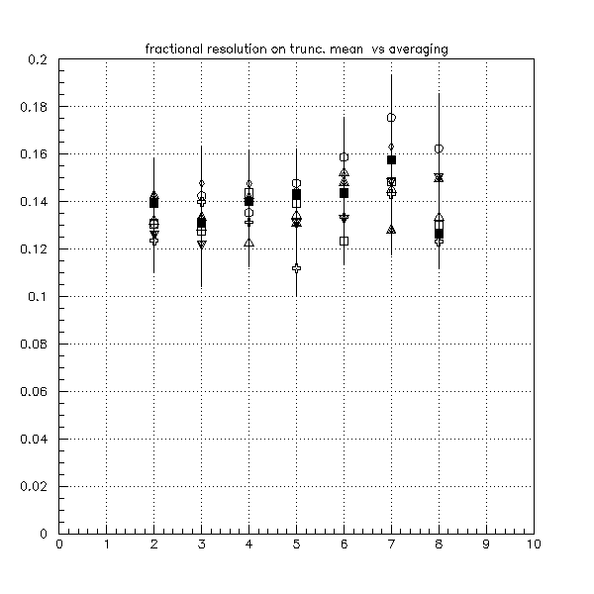
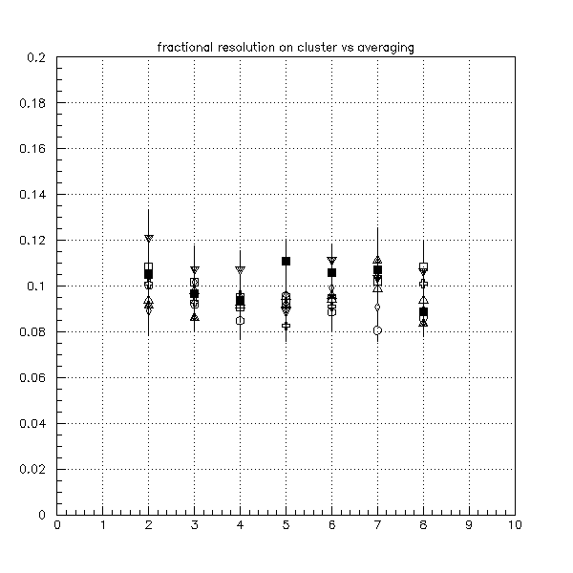
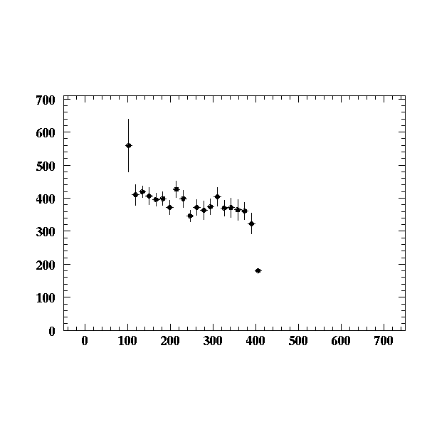
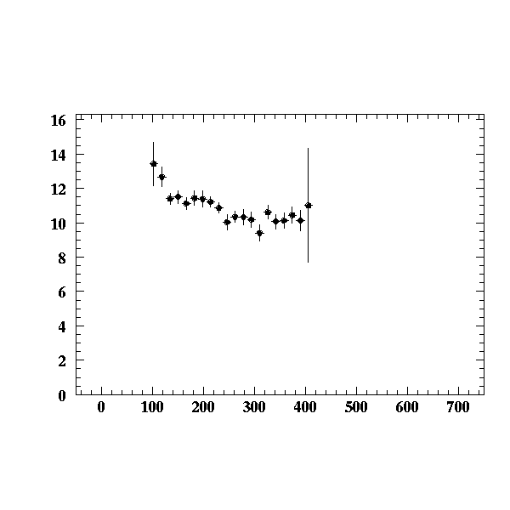
Energy loss and clusters
Fractional resolution for trunc.
dE/dx and # of clusters vs. # of
averaging SCA channels.
Profile histo for pulse height
and # of cluster vs. first cluster
time.
Moderate indications of
Saturation/packing losses

Slide 5
Total # of cluster and cluster charge
As mentioned at last meeting, one can evaluate the total # of cluster from total charge and the single electron cluster charge.
Single electron clusters are found integrating currents of found clusters during times consistent with the preamp expected pulse shape for a δ-type of excitation, requiring, in turn, that the baseline r.m.s before and after the spike is consistent with the expected null noise.

Slide 6
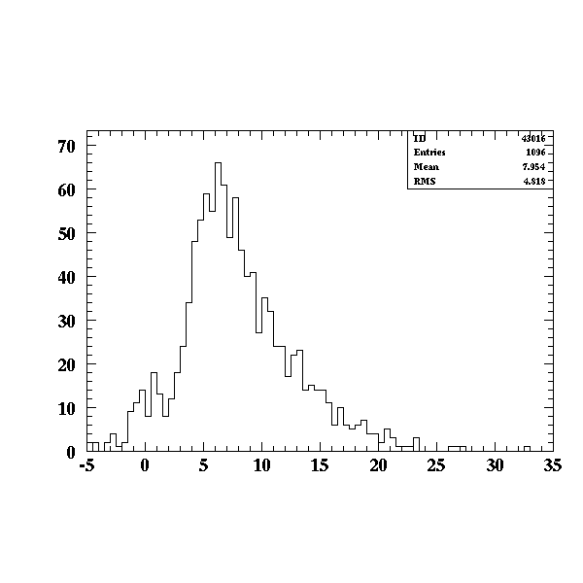
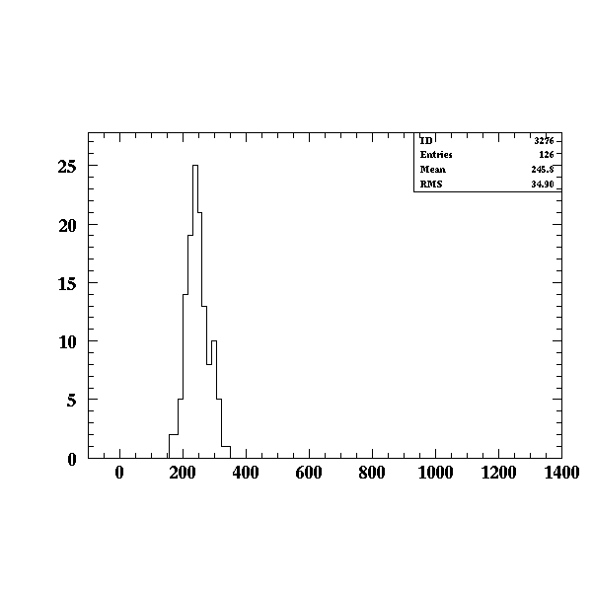
Cosmic single cluster plots
From the ratio of the most probable value of the single cluster charge to the most probable
value of the total amplitude we evaluate a total number of electron of ~ 40.

Slide 7
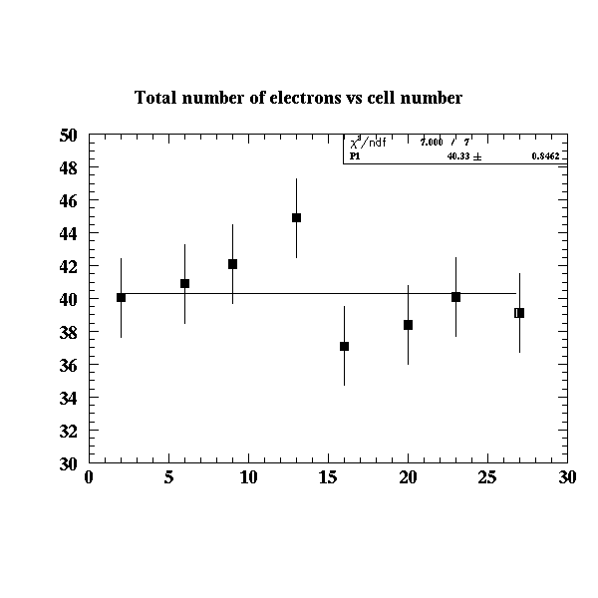
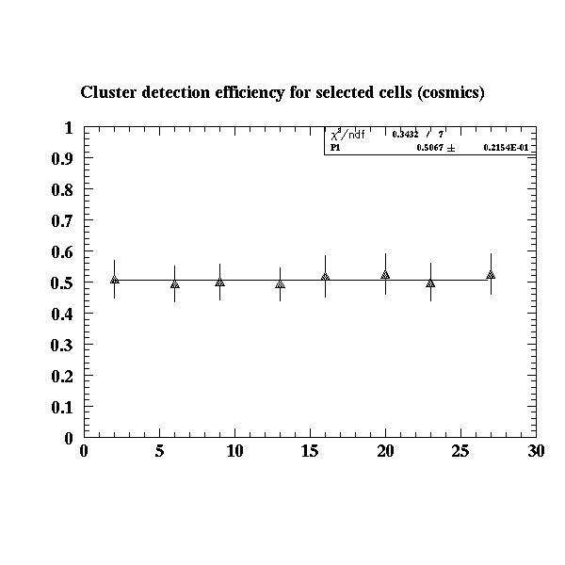
Cluster counting efficiency
From the amplitude ratio mentioned in the previous slide, on can then evaluate the experimental cluster counting efficiency for any given algorithm used to count cluster.
On our setup for cosmic data such an efficiency turns out to be around 50%.

Slide 8
Conclusion from cosmic μ
With 90/10 mix (He/Isob) one obtains in the Proto-2 cells around 20 ionization clusters in a time window of ~800 nsec.
The overall cluster detection efficiency ( at 15.0 mV thres.) is 50%.
Fractional resolution in energy loss is 15% with the traditional method of truncated mean, somewhat better then/around 10% with cluster counting.

Slide 9
Now for the BTF beam test
Giuseppe has already shown the main features of the BTF and the database collected there.
I will mainly show analyses similar to the ones I reported for cosmic and produce cosmic/BTF comparisons.
I did not implement Proto-2 tracking in my analysis of the electron data, but a straight cut on the # of SCA active channels acts, with reasonable efficiency , as a track finder….

Slide 10
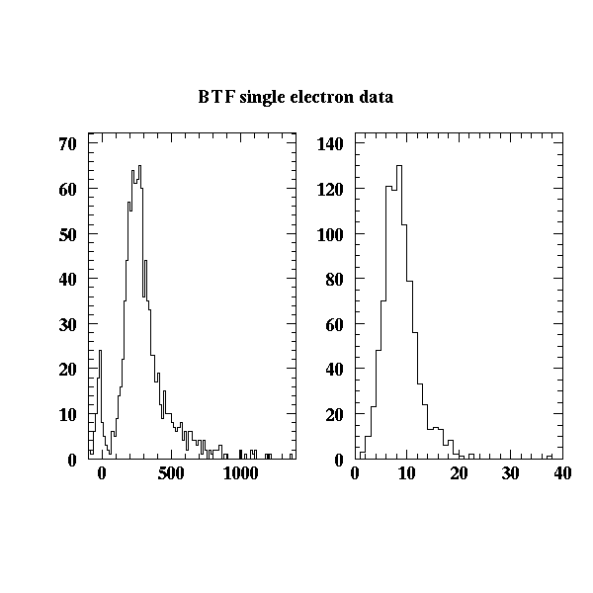
Electron data
We just repeated the cosmic analyses on the electron data: here are a couple of energy loss and number of cluster distribution, requiring a single (500 MeV/c) electron going through the Proto-2

Slide 11
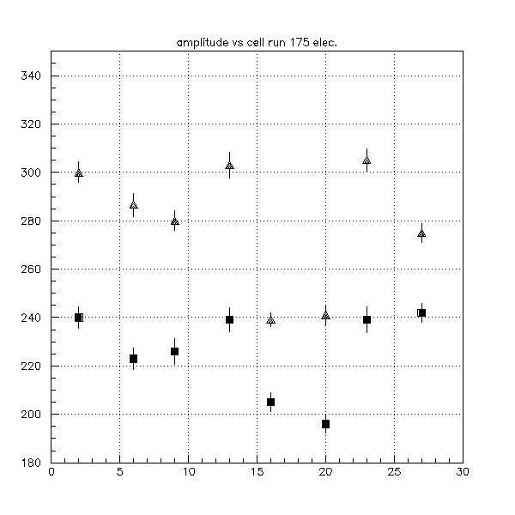
A surprise..
Looking at the amplitude for relativistic electrons we found that it was sizably less than the one for cosmic.
This would imply either a bigger energy loss for
cosmic μ or some kind of instability of the
setup.
In the plot, data from electrons are black
squares , cosmic are grey triangles.
On the horizontal axis is the cell number
On purpose I did not apply any calibration
To the data: difference from cell to cell (max
excursion ~20%) are due to electronic gain
differences.

Slide 12
Does it come from real energy loss?
We took a hard look to differences in operating conditions ( temps, gas-mixes etc.)
But apart from a possible temperature effect we could not finger anything.
So we went back and look to single electron amplitude.
We realized that even for monitoring purposes recording the waveform is relevant.

Slide 13
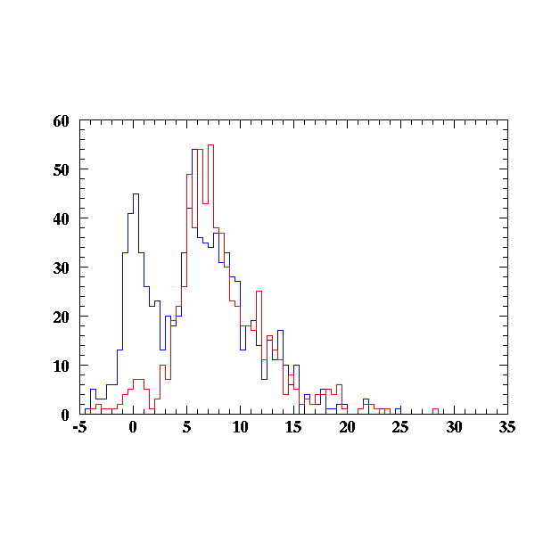
Single electron comparison
So we look at the single electron charge spectra for cosmic and electrons:

Slide 14
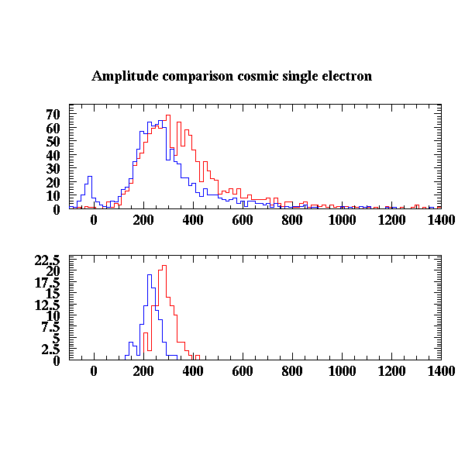
The amplitude difference
Here are the spectra for cell 9 for cosmic and single electron.

Slide 15
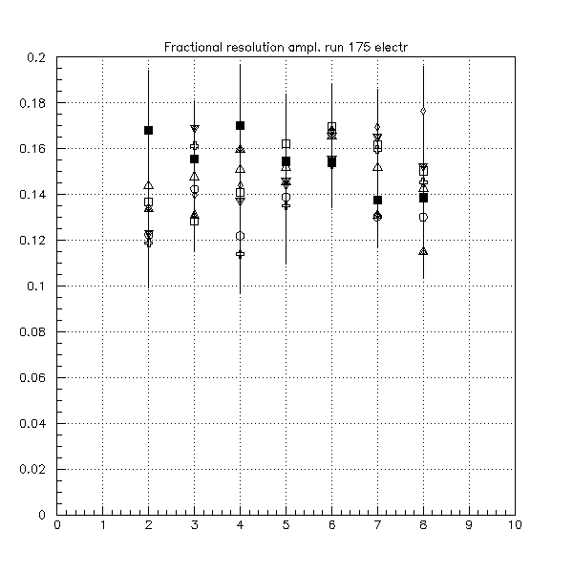
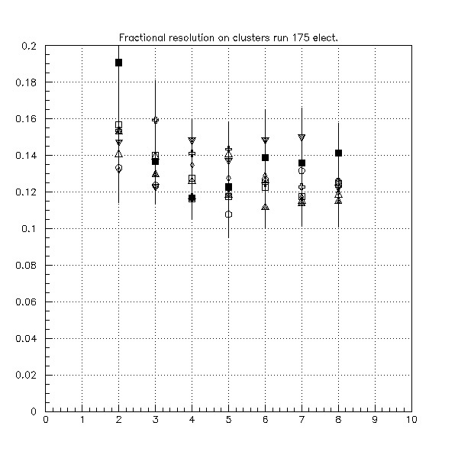
So… it seems real
Given the single electron charge spectra it seems that the apparatus is stable and that electrons loose less than cosmic.
So we see a moderate improvement here too, but smaller then what has been measured on cosmic

Slide 16
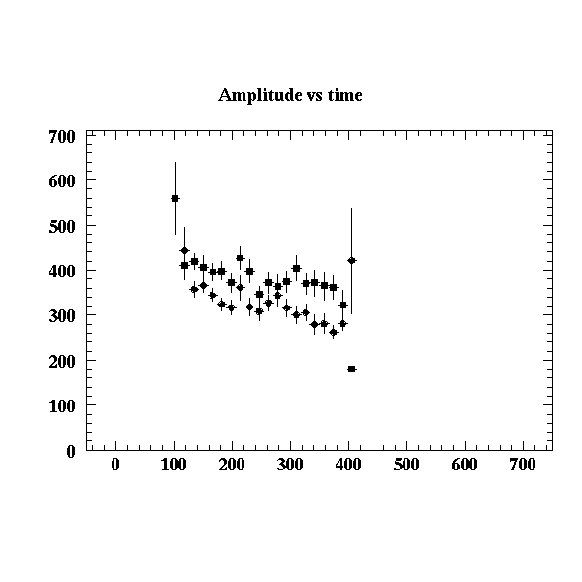
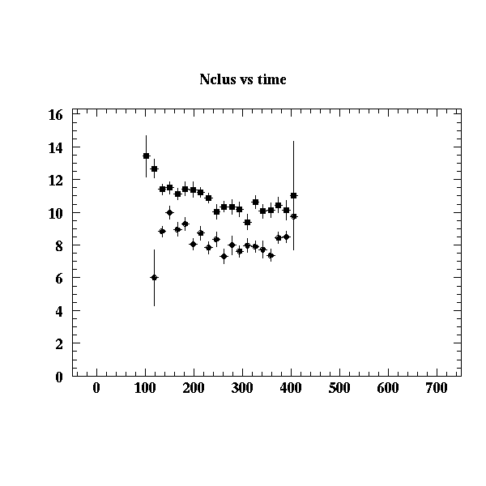
Amplitude and # of cluster vs. time

Slide 17
Typical # cluster and pulse height for cell 23
# of cluster and pulse height; center
# of cluster and pulse height; H.V. side
# of cluster and pulse height; elec side

Slide 18
Here are the figures
Cell # | Ratio cluster HV side | Ratio amplitude HV side | Ratio cluster Elec side | Ratio amplitude Elec side
2 | 1.22 | 1.11 | 0.67 | 0.88
6 | 1.42 | 1.08 | 0.78 | 0.92
9 | 1.39 | 1.11 | 0.84 | 0.92
13 | 1.32 | 1.06 | 0.82 | 0.97
16 | 1.34 | 1.05 | 0.81 | 0.97
20 | 1.45 | 1.07 | 0.81 | 0.89
23 | 1.23 | 1.07 | 0.90 | 0.94
27 | 1.37 | 1.12 | 0.84 | 0.97

Slide 19
Track length behavior
Looking at run 175 and 177 one can infer the behavior of the # of cluster and pulse height as a function of track length.
The proto was rotated by 45 deg. So that the track length was increased of about 40%.

Slide 20
Ratio for 90/45 deg inc. angle
Cell # | 177/175 # cluster | 177/175 pulse height
2 | 1.53 | 1.77
6 | 1.55 | 1.84
9 | 1.49 | 1.90
13 | 1.47 | 1.68
16 | 1.59 | 1.83
20 | 1.56 | 1.83
23 | 1.47 | 1.73
27 | 1.52 | 1.70
A reminder: the ratios should be around 1.41 , the values obtained would imply a
substantial amount of saturation especially in the pulse height compartment.

Slide 21
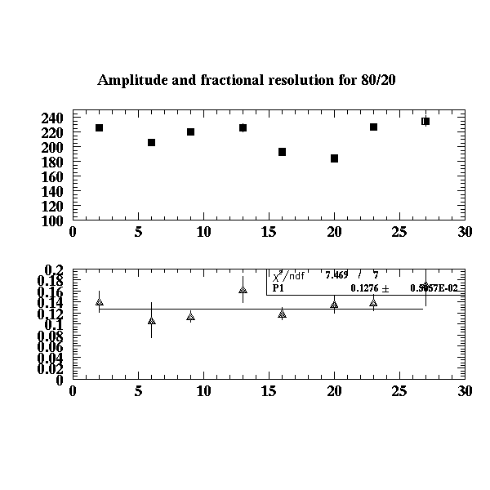
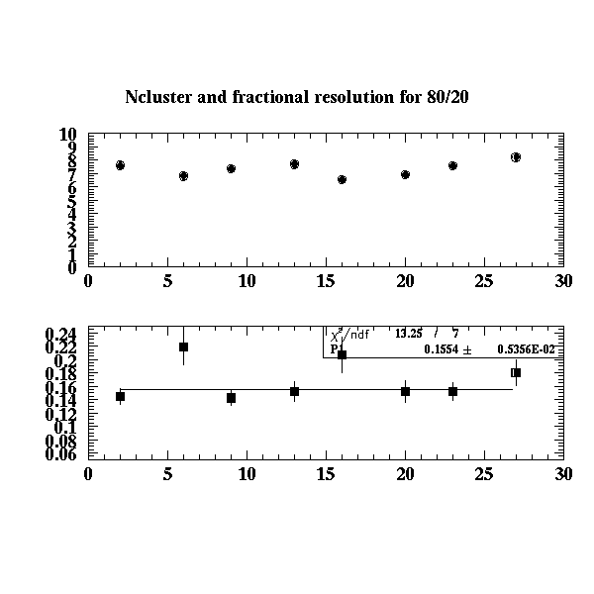
Few words for the BaBar mix

Slide 22
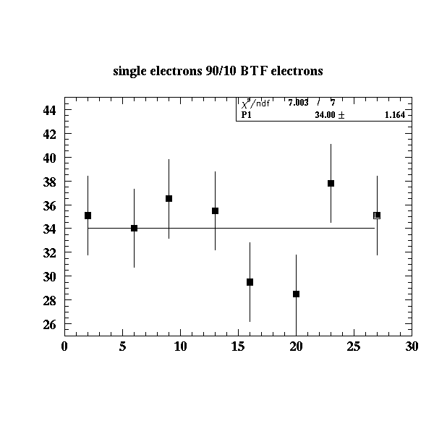
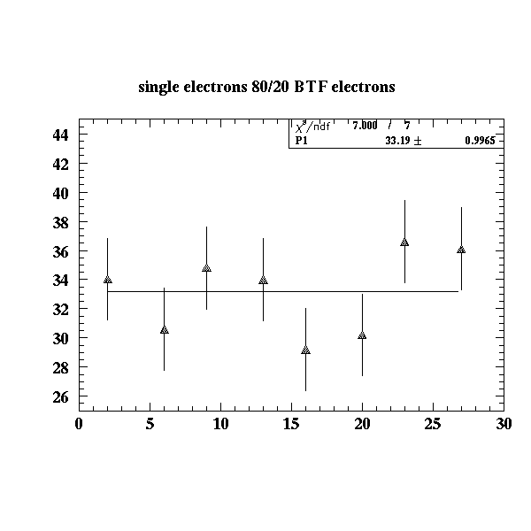
Single electron evaluation BTF.
The total number of single electrons for 90/10 and 80/20 from BTF data.

Slide 23
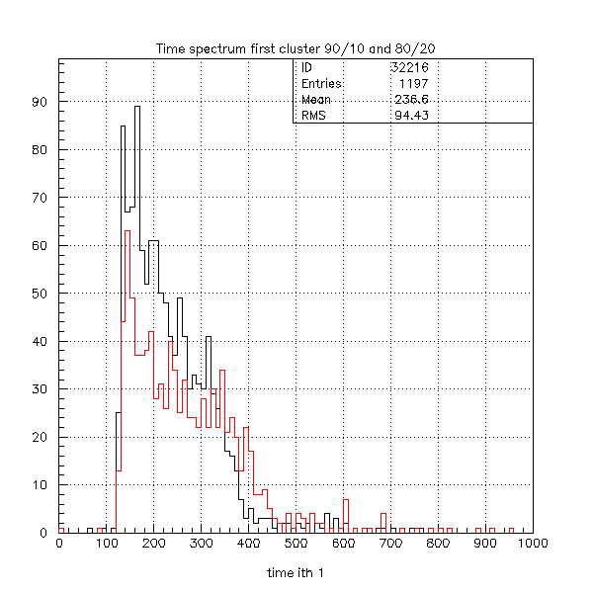
Time spectra
The 80/20 mix is some 10% faster
than the 90/10.
This ,in turn, reflects in an average
cluster time distance smaller for the
more quenched mix.

Slide 24
Conclusions
The data collected at the BTF do hold quite a number of answers to our questions: e.g.
The gain coming from cluster counting for the 80/20 mix. is nil (at least with the front end electronics we are using)
The cluster finding efficiency is about 50% both for cosmic and BTF electrons.
The main gain we measure in (low momentum) cosmic μ’s is reduced substantially for BTF electrons.
We clearly need to explore a bigger part of the (momentum) phase space.
We obviously plan to analyze in detail the complete BTF data-base and eventually collect more cosmic data at different momentum bites.

