Slide 1
Prototype2 BTF test overview and first results
G. Finocchiaro - LNF
3rd SuperB Collaboration Meeting
LNF Mar 2012

Slide 2
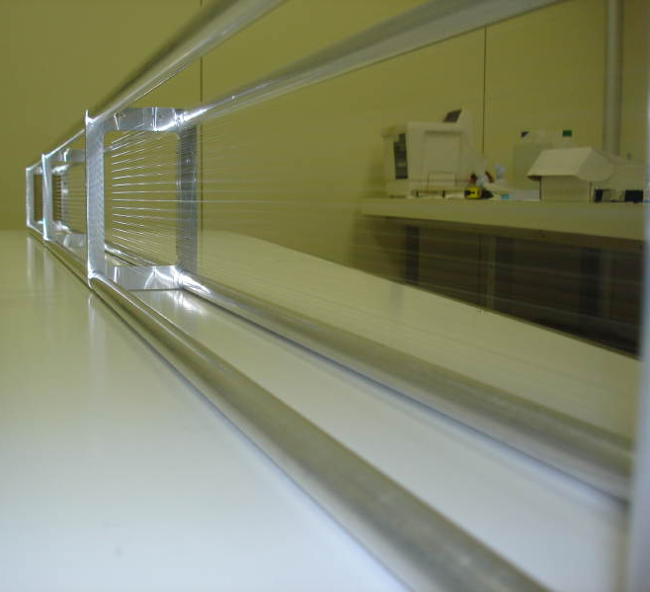
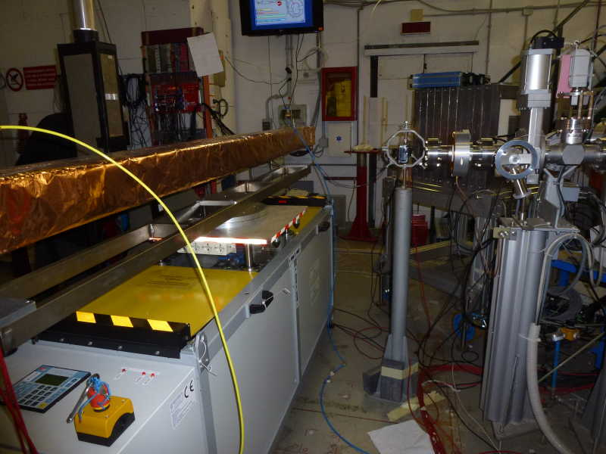
Beam test of Prototype2 at BTF
2.5m long prototype with 28 sense wires arranged in 8 layers
  Goal: study DCH response from single clusters in a realistic environment, and serve as a test bench for the final FEE and for test of DCH trigger implementation

Slide 3
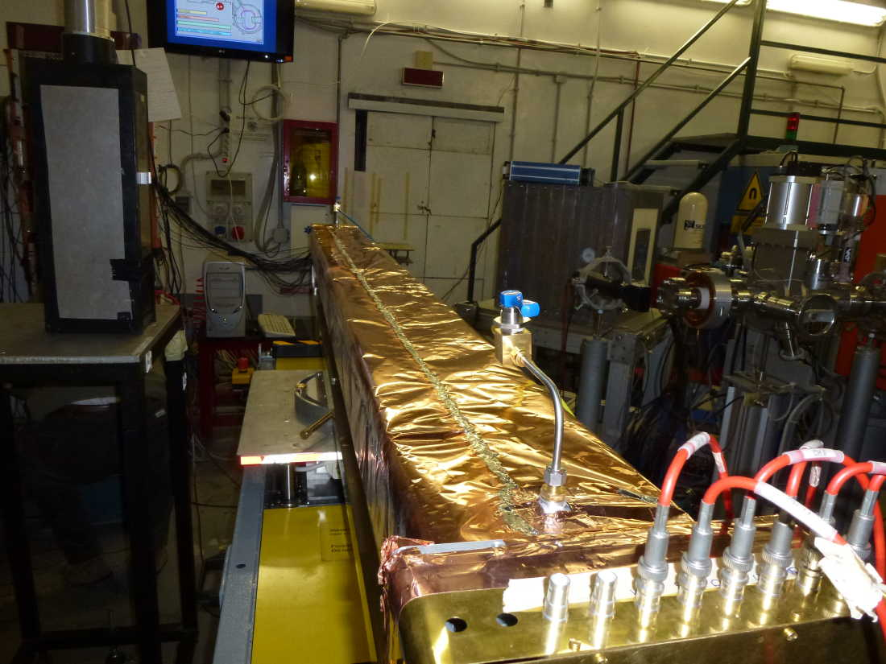
Beam test of Prototype2 at BTF
Chamber mounted on moving table and rotating support, allowing
  vertical displacements
  horizontal displacements (beam close or far from the preamp side)
  “θ” and “φ” rotations
We explored 3 different gas mixtures, using a few HV settings
Lead-Fiber calorimeter used to select n. of electrons

Slide 4
A summary form the “runlist” file
90%He-10%iC₄H₁₀ HV=1820-1850-1880
N_{runs} z_{beam} φ θ
190 middle 0 90
6 middle 0 45
11 HV 0 90
13 PRE 0 90
80%He-20%iC₄H₁₀ HV=1920-1950-1980-2010-2040
10 middle 0 90
10 middle 0 45
5 middle 20 90
90%He-10%iC₄H₁₀ HV=1820-1850-1880
15 middle 0 90
6 middle 0 45
3 middle 20 90
65%He-35%CH₄ HV=2250-2275
11 middle 0 90
3 middle 0 45
4 middle 20 45

Slide 5
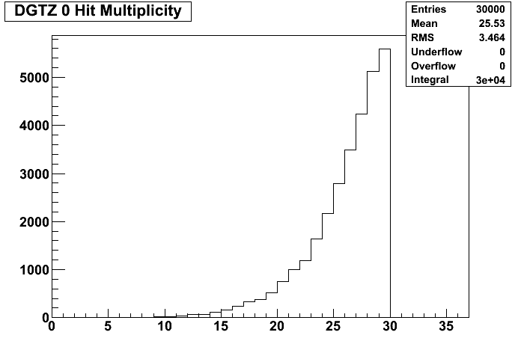
Number of digitizer channels
Run 106 – 3 Feb 2012

Slide 6
Compare with cosmic-ray data taking
Run 558– 17 Dec 2011

Slide 7
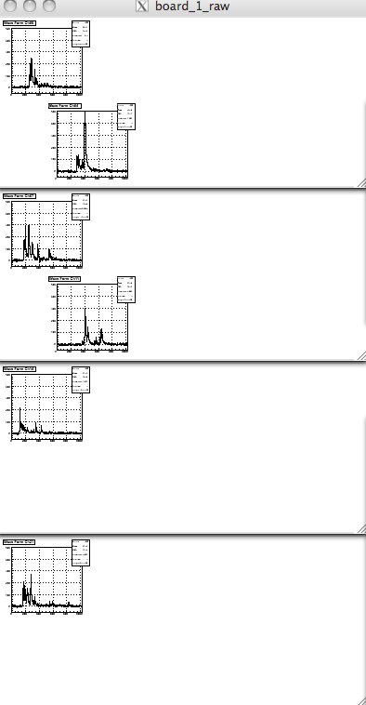
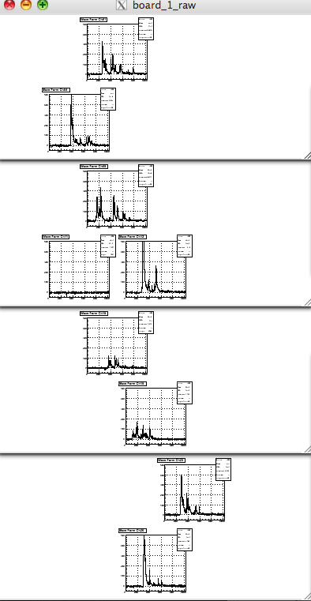
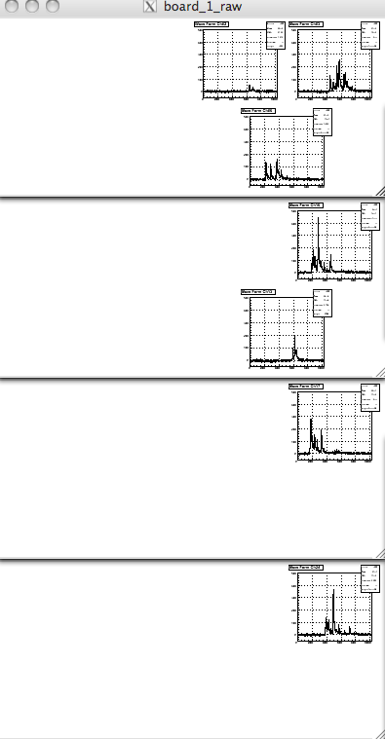
Cosmic rays - waveforms
Run 556– 15 Dec 2011 – first 3 events

Slide 8
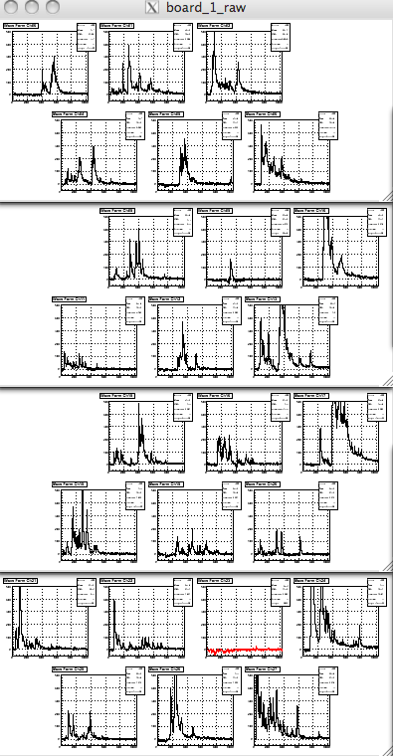
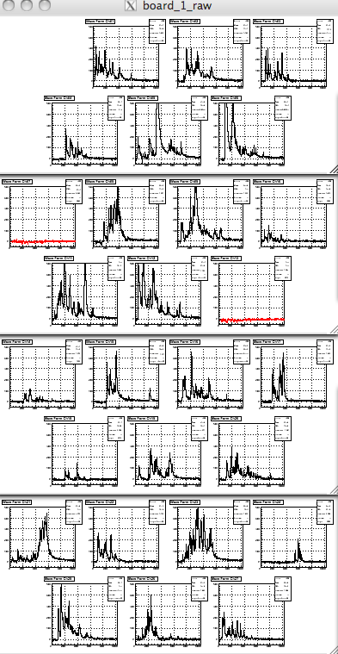
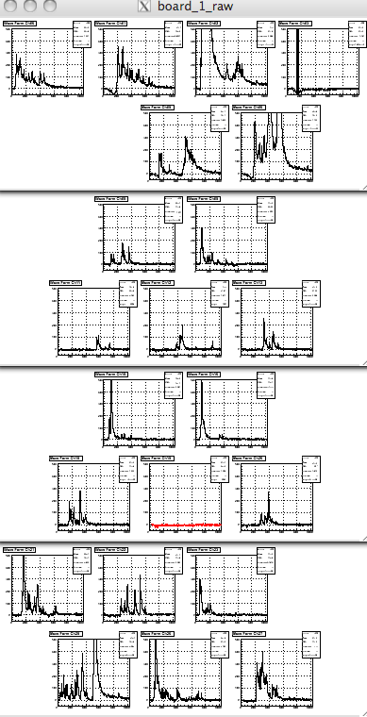
BTF events - waveforms
Run 106– 3 Feb 2012 – first 3 events

Slide 9
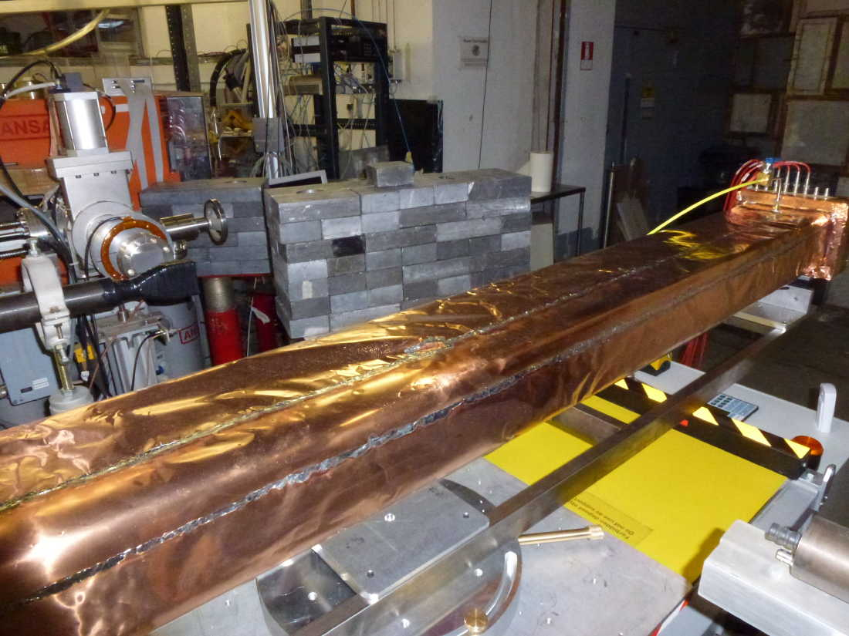
Controlling the occupancy
Two lead walls to shield the chamber
Low electron currents in the Linac
Slits closed to have low multiplicity

Slide 10
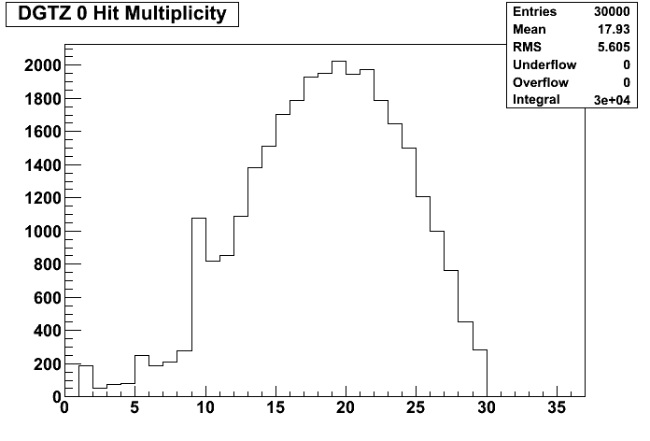
Number of digitizer channels–another run
Run 148– 7 Feb 2012

Slide 11
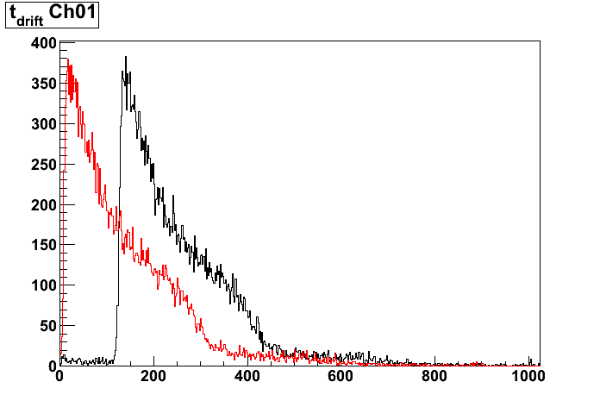
Basic variables – t[0]
Black is raw time
red is corrected by trigger time (tr-0/tr-1 on digitizer board):
  offset is removed
  somewhat sharper risetime (sampling time jitter of 8.5ns is removed)

Slide 12
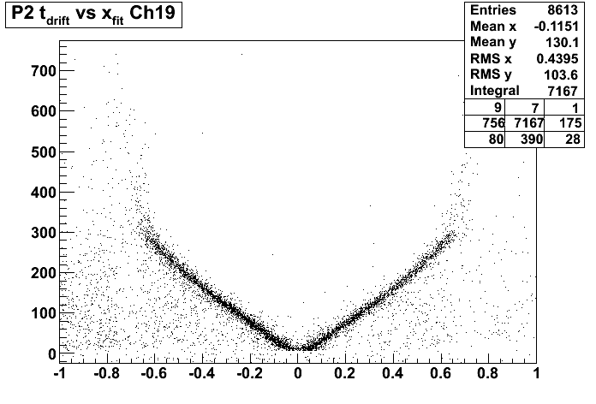
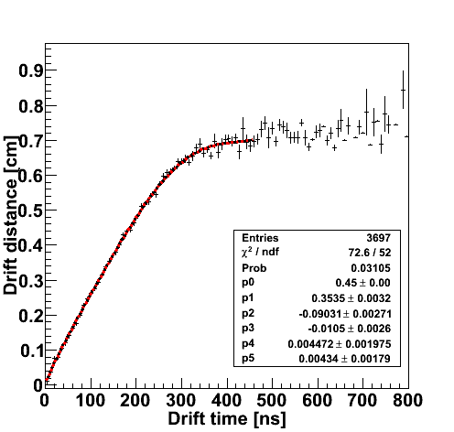
Un-optimized Space-Time Relation
From preliminary fit to cosmic-ray data
Next weeks will work on iterative procedure to improve space-time relations
Results shown in the next slides use current STR

Slide 13
Tracking in Proto2
Simplified straight-line fit tracking
Pattern recognition starts from the first layer with 1 and only 1 hit (seed layer, seed cell)
A pattern of hits is then searched among first-neighbor cells in the layers above and below
At most 2 hits in the same layer are accepted
At most 4 layers with 2 hits are accepted
Combination with best chi2 probability is selected (also LR ambiguity is solved choosing the highest probability fit)
If Prob(chi2,ndof)>0.02 and ndof>4 exclude hit with largest chi2

Slide 14
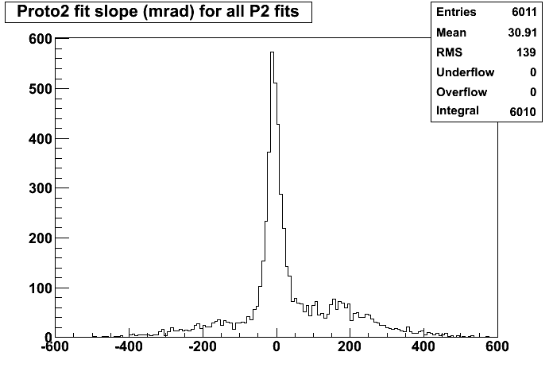
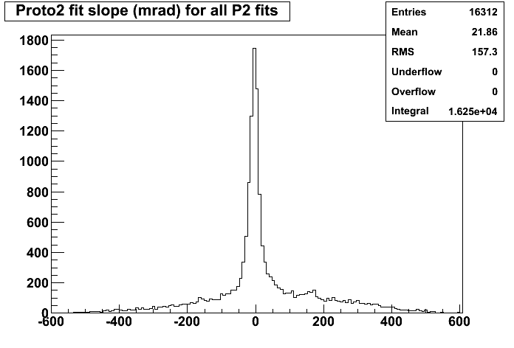
Track slope
Run 107 – 3 Feb 2012
Run 147– 7 Feb 2012

Slide 15
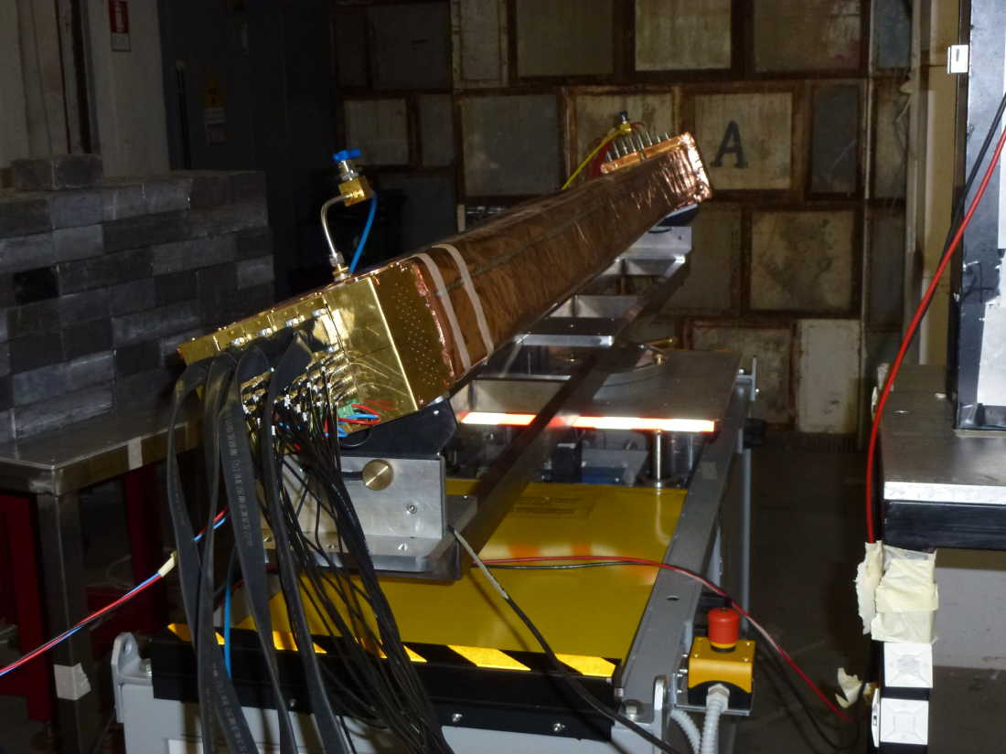
φ = 20 degrees

Slide 16
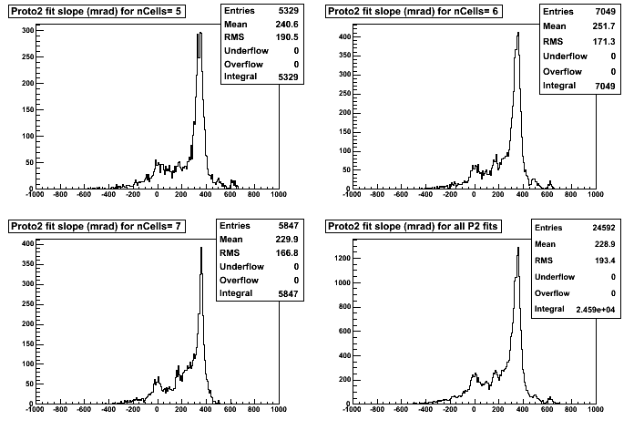
Run 236: φ=20 degrees

Slide 17
Beam profile
Run 212: y_{table}= 20mm
Run 219: y_{table}= 30mm

Slide 18
Preliminary cluster studies
Using the cluster finding algorithm shown by M. Piccolo a few months ago

Slide 19
dE/dx and nClus over fitted tracks
Considering only HOT’s (Hits On Track), one can:
  accumulate dE/dx (Nclus) on the same cell in different events, or
  accumulate the N cells along a given track
    Before comparing different cells, need to equalize the response

Slide 20
By cell - N_{clus} over 10 events
V_{thresh}=15mV
N_{clus} vs. bins in running average

Slide 21
Noise lever was lower at the BTF than in our Lab

Slide 22
N_{clus} vs. bins in running average
V_{thresh}=12mV

Slide 23
N_{clus} vs. bins in running average
2
3
4
5
6
7
8

Slide 24
Fake clusters vs. bins in running average
Number of clusters in the first 102 ns
  given the timing relative to the trigger, no clusters are expected
Question of how to rescale to the full time window (other than multiplying by 1024/100)
2
3
4
5
6
7
8

Slide 25
Nclus vs. threshold
N_{clu}
σ(N)/N [%]
N _{fake}
No hint of a plateau in the low threshold region, unfortunately

Slide 26
HOT by Trk - Intercalibration
Fit most probable value of total charge distribution for every cell
A per-board (7 channels) structure is observed
Normalize digitizer amplitude of all cells to amplitude of one particular cell (e.g. cell#1)

Slide 27
HOT by Trk - Intercalibration
Fit most probable value of total charge distribution for every cell
A per-board (7 channels) structure is observed
Normalize digitizer amplitude of all cells to amplitude of one particular cell (e.g. cell#1)

Slide 28
By Trk – dE/dx vs. n. of HOTS
Calculate truncated mean discarding the two highest charge measurements on the track
  2/4=50% truncation; 2/5=40%; 2/6=33%; 2/7=29%; 2/8=25%

Slide 29
By Trk – dE/dx vs. n. of HOTS
Would scale to 6.7% resolution with 40 samples

Slide 30
Summary
No conclusions yet, this is just a a first sample of measurements done with the data collected during the BTF test
  more in Marcello’s talk, and in the coming weeks.
Many thanks to all who contributed to this test
  E. Capitolo for designing the chamber and the support structure
  A. Zossi with the help of the Mechanical Shop for building the support structure
  L. Passamonti, D. Pierluigi, A. Russo for assistance in mounting/dismounting the setup
  F. Sgamma, M. Troiani for aligning the chamber in the BTF hall
  And of course, all the shifters:

