Slide 1
DC trigger test
Present layout
Trigger electronics
Experience with cosmic
Experience at test beam

Slide 2
DC SuperB present-1 design
 | SL1 | SL2 | SL3 | SL4 | SL5 | SL6 | SL7 | SL8 | SL9 | SL10 | TOT
Planes | 8 | 4 | 4 | 4 | 4 | 4 | 4 | 4 | 4 | 4
Type | A | U | V | U | V | U | V | U | V | A
#wires | 172*4 204*4 1504 | 118*4 472 | 134*4 536 | 150*4 600 | 166*4 664 | 182*4 728 | 198*4 792 | 214*4 856 | 230*4 920 | 246*4 984 | 8056
#TSF 48 opt | 32 | 10 | 12 | 13 | 14 | 16 | 17 | 18 | 20 | 21 | 173
#NBCD 48 opt | 2 | 1 | 1 | 1 | 1 | 1 | 1/2 | 1/2 | 1/2 | 1/2 | 15
#TSF 64 opt | 24 | 8 | 9 | 10 | 11 | 12 | 13 | 14 | 15 | 16 | 132
#NDCB 64 opt | 1/2 | 1 | 1 | 1 | 1 | 1 | 1 | 1 | 1 | 1 | 10/11
Number of wire could increase due to internal radius uncertainties.
The 48 vs 64 depends on the form factor of the FE board used at the moment a conservative
assumption has been made (i.e. 6U VME form factor)

Slide 3
BaBar Strategy (1)

Slide 4
BaBar Strategy (2)
Serialization occurs here
all DC hits on optical links
with this strategy 64 links.

Slide 5
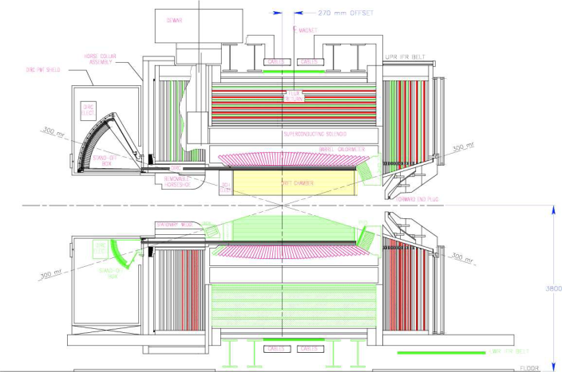
DC SuperB present design
Super B detector
1504 wires from DC
FE crate SL1
472 wires from DC
FE crate SL2
536 wires from DC
FE crate SL3
8056 wires
from DC
600 wires from DC
FE crate SL4
664 wires from DC
FE crate SL5
728 wires from DC
FE crate SL6
792 wires from DC
FE crate SL7
856 wires from DC
FE crate SL8
920 wires from DC
FE crate SL9
984 wires from DC
FE crate SL10
246 wires on SL10 is not what we would like to match the EMC sector in Φ. 240 would
be better because in this case we would have 40 cells a perfect match with 9 degree EMC
sector.

Slide 6
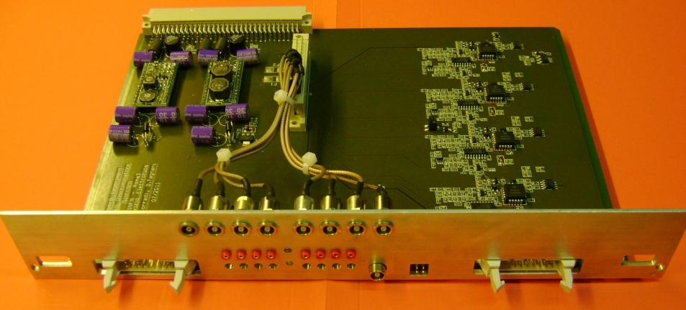
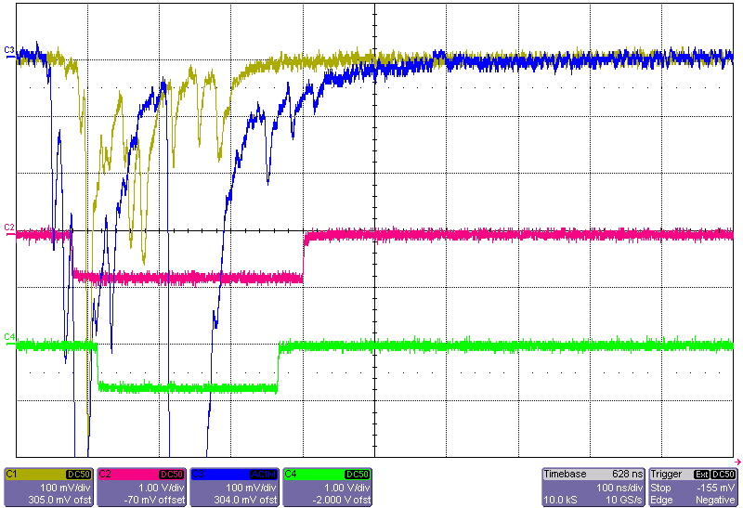
DC SuperB present design
FE crate Super layer 10
Test Discriminator needed @tbeam
DC FRONT END
Discriminator
• • •
CPU
DC FRONT END
Discriminator
DC FRONT END
Discriminator
copper/optical link
copper/optical link
copper/optical link
ethernet
link
64 channels
Input signals
from DC front end
64 channels
64 channels
• • • • •
In SuperB the discriminator board becomes a mez card and can be upgraded in order to compute TSFs and deliver them through a copper or optical link if there are radiation problems. Otherwise the «standard» solution would be welcome.
discriminated signals

Slide 7
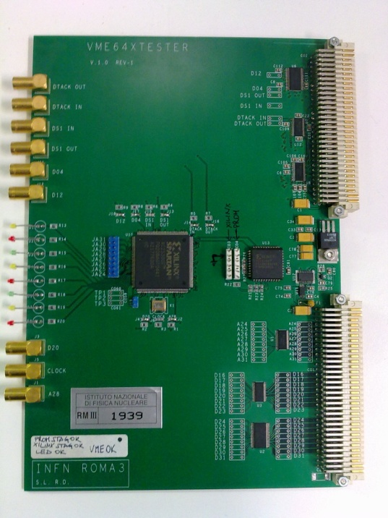
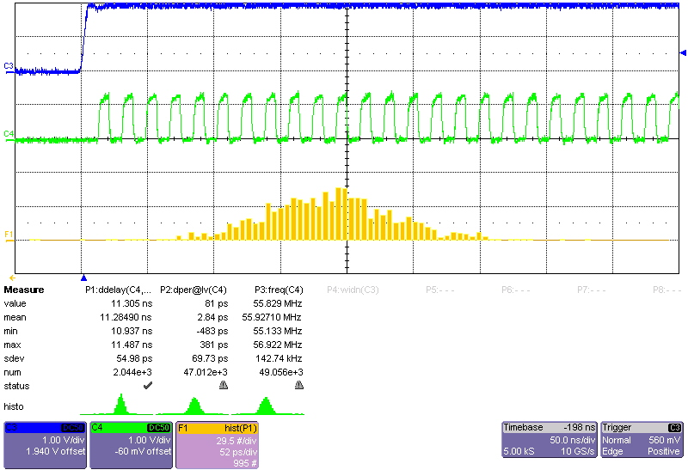
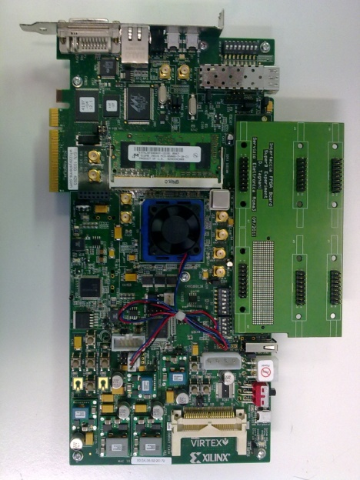
RF emulator needed @tbeam
We have also built a ring oscillator to emulate RF when a machine trigger occurs.
And a transition board to feed Virtex6 demo board with LVDS signals.

Slide 8
Some comments
In our case we had the signal from BTF. This signal intrisically jiitters by 10 ns. The reason being that the BTF cathode emits 350 micro bunch with a 28 ps time distance.
A single electron can belong to any of this micro-bunch.
The RF from BTF starts the ring-oscillator which mimicks the RF.

Slide 9
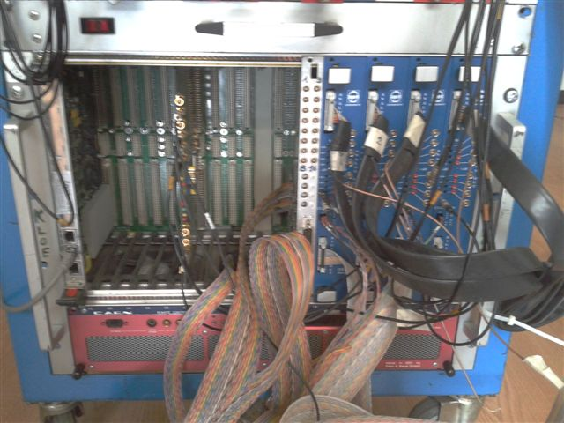
Trigger setup
Clocked discriminator
discriminator
ring oscillator

Slide 10
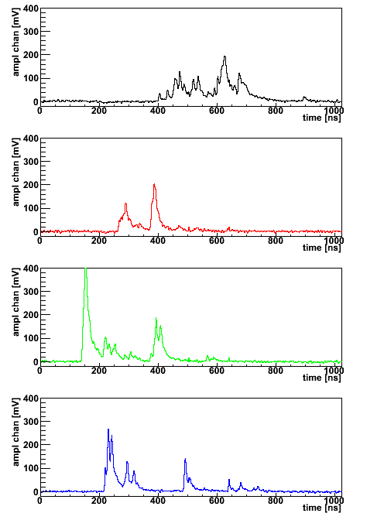
TSF (Track Segment Finder)
4 pattern for a fixed pivot tube. The other 4 pattern can be found via a parity transformation.
So in this example there are 8 patterns per pivot tube and 4 pivot tubes. In total 32 combinations. 5 bits are enough to code the info. 14.8 MHz sampling means 74 Mbit/s link.
P
P
P
P

Slide 11
The prototype
It consists of 8 layers.
So it was natural from the trigger point of view to split it in two equivalent SLs.
Only track candidate with all hits are here considered.
At the moment we are investigating the problem delivering hits to an HPTDC

Slide 12
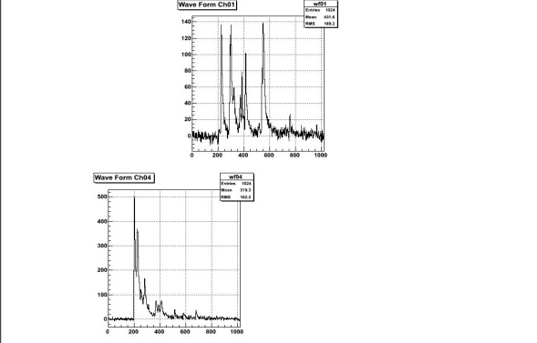
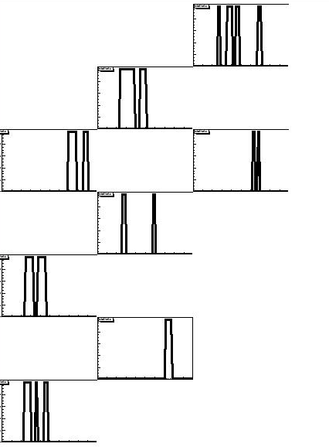
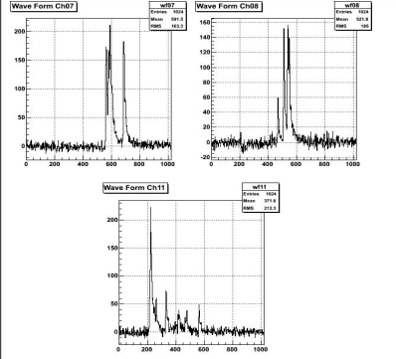
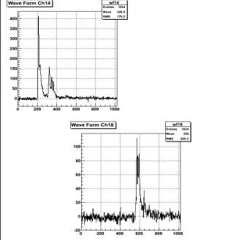
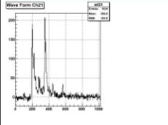
What we got on cosmic
In our case 20 address per
single multilayer

Slide 13
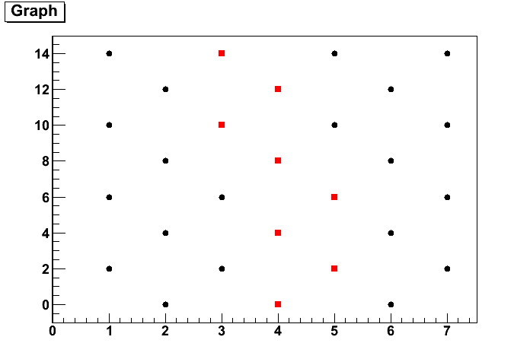
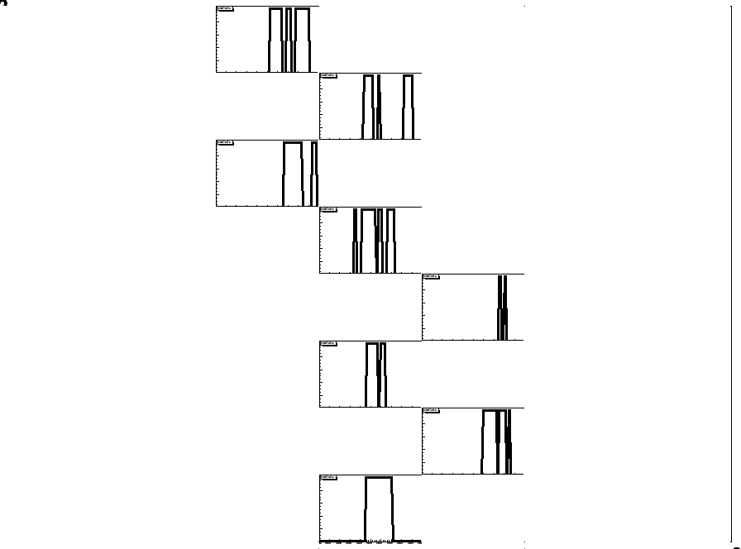
cosmics

Slide 14
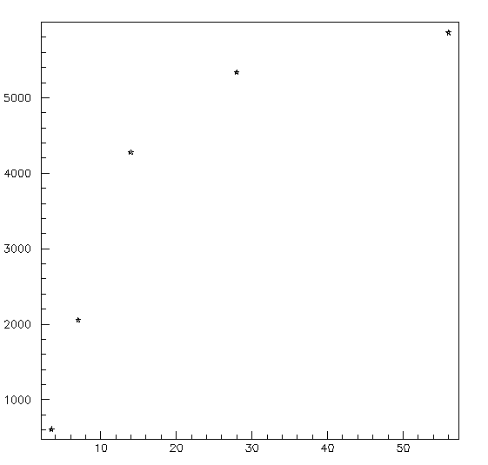
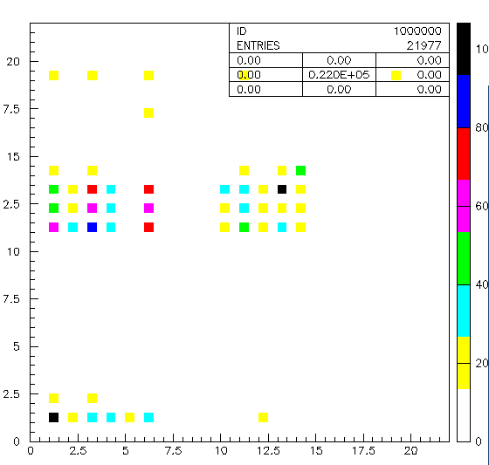
#Tracks vs sampling frequency data
Number of tracks
Sampling frequency (MHz)
addr1%addr2

Slide 15
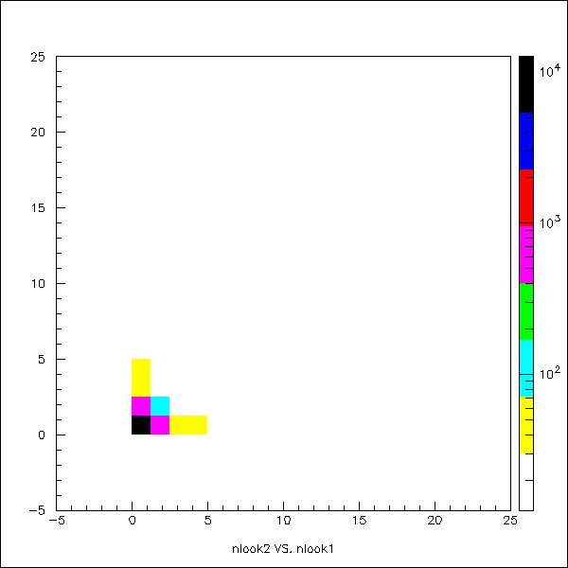
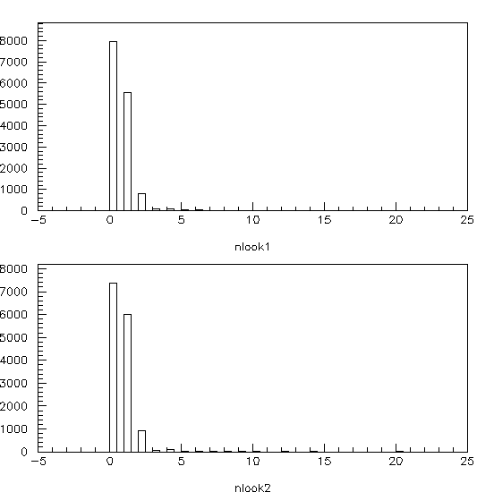
Number of fired lookup tables (on cosmic)

Slide 16
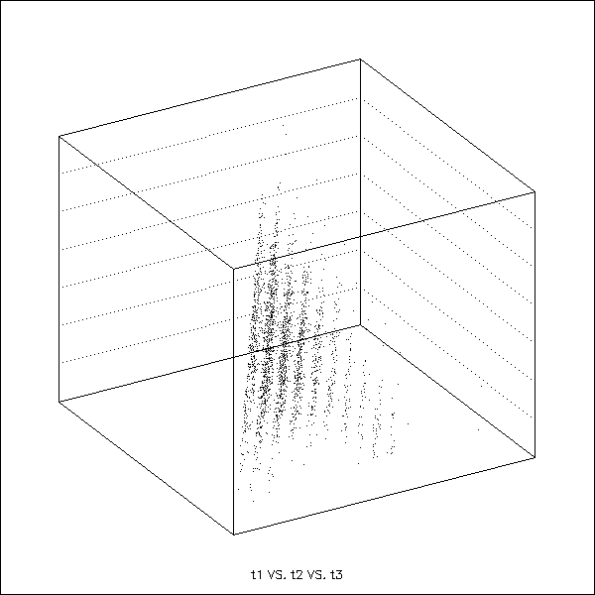
Time correlation among hits cosmic
Correlation in time
the three hits with lowest time

Slide 17
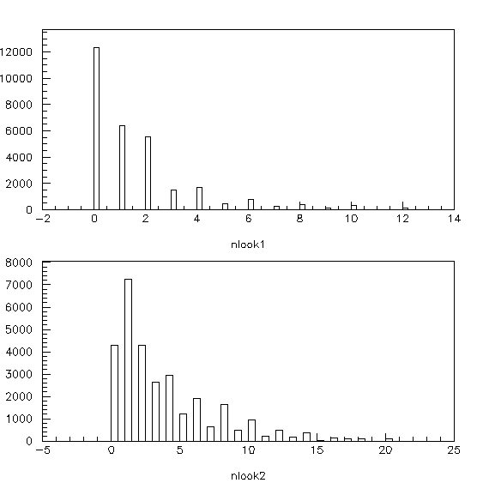
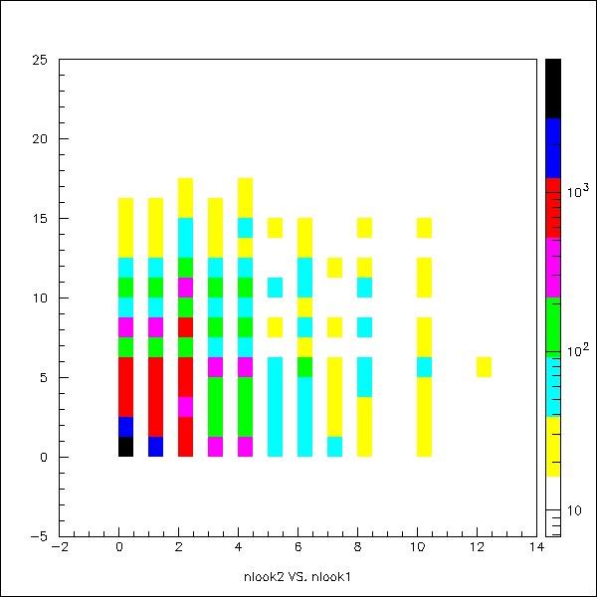
Number of fired lookup tables (on data)

Slide 18
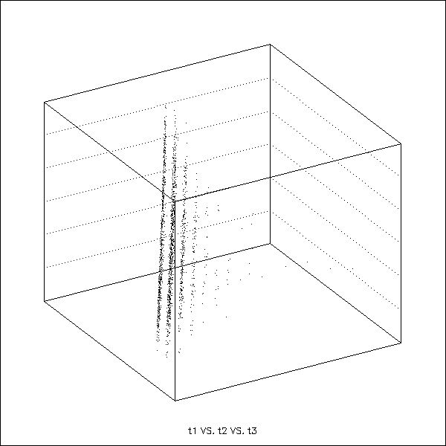
Time correlation among hits
Correlation in time
the three hits with lowest time

Slide 19
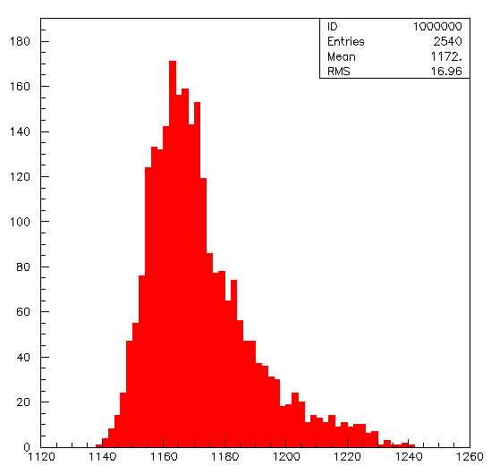
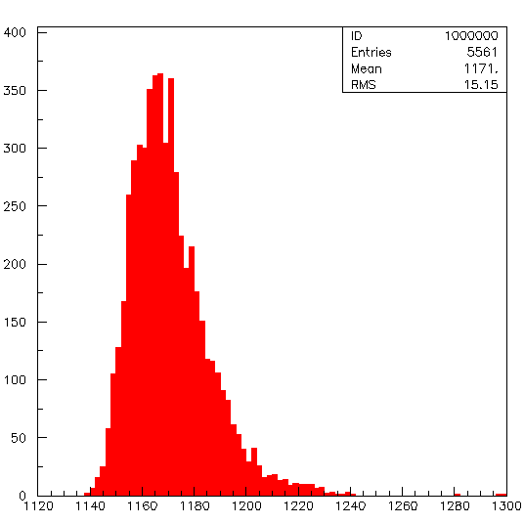
Resolution studies on cosmic
only 2 lookup tables fired
RMS=17 counts i.e. 27 ns
more than 1 lookup tables fired
RMS=15.15 counts i.e. 24 ns
The algorithm is rather simple we assert the trigger on the basis of the first hit coincidence we
have

Slide 20
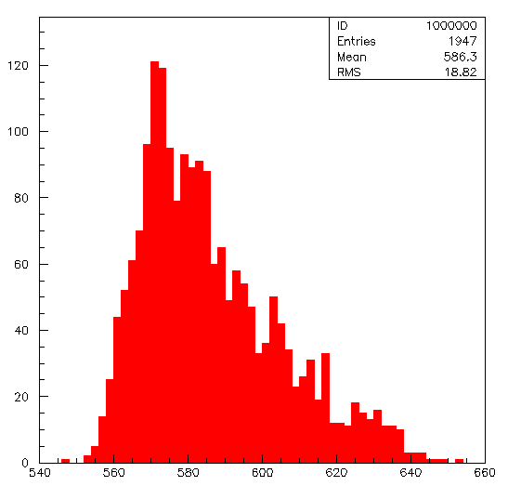
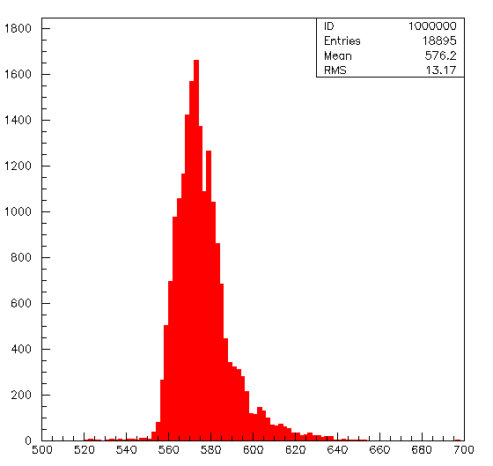
Resolution studies on beam
only 2 lookup tables fired
RMS=18.8 counts i.e. 30 ns
more than 1 lookup tables fired
RMS=13.17 counts i.e. 21 ns

