Slide 1
SuperB Integration
Summary of previous integration sessions.
SuperB Experimental hall.
Integration DHC SVT layer 0
Proposal of Focusing DIRC shielding
Summaries of questionnaire.
Future activities.
Conclusions.

Slide 2
Summary of the previous integration sessions
Experimental area:
We analyzed critically the floor plan of the experimental area of Babar considering all problems that made activities difficult.
We overcame them proposing a new layout that should make simple all operations.
We took the SuperB layout and we revised the mechanical interface of Babar of the reused elements.
We start circulating a service questionnaire to be able to check and track the services inventory.

Slide 3
SuperB experimental hall
The experimental floor size is set to 60 X 24 meters considering to concentrate most of the activities in that area.
We add schematically the shielding between the interaction area and the rest of the hall (1meter).
The beam position respect the floor is set to 4m.
We fit all components in it
A lot of details must be add tike the access gate to the interaction area.
Most of the cooling system could be located inside the service room and we could store gas and liquids there.
We need to have an interaction with the machine people to understand: the machine equipment near to the detector; the position of the tunnel; the constrain of the experimental building.

Slide 4
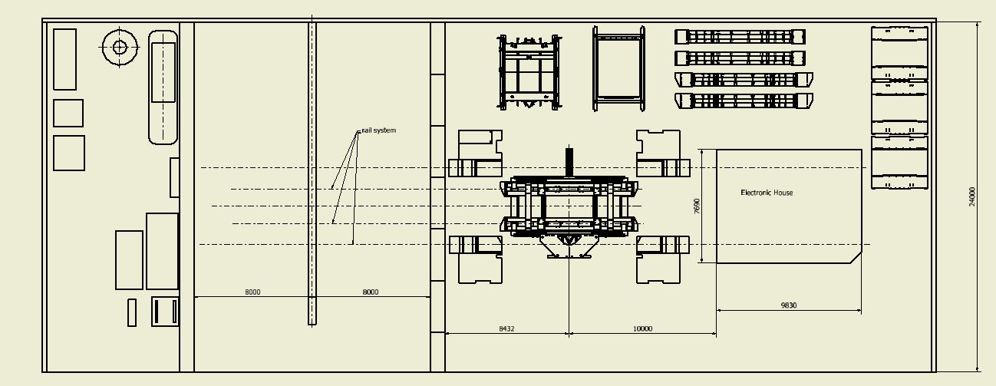
+500mm up beam axis

Slide 5
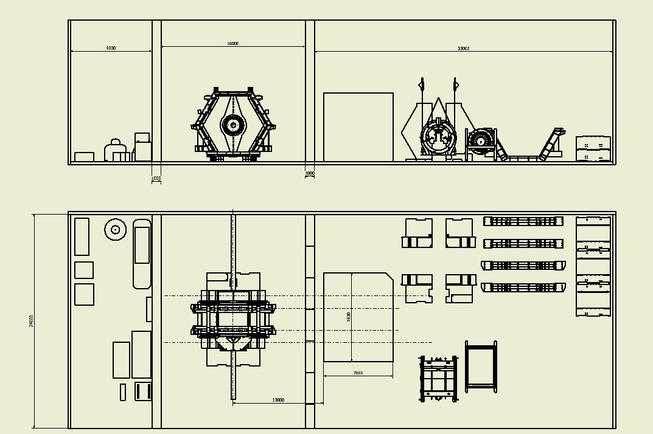
DCH
gas
Power cable
Read-out cable

Slide 6
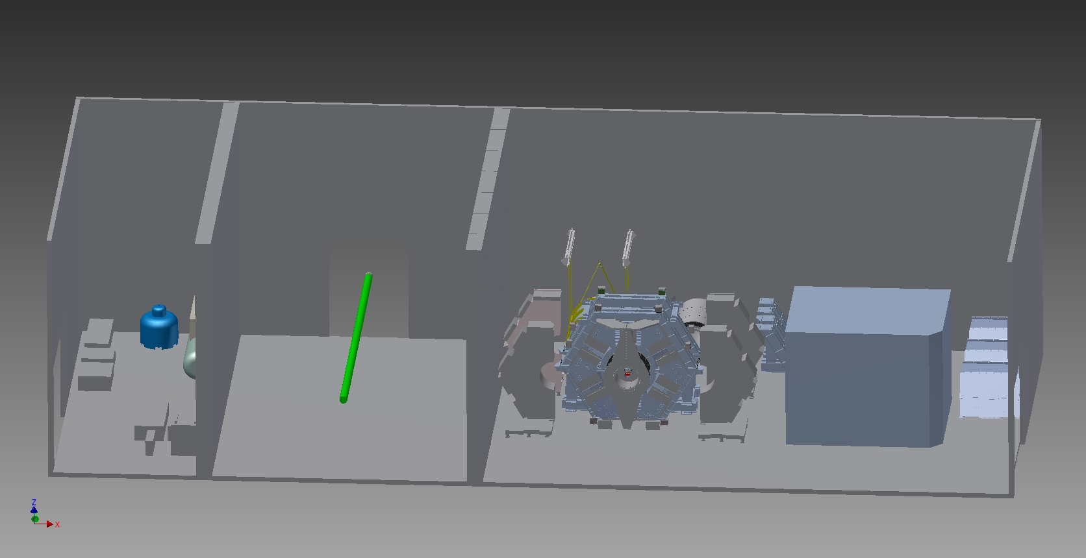

Slide 7
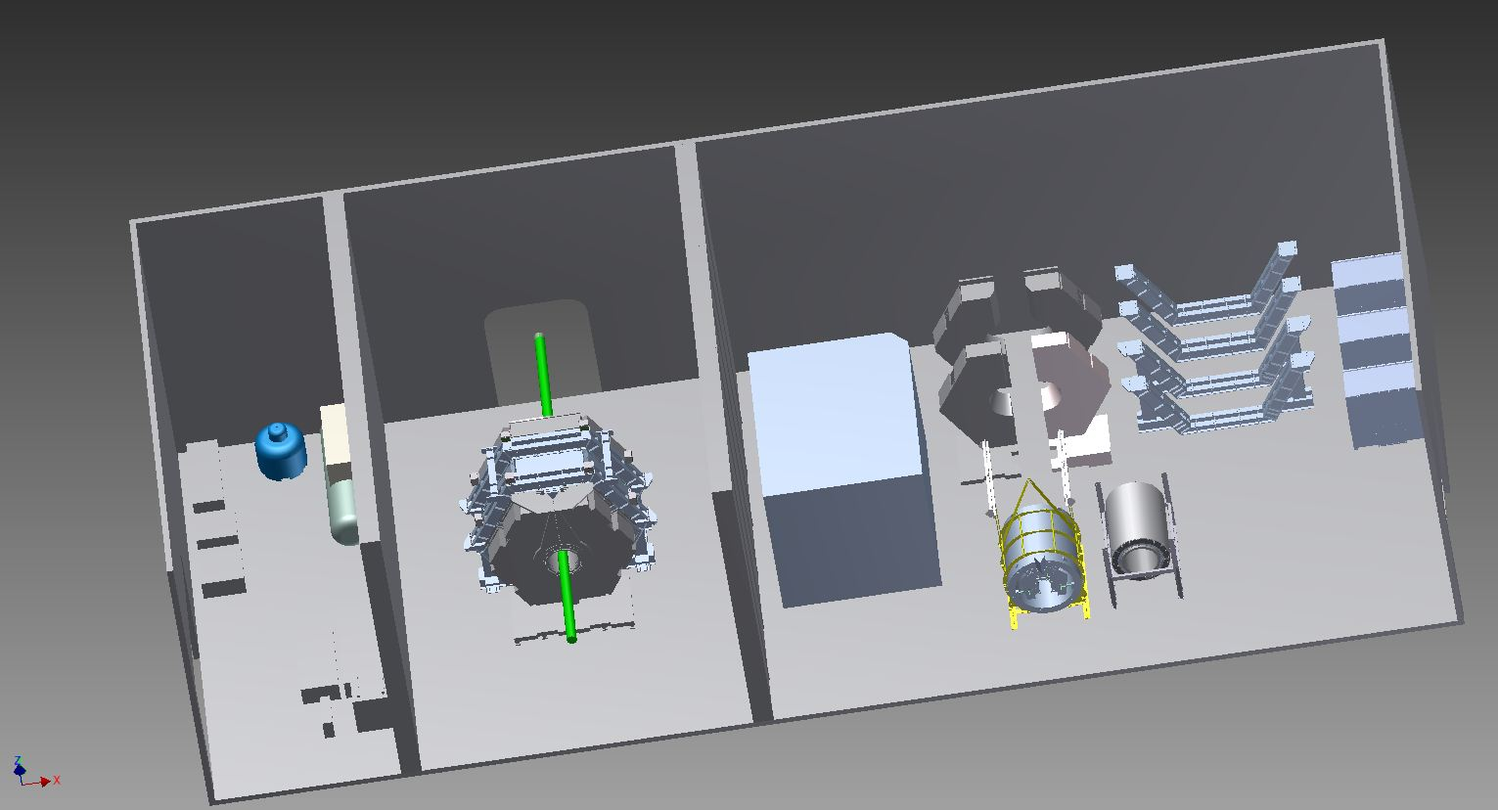

Slide 8
Some considerations:
The electronic house can be maintained always at same distance respect the detector (about 10m).
Power and read-out cables could go respectively on the top and bottom of the electronic house.
The length of the cable from SuperB to the electronic house are more them 10meter.
Power cables and read out cable of the doors must allow a compensation for their motions.
Cryogenic and cooling line can be extended for the two detector positions.

Slide 9
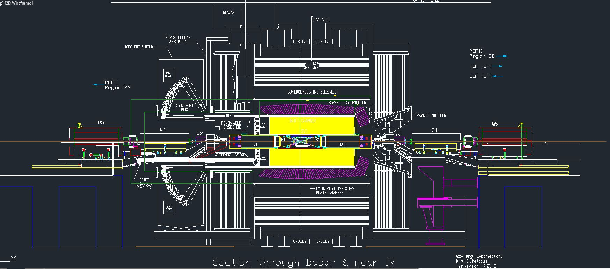
Babar reference geometry drawing

Slide 10
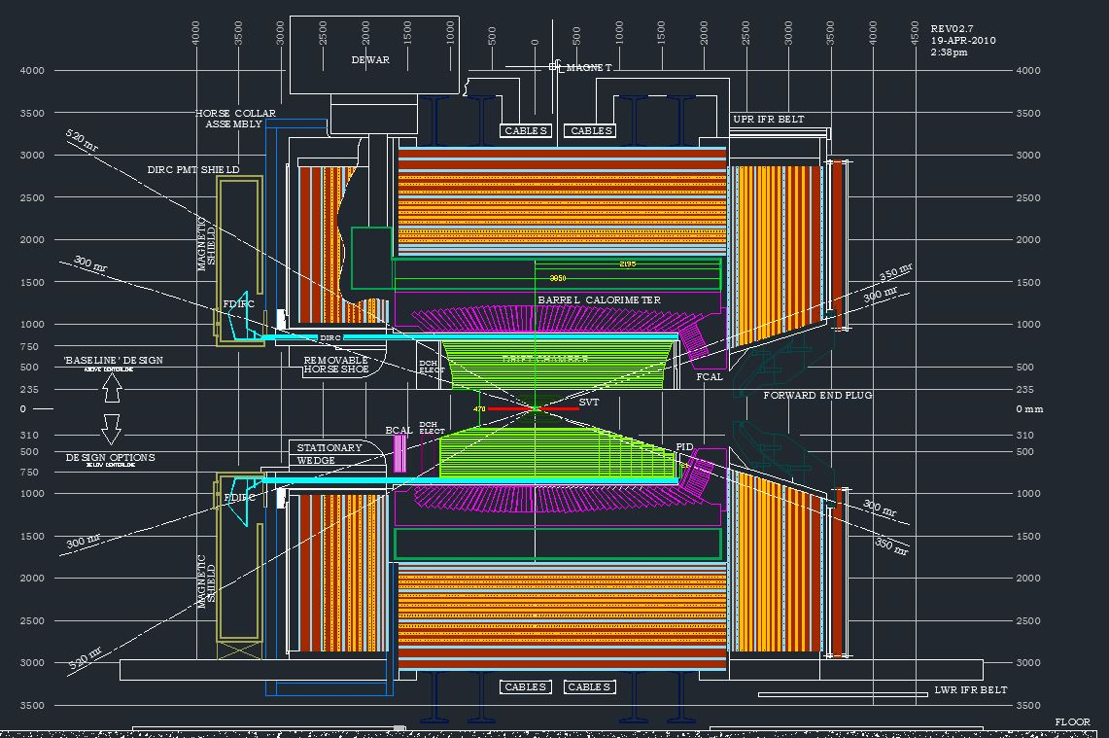
SuperB reference geometry drawing must be update constantly

Slide 11
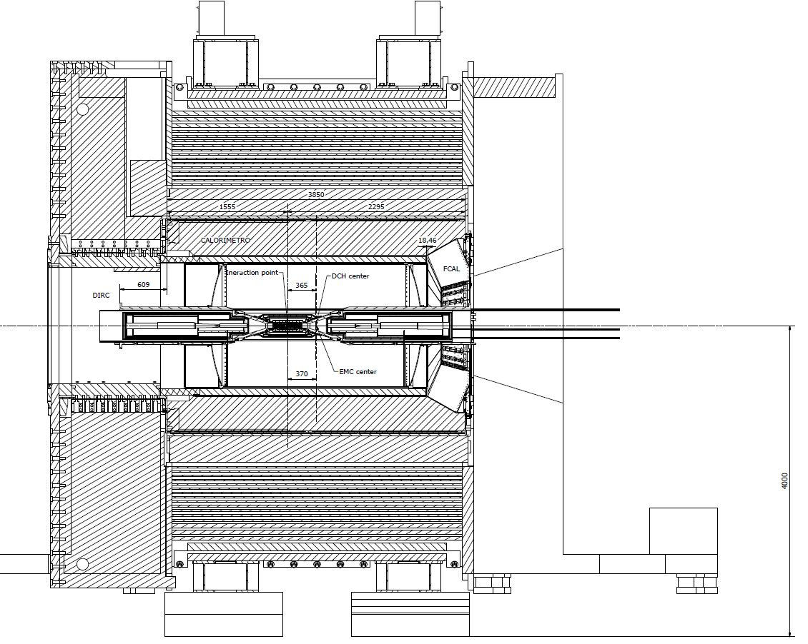
Rails extension for quick demount
367

Slide 12
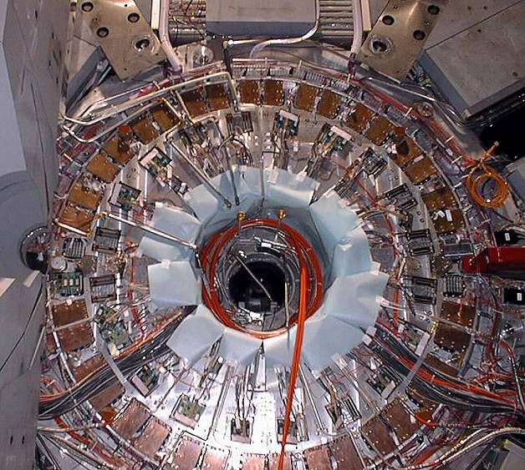
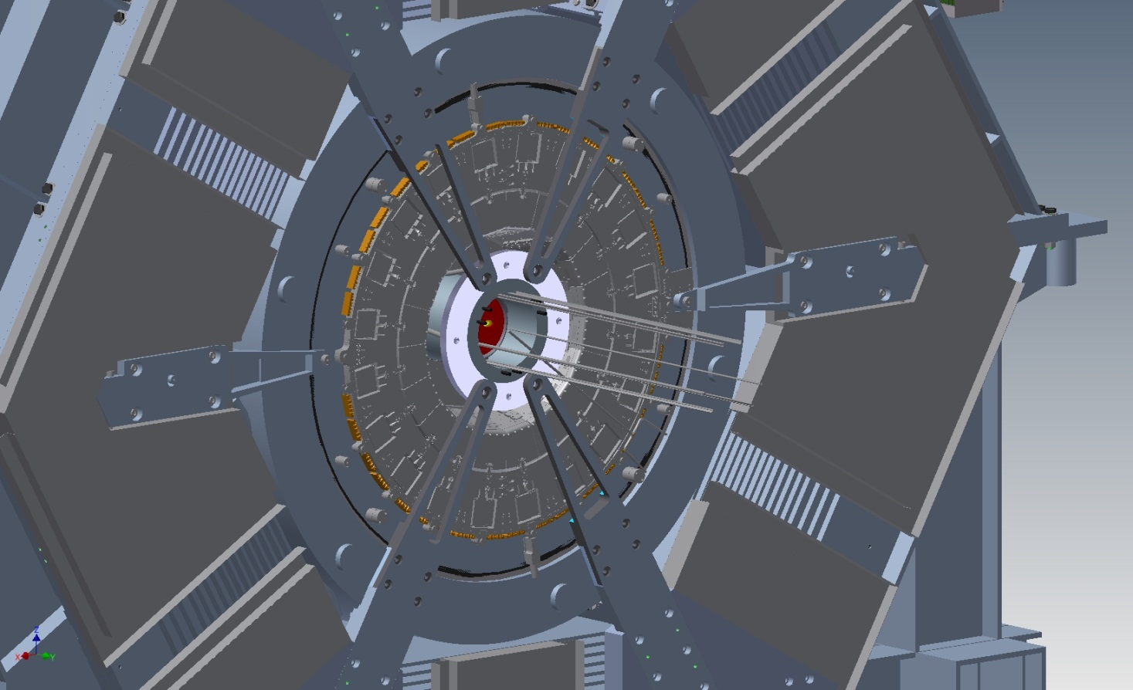
Integration DHC SVT layer0
Forward service of Babar
Extension of the Magnet ears
Struts and rods adjustable
Inner ring

Slide 13
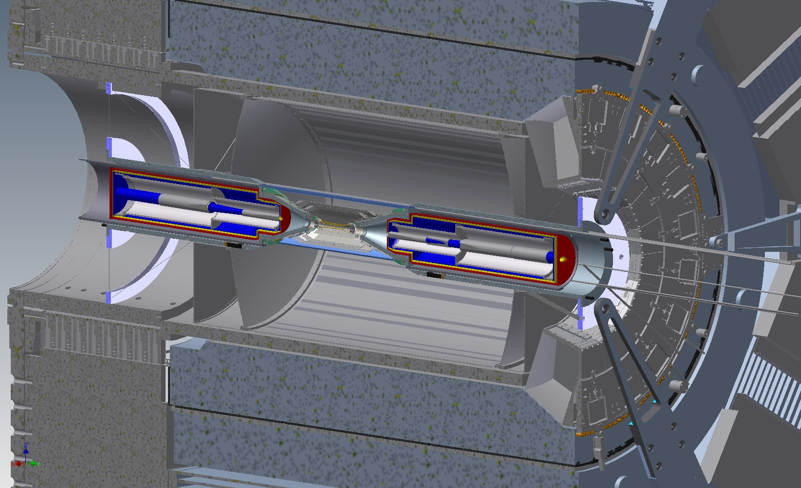
Rod supports
Ring support
Rails extension

Slide 14
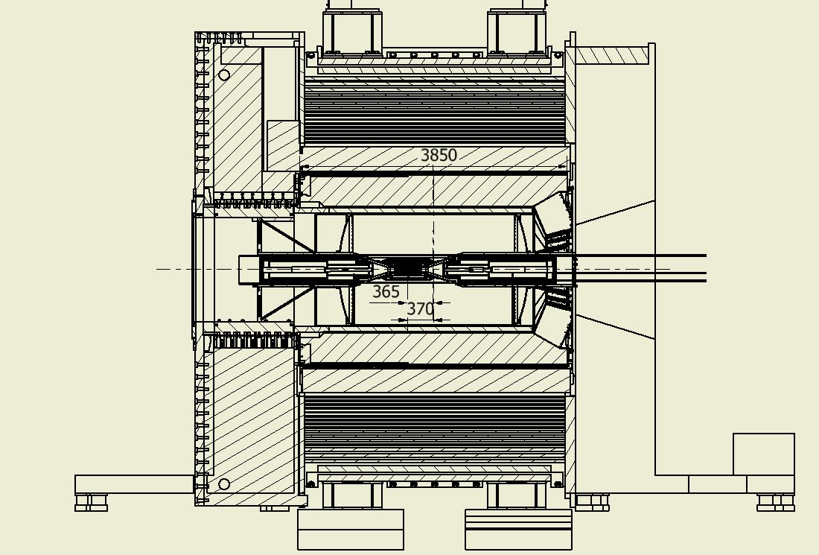
Support Position
Must be set

Slide 15
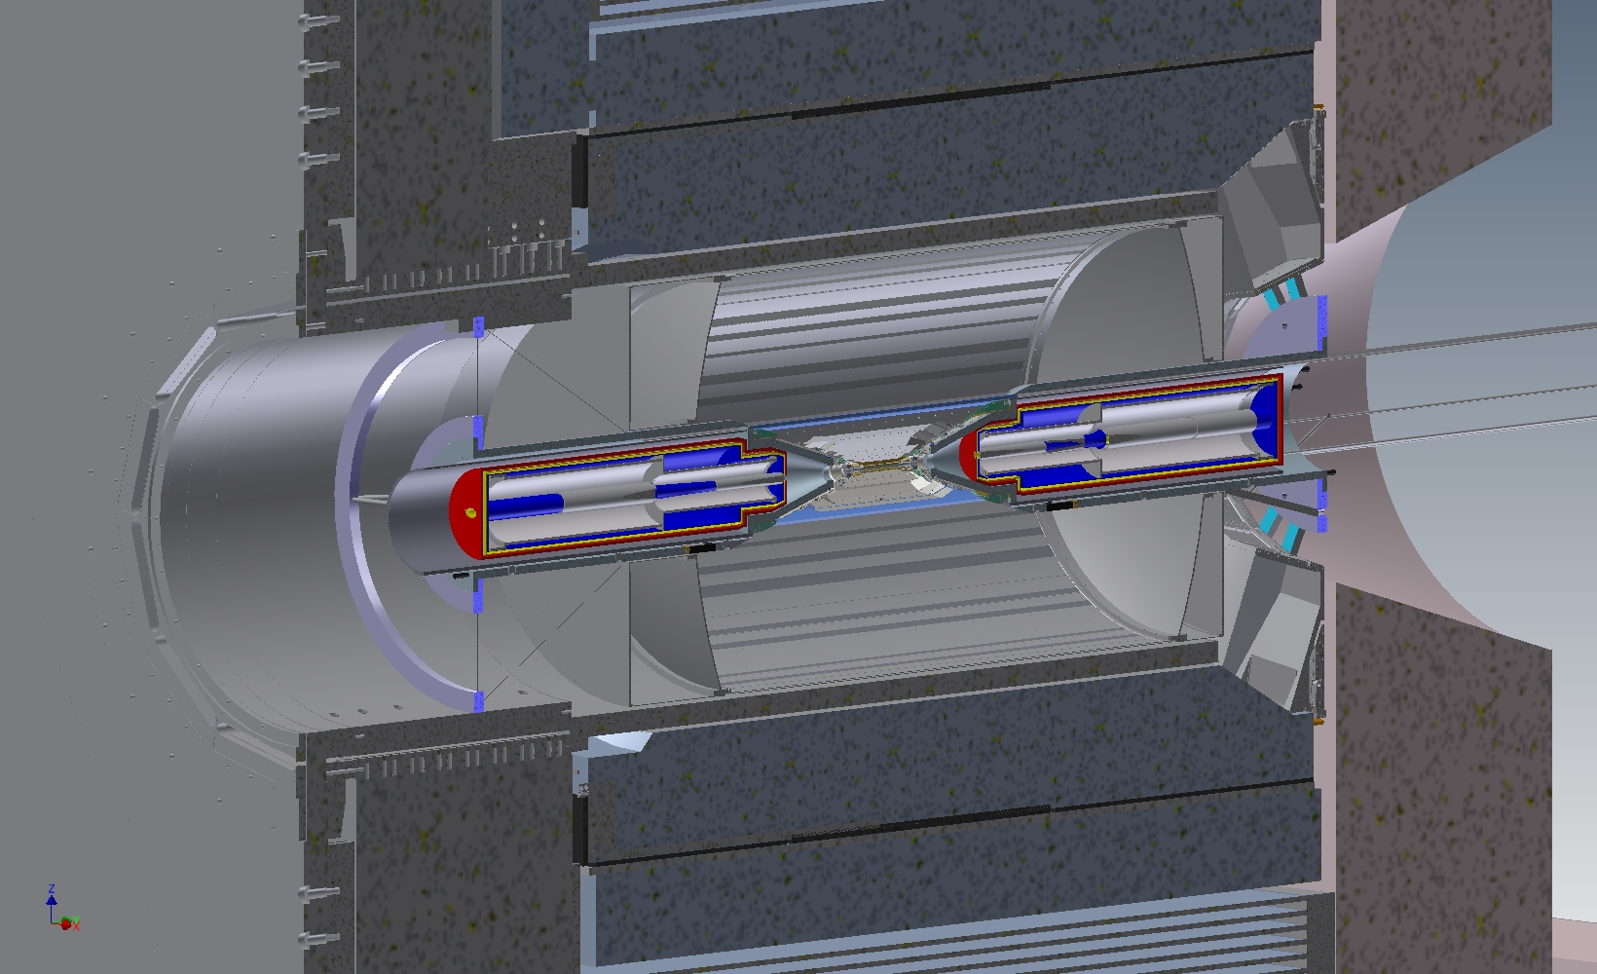

Slide 16
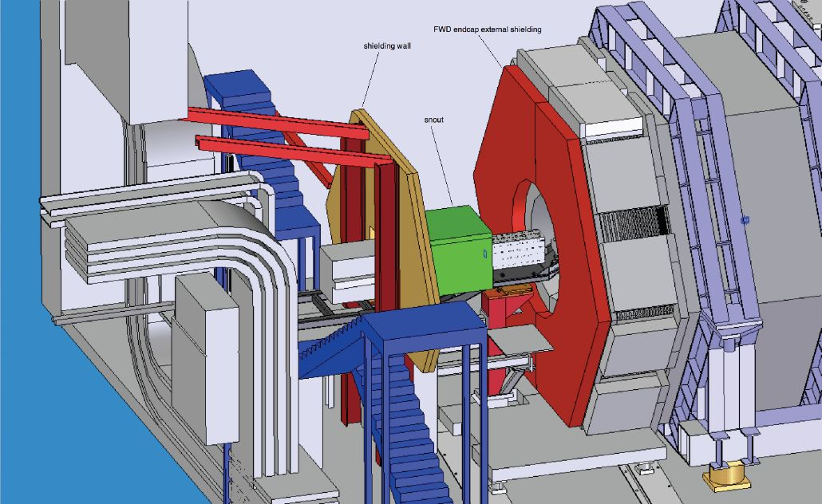
Example of Babar Forward Shielding

Slide 17
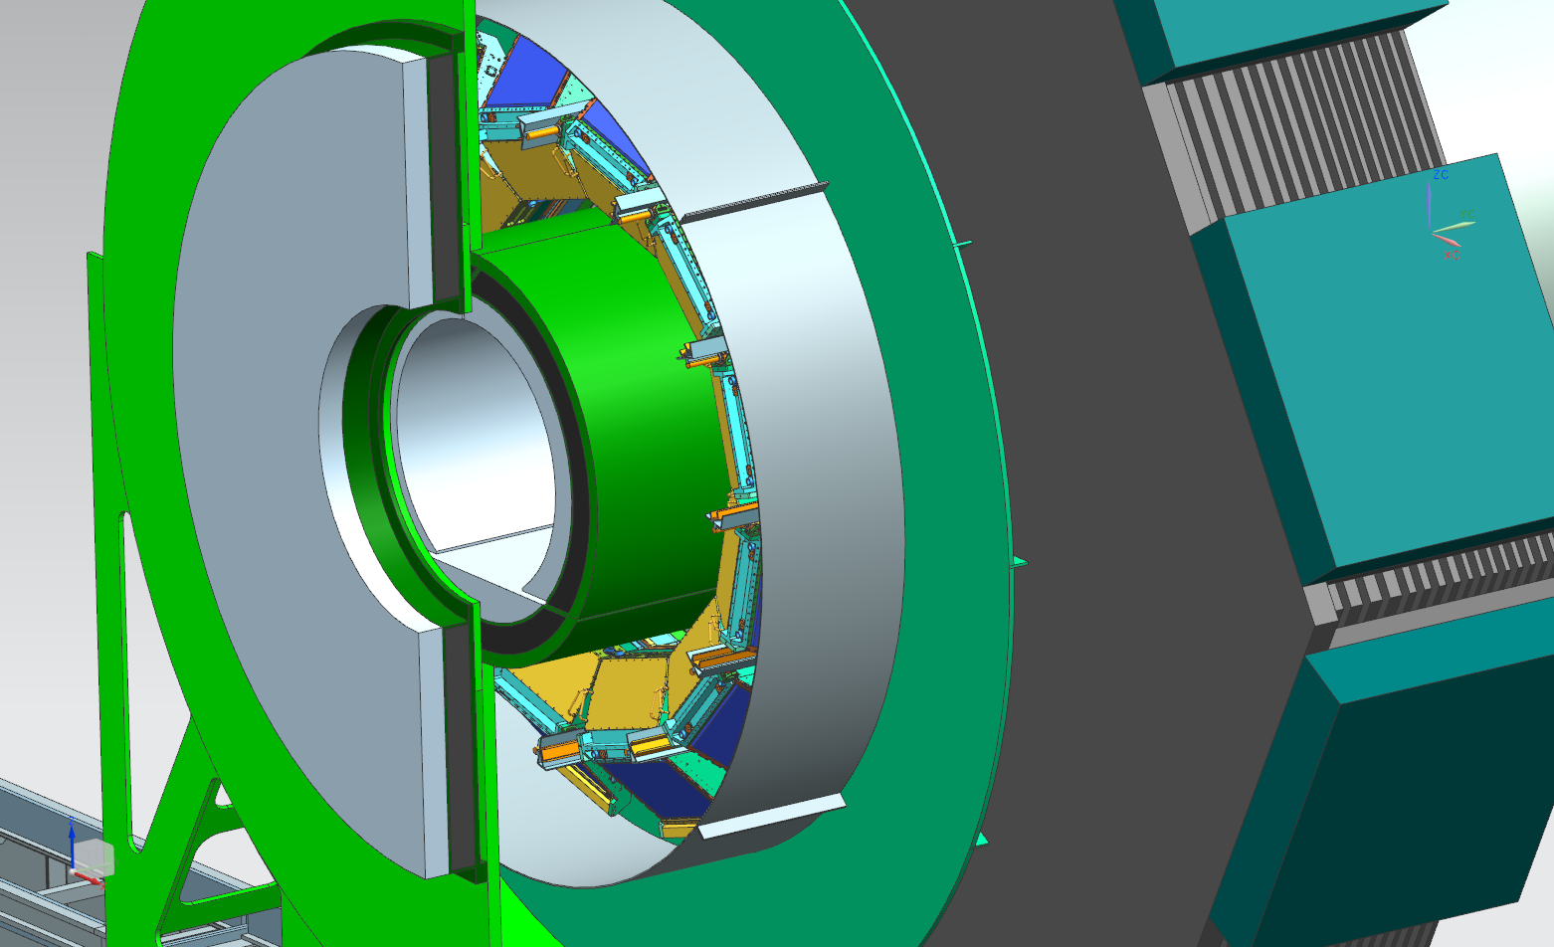
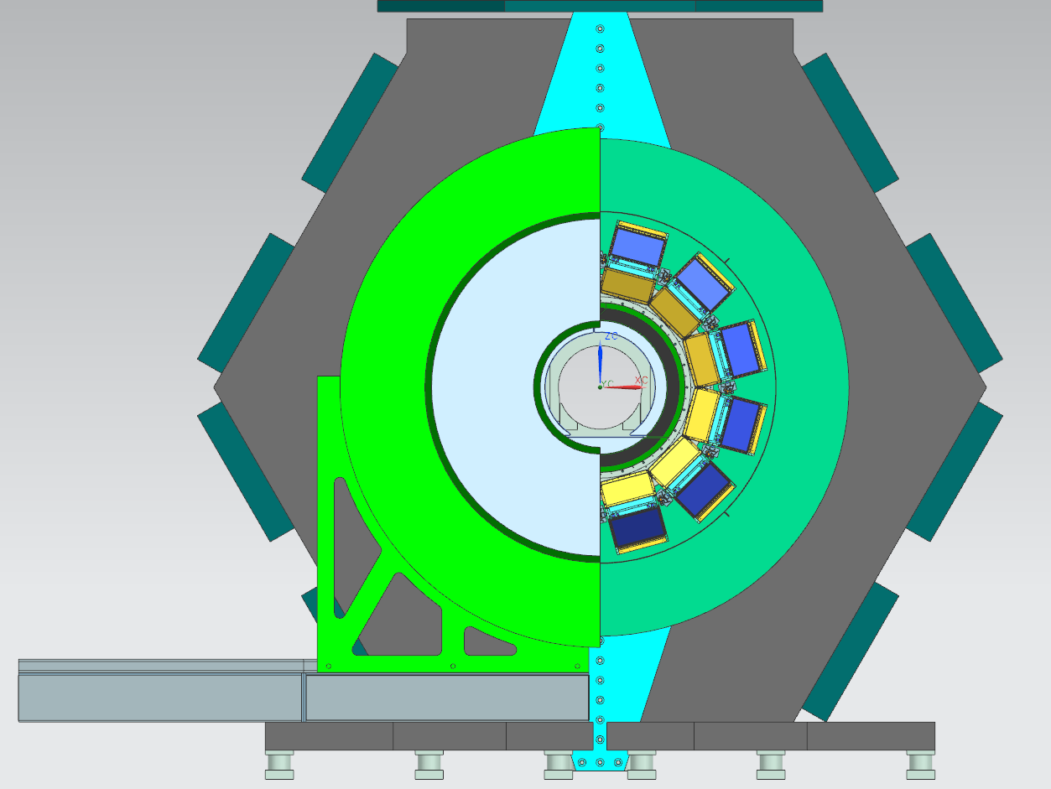
Focusing DIRC proposal of new Shielding must be approved and integrate on SuperB drawings
Plastic shield
Metallic shield

Slide 18
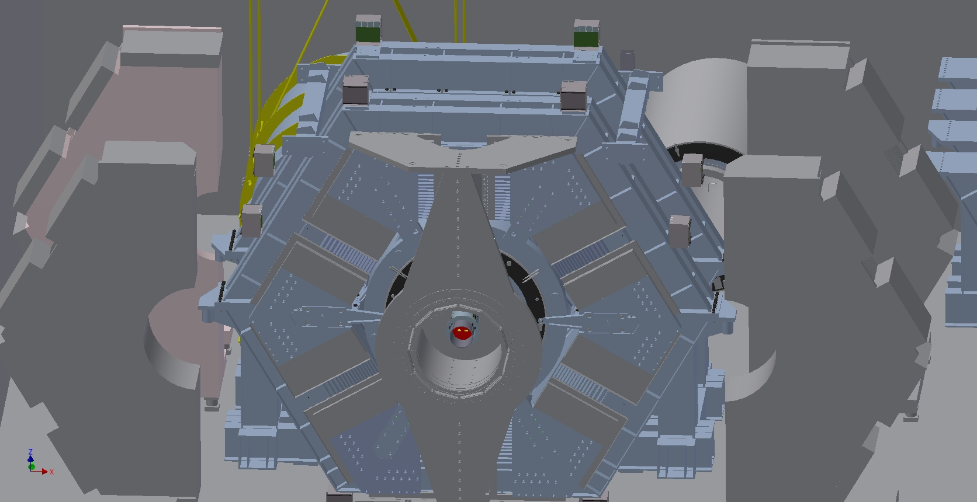
Questionnaire summaries
IFR service and electronic box are integrated in the 3d drawings
Electronics box
Cables channels 3”x5”

Slide 19
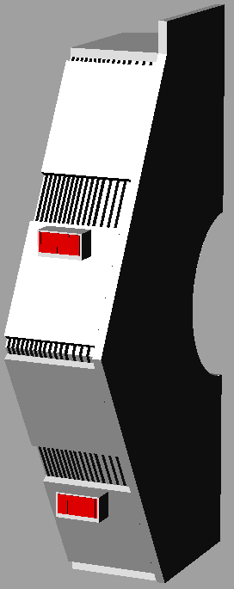
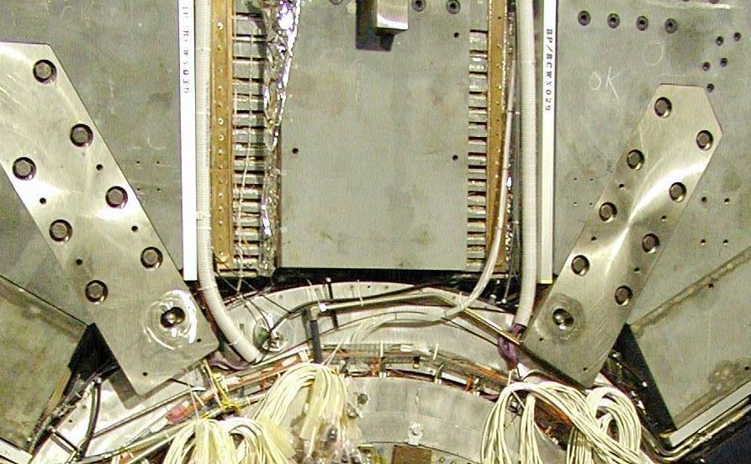
Questionnaire summaries
copper cooling plates at the top forward sextant of BaBar
Cooling required

Slide 20
Questionnaire summaries
Super conductive magnet
We know more or less all components that we need including their required power (liquefier, helium tank, power supplies, compress, control unit etc).
We have still to face the problems to set all magnet services properly like the dump resistor breaker.
Furthermore a lot of discussion must be done on all steps to bring the magnet to run. (qualification, restoring the cryogenic connections etc.
ITEM | WIDTH (m) | DEPTH (m)
Helium Liquefier | 7.68 | 1.95
Helium Liquefier with suction line | 7.68 | 3.11
4000 Liter Liquid Helium Dewar | 2.39 diameter | -
Helium Liquefier Adsorber Cabinet | 2.68 | 0.76
600 kW (800 HP) Helium Compressor | 5.18 | 2.13
300 kW (400 HP) Helium Compressor | 3.96 | 1.83
Pad size for compressor LN2 cooled charcoal helium gas purifiers | 2.44 | 1.52
Outside Pad for compressor alumina and oil demister purifiers | 7.32 | 3.66
Cryogenic Control Room (inside dimensions) | 5.79 | 4.72
PLC cryo control cabinet in control room | 1.80 | 0.50
BaBar Detector UPS (75 kVA) | 4.11 | ~1.5
BaBar Solenoid Power Supply | 1.83 | 1.98
BaBar Dump Resistor/Dump Breaker Box | 2.35 | 2.07

Slide 21
Questionnaire summaries EMC
Volume occupied by the electronics :
Barrel same occupancy of BaBar; we use the same minicrates.
Forward - There is not a real scheme of the forward depends from the final crystals decision.
Backward – No realistic drawings exist.
Forward EMC:
Lower diagonal slots both sides for all services so that end cap could be withdrawn for access to the DCH end plates and services
Included source calibration lines, cooling lines for each half of the endcap, signal fibers, low voltage cables (big for power hungry crates, 10 per half), timing cables, monitoring cables
Barrel EMC, forward end:
All 4 diagonal slots
Signal fibers, low voltage cables, timing cables, monitoring cables
10 crates per slot

Slide 22
Questionnaire summaries EMC
Cooling system.
Requirement of cooling system:
Barrel: Preamp heat removed by conduction to module strong back which are directly cooled using fluorinert; digitizing electronics housed in 80 mini-crates, each in contact with the end-flange support structure, cooled by chilled water flow through channels milled into the end-flanges close to the inner and outer radii (source: Babar NIM, §9.2.5). The SuperB follows the same system but we want to do a better study heat dissipation due of no high reliability of the system in Babar
Forward: Similar to Barrel.
Backward: No requirement for an active cooling system anticipated.

Slide 23
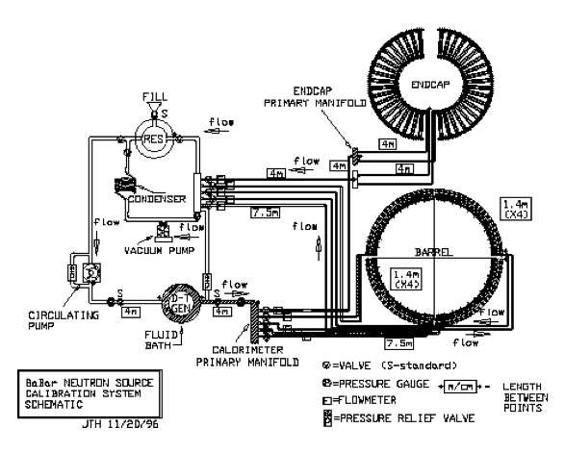
Questionnaire summaries EMC
Forward/Barrel - In addition to the requirements above, the barrel and forward calorimeter will have a radioactive source calibration system that will have significant requirements for space and assembly. The design is along the lines of the existing system for BaBar. A schematic of the system is shown below:

Slide 24
Questionnaire summaries DCH
Services for inner detectors that are taken out in the backward direction must exit the end of the DIRC support tube.
HV travels in the forward calorimeter.
Location of the gas mixing and storage area? In particular, the horizontal and vertical distance with respect to (for example) the detector center has an impact on the design. We will also need space for two racks close to the detector for bubblers and bypass valves. On BaBar, these were on top of the detector, but depending on the location of the gas hut, it might make more sense for them to be on the floor.
Cooling backward plate with air flow.
Cluster count 1Kw liquid required.

Slide 25
Questionnaire summaries SVT and layer 0
We have to have and idea of the cryogenic system for the magnet as well of all cables and cooling lines etc.
The quick demount is another issue that have an important impact on the integration.

Slide 26
Future activities
We have to make more detail drawings on services section and start outline service paths to their final position.
During the assembly of SuperB detector a lot of doubts are coming out.
A campaign of measurement and inspection of the reused Babar elements will be useful in future.
Most of mechanical interface that are shown only on pictures are not on the drawings.

Slide 27
Conclusions
We have to consolidate layout choices and services arrangement in a way to work efficiently on the detailed drawings.
For that we need to have more mechanical meetings with Physicists a engineers that are working on the sub-detectors and detector simulation.
A dedicated meeting should be made to analyze the assembly and commissioning scenario for SuperB that included the machine activities.
A planning of the envisage activities will be very useful too.

