Slide 1
Results from the cold test of the first QD0 prototype
and next steps
P.Fabbricatore
INFN Genova

Slide 2
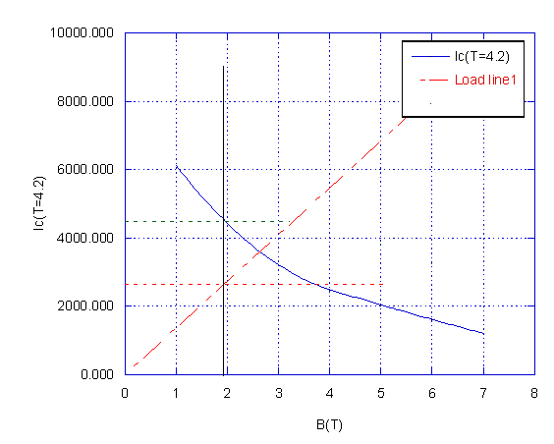
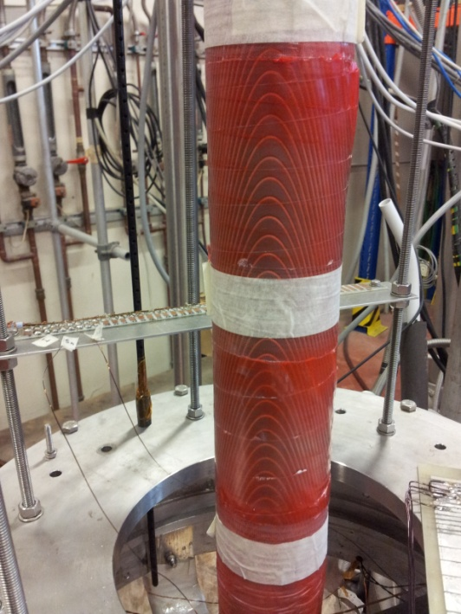
The prototype QD0 was test in December and January. We expected safe operation up to 2650 A and wanted to investigate the limits.

Slide 3
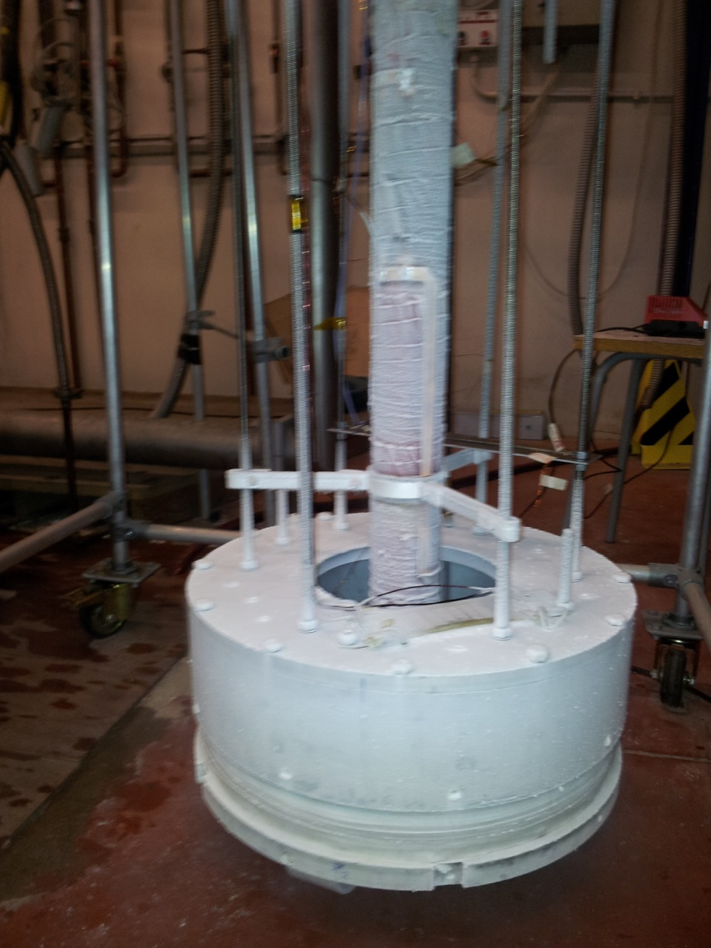
The model was successfully tested; it was fed with a current of 2750 A. The limitation seemed to be of mechanical nature (mechanical disturbances). Further test are planned for better investigate this aspect.
It was observed that:
Training started at 2300 A
The quench protection might have triggered some ‘quenches’
The magnet restored soon sc state after quench
The quench protection was dis-connected and the magnet survived to many quenches.
Why the magnet does behave so well?

Slide 4
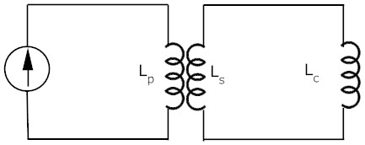

I remind that for limiting quench problems …
…we used a transformer system for charging the model so to limit the energy which in case of in case of quench can be dissipated as heat (1150 J)
As primary we use a large magnet we have in lab L_{p}=6H ; L_{c}= 330 μH; Using a reduced secondary inductance L_{s}=90 mH the current transformer ratio is abou 20 . In order to fast dump the current and extract energy from the coil, a heater is placed in the secondary winding.

Slide 5
1D quench→ Dangerous temperature
Wire heating due to ac losses
We need to redo measurements with fast acquisition for verifying this occurrence
The magnet heating after 8 ms. The ac losses in the wires causes a temperature increase over the critical one, quenching almost the all magnet

Slide 6
Moving towards an updated design
The test confirmed that high current could be involved (2750 A) →
We are developing a design with angles of 35º and high current. With respect the model we also reduced the thickness of each layer down to 2.5 mm (4 mm used for the model). The pitch is the minimum one (turns touch each other at 45º)
The wire is the CMS one with formvar (Φ 1.28 + 0.08= 1.36 mm) or a Nb3Sn wire Φ 1.20 + 0.14= 1.34 mm
R ext II layer
R aver II layer
R ext I layer | R aperture + 2.5 mm
Gap | 0.5 mm
R ext II layer | R aperture + 5.5 mm
Cave hosting wire | 1.4 mm x 1.4 mm
R int II layer
R ext I layer
R aver I layer
R int I layer
R aperture

Slide 7
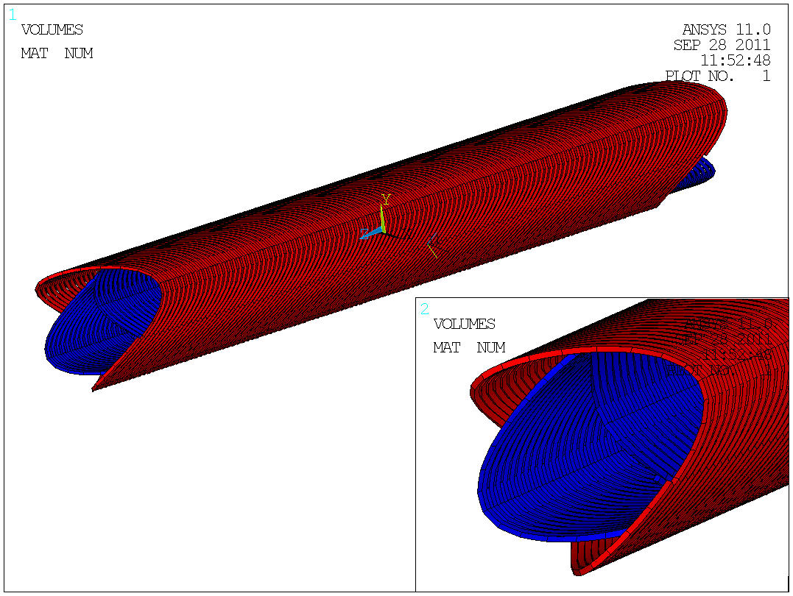

Slide 8
Main characteristics of all magnets last version (not yet frozen)

Slide 9
Margins (QD0H) with NbTi technology
At T=4.2K the margin on the current is 70% ←→ ΔT =1.2K (Not really high)
At T=1.9 K the margin on current is 42% ←→ ΔT =3.7 K

Slide 10
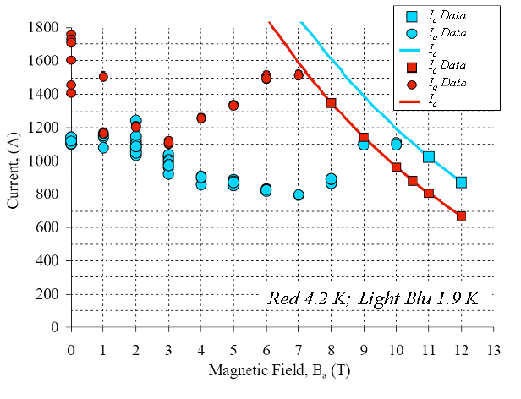
Margins (QD0H) with Nb₃Sn technology
Involving Nb3Sn (much more difficult technology) we could operate with a larger margin, but limitations can arise due to thermo-magnetic instabilities at low fields.
It would be better operating at higher temperature (Supercritical helium) or using a wire 1.2 mm diameter but lower Ic

Slide 11
The coil axial dimensions just allows to accommodate them into the cryostat, provided that:
1) The cold bore of the coils coincides with the inner cold bore of the cryostats and it is made of Al alloy
2) The position of the coil is acceptable
The present cryostat has 370 mm OD. The suspension system not yet studied. It shall be design to hold high axial forces (4 t)

Slide 12
Next Steps of model development and coil design
Construction of a NbTi prototype of QD0 May 2012
Construction of a Nb3Sn prototype of QD0 July 2012
2.b) Construction of a NbTi prototype of QF1 July 2012
3) Cryogenic test of the prototypes Sept. 2012
4) Finalize coil magnetic design Oct. 2012
5) Cryostat preliminary design Oct. 2012

Slide 13
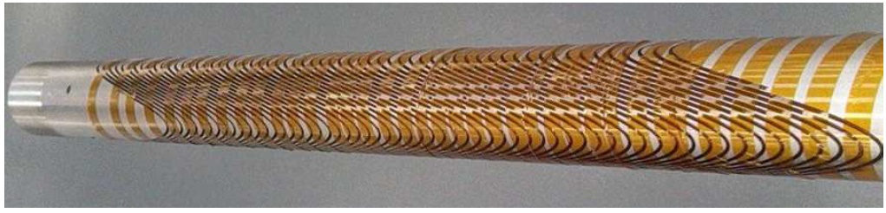
Thank you for your attention

