Slide 1
Project Status
Marcello A. Giorgi Università di Pisa & Pisa
3rd Collaboration & General Meeting
LNF March 19,2011

Slide 2
European Strategy
The CERN Council announced (Dec. 15) that it would hold an Open Symposium in Krakow, Poland, from Sept. 10-13, 2012, to update the European Strategy for Particle Physics. The previous set of a strategy like this was in July 2006.
Later SuperB was included in the European Strategy as a regional project. “ in the spirit of Lisbon”.

Slide 3
European Strategy
Submission of documents from the scientific community is expected with a dead line of July 31
After conducting the Open Symposium in Krakow and reviewing the submissions, the Cern Council plans to hold a special session in Brussels, Belgium, in the summer of 2013 to adopt a new formal strategy.

Slide 4
European Strategy
SuperB and Cabibbolab cannot miss this occasion, we must be officially part of the European Strategy.
Many document must be uploaded in the appropriated site about the Physics goals and the research infrastructure.
In agreement with our physics conveners and detector coordinators I intend to call a special meeting will be called during this week.
3/20/2012

Slide 5
European Strategy
I expect that during the Elba meeting (end of May) we can move towards the final editing of the documents about the Physics program and Goals.
The presence of SuperBers and Cabibbolab at the Krakow meeting must be strong.
BUT……I remind that at the last meeting in December a decision was taken about the 2012 SuperB calendar.
3/20/2012

Slide 6
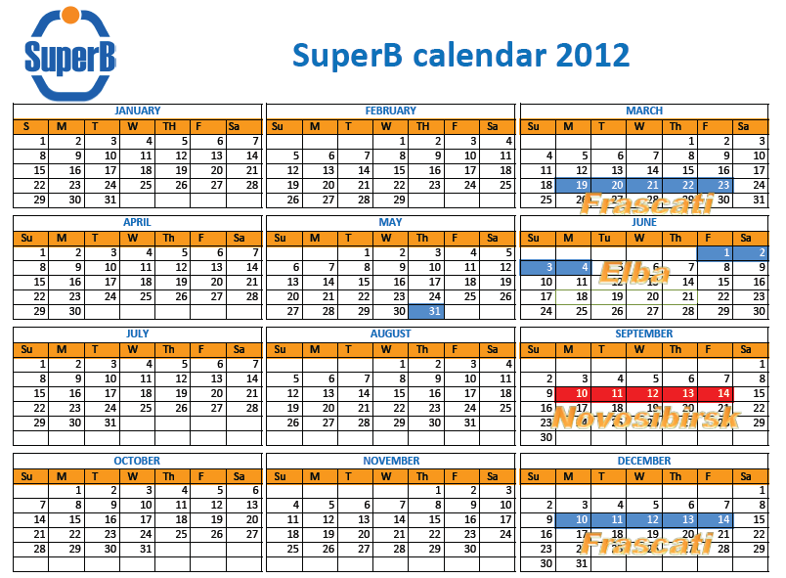
3/20/2012

Slide 7
Conflict !!!
Possible solutions:
Move the meeting @BINP from the week of September 10 to September 3 or to September 17.
The second solution could be preferable , since the first is quite close to the summer vacations in several european countries.
3/20/2012

Slide 8
Conflict – the week of 17 is crowded of events.
VERTEX 2012 -Korea ( September16-21)
Tau 2012 – Japan ( September17-21)
International Workshop on e+ e- collisions from Phi to Psi –Novosibirsk (September 19-22).
Decision needed by the end of this week.
3/20/2012

Slide 9
Few words about the agenda of this meeting , similar to previous meetings..
3/20/2012

Slide 10
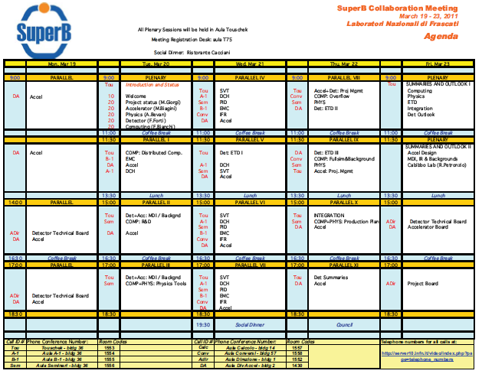

Slide 11
Agenda
A lot of progress expected!
The meeting called by Walter and held yesterday by the accelerator community was impressive, well attended and showing a highly determined group of experts.
Marica will report today on technical aspects and our DG will illustrate next Friday the Cabibbolab structure and the governance of the accelerator.
3/20/2012

Slide 12
Agenda: collaboration issues
IMPORTANT PROGRESS :
Meeting of collaboration council on Thursday.
Formation of the Executive Committee with designation of the Cabibbolab representative.
WE ARE ENTERING IN THE CONSTRUCTION PHASE WITH THE EXPERIMENT TOO.
3/20/2012

Slide 13
Common issue
It is clear that some issues as background need attention by a joint community of accelerator and experimental physicists.
The design of the experimental area with all the facilities needed is another example of what must be designed and optimized thanks to the cooperation between experts of the two communities.
3/20/2012

Slide 14
Common issue
During the phase of the TDR Special Project ther was a body devoted to the discussion of problems involving all the SuperB people (accelerator, detector, physics, computing, site and infrastructure) . After an initial period it has become largely ineffective.
A FORUM IS NEEDED ANYWAY, SINCE COMMON ISSUES EXIST!
3/20/2012

Slide 15
JOINT FORUM
We need to discuss this week . the format , the functions and the membership.
Regular meetings are needed .
Record of discussions and decisions must be kept.
3/20/2012

