Slide 1
GPGPU Evaluation – First experiences in Napoli
Silvio Pardi
Notes:
1
1
1

Slide 2
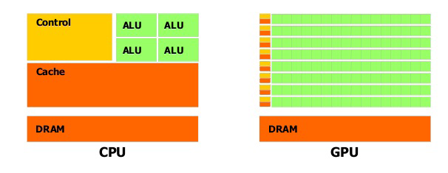
Goal of our preliminary tests
Achieve know-how on GPGPU architectures in order to test the versatility and investigate the possible adoption for some specific tasks interesting for SuperB.
multi-core Technology
High speed and complex processing unit
General Purpose
many-core technology
Hundred of simple Processing Units
Designed to match the SIMD paradigm (Single Instruction Multiple Data)
Notes:
2
2
2

Slide 3
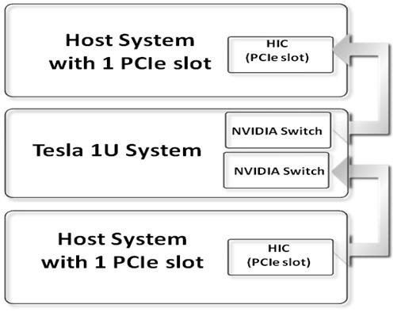
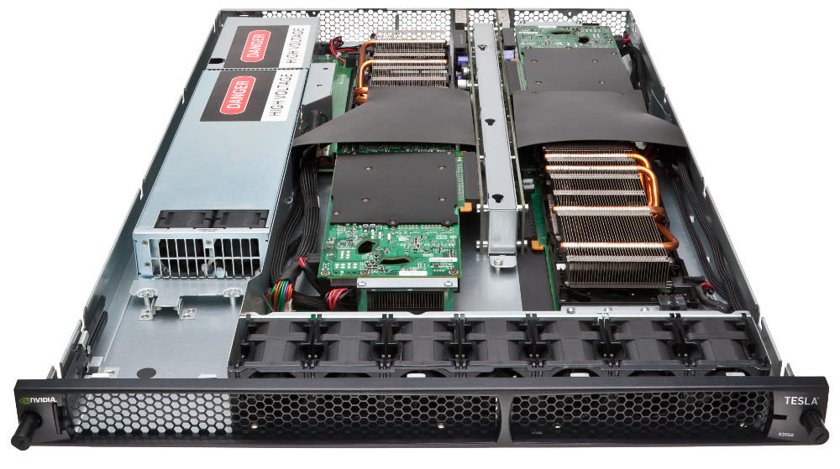
The Hardware Available in Napoli
1U rack NVIDIA Tesla S2050
4 GPU Fermi
Memory for GPU: 3.0 GB
Core for GPU: 448
Processor core clock: 1.15 GHz
2U rack Dell PowerEdge R510
Intel Xeon E5506 eight-core @ 2.13 GHz
32.0 GB DDR3
8 hard disk SATA (7200 rpm), 500 GB
Notes:
3
3
3

Slide 4
ENVIRONMENT
Cuda compilation tools, release 4.0, V0.2.1221
NVIDIA-Linux-x86_64-270.41.34.run
cudatoolkit_4.0.17_linux_64_rhel5.5.run
gpucomputingsdk_4.0.17_linux.run

Slide 5
Tuning for lazily modality remotion
The firsts test on the Tesla S2050 GPU with CUDA C show a starting overhead ~2 second due the “context” creation needed by the CUDA toolkit. The context is create on demand (lazily) and de-allocated when is not used.
SOLUTIONS (Suggested by Davide Rossetti):
Before the CUDA 4, Create a dummy process allways active that keep alive the CUDA context “nvidia-smi -l 60 -f /tmp/bu.log”
Since CUDA ver. 4 use the -pm (persistence-mode ) option from the nvidia-smi command to active the GPU contex.

Slide 6
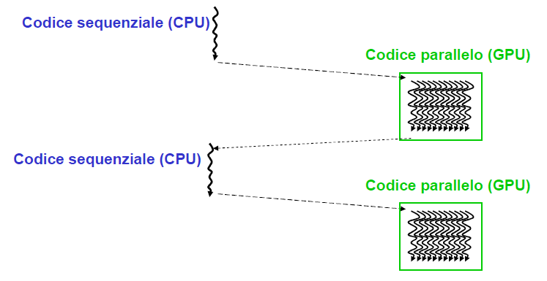
CUDA C
IBRID code: combination of standard C sequential code with parallel kernel in CUDA C.
Each code need of the following main steps:
➢ GPU Memory Allocation (CudaMalloc)
➢ Data transfer between CPU and GPU (CudaMemCopy H2D)
➢ CUDA Kernel execution
➢ Data transfer between GPU and CPU (CudaMemCopy D2H)
Notes:
6
6
6
Piccola premessa di cuda C / c++ /fortran

Slide 7
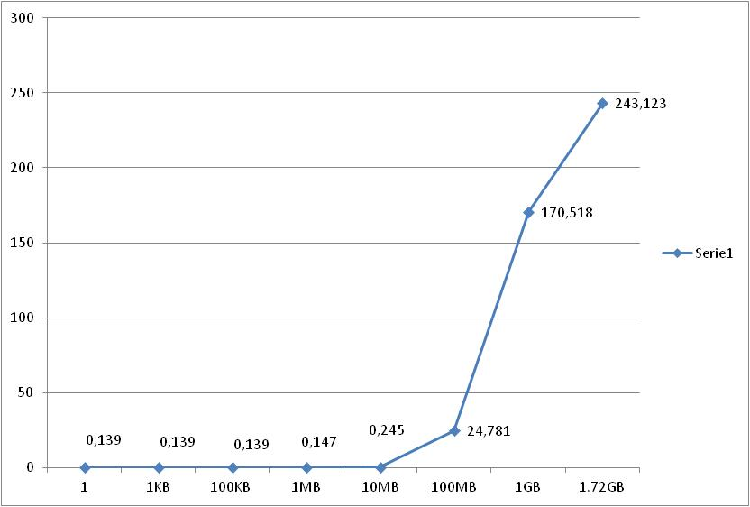
CUDAMALLOC Benchmark
BYTE | TIME (ms)
1 | 0,139
1KB | 0,139
100KB | 0,139
1MB | 0,147
10MB | 0,245
100MB | 24,781
1GB | 170,518
1.72GB | 243,123
Notes:
7
7
7

Slide 8
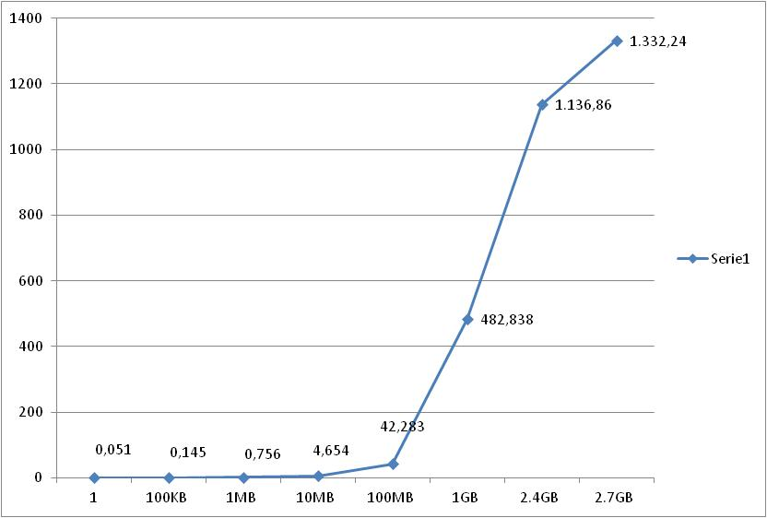
CUDAMEMCPY Benchmark
BYTE | TEMPO (ms)
1 | 0,051
100KB | 0,145
1MB | 0,756
10MB | 4,654
100MB | 42,283
1GB | 482,838
2.4GB | 1.136,858
2.7GB | 1.332,238
Max bandwidth acieved : 16Gbit/s
Notes:
8
8
8

Slide 9
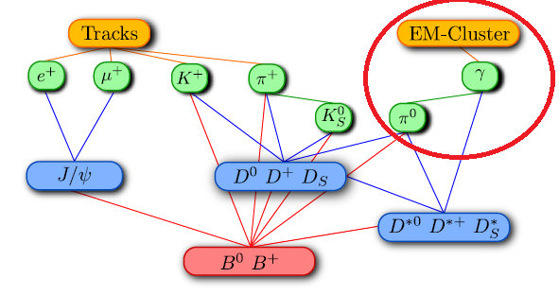
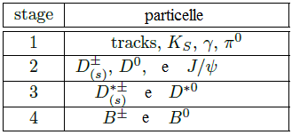
Exercise: B-meson reconstruction like algorithm
Combinatorial problem
Problem Modellization: given N quadrivector (spazial components and energy), combine all the couple without Repetition. Then calculate the mass of the new particle and check if the mass is in a range given by input.
GOAL: Understand the impact, benefits and limits of using the GPGPU architecture for this use case, through the help of a toy-model, in order to isolate part of the computation.
The algorithm has been implemented in
C CUDA
Notes:
9
9
9

Slide 10
Start
Parallel implementation
Sequential code(CPU)
Parallel code (GPU)
Read Input
CUDA MALLOC GPU
CUDA MEMCOPY CPU->GPU
Thread 0:
Sum of quadrivector: 0, 1
m²=E²-px²-py²-pz²
Thread 1:
Sum of quadrivector: 0 , 2
m²=E²-px²-py²-pz²
Thread k:
Sum of quadrivector N-2 , N-1
m²=E²-px²-py²-pz²
…
m0-Δ<m<m0+Δ
NO
m0-Δ<m<m0+Δ
NO
NO
m0-Δ<m<m0+Δ
SI
SI
SI
π⁰ found
π⁰ found
π⁰ found
MEMCOPY GPU->CPU
Notes:
10
10
10

Slide 11
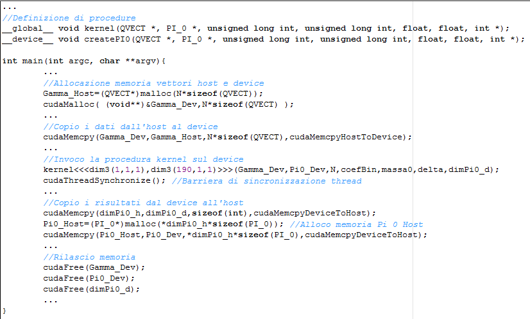
Cuda implementation (1/2)
GPU Function
Memory Allocation on GPU
Data transfer from CPU to GPU
Run GPU Kernel
Data transfer back from GPU to CPU
GPU Memory Free
Notes:
11
11
11

Slide 12
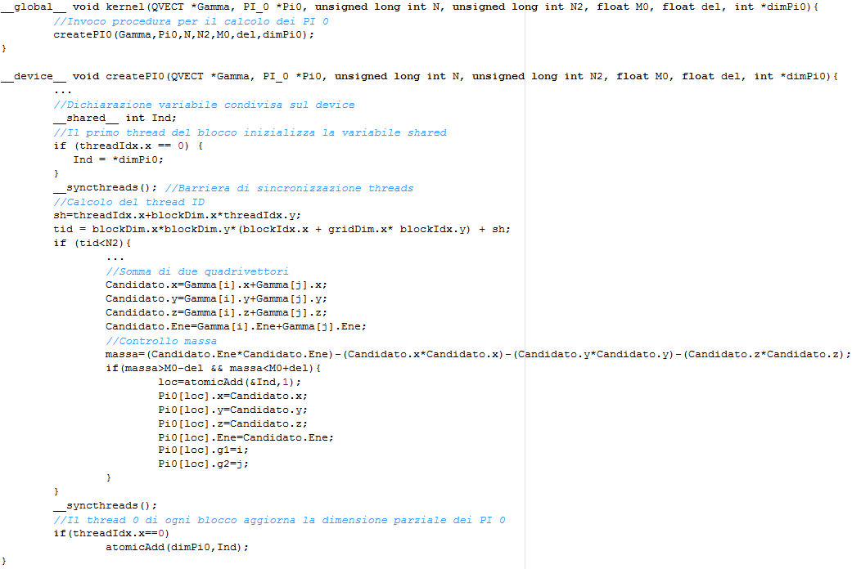
Cuda Kernel (2/2)
Thread ID Computation
Quandrivector Composition

Slide 13
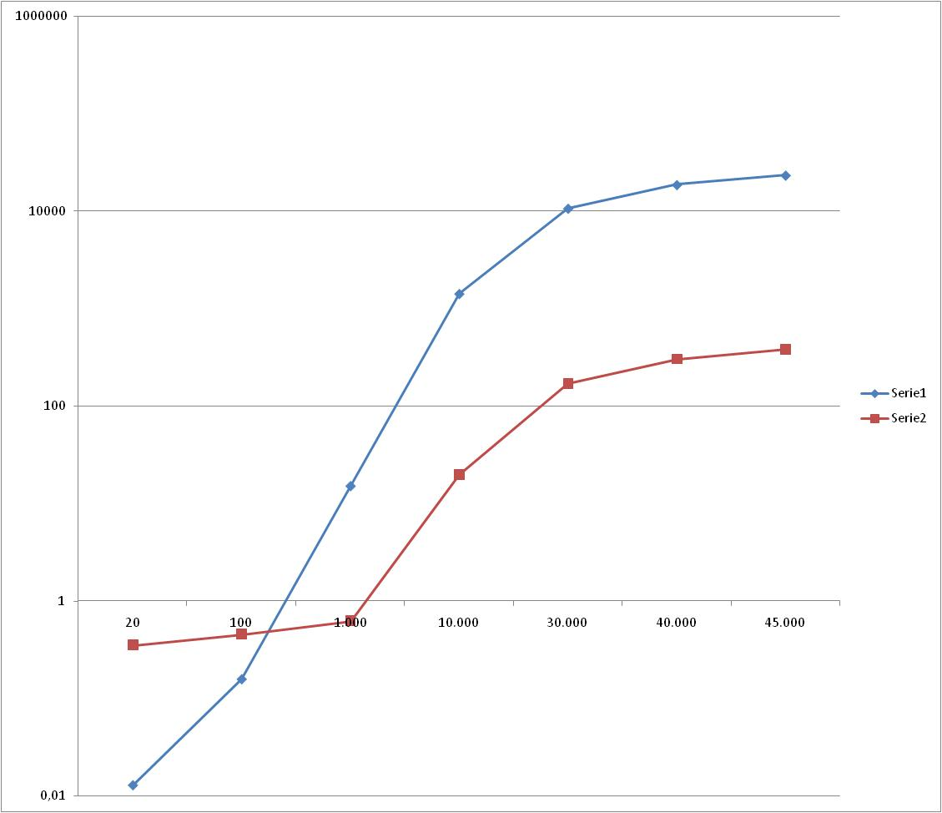
Testing Algorithm
Sequential
Parallel
Particles | Seq | Parallel
20 | 0,013 ms | 0,351 ms
100 | 0,159 ms | 0,457 ms
1.000 | 15,211 ms | 0,621 ms
10.000 | 1.422,742 ms | 19,699 ms
30.000 | 10.637,217 ms | 170,23 ms
40.000 | 18.613,341 ms | 301,756 ms
45.000 | 23.266,988 ms | 380,989 ms
Configuration parameters
512 threads for block.
Advanced tuning can improve these results
Notes:
13
13
13

Slide 14
Some Ideas
The first experience suggest to continue the investigation specially in the following way:
Tuning the memory management: Investigate the possibility to Overlapping Data Transfers and Computation through Async and Stream APIs.
Tuning the Grid/Block/Threads topology
Consider to rearrange the algorithms in term of operations per threads.
Notes:
14
14
14

Slide 15
Conclusion
In Napoli we started to test the NVIDIA GPGPU architecture and we are investigating how porting HEP code on these architectures.
A first experience using a toy algorithm as show several aspects to take in account in GPU programming:
Overhead management
Memory management
Algorithm re-engineerization
Work distribution for each Thread
Block and Thread topology definition
A lot of work is still due in order to achieve a full understanding of the architecture and the real benefits achievable. There are several work in progress.
Notes:
15
15
15

Slide 16
END
Notes:
16
16
16

Slide 17
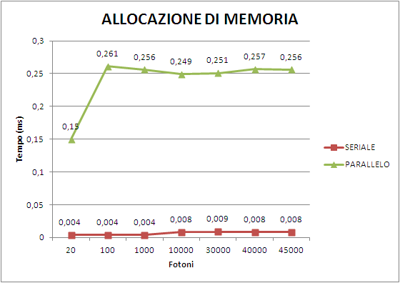
Comparison malloc e cudaMalloc

Slide 18
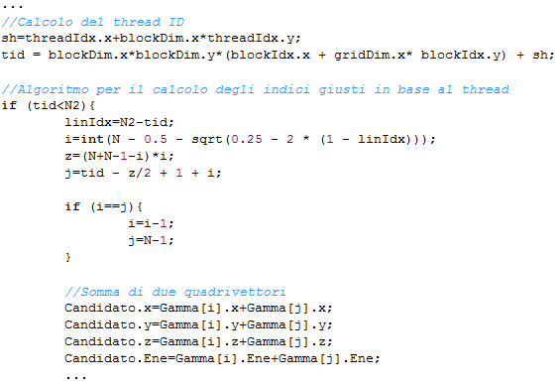
Algorithm for delegate a couple of vector to each Thread

