Slide 1

Scheduling the LHC accelerator installation works: an overview of what was done
Luisella.Lari@cern.ch
Acknowledge to Katy Foraz (LHC Planning section leader)
LNF Seminar – 21st March 2012

Slide 2
Outline
LHC main ring key factors & numbers
The LHC approach to planning and scheduling
The LHC schedule methodology used
Schedule maintenance and Updates
Lesson Learned

Slide 3
Key factors
LHC characteristics
Impact on the project
Time Horizon
  Multi-years
  Multi-phases
Chain of Command
  Multi-layers organization
  Matrix Structure
High‐degree of Specialization
  Subject Matter Expertise
  Cutting-Edge Technology
Dispersed Teams
  Virtual teams in multiple
  locations
  Outsourcing to other countries
Coordination becomes crucial
As well as clear and transparent communication
Responsibilities have to be clear
Risks have to be properly analyzed

Slide 4
Some numbers
Main components of the LHC accelerator
Magnets → About 60 variety of magnets → Main Dipole(14.3 m long). A total of 1232 are installed. → Cost: ~ 0.5 million CHF each.
Power Converters → 1700 different power converters or power supplies.
Cryogenics → LHC cryogenics need 40,000 leak-tight pipe junctions.
Vacuum → In the LHC LSSs 780 ion pumps.
Collimators → 108 Collimators around the ring, of which 97 are precision movable devices.
….

Slide 5
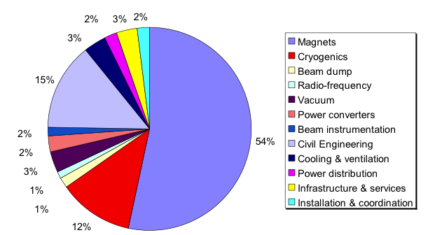
Some numbers
industrial contracts: ~ 2 billion €

Slide 6
The LHC approach
The WORK UNITS
The concept of “deliverables” was introduced.
Each WU contained information about work/hr/logistic.
WU timeframe maximum 3 months.
All WUs were directly supervised by a CERN staff.
The WU responsible was trigged to fill a written report and justify achievements and delays.
The report was sent to the project leader who accepts or rejects it. → Review each month.
The WUs were used to monitoring resources spent (EVM).

Slide 7
The LHC approach
The WORK UNITS
How the WU concept was integrated into
the planning and the monitoring of the
LHC installation works?

Slide 8
LHC schedule requirements
To co-ordinate the project requires an overall view, which can only be achieved by collecting and summarizing detailed information.
Multi level planning
Master Schedule
Design schedule
@ WU level
Manufacturing schedule
Installation schedule
Detailed schedule
Detailed schedule
Detailed schedule
Detailed schedule
8

Slide 9
LHC schedule methodology
1. Master Schedule
Review the strategic goals and major milestones of the project.
Used for communicating progress outside the project team

Slide 10
LHC schedule methodology
2. LHC Construction and installation Schedule (1/4)
From strategic to tactic.
3.3 BCHF
11.000 WU
Aim: implement and control the flow of installation.
Respect the main milestones of the master schedule.
Based on WBS and activities lists.
Linear schedule.
Essential for the project follow up.

Slide 11
LHC schedule methodology
2. LHC Construction and installation Schedule (2/4)
How was the schedule organized?
The multi-phases of LHC:
Civil Engineering phase
General services phase
Cryogenic phase
Machine phase
Hardware Commissioning Phase
Installation
Studies & Integration

Slide 12
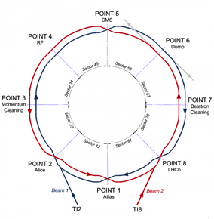
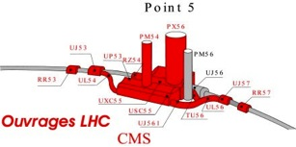
LHC schedule methodology
2. LHC Construction and installation Schedule (3/4)
How was the schedule organized?
Planning type “Chemin de fer”
No margins
For Cryo & Machine phases: pilot sector

Slide 13

2. LHC Construction and installation Schedule (4/4)

Slide 14
LHC schedule methodology
3. Detailed installation schedules (1/3)
Derives from details of the installation and the knowledge of each WU
The aim of these schedules was
to ensure the work to do was feasible within the time slot allocated.
to ensure that the resource to achieve every tasks were available.
Each sub-schedule faced to specific requirements of installation.
The level of details was chosen to maximize the freedom of the technical group to organize and manage their work.

Slide 15
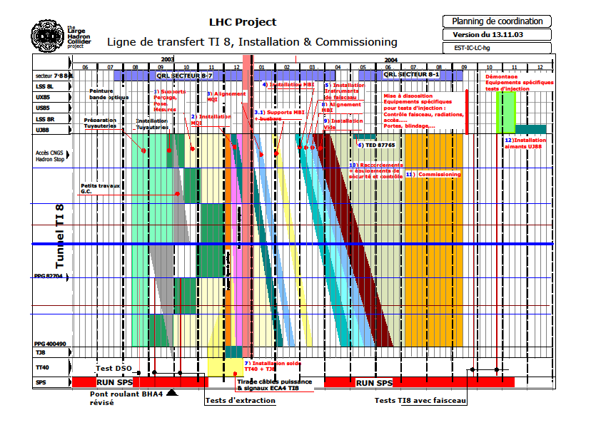
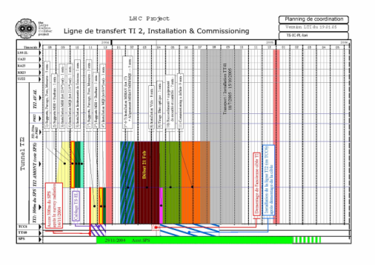
LHC schedule methodology
3. Detailed installation schedules (2/3)
Example 1.
Transfer line installation planning.
Major constraint: assure the test with beam end 2004, before SPS shutdown
Radiation constraint for the proximity to the SPS accelerator
1 year
Notes:
As a second example, I would like to mention the schedule that I have produced for the installation of the Phase I collimators, performing resource allocation studies to assure the work of the vacuum team without interruption for the timeframe required (i.e. about 2 year of installation time). At the time, that was the major constraint since the vacuum team was composed mainly by technicians from an external company.

Slide 16
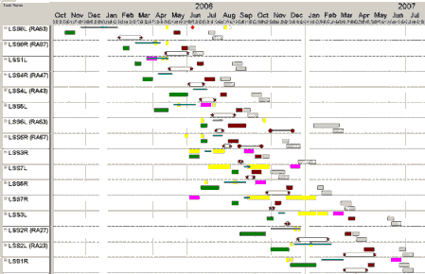
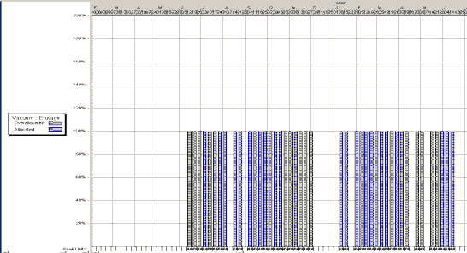
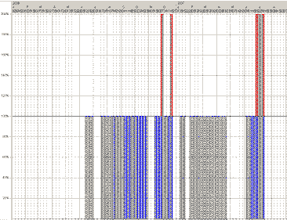
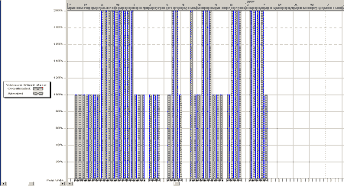
LHC schedule methodology
3. Detailed installation schedules (2/3)
Example 2.
Collimation installation planning.
Major constraint: assure a continuity of work for the external vacuum team
2 years planning
Resource allocation studies
Notes:
As a second example, I would like to mention the schedule that I have produced for the installation of the Phase I collimators, performing resource allocation studies to assure the work of the vacuum team without interruption for the timeframe required (i.e. about 2 year of installation time). At the time, that was the major constraint since the vacuum team was composed mainly by technicians from an external company.

Slide 17
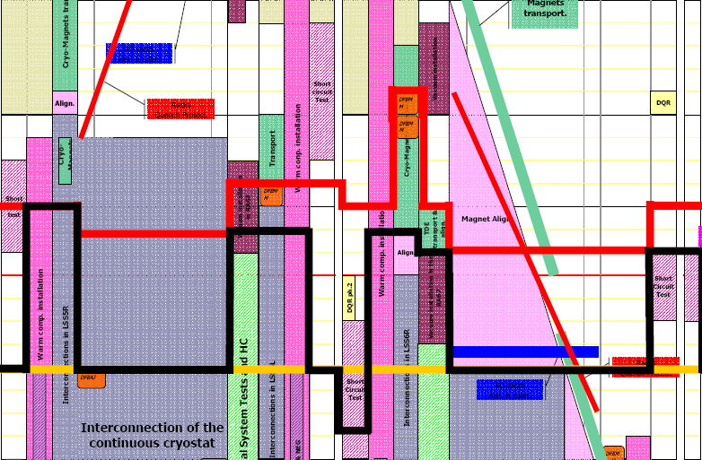
LHC schedule control
1. Determination the current status of the project schedule
  Weekly meetings → to follow the advancement progress of every installation work and to identify potential problems, through feedback from the production sites and from the field. → @ WU level
  Monthly meetings → to have a global review of the installation and to check the homogeneity of the installation procedure on the different work sites. → @ Management level
Schedule comparison bar charts

Slide 18
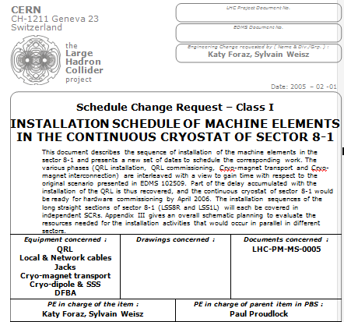
LHC schedule control
2. Evaluation of the factors that create schedule changes (1/3)
  Minor changes → impact limited to a restricted area of the activities → Revision of the Detailed Installation Schedule
  Major changes → impact on the whole project→ Schedule Change Requests circulated through the groups and approved by the project leader → Schedule Change Order

Slide 19
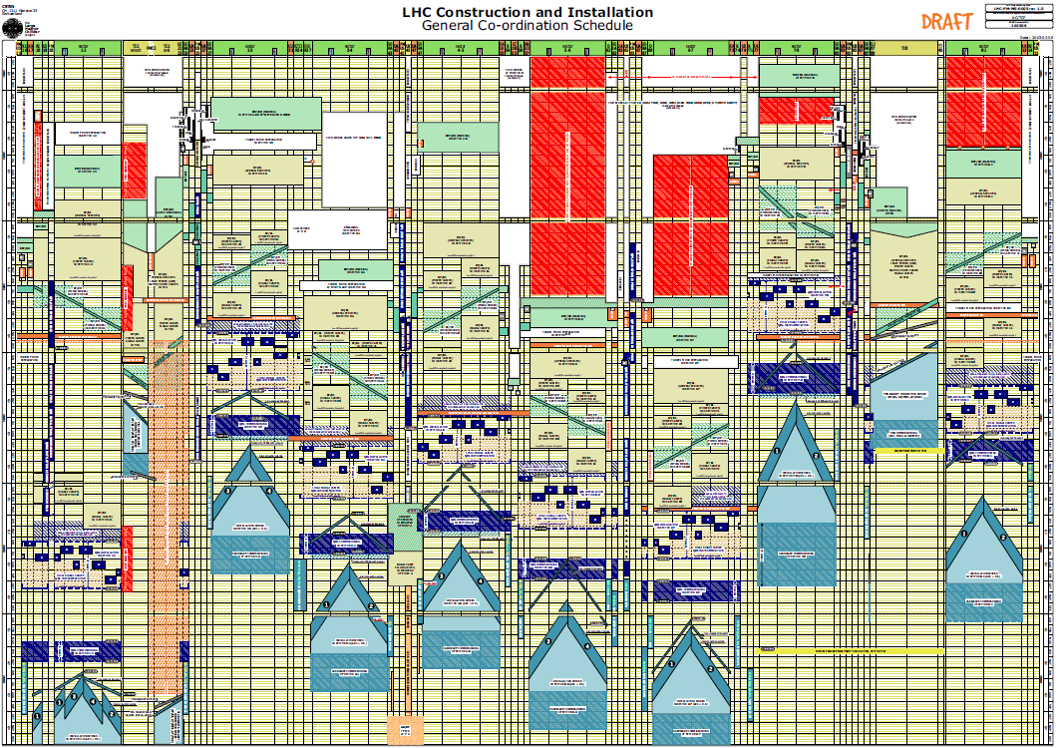
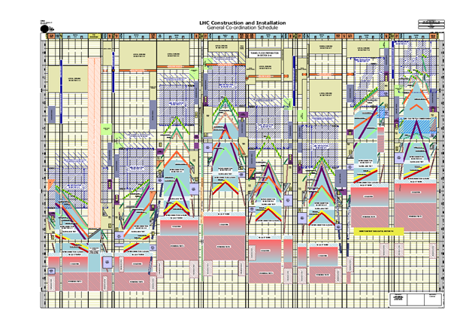
LHC schedule control
2. Evaluation of the factors that create schedule changes (2/3)
Prepared by 4
Planning Officers
end
2006
middle2007
end
2007
Dynamic process
middle
2008
19

Slide 20
LHC schedule control
General Services
Civil engineering
Cryogenic line installation
2. Evaluation of the factors that create schedule changes (2/3)
2002
2003
2004
2005
2006
Machine installation
2007

Slide 21
LHC schedule control
3. LHC Communication system (1/3)
  Aim: assure clear and transparent communication of the current situation & of the tactics changes
  Minutes of the weekly and monthly meetings were archived and available in the LHC Engineering Database Management System (EDMS).
  Progress reports that followed each monthly Installation Follow-Up meeting were prepared by the planning coordinators and published once a month on the WEB home page of the LHC project.
  The General coordination schedule was available on the WEB home page of the LHC project.

Slide 22
LHC schedule control
3. LHC Communication system (2/3)
  Very long lifecycles and need for internal knowledge transfer.
  Master Plan
  Specifications
  Presentations
  Meeting Minute
  Manufactoring data
  Tests & measures results
  Transport data
  Inventory
  Tests & measures results @delivery
  Dismantling regulations
  Procedures
CERN
EDMS
  Planning
  Installation progress
  ECRs with distributed approval process
  Corrective actions
  Maintenance estimation
  Commissioning procedures
  Safety notice

Slide 23
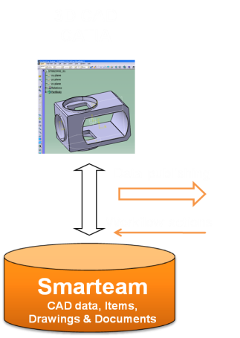
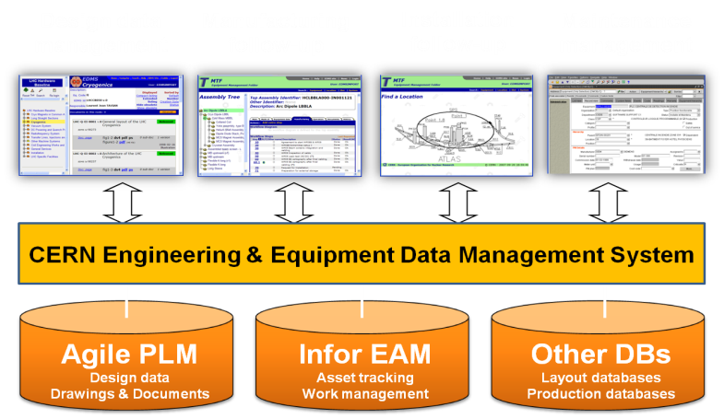
LHC schedule control
3. LHC Communication system (3/3)
  EDMS system also helpful to documenting the quality of the installation works.
  →[Example of some strong constraints: Components are in many cases not accessible
  once installed (like in satellites) and µm tolerances in an installation of several kilometers]
FULL TRACEABILITY

Slide 24
Lesson learned
Did it work?
  Yes! At least we got a realistic and always up-to-date picture of the installation works.
  Objective picture without intermediate management interpreting the status.
  All was WWW published to allow the internal and/or the external collaboration to check it.
  However the late implementation of the EVM system to monitor project performance has limited its expected results.

Slide 25
Lesson learned
How to improve the performances…
  Perform spatial integration studies before starting installation.
  Split the major contract on the critical path between at last 2 concurrent firms.
  Set-up internal “risk” teams in order to react quickly to technical problems.
  Set-up storage areas in key position, in order to easy logistics.
  Allocate contingency time for consolidation of each phase.
  Create individual and independent sub-projects, to improve the flexibility during the installation and commissioning.

Slide 26
References
P.Bonnal, J.DeJonghe “EVM 2.0 Lessons learned from the LHC Project Collaborative EVM System”, EVM World’09, 2009, Naples, Florida, USA.
K.Foraz et al. “Schedule evolution during the life-time of the LHC project”, EPAC06, 2006, Edinburgh, UK.
P.Bonnal, J.DeJonghe, J.Ferguson “A deliverable-oriented EVM system suited to a large-scale project” Project Manage. J. 37(1), 2006, pp. 67–80.
P.Bonnal, D.Gourc, A.P.Hameri, G.Lacoste, “A linear-discrete scheduling model for the resource-constrained project scheduling problem.” Constr. Manage. & Economics 23(8), 2005, pp. 797–814.
K.Foraz, H.Gaillard, L.Lari, S.Weisz “Scheduling the installation of the Large Hadron Collider”, EPAC04, 2004, Lucerne, Switzerland.
L.Lari et al. “Scheduling the installation of the LHC injection lines”, EPAC04, 2004, Lucerne, Switzerland
C.Hauviller, S.Weisz “Installation of a particle accelerator: from the theory to practice”, EPAC04, 2004, Lucerne, Switzerland.
P.Bonnal, J.DeJonghe “The use of a linear scheduling approach for optimizing the installation of the LHC.” at 3rd Project Science Workshop, 2003, Aspen, CO, USA.
P.Bonnal, M.Vitasse “Organization of the installation work of LHC and its experiments”, CERN LHC Project Document LHC-PM-MS-0005, 2003, Geneva, Switzerland.
R.Saban “L’installation du LHC – La coordination sur le terrain” CERN LHC Project Document LHC-PM-IP-003, 2003 Geneva, Switzerland.
P.Bonnal, O.Lindholm, “Logistic simulation of the transportation of cryo-magnets for the LHC Project”. LHC Project Note no. 298, 2002 CERN, Geneva, Switzerland.

Slide 27
Thanks for your attention!
Luisella.Lari@cern.ch
LNF Seminar – 21st March 2012

