Slide 1
Measurement of the γ,W,Z with ATLAS
Alexander Milov
for the ATLAS Collaboration

Slide 2
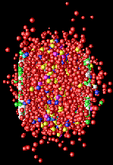
The goal
~true p_{T}
true p_{T}
e,μ⁺
true p_{T}
?
e,μ–
?
?
Step 1: binary scaling

Slide 3
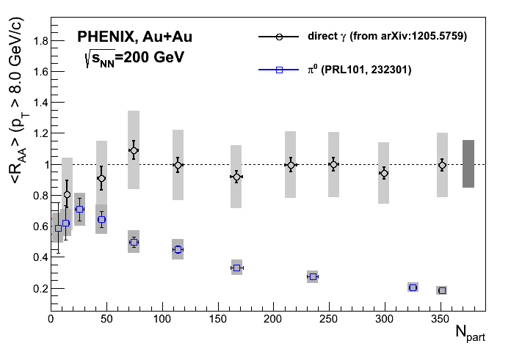
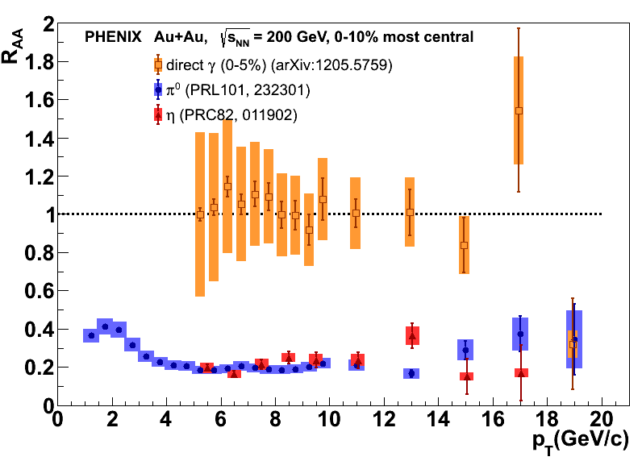
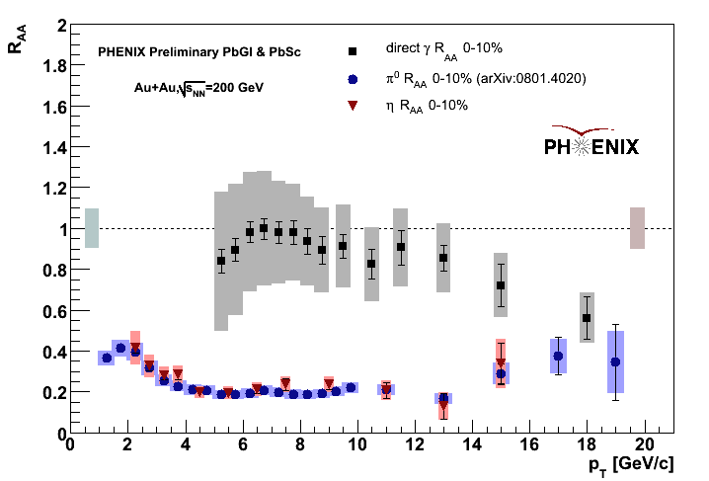
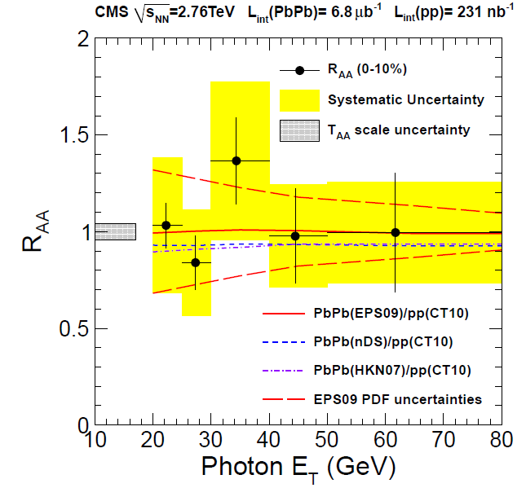
Photons in HI.
arXiv:0397962 [nucl-ex]
No suppression of photons in HI collisions at LHC and at RHIC

Slide 4
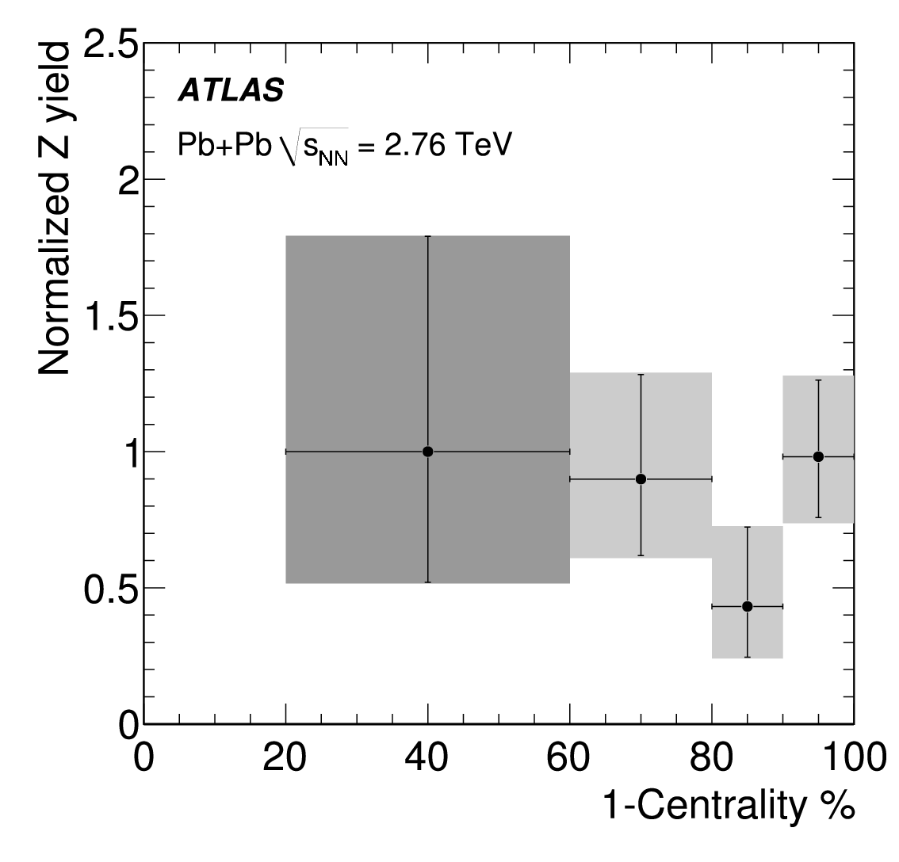
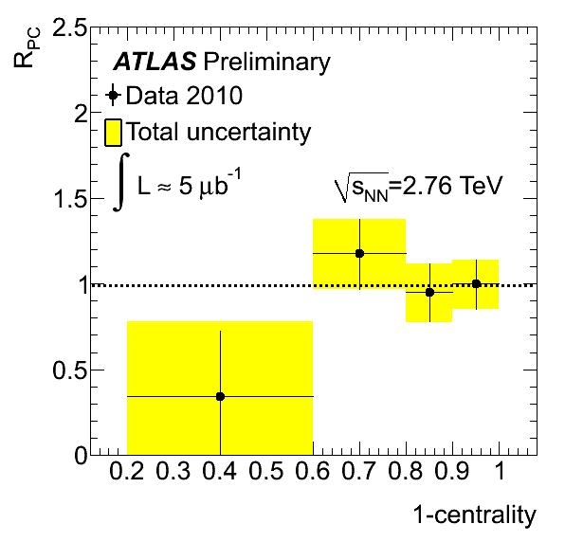
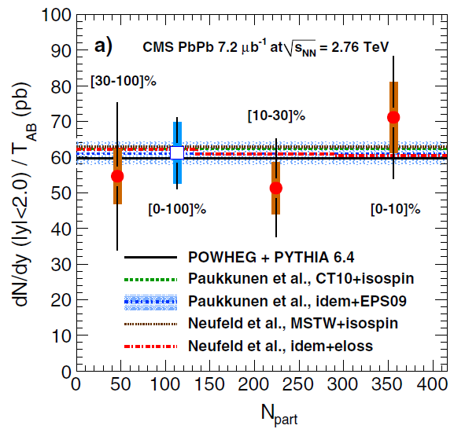
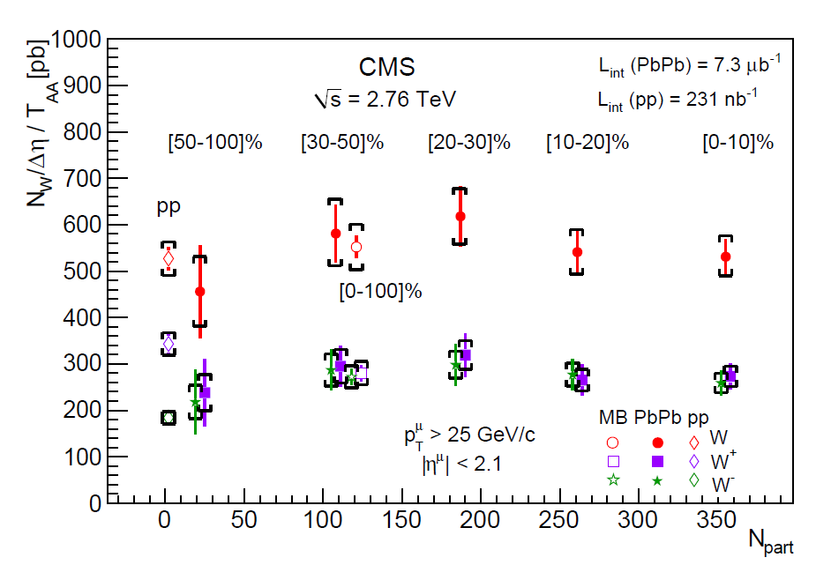
Bosons in HI
PLB697 (2011) 294-312
ATLAS-CONF-2011-078
PRL106, 212301 (2011)
nucl-ex:1205.6334v1 29 May 2012

Slide 5
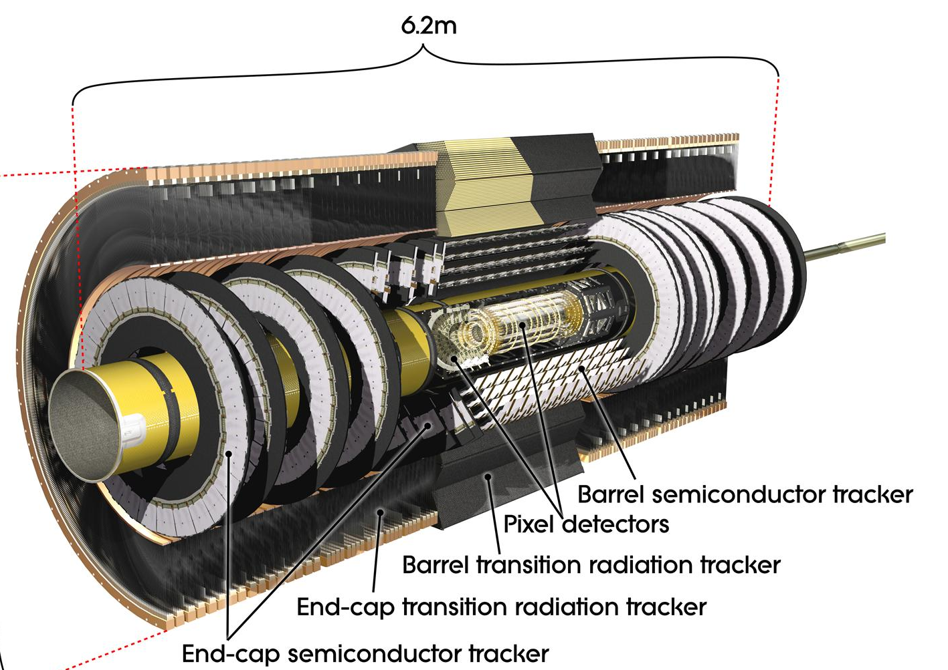
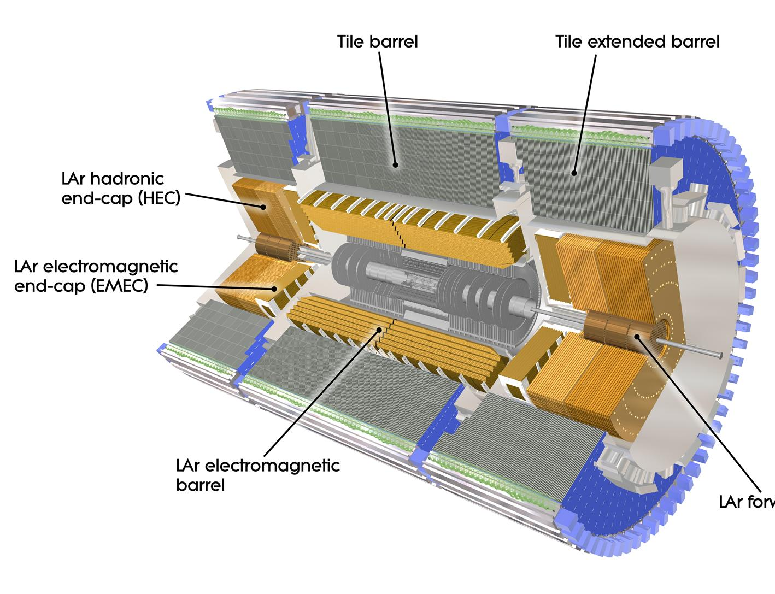
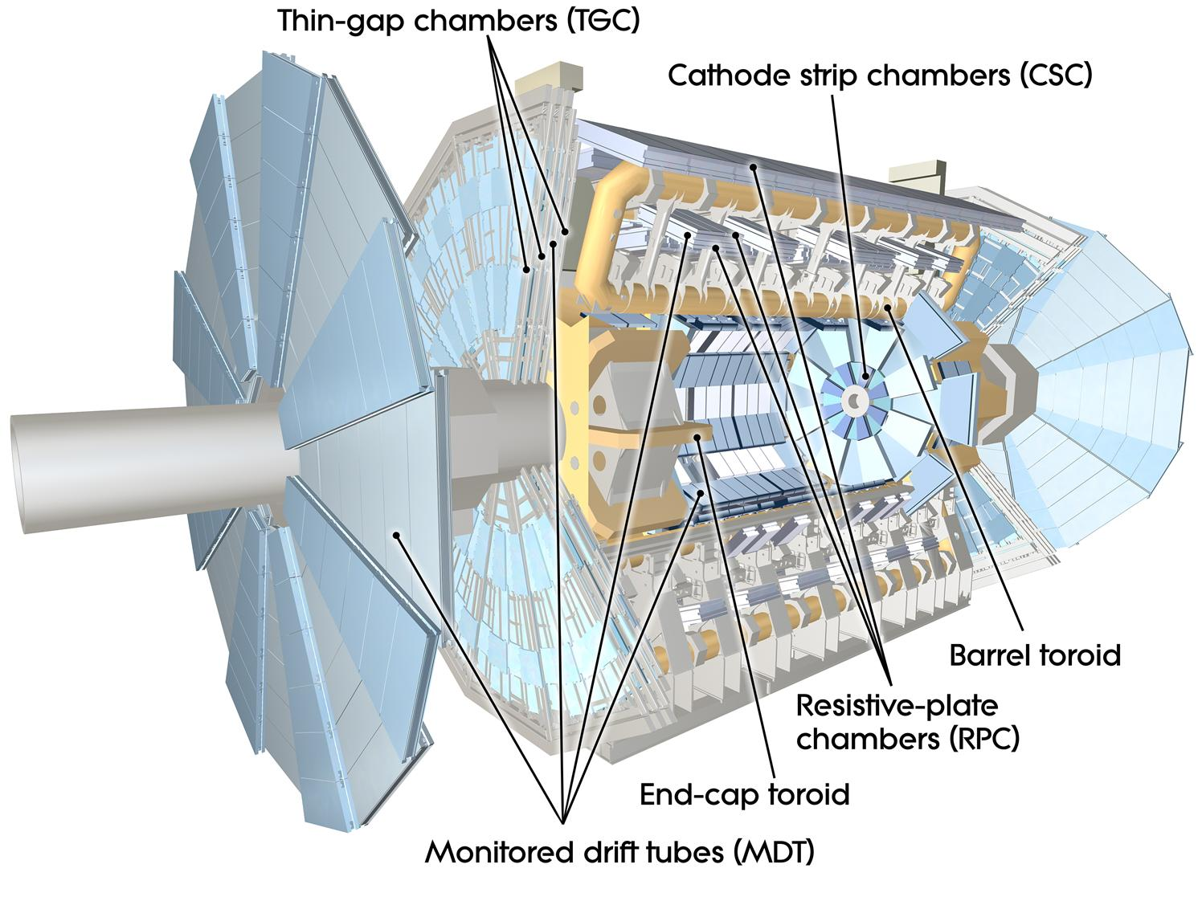
The ATLAS detector
EM calorimeter (LAr)
|η|<3.2, 3 layers + presampler, 22X₀
e/γ trigger, identification;
Granularity: 0.025x0.025 180x10³ chan.
Muon spectrometer (MS)
|η|<2.7
Shielded by Calorimeter
Tracking in torroidal B field
Inner Detectors (ID)
|η|<2.5 B (axial) =2T
Pixels (Si): σ = 10 μm [rφ]
80M channels; 3 layers and 3 disks;
SCT (106 Si strips ): σ = 17 μm [rφ]
4 double layers, 9 disks

Slide 6
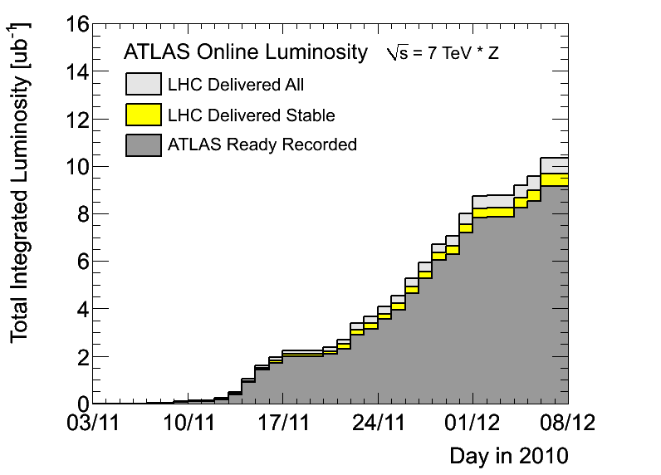
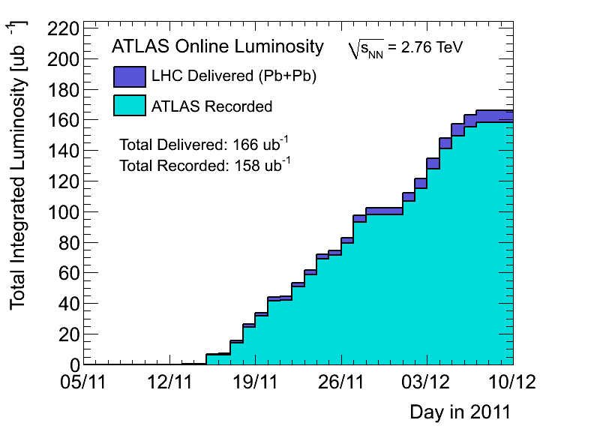
Data samples.
2010
2011
Run: | 2010 | 2011
L_{int} | 8ub⁻¹ | 0.15nb⁻¹
Triggers | Min Bias | γ(e), μ, jets, Min Bias, UPC
N_{events} (0-80)% | 30-40M | 750-800M

Slide 7
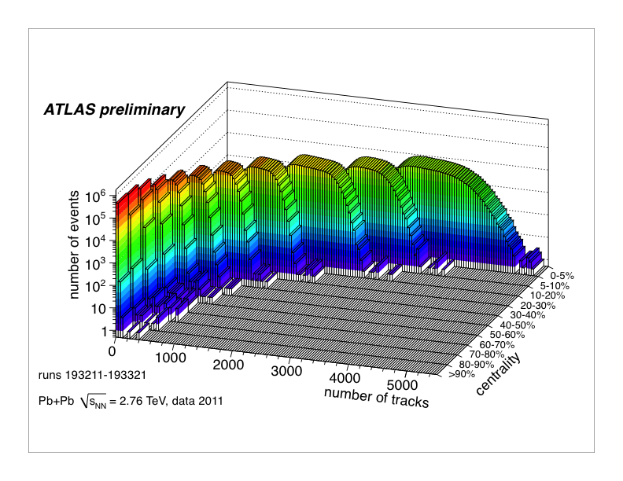
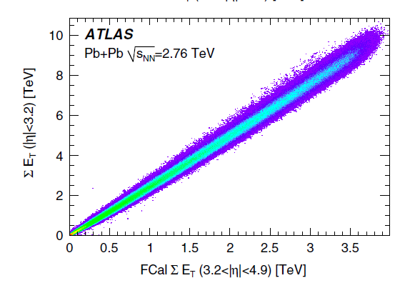
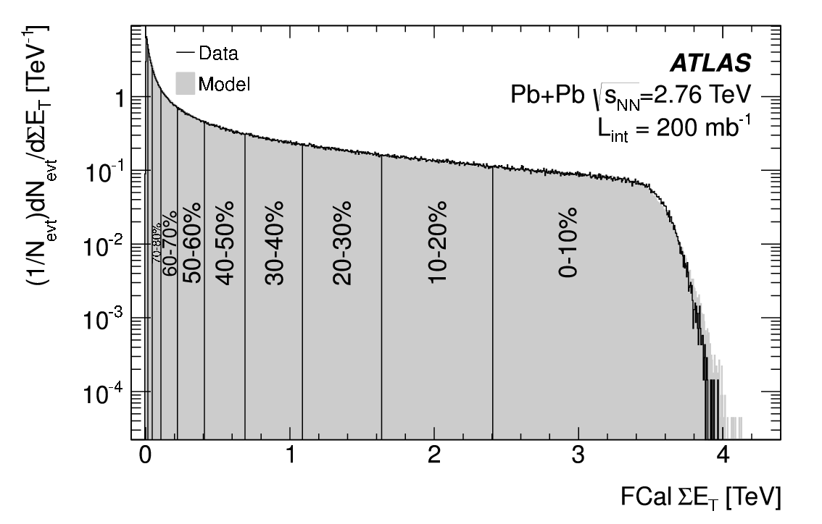
Centrality
log Z
 | <N_{part}> | <N_{coll}>
0-5% | 382±0.7% | 1683±8%
5-10% | 330±1% | 1318±8%
10-20% | 261±1.5% | 923±7%
20-40% | 158±2.5% | 441±7%
40-80% | 46±6% | 78±9%
MB fraction 98 ± 2%

Slide 8
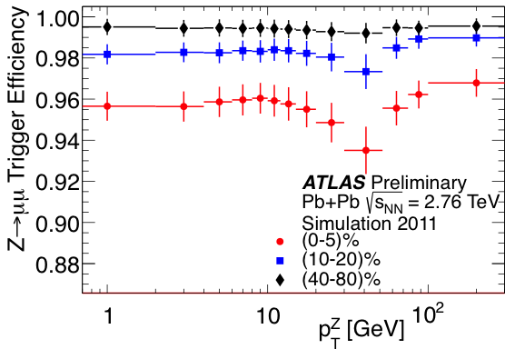
Triggers in Run 2011
Photon (e) triggers are based on LAr
For E_{T}>20 GeV, efficiency = 98.1 ± 0.1%
Pair efficiency:
99.9 ± 0.1%
Muon triggers is a combination:
L1 trigger with p_{T}>4 GeV
HLT trigger with p_{T}>10GeV
95-99% weak centrality dependence
>90%
MB triggers: (LAr E_{T}>50GeV) OR (ZDC & track)

Slide 9
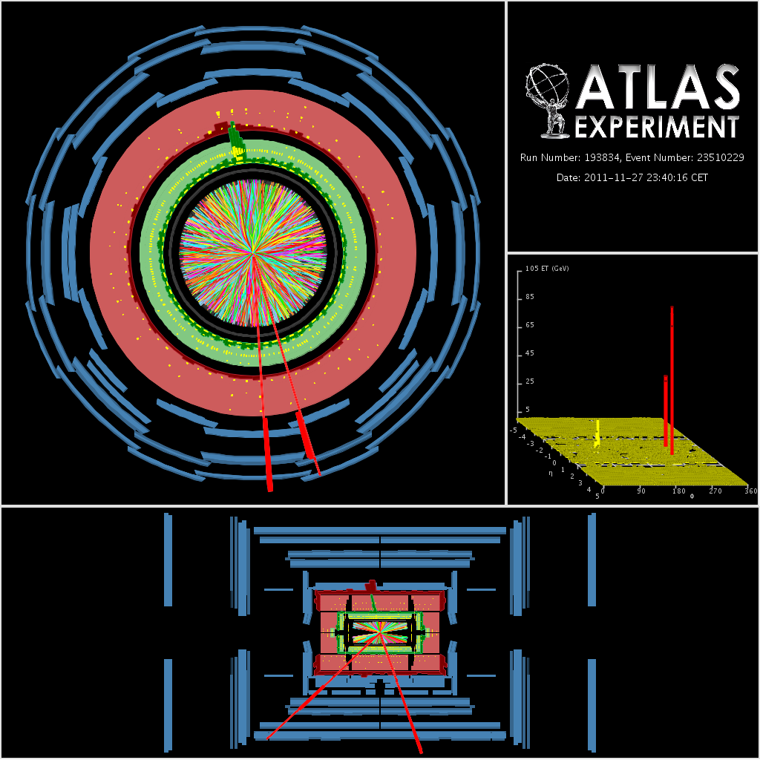
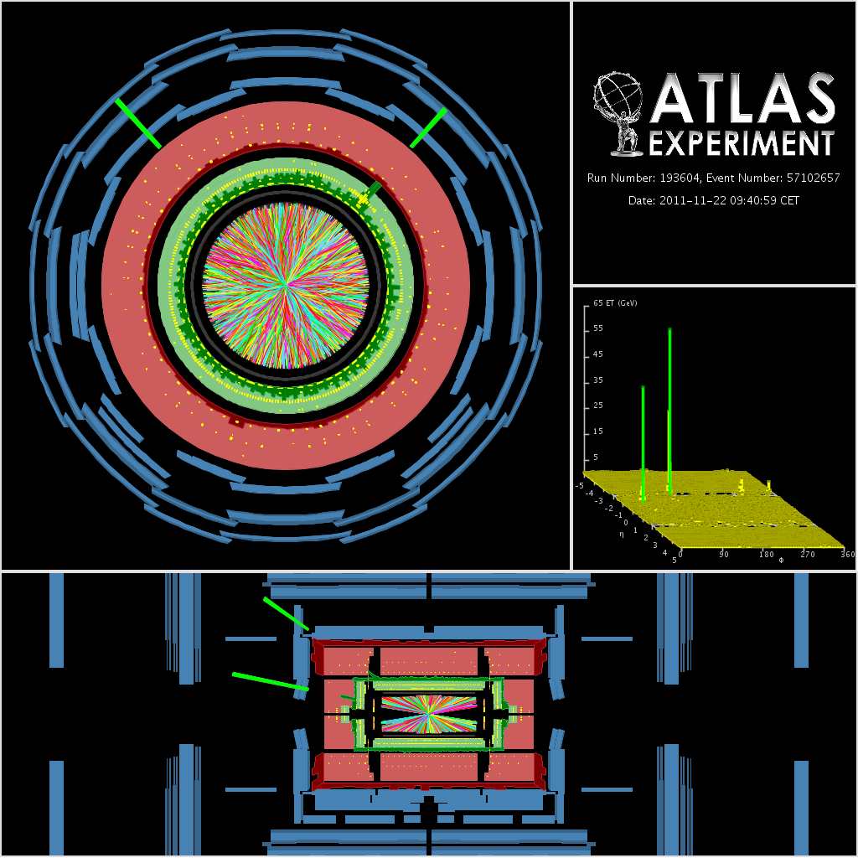
ATLAS events
FCal E_{T} = 2.63 TeV (5-10)%
m_{ee} = 78.1 GeV, p_{T}^{Z} = 81 GeV, y^{Z} = -1.9
p_{T}^{jet} = 58 GeV.
FCal E_{T} = 1.52 TeV (20-30)%
m_{μμ} = 87.5 GeV
p_{T}^{Z} = 147 GeV, y^{Z} = -0.1
p_{T}^{jet} = 142 GeV

Slide 10
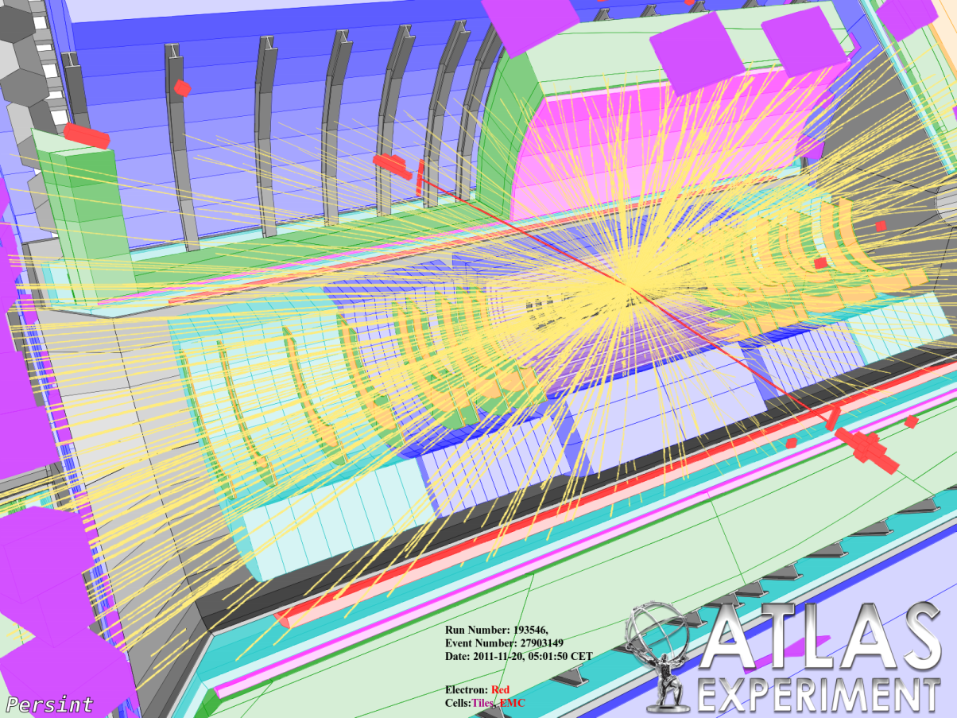
ATLAS events
FCal E_{T} = 2.16 TeV (10-20)%
m_{μμ} = 102 GeV, p_{T}^{Z} = 5.0 GeV
y^{Z} = -0.1
FCal E_{T} = 1.58 TeV (10-20)%
m_{ee} = 92.2 GeV, p_{T}^{Z} = 4.8 GeV
y^{Z} = -0.2.

Slide 11
Candidate selections:
 | Single | Pair (Z)
e,γ | E_{T} > 45 GeV |η| < 1.3 Trigger match Electron rejection | E_{T} > 20 GeV |η| < 2.5 Trigger match on one e 66 < m_{ee} < 102 GeV
 | Isolation cuts tuned to HI Underlying event subtraction from each cluster
μ | High quality μ p_{T} > 7 GeV Veto on pair m_{μμ} > 66 GeV |η| < 2.7 | High quality trigger μ if 2nd μ is high quality p_{T} > 10 GeV on both if 2nd μ is lower quality p_{T} > 20 GeV on both 66 < m_{μμ} < 102 GeV |η| < 2.7

Slide 12
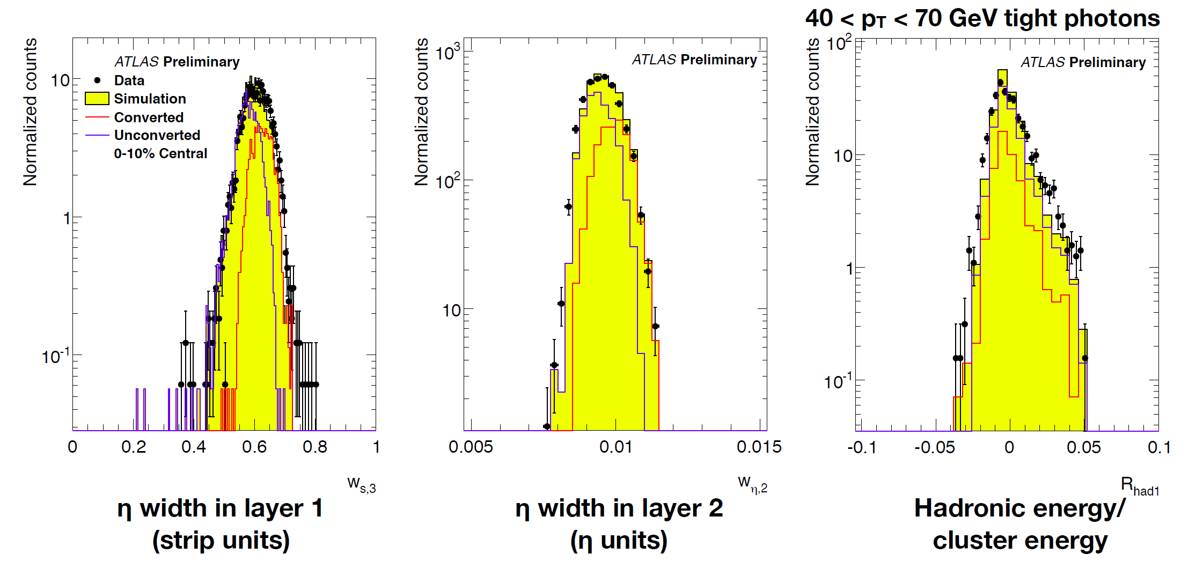
Photon reconstruction
Photon shower shape MC is in good agreement between data
Small average shifts are applied to MC
Talk by P. Steinberg May, 29 ATLAS-CONF-2012-051

Slide 13
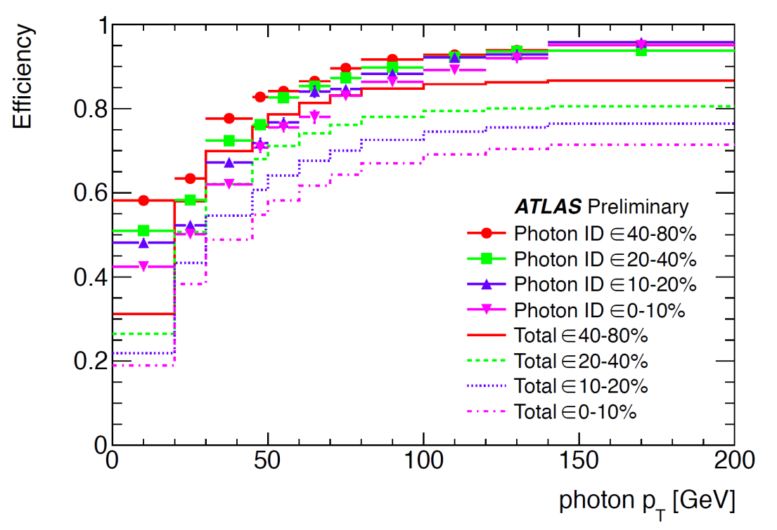
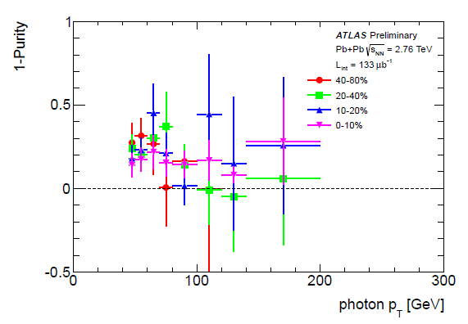
Efficiency for photons
Isolation cuts
Double sideband subtraction to eliminate jet contribution
Efficiency & Purity corrections

Slide 14
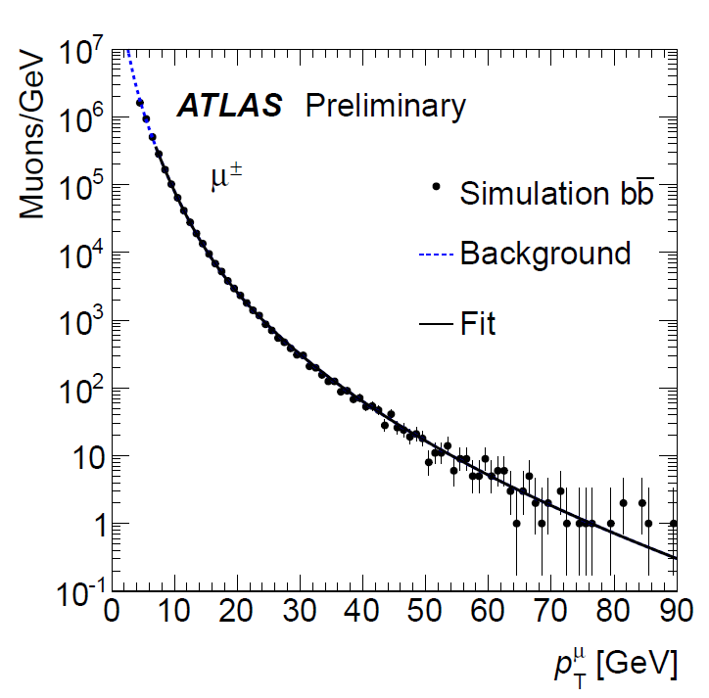
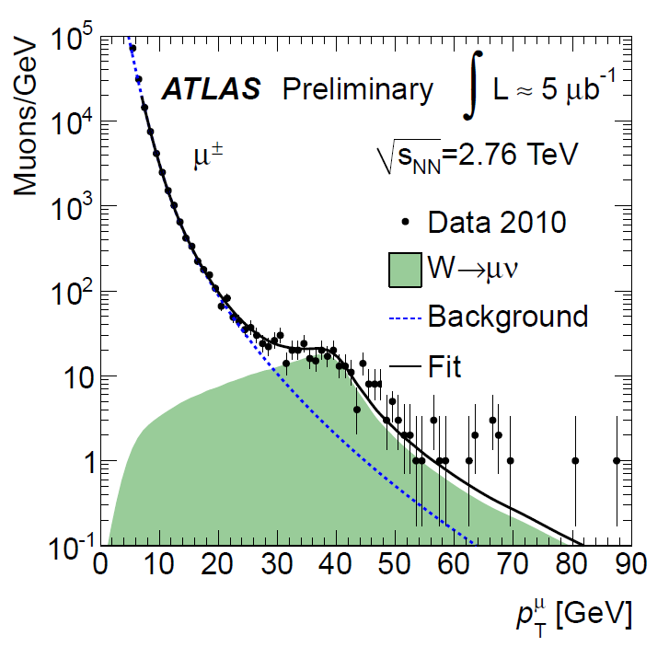
Extraction of W yields
ATLAS-CONF-2011-074

Slide 15
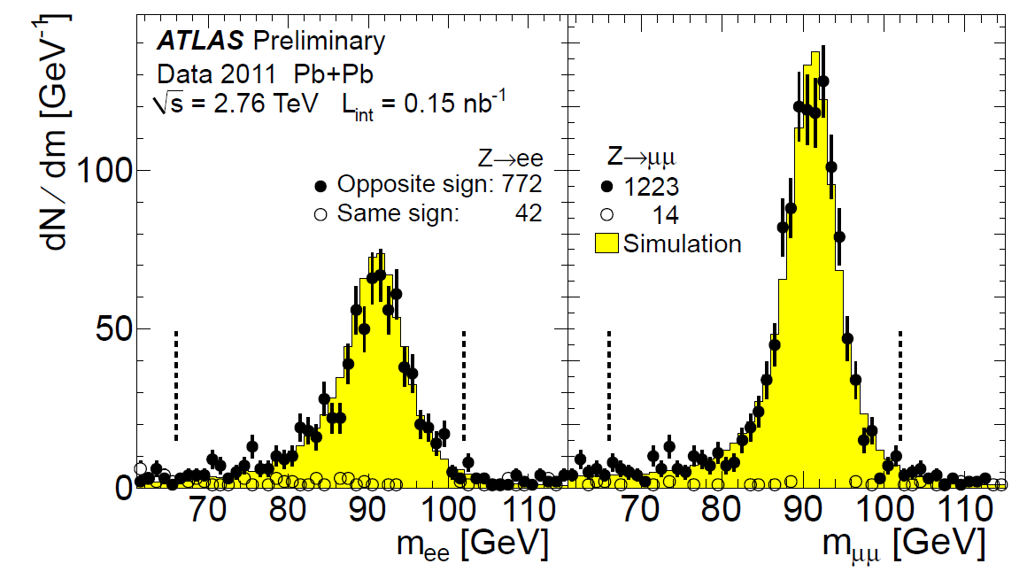
Z-mass distributions:
Talk by Z. Citron May, 29 ATLAS-CONF-2012-052

Slide 16
Z efficiency
Use PYTHIA Z → ll embedded into HIJING to calculate corrections:
momentum, rapidity, centrality
Bin-by-bin unfolding
Reconstruction efficiency (including minimum p_{T}^{lepton}, and mass)
Lepton identification cuts efficiency
Correct up to mass window 66-116 GeV

Slide 17
Uncertainties
 | γ | Z→ee | Z→μμ
MC-Data agreement | 20% | 2.5% | 7-20%
MC shape |  | 1-8% | 3-12%
Energy Scale / Resolution | 12% | 2.5% | 2.5%
Isolation / Background | 20%
Trigger |  |  | <1%

Slide 18
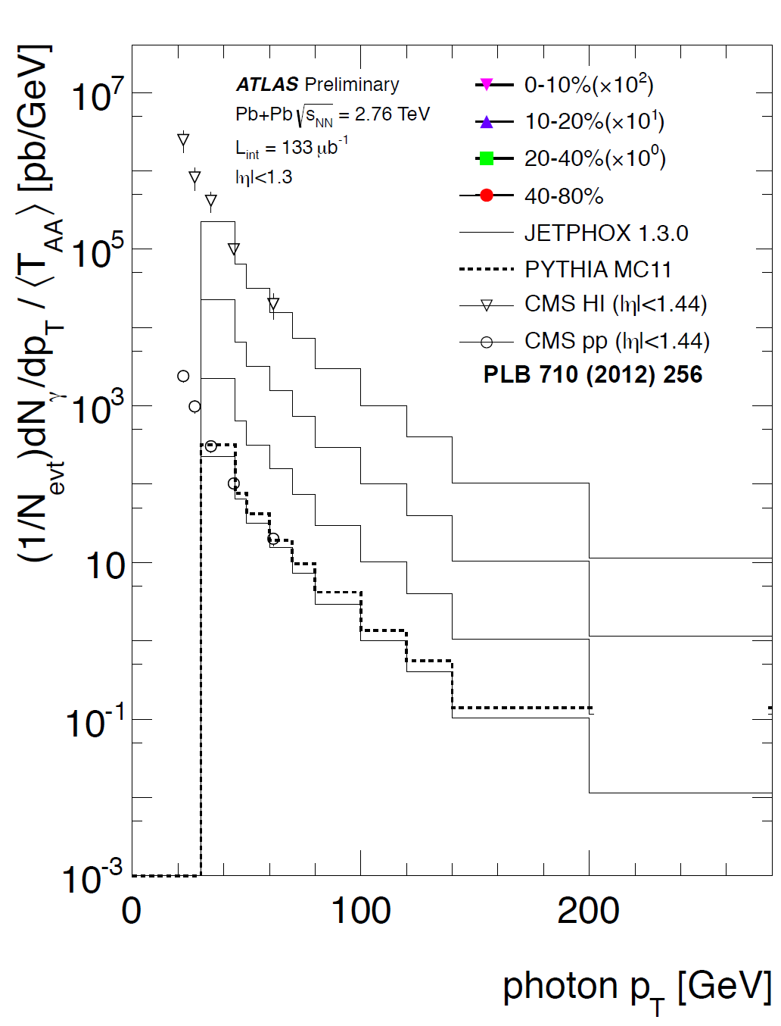
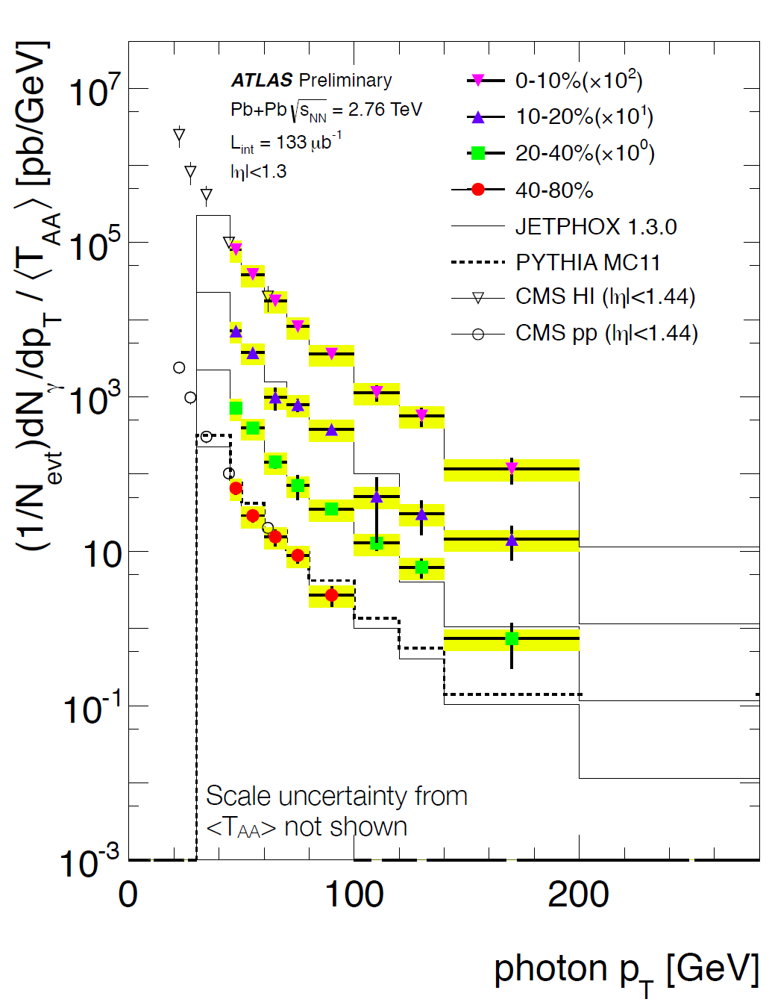
Corrected distributions
Reference: JETPHOX 1.3 E_{T}(R=0.3)<0.6 GeV

Slide 19
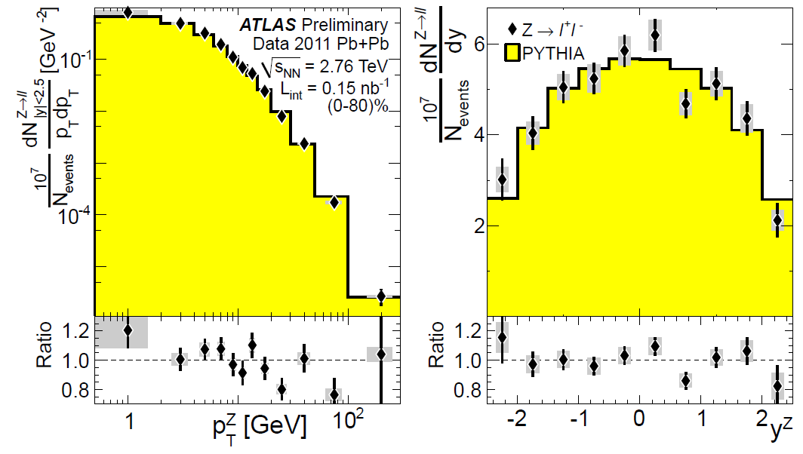
Corrected distributions
PYTHIA normalized by area for shape comparison

Slide 20
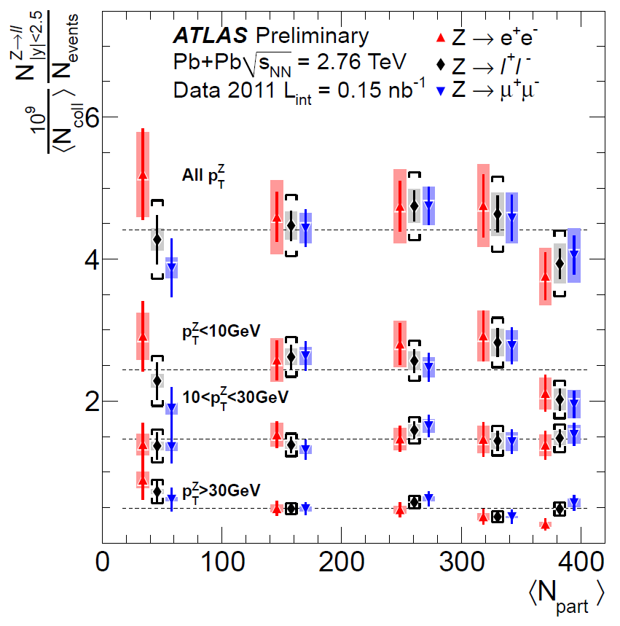
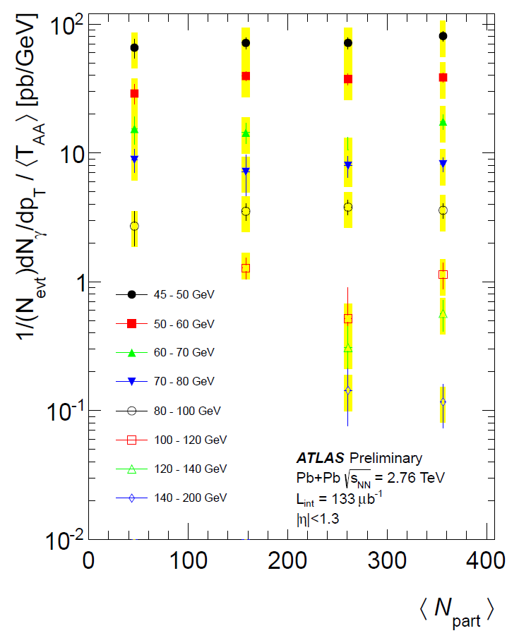
Binary scaling
High statistics measurement of Z and photons by ATLAS
Is consistent with the binary scaling

Slide 21
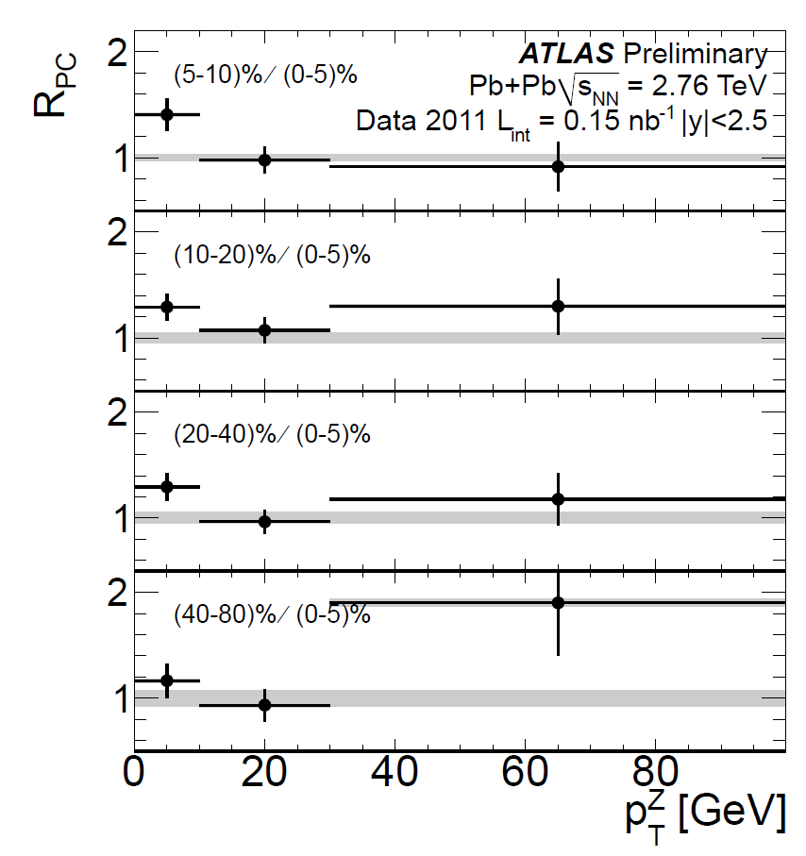
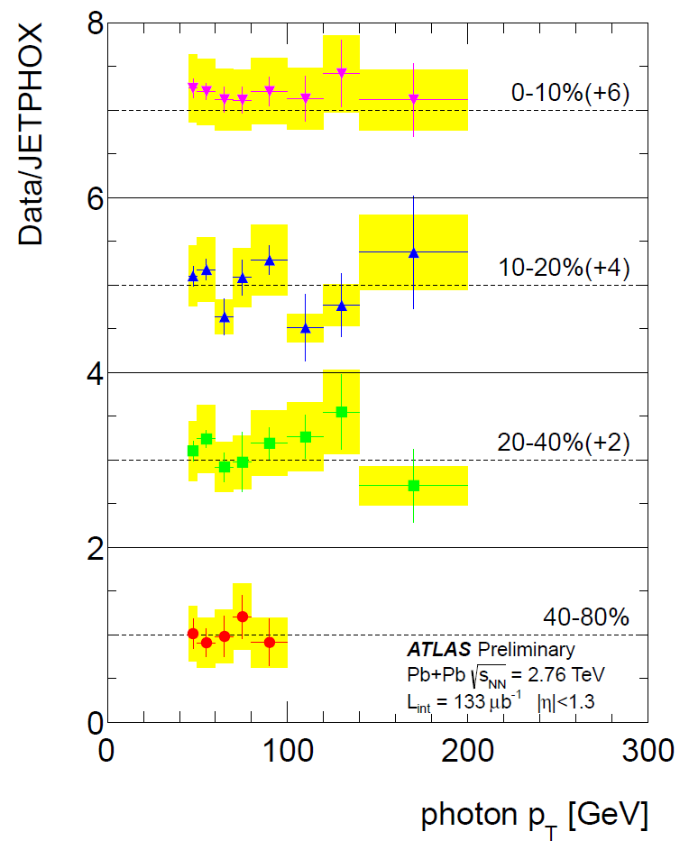
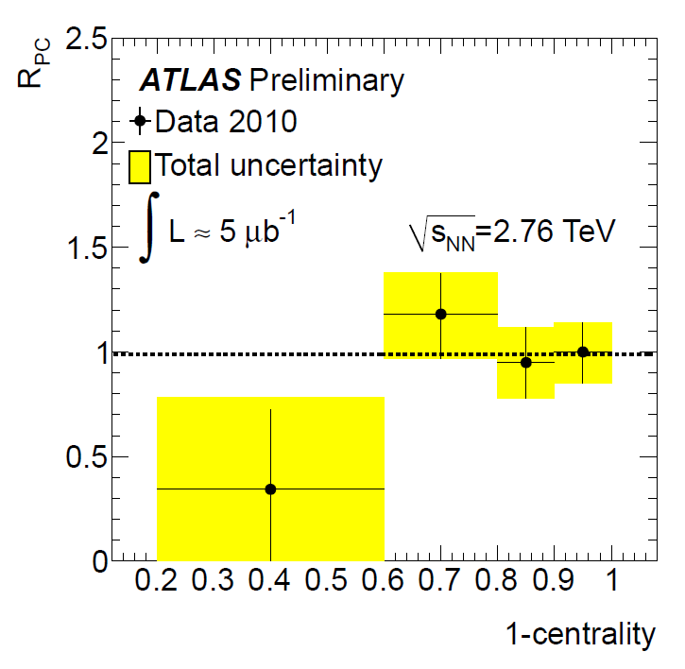
Nuclear modification factor
Consistent with unity for all measured points

Slide 22
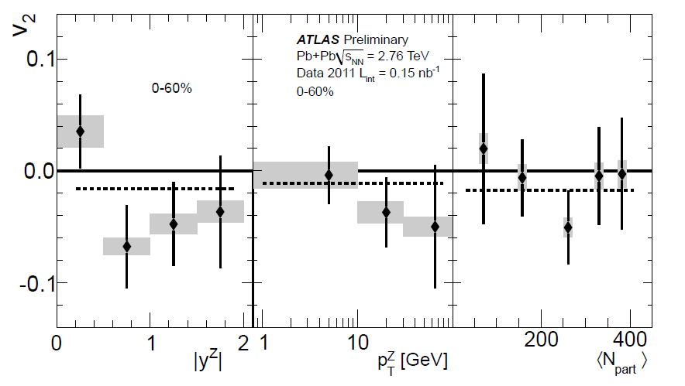
Binary scaling → zero flow
v₂ = −0.011 ± 0.018(stat.) ± 0.014(sys.)

Slide 23
In summary
ATLAS measured Z, W and photons using 2010 and 2011 data
The shape of the p_{T} distribution for photons and Z are consistent with the JETPHOX and PYTHIA generators.
For Z the rapidity distribution is also consistent with PYTHIA.
The total yields integrated in the |y| < 2.5 for Z and |η| <1.3 are consistent with the binary scaling.
The Nuclear modification factor (RPC) for Z and generator normalized for photons agree with unity as a function of pT
Z elliptic flow is consistent with zero.

Slide 24
Backups

Slide 25
Not a final version

Slide 26
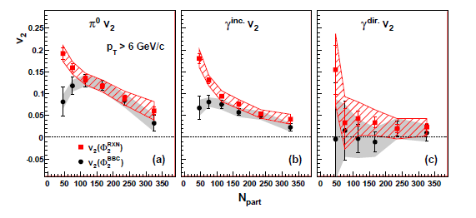
Photon flow
(PHENIX) arXiv:1105.4126 [nucl-ex]

Slide 27
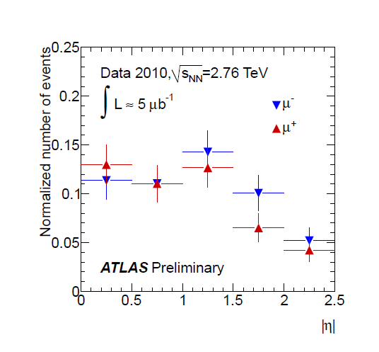
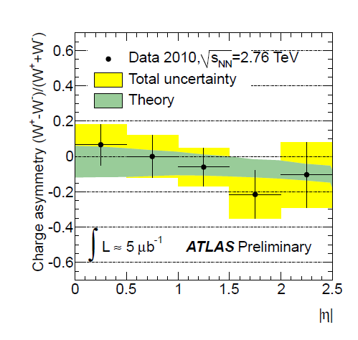
Asymmetry result

Slide 28
Candidate selection:

Slide 29
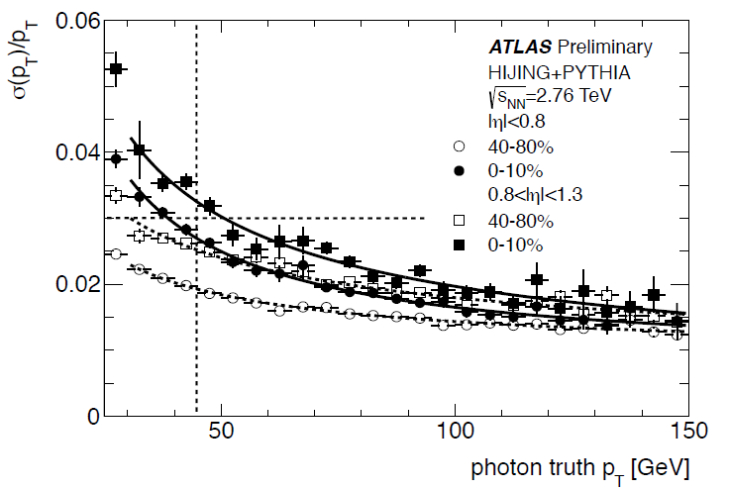
Photon reconstruction
σ(E_{T})/E_{T} = a ⊕ b/√E_{T} ⊕ c/E_{T}
Talk by P. Steinberg May, 29 ATLAS-CONF-2012-051

