Slide 1
Weakness or Strength in the Golden Years of RHIC and LHC?
W. A. Horowitz
University of Cape Town
May 28, 2012
With many thanks to Razieh Morad,
Miklos Gyulassy, and Yuri Kovchegov

Slide 2
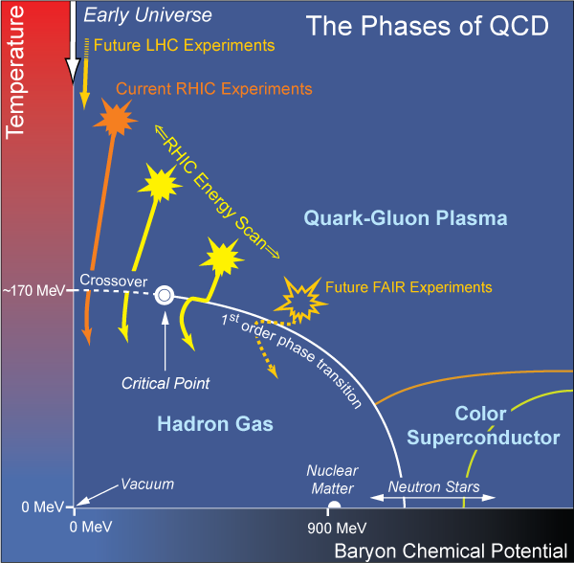
What Are We Interested In?
Measure many-body physics of strong force
Test & understand theory of many-body non-Abelian fields
Long Range Plan, 2008
Notes:
Unique as compared to strongly coupled Abelian problems

Slide 3
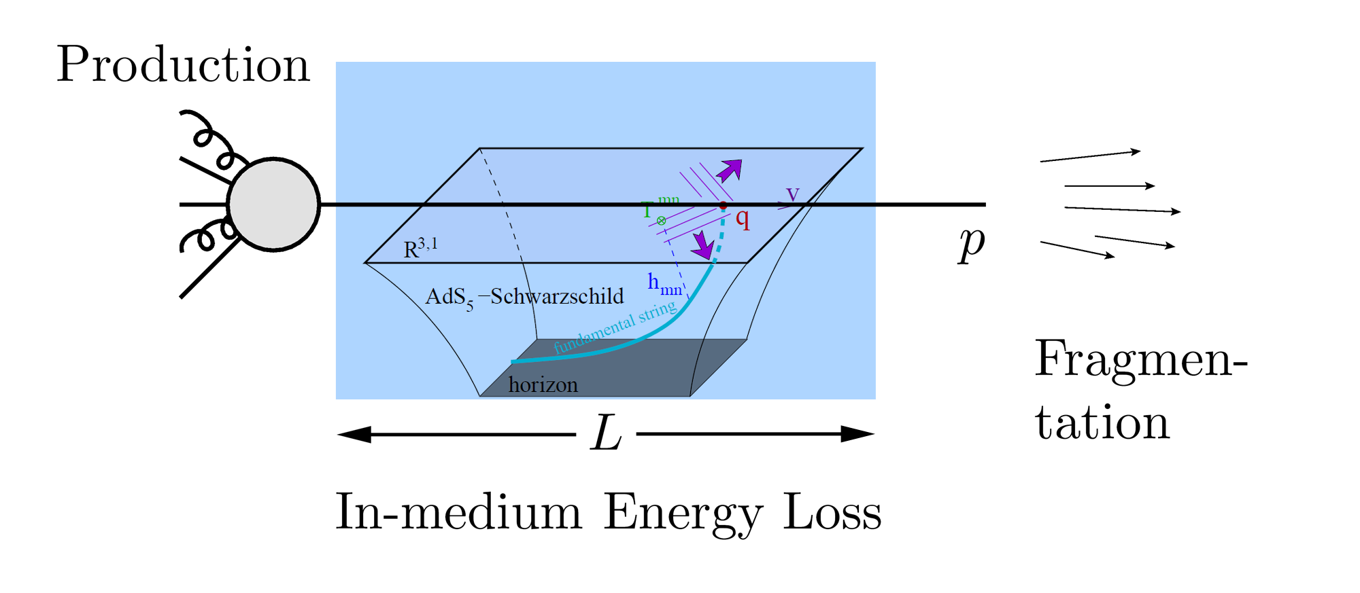
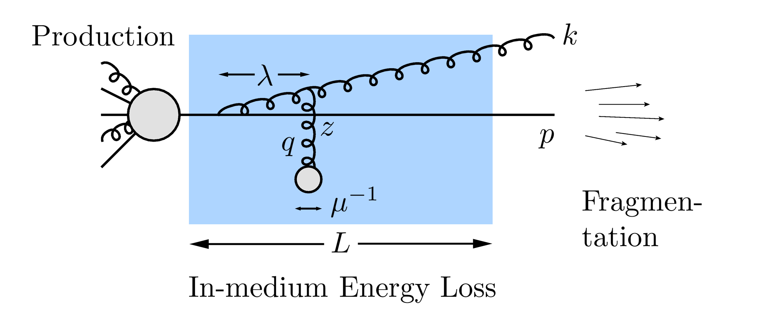
QGP Energy Loss
Learn about E-loss mechanism
Most direct probe of DOF
pQCD Picture
AdS/CFT Picture

Slide 4
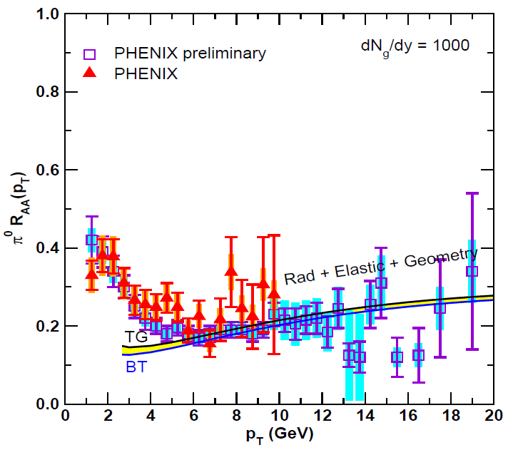
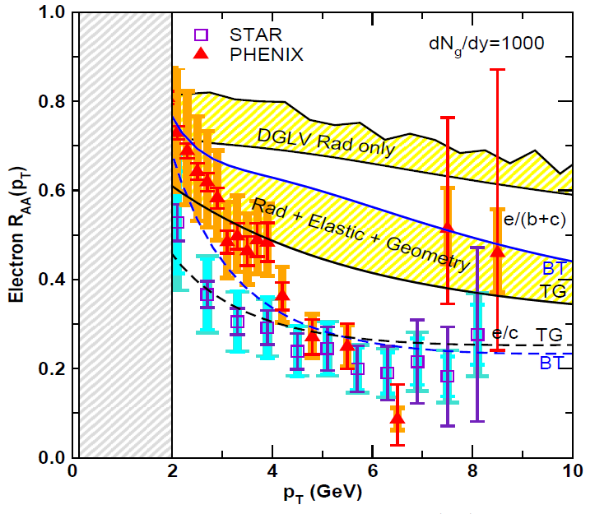
Lesson from RHIC
Extremely difficult to construct a theoretical model that consistently describes all observables
A simultaneous description of gluon/light quark AND heavy quark suppression places stringent constraint on possible E-loss mechanism
Wicks, WAH, Djordjevic, Gyulassy, NPA784 (2007)

Slide 5
Hot Nuclear Matter: pQCD

Slide 6
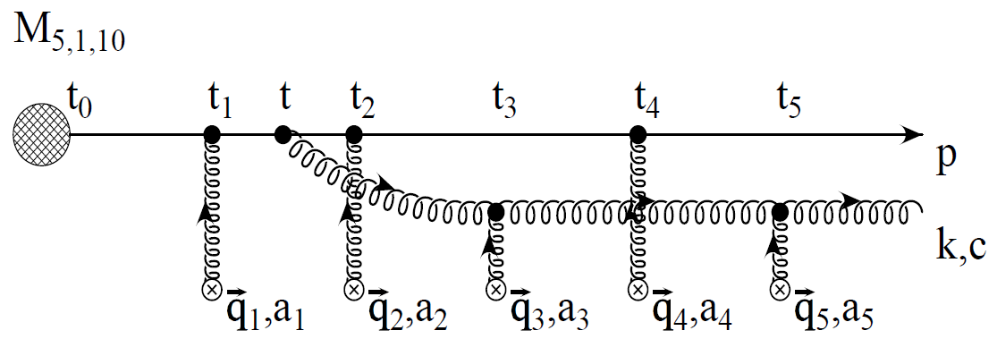
pQCD Rad Picture
Bremsstrahlung Radiation
Weakly-coupled plasma
Medium organizes into Debye-screened centers
T ~ 350 (450) MeV, g ~ 1.9 (1.8)
μ ~ gT ~ 0.7 (0.8) GeV
λ_{mfp} ~ 1/g²T ~ 0.8 (0.7) fm
R_{Au,Pb} ~ 6 fm
1/μ << λ_{mfp} << L
multiple coherent emission
Gyulassy, Levai, and Vitev, NPB571 (2000)
LPM
dp_{T}/dt ~ -LT³ log(p_{T}/M_{q})
Bethe-Heitler
dp_{T}/dt ~ -(T³/M_{q}²) p_{T}

Slide 7
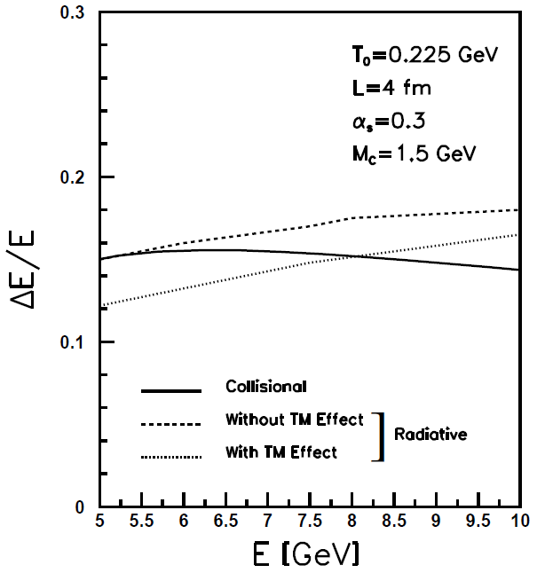
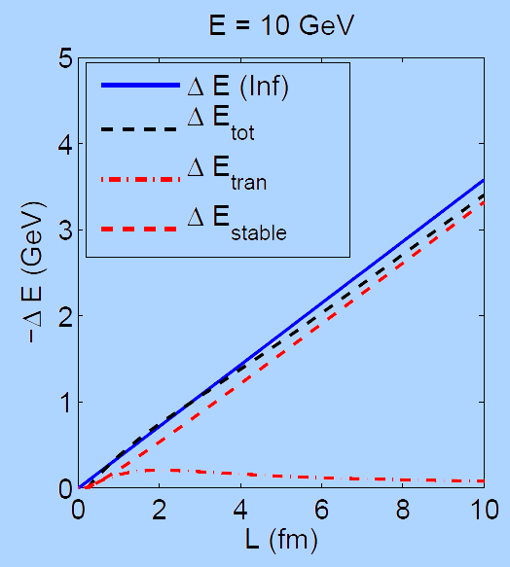
What About Elastic Loss?
Appreciable!
Finite time effects small
Mustafa, PRC72 (2005)
Adil, Gyulassy, WAH,
Wicks, PRC75 (2007)
For pQCD comparisons with data, use WHDG Rad+El+Geom model; formalism valid for g/lq & hq

Slide 8
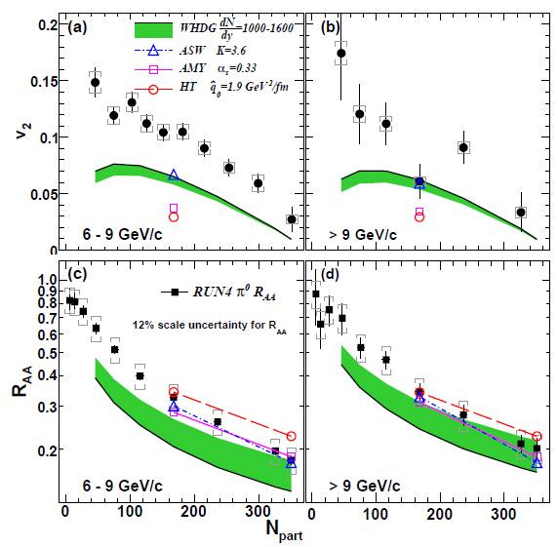
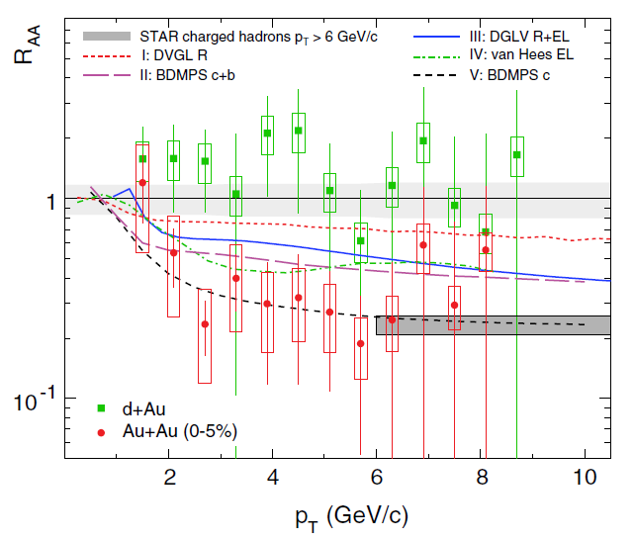
pQCD Not Quantitative at RHIC
Lack of simultaneous description of multiple observables
even with inclusion of elastic loss
PHENIX, PRL 105 (2010)
STAR, PRL106 (2011)
See also J Jia from QM09,
J Nagle QM09
LHC energies?

Slide 9
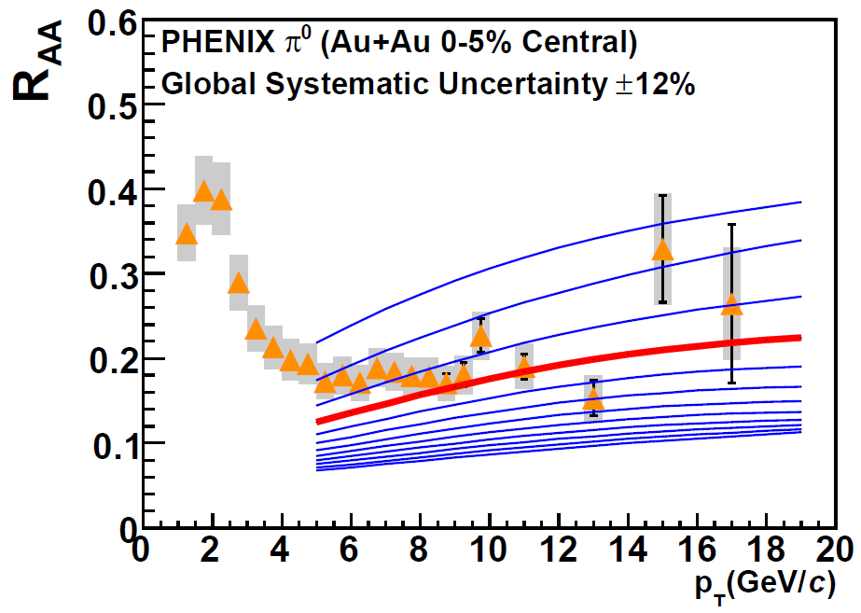
Constrain to RHIC
Best fit WHDG to PHENIX π⁰ R_{AA}
dN_{g}/dy = 1400⁺²⁰⁰
1400₋₃₇₅
PHENIX, PRC77 (2008)
Extremely conservative zero parameter extrapolation to LHC
Assume ρ_{medium} ~ dN_{ch}/dη
Keep α_{s} = 0.3 fixed

Slide 10
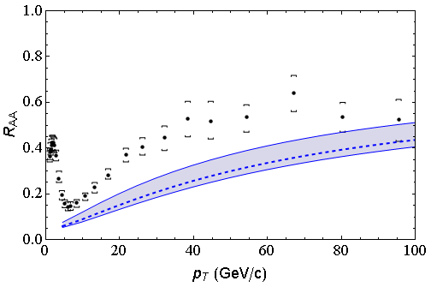
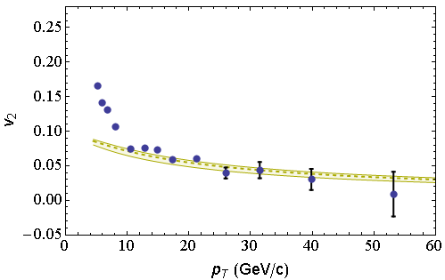
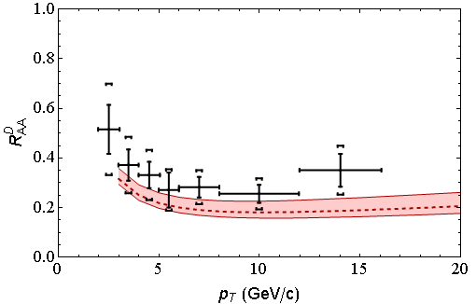
LHC Predictions vs. Data
CMS 0-5%
h±
CMS 40-50%
h±
CMS, arXiv:1202.2554
CMS, arXiv:1204.1850
ALICE 0-20%
D
All data preliminary
√s = 2.76 ATeV
ALICE, arXiv:1203.2160

Slide 11
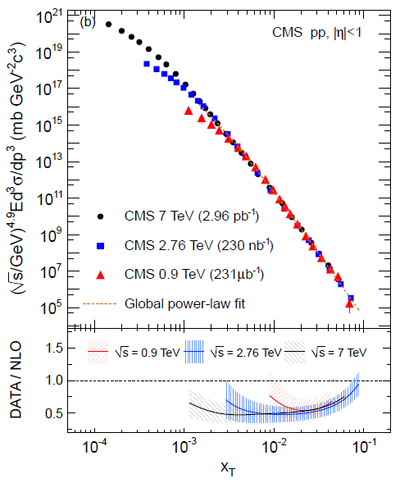
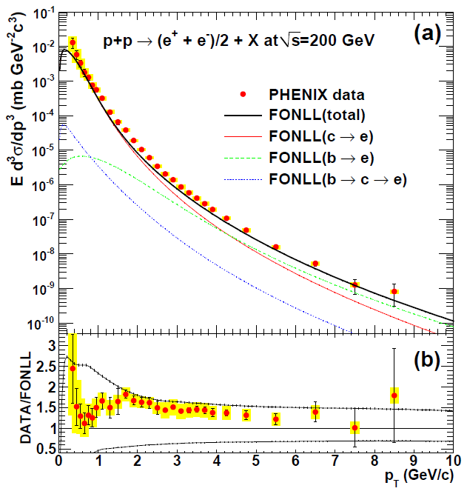
pQCD pp Predictions vs. Data
PHENIX, PRC84 (2011)
CMS, arXiv:1202.2554

Slide 12
Quant. (Qual?) Conclusions Require...
Further experimental results
Theoretically, investigation of the effects of
higher orders in
α_{s} (large)
k_{T}/xE (large)
M_{Q}/E (large?)
opacity (large?)
geometry
uncertainty in IC (small)
coupling to flow (large?)
Eloss geom. approx. (?)
τ < τ₀ (large: see Buzzatti and Gyulassy)
dyn. vs. static centers (see Djordjevic)
hydro background (see Renk, Majumder)
better treatment of
Coh. vs. decoh. multigluons (see Mehtar-Tani)
elastic E-loss
E-loss in confined matter

Slide 13
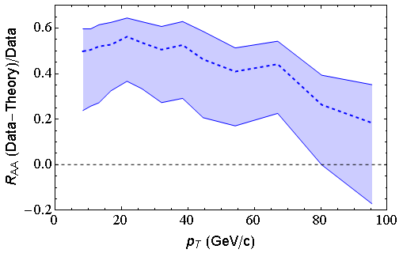
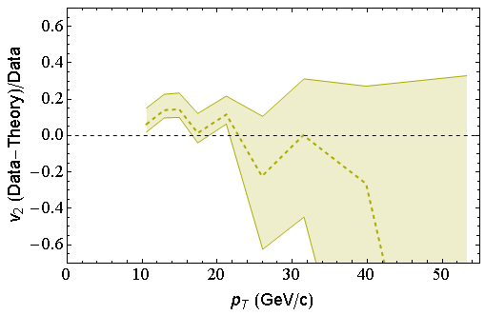
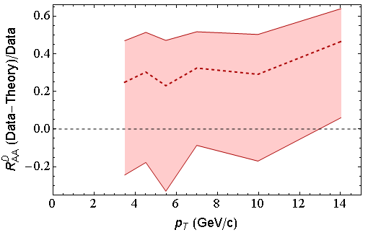
(Data – pQCD)/Data
CMS 40-50%
h±
CMS 0-5%
h±
LO
Calculation
ALICE 0-20%
D

Slide 14
Hot Nuclear Matter: AdS

Slide 15
Strong Coupling Calculation
The supergravity double conjecture:
QCD ⬄ SYM ⬄ IIB
IF super Yang-Mills (SYM) is not too different from QCD, &
IF we believe Maldacena conjecture
Then a tool exists to calculate strongly-coupled QCD in SUGRA

Slide 16
Heavy Quark E-Loss in AdS/CFT
Model heavy quark jet energy loss by embedding string in AdS space
dp_{T}/dt = - μ p_{T}
μ = πλ^{1/2} T²/2M_{q}
Similar to Bethe-Heitler
dp_{T}/dt ~ -(T³/M_{q}²) p_{T}
Very different from usual pQCD and LPM
dp_{T}/dt ~ -LT³ log(p_{T}/M_{q})
J Friess, S Gubser, G Michalogiorgakis, S Pufu, Phys Rev D75 (2007)

Slide 17
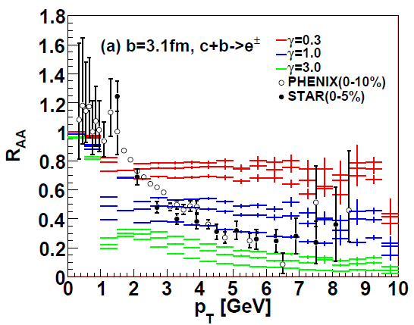
AdS/CFT and HQ at RHIC
String drag: qualitative agreement in heavy flavor sector
WAH, PhD Thesis
Akamatsu, Hatsuda, and Hirano, PRC79, 2009

Slide 18
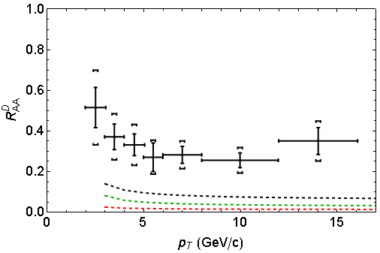
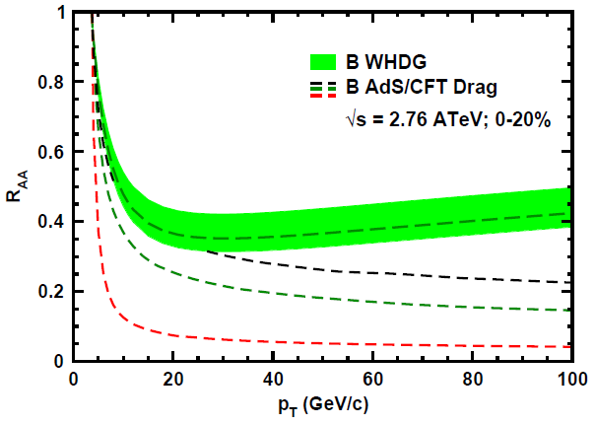
AdS/CFT and HQ at LHC
D Predictions
B Predictions
ALICE 0-20%
D
CMS B→J/ψ
WAH, PANIC11 (arXiv:1108.5876)
ALICE, arXiv:1203.2160
CMS, JHEP 1205 (2012) 063
AdS HQ Drag appears to oversuppress D
Roughly correct description of B→J/ψ

Slide 19
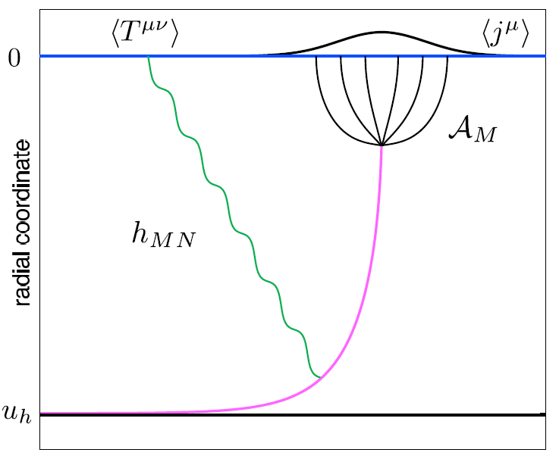
Light Quark E-Loss in AdS
Chesler et al., PRD79 (2009)
Complications:
string endpoints fall
=> painful numerics
relation to HI meas.
less obvious than HQ
In principle, compute T^{μν} from graviton emission
Extremely hard

Slide 20
Comparing to RHIC, LHC
Use prescription instead
Previously: define ΔE from energy lost distance Δx behind endpoint
Incorrect E-loss formula => generic Bragg peak
New suggestion: define ΔE from energy lost to small momentum scales
Correct E-loss formula => re-emergence of Bragg peak in static AdS background
See also K Rajagopal, A Ficnar

Slide 21
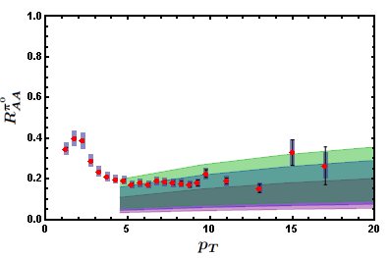
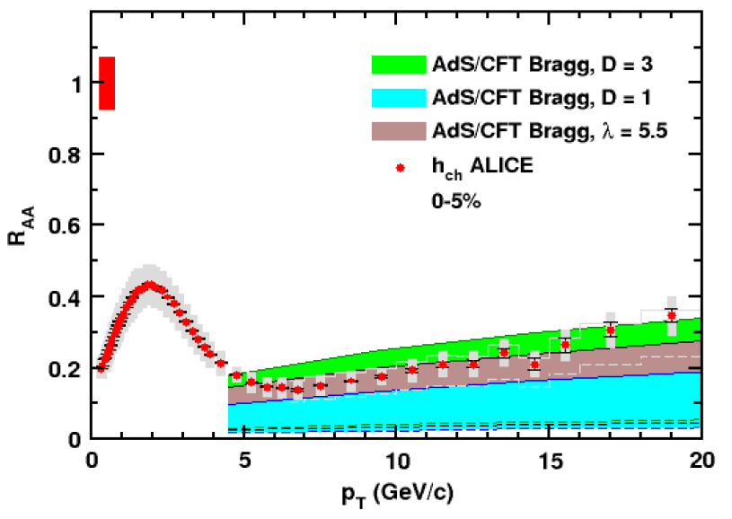
AdS/CFT Light q E-Loss
Static thermal medium => very short therm. time
τ_{th} ~ 2.7 fm
AdS likely oversuppresses compared to data
Examine T ~ 1/τ^{1/3} geom
τ_{th} ~ 4.1 fm; Bragg peak disappears
0.2 TeV
R Morad
2.76 TeV
WAH, JPhysG38 (2011)
Simple Bragg peak model

Slide 22
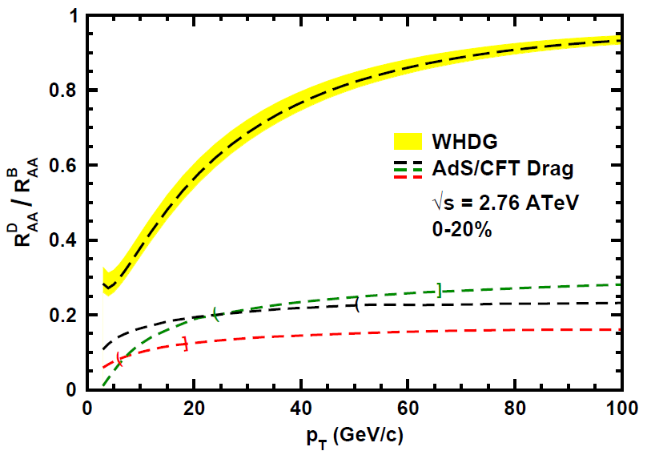
Does pQCD or AdS Yield Correct Mass & Momentum Dependecies at LHC?
WAH, PANIC11 (arXiv:1108.5876)
T(τ₀): “(”, corrections likely small for smaller momenta
T_{c}: “]”, corrections likely large for higher momenta
Qualitatively, corrections to AdS/CFT result will drive double ratio to unity
See also:
WAH, M. Gyulassy, PLB666 (2008)

Slide 23
Cold Nuclear Matter: AdS

Slide 24
AdS HQ E-Loss in Cold Nuclear Matter
Constant T Thermal Black Brane
Shock Geometries
P Chesler,
Quark Matter 2009
Nucleus as Shock
DIS
Embedded String in Shock
Albacete, Kovchegov, Taliotis,
JHEP 0807, 074 (2008)
Before
After
v_{shock}
z
Q
v_{shock}
z
Q
x
x
WAH and Kovchegov, PLB680 (2009)

Slide 25
Putting It All Together
This leads to
Can test AdS HQ E-Loss in both hot and cold nuclear matter!
Recall for BH:
Shock gives exactly the same drag as BH for Λ = π T
Λ is typical mom. scale of nucleus

Slide 26
Conclusions
Converging on picture of pQCD E-loss in sQGP
LO thermal pQCD qualitatively describes LHC single particle observables
Constrained by conservative assumptions & RHIC
Corrections likely large; drive towards data?
Precise RHIC measurements up to ~20 GeV/c or higher?
Better constraints & comparison above ~10 GeV/c
AdS not in qualitative agreement
HF: agreement at RHIC => oversuppression at LHC
Light Quarks: diff. to compare, but likely oversuppressed
Future comparison to heavy flavor separation
p + A:
Measure initial state effects
Additional test of strong coupling HQ E-loss

Slide 27
Backup Slides

Slide 28
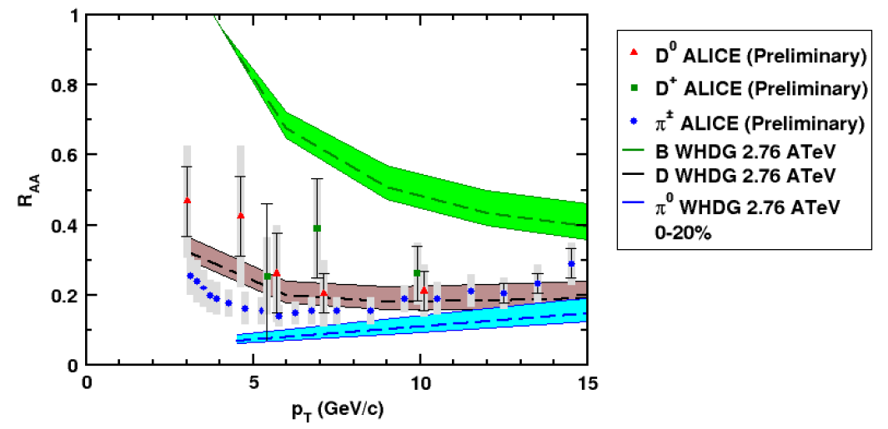
And D, B (?) R_{AA} at LHC
NB: R_{AA} requires production, E-loss, FF
Does not immediately follow that R^{π}_{AA} << R^{D}_{AA} << R^{B}_{AA}
CMS B → J/ψ
WAH and M Gyulassy, PANIC11 (arXiv:1107.2136)
ALICE, 1203.2160

Slide 29
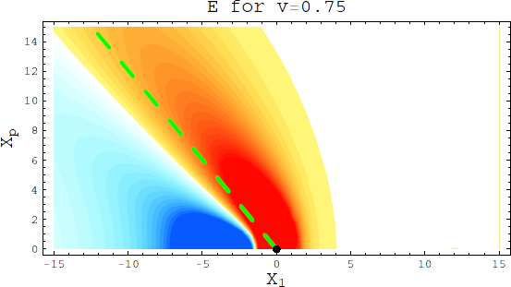
Comparing to RHIC, LHC
In principle, can compute Tmn from graviton emission
Extremely hard
Gubser, Pufu, Yarom, JHEP 0709 (2007)
See also Friess et al., PRD75 (2007)

Slide 30
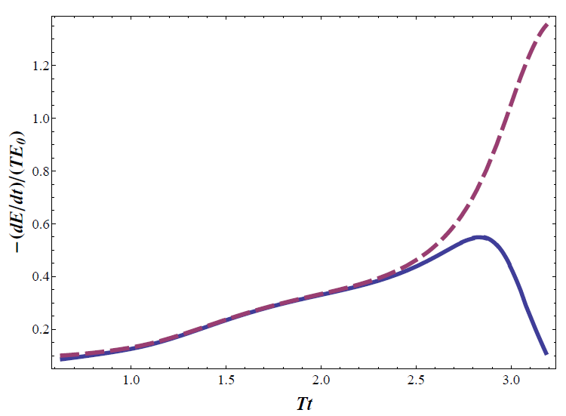
Use prescription instead
Previously: define DE from energy lost distance Dx behind endpoint
Incorrect E-loss formula => generic Bragg peak
Ficnar, arXiv:1201.1780

Slide 31
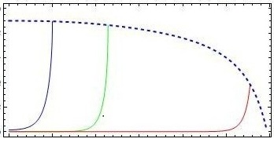
Jet Definition
Suggest new prescription:
define DE from energy lost to small momentum scales
We define jet as a part of string between the endpoint at and the point at
Such that
13

Slide 32
Jet Definition
Suggest new prescription:
define DE from energy lost to small momentum scales
We define jet as a part of string between the endpoint at and the point at
Such that
13

Slide 33
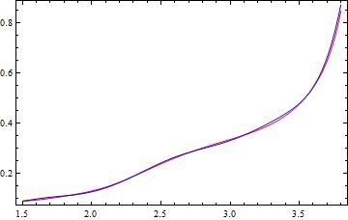
Energy Loss
Both formulae for energy loss have the same result!
Bragg peak appeared again!
Chesler formula
Also, the total energy loss approximately
equals to the initial energy of the quark
Ficnar formula
14

Slide 34
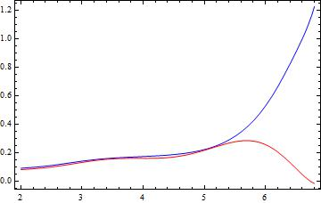
Energy Loss in a Boost-Invariant Geometry
Energy lost by definition
Chesler formula
Ficnar formula
T(τ) ~ τ^{1/3}
17

Slide 35
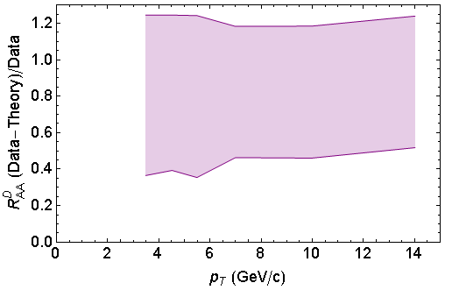
AdS D Comparison

Slide 36
Comparing to RHIC, LHC
In principle, compute Tmn from graviton emission
Extremely hard
Use prescription instead
Previously: define DE from energy lost distance Dx behind endpoint
Incorrect E-loss formula => generic Bragg peak
0.2 TeV
2.76 TeV
WAH,
JPhysG38 (2011)

Slide 37
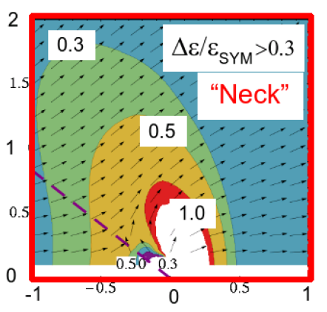
AdS/CFT Light q E-Loss & Dist.
0.2 TeV
2.76 TeV
Jo Noronha, M Gyulassy, and G Torrieri, PRL102 (2009)
Suggests wide angle energy loss
WAH, JPhysG38 (2011)
Simple Bragg peak model

Slide 38
AdS/CFT Light q E-Loss
Static thermal medium => very short thermalization time
tth ~ 2.7 fm
AdS likely oversuppresses compared to data
Examine T ~ 1/t^1/3 geom
tth ~ 4.1 fm, Bragg peak disappears
0.2 TeV
2.76 TeV
WAH, JPhysG38 (2011)
Simple Bragg peak model

Slide 39
Energy Loss in QGP
Claim: LHC predictions from rigorously RHIC constrained pQCD E-loss in qualitative/quantitative agreement with current data
Want to stress test the theory with as many experimental levers as possible
Counter-claim: LHC predictions from AdS/CFT not falsified by current data
Want an obvious distinguishing measurement

Slide 40
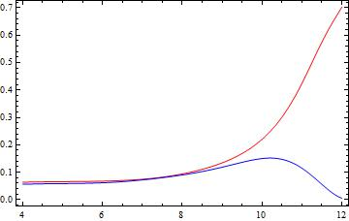
Light Quark E-Loss in AdS
Early Result: generic Bragg peak
Missing term kills peak
Calculation assumes
T ~ 1/τ^{1/3}
T_{therm} ~ 300 MeV
E_{q} ~ 180 GeV
-(dE/dt)/(T E₀)
t T
Razieh Morad and WAH, in prep
Chesler et al. PRD79 (2009)
Ficnar, arXiv:1201.1780
Jury is still out: Stay Tuned!

Slide 41
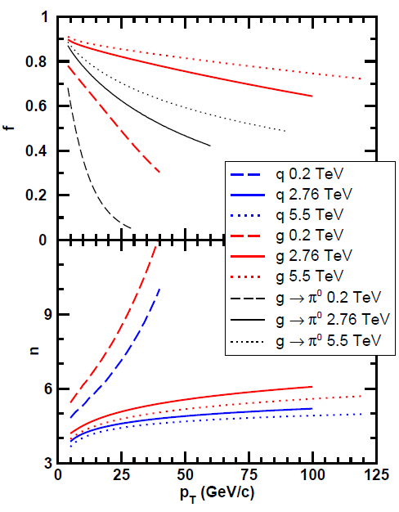
Qualitative Expectations for LHC
For approx. power law production and energy loss probability P(ε), ε = (E_{i} - E_{f})/E_{i}
Asymptotically, pQCD => ΔE/E ~ log(E/μ)/E
~ flat R_{AA}(p_{T}) at RHIC
Rising R_{AA}(p_{T}) at LHC
NB: LHC is a glue machine

Slide 42
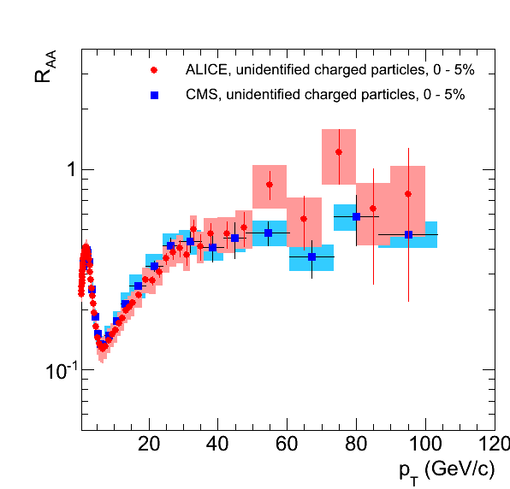
Qualitatively Perturbative at LHC
Appelshauser, ALICE, QM11
p_{T} rise in data readily understood from generic perturbative physics!

Slide 43
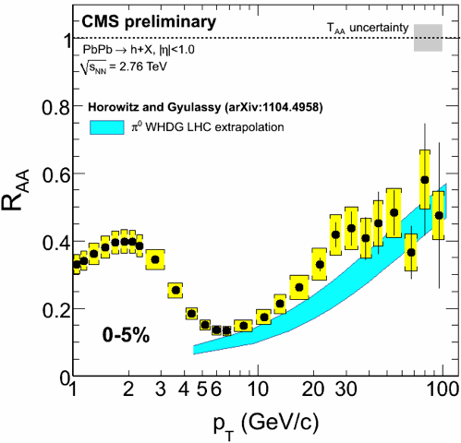
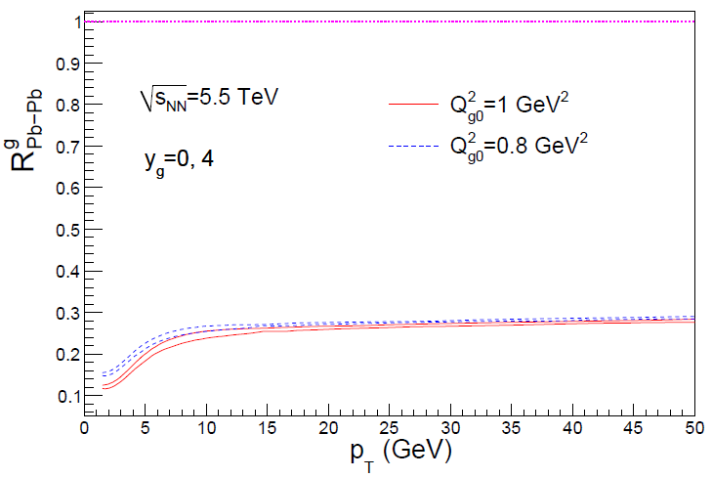
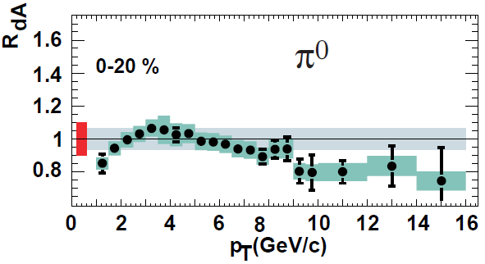
Rise in R_{AA} a Final State Effect?
Is rise really due to pQCD?
Or other quench (flat?)
+ initial state CNM effects a la CGC?
Y-J Lee, QM11
Albacete and Marquet, PLB687 (2010)
Require p + A and/or direct γ
PHENIX PRL98, 2007

Slide 44
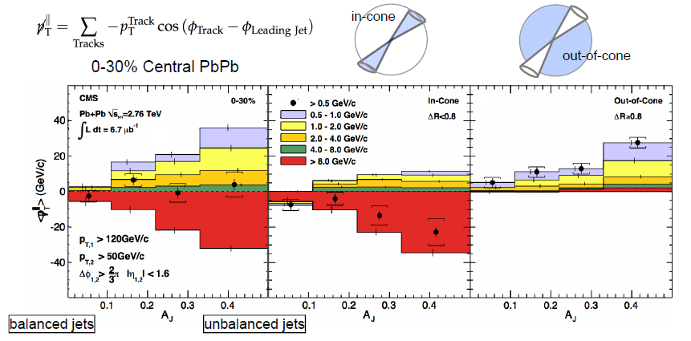
pQCD and Jet Measurements
CMS sees redistribution of lost energy at large angles
Naive pQCD expectation: collinear radiation
Wyslouch, CMS, QM11

Slide 45
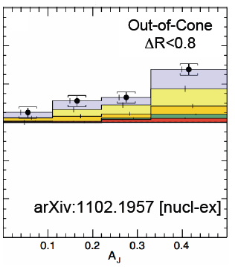
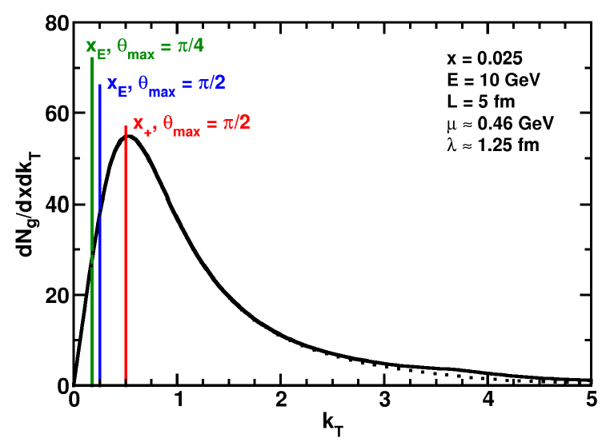
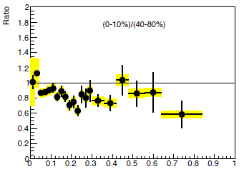
pQCD and Wide Angle Radiation
Naively, pQCD =>
x_{typical}, θ_{typical} ~ μ/E; μ ~ 0.5 GeV
All current Eloss calculations assume small angle emission
(k_{T} << xE)
Collinear approximation is (maximally) violated; x_{typ} ~ μ/E
pQCD is not inconsistent with data
C Roland, CMS, QM11
z
WAH and B Cole, PRC81, 2010
B Cole, ATLAS, QM11

Slide 46
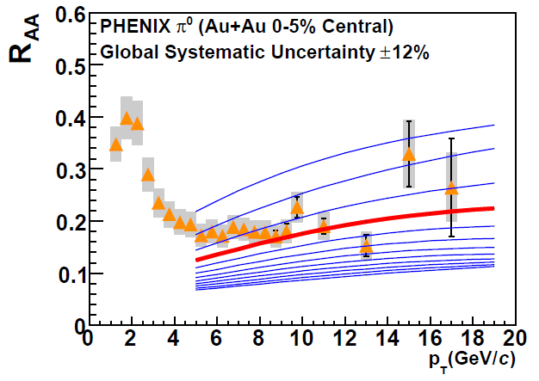
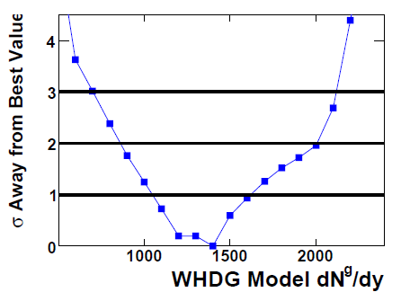
With Caveats in Mind...
Quantitatively compare a parameter free prediction from WHDG for LHC, rigorously constrained by RHIC
Increase density at LHC by observed increase in particle multiplicity
PHENIX PRC77, 2008

Slide 47
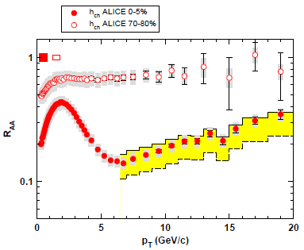
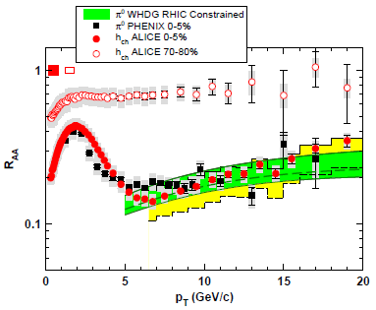
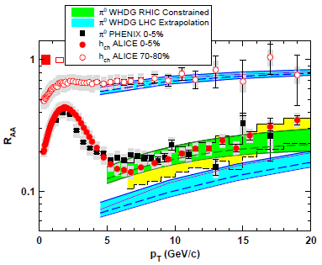
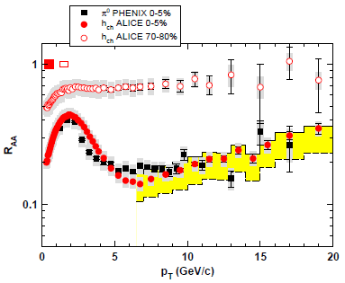
WHDG π⁰ R_{AA} at LHC: First Results
WHDG band from 1-σ RHIC dN_{g}/dy extraction
Note that constrained predictions have small uncertainty from collinear approx
Constrain WHDG at RHIC
Make LHC predictions assuming dN_{g}/dy ~ dN_{ch}/dη
=> dN_{g}^{LHC}/dy = 2.4 dN_{g}^{RHIC}/dy
Data shown at Kruger2010
WAH and M Gyulassy, NPA872 (2011)

Slide 48
WHDG Compared to R_{CP}
Examine R_{CP}, ratio of central to peripheral R_{AA}
p + p uncertainty cancels
0-5% R_{AA} to
70-80% R_{AA}
Validity of E-loss in very peripheral collisions?
WAH and M Gyulassy, NPA872 (2011)

Slide 49
WHDG Describes LQ R_{AA} and v₂!
Fixed by RHIC data, parameter-free WHDG describes preliminary R_{AA} and v₂ quite well
v₂ at very high p_{T}?
Y-J Lee, QM11 and
cdsweb.cern.ch/record/1352777
WAH and M Gyulassy,
JPhysG38 (2011)

Slide 50
And D, B (?) R_{AA} at LHC
NB: R_{AA} requires production, E-loss, FF
Does not immediately follow that R^{π}_{AA} << R^{D}_{AA} << R^{B}_{AA}
CMS B → J/ψ
WAH and M Gyulassy, PANIC11 (arXiv:1107.2136)
ALICE, 1203.2160

Slide 51
AdS/CFT and HQ at LHC
D Predictions
B Predictions
CMS B→J/ψ
WAH, PANIC11 (arXiv:1108.5876)
ALICE, arXiv:1203.2160
AdS HQ Drag appears to oversuppress D
Roughly correct description of B→J/ψ

Slide 52
AdS/CFT Light q E-Loss & Dist.
0.2 TeV
2.76 TeV
Jo Noronha, M Gyulassy, and G Torrieri, PRL102 (2009)
Suggests wide angle energy loss
WAH, JPhysG38 (2011)
Simple Bragg peak model

Slide 53
Comparing AdS and pQCD
But what about the interplay between mass and momentum?
Take ratio of c to b R_{AA}(p_{T})
pQCD: Mass effects die out with increasing p_{T}
Ratio starts below 1, asymptotically approaches 1. Approach is slower for higher quenching
ST: drag independent of p_{T}, inversely proportional to mass. Simple analytic approx. of uniform medium gives
R^{cb}_{pQCD}(p_{T}) ~ n_{b}M_{c}/n_{c}M_{b} ~ M_{c}/M_{b} ~ .27
Ratio starts below 1; independent of p_{T}
R^{cb}_{pQCD}(p_{T}) ∼ 1 - α_{s} n(p_{T}) L² log(M_{b}/M_{c}) ( /p_{T})

Slide 54
Top Energy Predictions
For posterity:
WAH and M Gyulassy, in preparation

Slide 55
RHIC R^{cb} Ratio
pQCD
pQCD
AdS/CFT
AdS/CFT
WAH, M. Gyulassy, JPhysG35 (2008)
Wider distribution of AdS/CFT curves due to large n: increased sensitivity to input parameters
Advantage of RHIC: lower T => higher AdS speed limits

Slide 56
Chesler et al., PRD79 (2009)

Slide 57
Mult. Obs. at LHC?
RHIC
J Jia, WAH, J Liao,
arXiv:1101.0290
Are pQCD predictions of both R_{AA} & v₂ consistent with data? At 100 GeV/c?
Jia, ATLAS, QM11
Wenger, private communication

Slide 58
Motivating High Momentum Probes
Probe
Medium
Medium

Slide 59
Light Quark and Gluon E-Loss
Chesler et al., PRD79 (2009)
SS Gubser, QM08
Light quarks and gluons: generic Bragg peak
Leads to lack of T dependence?
ΔL^{q}_{therm} ~ E^{1/3}
ΔL^{q}_{therm} ~ (2E)^{1/3}
Gubser et al., JHEP0810 (2008)
Chesler et al., PRD79 (2009)
Arnold and Vaman, JHEP 1104 (2011)
See also Marquet and Renk,
PLB685 (2010), and
Jia, WAH, and Liao,
arXiv:1101.0290, for v₂

Slide 60
Qual Norm of R_{AA} From RHIC to LHC
Assume QGP density scales with observed particle multiplicity: ~2.5x more dense than RHIC
ALICE, PRL105, 2010
WAH and M Gyulassy, arXiv:1104.4958
Suppression from RHIC to LHC generically increases

Slide 61
Strongly Coupled Qualitative Successes
AdS/CFT
Blaizot et al., JHEP0706
T. Hirano and M. Gyulassy, Nucl. Phys. A69:71-94 (2006)
STAR, PRL102 (2009)
Betz, Gyulassy, Noronha, Torrieri, 0807.4526

Slide 62
ALICE Published Results
NB: ALICE unmeasured p + p interpolation > LO pQCD
Also, small reported unc. in N_{bin}
Fluctuations important at large centralities
WAH and M Gyulassy,
arXiv:1104.4958

Slide 63
Varying α_{s} has huge effect
<ε>_{rad,pQCD} ~ α_{s}³; <ε>_{el,pQCD} ~ α_{s}²
Role of running coupling, irreducible uncertainty from non-pert. physics?
Nontrivial changes from better elastic treatment
S Wicks, PhD Thesis

Slide 64
Quantifying Sensitivity to Geometry IC
Effects of geom. on, e.g. v₂, might be quite large
KLN CGC vs. WS Glaub. and rotating RP
Effect not large enough for pQCD
Possibly truly extreme
initial geometry?
See also Renk et al., PRC83 (2011), Jia, WH, Liao, 1101.0290
Betz, Gyulassy, and Torrieri, arXiv:1102.5416 [nucl-th]

Slide 65
Quantification of Collinear Uncertainty
Factor ~ 3 uncertainty in extracted medium density!
“qhat” values from different formalisms consistent w/i unc.
WAH and B Cole, PRC81, 2010

Slide 66
Coll. Approx. and Constrained v₂
Fix dN_{g}/dy from R_{AA}, calculate v₂
Expect: larger v₂ for smaller opening angle
τ_{coh} = xE/k_{T}² larger for smaller θ_{max}
more paths in deep LPM (ΔE ~ L²) region
Not large sensitivity
Rad Only
Rad + El
20-30% π⁰
20-30% π⁰
v₂
v₂
p_{T}
WAH, in preparation
p_{T}

Slide 67
Geometry, Early Time Investigation
Significant progress made
Full geometry integration, dynamical scattering centers
RHIC suppression with dN_{g}/dy = 1000
Large uncertainty due to unconstrained, non-equilibrium τ < τ₀ physics
Future work: higher orders in opacity
Buzzatti and Gyulassy, 1106.3061

Slide 68
Not So Fast!
Speed limit estimate for applicability of AdS drag
γ < γ_{crit} = (1 + 2M_{q}/λ^{1/2} T)²
~ 4M_{q}²/(λ T²)
Limited by M_{charm} ~ 1.2 GeV
Similar to BH LPM
γ_{crit} ~ M_{q}/(λT)
No Single T for QGP
smallest γ_{crit} for largest T
T = T(τ₀, x=y=0): “(”
largest γ_{crit} for smallest T
T = T_{c}: “]”
D7 Probe Brane
Q
Worldsheet boundary Spacelike if γ > γ_{crit}
x₅
Trailing
String
“Brachistochrone”
“z”
D3 Black Brane

Slide 70
pQCD pp Predictions vs. Data
CMS, arXiv:1202.2554
ALICE, arXiv:1205.5423

