Slide 1
New Development of Silicon Drift Detectors for Gamma-ray Astronomy
C.Fiorini, R.Peloso, P.Busca, L.Bombelli, A.Marone, R.Quaglia
Politecnico di Milano and INFN, Milano, Italy
P.Bellutti, M.Boscardin, F.Ficorella, G.Giacomini, A.Picciotto, C.Piemonte, N.Zorzi
Fondazione Bruno Kessler - FBK, Trento, Italy
N.Nelms, B.Shortt
European Space Agency, ESTEC, The Netherlands
Research activity supported by European Space Agency
(contract n. 4000102940/11/NL/NR)
Notes:
B

Slide 2
Outline
Motivation of the work
The detector architecture
Design issues
  Energy resolution
  Electronics noise
  Effect of the SDD drift time
  single-side biasing of the detector
Experimental set-up and preliminary results
in X and γ-ray spectroscopy
Conclusions and future work

Slide 3
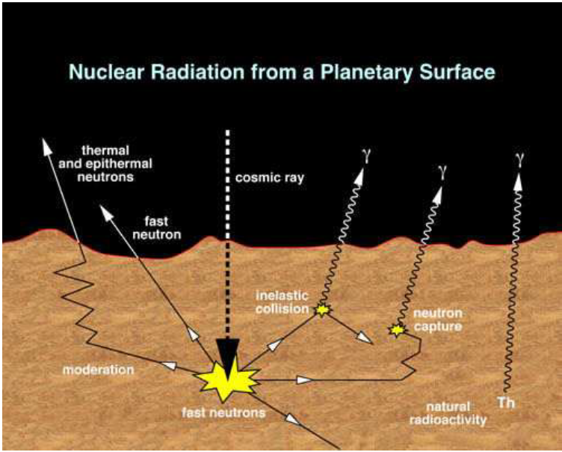
Motivation of the work
Development of large volume gamma-ray spectrometer for planetary observations
Energy range: 150keV – 15MeV
Energy resolution @662keV ~ 3%
Use of LaBr₃:Ce scintillator
Use of PMTs, although limitations as: low QE, size, high bias voltage, saturation effects in the target energy range
mettere ref.
Interest in exploring the use of Silicon Drift Detectors as LaBr₃:Ce photodetector

Slide 4
Key features of the development
SDDs arrays to cover the scintillator surface:
  optimization of single SDD area and number of units in the array (noise evaluations, dead area, yield, assembly issues, …)
‘Standard’ SDD technology (i.e. without FET integrated in the SDD), with QE optimized for LaBr₃ readout
‘CUBE’ CMOS preamplifier connected close to the SDD
  as readout alternative to conventional front-end JFETs

Slide 5
Solution to readout 3” and 2” LaBr₃ scintillators
monolithic array
of 3x3 SDDs with 8x8mm²
area each
chip area: 26x26mm²
(1mm dead area on
the perimeter)
Ø = 3 inches
81 units (69 active with signals)
dead area ~ 15%
8mm
Ø = 2 inches
36 units (32 with signals)

Slide 6
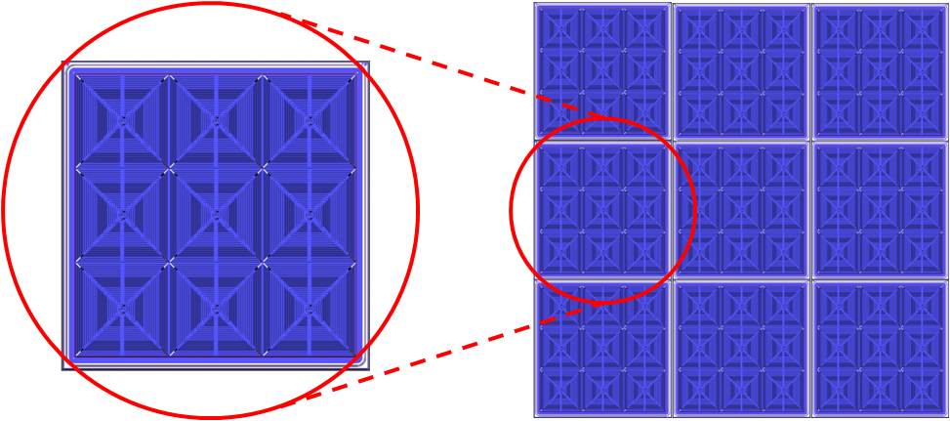
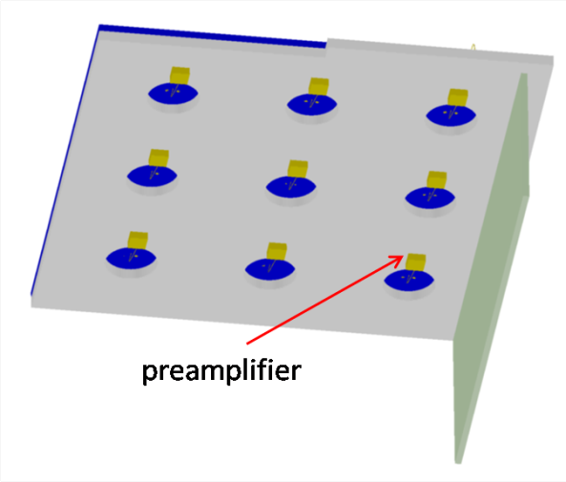
78mm
26mm
78mm
26mm
Each monolithic array is composed by 9 SDDs
assembly of 9 monolithic arrays
Each SDD is readout by a ‘CUBE’ CMOS preamplifier

Slide 7
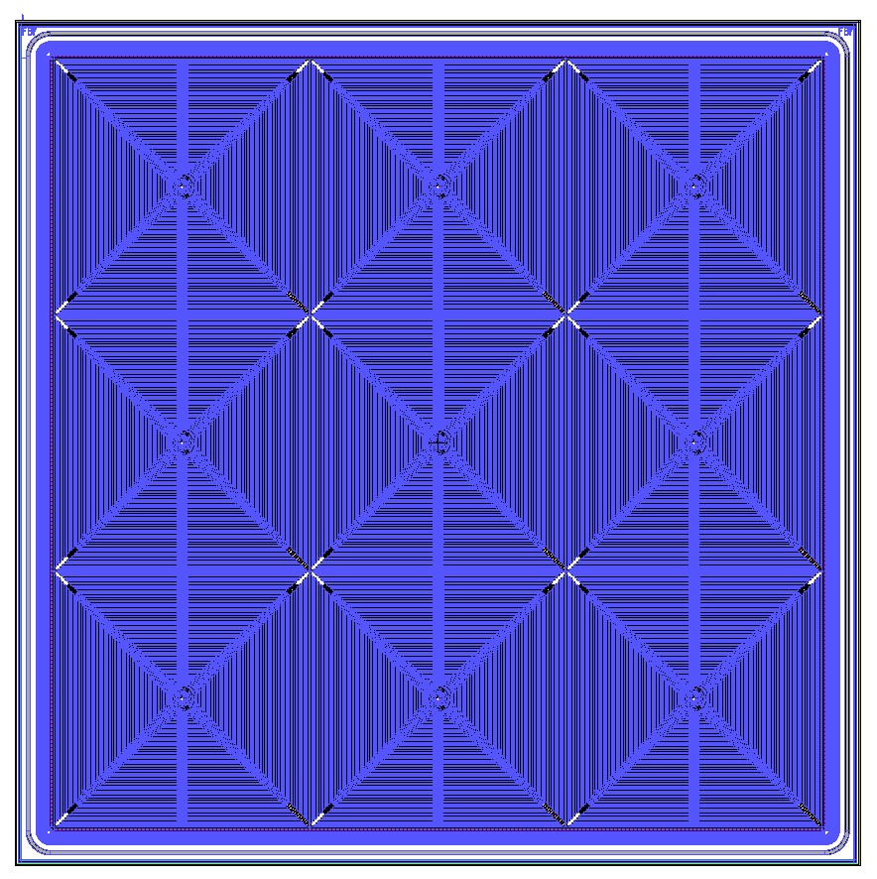
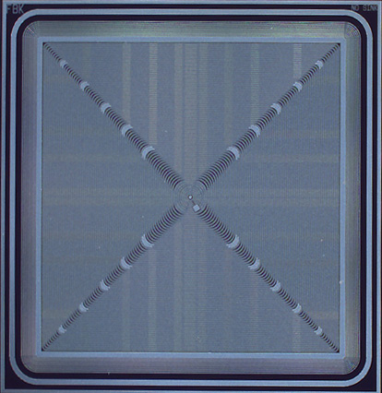
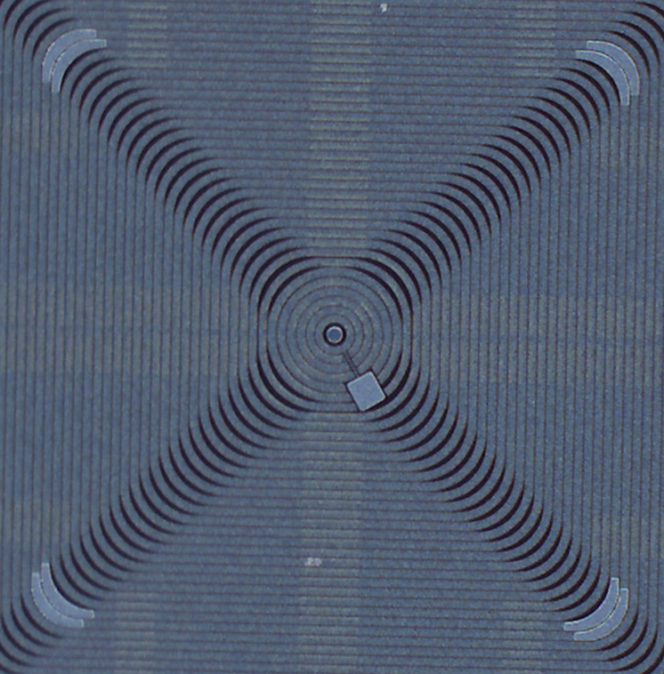
SDD layout

Slide 8
Cube: a low-noise CMOS preamplifier for SDDs
A full CMOS preamplifier with optimized input PMOSFET replaces the conventionally used JFET+Cf+reset component
It is mounted close to the SDD anode
Features:
Preamplifier signal available already close to the SDD.
No long loop between FET and remaining stage of the preamplifier.
Possibility to drive “long” connection.
Better noise vs. conventional/integrated JFETs
SDD
CUBE

Slide 9
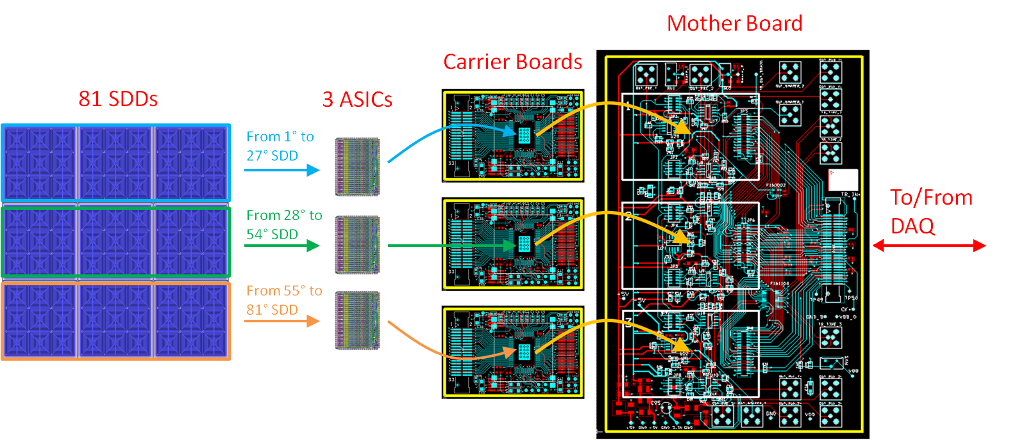
Readout electronics (1)
81 SDDs+CUBEs

Slide 10
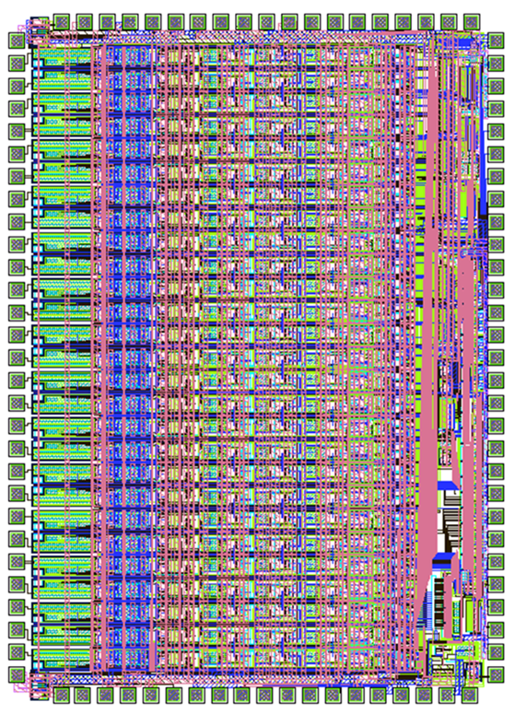
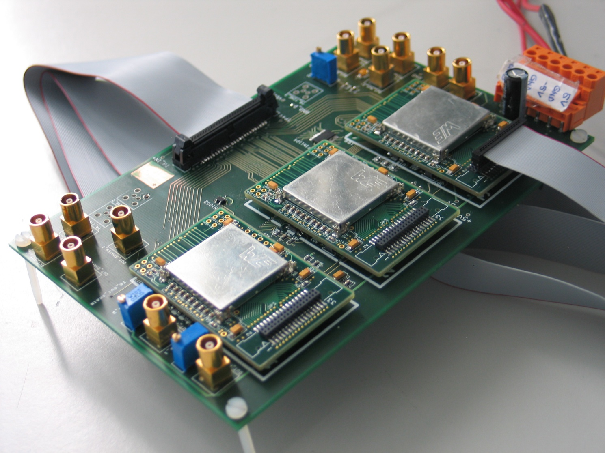
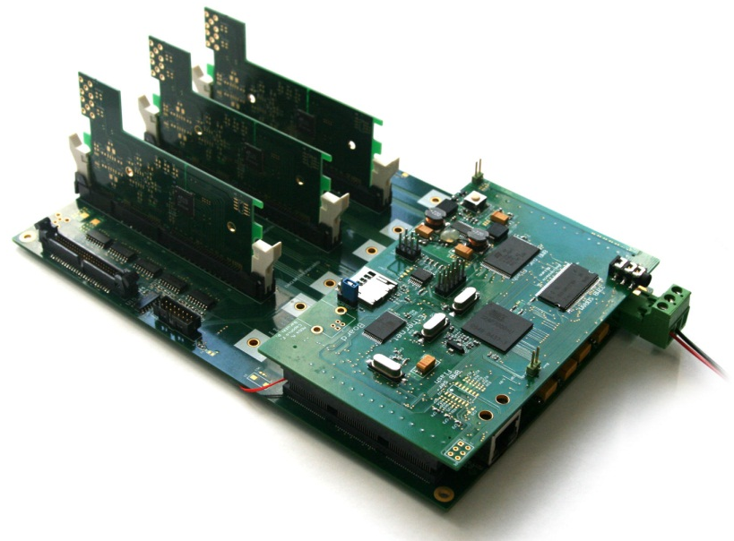
Readout electronics (2)
ASICs board
27 analog channels (7th order semig. shaper, peak stretcher, discr.)
27:1 multiplexer running at 10MHz
SPI programming (gain, shaping times, thresholds, ..)
DAQ board

Slide 11
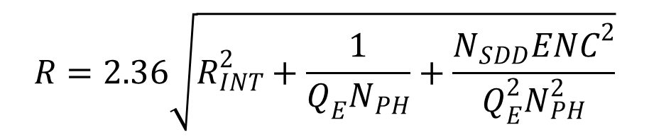
Energy resolution
$$R=2.36\sqrt{R_{INT}^{2}+\frac{1}{Q_{E}N_{PH}}+\frac{N_{SDD}{ENC}^{2}}{Q_{E}^{2}N_{PH}^{2}}}$$
intrinsic
Poisson
electronics noise
Photodetector parameters:
Q_{E}: SDD quantum efficiency (incl. dead areas)
N_{SDD}: number of SDDs which read scintillator light
ENC: electronics noise of each SDD

Slide 12
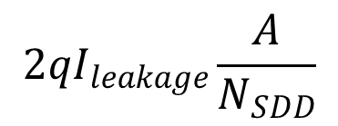
The SDD electronics noise
$$2qI_{leakage}\frac{A}{N_{SDD}}$$
8mmx8mm SDD
T= -20°C
A: scintillator area
C_{D}: SDD capacitance
C_{G}: FET input capacitance
a: FET thermal noise
c: FET 1/f noise
τ : peaking time
Leakage current=2nA/cm²@20°C

Slide 13
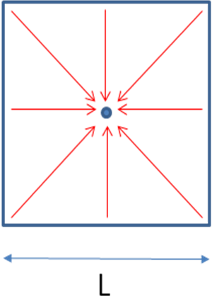
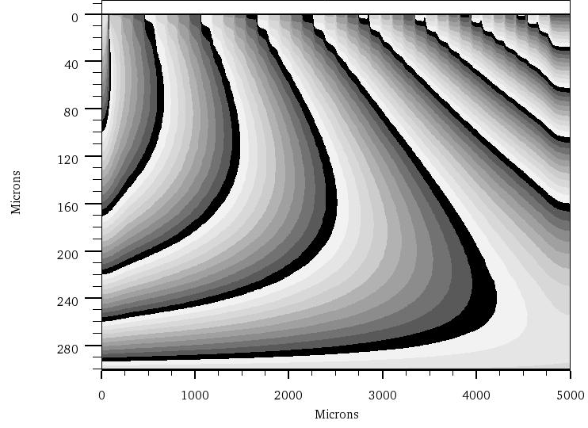
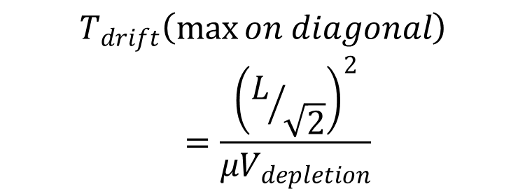
Effect of the drift time inside the SDD
anode
last ring
e- path
entrance window
$$T_{drift}\left(\max{on diagonal}\right)=\frac{{\left(L/{\sqrt{2}}\right)}^{2}}{μV_{depletion}}$$
equipotential lines in a cross section of the device
theoretical estimation supposing constant field

Slide 14
drift time vs. injection point of the charge simulated along the short path on the SDD
(L/2=4mm length)
calculated waveform of the current signal at the anode of the SDD, in correspondence of a uniform illumination of photons on the entrance window of the device

Slide 15
Ballistic deficit due to SDD real current signal
Ballistic deficit (BD) calculated as normalized to ideal pulse amplitude

Slide 16
Worsening of the electronics noise due to ballistic deficit
ENC_{effective} = ENC/(1-BD)
ballistic deficit calculated for a 8mmx8mm SDD as a function of the peaking time of the shaping amplifier (6th order real poles)
ENC without ballistic deficit (blue line) and with ballistic deficit (green line).

Slide 17
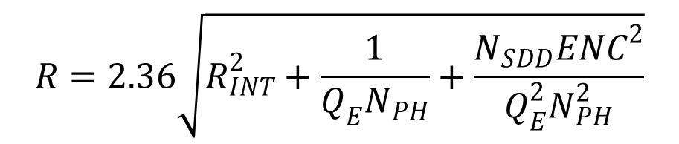
Expected energy resolution
$$R=2.36\sqrt{R_{INT}^{2}+\frac{1}{Q_{E}N_{PH}}+\frac{N_{SDD}{ENC}^{2}}{Q_{E}^{2}N_{PH}^{2}}}$$

Slide 18
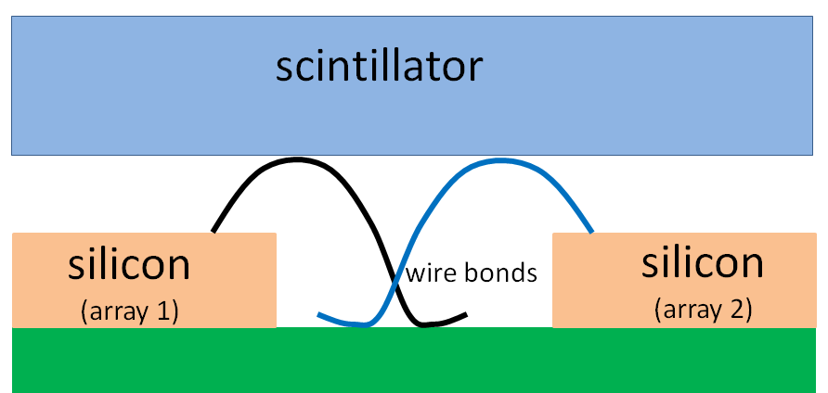
Interference of bonding wires on electrodes coupled to scintillator

Slide 19
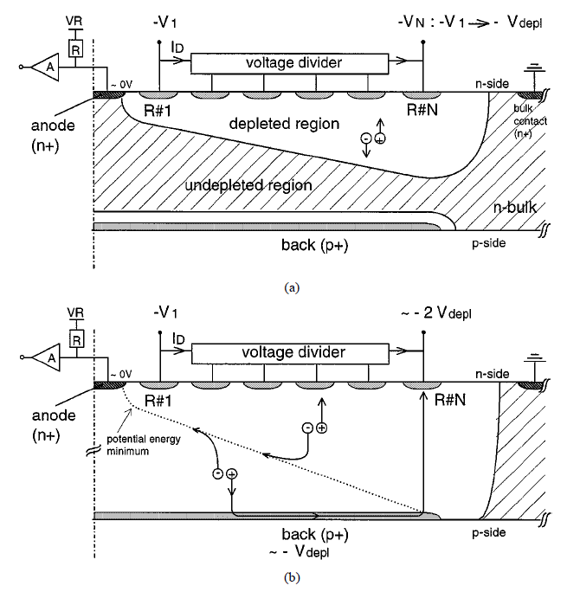
Single-side biasing only (no bonding on back side)
punch-
through
C. Fiorini, A. Longoni, P. Lechner, IEEE Trans. on Nucl. Sci., Vol. 47, n° 4, p. 1691-1695, August 2000

Slide 20
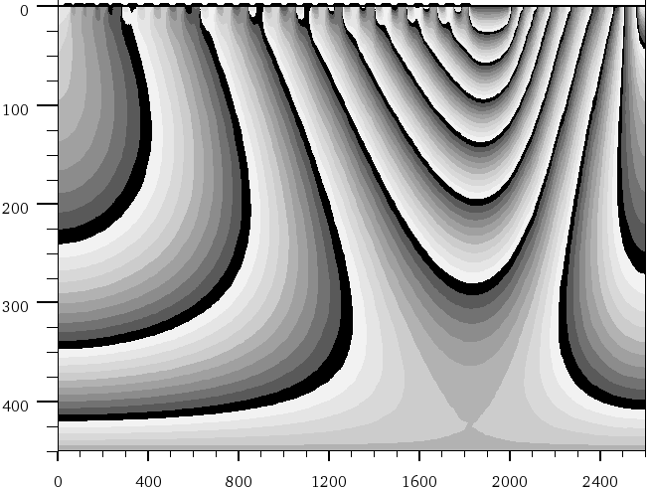
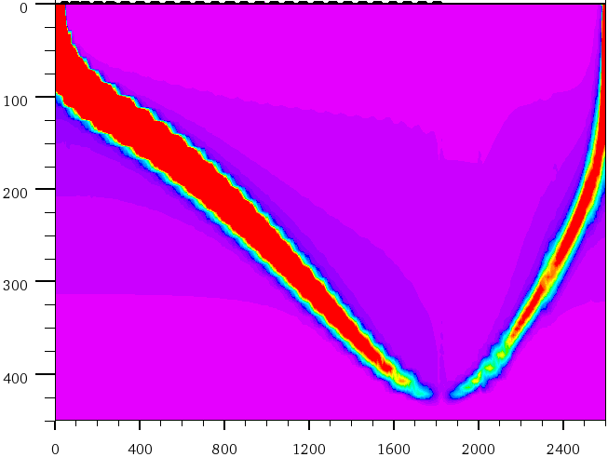
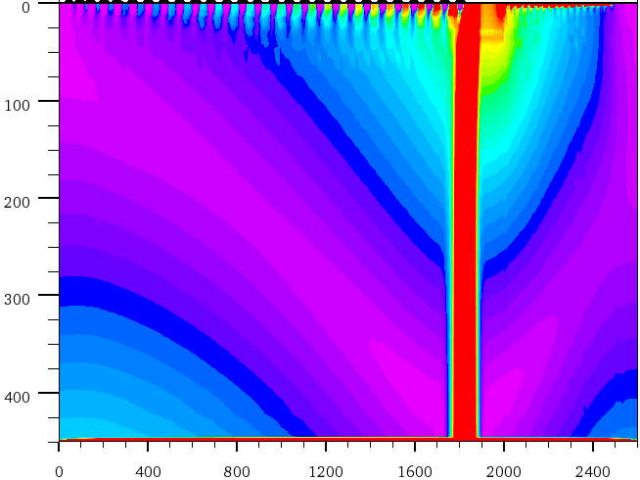
anode
drift rings
back electrode
electrons current density
holes current density

Slide 21
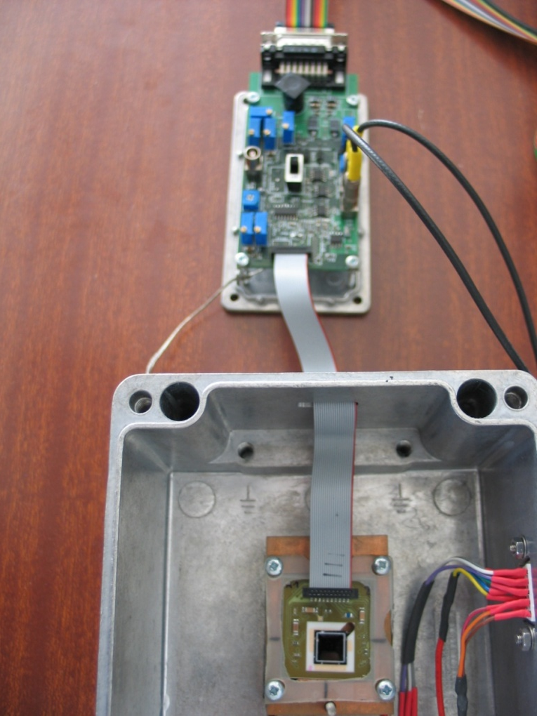
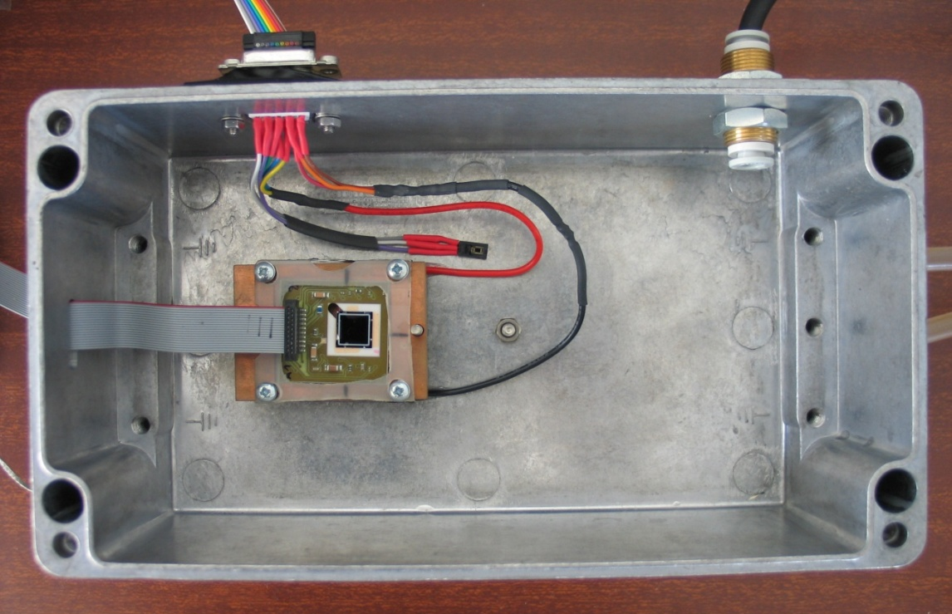
Experimental setup
ceramic board
Biasing electronics
Copper block
and Peltier cell
SDD

Slide 22
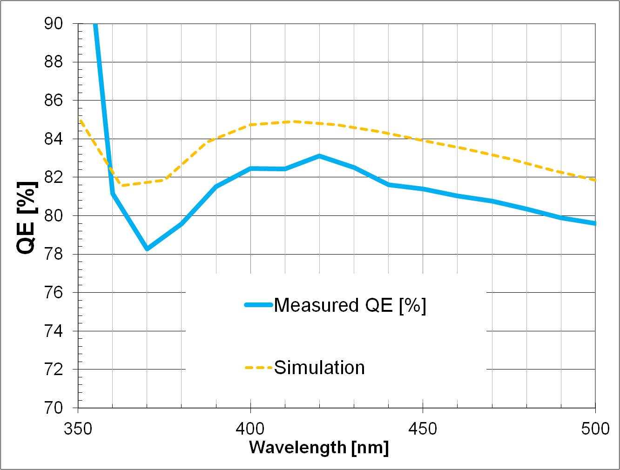
Measured quantum efficiency
LaBr₃:Ce emission spectrum

Slide 23
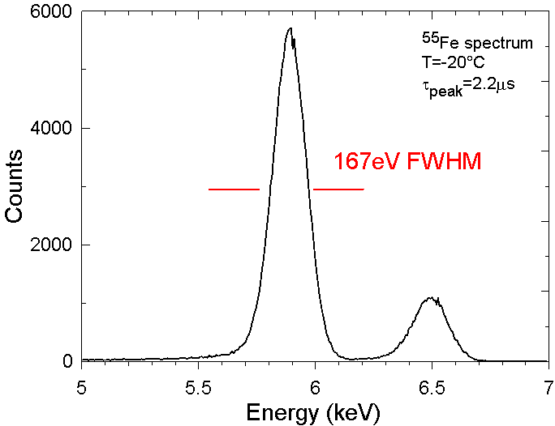
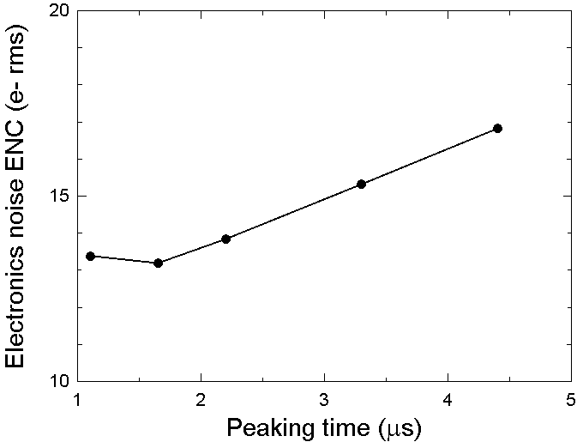
Experimental characterization of single 8x8mm² SDD
1.5nA/cm²
2nA/cm²
T= -20°C
ENC = 13.8e- rms
ENC simulations

Slide 24
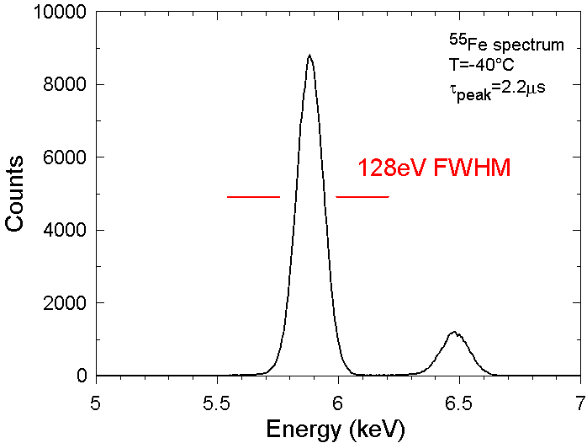
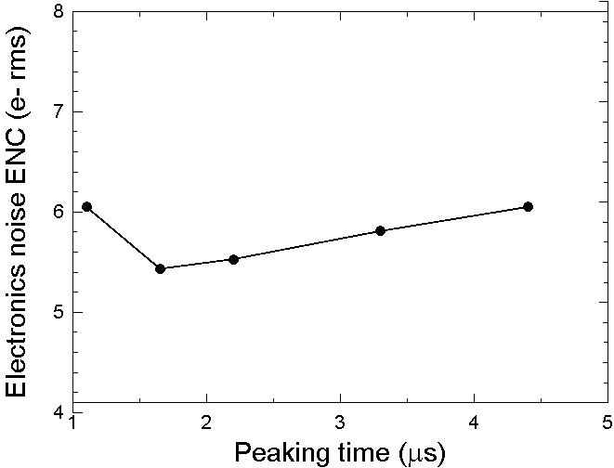
T= -40°C
ENC = 5.5e- rms

Slide 25
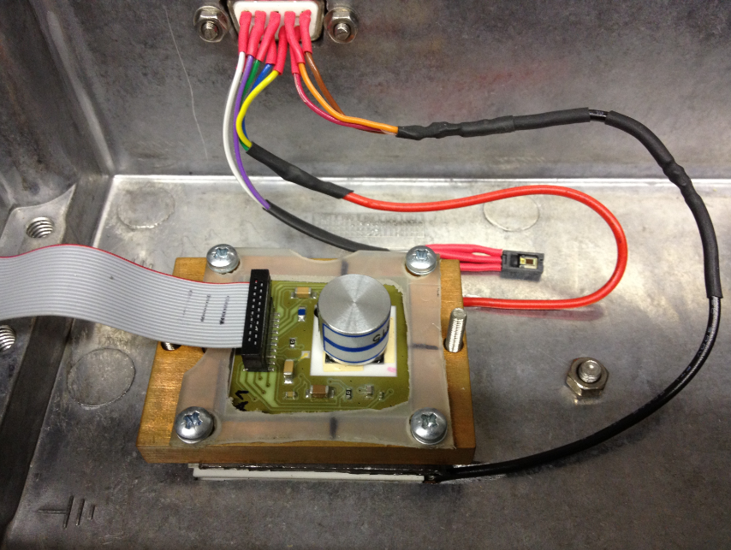
Gamma-ray measurements with LaBr₃ on single SDD
cylindrical LaBr₃: 6mm diameter, 9mm thickness
no back bonding (single side biasing)

Slide 26
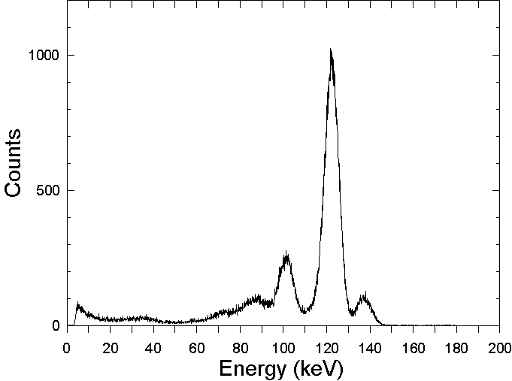
⁵⁷Co spectrum
122keV
5.6% FWHM
136keV
T=-20°C
6μs peak. time
28e-/keV
The same crystal sample measured with a PMT (S.Gobain)
provides 7.3%@122keV

Slide 27
⁵⁷Co+¹³⁷Cs spectra
122 KeV
32 KeV
662 KeV
662 KeV
2.7% FWHM
T=-20°C
8μs peak. time

Slide 28
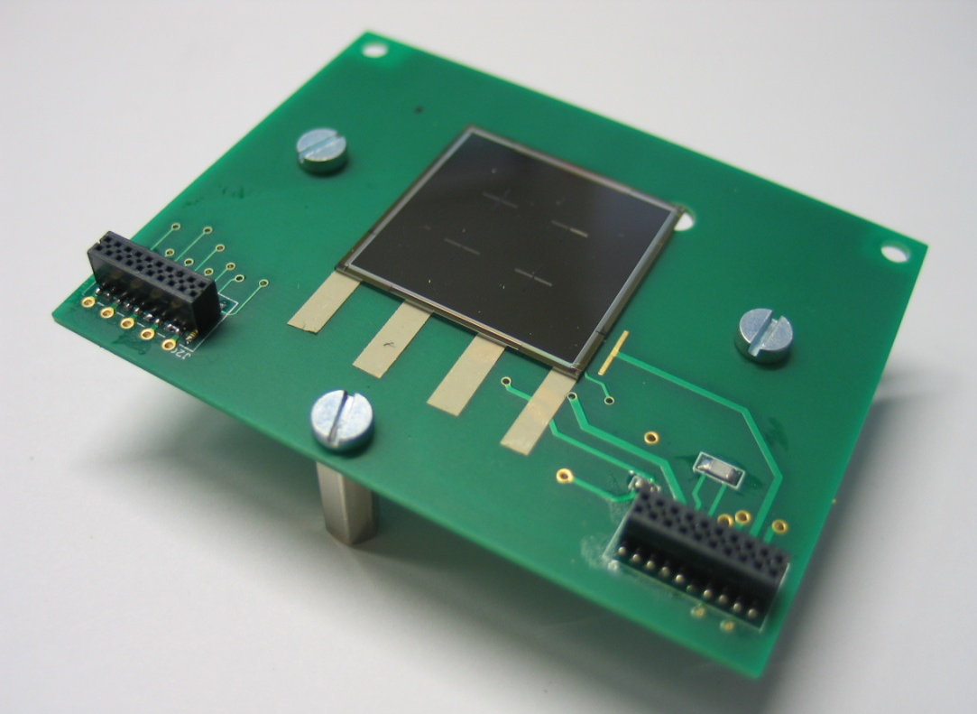
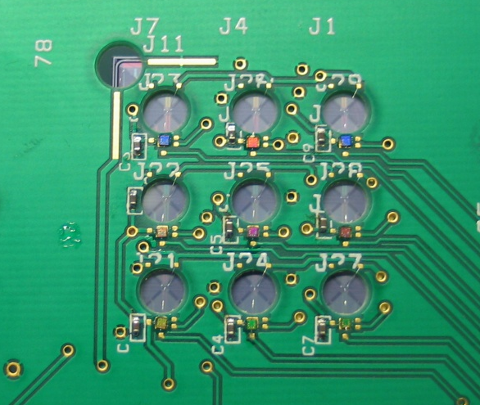
Experimental characterization of the 3x3 SDDs array
3x3
SDDs array
Holes for bondings
Cube preamplifier

Slide 29
⁵⁵Fe spectra measured with the SDD array
T=-20°C
2μs peak. time

Slide 30
Conclusions and future work
First run of production of SDDs at FBK for the ESA project has been successful
Preliminary X and gamma-ray measurements and a single SDD show state-of-the-art performances
Development of the complete gamma-ray detection module and electronics is under way
Other application opportunities:
  X-ray spectroscopy detectors for SIDDHARTA2 experiment (INFN)
  imaging and spectroscopy gamma-ray detectors for nuclear physics experiments (GAMMA exp. INFN)
  development of a multimodality SPECT/MRI imaging system for medical diagnostics (EC-funded project starting in 2013)

