Slide 1
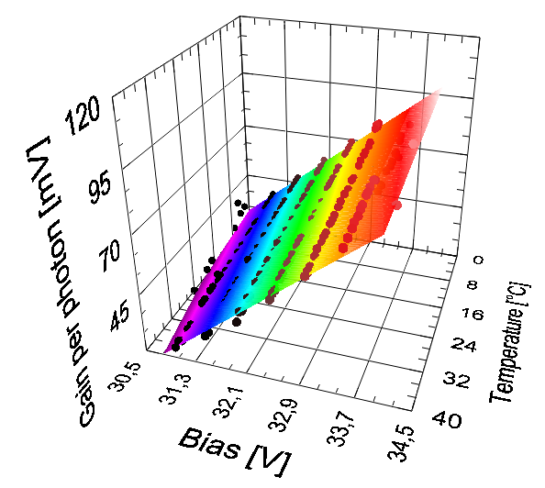
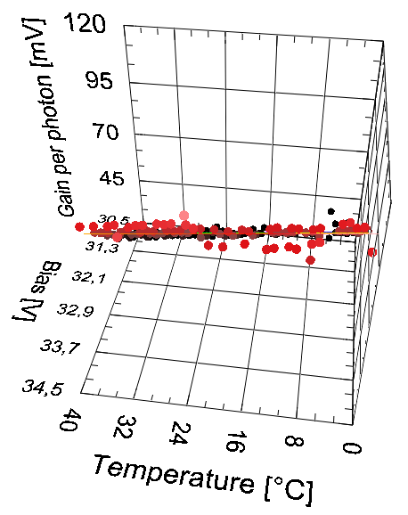
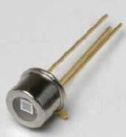
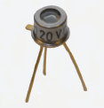
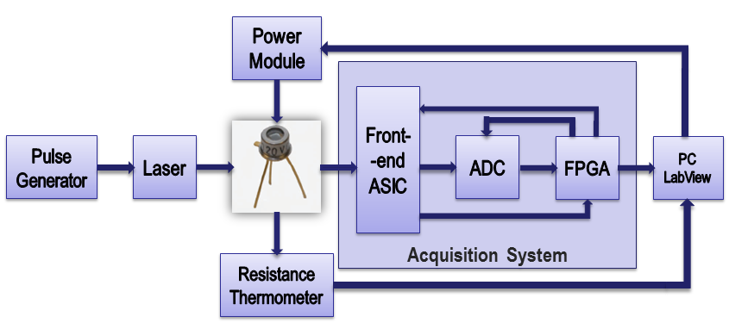
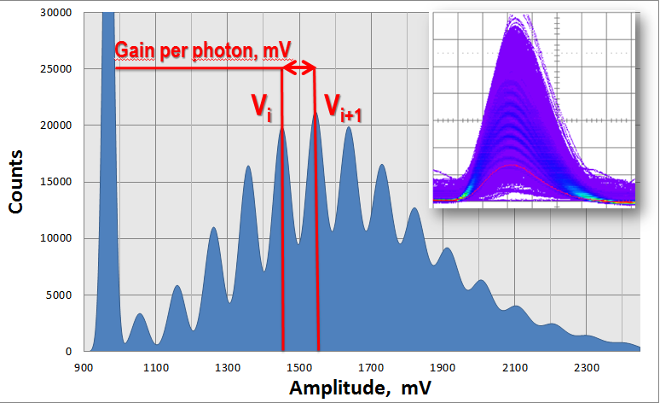



Silicon Photomultiplier's Gain Stabilization by Bias Correction for Compensation of the Temperature Fluctuations
P. Dorosz, M. Baszczyk, S. Glab, W. Kucewicz, L. Mik, M. Sapor
AGH University of Science and Technology
Faculty of Electrical Engineering, Automatics, Computer Science and Electronics
Department of Electronics
al. A. Mickiewicza 30
30-059 Krakow, Poland
e-mail kucewicz@agh.edu.pl
Introduction
Measurements using the Silicon Photomultiplier (SiPM) as a photon detector have required stable gain specially for a sensitivity on the level of a single photon. The temperature has a significant influence on the value of detector’s gain. SiPM have been used in many applications, where heat is emitted mainly by other devices. In order to keep gain of a detector on a stable level, these applications would have to be kept in controlled, air conditioned rooms. Very often it is hard to control the temperature, especially in large systems.
The paper presents a method for compensation of SiPM’s gain variation caused by temperature fluctuations. Instead of stabilizing the temperature we can correct the bias voltage of the detector. Gain of the SiPM is a linear function of the temperature and the bias. Increase of the temperature leads to the decrease of gain. On the other hand, an increase of the bias makes value of the gain higher.
Silicon Photomultiplier | Serial Number | Breakdown Voltage, V | Number of Microcells | Microcell Gain
Hamamatsu s10362-11-100U | 698 | 69,2 | 100 | 2,4x10⁶
Hamamatsu s10362-11-100U | 699 | 69,32 | 100 | 2,4x10⁶
SensL S1020 | 21 | 28 | 848 | >1x10⁶
Figure 5,6. Solid spheres represent measured data, the surface represents the best fit function from equation (4)
Table 1. Silicon Photomultipliers used in measurements
Parameters and Gain Stabilization Results
SiPM’s Gain and Measurement Setup
SiPM | b | a | c | Residue
Hamamatsu s10362-11-100U (698) | -4,244 | 80,645 | -5556,32 | 0,027
Hamamatsu s10362-11-100U (699) | -4,247 | 80,15 | -5521,29 | 0,021
SensL S1020 | -0,3 | 20,704 | -605,197 | 0,037
Measurements were performed on the setup presented in Fig. 1. Power module that supplies SiPM with bias voltage is controlled by LabView appllication. Bias applied to the photodetector is calculated on the basis of the temperature it operates in. Variation of the SiPM’s gain caused by temperature fluctuations is minimized by adjusting proper bias voltage. Gain of the SiPM is kept on a stable level.
Table 2. Parameters for gain stabilization equations
0,55%
The parameters a, b, c were calculated from measurements taken in temperatures ranging from 0 - 40°C. Bias voltage was calculated automatically in LabView, according to the gain of the detector (gain per photon) previously chosen and changing temperature. Results have shown that gain remains stable in the whole temperature range. Standard deviation of the stabilized gain per photon value, for various SiPMs is smaller than 1% (Figures 7, 8 and 9).
Figure 1. Measurement setup
Figure 2. Data acquired from acquisition system
0,44%
Figure 3. SiPM’s gain per photon as a function of bias voltage
Figure 4. SiPM’s gain per photon as a function of the temperature
Figure 7, 8, 9. Results of gain stabilization with bias correction. Stabilization have been confirmed for three various SiPMs. Standard deviation is expressed in percentage
$$G=\frac{1}{N}\sum_{i=1}^{N}{V_{i+1}−V_{i}}$$
(1)
Gain of the SiPM is calculated from histogram of data gathered from a photodetector. Gain has been obtained by determining arithmetic mean of the distances between subsequent local maxima (Equation 1) and it has been called „Gain per Photon”. V_{i} is the local maximum of i-th peak on the histogram; N is the number of peaks.
0,46%
Figures 3 and 4 show that both the temperature and applied bias voltage have a significant influence on the value of detector’s gain. Higher temperature causes a decrease of the gain due to the diminishment of the avalanche current at steady voltage.
Conclusions
To confirm the idea of gain stabilization by bias correction measurement setup has been established where the bias was automatically moderated depending on the temperature. Measurement results for this method of temperature compensation, has shown that the stability of the gain of SiPM can be kept with good precision (σ < 1% of the stabilized gain value). Apart from gain stabilization itself, the coefficients a, b and c allow better characterization of the different types of the sensors. This knowledge helps to choose the best SiPM for a particular purpose.
SiPM’s Gain as a Function of Bias Voltage and Temperature
Each point at the 3D graph (Fig. 5 and 6) represents single measurement. Measurement points are arranged on a plane, specific for applied SiPM. Spatial distribution shows that dependencies between gain, temperature and bias of the photodetector are linear.
Gain of the SiPM can be characterised as a function G(V,T) ((2), (3)), where V is the bias voltage appllied to the photodetector and T is its temperature. Both dependencies are linear.
Acknowledgment
$$G(V,T)=\frac{dG}{dV}\left(V−V_{BD}\left(T\right)\right)$$
$$G\left(V,T\right)=\frac{dG}{dT}T+G(T_{0},V)$$
$$a=\frac{dG}{dV}$$
$$b=\frac{dG}{dT}$$
(2)
This work has been partially supported by MNS-DIAG project (POIG 01.03.01.-00-014/08-00).
(3)
$$\sum_{i=0}^{M}{{(y_{i}−G\left(V_{i},T_{i},a,b,c)\right)}^{2}}$$
(4)
References
$$G(V,T)=aV+bT+c$$
[1] V.Golovin, V.Saveliev, “Novel type of avalanche photodetector with Geiger mode operation”, Nuclear Instruments and
Methods in Physics Research A 518 (2004) 560–564.
[2] M. Ramilli, “Characterization of SiPM: Temperature dependencies.”, Nuclear Science Symposium Conference Record,
2008. NSS '08. IEEE.
[3] D. A. Neamen, “Semiconductor Physics and Devices. Basic Principles”, McGraw-Hill Higher Education, 3rd Edition, New
York, 2003.
[4] J. Barszcz et al., “Four Channels Data Acquisition System for Silicon Photomultipliers”, Mixdes 2011.
Determining parameters a, b and c is crucial in acquiring the equation of gain stabilization. The parameters are determined by minimazing the weight mean square error between the measured data $y_{i}$and the Levenberg-Marquardt best fit function $G(V_{i},T_{i},a,b,c)$. M is the number of measured data points (4).

