Slide 1
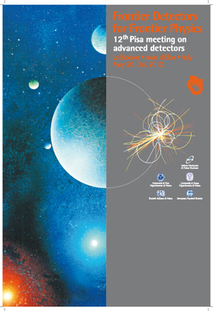
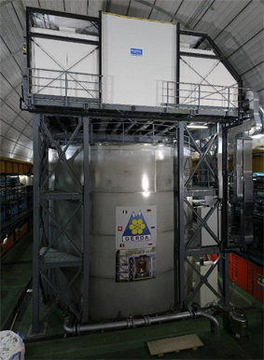
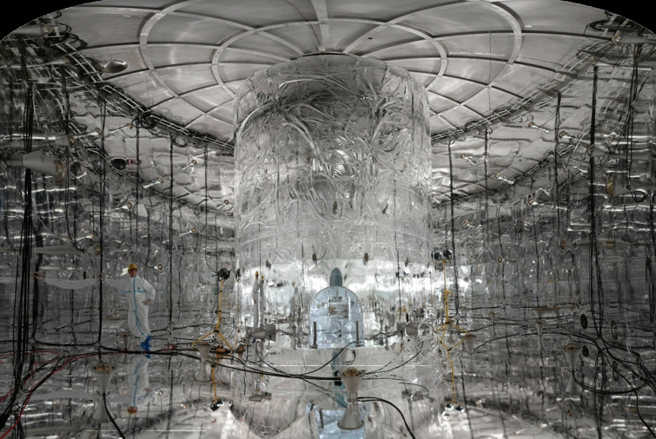
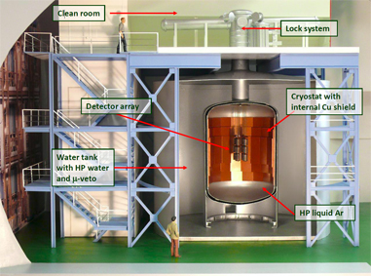
Status Report of the GERDA Experiment Phase I
S. Riboldi on behalf of the GERDA Collaboration (95 Physicists and 17 Institutions from Germany, Italy, Russia, Poland, Belgium, Switzerland, China)
GERDA Experiment - Phase I - is active at INFN LNGS since November 2011,
investigating neutrino-less double beta decay of ⁷⁶Ge, with 4 goals:
prove the Majorana nature by searching for the Oνββ of ⁷⁶Ge with a sensitivity of T_{1/2} >10²⁵ y
probe the neutrino mass at the level of 300 meV in a couple of years of data taking
demonstrate a low radiation level facility with background reduction by 2 orders of magnitude
definitely validate the operation of non-encapsulated Germanium detectors in liquid Argon

Slide 2
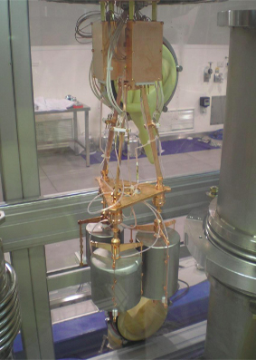
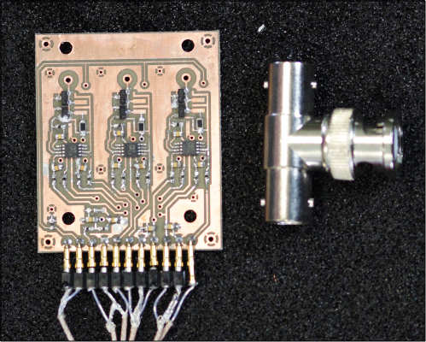
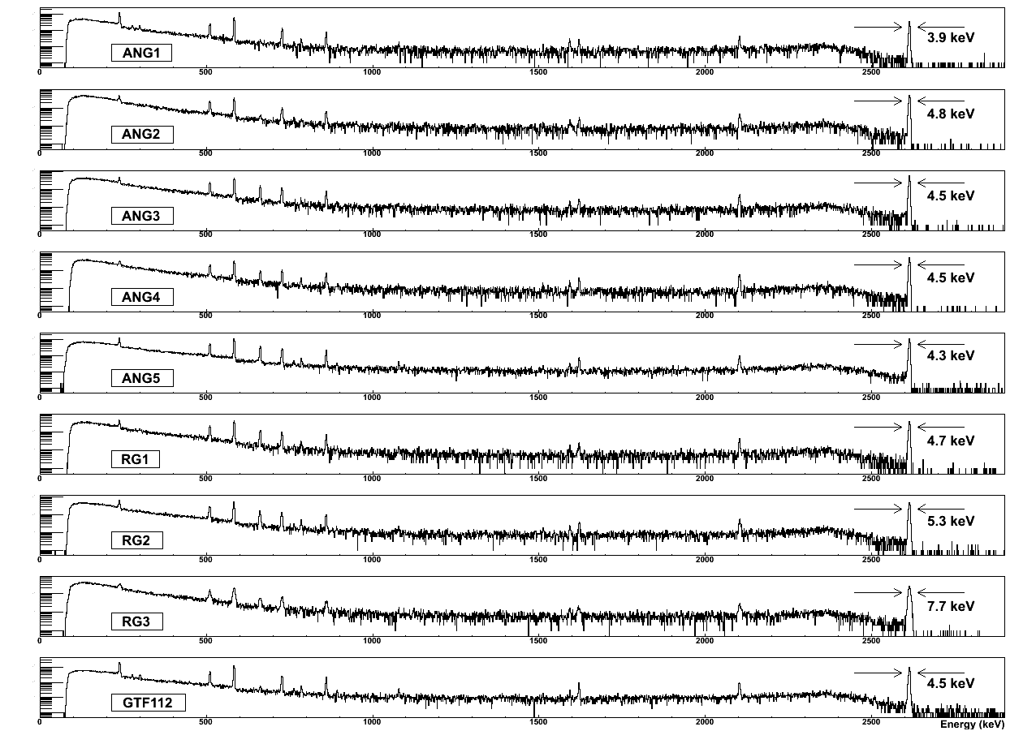
The front-end readout electronics, based on the CC2, a 3-channel, cryogenic charge sensitive preamplifier designed and manufactured to cope with the requirements of the GERDA experiment, including radio-purity.
The 3-string arm inside the GERDA glove box, holding 3 naked Germanium detectors (at the end of the set-up phase there will be 9 in total), to be subsequently lowered in the liquid Argon cryostat.
The naked, enriched Ge detectors operate satisfactory in liquid Argon since months, almost of them providing the expected energy resolution and stability of leakage current. Calibration spectra are shown.
Data taking is in progress…

