Slide 1
Analog Front End
For outer Layers of SVT (L.4 & L.5)
Team: Luca Bombelli Post Doc.
Bayan Nasri Ph.D. Student
Paolo Trigilio Master student
Carlo Fiorini Professor

Slide 2
Table of Contents
ENC estimation of input MOSFET
“Ideal” Shapers noise performances
Proposed architecture of Front End circuit
Charge Pre-Amplifier performances
Shapers implementations
Conclusion and future activities

Slide 3
ENC estimation of input MOSFET
Charge preamplifier
(ideal)
Shaping amplifier
(CR-(RC)² ideal)
Detector
(Cd, Rs)
(NMOS, PMOS)
Considered parameters: Detector parameters:
1 MIP ≈ 27500 electrons
Dynamic range ≈ ±15 MIP
Noise = 1000 electrons
Layer | Rs (Ω) | Cd (pF)
4 | 234 | 52.6
5 | 300 | 67.5

Slide 4
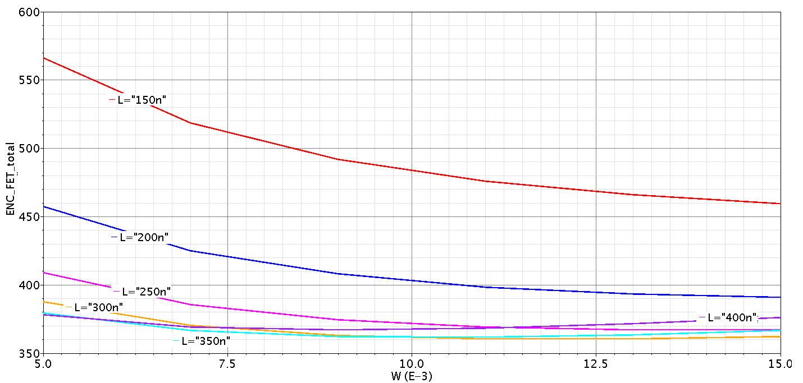
Optimization of input MOSFET
ENC estimation for different sizes of input MOSFET
Example: Layer 5, NMOS, Ibias=500µA, TP=1µs

Slide 5
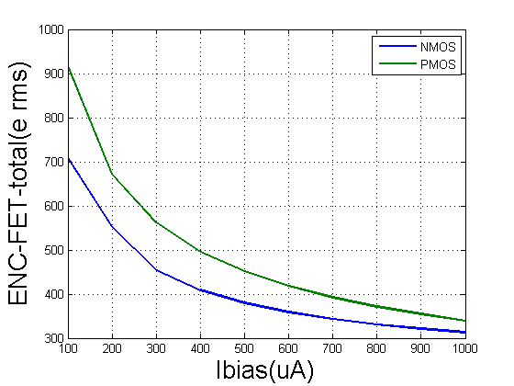
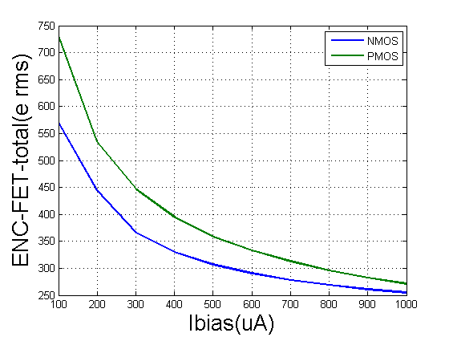
Optimization of input MOSFET current
ENC estimation for different Ibias
Layer 5
TP=1µs
NMOS W=9mm, L=250nm
PMOS W=7mm, L=150mm
ENC estimation for different Ibias
Layer 4
TP=0.5µs
NMOS W=9mm, L=250nm
PMOS W=7mm, L=150mm

Slide 6
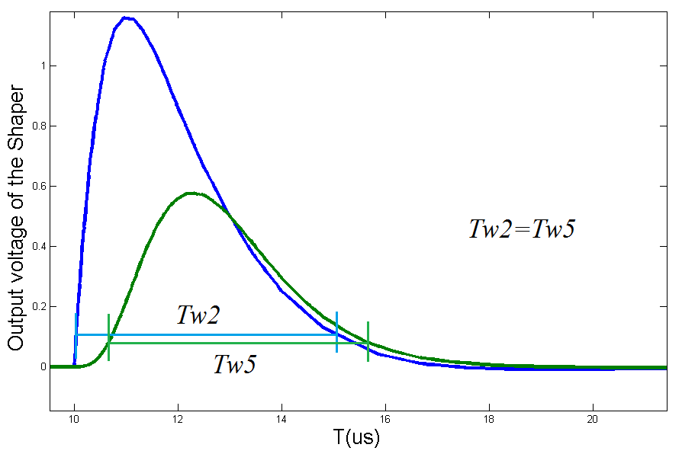
Shaper study
Types of the shaper:
Real-pole shaper
Complex-pole shaper
Compared with the same
detection efficiency
(constant Tw)
Peaking time of the Real shaper
Peaking time of the Complex shaper
2° order
5° order
Order of the Shaper | RU-2 | RU-3 | RU-4 | RU-5 | RU-6 | RU-7 | RU-8 | RU-9
Peaking time(µs) | 1 | 1.47 | 1.92 | 2.26 | 2.57 | 2.83 | 3.11 | 3.32
Order of the Shaper | CU-2 | CU-3 | CU-4 | CU-5 | CU-6 | CU-7 | CU-9
Peaking time(µs) | 1 | 1.65 | 2.15 | 2.54 | 2.87 | 3.15 | 3.62

Slide 7
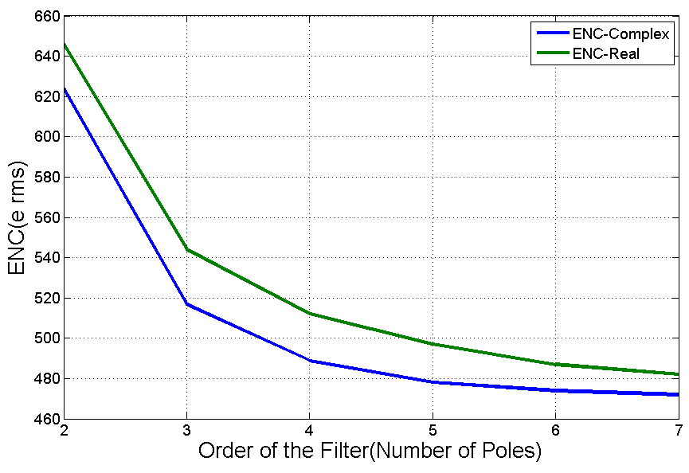
Noise performance of the considered Shapers
Layer 5
NMOS: W=9mm L=250nm
Increasing the order after 5 is not useful.
The performance of both types are quite similar with a small advantage for the complex-pole shaper

Slide 8
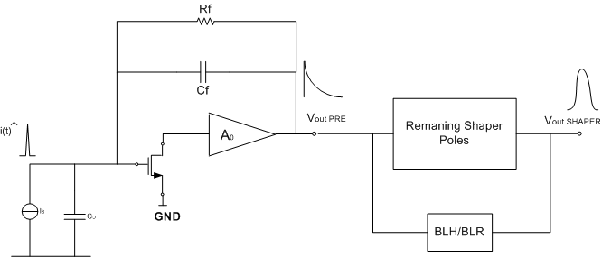
Readout architecture
First pole of the shaper implemented in the preamplifier
Complex or real poles
Advantages:
Simple architecture (area, power)
High sensitivity (1/Cf) in the charge preamplifier (no pile-up at the PRE output)
Leakage current of detector intrinsically discharged
Drawback:
Noise of the Rf

Slide 9
Charge Pre-Amplifier
Types of the preamplifier:
NMOS was selected as input FET
Two charge Pre-amplifier were designed and compared
3-stages amplifiers
Folded-cascode architecture
The results show better performance of 3-stage amplifier
Specification | 3-stage CPA | Folded-cascode CPA
DC gain (dB) | 82.8 | 71
BW (MHz) | 6.95 | 17.5
PM (Deg) | 117 | 103
Rise time (ns) | 28.7 | 17.56
Slew rate (V/µs) | 4.45 | 7.96
Dynamic range (MIP) | 57 | 47
Output voltage peak from DC level (mV) @ 15MIP | 290 | 261

Slide 10
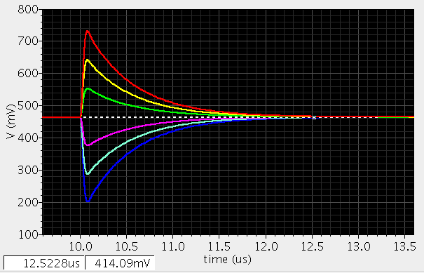
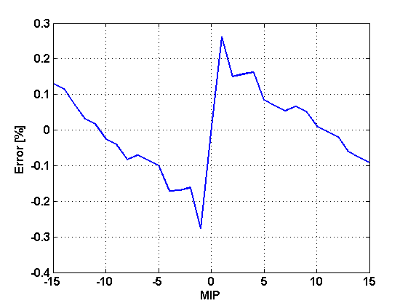
Charge Pre-Amplifier Dynamic Range
+15 MIPs
Cadence simulation of the preamplifier
-15 MIPs
Output of Charge Pre-amplifier in different MIPs
Linearity error of the charge Pre amplifier at the output of the shaper

Slide 11
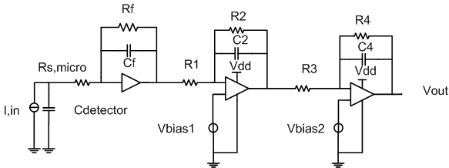
Preliminary shaper architecture : CR – RC²
Very simple implementation of the real-poles
Tentative shaper already designed.

Slide 12
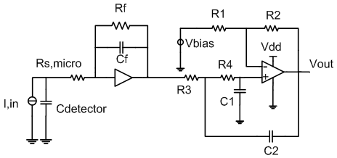
Preliminary implementation of the complex-pole shaper
Implementation of 2 complex-pole with Sallen-key architecture.
Possibility to design a fully differential architecture (currently under evaluation).

Slide 13
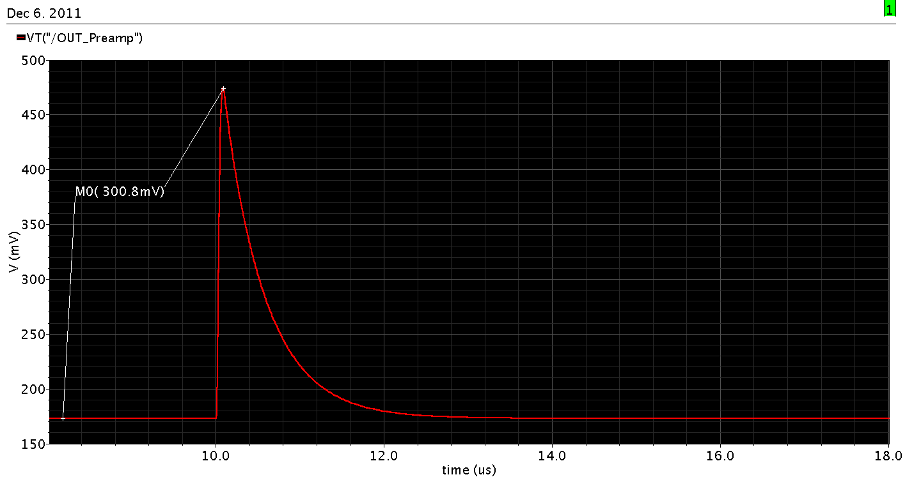
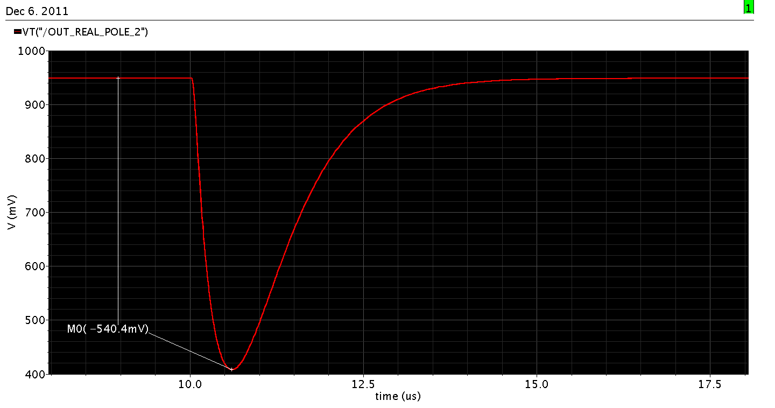
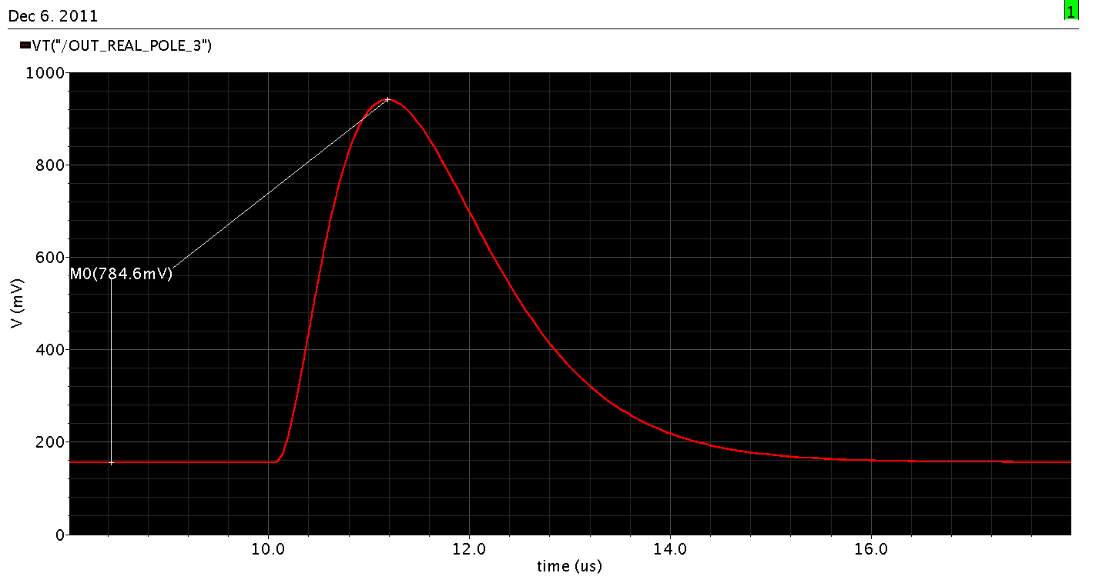
Output preamp L5, 15 MIPs

Slide 14
Power dissipation
Design targets:
1,2 mW/channel
All Triple-well nMOSFET, low-Vt pMOSFET
Keep constant power request Vs. Input signal
PSRR: Shaper Ok, differential amplifier
Preamplifier Sensibility to GND
Current consumption
Input Fet | Charge Pre-amplifier | Shaper | Rest of the circuit
500µA | 140µA | 83µA | NA
Used power: 0.87 mW

Slide 15
Noise evaluation of the circuit
ENC of the different stages. (All values in electrons rms)
 | Peak. time | Strip Rs | Input FET | Charge Pre-amplifier | Rf | Other shaper stages | Total
Layer5 | 1us | 445 | 416 | 181 | 594 | 285 | 915
Layer 4 | 500ns | 471 | 434 | 207 | 611 | 302 | 957
Charge Pre-Amplifier with real-pole shaper

Slide 16
Analog FE efficiency simulation
Layer | CD (pF) | Selected Tp (ns) | Hit rate/stripe (KHz) | Efficiency
4 | 52.6 | 500 | 17.5 | 0.993
5 | 67.5 | 1000 | 11.3 | 0.990
CR – RC² shaping
Efficiency based on BG hit energy distribution
Data from: M. Manghisoni, L. Ratti, C. Stella.

Slide 17
Conclusion and future activities
Refine preamplifier design and define ultimate performances
Choose shaper filter (type, order, differential structure?)
Design final shaper (also including an inversion stage)
Design the remaning blocks (BLR, trim. DACs, ToT, ....)

