Slide 1
Injection System
S. Guiducci
for the Injection Team
2nd SuperB Collaboration Meeting
LNF-INFN, Frascati, 15/12/2011

Slide 2

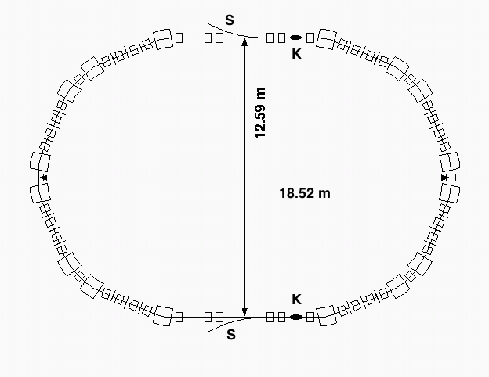
Injection system layout
positron linac
Positron Source
e⁺ Damping Ring
1 GeV e+
L-band
CAPTURE
SECTION
PC
0.6 GeV
SHB
THERMIONIC
GUN
≈ 350 m
e+
Main Linac
BUNCH
COMPRESSOR
5.7 GeV e+ 3.9 GeV e-
POLARIZED
SLAC GUN
50 MeV
CAPTURE
SECTION
0.2 GeV
SHB
e-
combiner
DC dipole
Polarized Electron Source
Transfer lines
Positron Source to Damping Ring
Damping Ring to Main Linac
Electron Source to Main Linac
Main Linac to HER
Main Linac to LER
Details:
“SuperB Progress Reports – Accelerator”, (Dec. 2010) – Chapter 15 http://arxiv.org/abs/1009.6178v3.
“Updated Design of the Italian SuperB Factory Injection System”, IPAC’11

Slide 3
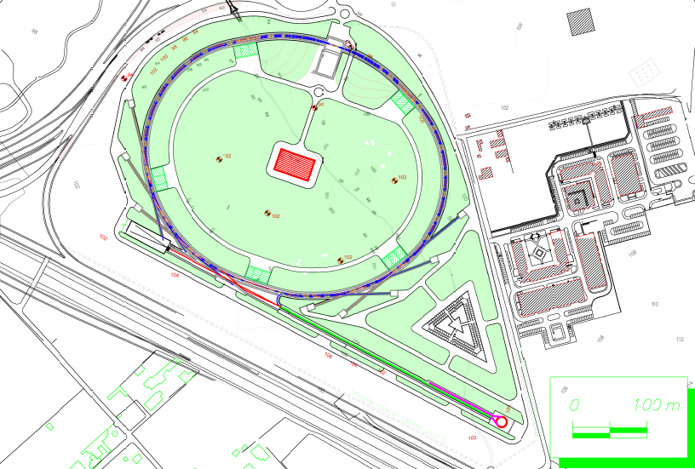
SuperB Layout
Injection complex

Slide 4
Relevant parameters of SuperB
Main Rings for injection
 | e⁻ | e⁺
Energy (GeV) | 4.18 | 6.70
Number of bunches | 978 | 978
Particles/bunch | 6.6x10¹⁰ | 5.1x10¹⁰
Charge/bunch (nC) | 10.6 | 8.2
Horizontal emittance (nm) | 2.5 | 2.0
Vertical emittance (pm) | 6.2 | 5.0
Relative energy spread | 7.3x10⁻⁴ | 6.4x10⁻⁴
Lifetime (s) | 269 | 254
Polarization | ≈80% | 0

Slide 5
Charge per Bunch Required at injection
Assuming 50 Hz continuous injection in a single bunch,
each one of the 978 bunches will be refilled after Δ t = 20 s, with a number of particles
The average relative loss will be the half
Since the luminosity is proportional to the square of the bunch current the average luminosity loss with respect to the peak value will be
Injecting in the main rings few bunches per pulse with 4 ns bunch spacing, say 5, we can keep the peak luminosity reduction within 2% and reduce the number of injected positrons per bunch below 1x10⁹

Slide 6
Charge per Bunch Required at injection
To restore the luminosity the charge/bunch required for injection (1 bunch/pulse, 50 Hz) is:
LER 0.79 nC HER 0.65 nC
To inject from scratch it is needed a higher rate, for example 2 bunches with the same charge
Which is the safety factor needed on this number?
And on the beam lifetime value?

Slide 7
Injection to SuperB, HER
D. Shatilov, M. Zobov, S. Guiducci
Parameters of the stored and injected beams at the injection point
β_{x} (st / inj) (m) | 270 / 120 | Horizontal beta-function
β_{y} (st / inj) (m) | 28 / 28 | Vertical beta-function
η_{x} (st / inj) (m) | 0.63 / 0.63 | Horizontal dispersion
ε_{x} (st / inj) (m) | (2.0 / 4.1)·10⁻⁹ | Horizontal emittance
ε_{y} (st / inj) (m) | 5.0·10⁻¹² / 7.2·10⁻¹⁰ | Vertical emittance
σ_{z} (st / inj) (m) | 0.005 / 0.00054 | Bunch length
σ_{E} (st / inj) | (6.43 / 8.0)·10⁻⁴ | Energy spread
d (x / y / z) (turns) | 6370 / 6370 / 3185 | Damping decrements
Δ_{x} (m) | 8.04·10⁻³ | Injected bunch’s X-shift
δ_{E} | 3.0·10⁻³ | Injected bunch’s energy shift

Slide 8
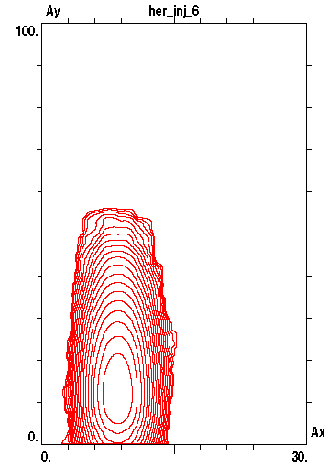
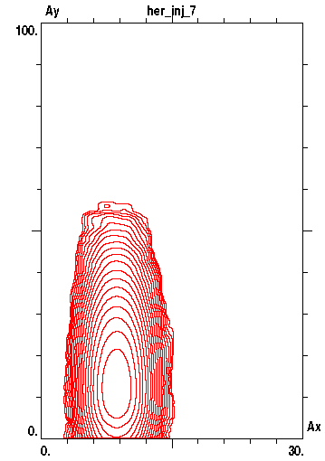

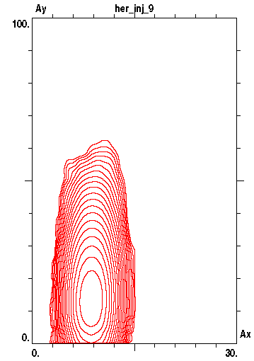
Contour plots of the injected beam distribution in the plane of normalized betatron amplitudes. 10⁵ particles were tracked, and their coordinates over 100 consecutive turns were collected to build the distribution.
Average over (1 ÷ 100) turns
No beam-beam Crab = 1 Crab = 0.5 Crab = 0

Slide 9
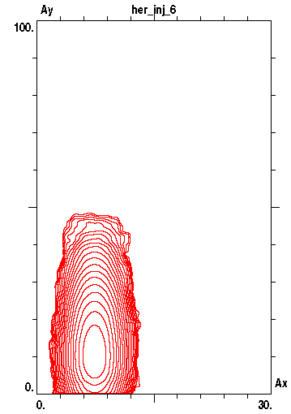
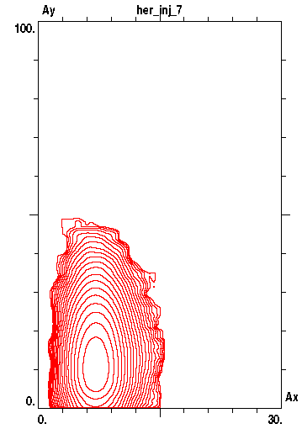
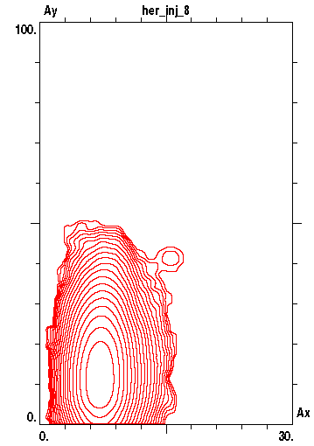
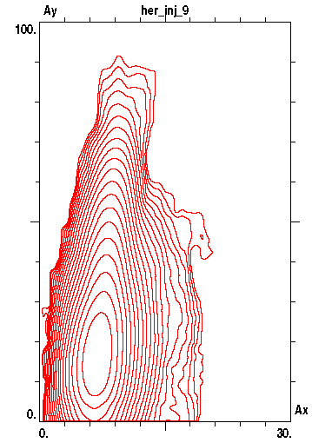
Average over (1001 ÷ 1100) turns
No beam-beam Crab = 1 Crab = 0.5 Crab = 0

Slide 10
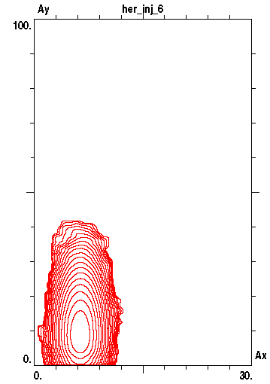
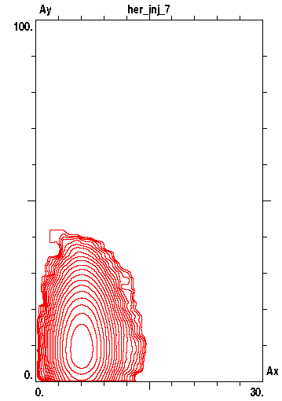
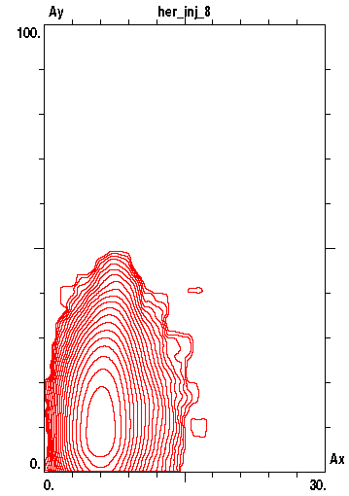
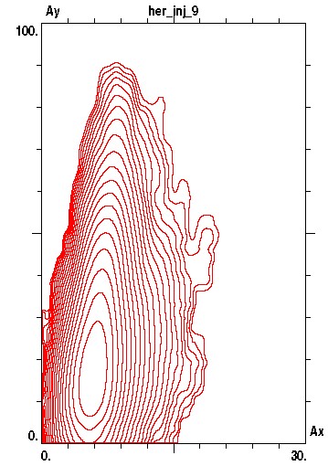
Average over (2001 ÷ 2100) turns
No beam-beam Crab = 1 Crab = 0.5 Crab = 0

Slide 11
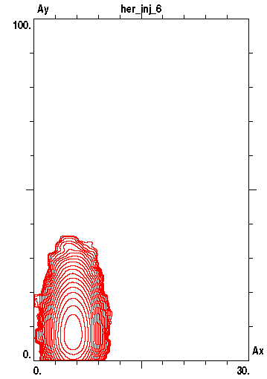
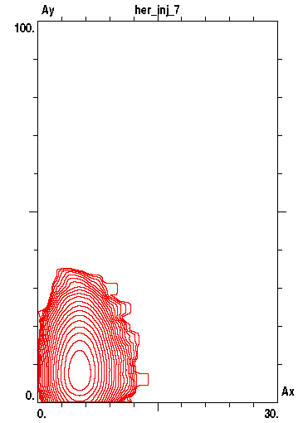
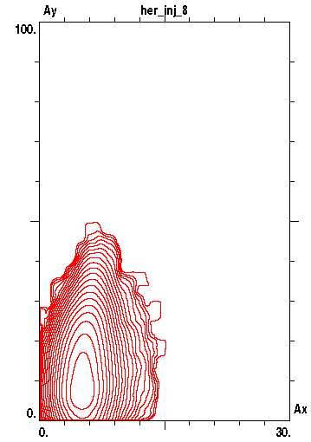
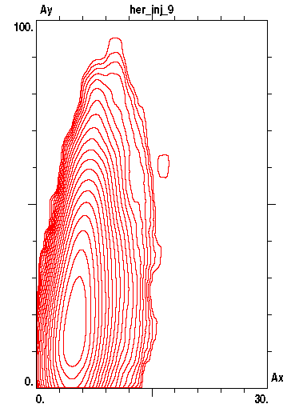
Average over (3001 ÷ 3100) turns
No beam-beam Crab = 1 Crab = 0.5 Crab = 0

Slide 12
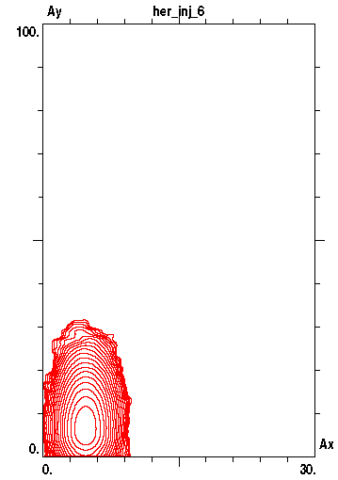
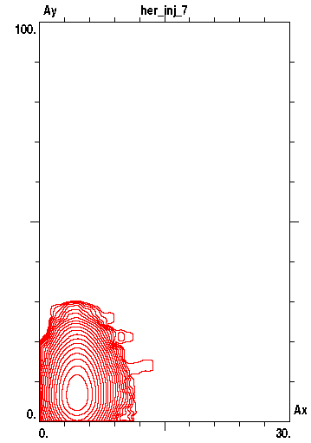
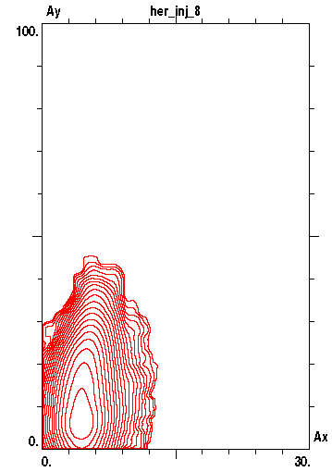
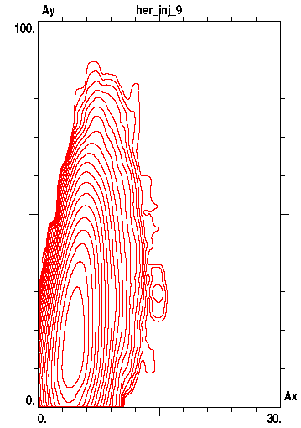
Average over (4001 ÷ 4100) turns
No beam-beam Crab = 1 Crab = 0.5 Crab = 0

Slide 13
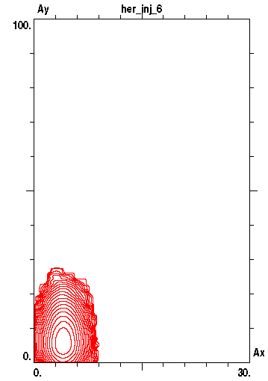
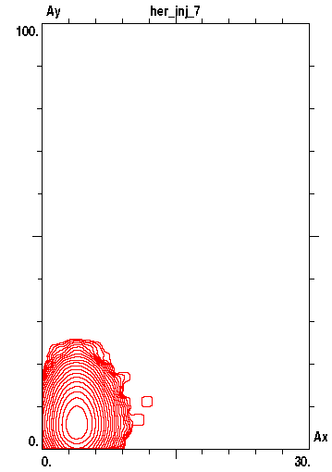
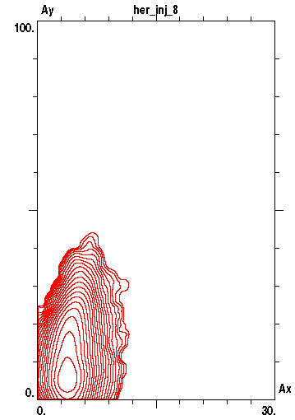
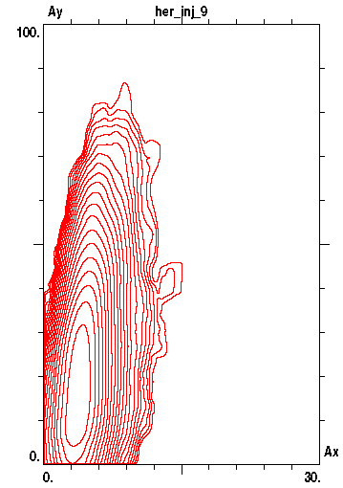
Average over (5001 ÷ 5100) turns
No beam-beam Crab = 1 Crab = 0.5 Crab = 0

Slide 14
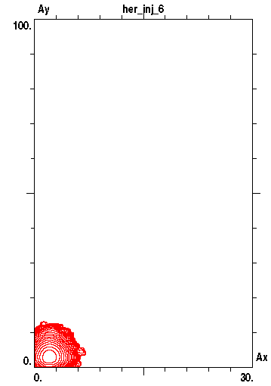
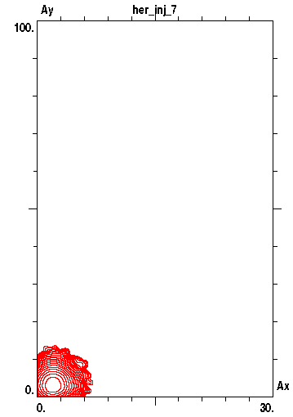
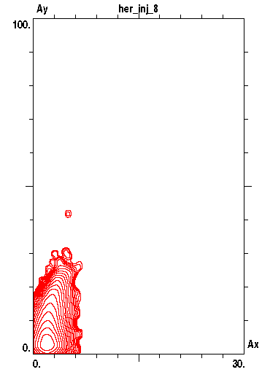
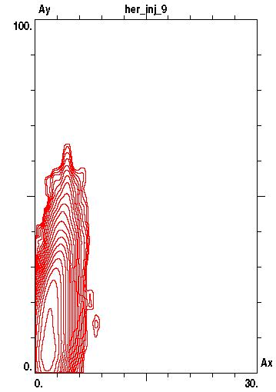
Average over (10001 ÷ 10100) turns
No beam-beam Crab = 1 Crab = 0.5 Crab = 0

Slide 15
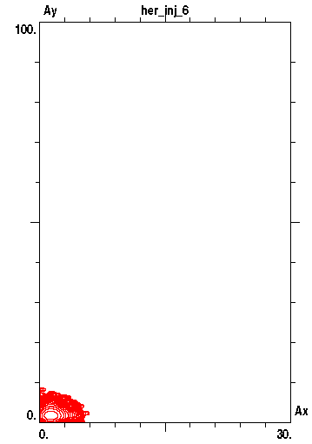

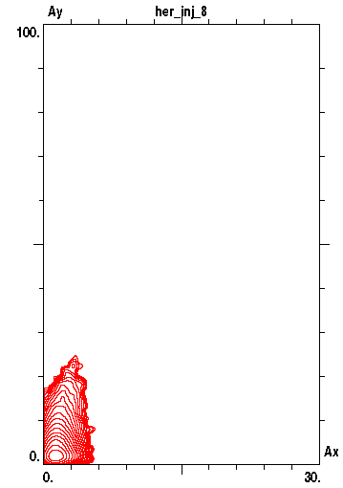
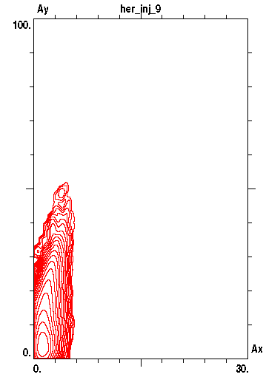
Average over (15001 ÷ 15100) turns
No beam-beam Crab = 1 Crab = 0.5 Crab = 0

Slide 16
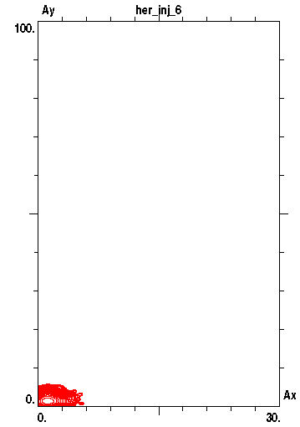
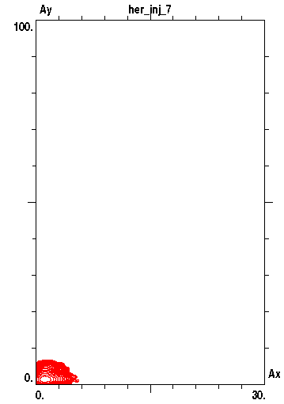
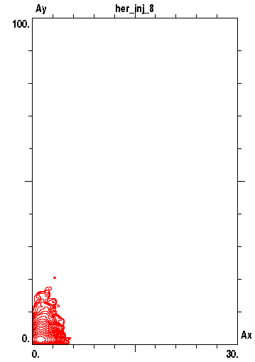
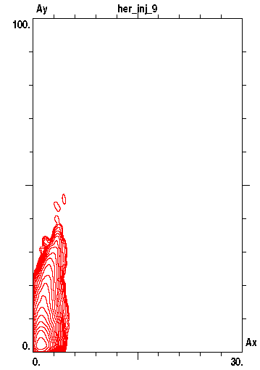
~ 3 τ_{x}
Average over (20001 ÷ 20100) turns
No beam-beam Crab = 1 Crab = 0.5 Crab = 0

Slide 17


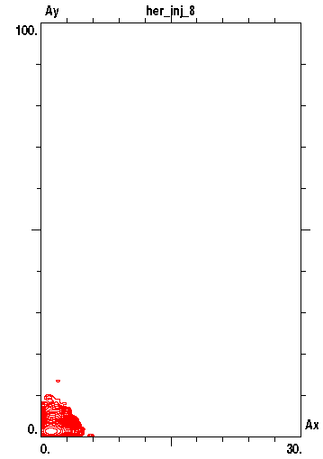
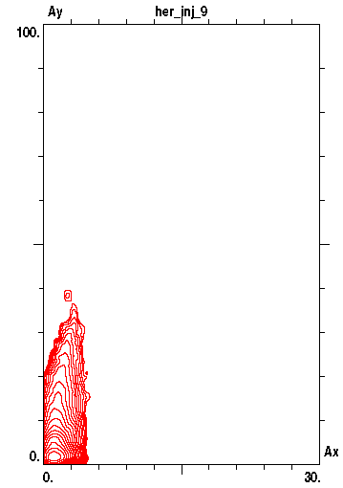
Average over (25001 ÷ 25100) turns
No beam-beam Crab = 1 Crab = 0.5 Crab = 0

Slide 18



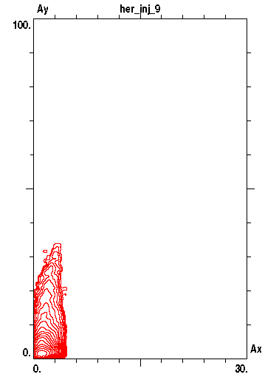
Average over (30001 ÷ 30100) turns
No beam-beam Crab = 1 Crab = 0.5 Crab = 0

Slide 19
Emittance Evolution after Injection
CW off
CW on

Slide 20
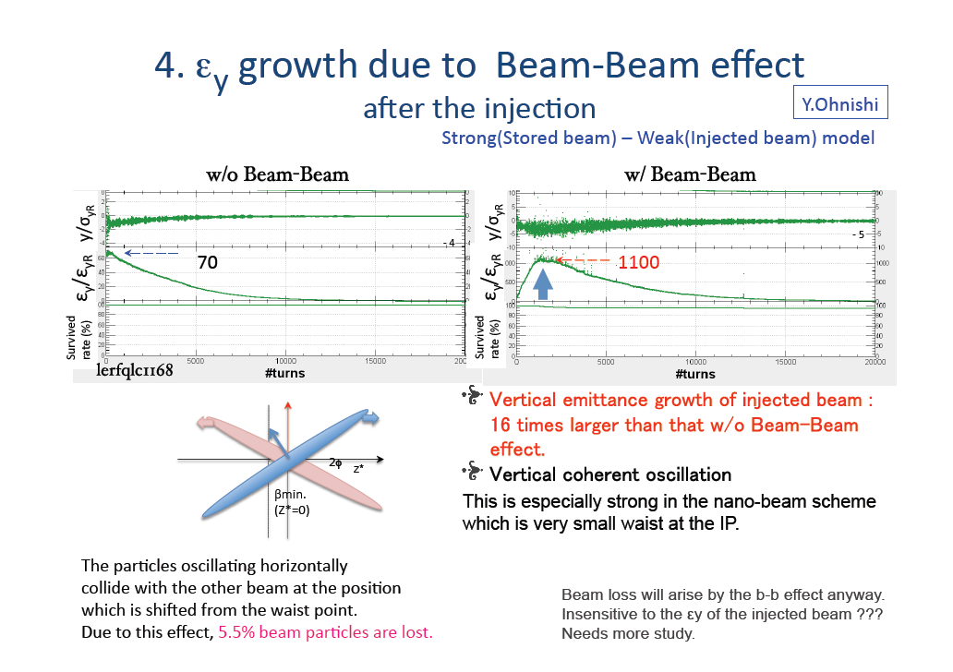
SuperKEKB

Slide 21
Positron Source
LAL group has studied different solutions and has proposed a high efficiency conversion system, consisting of an adiabatic capture system and an L-band linac
In this proposal, e+/e- conversion takes place at 600 MeV
Status will be discussed in Alessandro Variola’s presentation

Slide 22
Damping Ring
Ready for TDR
Parameters and lattice defined
Very good dynamic aperture (errors still to be included)
A_{x} = x_{max}²/β_{x}= 1 10⁻⁴ m
at ΔE/E = ± 2%
Injection acceptance including 99% of the positrons
A_{x} = x_{max}²/β_{x}= 1 10⁻⁵ m
ΔE/E = 1.5 10⁻²
Effects of CSR instability evaluated (Demin Zhou’s talk)
Touscheck effect evaluated (Theo Demma’s talk)
Preliminary tracking of a positron distribution trough the transfer line and for 100 turns in the DR (Sophie Cavalier)

Slide 23
Polarized electron source
A design choice is needed: electrons injection with/without passing through the DR
Is it possible to produce and accelerate to 4.18 GeV polarized electrons with ~ 1 nC charge, low emittance and small energy spread?
Very preliminary beam dynamics study
Further checks are needed:
  Very important to define the charge and bunch length needed/feasible at gun exit

Slide 24
SuperB, electron Source Proposal
A.Bacci - A.R.Rossi
Tracking of one bunch:
@ GaAs Cathode - Laser 860 nm
Q= 160 pC ; Sig_X_laser=1.27 mm; Flat-top = 20 psec; Thermal_emit,n=0.415 mm-rad
Very preliminary layout:
-DC gun (Jlab type) Energy exit at 100keV
- I SubHBuncher&boost (Ep=3.4MV/m), Energy exit at 560 keV
II SubHBuncher&boost (Ep=3.4MV/m), Energy exit at 890 keV
- L-Band cavity SW Pitz type (VBunching) (Ep=8MV/m), Energy exit at 6.2 MeV
S-Band cavity (ligth VB and Boost, Ep=14.2 MV/m), Energy exit at 37 MeV
64 S-Band cavity, ~25MeV/m from 37 MeV up to 4.23 GeV
- X-band TW cavity (120 Cells ~ 1 m length), E_spread correction, Energy exit at 4.183MeV

Slide 25
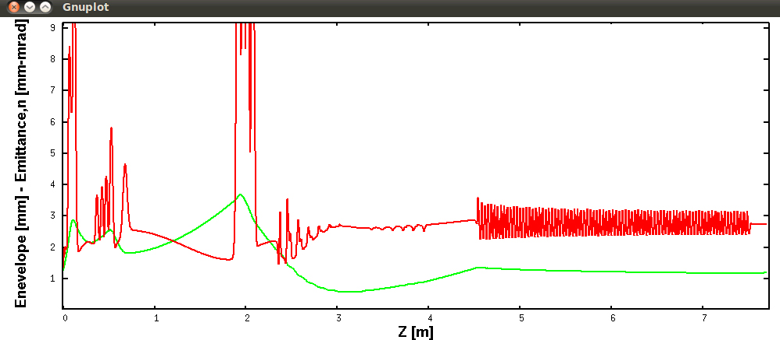
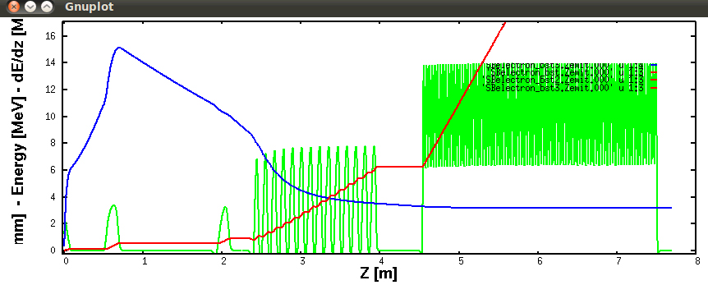
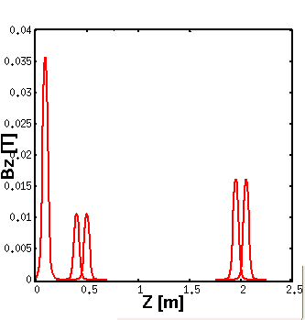
Injector Dynamics
Values @ 7.8 m:
σ_{x}= 1.2 mm
ε_{x}= 2.8 mm
Values @ 7.8 m:
σ_{z}= 3.1 mm
E= 37 MeV
E_{z} [MV/m]
B_{z} [T], B_{paek}= 0.035 [T]

Slide 26
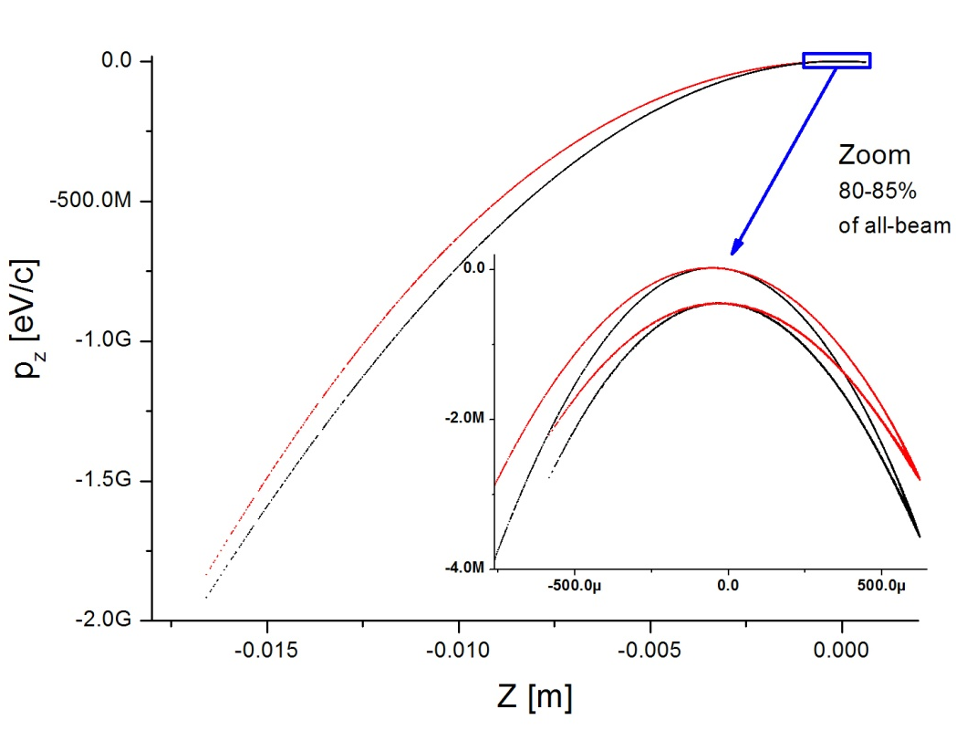
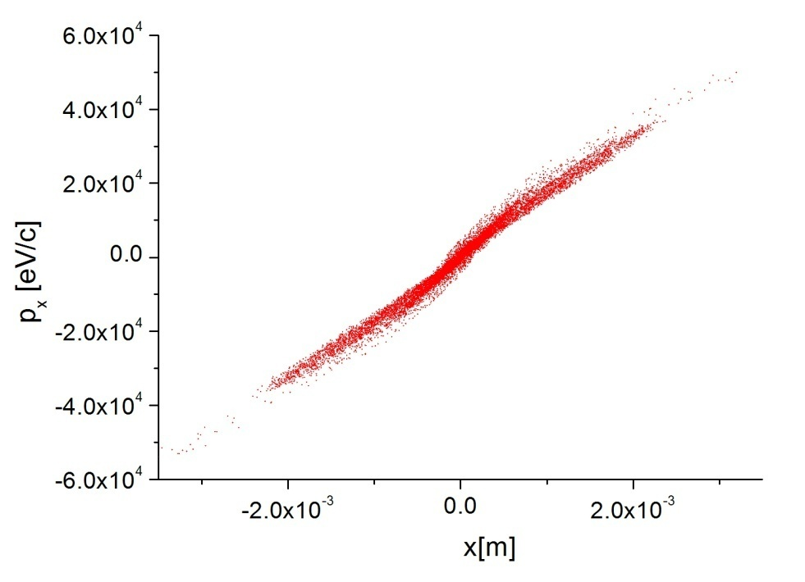
Bunch at Linac Exit
Longitudinal Space Phase:
In red – X-band E_spread correction
In black – No E_spread correction
Transversal Space Phase:
X-band correction case (the distribution for the NO Correction case is equal)

Slide 27
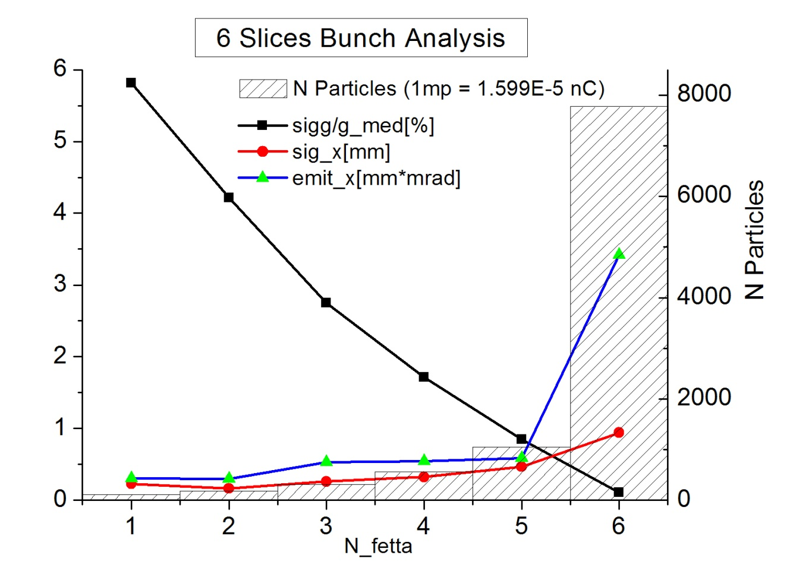
Bunch at Linac Exit – Slice analysis
Slice N. 6
80% of the charge
Q = 125 pC
Normalized emittance
ε_{x}= ε_{y}= 3.4 mm mrad
Relative energy spread
σ_{γ}/γ = 1.1e-3
Requirements
5 bunches, Q = 130 pC
Normalized emittances
ε_{x}= 45 mm mrad
ε_{y}= 6 mm mrad
Relative energy spread
σ_{γ}/γ = 1.3e-3
X-band @ linac exit:
On σ_{γ}/γ = 1.06e-3 (Energy variation from 4.24 to 4.18 GeV)
Off σ_{γ}/γ = 1.40e-3 (Energy 4.18 GeV)

Slide 28
Main Linac
S-band linac
  e⁺ from 1 to 6.7 GeV
  e⁻ from 0.2 to 4.2 GeV
RF layout defined
A focusing system suitable for both beams has been calculated at a gradient of 15 MeV/m: redo at 23 MeV/m
Evaluate beam dynamics effects with 5 bunches at 4 ns distance
Ready for TDR

Slide 29
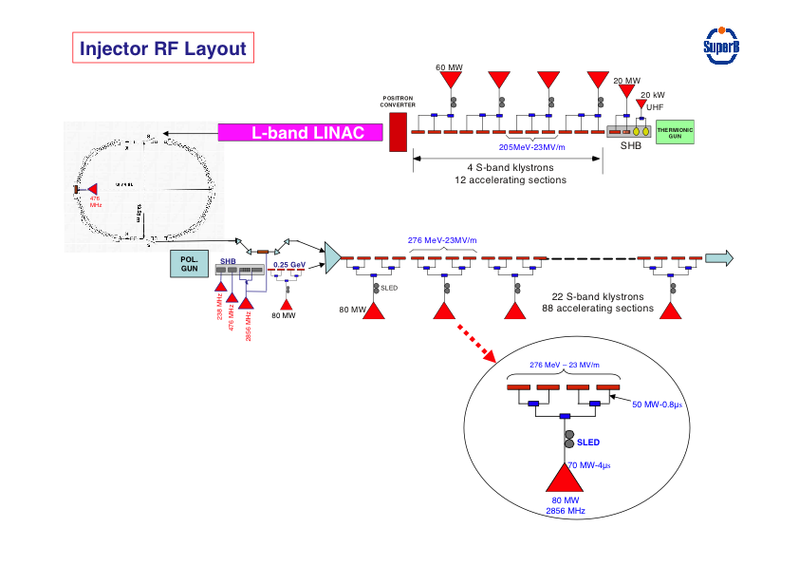

Slide 30
Distribution of the high-energy linac RF power
1
nk
P_{k} = klystron RF power in MW
n_{sk} = acc. sections per klystron
U = acc. gradient in MV/m
E_{k} = energy gain per klystron in MeV
n_{k} = tot. number of klystrons
n_{sT} = tot. number of acc sections
E_{T} = total energy in MeV
E_{T-1} = energy with 1 klystron OFF
Pk
Pk
X
SLED
X
SLED
U,
nsk, Ek
U,
nsk, Ek
ET-1(MeV) ≈ 17.3 (nk-1).(0.8.Pk.nsk)^{1/2}
with 0.8 = power derating factor
(RF wg losses + kly power margin)
P_{k} | n_{sk} | U | E_{k} | nk | n_{sT} | E_{T} | E_{T-1}
50 | 2 | ≤ 25(*) | 150 | 39 | 78 | 5850 | 5700
60 | 3 | 23 | 207.5 | 29 | 87 | 6020 | 5813
60 | 4 | 20 | 240 | 24 | 96 | 5992 | 5753
80 | 3 | ≤ 25(*) | 225 | 27 | 81 | 6075 | 5850
80 | 4 | 23 | 276.5 | 22 | 84 | 6083 | 5810
Cost = 100 (°)
(°) arbitrary unit
Cost ≈ 75
(*) limited to 25 MV/m

Slide 31
Injector approximate size
positron linac
1 GeV e+
L-band
CAPTURE
SECTION
PC
0.6 GeV
SHB
THERMIONIC
GUN
≈ 170 m
≈ 350 m
e+
BUNCH
COMPRESSOR
5.7 GeV e+ 3.9 GeV e-
POLARIZED
SLAC GUN
50 MeV
CAPTURE
SECTION
0.2 GeV
≈ 300 m
SHB
e-
≈ 50 m
combiner
DC dipole

Slide 32
Transfer lines
Positron Source to Damping Ring
X
No kickers and septa
X
Damping Ring to Main Linac
A. Chancé
Positron Source to Damping Ring CDR Design ok
Damping Ring to Main Linac simulation to check bunch compressor
Electron Source to Main Linac very simple
Main Linac to HER Modify CDR design; simpler, no vertical dog-leg
Main Linac to LER

Slide 33
Injection Complex
Present status
  Parameters and site layout selected
  Layout and parameters of the system components defined
  Beam dynamics evaluation started
Remaining work:
  Baseline decision on electron source: direct injection or damping ring
  Baseline decision on positron source: conversion at low energy (.6 GeV), L-band linac for capture and acceleration up to 1 GeV (or a combination of S and L band)
  Transfer lines layout and composition follows
Systems ready for TDR
  Damping ring
  Main linac
Start working on WBS

