Slide 1
SuperB Integration
Summary of the Integration Status
SuperB Experimental hall.
Detectors interfaces and problems
Questionnaire.
Conclusions

Slide 2
Summary of the status of superB Integration
-We decided the architecture of the experimental area.
The interaction region must be independent from the assembly area. Most of activity are localized in the exp. area, like detector preparation, commissioning etc.
We would like to have the access to the experimental area directly from outside. We consider to have to two access ramps.
Some implications:
we have to move all detectors including some services from the assembly to interaction area.
The SVT and the layer0 and beam pipe can be installed in interaction region.
We need a structure supporting the MDI during the acceleration commissioning.

Slide 3
Summary of the status of superB Integration
We need to have an interaction with the machine people to understand:
a)The machine equipment near to the detector.
b)The position of the beam and tunnel respect to the ground level.
c)The amount of required shielding between the interaction and the assembly area.
d) Specification on the position and stability accuracy of the detector.
A better understanding of the detectors requirements in term of services, will add specification to the experimental area.
To gathering all the information we start circulating a questionnaire to all people involved of detector.
Only the IFR detector answer to the questionnaire.
This include also: Describe other requirements that have an impact of the space available like auxiliary equipment, minimum space for accessibility, etc
Describe other requirements that have an impact of the space available like space for the commissioning operations and assembly.

Slide 4
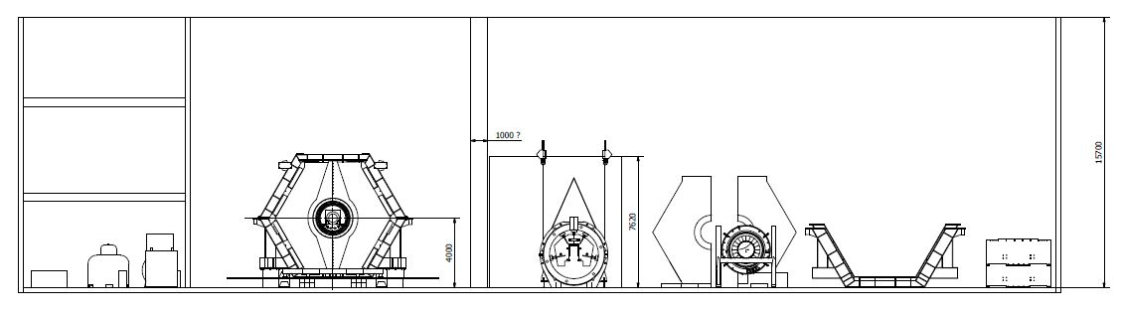
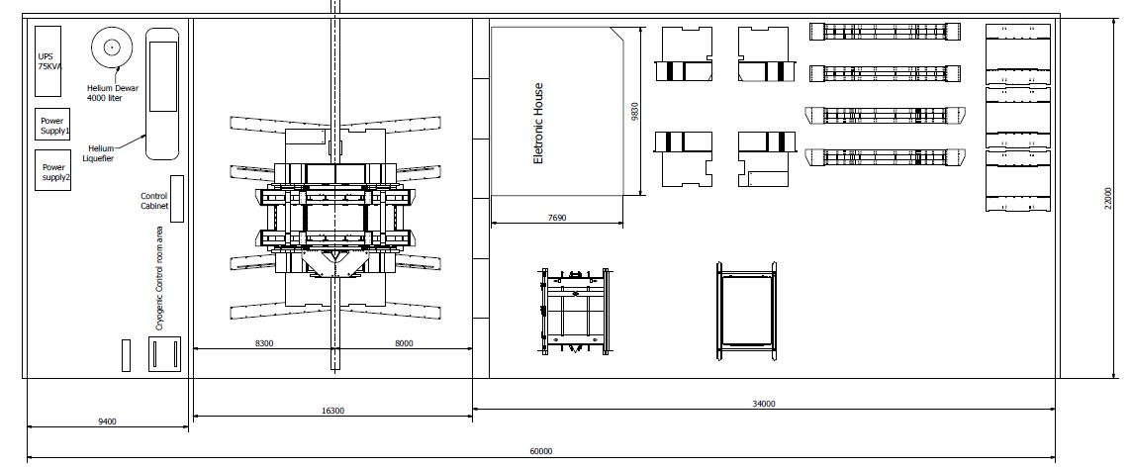
SuperB Experimental hall dimension are derived by the previous experience still service need to be optimized in term of positioning and modularity.
Shielding in its final position
Which can be its position during acc.
commissioning ?

Slide 5
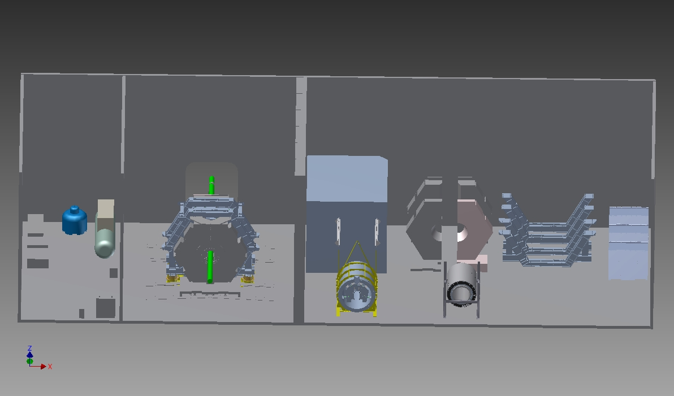

Slide 6
General considerations on the experimental hall:
The design actual Babar hall was driven by an exiting building structure. Floor plan about 38mX22m.
The actual space in the interaction area does not allow an easy access to the detector for maintenances.
The doors can not clear complete the central part of the detector IFR.
The new inner tracker + machine interface will require maybe more longitudinal space for extraction.
The door sliding system must be redone. We have to include a central stops to protect the beam line and an large travel to clear IFR complete.
The position of the beam axis respected to the floor should be 3.5 m + .5m + the increase of the steel size.
The increase of high of the beam axis respects to the floor is going to facilitate the positioning of doors and service passages on the bottom.
The overhead crane hook high was 34.10’ ( 10.39meter). It was not comfortable for assembly the detector. We need to increase up .5 meter or more.
The position of the compressors for the helium serving the Magnet were far away.
This implied that the control of the helium level in the magnet was difficult and the power loss in the transfer line was 160 watt while the power consumption of magnet in only 40 watt. We provide a room closer to the SuperB detector with a independent access to overcame to these problems.

Slide 7
Summary of status of SuperB integration
We must have a converging processes to technical solutions:
IFR Mechanic which solution is going to take to increase the material ? It is going to increase the size? We have to check the compatibly with the rest of detector.
SM Superconducting magnet strategy to transport, to verify the performance (small Leak, restraining the cold mass and the shield).
DIRC The transportation on airplane will be possible ? we have concern on its mechanical integrity.
FDIRC Review the shielding for better access.
EMC We must have a strategy to decided how to transport the EMC.
We have to start analyzing the mechanical structure to understand how strong it is. Furthermore we have to understand how has been maintained its integrity in time to be able to find the weak point and make the transport decision.
DCH the design is in progress a drawing to verify the integration issues can be gathered. The actual drawing it is compatible with the assembly tooling ?
The supported attachment are implemented ? The electronic position and its size need to be verified.

Slide 8
Summary of status of SuperB integration
SVT Problems of integration with MDI (This is integrated with the beam pipe), supporting, maintenance and service. Which it is the current idea ? (supporting everything from a structure connected to the ground ?
Layer0 it is integrate with the beam pipe.
The level of integration of SVT Layer 0 and MDI due to a limited space available must be analyzed in detail in all phases (assembly , commissioning, maintenance, etc)
Doors they should be remade or modified ?

Slide 9
Review of the mechanical interfaces
Coordinate reference system and survey are general issue for all parts.
Whole detector.
IRF versus superconducting solenoid.
Super conducting solenoid to EMC.
EMC to DIRC.
DHC to SVT
SVT to machine interface.

Slide 10
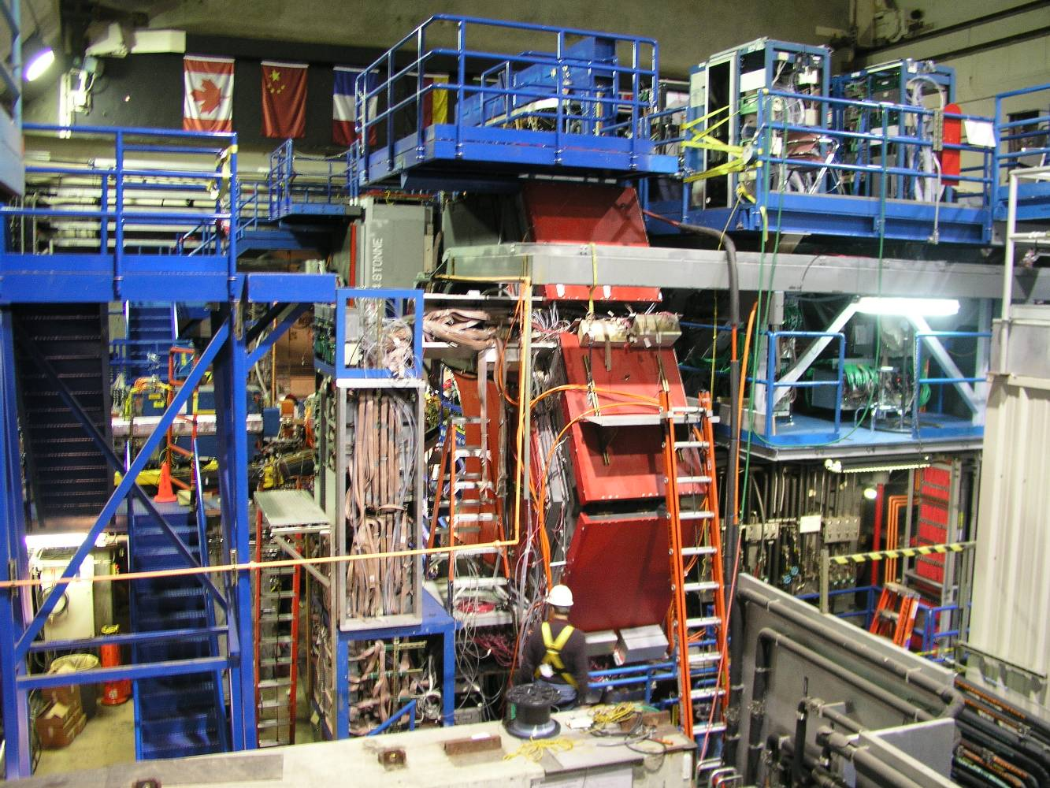
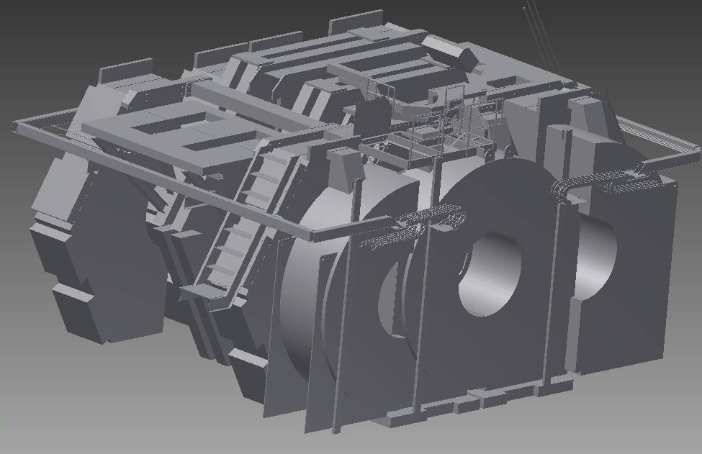
Whole detector
The interface with whole detector are the assembly and interaction halls.
Soon we must define the envelope and total weight of all SuperB detector.
The contact of SuperB detector with the hall is thru the rolling system and the supporting feet. The strategy on positioning can be: we assembly the superB in a lower position on a roller and we raise in the interaction area setting it in his final position. The SVT and layer00 and MDI can be mounted in the interaction area.
The Interaction of the detector with the acceleration is very important because we carry some machine interfaces that requires additional requirements in term of precision, mechanical stability may be more stringent of the detector itself and additional services.

Slide 11
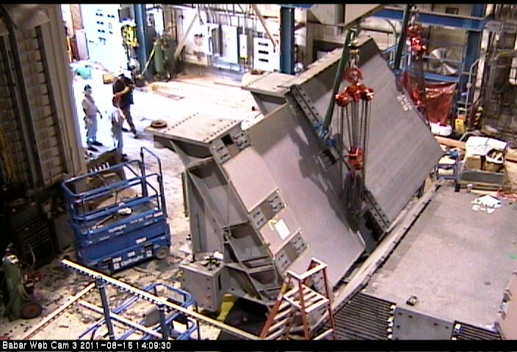
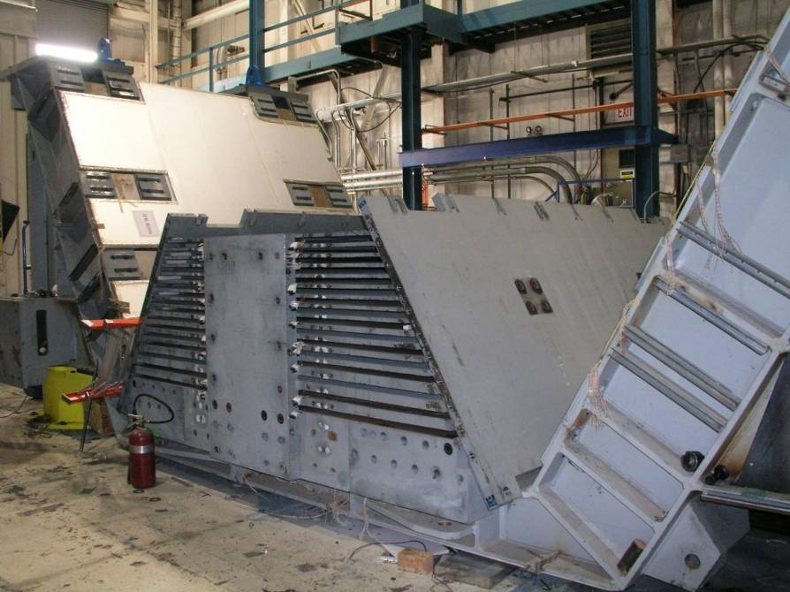
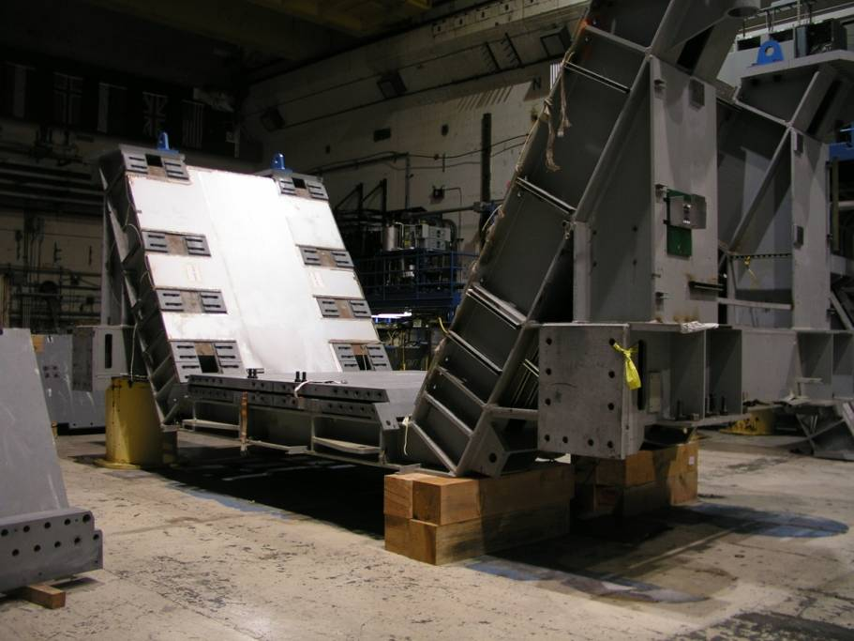
Gaps measurements are critical for detector design.
Survey have been done before dismount the sextant.
No precision parts are present. The assembly has been preformed using shimming packs.
There are Lifting tooling and documentation.
We have to remember that also the top arches are joint together their weight is about 35 Ton
Not in the solid model

Slide 12
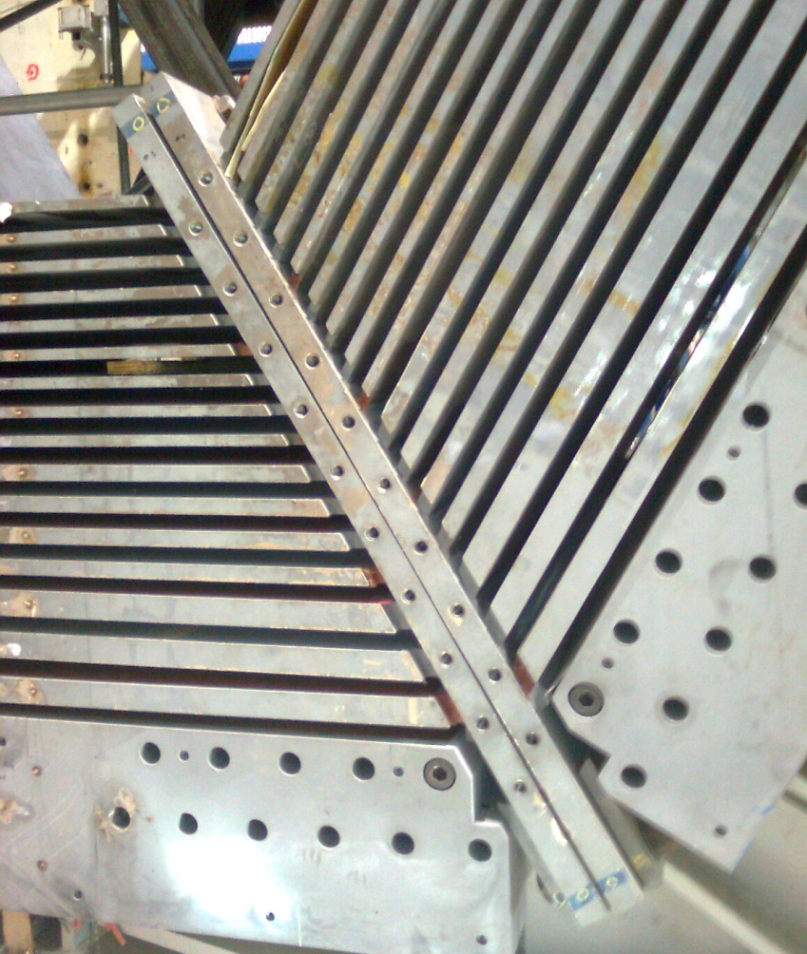
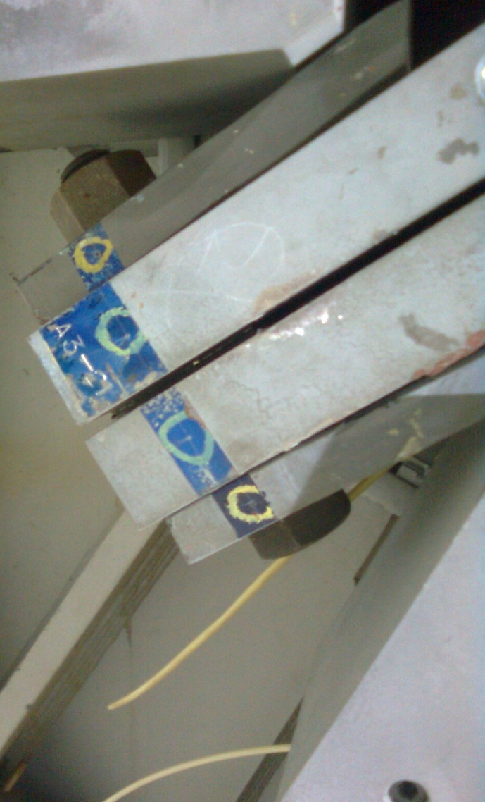
Survey
XYZ of each point respect the a coordinate system

Slide 13
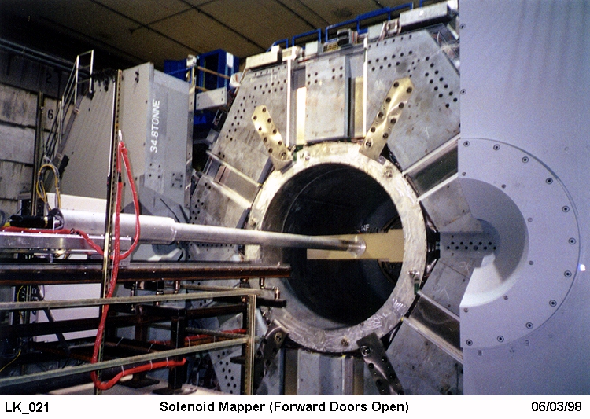
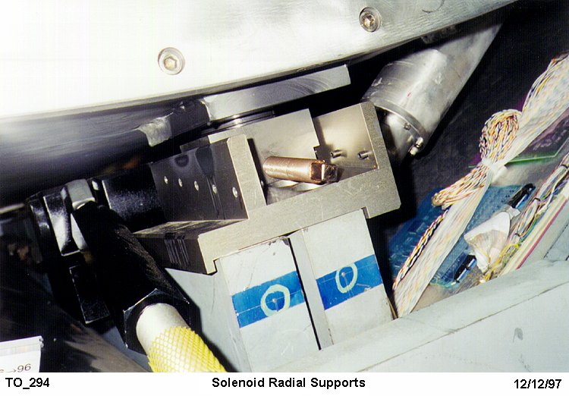
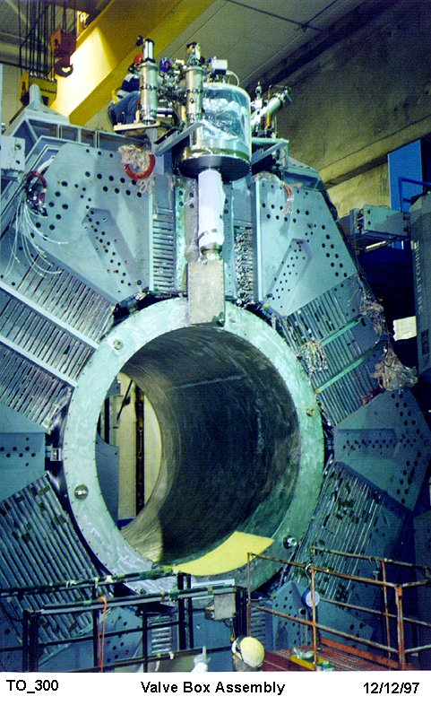
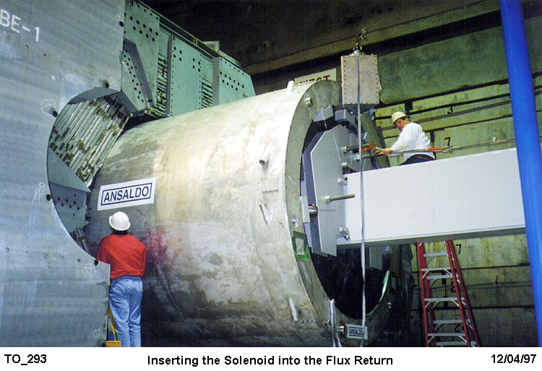
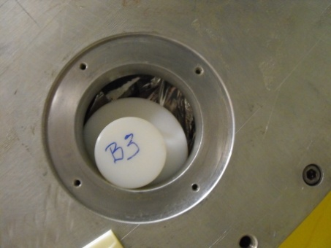
IFR versus superconducting solenoid
No survey has been done before dismount it documentation on the operation are present. Tooling and transportation cradle are available.
Restrain of the cold mass must be done before transportation.
Planning on acceptance test, etc
Scenario: test outside the IFR 1/3 of power installation with all cryo parts attached ?
Top cryo

Slide 14
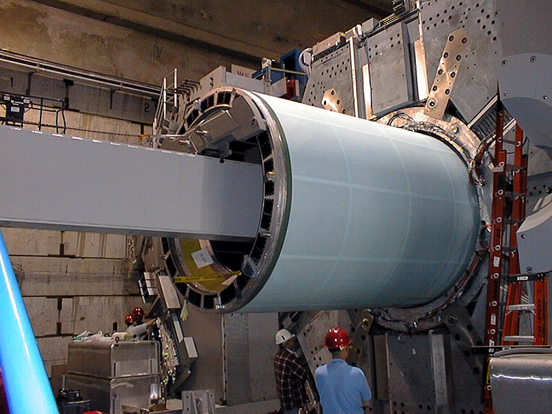
Super conducting solenoid to EMG
Connection IFR To EMC
Adjustment are build on the connection
Transportation problems must be address.
Allowable Temperature and accelerations.
Tooling for mounting and demounting
A cradle

Slide 15
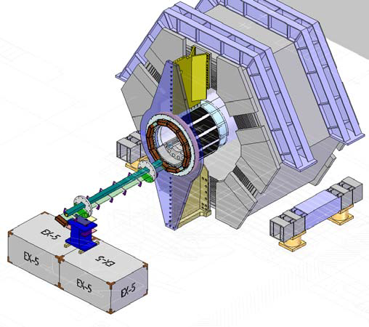
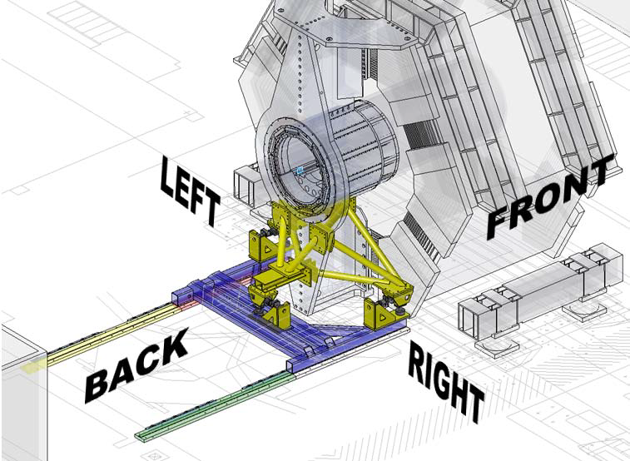
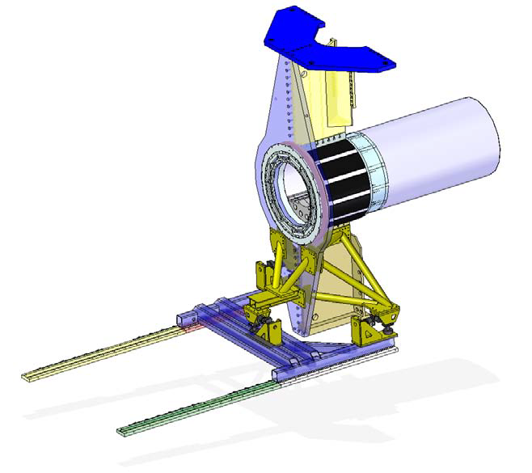
EMG to DIRCH PID
Barbox insertions

Slide 16
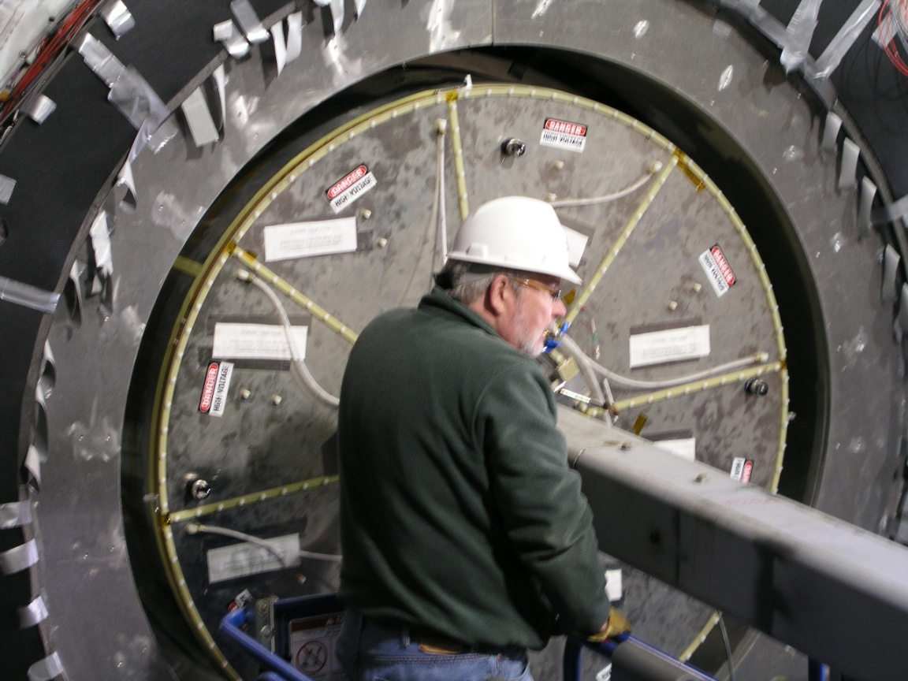
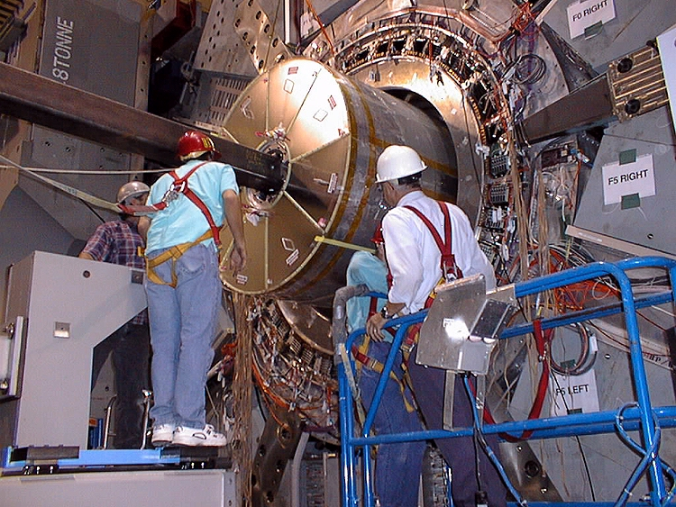
DIRC to DCH
A new chamber could have the same interface with the EMC, if this is satisfactory.
Drawing documentation of the support system are not available, but It not crucial because we can have access to it. His inner radius must be verified with the evolution of design of the SVT, layer00 and MDI.
DCH supports

Slide 17
DHC to SVT
This interface must be reconsidered as the chamber envelope is going to be set.
Since the DHC and SVT are going to be designed and are going to integrate the tungsten shielding and magnets for the machine.
The design of the wire chamber needs to be remade because its inner radius has been changed to 490mm.
SVT to machine interface
The beam pipe and the layer0 are integrated.
Engineering study allowing an easy maintenance on layer0 are required.
General supporting strategy need to be developed.

Slide 18
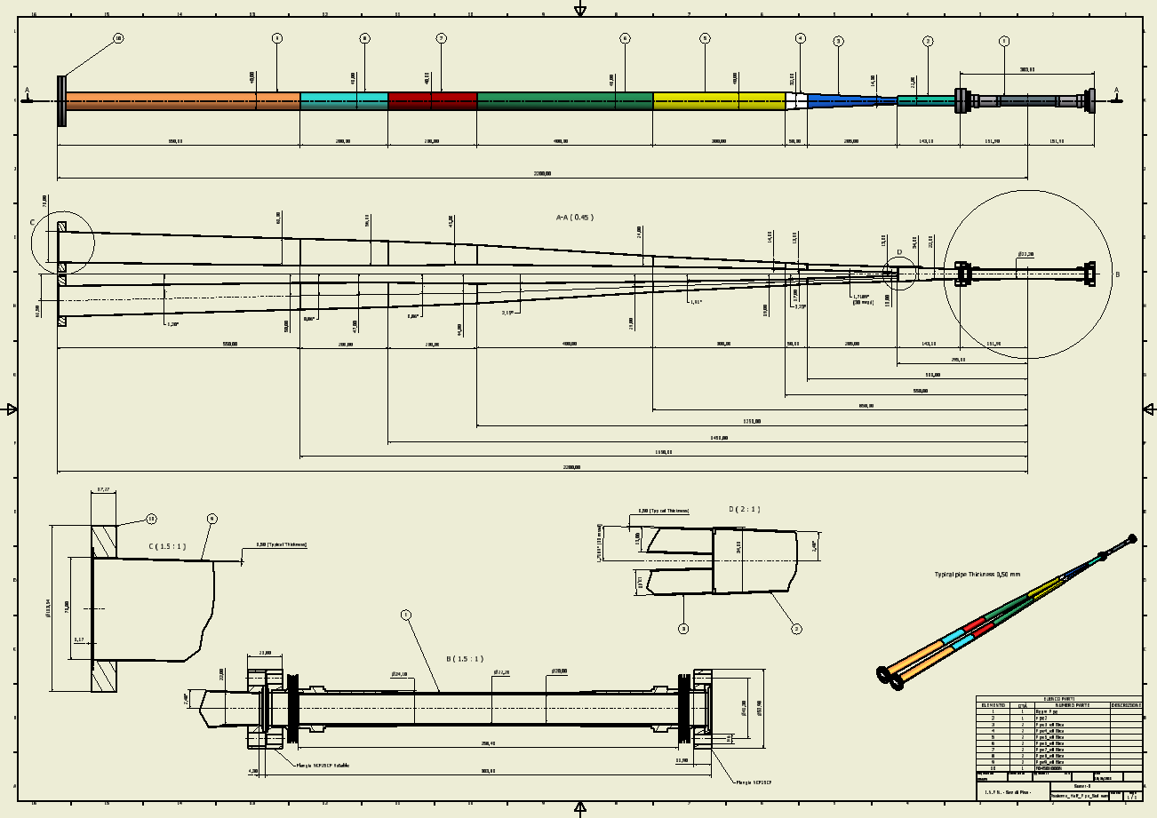

Slide 19
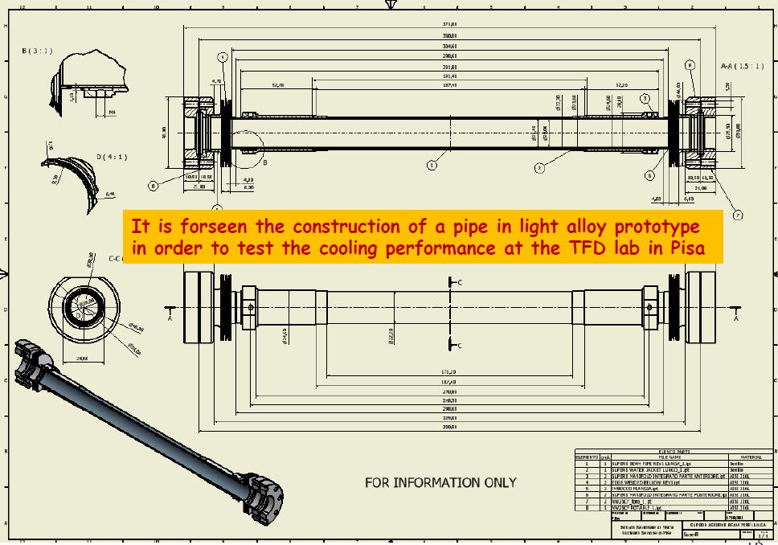

Slide 20
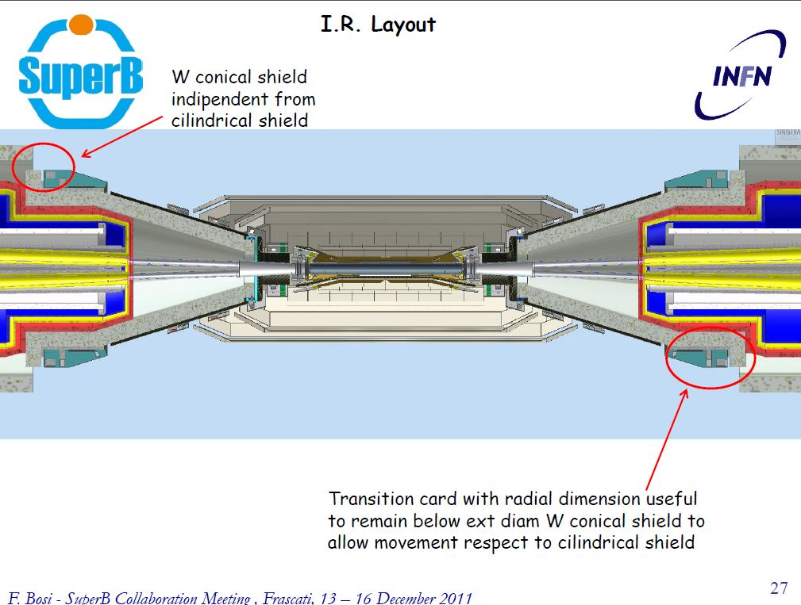

Slide 21
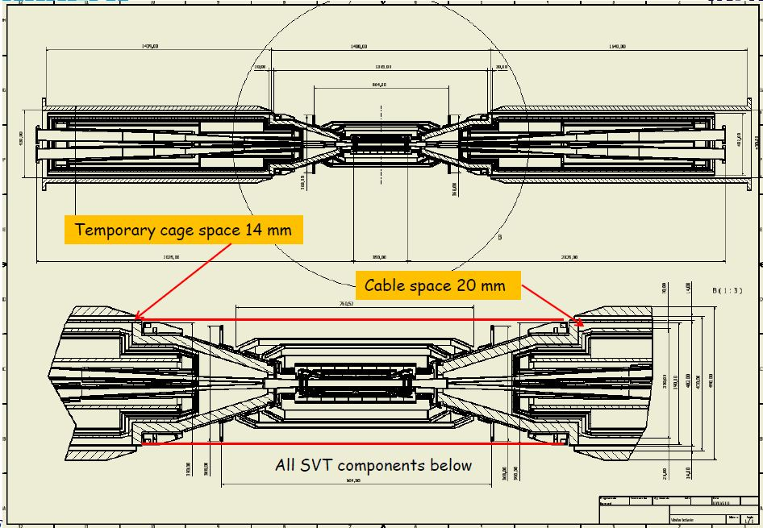
From Filippo Bosi INFN Pisa

Slide 22
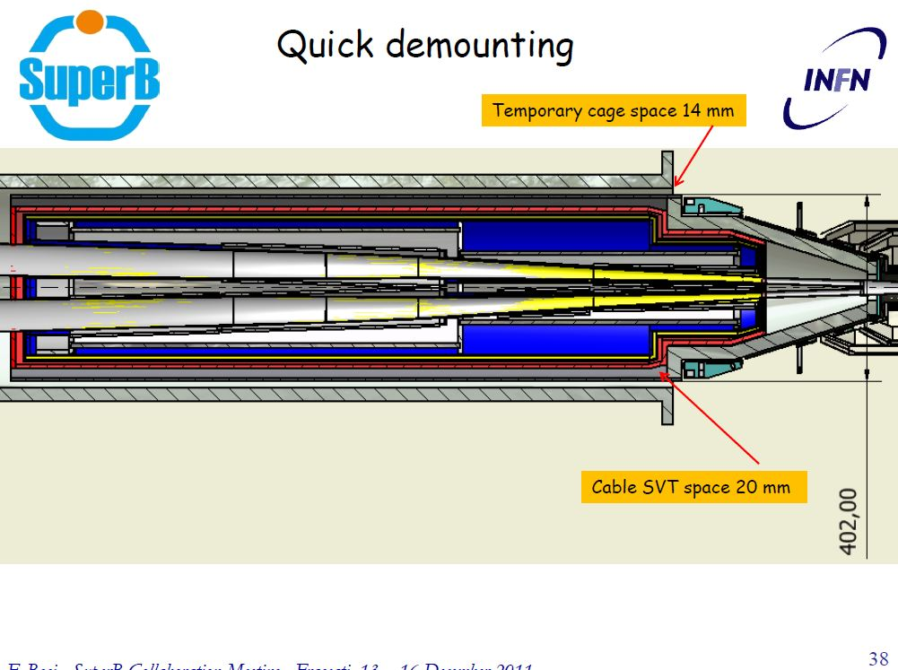

Slide 23
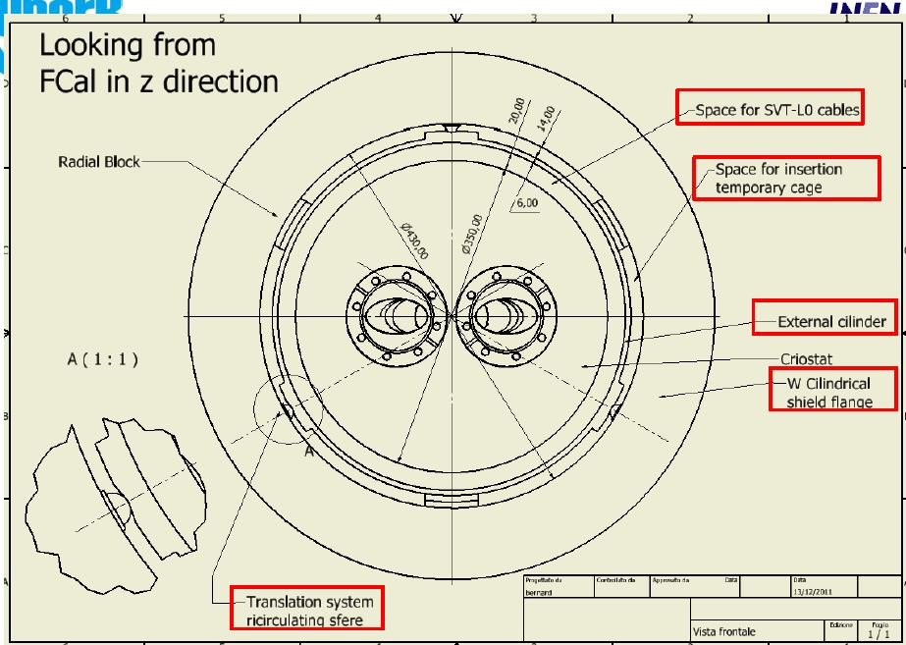

Slide 24
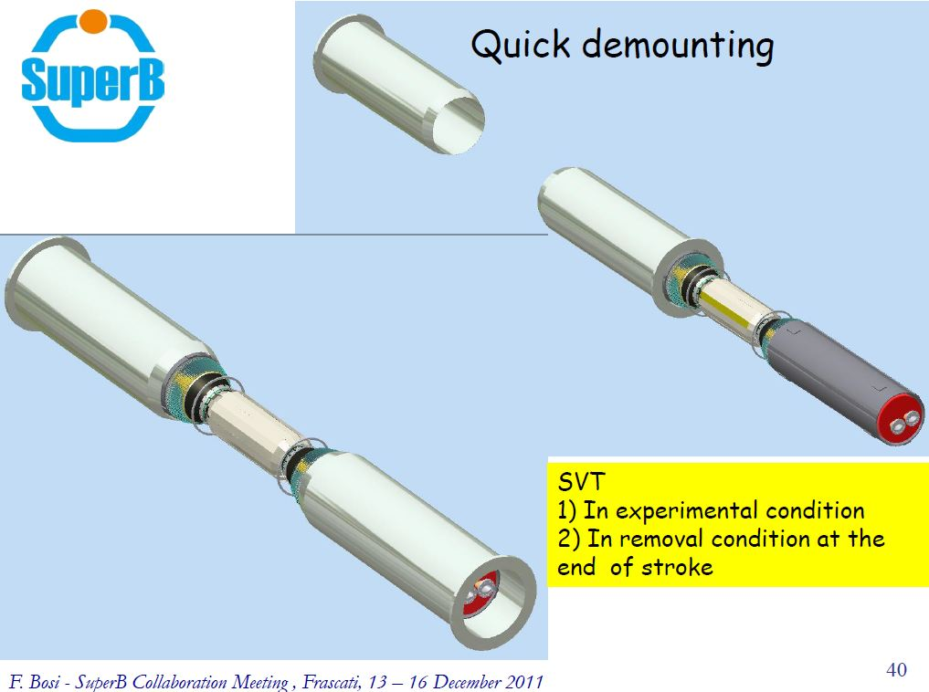

Slide 25
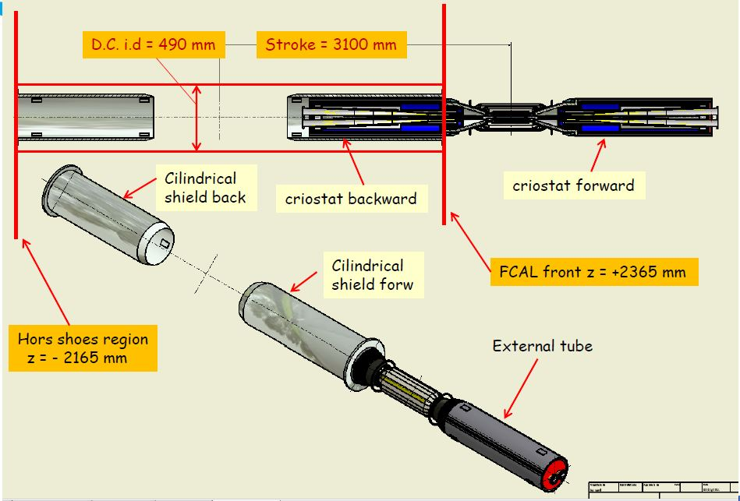
Concerning about the quick demounting are:
The extraction of the two magnet from one side
Is possible having a long transfer line to compensate 3100mm of movement.

Slide 26
Some Results of the Questionnaire
IFR
Power dissipated 2200 W in the barrel 1800W for both endcaps must be verify
2 CRATEs PER ENDCAP DOOR → 8 CRATES IN TOTAL for the ENDCAP IFR
1 CRATE PER BARREL CORNER → 12 CRATES IN TOTAL for the BARREL IFR
A proposed choice of crate standard is ATCA.
The dimensions of an ATCA crate are: 449.5 x 531.9 x 383.1 mm (W x H x D)
Length of such conduits should not be increased over about 5m.
Allowed cooling temperature variation+ / - 2 °C
External power dissipated each crate have a power limited to 800Watt.

Slide 27
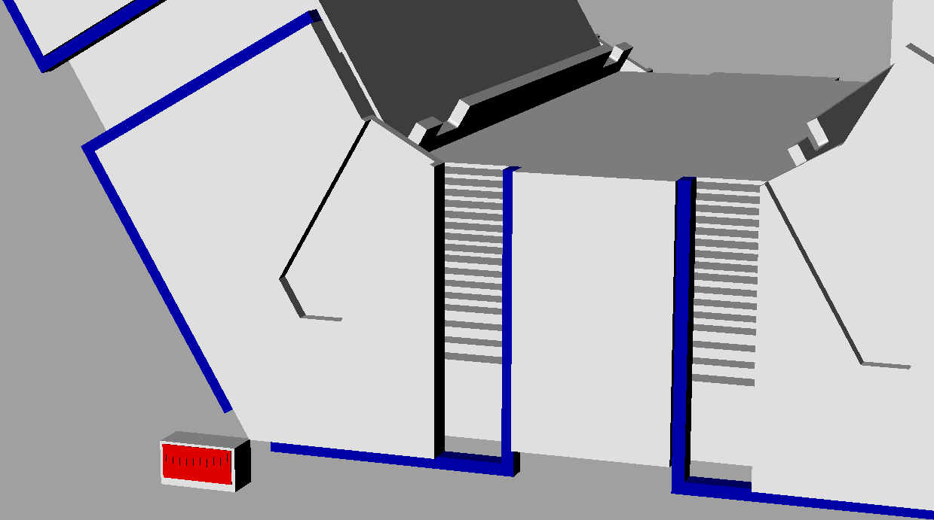
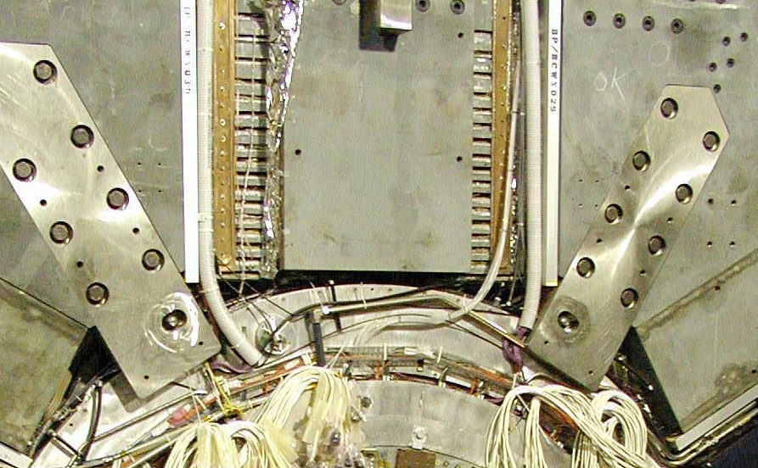
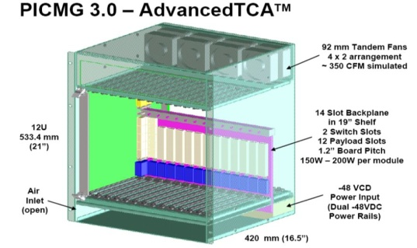
Results of questionnaire
3” x 5” cable conduits used for signal and power
copper cooling plates at the top forward sextant of BaBar
Six modules per end
a.c.r. 2011-11-02
Power Limited to 800W

Slide 28
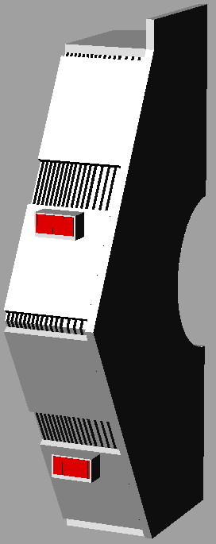
Questionnaire

Slide 29
Conclusions
- A detail floor plan of the experiential area will be possible when we will get all the information of services requirement from the detector and from the accelerator.
We notice an improvement in the SuperB detector design that must be followed by a check from the point of view of the services integration. Especially a special review must be made on SVT, MDI, Layer 00 integration.
-Only the IFR provided the required information to be able to integrate the service on SuperB.
-At this time we can make the distribution of the collected on Babar . (static data)
-We look forward to receive information as the design progress. --We suggest to establish a procedure to exchange information in a efficient way.

