Slide 1




SuperB SVT
Update on sensor and fanout design in Trieste
Irina Rashevskaya, Lorenzo Vitale, Carlo Stella, Luciano Bosisio
Erik Vallazza, Michela Prest*
INFN-Trieste e Università di Trieste
* INFN-Milano e Università dell’Insubria

Slide 2
Update on activities in Trieste
Microstrip Sensor design for Layers 1 - 5
  Definition of ladder composition, sensor models and dimensions, strip pitches
z-side Fanout design for Layers 1 - 5
  Evaluation of strip connection schemes (ganging/pairing)
  Definition of fanout technology
  Preliminary fabrication tests
Not covered here:
  Analysis of 2011 Beam-Test data
  Evaluation of background from e⁺e⁻ pairs (Carlo Stella)

Slide 3
Layer 1-5 - Sensor dimensions
We assume the layer dimensions given by Filippo
  the r-φ cross-section remains the same as in BaBar
  the length of the barrels is increased by a factor of ~1.5
  the wedge sensors retain the same size as in BaBar
We minimize the number of sensors in each ladder, with the following constraints:
  8 different sensor models, fitting within a 150 mm wafer (a dedicated sensor for each barrel ladder type, plus the wedge sensor)
  Even number of sensors in each ladder, allowing symmetric forward-backward readout

Slide 4
Sensor geometry table in the TDR
Physical dimensions, number of strips and pitches for the nine different sensor models.
Active area is:
0.7 mm inside the physical sensor area in Ly 1 – 5 (300 µm thick)
0.6 mm inside the physical sensor area in Ly 0 (200 µm thick)

Slide 5
Sensor geometry table in the TDR
Number of the different sensor types per module, and total required number of sensors,
including one spare module per module type (two for layer 0).
For layers 1 – 5 :
Total sensor area 1.51 m²
Total number of sensors 300
Total number of wafers 254 (two wedge sensors can fit in a 150 mm wafer)

Slide 6
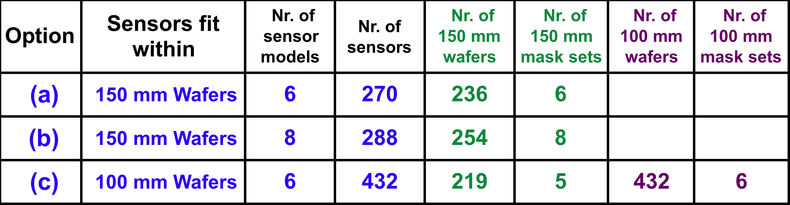
Three options had been considered
The cost of the various options is difficult to evaluate.
We feel that the differences would not be large (± 15% ?).
Option (c) on 100 mm wafers is likely the most expensive, on 150 mm wafers the least expensive.
We think that we should favour the efficiency of testing and assembly, and the performance of the detector (minimize dead regions).
  option (a) is preferred, or option (b) if we require a symmetric forward/backward readout.
The chosen solution is (b).s

Slide 7
Sensor Suppliers
Possible suppliers of double-sided sensors on 150 mm wafers:
  Micron
    200 µm and 300 µm thickness OK
    5 mm minimum clearance from wafer edge
  Sintef
    300 µm thickness only
    8 mm minimum clearance from wafer edge
  Hamamatsu
    320 µm minimum thickness
    5 mm minimum clearance from wafer edge
  CiS (Erfurt, D) presently only 100 mm, 150 mm within 2013 (?)
  FBK-irst (Trento) presently only 100 mm, 150 mm within 2014 (?)
  E2V (UK) is evaluating the possibility to fabricate DSSD.

Slide 8
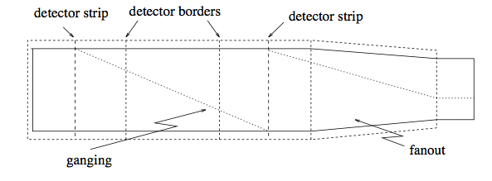
z-side readout: ganging of strips
Number of readout strips exceeds the available amplifier channels => at least a part of the readout channels must be connected to more than one strip.
In BaBar we choose to gang together two far apart strips:
In the SuperB SVT the increased length of the modules will force us to gang together up to three strips in Ly 4 & 5, with a further increase in capacitance and noise.

Slide 9
An alternative option: ‘pairing’ of strips
At small theta angles (large incidence angles) the track traverses several z-strips (up to 9 in the inner layers!) and the signal becomes proportional to the strip pitch.
This suggest to bond two or more adjacent strips to a single fanout trace, effectively increasing the strip pitch and the signal into a readout channel, with only a modest increase in capacitance.
This gives better S/N and efficiency at small theta angles compared to non-paired strips. The improvement is more important when compared to ganging, for which the strip capacitance is proportional to the number of strips ganged together. Moreover, in the pairing scheme the fanout capacitance too is lower, because of the doubled trace pitch.
In addition, at small theta angles pairing is not expected to have a significant impact on spatial resolution.

Slide 10
Next steps
An evaluation of strip pitches and ganging/pairing schemes for the various layers is ongoing.
We plan to measure the capacitance of different pairing configurations on a BaBar Model II sensor.
The final design should be based on a realistic evaluation of S/N and spatial resolution, obtained through an ad hoc MC simulation of the detector response.

Slide 11
Fanout prototyping for Layers 1-5
The plan is to produce the SVT fanouts at the CERN PCB workshop, with a similar technology as for BaBar, but with lower costs, higher turnaround, better yield.
Automatic optical inspection (detecting opens and shorts) will be made by CERN before delivery. No electrical test is foreseen.
A first sample has been fabricated using a BaBar layout, in order to check the technology.
A macro for the automatic layout generation of the new Ly 4-5 fanouts has been prepared.
Minimum trace pitch is ~ 40 µm, with minimum gap of 15 µm.

Slide 12
Backup Slides

Slide 13
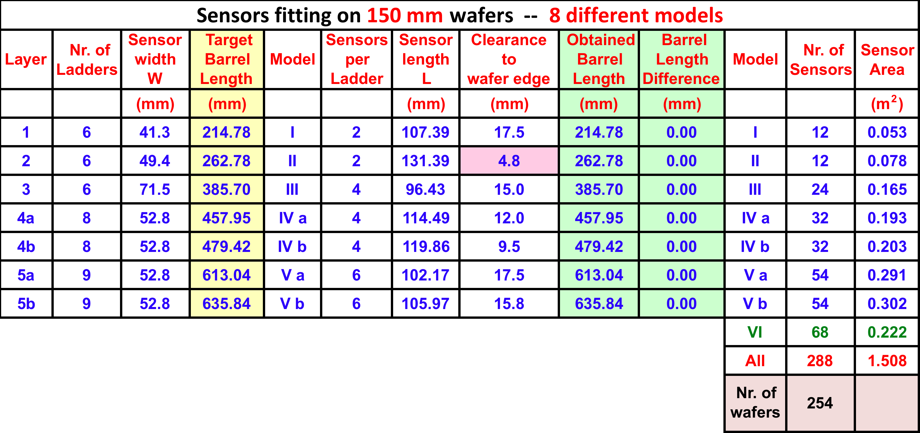
Sensors fitting on 150 mm wafers
Eigth different sensor models
Each barrel layer has its own dedicated sensor
even number of sensors in each ladder
  (=> symmetric forward/backward readout possible).
254 wafers (150 mm)
8 mask sets

