Slide 1
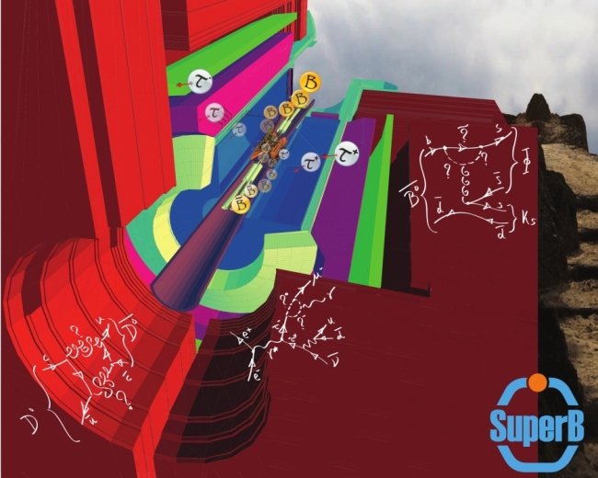
SuperB Physics Closeout
Adrian Bevan
1st SuperB Collaboration Meeting, London 13-16th Sept. 2011
email: a.j.bevan@qmul.ac.uk

Slide 2
Changes since Elba
Charm WG:
Nicola Neri and Miland Purohit have joined Brian.
Mixing and CPV in B Physics:
Jure Zupan has joined AB.
B_{S}:
Alexander Lenz has joined Alexey Drutskoy

Slide 3
Very active meeting
Lots of charm (threshold running related studies)
Starting to study triple product correlations (See Marcin's talk from yesterday) using B→φφK
Continuing to hone the precision EW programme: measure _{ALR} and A_{FB}

Slide 4
Matteo gave a very complete introduction to the FastSim yesterday
John Ellis gave a nice overview of SUSY after 1/fb of LHC data before lunch.
+ a number of discussions on some technical/documentation issues and the December workshop ...

Slide 5
WP – Known Short Falls (Need to be done)
From Brian
Few Fastsim simulations exist
Mixing in D⁰→K_{s}π⁺π⁻ at Y(4S)
Preliminary feasibility study of D⁰→ μ⁺μ⁻ at Ã(3770)
Studies at Y(4S):
Mixing
Use of other modes to find x and y are all estimated from Babar analyses
Do not include measurement of |q/p|, arg {q/p} from D⁰ -D⁰ asymmetries
Rare decays
Realistic understanding reach for D⁰→ μ⁺μ⁻, D⁰→ γ γ D⁰→ h⁺l⁺ l⁻, D⁰→ ρ⁰ l⁺ l⁻
Running at ψ(3770) ~DD threshold
QC phase measurements - how to include them in 4S mixing measurements
Better estimates for σ(A_{SL})
Rare decays such as D⁰→ μ+μ⁻, D⁰→ γ γ
How to use time-dependent decay correlations
Use of other thresholds (D_{s}, Λ_{c} ?)
Rolf’s talk
Mike, Gianluca,
Adrian,
Fernando talks
Elaborate
in thistalk

Slide 6
Other Studies
From Brian
Various physics items added since the WP
D⁰ -> invisible , γ + invisible, “X⁰ ” + invisible at BOTH Y(4S) and threshold.
T-correlations in D⁰ -> l⁺ l⁻h⁺h⁻ and D⁰ -> l⁺l⁻l⁺l⁻
IFF we ever find any such events, of course !!
CPT Violation
Charm baryons
Run at D_{s} threshold too – f(D_{s}) and semi-leptonic decays (V_{cs})
Time-dependent quantum correlated decay studies
Various double-tagged combinations
K
π
D⁰ → invisible
Background
Beam pipe
D⁰ tag

Slide 7
From Marcin

Slide 8
From Mike
NOT
∧
Can directly measure polarisation of the beams AT the IP, so don't have to rely on the Compton polarimeter and extrapolating the measured polarisation at some source point to the IP.

Slide 9
Physics tools
Many opportunities to contribute:
detector response simulation in FastSim (SVT, DCH, DIRC, EMC, IFR)
PID selectors
simulation of background
physics analysis tools (tagging, vertexing, …)
development of ‘skims’ for physics studies
documentation
for more information contact Matteo Rama

Slide 10
Tools Documentation
Discussion on migrating tools documentation from BaBar to SuperB:
Covered under code transfer agreement,
SuperB would benefit from the following
Workbook
Vertexing
SimpleComposition
BtaTupleMaker
Aim: Provide detailed instructions on how to use BetaCode, tcl and get started.
Would need some minor reworking of the workbook to remove any BaBar-specific information.
Would need to be private.
Need a volunteer to do the work: Please contact Matteo

Slide 11
Request for BaBar internal documentation
Not covered by code transfer agreement
All technical documents
Will request these from BaBar to be placed in the private alfresco document repository as internal SuperB notes: Need SuperB note naming scheme.
BAD # Title
53 Choice of Kinematic Variables in B Meson Reconstruction---Take 3
102 Vertexing
509 sPlots
522 EvtGen documentation
1657 A Likelihood-based Charm Flavor Tag
2082 Studies towards an improved tagging algorithm: Tag
246, 332, 497, 1471 Related to backgrounds and trickle injection impacting
upon data quality
1500 PID
2126 Summary of Upsilon(2S) Counting
2186 Offline measurement of recorded BaBar luminosity in R24
+ Statistics WG recommended practice document

Slide 12
Regular (bi-weekly) physics meetings
These are starting up again.
Tuesday: 17:00 (Roma) / 16:00 UK / 08:00 West Coast
Regular intervals: meeting every 2 weeks
Work toward the December physics workshop
Elucidate new areas of the programme
Hone physics interpretation in light of summer conference results
Develop tools for future physics studies.
Meetings will be via EVO, listed on Indico:
http://agenda.infn.it/categoryDisplay.py?categId=480

Slide 13
December workshop: 11th & 12th December, LNF
Day 1
Welcome: Aims/intro
DESY sll workshop summary
WG5 session
Precision EW
Dark Forces (possibly)
b→sγ session
Theory + Expt overview, esp A_{CP}
B_{u,d,s} session(s)
Bs→gg &/or ASL Fast Sim progress
b→sll inclusive/exclusive FastSim progress
Day 2
Charm
TDCPV progress
tau
LFV/CPV
Planning Session
Discuss tools required, and what FastSim mode studies we need for TDR/Book
TDR chapters/Physics Impact Document/Elba planning session
Will also have a few sessions during the CM.
Currently have one room booked for both days: all plenary.
+ 2 additional parallel session rooms requested for Monday morning.

Slide 14
Interim updates
On the timescale of the December meeting we will have a honed interpretation of the physics programme accounting for the current constraints from the LHC.
Also need to be mindful of the potential from 2012 data taking at the LHC (e.g. using a sensible value for Λ_{NP}).
We have considerable levels of activity that will lead to a broader understanding of the programme by the end of the year.
Interim updates should be prepared as and when necessary.
Long term goal is the SuperB physics book a few years from now.

Slide 15
TDR Contributions
Need to work with the detector and accelerator teams to prepare:
Physics chapter for the detector TDR: an overview of the whole programme.
Physics motivation for the accelerator features: (i) 4S running (+ adjacent resonances), (ii) Physics requirements for polarisation, and (iii) Physics programme at charm threshold.

