Slide 1
Update on Lab activities @ LNF
DCH–I Parallel session
1st SuperB Meeting – London, 13 September 2011
G. Finocchiaro - LNF

Slide 2
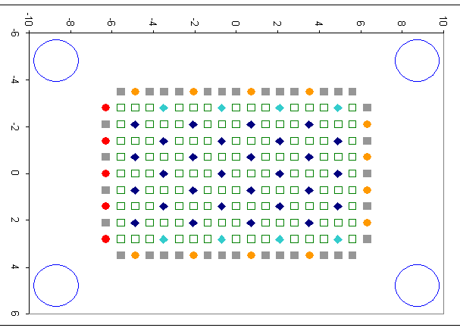
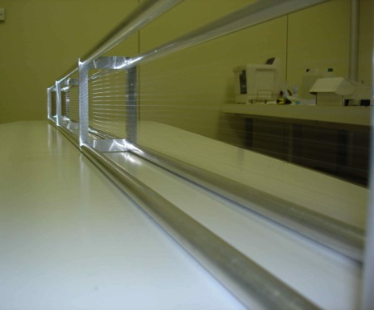
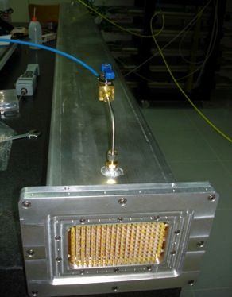
Prototype 2
Full-length prototype to:
study cluster counting under realistic conditions (discrete-cathode cells, L=2.5m)
serve as a test bench for the final FEE
test implementation of 1st level DCH trigger Track Segment Finding
Read-out boards provide independent analog output for the trigger system
28 square cells (1.4cm side, Rfs=3:1), on 8 staggered layers (3-4-3-4-3-4-3-4 cells)

Slide 3
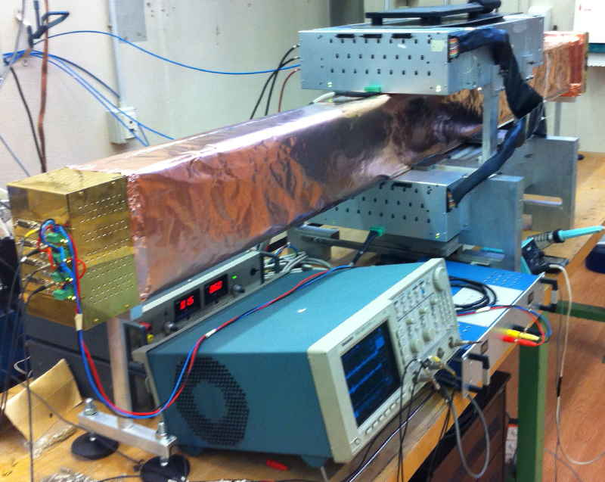
Proto2 Status
All HV distribution and read-out boards commissioned
Inserted inside the tracking telescope
Still only 4 channels read-out at the moment, with DRS4 evaluation board

Slide 4
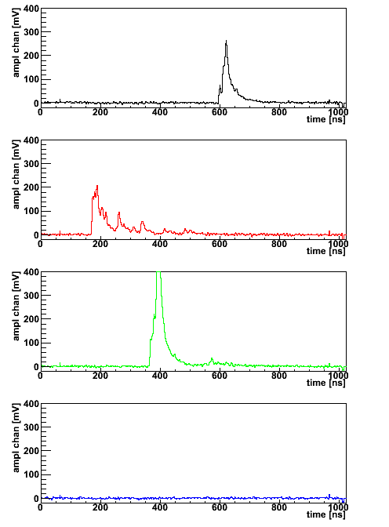
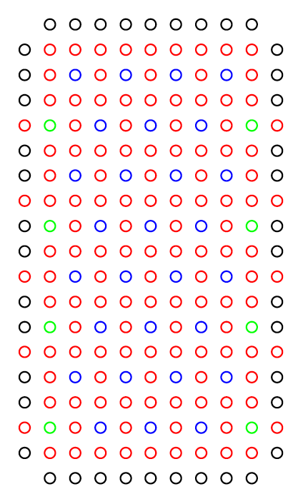
Sample waveforms
90%He-10%iC₄H₁₀
HV=1775V
Run “A”
“#1 cells"

Slide 5
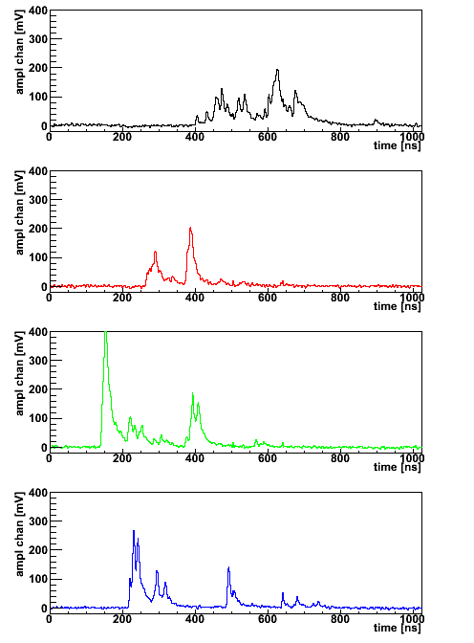
Sample waveforms
90%He-10%iC₄H₁₀
HV=1775V
Run “A”
“#1 cells"

Slide 6
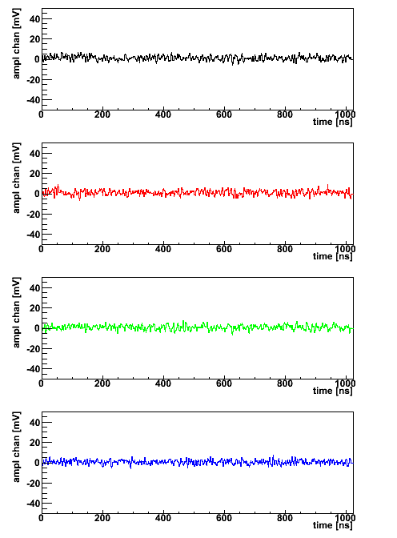
Sample waveforms – noise level
90%He-10%iC₄H₁₀
HV=1775V
Run “A”
“#1 cells"

Slide 7
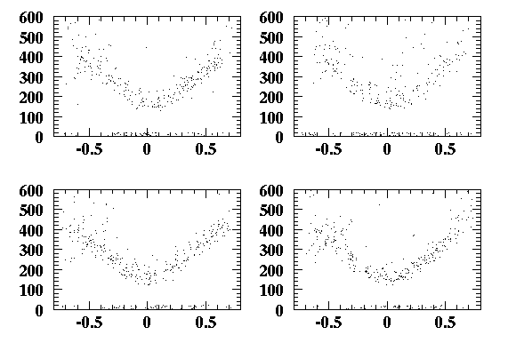
Preliminary space-time relations
90%He-10%iC₄H₁₀
HV=1775V
Run “A”
“#1 cells"
5.5mV threshold to determine the time of the 1st electron

Slide 8
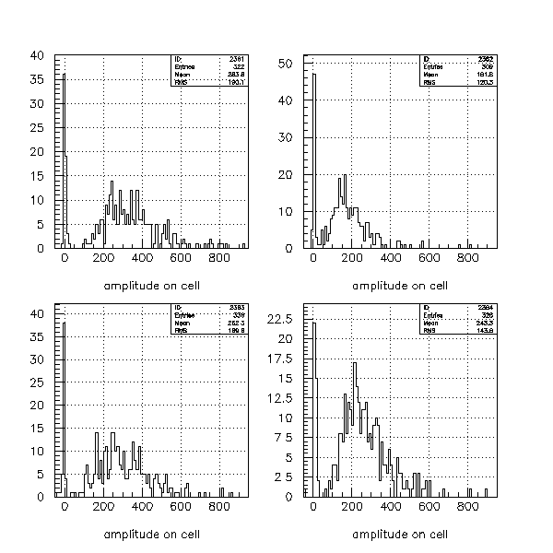
Integrated amplitude
90%He-10%iC₄H₁₀
HV=1775V
Run “A”
“#1 cells"

Slide 9
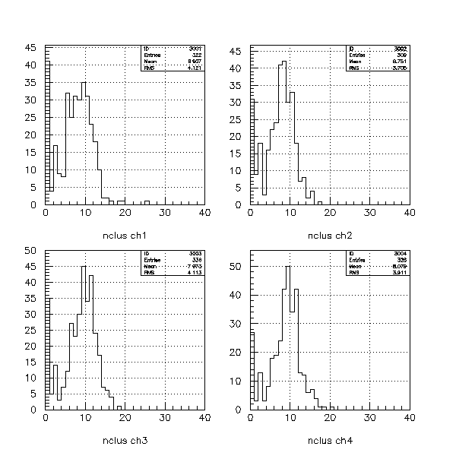
Clusters from “threshold algorithm”
90%He-10%iC₄H₁₀
HV=1775V
Run “A”
“#1 cells"

Slide 10
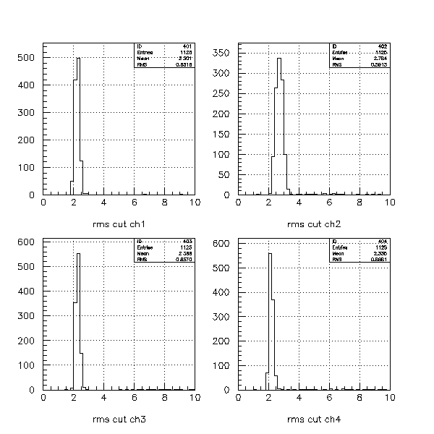
The “cut variable”
90%He-10%iC₄H₁₀
HV=1775V
Run “A”
“#1 cells"

Slide 11
Spurious clusters
90%He-10%iC₄H₁₀
HV=1775V
Run “A”
“#1 cells"
Clusters found when track |DOCA| > 3cm
proto2 cells ∈[-2.8,+2.8] cm

Slide 12
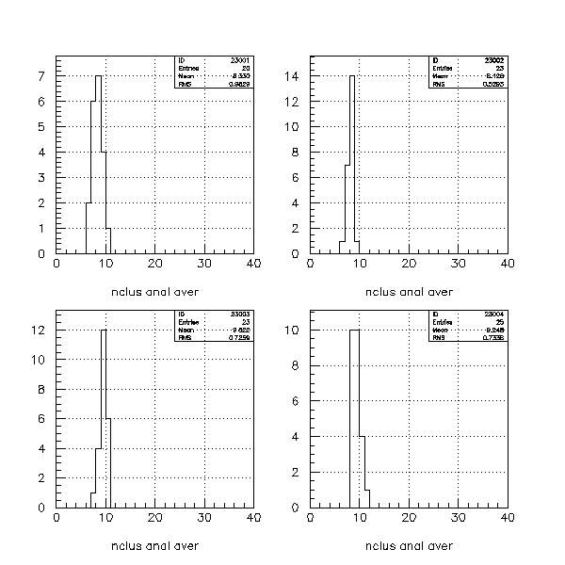
Clusters: simulating 10-cell tracks
90%He-10%iC₄H₁₀
HV=1775V
Run “A”
“#1 cells"

Slide 13
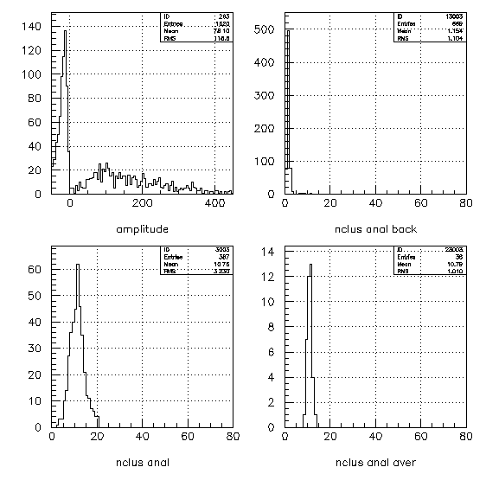
What we had on the 17mm-Brass Tube
@ HV=1575V

Slide 14
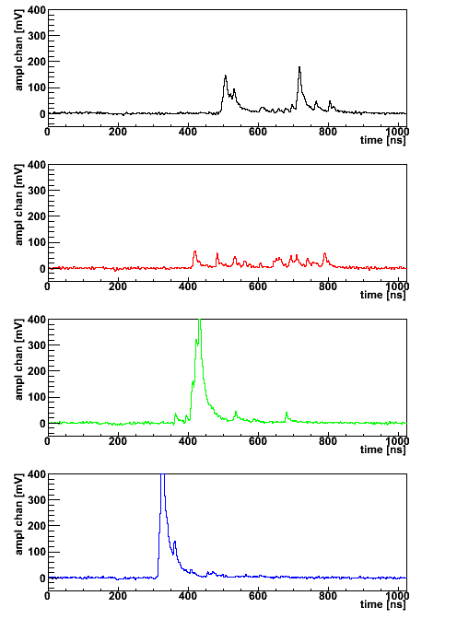
Sample waveforms – a different run
90%He-10%iC₄H₁₀
HV=1775V
Run “B”
“#1 cells"
Amplification of
board #2 looks
way too low

Slide 15
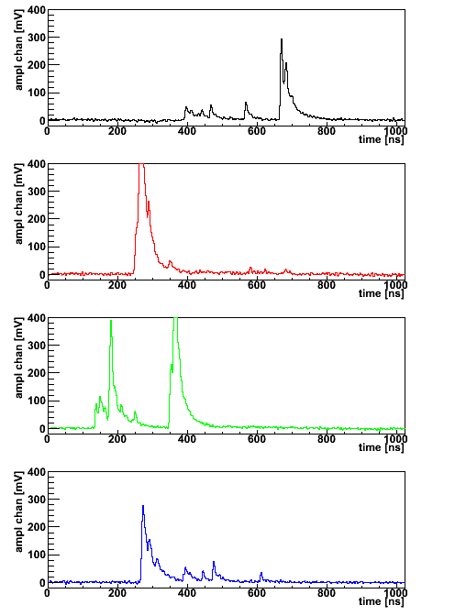
Sample waveforms
90%He-10%iC₄H₁₀
HV=1775V
Run “B”
“#1 cells"

Slide 16
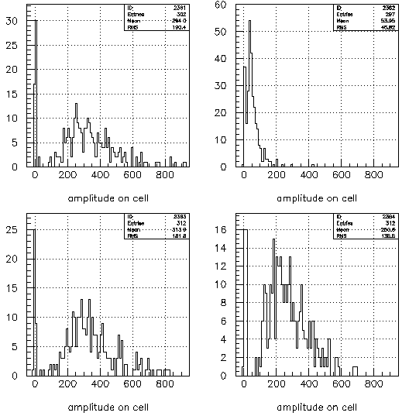
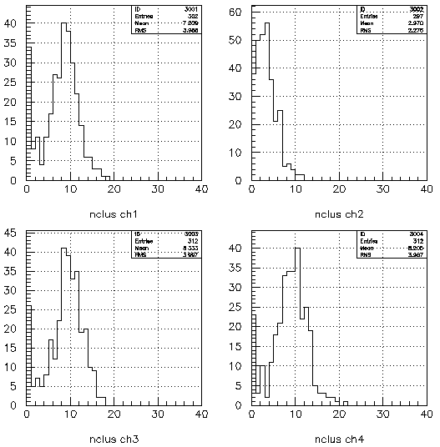
Integrated amplitude, counted clusters
90%He-10%iC₄H₁₀
HV=1775V
Run “B”
“#1 cells"

Slide 17
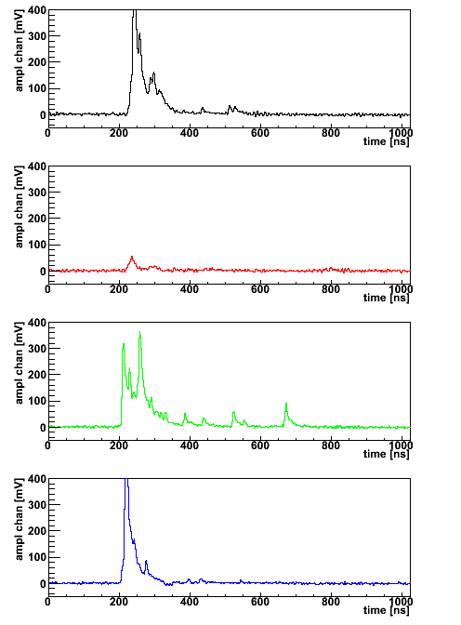
Sample waveforms – 4 different cells
90%He-10%iC₄H₁₀
HV=1775V
Run “C”
“#7 cells"

Slide 18
Summary and Plans
The commissioning of Prototype 2 is still ongoing
Encouraging results from first data
e.g., noise level not as high as one could fear because of the full scale detector size (2.5m long wires, discrete cathode structure, 28 channels…), and faster preamps
roughly, the same (not high) cluster efficiency as in the square tubes
Next steps
Fix problem with board #2
Precise alignment of proto2 and external tracker
Acquire all the 28 waveforms with CAEN VME module
Prepare setup with 2.5m long scintillators as trigger (anticipate increase of usable rate in proto2 by x10)
Prepare rotating support for test beam

Slide 19
Test Beam Plans
One week of beam time at the BTF assigned on Nov 28th – Dec 4th
electron gun cathode not delivered to Frascati yet
Financial request submitted to run a beam test in 2012
PSI? CERN? TRIUMF?

