Slide 1
Virtualization with xen
Federico Nebiolo, Riccardo Brunetti
Notes:
In questo tutorial considereremo velocemente alcuni aspetti della gestione di base ed avanzata delle macchine virtuali utilizzando la tecnologia Xen.
Le possibilita' e le soluzioni tecniche per la gestione dei data center offerte da Xen sono certamente molto piu' numerose e raffinate di quello che in queste tre ore avremo la possibilita' di vedere; quello che abbiamo cercato di fare e' di realizzare una panoramica di Xen, a partire dai concetti di base fino alle soluzioni piu' interessanti come la migrazione dei servizi, la possibilita' di realizzare soluzioni di virtual appliance e di alta affidabilita'.
Ho detto "abbiamo" in quanto il materiale che presentero' e' frutto del lavoro mio e di Federico Nebiolo, che non puo' essere presente oggi, ma che tra i due e' il vero esperto di virtualizzazione.

Slide 2
Overview
What is virtualization
Virtualization à-la-xen
Deploying a virtual machine in Xen
The administrator console and other management tools
Advanced management of virtual machines
Notes:
Questi sono, a grandi linee, gli argomenti che tratteremo:
In questa prima parte, di un'ora circa, faremo una breve panoramica dei concetti di base della virtualizzazione, e delle caratteristiche di Xen come strumento per la gestione di macchine virtuali.
Poi seguira' una parte in cui verra' descritta l'installazione di base di Xen dal punto di vista della macchina host.
In seguito vedremo come installare le macchine guest e come gestirle con i tool e gli strumenti di amministrazione nativi.
Nella seconda parte considereremo alcuni aspetti piu' avanzati della gestione delle virtual machines e come utlizzare Xen per la gestione organizzata dei data center.

Slide 3
What is Virtualization
«A framework or methodology of dividing the resources of a computer hardware into multiple execution environments, by applying one or more concepts or technologies such as hardware and software partitioning, time sharing, partial or complete machine simulation, emulation, quality of service, and many others.»
A virtualization product has to accomplish some of the following key points
Add a layer of abstraction between the application and the hardware
Enable a reduction in costs and complexity
Provide the isolation of computer resources for improved reliability and security
Improve service levels and the quality of service
Better align IT processes with business goals
Eliminate redundancy in, and maximize the utilization of, IT infrastructures
Notes:
Anzitutto: cosa e' la virtualizzazione?
Uno strumento di virtualizzazione e' progettato per inserire un livello di astrazione tra le applicazioni e le risorse hardware tale da suddividere le risorse di un computer in modo che possano coesistere ambienti multipli di esecuzione, in modo isolato e controllato.
Questo puo' portare ad una serie di benefici sulla qualita' dei servizi e sull'efficienza di utilizzo delle macchine di calcolo, ed in particolare……

Slide 4
Benefits of Virtualization
Consolidation
Increase server utilization
Simplify legacy software migration
Host mixed operating systems per physical platform
Streamline test and development environments
Reliability
Isolate software faults
Reallocate existing partitions
Create dedicated or as-needed failover partitions
Security
Contain digital attacks through fault isolation
Apply different security settings to each partition
Notes:
Consolidamento dei servizi
ovvero una gestione piu' organizzata ed efficiente delle risorse di calcolo. Questo grazie al fatto di poter utilizzare piu' sistemi operativi contemporaneamente, di poter sfruttare al meglio i server (spesso le macchine dedicate ad un singolo servizio sono sottosfruttate), di poter utilizzare le stesse risorse in modo isolato e sicuro sia per la produzione che per lo sviluppo.
Affidabilita' dei servizi
L'utilizzo di macchine virtuali permette di isolare i problemi software dei servizi ospitati sullo stesso hardware senza che il fault di uno abbia ripercussioni sugli altri (si pensi ad un servizio che, eventualmente, esaurisca semplicemente lo spazio disco, oppure che a causa di un bug tenda ad occupare una porzione sempre maggiore di memoria)
Sicurezza
Poter utilizzare macchine virtuali separate su uno stesso hardware permette di definire politiche di accesso e configurazioni di sicurezza in modo indipendente per i vari servizi.

Slide 5
Virtual Machine Monitor and Ring-0
VMM (Hypervisor)
Manages and arbitrates requests of guest Oss
Most performance if running on Ring-0
Popek and Goldberg requirements
Equivalence/Fidelity
Resource control/Safety
Efficiency/Performance
Ring-0
Ring-1
Ring-2
Ring-3
Notes:
Come funziona la virtualizzazione?
Strettamente legata all’architettura dei calcolatori.
Nell’architettura i386 esistono 4 livelli di esecuzione.
Il Ring-0 e’ quello piu’ privilegiato (kernel)
Il ring-3 e’ quello – privilegiato (applicazioni)
Il layer che astrae le risorse hardware dalle applicazioni e’ chiamato hypervisor
Le migliori performances si ottengono quando l’hypervisor viene eseguito al ring-0 ed i guest os al ring-1
Equivalence : un programma che gira in ambiente virtualizzato deve esibire lo stesso comportamento che avrebbe nativamente
Resource control : Il VMM deve avere sempre il completo controllo delle risorse virtualizzate
Efficiency : una frazione alta delle istruzioni deve poter essere eseguita senza intervento del VMM

Slide 6
Popek and goldberg requirements
Equivalence :
A program running under the VMM should exhibit a behavior essentially identical to that demonstrated when running on an equivalent machine directly.
Resource control:
The VMM must be in complete control of the virtualized resources.
Efficiency:
A statistically dominant fraction of machine instructions must be executed without VMM intervention.
i386 architecture does not fit all these requirements
Notes:
Resource control e’ evidenziato in quanto e’ l’aspetto piu’ problematico della virtualizzazione i386.
L’architettura i386 possiede un certo numero di istruzioni sensibili che non generano trap quando vengono eseguite ad un livello diverso dal ring0. Dunque il VMM non puo’ avere il controllo delle situazioni di conflitto.

Slide 7
Types of server virtualization
Para-virtualization
Provides partial simulation of underlying hardware
Easier to implement, highest software performance
Operating system virtualization
Single operating system instance
Lean and efficient, single host installation, runs at native speed
Native (Hybrid) virtualization
Full or paravirtualization “on steroids” (=with hardware acceleration techniques)
Handles non-virtualizable instructions with hardware traps, highest performance
Full virtualization
Provides complete simulation of underlying hardware
Complete isolation, no guest modifications, near-native CPU performance
Not quite possible on x86 architecture in its pure form
Guest operating systems need modifications
Does not support mixed OS, VMs not isolated or secure, huge hypervisor
Requires CPU architecture
Notes:
Operating system virtualization.
Unico kernel patchato che separa memoria ed accesso risorse e le destina a diverse istanze di OS.
Le macchine non sono isolate. (chroot “on steroids”) Ex: Linux-VServer

Slide 8
Introducing Xen

Slide 9
Virtualization model explored
Paravirtualization: hypervisor provides a lightweight support role to overlying guests, taking responsibility of access control and resource scheduling
Architecture currently supported on x86 (with PAE) and x64. Limited support for IA-64 and POWERPC
Guests presented in a construct called domains, with management API
Privileged (principle called Domain-0): direct access to devices + granted creation of others
Unprivileged (Domain-Us)
Hypervisor executes in Ring-0, thus maintaining full control over hardware, domains run in Ring-1
System calls within OS sent to hypervisor as hypercalls; event notification mechanism on the other way round
Physical host hardware
(CPU, memory, network, disk)
Xen hypervisor
Virtual Hardware API + Management API
Domain-0
Management code
Physical device drivers
Domain-U
Virtual resources
PV drivers
Domain-U
Virtual resources
PV drivers
Application
Application
Notes:
Xen utilizza il metodo della paravirtualizzazione.
L’ hypervisor gestisce una serie di macchine guest chiamate domini e fornisce una serie di API per la loro gestione.
Uno dei domini ha maggiori privilegi sull’accesso all’hardware e possiede gli strumenti per gestire i domini non-privilegiati.
L’hypervisor viene eseguito al ring-0 e comunica con l’hardware e con i guest tramite un set di hypercalls, che sostituiscono le istruzioni privilegiate “pericolose” dell’architettura i386.

Slide 10
CPU virtualization
Trapping mechanism to handle privileged instructions from guest OSs
Hypervisor responsible for managing scheduling :
Simple Earliest Deadline First (sEDF) scheduler
Weighted CPU sharing
CPUs allocated to domains on the basis of a priority queue
Credit scheduler optimized for SMP platforms
Proportional fair share. Priorities of domU adjiusted dinamically
Default scheduler
CPU pinning
Guests must be aware both of real and virtual time
Calculation of system, wall-clock, domain virtual and cycle counter times
Notes:
L’hypervisor e’ responsabile dello scheduling delle cpu
Wallclock time = Unix timestamp del dom0 (ntpd)
System time = Tempo da quando il domU e’ stato avviato
Domain virtual time = tempo di attivita’ del dominio (importante per lo scheduling)

Slide 11
I/O virtualization
Devices presented as an abstraction class device rather than an emulated copy
I/O rings in a producer-consumer relationship: asyncronous + allow flexible control of reordering
Event channels enable reverse communication to guests (they know when there's data)
Requests
Xen VMM
Responses
Guest VM
Drop
Pick-up
Pick-up
Drop
Notes:
Ogni dominio possiede un producer per le richieste ed un consumer per le risposte.
Producer e consumers utilizzano rispettivamente code pubbliche e private per gestire le richieste.
Gestione asincrona: ogni richiesta ha un proprio identificativo e possono essere riordinate dal VMM

Slide 12
I/O virtualization
Virtual network interfaces (VIFs) and virtual block devices (VBDs)
Abstraction of I/O devices
Validation, scheduling and logging
Bus to bridge data transfers
Between frontend device driver and backend driver in privileged domain
Driver domains
Domain-Us can be granted direct access to physical I/O devices using unmodified drivers
Notes:
Xen fornisce una visione virtualizzata dei devices.
Non e’ un’emulazione, ma sono devices che i domU utilizzano per comunicare con l’hardware

Slide 13
Virtual Network Interfaces
Default naming: vif<DomID>.<Interface>
vif0.0 = first ethernet (eth0) on Domain-0
Hotplug creates a new vif when a Domain-U is started, mapping domain and interface in the guest system
How traffic from domU is handled on dom0 and routed to outside networks depends on the type of networking used
vif-script parameter in /etc/xen/xend-config.sxp
Notes:
Come sono organizzate le interfacce di rete

Slide 14
(i/O) Networking
Natted Networking (network-nat) All domains use NAT to talk to the external network. Optionally virtual interfaces can be bridged
Bridged Networking (network-bridge) All domains are hosted on a bridge and talk to the external network
Routed Networking (network-route) Traffic to all domains is simply routed through the physical interface
Notes:
- Dom0 is configured to forward IP packets
- Iptables used to configure Dom0 kernel to do NAT
- Optionally DHCP can be used to provide IP addresses to DomU guests
- Dom0 and DomU hosts are connected to a virtual network (one per physical interface)
- The virtual network is then connected to the physical network
- Xen default configuration
- Dom0 is configured to forward IP packets and to handle ARP proxying
- A static route for each DomU is added to Dom0 as DomU comes up

Slide 15
Configuring Xen network startup
Customizing networking startup behavior
By passing parameters to the existing network scripts
By creating a custom script
General parameters
vifnum: number of virtual device to associate with bridge
bridge: name of the bridge to use (default xenbr$vifnum)
netdev: physical network interface to use (default eth$vifnum)
antispoof: whether to use iptables to prevent spoofing
dhcp: whether to directly modify local DHCP configuration
Example using eth1 instead of eth0
(network-script ‘network-bridge netdev=eth1’)
Notes:
Parametri utilizzabili nello script di default (xend-config.sxp)

Slide 16
Creating a custom script
If we want to create two bridges
(network-script ‘dual-bridge.sh’)
Both scripts calling builtin ones and fully custom can be used
#!/bin/sh
dir=$(dirname “$0”)
$dir/network-bridge “$@” vifnum=0 netdev=eth0 bridge=xenbr0
$dir/network-bridge “$@” vifnum=1 netdev=eth1 bridge=xenbr1

Slide 17
Deploying a xen host

Slide 18
Deploying a Xen Host
Installing a Xen host is as simple as installing virtualization binary packages (“virtualization” group in rhel)
Also possible to take the software directly from xensource.com
Modify the grub.conf:
title Xen….
root (hd0,0)
kernel /boot/xen.gz
module /boot/vmlinuz-xen…
module /boot/initrd-xen….

Slide 19
Overview of the xen daEmon
dom0-cpus
dom0-min-mem
Number of CPUs that dom0 will initially use (default 0=all)
network-script, vif-script
xend-relocation-server, xend-relocation-port, xend-relocation-hosts-allow
Minimum amount of ram that dom0 must preserve (default 256M)
Script used for networking setup and for creating or destroying virtual interfaces
xend-tcp-xmlrpc-server, xen-tcp-xmlrpc-server-address, xen-tcp-xmlrpc-server-port
Parameters controlling hosts and ports for domU’s migration to/from this server
Parameters controlling the behavior of the internal TCP RPC server used to communicate with this server

Slide 20
Deploying a virtual machine in xen

Slide 21
requirements
Xen enabled kernel
A root filesystem
All needed modules
Optionally an initial ramdisk
A guest configuration file

Slide 22
Building the filesystem for a VM
PV guests
Can use storage both at the filesystem level and device level
Each device can contain a single filesystem or a disk as a whole
HV guests
Use storage at device level only
Expect each device to contain its own partition table and, in case of a boot device, a boot loader
Notes:
L’accesso alle risorse di storage da parte delle macchine virtuali dipende dal tipo di macchina.
I guest paravirtualizzati possono accedere ai dispositivi di storage sia come interi device che a livello di singola partizione.

Slide 23
Building the filesystem for a VM
Physical storage volumes or directories
Filesystems or disk images
A single file is created on dom0 wich contains a filesystem or a whole disk image.
Ease of use
Less efficient
Portability
Better performances
Reduced portability
A disk volume on dom0 is used to store the guest filesystems
More difficult to manage
Type
Description
Pro
Cons
Memory requirement for loop mounting
Notes:
Dove allocare il filesystem volume vs. file

Slide 24
Preparing the root filesystem
Filesystem on an image file
dd if=/dev/zero of=image_file.img bs=1024k seek=4096 count=0
Filesystem on a disk volume
fdisk
pvcreate+vgcreate+lvcreate
mkfs.ext3 image_file
mkfs.ext3 volume_name
mount –o loop image_file /mnt/tmp
mount volume_name /mnt/tmp
Notes:
Il metodo piu’ diretto per preparare il root filesystem per una macchina PV, e’ quello di inizializzare una porzione di storage e di popolarla successivamente con le directory necessarie clonando un fs esistente.
Il root fs puo’ risiedere su un unico file immagine oppure su un volume fisico su disco.
In entrambi i casi, il primo passo e’ quello di preparare lo spazio, formattarlo e montarlo su una directory temporanea sul dom0

Slide 25
Populating the root filesystem
1
rsync –ax --exclude=/proc --exclude=/sys --exclude=/home --exclude=/opt <source-root> /mnt/tmp
2
mkdir /mnt/tmp/{home,proc,sys,tmp,opt}
3
cp –ax /lib/modules/mod_version/ mnt/tmp/lib/modules
chmod 1777 tmp
5
rpm –root /mnt/tmp –uvh package_name
yum –installroot=/mnt/tmp install package_name
4
Customize configuration files (ex. fstab, networking, ec…)
Notes:
Una volta ottenuto uno spazio sufficiente, si possono copiare le directory necessarie. E’ importante mantenere le ownership ed i permessi corretti, quindi risulta comodo utilizzare comandi di copia come rsync, che hanno questo tipo di proprieta’.
Le directory ….. Possono essere create vuote.
Successivamente occorre copiare i moduli del kernel che si vuole utilizzare nell’apposita directory.
A questo punto si possono customizzare i files di config della directory /etc in modo da renderli adatti alla nuova macchina.
E’ utile, in molti casi, sfruttare le opzioni di installazione di rpm o yum per poter installare gia’ nuovi pacchetti sulla nuova macchina virtuale.

Slide 26
Exporting filesystems to guests
Filesystems or disks images
Use the Xen’s blktap driver (Xen > 3.0)
disk = [ ‘tap:aio:path_to_img,domU_dev,mode’ ]
Disk volumes or partitions
Use the Xen’s xenblk driver
disk = [ ‘phy:disk_volume,domU_dev,mode’ ]
disk = [ ‘tap:qcow:path_to_img,domU_dev,mode’ ]
disk = [ ‘tap:vmdk:path_to_img,domU_dev,mode’ ]
disk = [ ‘phy:partition,domU_dev,mode’ ]
Notes:
Una volta realizzato il root filesystem, a seconda del tipo di device, lo si puo’ esportare alla macchina guest.
Nel caso di file contenenti immagini di dischi o di filesystems, si utilizza il driver blktap mediante la direttiva tap:
Blktap supporta i/O asincrono ed e’ piu’ performante
Nel caso di volumi fisici si utilizza il driver xenblk mediante la direttiva phy:

Slide 27
Installing a PV guest using qemu
Get a boot.iso image
Prepare a qemu disk image
qemu-img create -f raw <name.img> <size>
Install the guest OS
qemu -hda <name.img> -cdrom <boot.iso> -boot d -m 512 -net nic -net tap
Boot the machine (HVM)
qemu -hda <name.img> -m 512 -net nic -net tap
Install the “virtualization group”
Modify menu.lst
Build a new initial ramdisk including xennet and xenblk modules
mkinitrd –with=xennet –with=xenblk \ /boot/<initrd.img> <xen-kernel>
Prepare a xen guest config file

Slide 28
Installing a PV guest Using virt-install
Virt-install is a command line tool for PV and HVM guest installation
Download latest from
http://virt-manager.et.redhat.com
Prepare a disk image
qemu-img create -f raw <name.img> <size>
Install the guest OS
virt-install --name <name> --ram 512 --file <name.img> --location <OS-install-URL> -w bridge:<bridge>
The xen guest config file is authomatically generated
No need to make a new initrd

Slide 29
Paravirtualized virtual machine with xen
For rhel4(CentOS-4) only domU kernel-xenU available in the standard repository. Dom0 available from xensource.com
From rhel5(CentOS-5) same kernel-xen both for dom0 and domU available in the standard repository
For advanced configurations better to use the xensource.com kernels (rhel kernel heavy patched)
Notes:
Alcuni esempi di installazione di macchine virtuali per sistemi di uso comune

Slide 30
Xen config file for a PV machine 1/2
name = "pv-centos5.1"
import os, re
arch = os.uname()[4]
if re.search('64', arch):
arch_libdir = 'lib64'
else:
arch_libdir = 'lib'
#----------------------------------------------------------------------------
# Kernel, mem and cpu.
#----------------------------------------------------------------------------
bootloader = "/usr/bin/pygrub"
memory = 768
maxmem = 1024
shadow_memory = 8
vcpus=1
#----------------------------------------------------------------------------
# Networking
#----------------------------------------------------------------------------
vif = [ 'ip=10.0.1.1' ]
dhcp='dhcp'
Notes:
Shadow mem: quanta ram utilizzare

Slide 31
Xen config file for a PV machine 2/2
#----------------------------------------------------------------------------
# Disks
#----------------------------------------------------------------------------
disk = [ 'tap:aio:/mnt/tmp/image.raw,hda,w', 'phy:/dev/hda,hdc:cdrom,r' ]
#-----------------------------------------------------------------------------
# Boot order
#-----------------------------------------------------------------------------
boot="cd“
#-----------------------------------------------------------------------------
# Graphics
#-----------------------------------------------------------------------------
vfb=[ ‘type=vnc’ ]
vnclisten="127.0.0.1"
vncunused=0
#-----------------------------------------------------------------------------
# Keyboard layout
#-----------------------------------------------------------------------------
keymap='it'

Slide 32
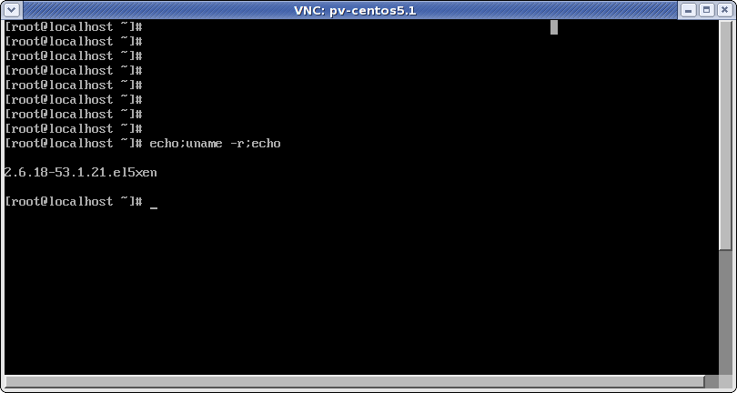
CentOS5.1 (PV) on xen
Notes:
Finestra superiore: pygrub al posto di grub nativo
Finestra inferiore: macchina virtuale running con kernel xen

Slide 33
Hardware virtual machine with xen
Only possible in fully virtualized mode on capable hardware (Intel VT-x or AMD-SVM processors)
$ cat /proc/cpuinfo | grep flags
flags : fpu tsc msr pae mce cx8 apic mtrr mca cmov pat pse36 clflush dts acpi mmx fxsr sse sse2 ss ht tm pbe nx lm constant_tsc up pni monitor ds_cpl vmx est tm2 cx16 xtpr lahf_lm
$ cat /sys/hypervisor/properties/capabilities
xen-3.0-x86_32p hvm-3.0-x86_32 hvm-3.0-x86_32p
Hardware emulated via a patched QEMU device manager (qemu-dm) daemon running as a backend in dom0

Slide 34
Xen config file for a HVM machine 1/2
name = “winxp"
import os, re
arch = os.uname()[4]
if re.search('64', arch):
arch_libdir = 'lib64'
else:
arch_libdir = 'lib'
#----------------------------------------------------------------------------
# Kernel, mem and cpu.
#----------------------------------------------------------------------------
kernel = "/usr/lib/xen/boot/hvmloader"
builder='hvm'
memory = 768
maxmem = 1024
shadow_memory = 8
vcpus=1
#----------------------------------------------------------------------------
# Networking
#----------------------------------------------------------------------------
vif = [ 'type=ioemu, bridge=virbr0' ]
dhcp='dhcp'

Slide 35
Xen config file for a HVM machine 2/2
#----------------------------------------------------------------------------
# Disks and device model
#----------------------------------------------------------------------------
disk = [ 'phy:/dev/VolGroup00/windows,hda,w', 'phy:/dev/hda,hdc:cdrom,r' ]
device_model = '/usr/' + arch_libdir + '/xen/bin/qemu-dm'
#-----------------------------------------------------------------------------
# Boot order
#-----------------------------------------------------------------------------
boot="cd“
#-----------------------------------------------------------------------------
# Graphics
#-----------------------------------------------------------------------------
vnc=1
vnclisten="127.0.0.1"
vncunused=0
#-----------------------------------------------------------------------------
# Keyboard layout
#-----------------------------------------------------------------------------
keymap='it'

Slide 36
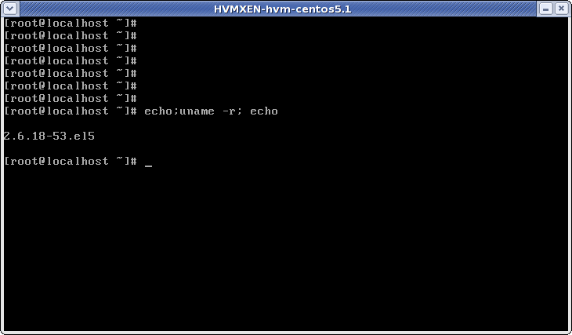
centos-5.1 (HVM) on xen

Slide 37
Windows (HVM) on XEn

Slide 38
The administrator console and other management tools

Slide 39
VM management
The standard installation of Xen provides basic VM management tools:
xm command suite
xenstore DB
xendomains daemon
In addition, a set of tools are available based on libvirt libraries (virt-manager, virt-install, virsh …)
http://libvirt.org/index.html
http://virt-manager.et.redhat.com/index.html

Slide 40
Using the xm command
Primary command to create,destroy,modify,monitor ecc.. the dom0 and domUs
Essentially a command suite with many different functions defined by “subcommands” (59 in total)
It can be considered as an interface to the xenstore tree
xm info
xm list
xm create
xm console
xm mem-set (mem-max)
xm block-attach (block-detach)
xm network-attach (network-detach)
xm pause (unpause)
xm save (restore)
xm migrate

Slide 41
Getting information on domains
xm info
xm list dom-ID
Displays information about the dom0: hardware, configurations (xen_scheduler), capabilities (hw_caps), status (free_memory)
Displays information about a specific or all (running, paused, blocked…) xen domains.
If –long option is used, displays all config information in SXP format

Slide 42
Pausing and hybernating a domain
xm save dom-id state-file xm restore state-file
The domain is put in hybernate state. The entire memory content and configuration is saved on state-file and the resources are released.
xm pause dom-id xm unpause dom-id
The domain is paused and retains all the allocated resources. Nevertheless it is not scheduled for execution anymore

Slide 43
Managing domain memory allocation
xm mem-set domID mem
xm mem-max domID mem
Changes the amount of memory used by the domain. Note that mem can’t never be greater than “maxmem” specified in the config file.
Changes the maximum amount of memory that the hypervisor can allocate to the domain

Slide 44
Managing block devices
It’s always possible to attach block devices in order to have it mounted and used by a DomU
xm block-attach dom-id [phys_dev] [virt_dev] [mode] (ex: xm block-attach 10 phy:/dev/VolGroup/test xvdb w)
Once a block device is attached to a DomU, it remains in the XenStore db until it is detached
xm block-detach dom-id [virt_dev] ex: xm block-detach 10 xvdb
Few basic conditions must be satisfied:
The block device must not be already mounted and writable by the Dom0
The block device must not be already attached and writable to another DomU
The DomU must provide a suitable driver for the file system (if it already exists)
To list the block devices attached to a domain:
xm block-list dom-id

Slide 45
Managing network devices
Similar commands can be used to add/remove network devices
xm network-attach dom-id [script=scriptname] [ip=ipaddr] [mac=macaddr] [bridge=bridge-name] (ex: xm network-attach 10 ip=192.168.122.100 script=vif-nat)
xm network-detach dom-id [dev-id] [-f] (ex: xm network-detach 20 1)
To list the network devices attached to a domain:
xm block-list dom-id

Slide 46
Using xen-store
Directory database used to store configuration, events and status information about Xen domains.
Three top-level nodes:
/vm (config info on Xen domains by UUID)
/local/domain (state and execution by domID)
/tool (Xen related tools)
Accessed by
xenstore-ls
xenstore-list
xenstore-read
xenstore-write
xenstore-rm

Slide 47
Using xenstore
$ xenstore-ls /local/domain/16
vm = "/vm/75c190f8-f49d-44ca-8d1c-358dfcd35125"
device = ""
vbd = ""
768 = ""
backend-id = "0"
virtual-device = "768"
device-type = "disk"
state = "1"
backend = "/local/domain/0/backend/vbd/16/768"
5632 = ""
backend-id = "0"
virtual-device = "5632“
vif = ""
0 = ""
state = "1"
backend-id = "0"
backend = "/local/domain/0/backend/vif/16/0"
device-misc = ""
vif = ""
nextDeviceID = "1"
console = ""
port = "3"
limit = "1048576"
tty = "/dev/pts/1"
name = "winxp”
[…..]

Slide 48
Using xendomains
/etc/sysconfig/xendomains
VM startup
XENDOMAINS_AUTO (type = string)
XENDOMAINS_RESTORE (type = bool)
VM shutdown
XENDOMAINS_SAVE (type = string)
XENDOMAINS_MIGRATE (type = string)
Dir containing links to automatic startup domains
Whether to try to restore domains whose checkpoint is in XENDOMAINS_SAVE dir
Dir containing the checkpoint for domains to be saved when dom0 shuts down
String to be passed to migrate command for domains relocation at dom0 shutdown. If empty the domain is not migrated

Slide 49
Xendomains startup sequence
If XENDOMAINS_AUTO dir contains files domUs are started (xm create)
If XENDOMAINS_RESTORE=true domains in the XENDOMAINS_SAVE dir are restored (xm restore)
If exists /var/lock/subsys/xendomains xendomains terminate

Slide 50
Xendomains shutdown sequence
If XENDOMAINS_MIGRATE is set domUs will be migrated according to the options
If XENDOMAINS_SAVE is set domUs will be saved in the specified dir.
All the other domains will be shutted down

Slide 51
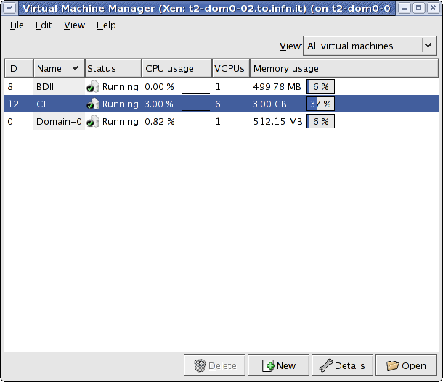
Tools based on libvirt
virt-manager
GUI based on libvirt libraries.
Easier to install both PV and HVM guests
Commands for save/suspend/resume VM
Integrated graphic console
Widgets to:
add/remove devices
Change memory
Change number of vcpus

Slide 52
Remote VM management with virsh
Virsh is a remote management utility included in the libvirt package.
Using virsh it is possible to connect to a remote Xen hypervisor and to perform actions on the guest domains
By default a TLS connection is used which uses client/server autentication with certificates
virsh -c xen://<remotehypervisor>/
As an alternative a ssh tunnel connection is also possible
virsh -c xen+ssh://<user>@<remotehypervisor>/

Slide 53
Server setup for virsh
Install latest libvirt package
Generate a self-signed CA certificate
Generate a couple key/certificate for the server
Put server certificate in /etc/pki/libvirt/
Put server key in /etc/pki/libvirt/private
Put CA certificate in /etc/pki/CA
Ensure that Xend is listening for tcp connections “(xend-unix-server yes)”
Check /etc/libvirt/libvirtd.conf for consistency of certificates and keys paths
Check that LIBVIRTD_ARGS="--listen“ is set in /etc/sysconfig/libvirtd

Slide 54
Client setup for virsh
Install latest libvirt package
Generate a couple key/certificate for the client
Put client certificate in /etc/pki/libvirt/
Put client key in /etc/pki/libvirt/private
Put CA certificate in /etc/pki/CA
Check /etc/libvirt/libvirtd.conf for consistency of certificates and keys paths

Slide 55
Convirt (ex. Xenman)
Convirt is a X-based application for multiple remote hypervisors management.
It allows to start/stop/pause/resume domains
It allows to manage server pools
Drag&drop live migration
Image store and provisioning of VM on dom0s (simple and customizable by using a shell script)
Ssh tunnel used with keys or username/password authentication
http://xenman.sourceforge.net/index.html

Slide 56
Convirt requirements
Server side:
Xend daemon (Xen 3.0.2 or later) running and listening for tcp-xmlrpc connections “(xend-tcp-xmlrpc-server yes)”
SSH server with login permissions to control the Xend daemon (the X server is not required)
Client side:
Xend daemon (Xen 3.0.2 or later) running
X Server
SSH Client to connect to the server
Paramiko library (to be properly patched)

Slide 57
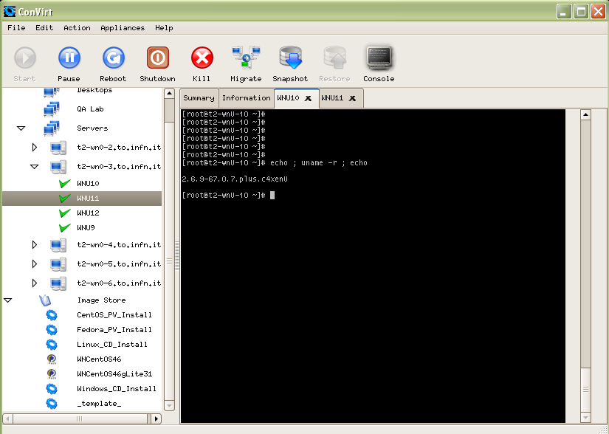
Convirt usage example

Slide 58
Advanced VM configuration and management
Part II

Slide 59
summary
Techniques to improve performances
Memory management
Privileged access to hardware (driver domains)
Management of graphics for guest domains
Migration of PV guests
Fault tolerant solutions
Network channel bonding
Xen VM guests as a linux HA resource
Stateless linux machine with Xen

Slide 60
Controlling Dom0 memory usage
May improve performances reducing the "memory ballooning" overhead
In GRUB configuration file:
kernel ……… dom0_mem=X
dom0_mem=min:X
dom0_mem=max:X
dom0_mem=min:X,max=Y
module
………
N.B. do not confuse “dom0_mem=“ with “mem=“. The latter limits the overall memory that the hypervisor will be able to use.

Slide 61
Virtual Split Devices Model
Virtual split device drivers for virtual I/O with frontend and backend layers
Frontend in unprivileged guests
Backend in Domain-0
Frontend and backend use shared memory pages for communication
Access is controlled through use of grant tables
"Driver domains": additional domains with unmodified drivers for the underlying I/O devices

Slide 62
Dedicating hardware to guest domains (driver domains)
Usefull to increase performances of a domU with a particular scope (ex. dedicate a network card to a WEB server or a SCSI card to a storage server)
Still possible only for paravirtualized guest
Drawback: reduced flexibility (the domU can’t be easily migrated to another dom0)
PCI device must first be “hidden” from dom0 using Xen “pciback” driver
domU must provide a suitable driver for that PCI device (probably better to use the original xen kernel and initrd)
Once the device is hidden from dom0 add
pci=[ ‘xx:xx.x’ ]
to the domain configuration file

Slide 63
Hiding PCI devices from dom0
Locate the pci bus address on dom0
lspci
Load module “pciback” on dom0 (if not compiled into kernel)
Unbind the device from the dom0 driver
echo -n “<pci-bus-address” > > /sys/bus/pci/drivers/<module-name>/unbind
Bind the device to pciback module
echo -n “pci-bus-address” > > /sys/bus/pci/drivers/pciback/new_slot
echo -n “pci-bus-address” > > /sys/bus/pci/drivers/pciback/bind
Pay attention with RHEL-5.1 and CentOS-5.1. Apply patch:
http://xenbits.xensource.com/xen-unstable.hg?rev/0ae1d493f37c

Slide 64
Hiding PCI devices from dom0
Check if pciback driver is availlable
Unload all the device related modules
Stop xend daemon
Bind the device to the pciback driver (/etc/modprobe.conf)
options pciback hide = (xx:xx.x)
Try “modprobe pciback”
Locate the PCI identifier of the device on dom0
lspci
lsmod | grep pci
ls /sys/bus/pci/drivers/pciback (built in kernel)
install <device> /sbin/modprobe pciback ;/sbin/modprobe –first-time –ignore -install <device>
Start xend daemon
Pay attention with RHEL-5.1 and CentOS-5.1. Apply patch:
http://xenbits.xensource.com/xen-unstable.hg?rev/0ae1d493f37c

Slide 65
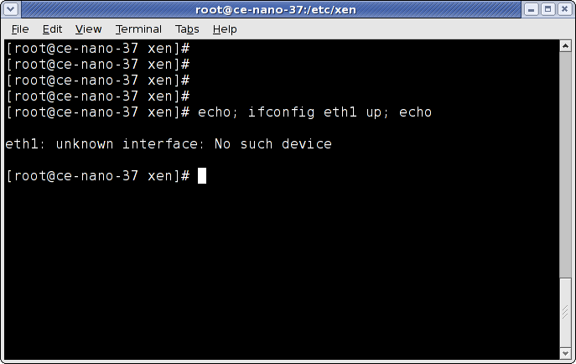
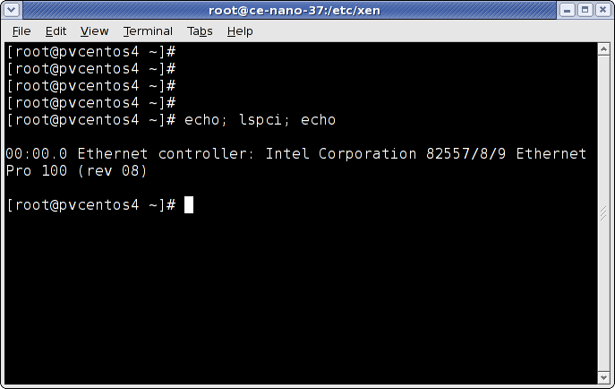
example
eth1 network card hidden
from dom0
The network card is seen on domU as a PCI device

Slide 66
Time synchronization of domains
By default domU’s clock is synchronized with dom0 clock
In order to have a different (independent) clock sync for domUs:
Add “xen.independent_wallclock = 1” to domU’s /etc/sysctl.conf file
echo 1 > /proc/sys/xen/independent_wallclock
Add “independent_wallclock = 1” to “extra” option in domU config file

Slide 67
Managing graphics for guest domains
Xen supports guest domain graphics in either:
SDL (Simple DirectMedia Layer) windows
VNC (Virtual Network Computing) windows
SDL
VNC
Superior graphics quality and precision in tracking input events
Makes use of dom0 native graphics, thus it’s heavier and requires an Xserver on it Does not allow remote usage
Designed for remote management Lighter if vnc server runs directly on domU
Some problems in event synchronization, specially with the mouse

Slide 68
Managing graphics for HVM domains
Using SDL for HVM guests
sdl = 1
vnc = 0
Using VNC for HVM guests
sdl = 0
vnc = 1
Vnc server available on dom0 at: 127.0.0.1:(<domID>+5900)
or depending on parameters : vnclisten, vncdisplay, vncpasswd (guest config)

Slide 69
Managing graphics for PV domains
Using vfb and dom0 VNC server:
vfb = [ ‘type=vnc, keymap=xx’ ]
N.B: in order to be able to use the text-only console:
(inittab) → co:2345:respawn:/sbin/agetty xvc0 9600 vt100-nav
(securetty) → xvc0
Using vfb and dom0 SDL support:
vfb = [ ‘type=sdl, keymap=xx’ ]
Using a domU VNC server (preferred solution)
Install and configure the X server and VNC server on domU and let him provide graphics to the client over the network. Pay attention to the firewall (ports 590x,580x and 6000)

Slide 70
Xen VM Migration
Guest domain migration is the possibility to move a running domU from one domain0 to another without visible interruption in services.
There are a number of caveats in the migration process, concerning also the security.
In the migration process, the vm configuration and memory is first copied to the dom0 target, then the source vm is stopped and the target is started.
Main requirements:
Both dom0 must be running a version of the Xen daemon which supports the migration
Relocation must be enabled in both Xen daemons, so that dom0s can communicate with each other
The root filesystem of the domUs must be shared, visible by both dom0s and with same privileges and permissions
Dom0s must be on the same ip subnet
Sufficient resources must be available on the target dom0

Slide 71
Xend configuration for migration
xend-relocation-server
xend-relocation-port
xend-relocation-hosts-allow
Set to “yes” to enable migration
Specify port for migration (def. 8002)
Regexp to specify hosts allowed to migrate to this domain
xend-relocation-address
Specify the network address to listen to for relocation (def all)

Slide 72
Migration demo

Slide 73
Fault-tolerant virtualization with channel bonding
In Xen, a bridge is equivalent to a virtual switch
Connection to physical interface (uplink)
And virtual interface (kernel module)
Linux provides native bonding module
Achieves adapter fault tolerance
Documented in networking/bonding.txt
Has several possible modes
Load balancing + link aggregation
Active/backup policy (explained for simplicity)

Slide 74
Configuration of bonding and bridge
Load the bonding driver (/etc/modprobe.conf)
alias bond0 bonding
options bond0 miimon=100 type=active-backup
Configure the bond interface startup script (/etc/sysconfig/network-scripts/ifcfg-bond0)
DEVICE = bond0
BOOTPROTO = none
ONBOOT = no

Slide 75
Attaching interfaces to bridge
Both interfaces join the bond (/etc/sysconfig/network-scripts/ifcfg-eth{1,2}
DEVICE = eth{1,2}
BOOTPROTO = none
ONBOOT = no
MASTER = bond0
SLAVE = yes

Slide 76
Bridge configuration
Create the additional bridge for guests
brctl addbr xenbr1
Disable ARP and multicast for bridge and bond + set a bond MAC address that would not interfere with public MAC addresses
ip link set xenbr1 arp off
ip link set xenbr1 multicast off
ip link set xenbr1 up
ip link set bond0 address fe:ff:ff:ff:ff:ff
ip link set bond0 arp off
ip link set bond0 multicast off

Slide 77
Ensalve bridge and configure guest to use it
Add the bond to the bridge and bring up bond with enslaved interfaces
brctl addif xenbr1 bond0
ifup bond0
Configure a guest domain to use the new bridge (/etc/xen/<guest>)
vif = [ ‘bridge = xenbr1’ ]
# tail –f /var/log/messages
xendomain0 kernel: bonding: bond0: releasing active interface eth1
xendomain0 kernel: device eth1 left promiscuous mode
xendomain0 kernel: bonding: bond0: making interface eth2 the new active one
xendomain0 kernel: device eth2 entered promiscuous mode

Slide 78
HA with xen guest servers
Scenario
We need to make a set of services highly available in an Active/Passive configuration
Instead of having a couple of real servers for each service, we use PV guest servers (dumUs) and a single backup machine (dom0) in standby
The goal is to have the PV guest treated like a service and managed by heartbeat

Slide 79
Required components
A storage volume where all nodes involved in the cluster can write to at the same time
A filesystem that allows for simultaneous writes
The Heartbeat software for high availability clustering
One or more Xen virtual machines

Slide 80
Some preliminary work
SSH key-based authentication
NTP time synchronization
Atd service running on all nodes
Double-check name resolution

Slide 81
Configuring the SAN
Xen disk images and configuration files must be stored on a location where they can be reached by both nodes simultaneously
Use your own SAN or create one based on iSCSI
No hardware equipment strictly necessary
Network block device protocol over TCP
Both target and initiator available on Linux platform
Could be also replaced with AoE

Slide 82
Configuring the storage server
Device to share: either hard disk, partition, logical volume (better) or disk image file
Install iSCSI target tools and kernel module on storage server
Configure ietd.conf to define LUN
Install iSCSI initiator on clients
Configure iscsi.conf to access the share
isscsi + iscsiadm

Slide 83
Configure the cluster safe file system
File system that can be written by multiple nodes simultaneously
OCFS2 has its own high availability manager
In our use case we want OCFS2 volumes managed by Heartbeat
Some additional steps required
GFS
Available in Cluster Suite
Red Hat Gobal File System
OCFS2
Configurable with Linux-HA
RPMs available from Oracle
Oracle Cluster File System

Slide 84
Run the OCFS2 configuration tools
Use ocfs2console GUI
Add nodes to the list
Review /etc/ocfs2/cluster.conf by hand
Run o2cb configure
Accept all defaults except user space heartbeat
Fine tuning /etc/sysconfig/o2cb
On both nodes
O2CB_IDLE_TIMEOUT parameter
Format the ocfs2 partition (mkfs.ocfs2) and copy the filesystem image file on it

Slide 85
Ocfs2 Gui console

Slide 86
Configuring Heartbeat
This ensures service is going to be available where needed
Create the cluster itself
Configure cluster resources
For STONITH device
For OCFS2 system
A cluster resource for every single Xen virtual machine
Tell the cluster to load OCFS2 fs before starting Xen VMs

Slide 87
Creating Heartbeat configuration
Base configuration file /etc/ha.d/ha.cf
Use sample provided in /usr/share/doc/heartbeat-<version>
Customize bcast address (heartbeat link)
Customize node list (with all nodes participating the cluster)
Customize logd to enable logging daemon (better than syslogd)
Add “crm on” directive to use heartbeat-2 style
Propagate configuration over all nodes
/usr/lib/heartbeat/ha_propagate
Use GUI for further configuration
/usr/lib/heartbeat/hb_gui
Verify cluster is up n’ running
crm_mon –i 1

Slide 88
Creating a STONITH resource
«Shoot the other node in the head»
Makes sure that when the cluster thinks a resource is dead, it will make sure it is dead
Normally implemented with a special device like a power switch
For test purposes SSH based
Easy way
Hard way
Configure through GUI
cibadmin parses XML files

Slide 89
Cibadmin and reusable XML configuration files: generic properties
<cluster_property_set id=“cibbootstrap”>
<attributes>
<nvpair id=“bootstrap-01” name=“transition-idle-timeout” value=“60” />
<nvpair id=“bootstrap-04” name=“stonith-enabled” value=“true” />
<nvpair id=“bootstrap-05” name=“stonith-action” value=“reboot” />
<nvpair id=“bootstrap-06” name=“symmetric-cluster” value=“true” />
<nvpair id=“bootstrap-07” name=“no-quorum-policy” value=“stop” />
<nvpair id=“bootstrap-08” name=“stop-orphan-resources” value=“true” />
<nvpair id=“bootstrap-09” name=“stop-orphan-actions” value=“true” />
<nvpair id=“bootstrap-10” name=“is-managed-default” value=“true” />
<nvpair id=“bootstrap-11” name=“default-resource-stickness” value=“INFINITY” />
</attributes>
</cluster_property_set>

Slide 90
Cibadmin and reusable XML configuration files: define STONITH
<clone id=“stonith_cloneset” globally_unique=“false”>
<instance_attributes id=“stonith_cloneset”>
<attributes>
<nvpair id=“stonith_cloneset-01” name=“clone_node_max” value=“1” />
</attributes>
</instance_attributes>
<primitive id=“stonith_clone” class=“stonith” type=“external/ssh” provider=“heartbeat”>
<operations>
<op name=“monitor” interval=“5s” timeout=“20s” prereq=“nothing” id=“stonith_clone-op-01” />
<op name=“start” timeout=“20s” prereq=“nothing” id=“stonith_clone-op-02” />
</operations>
<instance_attributes id=“stonith_clone”>
<attributes>
<nvpair id=“stonith_clone-01” name=“hostlist” value=“node1, node2” />
<attributes>
</instance_attributes>
</primitive>
</clone>

Slide 91
Apply configuration files
Add contents to cib.xml (heart of cluster, keeps all configurations)
cibadmin –C –o crm_config –x bootstrap.xml
cibadmin –C –o resources –x stonithcloneset.xml
Check successful configuration
crm_mon –i 1

Slide 92
Creating the OCFS2 file system resources
<clone id=“imagestorecloneset” notify=“true” globally_unique=“false”>
<instance_attributes id=“imagestorecloneset”>
[…]
</instance_attributes>
<primitive id=“imagestoreclone” class=“ocf” type=“Filesystem” provider=“heartbeat”>
<operations>
[…]
</operations>
<instance_attributes id=“imagestoreclone”>
<attributes>
<nvpair id=“imagestoreclone-01” name=“device” value=“/dev/shareddevice” />
<nvpair id=“imagestoreclone-02” name=“directory” value=“/srv/mountpoint” />
<nvpair id=“imagestoreclone-03” name=“fstype” value=“ocfs2” />
</attributes>
</instance_attributes>
</primitive>
</clone>
Same file needed for shared directory containing Xen configuration files

Slide 93
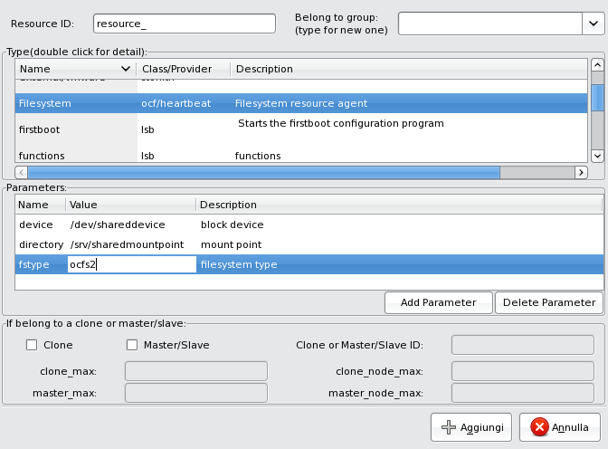
Adding the ocfs2 resource

Slide 94
Creating the Xen Cluster Resource
<primitive id=“centos5” class=“ocf” type=“Xen” provider=“heartbeat”>
<operations>
<op name=“monitor” interval=“10s” timeout=“60s” id=“xen-op-01” />
<op name=“stop” timeout=“60s” id=“xen-op-02” />
</operations>
<instance_attributes id=“centos5_instance”>
<attributes>
<nvpair id=“xen-01” name=“xmfile” value=“/etc/xen/vm/centos5” />
</attributes>
</instance_attributes>
<meta_attributes id=“centos5_meta”>
<attributes>
<nvpair id=“xen-02” name=“allow_migrate” value=“true” />
</attributes>
</meta_attributes>
</primitive>

Slide 95
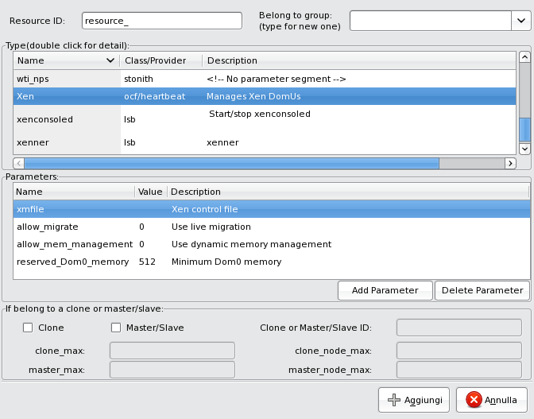
Adding the Xen resource

Slide 96
3… 2… 1… Ignition!
Still need to add constraints
Ensure Xen resource is brought up after OCFS2 volumes
Review configuration through GUI
Highlight the Xen resource, right click it and next select “Start”
This should activate the virtual machine as a resource in the cluster

Slide 97
Testing the high-availability of the virtual machine: simulate crash
Kill hearbeat on node 1
After a short time, node1 reboots due to a STONITH operation initiated on the DC
The virtual machine will be migrated to node2
Node1 will reboot into the cluster, and after some seconds the imagestore and configstore will be remounted on node1
The virtual machine will then be migrated back to node1.
After a crash of node1, the virtual machine is now running on node2
Once node1 rejoins the cluster, Heartbeat 2 migrates the virtual machine back to node1

Slide 98
Stateless virtual machines served via NAS
StatelessLinux is a new way of thinking about how a system is supposed to run and to be managed
To be stateless, a system should be able to be replaced at any time, whether it’s running diskless or with local storage
Most famous use case: MareNostrum @ BSC (www.bsc.es)
«BSC-CNS hosts MareNostrum, one of the most powerful supercomputer in Europe and the number 13 in the world, according to the last Top500 list. […] MareNostrum […] has now 10.240 processors with a final calculation capacity of 94.21 Teraflops. »
Making a Linux filesystem for serving read-only NAS-root
Marked as a Technology Preview since RHEL 5
Still in RHEL 5.2 with some updates
Debian provides a huge set of tools integrated with FAI
Notes:
Separare la parte statica del filesystem da quella variabile (che contiene lo stato)
Xen facilita il compito in quanto demanda all’hypervisor la gestione dello storage locale (e in generale dell’accesso alle risorse di I/O) che contiene la parte variabile. Si pensi a che succederebbe se si avessero macchine con hardware eterogeneo (la parte fissa dovrebbe fornire tutti i moduli e drivers e le macchine utilizzarli propriamente) Es. Con systemimager occorre definire “golden images” per le diverse macchine.
NFS con cache permette di migliorare le performances
La parte fissa viene acceduta di rado (quindi anche NFS non rappresenta un collo di bottiglia)
FAI = fully automated Installation

Slide 99
Create a Linux filesystem
Need a complete Linux filesystem which you can export from your NAS box
Single partition is recommended but not required
Debian: just use debootstrap to get a boot-ready filesystem
RHEL, CentOS, Fedora:
anaconda –G –m <mirror source> --rootpath=<exportable path> --kickstart=<base ks>
rsync -av --exclude '/proc/*' --exclude '/sys/*' <golden client> :/ /srv/images/centos-5
Golden client = already existing installation (best if freshly installed)
rinse (works like deboostrap, installs base system)
Notes:
Rinse = deboostrap per redhat

Slide 100
Export it
Export filesystem read-only from NAS box to the nodes which will be mounting it
Add a line to /etc/exports
/srv/images/centos-5 192.135.19.0/24(ro,async,no_root_squash)
Reload nfs (exportfs –r)
Showmount can help you in troubleshooting
Notice no_root_squash option since this will be the root filesystem
Exporting it read-only

Slide 101
Make it work when mounted read only
CentOS 5
StatelessLinux scripts merged into its startup scripts
Enable the read-only filesystem setup in /etc/sysconfig/readonly-root
Change both READONLY and TEMPORARY_STATE variables to 'yes‘
Edit /etc/rwtab to mount --bind any additional files or directories and make them writable
“dirs” will copy the entire directory from the read-only filesystem onto the ramdisk
“empty” creates an empty directory in the ramdisk
“files” copies that file from the read-only filesystem into the ramdisk
Instead of using a ramdisk, logical volumes are usable as well
Created in Domain-0
Default labels are stateless-rw and stateless-state
Others
Patch /etc/rc.d/rc.sysinit to run the same sort of scripts
Notes:
--bind permette di montare la stessa partizione (che sara’ quella locale che contiene la parte variabile del sistema) in + punti (quelli identificati in rwtab)

Slide 102
Some additional configuration
Turn off onboot for eth0 in /etc/sysconfig/network-scripts/ifcfg-eth0 (already network booted)
Edit /etc/fstab for nfs root environment
Soft link /etc/mtab to /proc/mounts (Centos-5.1)
Edit iptables to allow traffic to nfs server (use fixed ports)
SELinux cannot be enabled on nfsrootclients!
«In general, Red Hat does not recommend disabling SELinux. As such, customers must carefully consider the security implications of this action.»

Slide 103
Create a suitable kernel
Support for nfsroot included in 2.6 kernel, but not included in most RHEL rpm packages
mkinitrd way (not tested)
--rootdev <nfs-server>:</nfs-path>
--rootfs nfs
--with xennet, --with xenblk (should use your modules for physical nfsrooted machine)
“Recompile-your-kernel” way (tested)
rpmbuild -bp –target i686 SPEC/kernel-2.6.spec
make menuconfig (set as yes)
PNP_IP + suboptions
NFS_FS
NFS_FSCACHE
ROOT_NFS
Enable frontend drivers as builtin, not modules
rpmbuild –bb –target i686 –with xenonly SPEC/kernel-2.6.spec

Slide 104
Build proper configuration file
nfs_root = ‘path’
Specifies the IP address of the NFS server, in dotted – quad notation, that hosts the NFS root filesystem
root = ‘device [mount]’
Specifies the name of the device containing the root filesystem, and how it should initially be mounted
Set to ‘/dev/nfs ro’
Specifies the full remote pathname for the NFS root filesystem
nfs_server = ‘aaa.bbb.ccc.ddd’
Set disk = [ ‘….’ ]
disk = [ ‘phy:/dev/VolGroup/stateless-rw, xvda1, w’, ‘phy:/dev/VolGroup/stateless-state, xvdb1, w’ ]

Slide 105
Other point of view
“Paravirtualization is a dead end approach”
“….. Paravirtualization requires substantial engineering efforts in modifying and maintaining an operating system. However, these heroic efforts are inevitably losing the battle against Moore's Law and hardware advances being made in the x86 space …..”
Alex Vasilevsky (founder of Virtual Iron)

Slide 106
References
http://www.xen.org/
William von Hagen, Professional Xen Virtualization, Wiley Publishing Inc
David E. Williams, Juan Garcia, Virtualization with Xen, Syngress
http://unit.aist.go.jp/itri/knoppix/xen/index-en.html

Slide 107
extra

Slide 108
Bridged Networking: startup
Built-in support
Connect multiple networks and network segments
Packets across a bridge based on Ethernet address
Starting network-bridge
Create a new bridge (xenbr0) with brctl
Copy info from physical network (eth0) to virtual (veth0)
Shut down physical network, rename eth0 to peth0 and veth0 to eth0
Add peth0 and vif0.0 (associated with veth0) to the bridge
Brings up bridge and interfaces
Delete routes associated to original eth0 and recreates attached to bridge
Notes:
Funzionamento del bridged networking

Slide 109
Bridged Networking: guest operations
Display status with network-bridge status command
If manually create/delete bridges, Xen could recreate some of them each reboot, depending on the state of system before last restart
Xen daemon stores persistent state information in /var/lib/xend/state
Purge deleted bridges from the /var/lib/xend/state/network.xml, delete the bridge manually, and then restart the Xen daemon.
If antispoofing enabled (default)
Incoming packets forwarded to bridge
Associates device with vif1.0
Bring up Domain-U
Attaches vif1.0 to bridge
Brings up vif1.0
Set forwarding rules
Notes:
I pacchetti per i domU contengono un indirizzo mac di destinazione che non e’ quello del dom0 e sarebbero rigettati se non ci fosse una regola di iptables per il forward dall’interfaccia vif1.0

Slide 110
NAT Networking: startup
Network Address Translation , technique by which systems with no externally visible IP addresses can route traffic through a host that does
Requires packet addresses and checksums to be recomputed and rewritten
Managed by iptables chains (PREROUTING and POSTROUTING)
Much simpler than bridged networking, but is much less powerful
Can cause problems or prevent connectivity in network services that require all participants to have “real” IP addresses
Connectionless protocols (UDP) more complex
If already running a DHCP server, optionally configure DHCP server on Domain-0 host to hand out IP addresses on the 10.0.0.0 subnet to Domain-U hosts via DHCP
Modify dhcp=${dhcp:-no} entry in the /etc/xen/scripts/network-nat file

Slide 111
NAT Networking: guest operations
Bringing up NAT on Domain-0
Activate IP forwarding
Set up postrouting rule for masquerading
(DHCP optional) Enable guests to get addresses on 10.0.0.0
Bringing up guest domains
Associate eth0 in guest with vifDomID.Interface
Configure routing for vifDomID.Interface through domain0
Handle ARP requests for vifDomID.Interface
(DHCP) Guest get address used when configuring routing

Slide 112
Routed Networking: setup
Routing enables packets for one host to be sent through another host
It has to understand how to send those packets to their destination and also how to redirect responses
Support for routing is built into the kernel
Using routed networking with Xen is very similar to using NAT, except that
traffic to domainU guests is directly routed through Domain-0
and that a static route to each Domain-U guest must exist in the domain0 routing table

Slide 113
Routed Networking: guest operations
The network-route script performs the following actions when Xen daemon starts
Activates IP forwarding
# echo 1 > /proc/sys/net/ipv4/ip_forward
Configures Domain-0 to also handle (proxy) ARP requests for domain-U # echo 1 > /proc/sys/net/ipv4/conf/eth0/proxy_arp
Bringing up Domain-U guest (run vif-route script)
Copies the IP address from gateway interface to vifDomID.Interface
Brings up vifDomID.Interface
Adds a static route for Domain-U IP address to vifDomID.Interface

