Slide 1
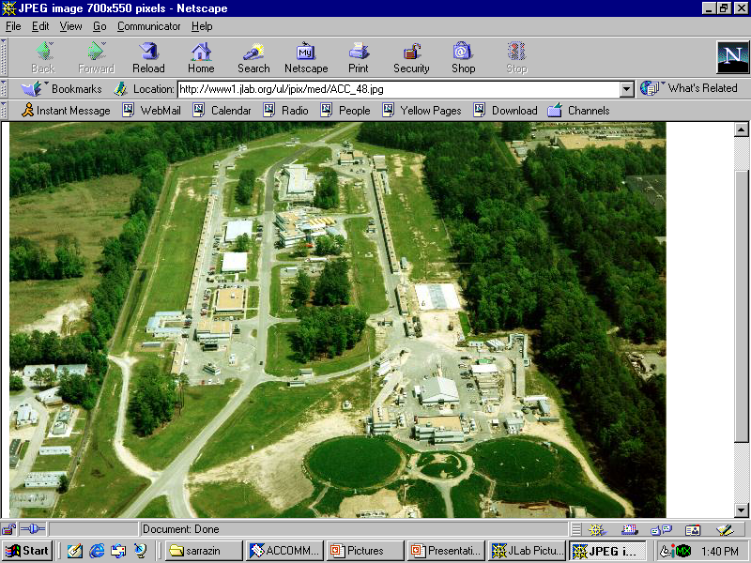
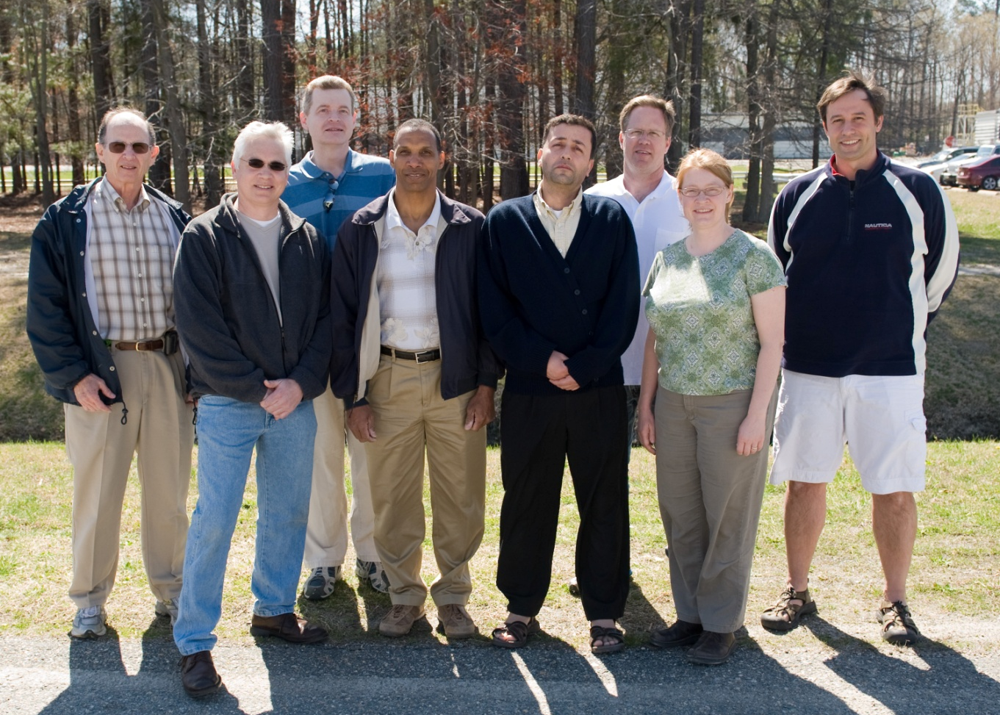
Continuous Electron Beam Accelerator Facility
Polarized e-Source - Talking Points for PV experiments:
P. Adderley, M. BastaniNejad, J. Clark, S. Covert, J. Hansknecht, J. Grames,
R. Mammei, Matt Poelker, M. Stutzman, R. Suleiman, K. Surles-Law

Slide 2
Continuous Electron Beam Accelerator Facility
A parity factory….
Beam energy 0.4 - 6 GeV
Current ~ nA to 180uA
Polarization ~ 85%
0.6 GeV linac
(20 cryomodules)
1497 MHz
67 MeV injector
(2 1/4 cryomodules)
1497 MHz
Gain switched
A
B
C
RF separators
diode lasers
499 MHz
499 MHz,
Δφ
= 120°
B
A
B
Pockels cell
A
C
C
Gun
HAPPEx
PVDIS
PREx
Moller
Double sided
G0
Qweak
septum

Slide 3
Worth Talking About…
Accelerator parity tools
  Properly aligned pockels cell
  Charge/position feedback techniques
  Spin flip schemes: line or non-line locked, pairs/quartets/octets, etc
  Two-Wien spin flipper
  Fast pockels cell switch
  The photogun and its properties
  Helicity control board
  Helicity magnets for active position feedback
  Proper grounding techniques
  Beam envelope matching for optimum adiabatic damping
What makes each experiment difficult?
  G0: low repetition rate, very high bunch charge
  Qweak: high current (photogun lifetime, minimizing beam scraping)
  Moller: duration, tightest proposed beam quality specs: charge, position and angle, synchrotron radiation at high energy might introduce beam noise
Global questions
  How to detect small helicity pickup without requiring months of beam?
  Hall beamline configuration, too many constraints (Hall A)
  Accelerator staff: getting them to appreciate the nature of beam requirements
  Finding that one person to manage all the details…..
  At what point can’t we do a proposed PV experiment?

Slide 4
Worth Talking About…
Accelerator parity tools
  Properly aligned pockels cell
  Charge/position feedback techniques
  Spin flip schemes: line or non-line locked, pairs/quartets/octets, etc
  Two-Wien spin flipper
  Fast pockels cell switch
  The photogun and its properties
  Helicity control board
  Helicity magnets for active position feedback
  Proper grounding techniques
  Beam envelope matching for optimum adiabatic damping
What makes each experiment difficult?
  G0: low repetition rate, very high bunch charge
  Qweak: high current (photogun lifetime, minimizing beam scraping)
  Moller: duration, tightest proposed beam quality specs: charge, position and angle, synchrotron radiation at high energy might introduce beam noise
Global questions
  How to detect small helicity pickup without requiring months of beam?
  Hall beamline configuration, too many constraints (Hall A)
  Accelerator staff: getting them to appreciate the nature of beam requirements
  Finding that one person to manage all the details…..
  At what point can’t we do a proposed PV experiment?

Slide 5
Parity Experiments Requirements
can’t measure
Experiment | Energy (GeV) | I (µA) | Target | A_{pv} (ppb) | Maximum Charge Asym (ppb) | Maximum Position Diff (nm) | Maximum Angle Diff (nrad) | Maximum Size Diff (δσ/σ)
HAPPEx-II (Achieved) | 3.0 | 55 | ¹H (20 cm) | 1400 | 400 | 1 | 0.2 | Was not specified
HAPPEx-III (Achieved) | 3.484 | 100 | ¹H (25 cm) | 16900 | 200±100 | 3±3 | 0.5±0.1 | 10⁻³
PREx | 1.056 | 100 | ²⁰⁸Pb (0.5 mm) | 500±15 | 100±10 | 2±1 | 0.3±0.1 | 10⁻⁴
QWeak | 1.162 | 180 | ¹H (35 cm) | 234±5 | 100±10 | 2±1 | 30±3 | 10⁻⁴
Møller | 11.0 | 85 | ¹H (150 cm) | 35.6±0.74 | 10±10 | 0.5±0.5 | 0.05±0.05 | 10⁻⁴

Slide 6
Two Wien Filters: Slow Helicity Reversal for PREx and Qweak
Insertable Half Wave Plate (IHWP), used for years: slow helicity reversal of laser polarization
  Identify false asymmetries
  Cancel out some helicity correlated systematic effects, but not all…
New: Slow helicity reversal of electron polarization using two Wien Filters and solenoid:
  Cancel out another class of helicity-correlated beam asymmetries from the source including spot size
  Solenoid rotates spin by +/- 90° (spin rotates as B, but focus as B²)
    Maintain constant Injector and Accelerator configuration (that’s the goal)
  Today’s design can be used up to maximum voltage of 140 kV

Slide 7
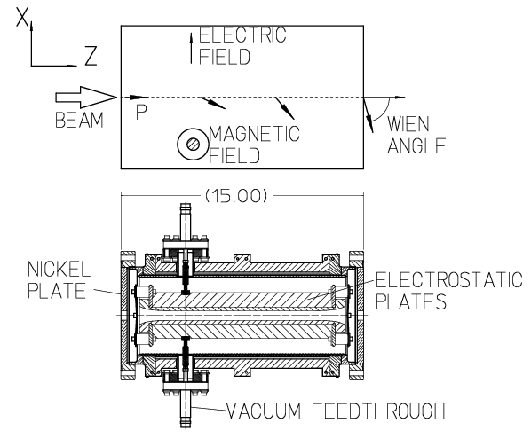
Wien Filter Spin Manipulator
Equal but opposite E and B forces, rotate the spin and leave trajectory constant

Slide 8
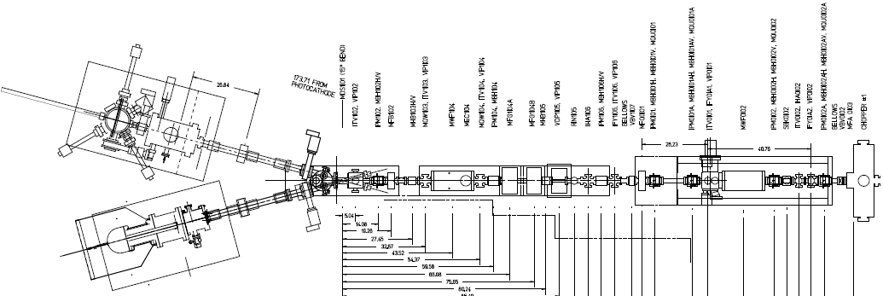
Electron Polarization Slow Reversal
“Spin Flipper”
Vertical Wien = 90 deg
Two Solenoids = ±90 deg
“Longitudinal Polarization”
Horizontal Wien = {-90 … +90}
From Gun
FLIP - LEFT
FLIP - RIGHT
Joe Grames, Kent Paschke, Reza Kazimi

Slide 9
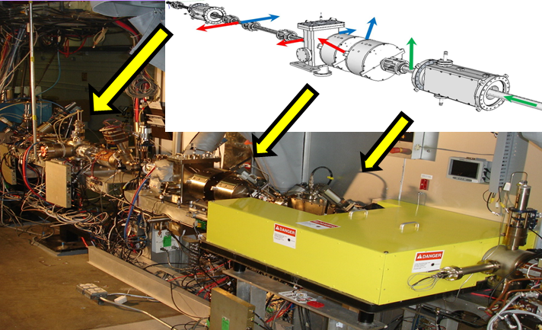
Two-Wien Spin Flipper
flip spin each week to cancel out HC laser spot variation
Baked beamline for good vacuum
Good for beams up to 140kV
Some steering required. Users complain beam quality not optimized after wards (Compton bkgd)
One mistake: Prebuncher should have been moved downstream of 2nd Wien.

Slide 10
Fast Helicity Reversal
We have been using 30 Hz helicity reversal for years:
  Power line 60 Hz frequency is major source of noise in parity experiments
  For 30 Hz reversal, T_Stable (= 33.333 ms) contains exactly two cycles of 60 Hz line noise → this reversal cancels line noise
Problem:
  target density fluctuations, occurring faster than 30Hz
Solution: Flip helicity faster, but need a better pockels cell switch
60 Hz beam motion a nuisance….

Slide 11
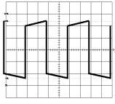

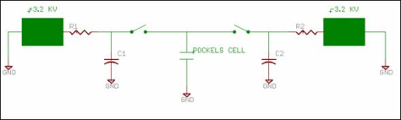
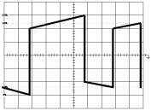
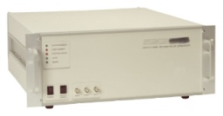
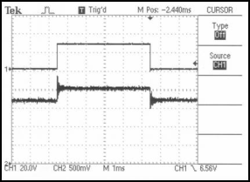
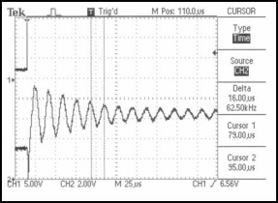
Initial attempts and problems encountered
This approach needed big capacitors…. lots of current
Two commercial high-speed / high-voltage transistor (~$8000)
Exaggeration of voltage droop on cell and subsequent re-charge after a helicity flip. Droop causes a serious problem when helicity flip rate was changed from a toggle to a pseudo-random pattern: pockels cell “memory”
high-voltage switch (~$10,000) All-in-one commercial bipolar
Charge droop was greatly improved, but high speed ringing of the cell was a problem for the settling time. In addition, the large high-speed switching currents created a noise induced helicity pickup on sensitive helicity DAQ components.
Work of John Hansknecht

Slide 12
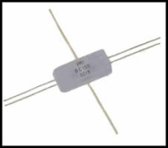
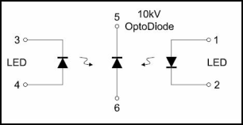
Solution: Opto-diode
Encapsulated Opto-diode $67 each
I = CΔV/ Charge time
+/- quarter wave voltage = 5120V
Cell capacitance = 6pf
Desired charge time = 100us
Calculated current is only 307uA !!
Work of John Hansknecht

Slide 13
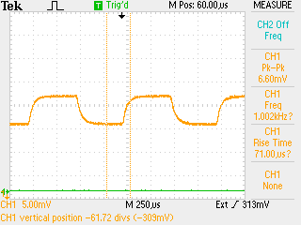
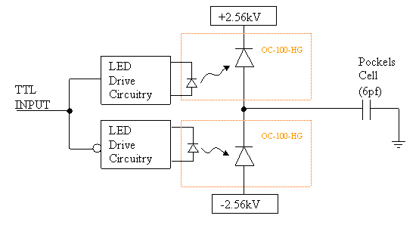
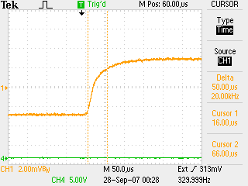
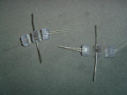
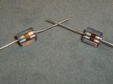
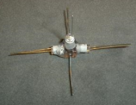
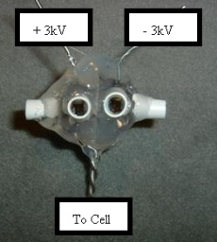
New Opto Diode Pockels Cell Switch
Pockels cell λ/2 flipping at 1kHz.
Perfect symmetry and no voltage droop over time.
Push-Pull Circuit
Pockels cell λ/2 transition optical result. ~70us with no ringing.
1
2
3
The old switch was limited to 30 Hz helicity flip rates due to power handling limitations. Now we flip at 1kHz for ~ 400$.
Pockels cell “memory” not an issue anymore….
4
Work of John Hansknecht

Slide 14
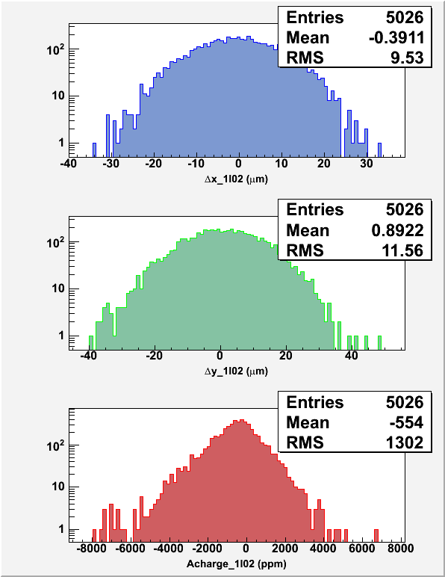
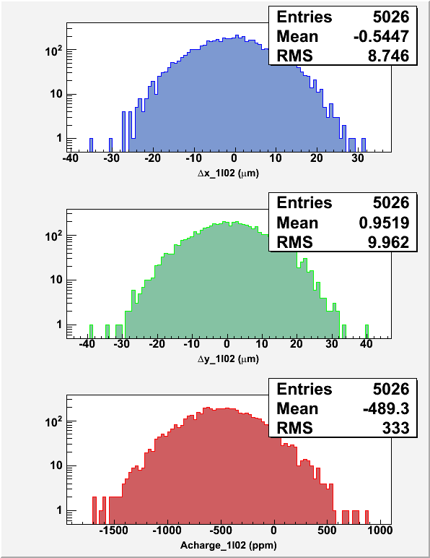
Widths at 30 Hz and 1 kHz: For white noise, the increase in width going from 30 Hz to 1 kHz should be:
30 Hz, T_Stable = 33.333 ms, T_Settle = 500 µs
1 kHz, T_Stable = 0.980 ms, T_Settle = 60 µs
But we don’t have white noise. Mostly we have low frequency noise. So an unexpected benefit of flipping faster….

Slide 15
Qweak e-Source Issues
Provide high current,180+ uA, with very little beam loss
  Option 1: Increase gun bias voltage
    Modest increase from 100kV to 130kV
    Why not higher? risk damaging gun due to field emission
    Some injector magnets operating at max current right now
  Option 2: Increase laser spot size
Qweak is a long experiment: how to maintain stability of front end with acceptable parity quality?
  Injector drift, something charging up?
  Minimize cycling gun HV ON/OFF
  Coordinate Beam Studies, Spot Moves, and 2-Wien Spin Flips

Slide 16
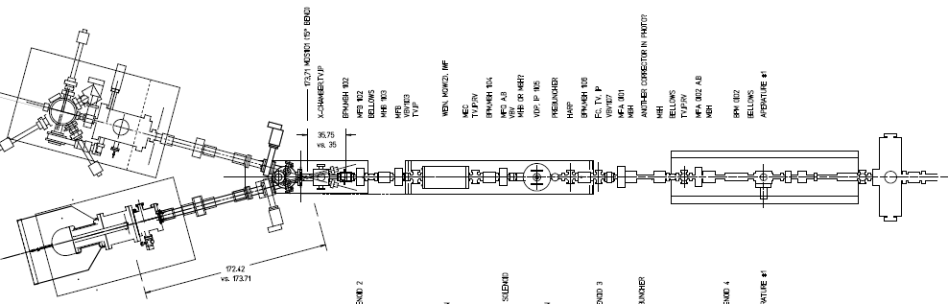
35ps bunches from the gun
prebuncher
Emittance filter A1 and A2 (4 and 6 mm)
Master slit sets bunchlength at buncher/capture section: 111ps
With our 100kV gun, lots of beam loss at front-end apertures when delivering 180uA: this introduces unwanted helicity correlated asymmetries, and wasted beam degrades photogun operating lifetime.

Slide 17
Benchmarking PARMELA Simulation Results Against Beam-Based Measurements at CEBAF/Jefferson Lab – work of Ashwini Jayaprakash, JLab
Measurements at CEBAF/JLab
PARMELA Simulation Results
Similar Trends
Message: Beam quality, including transmission, improves at higher gun voltage

Slide 18
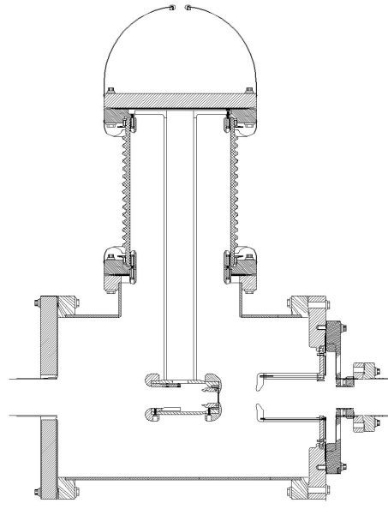
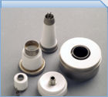
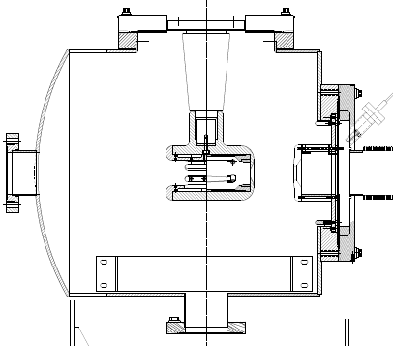
“Inverted” Gun
Old Gun Design
Present Ceramic
Exposed to field emission
Large area
Expensive (~$50k)
Lots of metal at HV
Medical x-ray technology
We had low level field emission
e⁻
New Ceramic
Compact
~$5k
Less metal at HV
No SF6 of N2
New design
Move away from “conventional” insulator used on most GaAs photoguns today – expensive, months to build, prone to damage from field emission.
High gradient locations not related to beam optics, lots of metal to polish

Slide 19
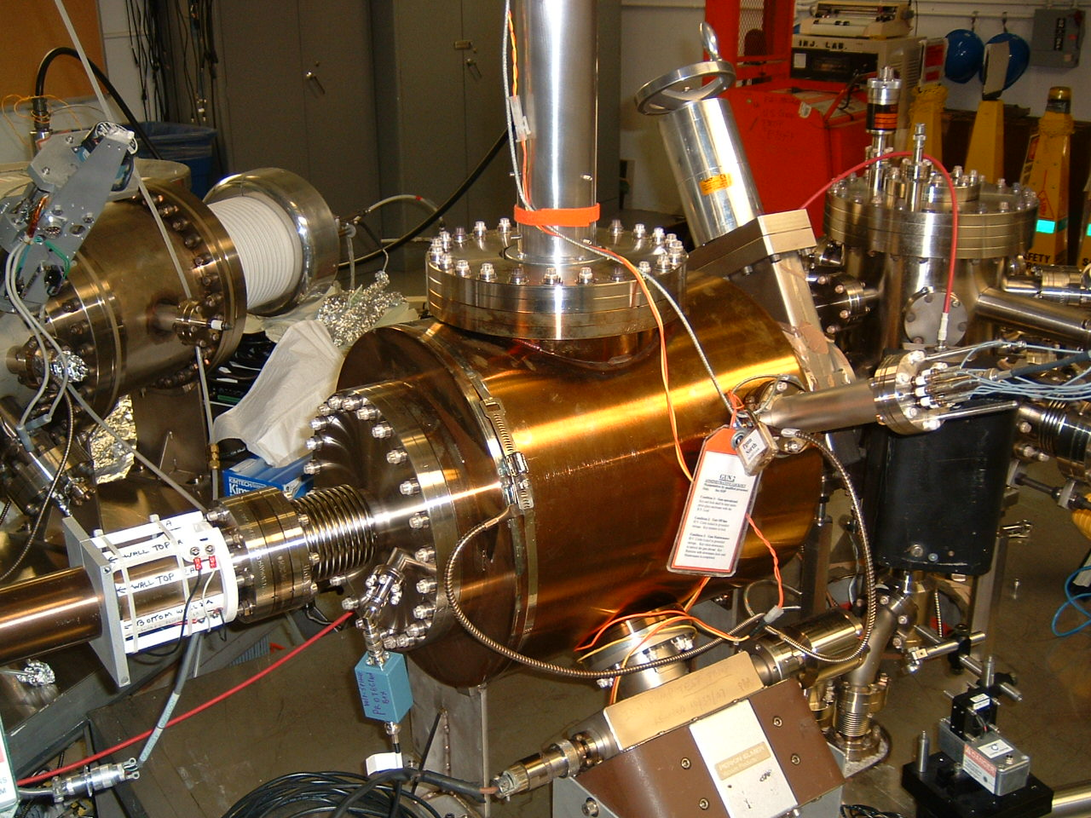

Paid for by ILC
Inverted Gun #2 at Test Cave
Large grain niobium electrode
Problematic field emission at 140kV
Repeated BCP treatment, no measurable field emission at 225kV
Have since demonstrated many months of beam delivery at 200kV
Our spare gun……
Inverted Gun #1 at CEBAF
Operational since July, 2009
Stainless steel electrode
Operated at 100kV for HAPPEx, PVDIS and PRex (70C @ 150uA)
Operated at 130kV for Qweak (70C @ 300 uA), improved transmission
Expected better lifetime….puzzling

Slide 20
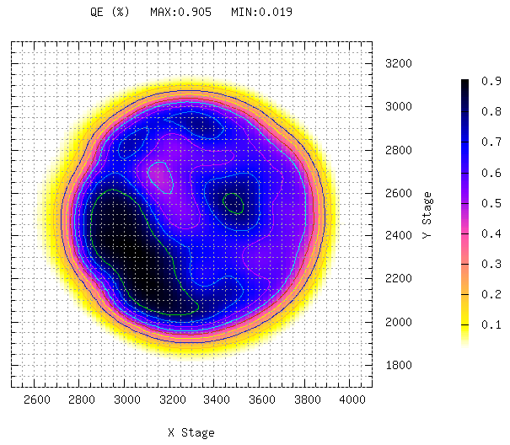
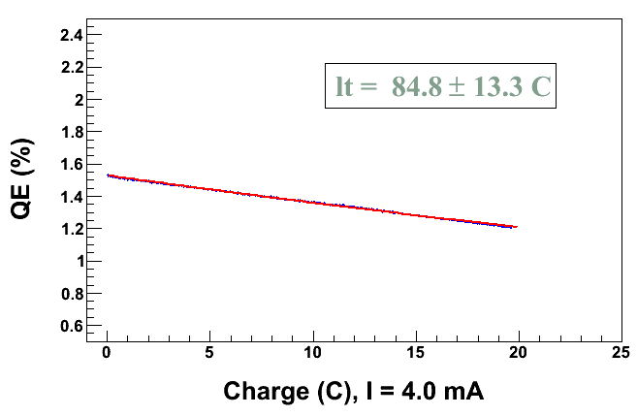
4mA at High Polarization*
Parameter | Value
Gun Bias Voltage | 200kV
Laser Rep Rate | 1500 MHz
Laser Pulselength | 50 ps
Wavelength | 780 nm
Laser Spot Size | 350 mm
Current | 4 mA
Duration | 1.4 hr
Charge | 20 C
Lifetime | 80 C
* Note: did not actually measure polarization
QE
Work of Riad Suleiman

Slide 21
Improve Lifetime with Larger Laser Spot?
(Best Solution – Improve Vacuum, but not easy)
Bigger laser spot, same # electrons, same # ions
Ionized residual gas
strikes photocathode
Ion damage distributed
over larger area

Slide 22
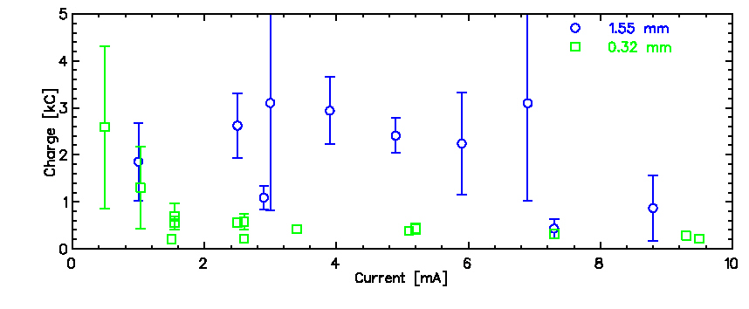
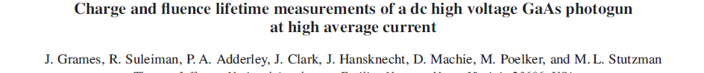
Lifetime with Large/Small Laser Spots
Tough to measure large Coulomb lifetimes accurately with only 100-200 C runs
Observed factor of 5 to 10 improvement with larger laser spot size
Expectation:
2
1550
≈ 23
320
Discrepancy explained in paper shown below
For Qweak Part2, we can operate with 800um laser spot instead of 500um spot. Two benefits:
Enhance lifetime by ~ 2.5
Reduce space charge forces which should improve transmission (G0 trick), maintain parity quality at 180+uA

Slide 23
Møller Experiment
Max run avg charge asym 10 ppb. Transmission must be very high, 100%
Need position and angle feedback
No transverse polarization: how to measure?
Slow Helicity Reversal:
    g-2 Spin Flip (change energy by 100 MeV)
    Two-Wien Flip
2 kHz Fast Helicity Reversal and 10 µs Pockels Cell Settle
Beam Jitter:
    Position Jitter/width < 10 µm
    Charge Jitter/width < 300 ppm

Slide 24
Møller Experiment
30 Weeks
Vertical/transverse polarization not measured at Hall. Feedback on vertical polarization?
How to measure HC pickup and ground loops on this new scale?
Compton spec, no accelerator diagnostic to tune to
3? (competing?) requirements at Hall: spot size at target, spot size at compton, phase advance and position of modulation coils, raster, etc.,
Synchrotron radiation might limit adiabatic damping, increase widths of HC measurements, and degrade polarization?

Slide 25
A New Injector for ~ 2015….
200kV polarized electron gun, upgraded 2-Wien
An SRF capture section inside a…
New cryomodule that contains a single 7-cell SRF cavity to make 10MeV beam
Replace one older full module with new C-100 to operate injector at 110MeV energy
This helps us do PV experiments by…
Making a stiff beam out of gun, very little beamloss
Eliminate x/y coupling that hinders our ability to optimize position damping

Slide 26
Worth Talking About…
Accelerator parity tools
  Properly aligned pockels cell
  Charge/position feedback techniques
  Spin flip schemes: line or non-line locked, pairs/quartets/octets, etc
  Two-Wien spin flipper
  Fast pockels cell switch
  The photogun and its properties
  Helicity control board
  Helicity magnets for active position feedback
  Proper grounding techniques
  Beam envelope matching for optimum adiabatic damping
What makes each experiment difficult?
  G0: low repetition rate, very high bunch charge
  Qweak: high current (photogun lifetime, minimizing beam scraping)
  Moeller: duration, tightest proposed beam quality specs: charge, position and angle, synchrotron radiation at high energy might introduce beam noise
Global questions
  How to detect small helicity pickup without requiring months of beam?
  Hall beamline configuration, too many constraints (Hall A)
  Accelerator staff: getting them to appreciate the nature of beam requirements
  Finding that one person to manage all the details…..
  At what point can’t we do a proposed PV experiment?

Slide 27
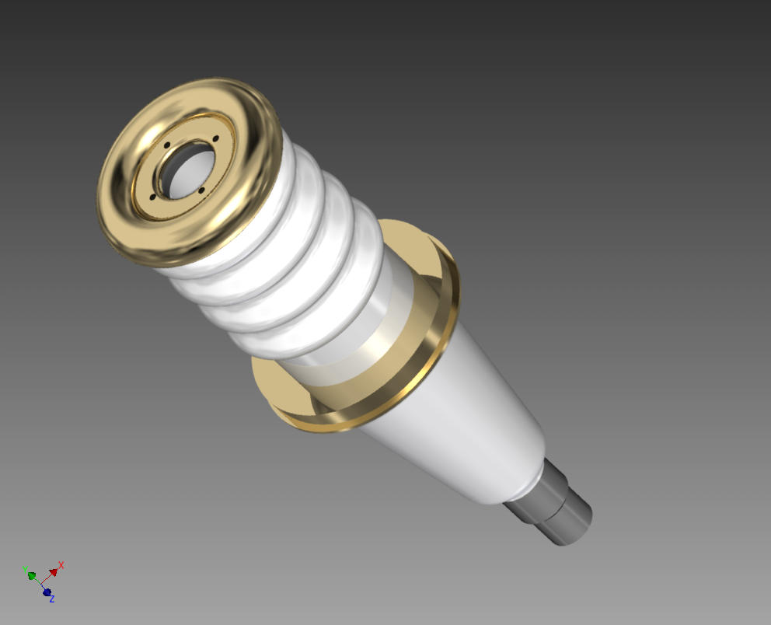

Slide 28
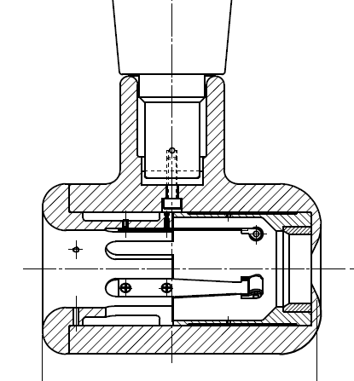
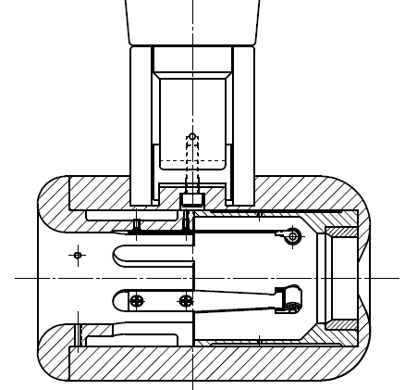
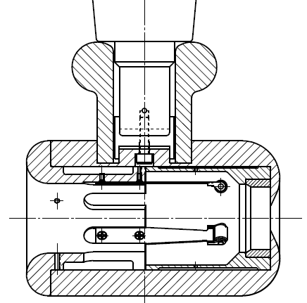
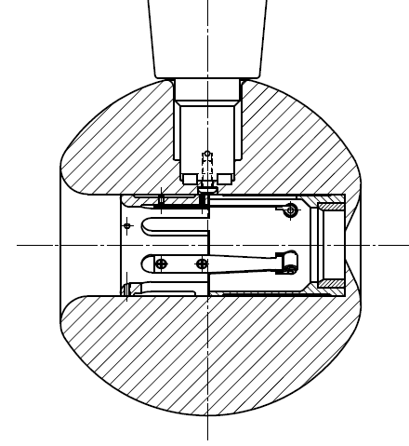
Plan B
Insulator sleeve
Plan A
No Improvement
Plan D
Plan C
In hand, but untested
Test this year

Slide 29
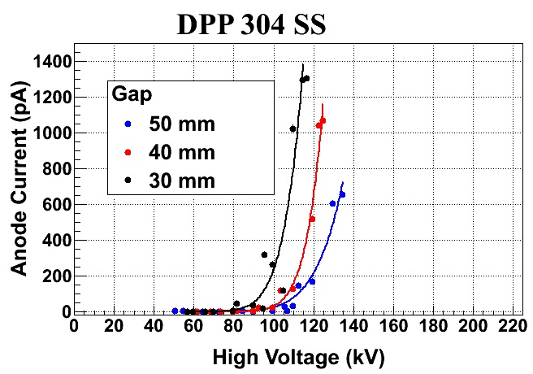
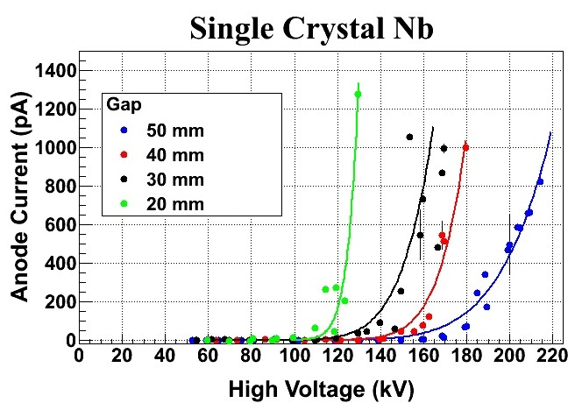
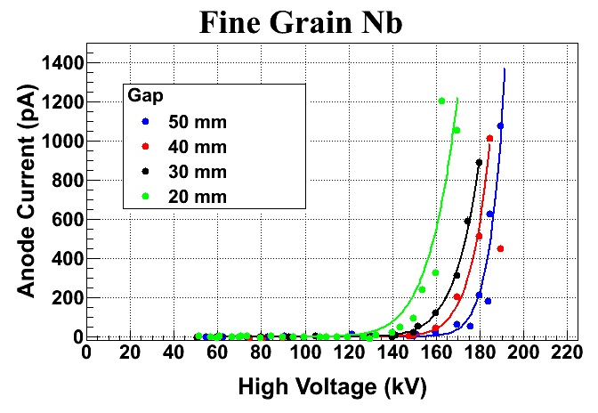
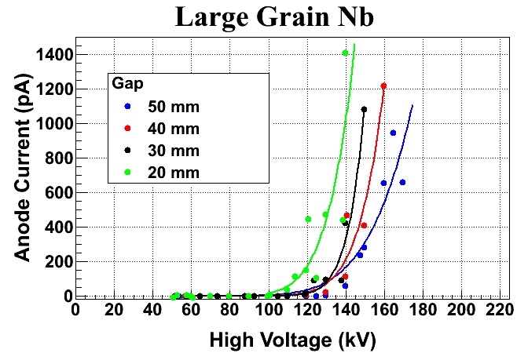
Why a Niobium Cathode Electrode?
Work of Mazhad BastaniNejad

Slide 30
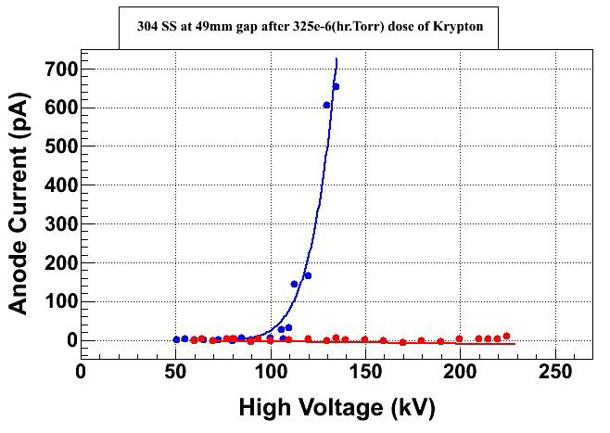
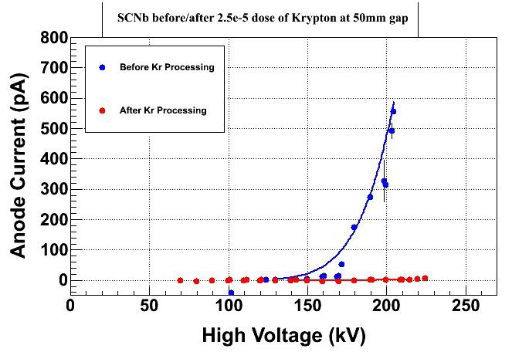
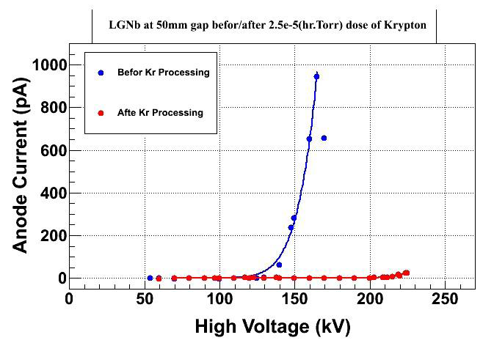
Krypton Processing High Voltage Electrodes
Diamond Paste Polished SS
Single Crystal Niobium and BCP
Large Grain Niobium and BCP
Work of Mazhad BastaniNejad

Slide 31
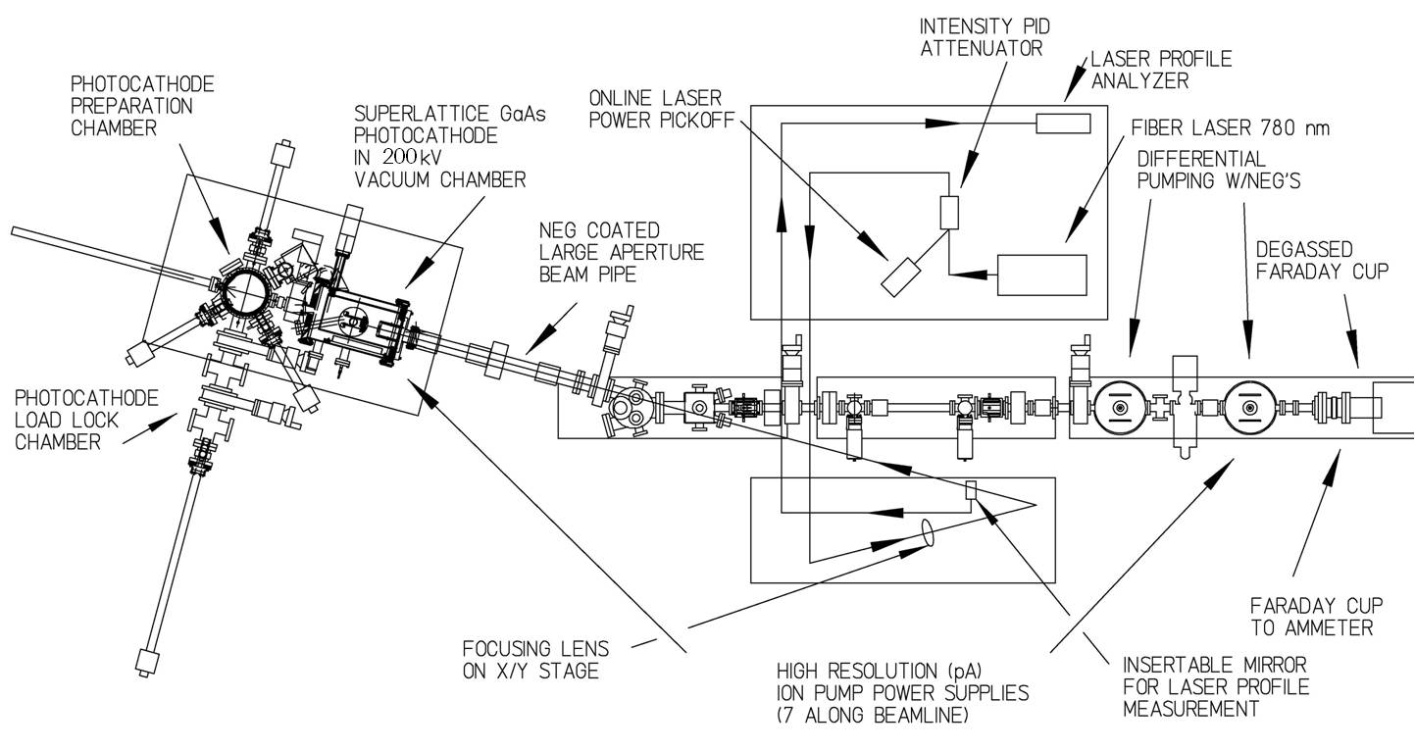
Injector Test Cave

Slide 32
Backup slides

Slide 33
Summary of Fast Helicity Reversal Studies
  Fast Helicity Reversal is needed:
    Huge reduction of noise from target density fluctuations
    Reduces noise on beam current by factor of 3
    Reasonable reduction in beam position noise
  T_Settle of 60 µs is very reasonable
  Parity Experiment:
Experiment | Frequency | Clock | Pattern
HAPPEx III & PVDIS | 30 Hz | Line-Locked | Quartet
PREx | 240 Hz | Line-Locked | Octet
QWeak | 1 kHz | Free | Quartet
Moller | 2kHz

Slide 34
Spin Flipper = Wien + Solenoid
Long. Pol = Wien
4 Most Important Configurations | Vertical Wien (MWF1I04) | Two Solenoids (MFG1I04A/B) | Horizontal Wien (MWF0I02)
NO FLIP (old method) | 0 deg | 0 deg | +43 deg
VERTICAL POL | 90 deg | 0 deg | +0 deg
FLIP - LEFT | 90 deg | -90 deg | -47 deg
FLIP - RIGHT | 90 deg | +90 deg | -47 deg
Some facts…
“Spin Flipping” is accomplished without changing Wien filters
Vertical Polarization is a “subset” of “Spin Flipper” operation
“Old Method” achieved by turning Vertical Wien off
Ability to uniquely define spin in 4π

Slide 35
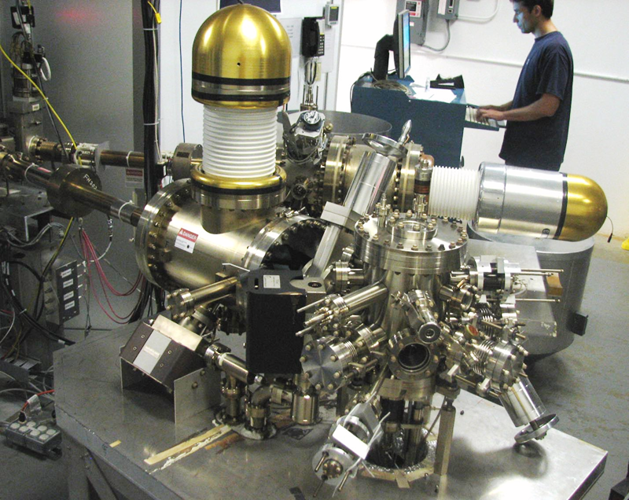
Want to move away from “conventional” insulator used on all GaAs photo-guns today: expensive, months to build, prone to damage from field emission.

Slide 37
Other Developments
Charge Feedback: Ability to do Charge Feedback using either Pockels Cell or Intensity Attenuator without or with the option to correct for Pockels Cell hysteresis
Helicity Magnets: Ability to do Position Feedback using the newly commissioned helicity magnets located in the 5 MeV region of the Injector
Pockels Cell Motion: Pockels Cell is equipped with remote controlled x & y translational stage for minimizing position differences while measuring the position differences of electron beam
Photocathode Rotation: With Load-Locked Gun, now we can zero the offset term in the charge asymmetry caused by the vacuum window birefringence by rotating the photocathode

Slide 38
Attenuator
IA
Rotatable GaAs
Photocathode
Gain-switched Diode Laser and Fiber Amplifier
LP HWP LP
PC WP LP
Shutter
Helicity Control Board
Helicity Flip Fiber
HV Supply
(0 – 90 V)
15° Dipole
nHelicity
Flip Fiber
Vacuum
Window
Delayed
Helicity Fiber
T-Settle
Fiber
Hall
RHWP
Charge Feedback (IA)
V-Wien Filter
Target
DAQ
Spin Solenoids
BCM
Charge Feedback (PITA)
H-Wien Filter
BPMs
Position
Feedback
Pockels
Cell
HV Supply
(0 – ±4000 V)
CEBAF
5 MeV
Helicity Magnets
PZT
Mirror
IHWP
Electron
Beam

Slide 39
Normal Grounded VME CRATE
(slow status and control - nothing occurs at helicity flip rate)
16 bit DAC: Pockels Cell (PC) ±HV setpoints (0 – ±4000 V)
16 bit DAC: Hall A, B, C Intensity Attenuator (IA) HV setpoints
RS-232: Rotating half-wave plate (RHWP) and laser attenuators
Discrete Digital I/O: Insertable half-wave plate (IHWP)
FLOATING VME CRATE
Helicity Control Board
Helicity Flip Fiber
IA0 Fiber
IA1 Fiber
Injector Service Building
Injector Tunnel Laser Hut
Optical Switch Control
Galvanic Analog/Digital Isolation Card
PC +HV Supply
Fast High Voltage Switch
Floating Analog/Digital I/O
PC -HV Supply
IHWP
RHWP &
Attenuators
IA
HV Supply
PockelsCell
AC Power Source
Floating DC Power
To Floating Components
Halls IA’s
Floating Circuit Common

Slide 40
Electronic Cross-talk & Ground Loop Elimination in Injector
VME Crate of Helicity Control Board is floating and powered with isolation transformer.
Helicity Board generates two real time helicity signals: Helicity Flip and nHelicity Flip. Current drawn by board does not depend on helicity state.
Helicity signal is generated by pseudo-random bit generator. No correlation between helicity signal and any other signal in Accelerator or in Hall.
Outside world receives only Delayed Helicity signal. This signal tells what helicity was in the past so there is no knowledge of real time helicity.
Helicity Magnets VME Crate which receives one of the two real time helicity signals (nHelicity Flip) is also floating and powered by isolation transformer.
Real time helicity signal (Helicity Flip) that goes to Laser Hut is isolated. All electronics that can see real time helicity are floating (next slide).
All helicity-correlated beam asymmetries (position, angle, charge, energy, and size – and thus beam scraping) are minimized so helicity is the only real time property of beam that is changing.
Programming of voltage setpoints of Pockels Cell and IA’s (both receive Helicity Flip signal) in Laser Hut passes through galvanic isolation card and there are no readbacks of these voltages.

Slide 41
Other Developments
Charge Feedback using either PITA or IA
4-peak IA correction for Pockels Cell hysteresis (“memory”), although fast PC switch has significantly reduced this ill-effect
Cleanup Insertable Linear Polarizer before the Pockels Cell is available during one Hall operation
Pockels Cell is equipped with remote controlled x & y translational stage for minimizing position differences while measuring the position differences of electron beam. Pitch, roll and yaw adjustments could be added…
With Load-Locked Gun, we can zero the offset term in the charge asymmetry caused by the vacuum window birefringence by rotating the photocathode

Slide 42
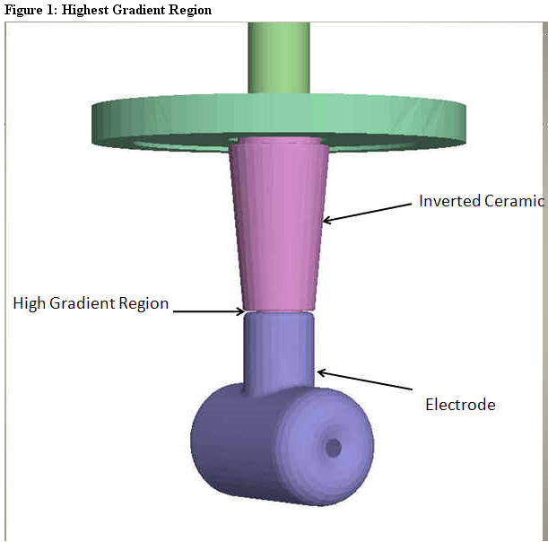
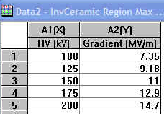
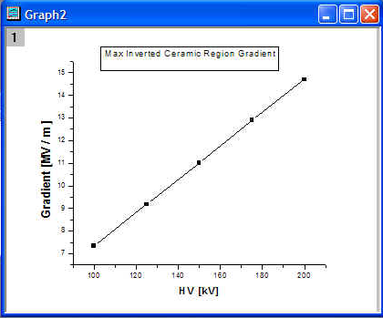
Our design has one region of “unintended” high gradient – could be problematic…..exploring new designs via electrostatic modeling
Work of Ken Surles-Law

Slide 43
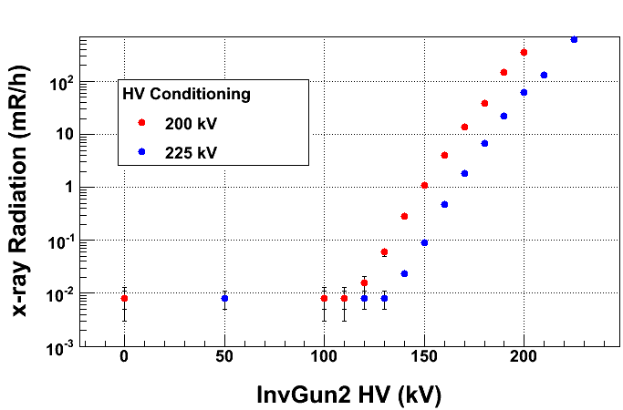
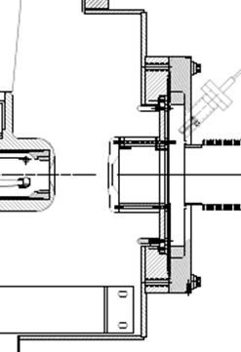



Anode won’t always capture all FE…. Better to look for x-rays….
Building an inexpensive radiation monitoring system: lots of GM tubes, powered by one HV supply and data stream to computer via RS232
Installation during 6MSD
2”
Work of Riad Suleiman, Steve Covert, J. Hansknecht
50$

Slide 44

After re-BCP, no FE at 225kV
5 January, 2011
A similar plot exists for our tunnel gun, but no data past 150kV
Message: source group getting better operating photoguns at voltage > 100kV but there’s always some possibility a field emitter is born
When this happens, the gun cannot provide high current. It must be replaced, or electrode re-polished. Expect one week downtime.

Slide 45
Qweak e-Source Issues
Provide high current,180+ uA, while maintaining good injector transmission and parity-quality
  Option 1: Increase gun bias voltage?
    it took a long time to find injector settings for 130kV
    risk damaging gun due to field emission
    some injector magnets operating at max current right now
  Option 2: Increase laser spot size
Minimize tuning required to achieve parity quality
  Injector drift, something charging up?
  Minimize cycling gun HV ON/OFF
  Coordinate Beam Studies, Spot Moves, and 2-Wien Spin Flips (per J. Benesch)
Poelker, Qweak collaboration meeting, W&M, June 23, 2011

Slide 46

Functionality of spin controls – operate to 140 keV
150 keV
140 keV
130 keV
120 keV
110 keV
100 keV

Slide 47

January 27, 2010
Region 1 Girder – “Spin Flipper”

Slide 48


January 27, 2010
Region 2 Girder – “A1/A2 + Horizontal Wien Filter”

Slide 49
How to reduce injector tune time?
Orbit drift near gun. Seemed like something was “charging up” and moving the beam, mostly in vertical direction
Field emission induced accumulation of charge on insulator? Purchased mildly conductive insulator but untested
Electron/hole production within insulator due to x-rays? Minimize beam loss and x-ray production by doing a better job steering through bend magnet vacuum chamber using new radiation monitors installed 6MSD
Turn the gun HV ON and leave it ON. Unfortunately, PSS tied to gun high voltage power supply. Hall accesses require gun HV OFF. Smooth ON/OFF better than instant ON/OFF - sometimes we lost QE when gun voltage was dropped to Zero due to PSS fault.
  Coordinate Beam Studies, Spot Moves, and 2-Wien Spin Flips (per J. Benesch)
  Qweak wants a ~ weekly spin flip, and this always requires injector tuning
  Schedule the spin flips to coincide with weekly spot move and beam studies. Exact schedule determined by photocathode lifetime, e.g., 5 days, 7 days or 10 days between spot moves…..

Slide 50
Conclusions
We will heat and reactivate the photocathode used during Qweak. Polarization was high, analyzing power was acceptable
Hoped for better photocathode lifetime but can’t attribute much downtime to photocathode maintenance. Conservative estimate: 5 days per spot, and there are at least 5 spots on photocathode, even with 800um laser beam, so ~ one month between heat and reactivations, and four 12-hour downtime periods during Qweak part2. ?
Continue to operate gun at 130kV
  Conservative approach seems prudent
  Expect quick injector start up, provides more time to focus on recovering the rest of the machine
Improve transmission at 180+ uA using large laser spot – a reasonable expectation based on g0 results. Lifetime should also improve based on Test Cave measurements
Fight injector drift by minimizing x-ray production using new radiation monitoring system. Should improve lifetime too.
Plenty of time during 6MSD for pockels cell studies and optimization
Positron experiment will not interfere with CEBAF startup or operations

