Slide 1
First measurements of parity-violating excitation
of the Δ and pion photoproduction
New results from G⁰
David S. Armstrong
College of William & Mary
(for the G⁰ Collaboration)
PAVI 2011 Workshop
Rome, Italy
Sept 5 2011

Slide 2
Outline
G⁰ experiment
Inelastic processes in parity-violating electron scattering
Results from
Results from on deuteron
Interpretation
Inelastic analysis: Carissa Capuano (W&M)
Pion analysis: Alex Coppens (U.Manitoba)
Thanks to Carissa, Alex, Jeff Martin (U. Winnipeg) for figures…

Slide 3
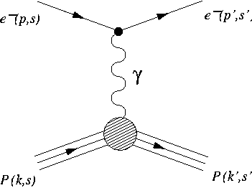
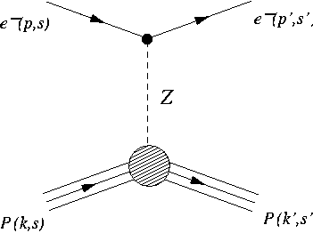
Parity-Violating Electron Scattering
Weak NC Amplitudes
scatter electrons of opposite helicities from unpolarized target
Interference: σ ~ |M^{EM} |² + |M^{NC} |² + 2Re(M^{EM*})M^{NC}
Interference with EM amplitude makes Neutral Current (NC) amplitude accessible
Small (~10⁻⁶) cross section asymmetry isolates weak interaction

Slide 4
G⁰ overview
Superconducting toroidal magnetic spectrometer – counting expt.
Forward angle mode:
LH₂: E = 3.0 GeV
Recoil proton detection
 0.12 ≤ Q² ≤ 1.0 (GeV/c)²
Backward angle mode:
E = 362, 687 MeV
LH₂, LD₂ electron, pion detection
(quasi)elastic at ~108º
Q² = 0.22 GeV², 0.63 GeV²
Main Goal: Strange Form Factors of Nucleon
PRL 95 (2005) 092001
PRL 104 (2010) 012001
NIM A 646 (2011) 59

Slide 5
G⁰: Ancillary measurements
In the backward angle mode:
Also measured (in parallel with elastic data) asymmetry for
inelastically scattered electrons in the Δ(1232) region
(from hydrogen and deuterium targets)
as well as produced from deuterium target.
Backgrounds for main (elastic) measurement, but have physics interest in their own right…
Experiment was not optimized for these processes!

Slide 6
G⁰ N-Δ: Introduction
First look at G^{A}_{NΔ} in neutral current process
Q² = 0.34 GeV/c².
What does G^{A}_{NΔ} describe?
G^{A}(Q²) → Axial elastic form factor for N
How is the spin distributed?
G^{A}_{NΔ}(Q²) → Axial transition form factor for N →Δ
How is the spin redistributed during transition?
Measure Parity-violating asymmetry A_{inel}
Allows a direct measure of the axial response during N →Δ
Accessing G^{A}_{NΔ} :
Previous Measurements: Charged current process
Both quark flavor change and spin flip
G⁰ N-Δ Measurement: Neutral current process
Quark spin flip only
PV first considered by Cahn & Gilman PRD 17(1978) 1313
…proposed as a Standard Model test!

Slide 7
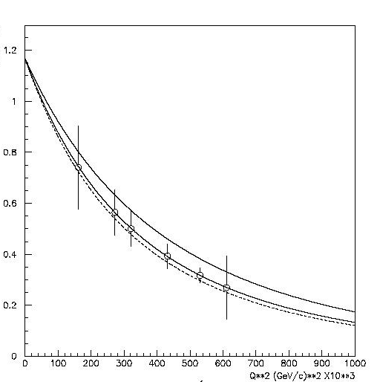
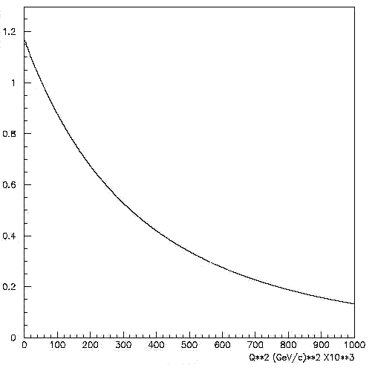
G⁰ N-Δ: Theory
Zhu et al. PRD 65 (2002) 033001
Q² Range of
G⁰ Measurement
Δ^{π}₍₁₎ = 2(1−2sin²θ_{W}) ≈ 1
Δ^{π}₍₂₎ = non-resonant contribution
Δ^{π}₍₃₎ = 2(1−4sin²θ_{W}) F(Q²,s)
(resonant term)
At tree-level:
F contains kinematic information & weak and electromagnetic transition form factors
Extract G^{A}_{NΔ} from F

Slide 8
G⁰ Backward angle: Detectors
Cerenkov detector
Elastic electrons (green)
Inelastic electrons (red)
Detector System (one octant shown):
Scintillators:
Kinematic separation of elastic and inelastic electrons
Cryostat Exit Detectors (CED)
Focal Plane Detectors (FPD)
Cerenkov Detectors :
Distinguish pions from electrons; one per octant
Coincidences send to scalers, accumulated during helicity states

Slide 9
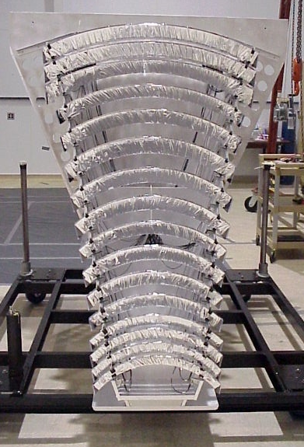
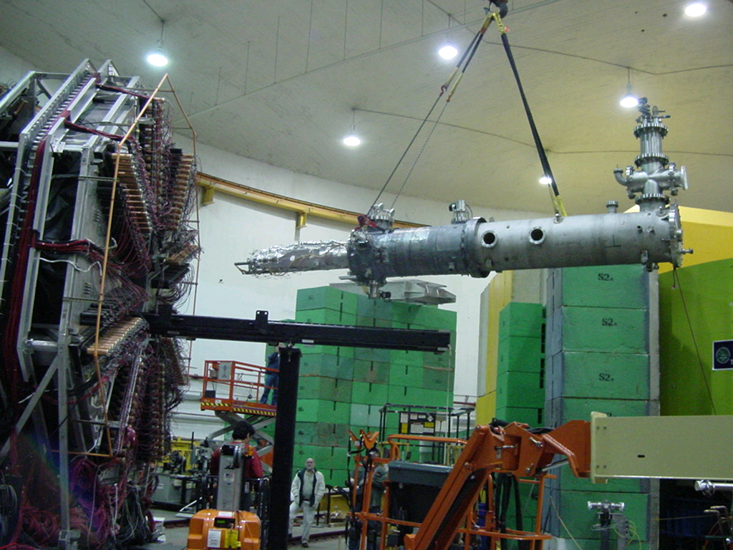
G⁰ Backward angle
Superconducting
Magnet
Cherenkov
FPD
FPD (1 octant)
CED
Target system installation
Detector package

Slide 10
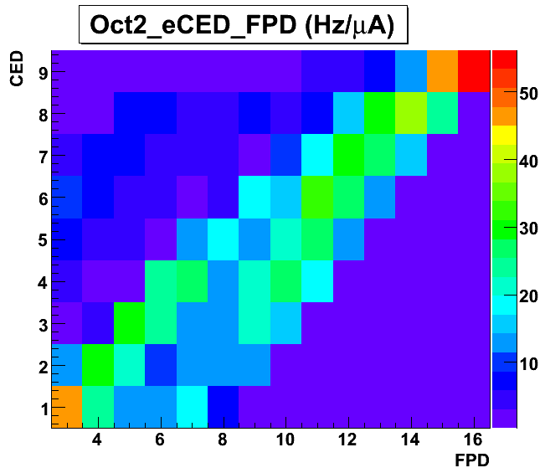
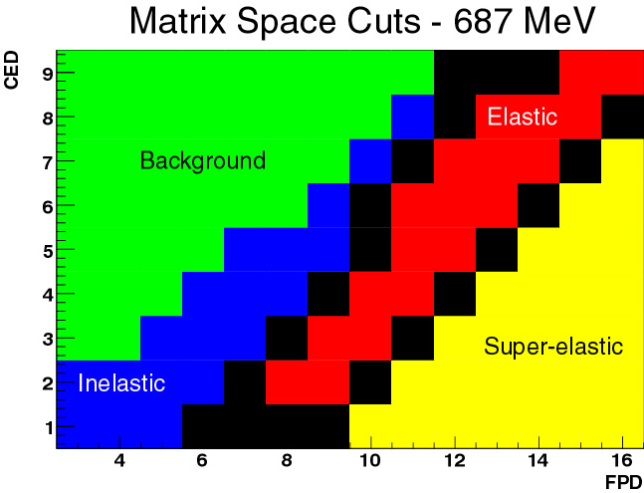
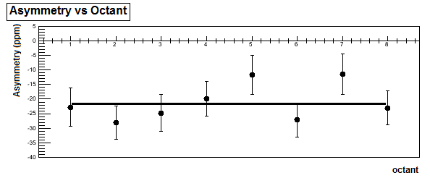
G⁰ N-Δ: Data
LH₂
Electron Yield (Octant2)
CED
CED
elastics
inelastics
FPD
FPD
A_{meas} = -22.3 ± 2.2 (stat) ppm (before background correction)

Slide 11
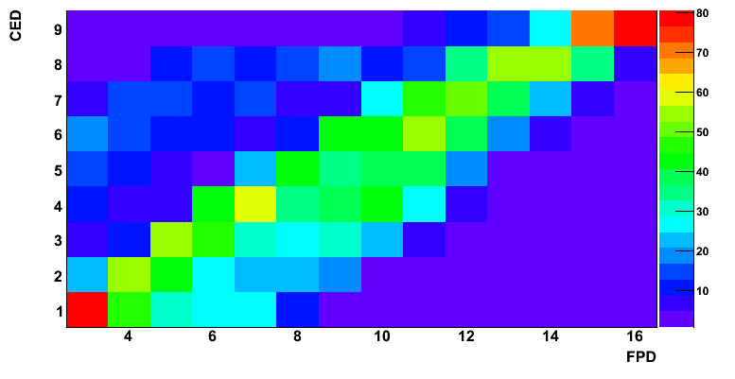
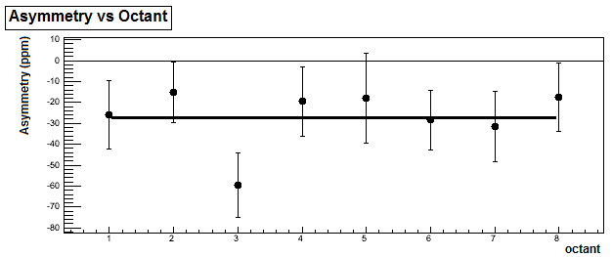
G⁰ N-Δ: Data
LD₂
Electron Yield (Octant2)
CED
CED
elastics
inelastics
FPD
FPD
A_{meas} = -26.4 ± 5.9 (stat) ppm (before background correction)

Slide 12
G⁰ N-Δ: Corrections (all except backgrounds)
Corrections well understood, statistical error dominates

Slide 13
G⁰ N-Δ: Inelastic locus

Slide 14
G⁰ N-Δ: Pion locus
Misidentified pions a significant background

Slide 15
G⁰ N-Δ: Background Correction
Correcting the Asymmetry:
Extract A_{inel} from A_{meas} by subtracting backgrounds:
Backgrounds:
Electrons scattered elastically from target
Electrons scattered from Al target walls
Electrons from π⁰ decay
Misidentified π⁻
Background Asymmetries:
Background from Al target walls: Dominated by inelastics
Inelastic Al asymmetry unmeasured -> use D asymmetry
Pion contamination:
Negligible in H target, but significant for D; use direct pion measurement
Elastic contribution:
Mostly comes from radiative tail: use elastic data & simulation to extrapolate

Slide 16
G⁰ N-Δ: Background Dilutions
Scale Yield vs. FPD for each CED
Before fitting, subtract contamination and Al target-wall yield
Target wall yield: use separate low-density Gas target measurement;
scale to remove gas contribution & account for kinematic differences
between liquid and gas target
Scale the remaining contributions independently to fit the data
Require scale factors to vary smoothly across CEDs
Constrain scale factors same for all octants

Slide 17
G⁰ N-Δ: Background Dilutions LH2

Slide 18
G⁰ N-Δ: Background Dilutions LH2

Slide 19
G⁰ N-Δ: Background Dilutions LD2

Slide 20
G⁰ N-Δ: Background Dilutions (by cell)
For each cell, all octants separately plotted

Slide 21
G⁰ N-Δ: Background Dilutions (by octant)

Slide 22
G⁰ N-Δ: Elastic Radiative Tail
Asymmetry of elastic radiative tail varies strongly
over inelastic region.
Use GEANT 3, scaled to our own elastic backward angle results, make cell-by-cell correction.

Slide 23
G⁰ N-Δ: Result
Acceptance Averaging:

Slide 24
G⁰: Axial radiative corrections
Axial radiative corrections can be large and uncertain…
S.L. Zhu, C.M. Maekawa, B.R. Holstein & M.J. Ramsey-Musolf PRL 87 (2001)20180,2
S.L. Zhu, et al. PRD 65 (2002) 033001
Found in particular: “many-quark” axial r.c. leads to new PV γNΔ coupling
Inelastic asymmetry does not
vanish at Q²=0 !
“Natural” scale
Enhancement mechanism proposed: (or larger)
would help solve puzzle of large asymmetries in Hyperon radiative decays
Enhanced values would lead to measurable (few ppm) asymmetries in
Would confuse extraction of G^{A}_{NΔ}(Q²) from inelastic data

Slide 25
G⁰: Pion photoproduction
362 MeV LD2 data
Misidentified electrons a background:
Use TOF spectra from pulsed-beam runs to determine Cerenkov detector inefficiency ➔ 2.6% background.
Target wall background: 2%
Corrections for:
- rate-effects
- polarization, - helicity-correlated beam properties
➔ under good control

Slide 26
G⁰: Pion photoproduction:
Correct for electroproduction
(average Q² = 0.0032 GeV²) using
GEANT 3 simulation
Result: A⁻_{γ} = - (0.36 ± 1.1 ± 0.4) ppm
Implies: = (8.4 ± 24± 8.3) g_{π}
Will neglect this contribution in the following…

Slide 27
G⁰ N-Δ: Models (Δ₍₂₎ and Δ₍₃₎ )
“Default” model:
MAID for Δ₍₂₎
use dipole form for G^{A}_{NΔ}(Q²) with M_{A} = 1.03 GeV
F(Q²) from Adler parameterization (S.L. Adler PRD 12(1975)2644)
parameters from N. Mukhopadhyay et al. (Nucl. Phys. A 633(1998) 481.)
Dynamical Model of electroweak pion production:
K. Matsui, T. Sato & T.S.H. Lee, Phys. Rev. C 72, 025204 (2005).
and T.S.H. Lee (private communication)
- hadronic effective chiral Lagrangian; field operators: N,Δ,π,ω,ρ and
effective Lagrangians for πNN,πNΔ,ωNN…
Δ₍₃₎ uses alternate form:
with a = 0.154 GeV⁻² b = 0.166 GeV² and M_{A} = 1.02 GeV
(from fit to neutrino charged-current pion production data)

Slide 28
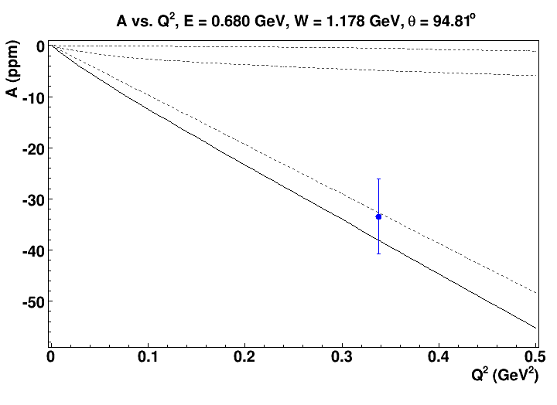
G⁰ N-Δ: Result (default model)
Δ₍₂₎
Δ^{π}₍₂₎
Δ^{π}₍₃₎
Δ^{π}₍₁₎
G⁰ result: A = -(33.4 ± 7.4) ppm

Slide 29
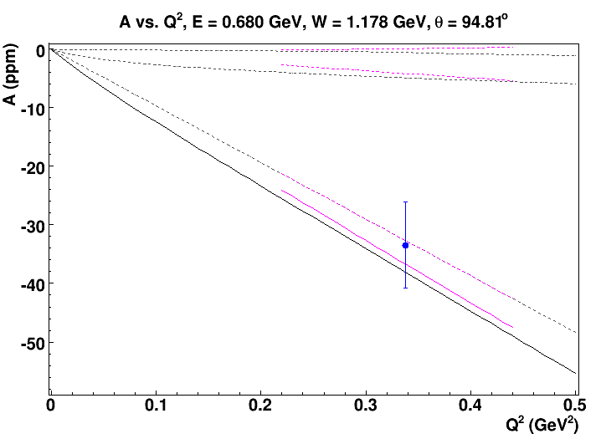
G⁰ N-Δ: Dynamical Model of Matsui, Sato and Lee
Δ^{π}₍₂₎
Δ^{π}₍₃₎
Δ^{π}₍₁₎

Slide 30
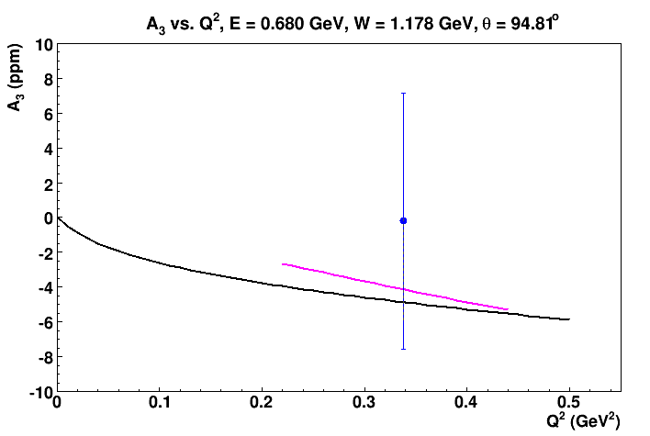
G⁰ N-Δ: extracting Δ^{π}₍₃₎
Subtract off Δ₍₁₎ and Δ₍₂₎
Δ^{π}₍₃₎ consistent with theory, but data not precise enough to provide G^{A}_{NΔ}

Slide 31
G⁰ N-Δ: Axial Mass ?
One would need a precision of about ± 0.5 ppm to say anything significant about M_{A} …
MiniBooNE arXiv:1002.2680 [hep-ex].
similar large values reported by
MINOS, K2K SciBar K2K SciFij
Pion electroproduction & pre-1990 υ data
Bernard, Elouadrhiri & Meissner,
J. Phys. G 28, R1 (2002)
Recall: G⁰ error bar: ±7.4 ppm

Slide 32
Summary
First measurement of PV asymmetry in inelastic scattering to the Δ
First measurement of PV asymmetry in
consistent with theory, but not precise enough to give useful information on G^{A}_{NΔ}(Q²) or on axial mass M_{A}
consistent with theory; does not favor very enhanced
but still room for sizable values
Qweak has data in-hand on asymmetry at very low Q² ;
analysis underway & more data likely will be taken…
improve precision on ?

