Slide 1
NUOVE TECNICHE
DI
ACCELERAZIONE
Andrea Ghigo
Giornate Romane su “Particelle e Fisica Applicata” Roma 13-14 June 2011

Slide 2
La ricerca e sviluppo sugli acceleratori di particelle è stata spinta dalla necessità di aumentare l’energia e la luminosità nei collisori di particelle

Slide 3
1 CERN
1 ITALY
2 SIBERIA
1 CINA
1 JAPAN
2 USA
Nuclear
physics
Isotopes for
Medicine
Colliders
Synchrotron light
Non nuclear
Investigation
Radiotherapy
Industry
Ion implatantion
Hadrontherapy
Accelerators in the world > 15000

Slide 4
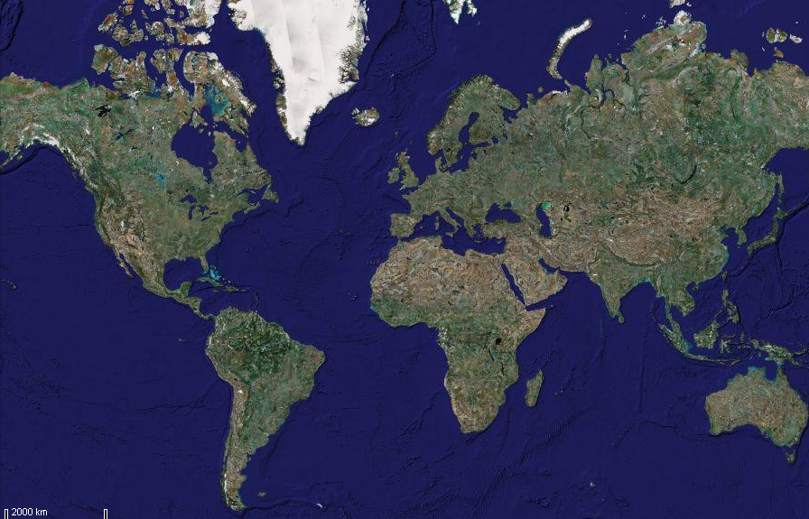
COLLIDERS - 2011
Leptons
Hadrons
VEPP-2000
VEPP-4M
(e+e- 1-4 GeV)
LHC
(p-p 14 TeV)
RHIC
(ions)
KEK-B
(e+e- 10 GeV)
DAFNE
(e+e- 1 GeV)
TEVATRON
(p-ap 2 TeV)
BEPCII
(e+e- 4 GeV)
Future: ILC, CLIC, SuperB, eRHIC, ELIC

Slide 5
Collider energies
e+ e-
Hadrons
e - protons

Slide 6
Collider luminosities
e+ e-
Hadrons
e - protons

Slide 7
Collider luminosities versus energies
LHC
e+ e-
Hadrons
e - protons

Slide 8
Energy frontiers

Slide 9
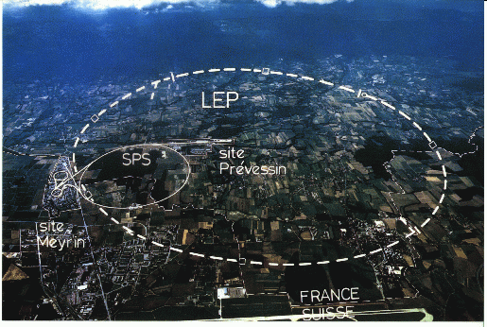
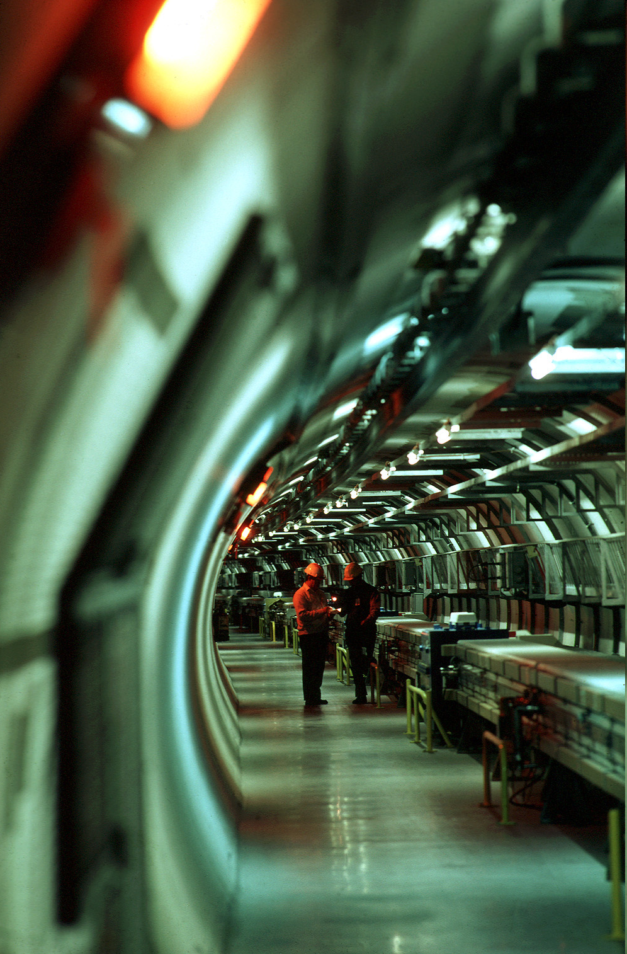
ENERGY frontiers – e+ e-
: last circular collider
E = 100 GeV / beam
Energy lost per turn
by synchrotron radiation
ρ = 3 km

Slide 10
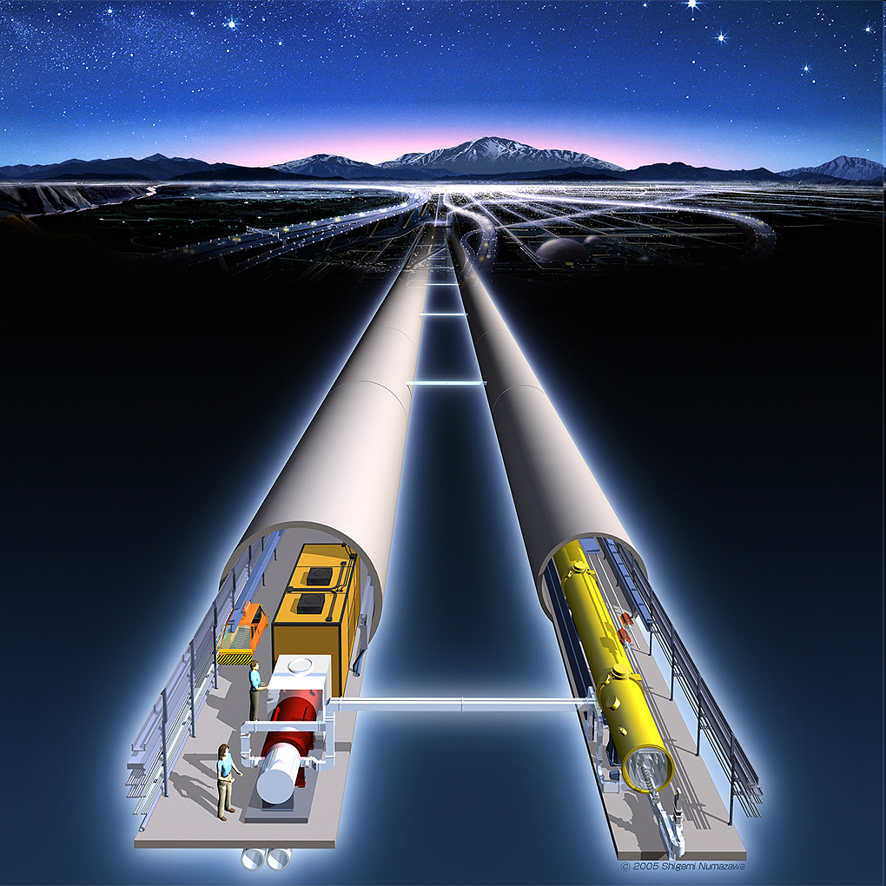
Future : e+ e- Linear colliders
High gradient cavities

Slide 11
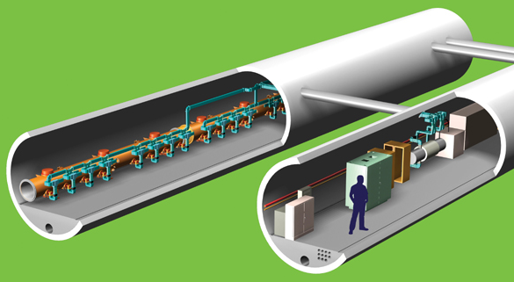
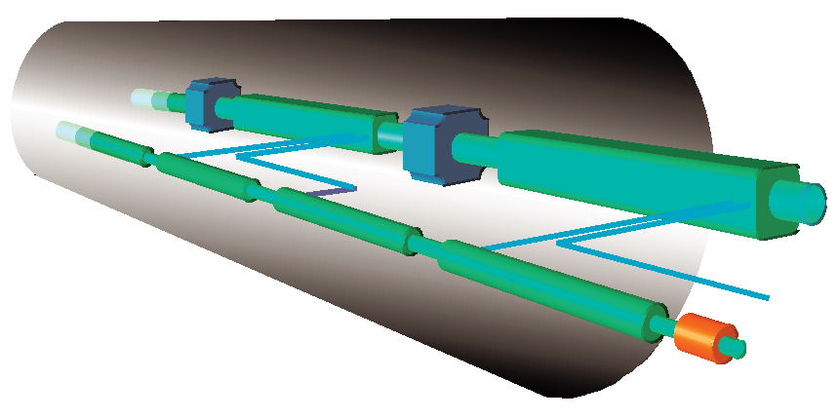
Future e+/e- Linear Colliders
CLIC and ILC
http://clic-study.web.cern.ch/CLIC-Study/
http://www.linearcollider.org/cms/

Slide 12
CLIC ILC
Dual beam acceleration technology
R&D at CERN ~ 20 y
Normal conducting cavities
12 GHz, 100 MV/m
Maximum energy 3 TeV cm – Phase I at 0.5 TeV
International collaboration around CTF3
Well extablished SC rf technology (TESLA, FLASH, XFEL…)
Decision in 2004
Rf cavities ~ TESLA like
1.3 GHz, 31.5 MV/m
Maximum energy 1 TeV cm - Phase I at 0.5 TeV
GDE (Global Design Effort) - International collaboration
Site independent

Slide 13
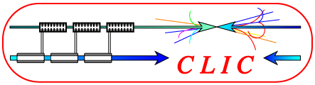
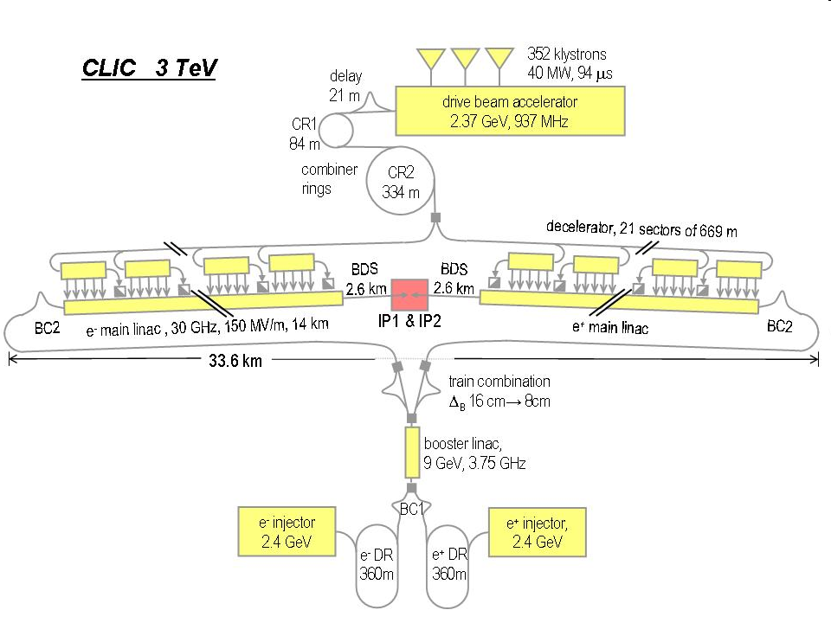
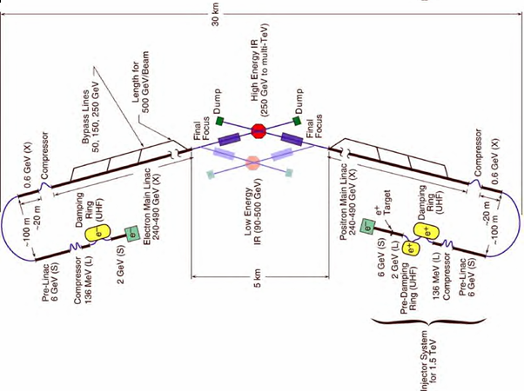
CLIC 3 TeV – 48 km
CLIC 0.5 TeV – 13 km
ILC 0.5 TeV – 30 km

Slide 14
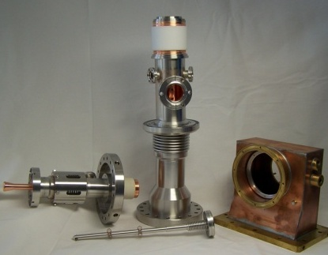

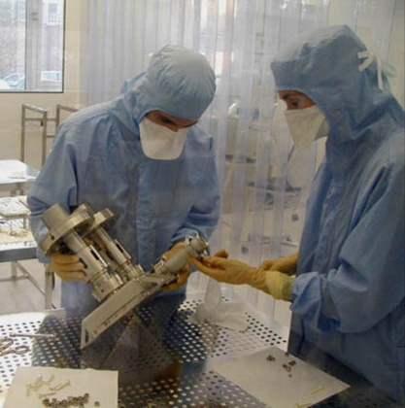
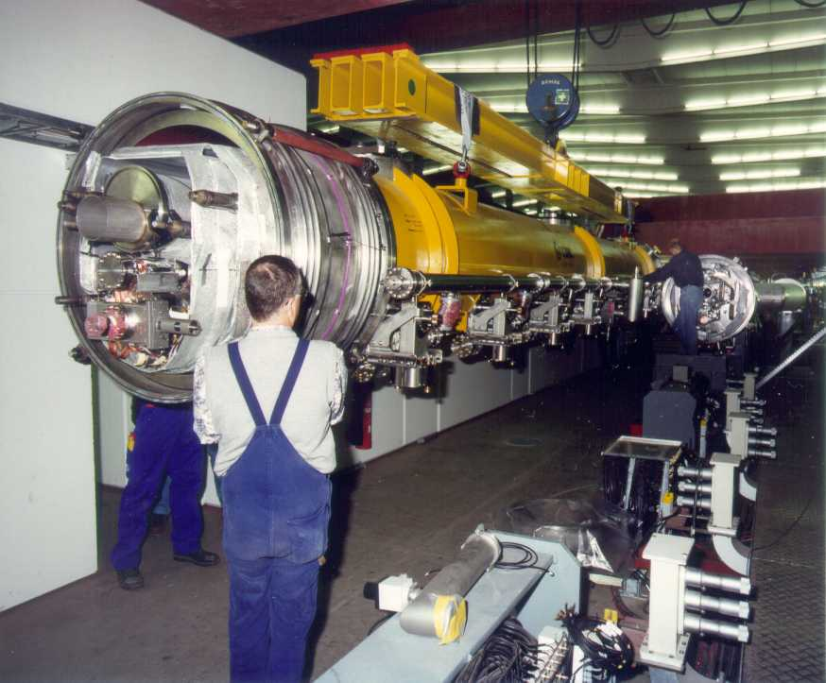
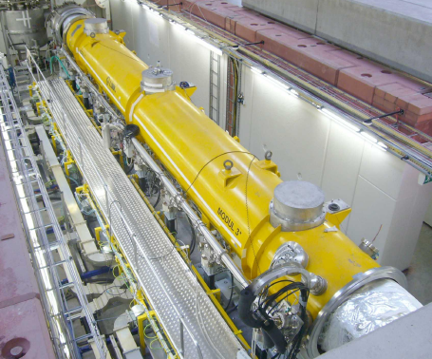
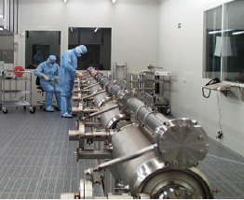
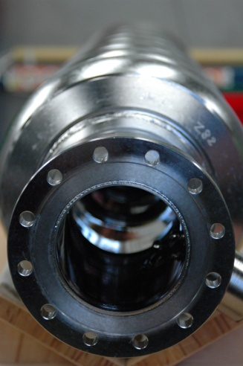
Global SCRF Technology
FNAL, ANL
◉
Cornell
DESY
◉
JLAB
◉
KEK, Japan
SLAC
◉
LAL
Saclay
◉
◉
◉
◉
INFN Milan
N. Walker - ILC08
14

Slide 15
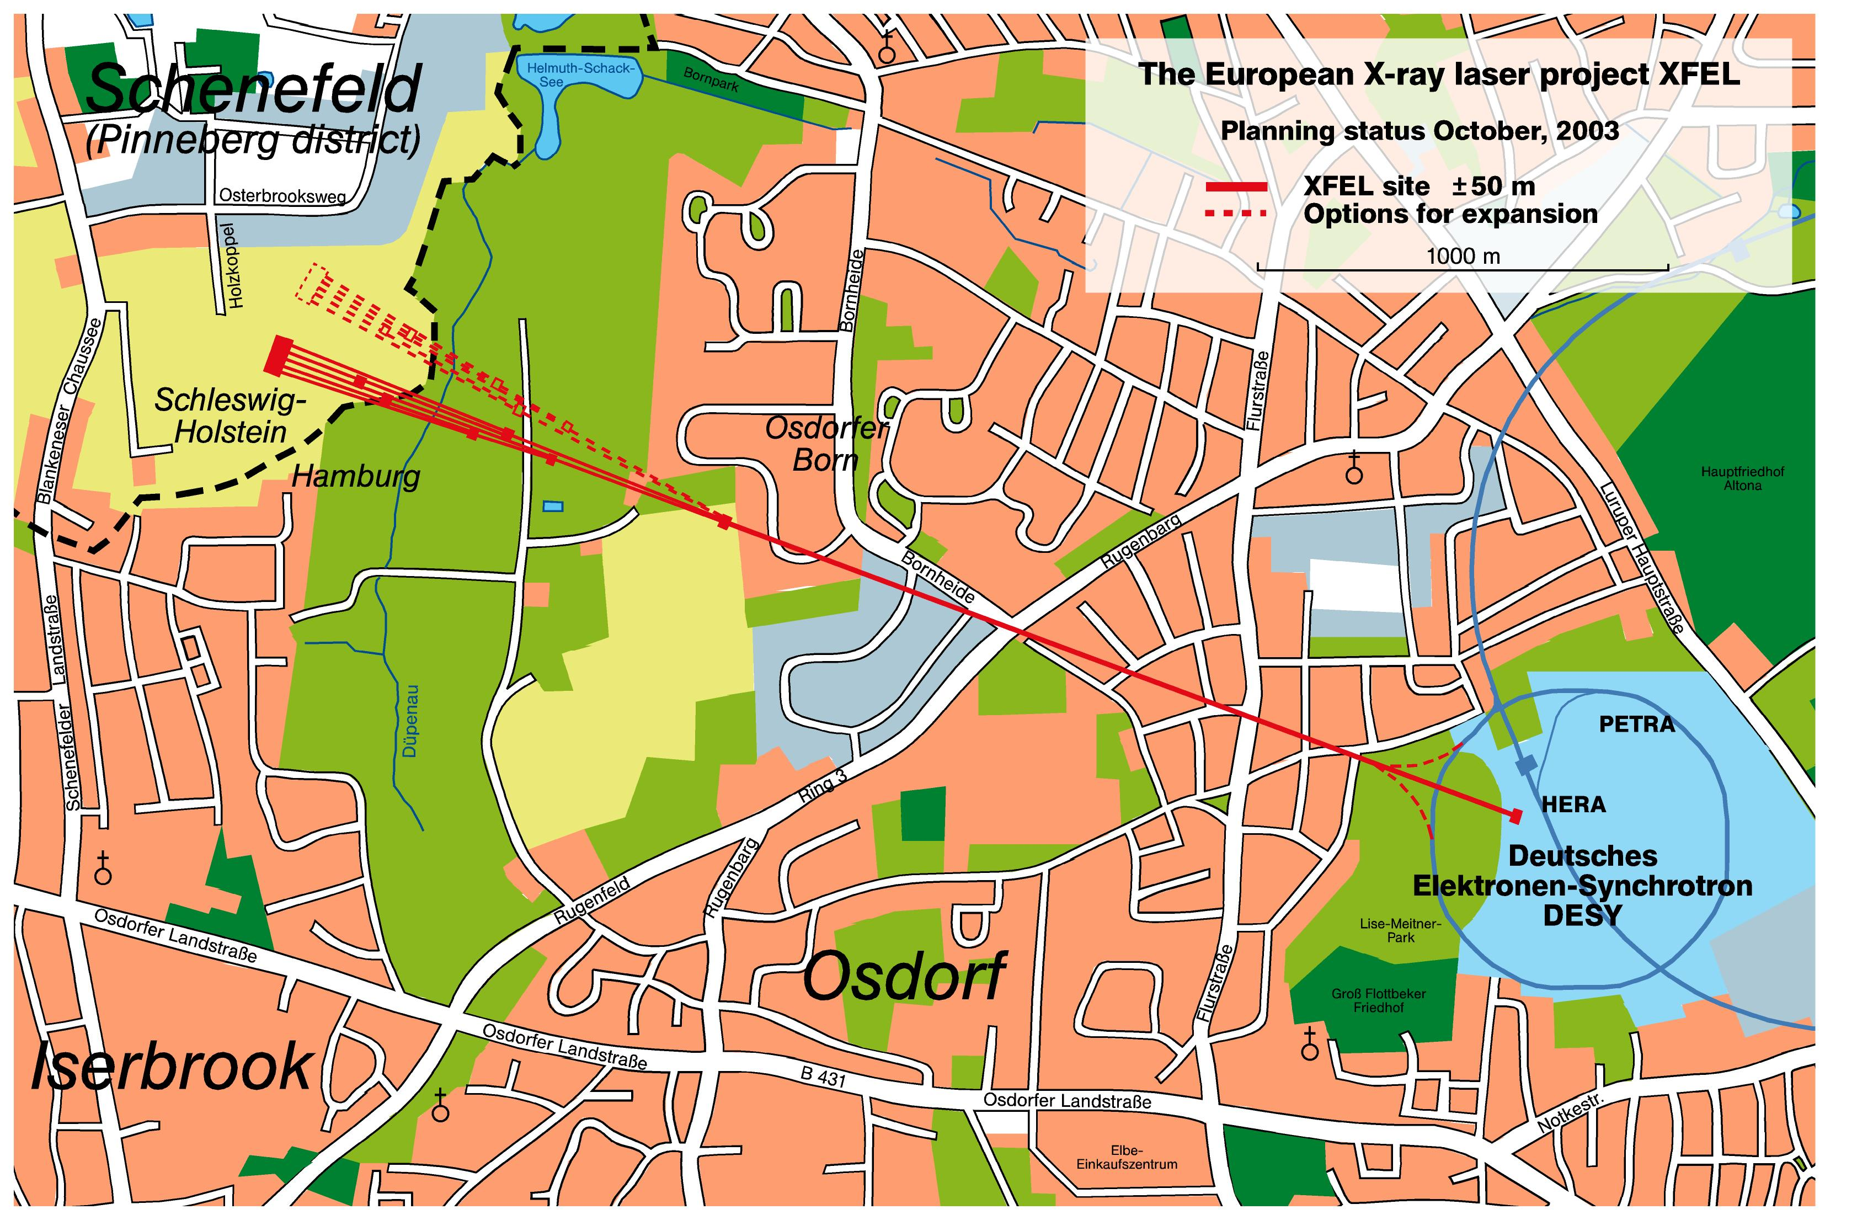
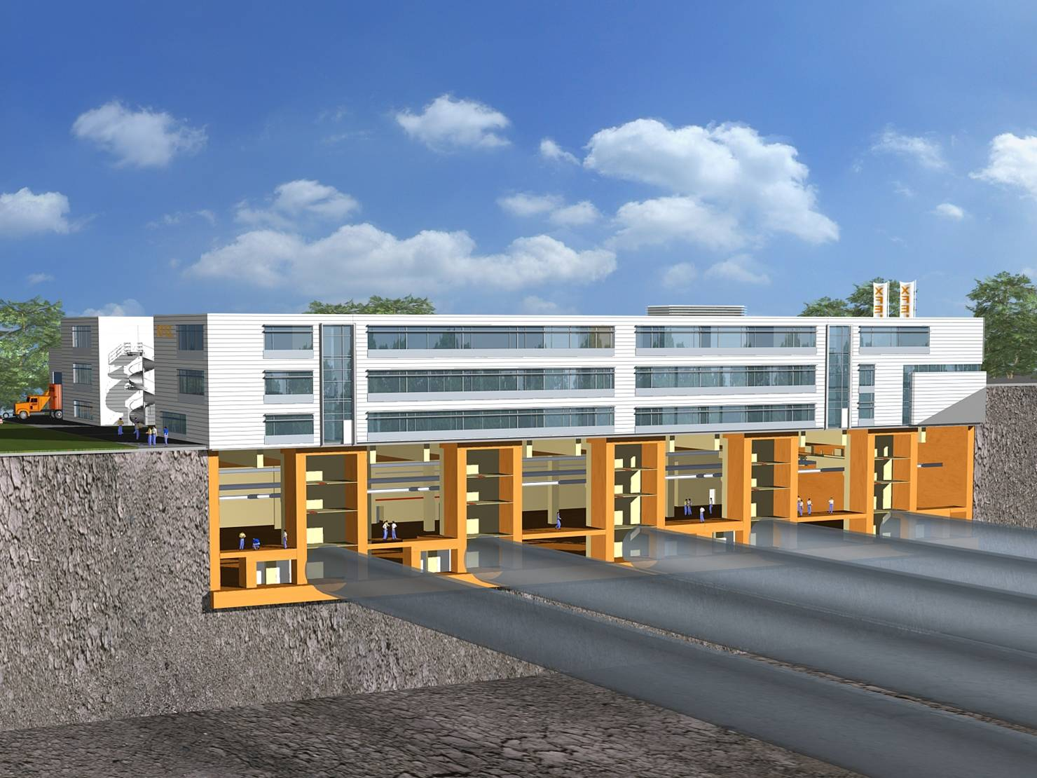
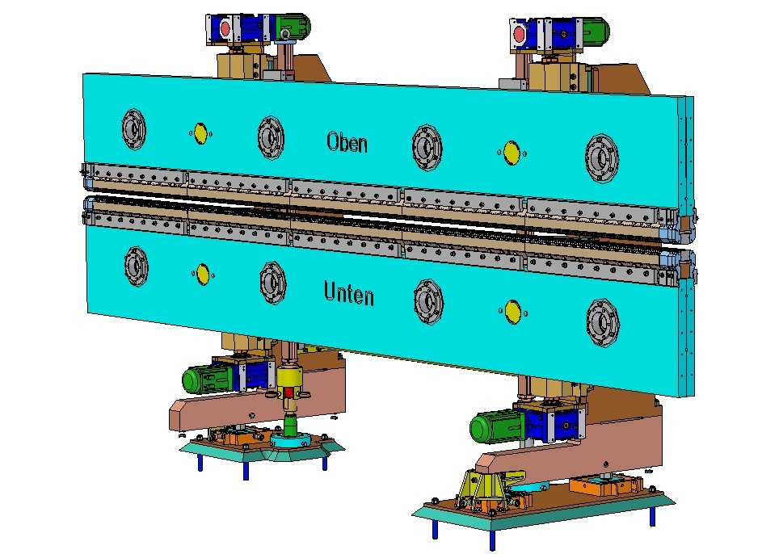
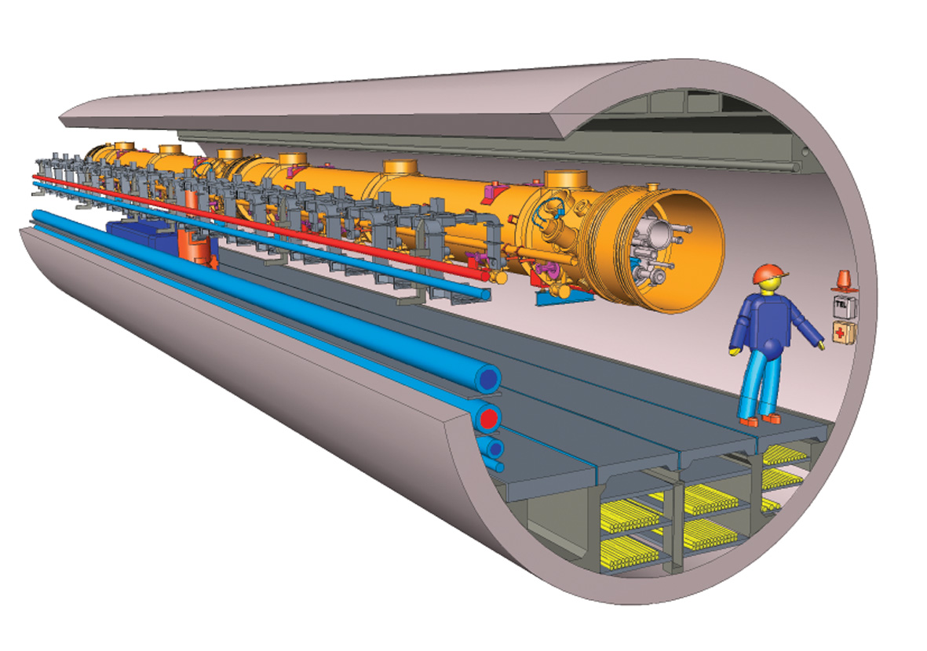
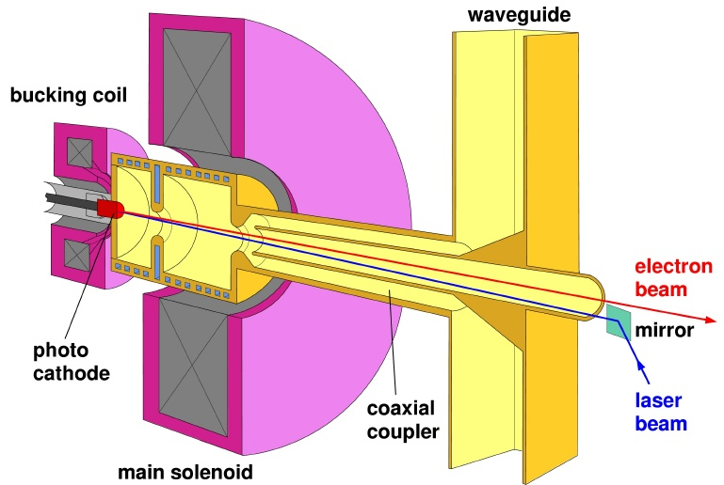
X-FEL at DESY
a 10% ILC and a GEuros Test Facility!
3.4km

Slide 16
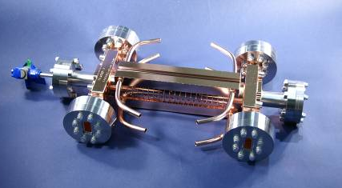
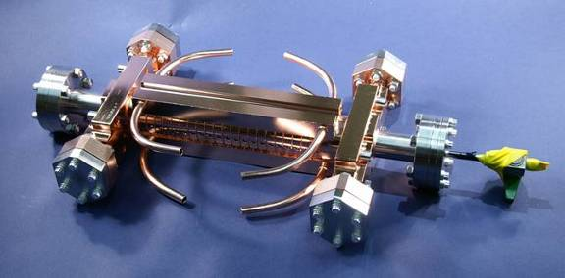
Nominal performance of Accelerating Structures
Design@CERN, Built/Tested @KEK, SLAC
CLIC
target
Breakdown voltage threshold
in the RF cavities is
approximately proportional
to the square
root of RF frequency

Slide 17
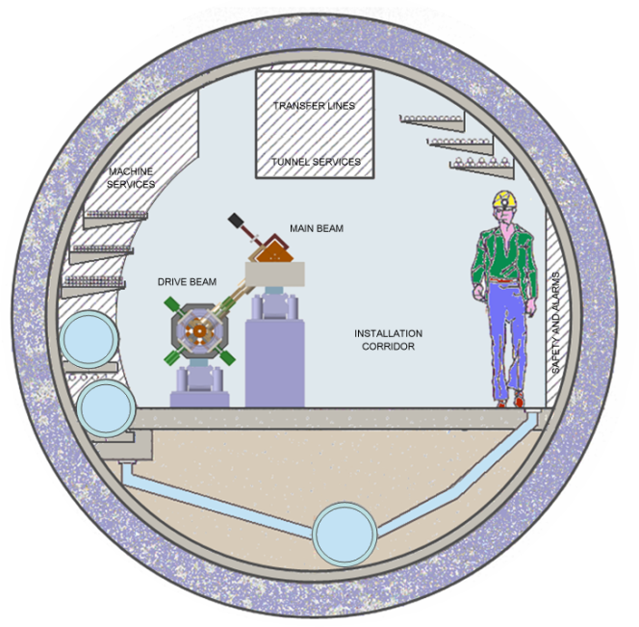
CLIC layout
QUAD
QUAD
POWER EXTRACTION
STRUCTURE
ACCELERATING
STRUCTURES
DRIVE BEAM COMPLEX
BPM
MAIN BEAM COMPLEX

Slide 18
LC Main parameters
http://clic-meeting.web.cern.ch/clic-meeting/ComparisonTable.html
Center-of-mass energy | ILC 500 GeV | CLIC 500 G Nominal | CLIC 3 TeV Nominal
Total (Peak 1%) luminosity | 2.0(1.5)·10³⁴ | 2.3(1.4)·10³⁴ | 5.9(2.0)·10³⁴
Repetition rate (Hz) | 5 | 50 | 50
Loaded accel. gradient MV/m | 33.5 | 80 | 100
Main linac RF frequency GHz | 1.3 (SC) | 12 | 12
Bunch charge10⁹ | 20 | 6.8 | 3.72
Bunch separation ns | 176 | 0.5 | 0.5
Beam pulse duration (ns) | 1000 | 177 | 156
Beam power/linac (MWatts) | 10.2 | 4.9 | 14
Hor./vert. norm. emitt (10⁻⁶/10⁻⁹) | 10/40 | 2.4 / 25 | 0.66/20
Hor/Vert FF focusing (mm) | 20/0.4 | 8/0.1 | 4 / 0.07
Hor./vert. IP beam size (nm) | 640/5.7 | 202/ 2.3 | 40 / 1.0
BDS length (km) | 2.23 (1 TeV) | 1.87 | 2.75
Total site length (km) | 31 | 13.0 | 48.3
Wall plug to beam transfer eff. | 9.4% | 7.5% | 6.8%
Total power consumption MW | 216 | 129.4 | 415

Slide 19
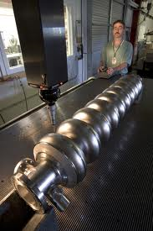

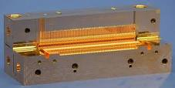
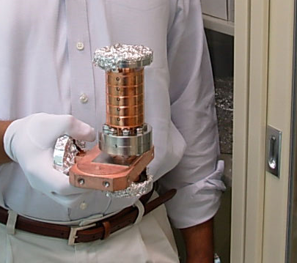
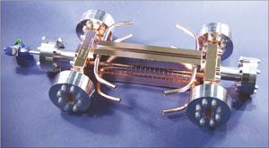
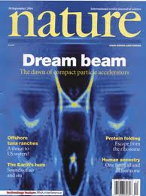
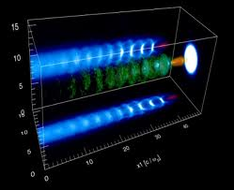
1.3GHz SC
12 GHz NC
THz Plasma

Slide 20
25 GeV/m (100 MeV/m @ CLIC)

Slide 21
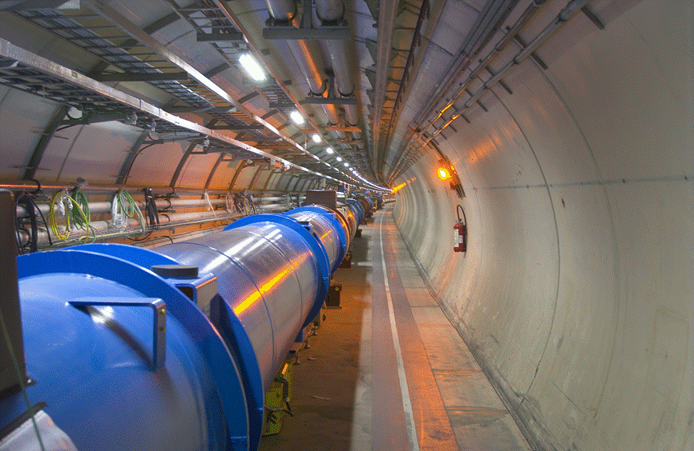
LHC
Energy frontiers in Hadron colliders
Maximum Energy : 7 TeV
Injection Energy : 450 GeV
1’700 circuits, 10’000 magnets
16 rf cavities – 500 MHz
Design Luminosity | 10³⁴ cm⁻²·s⁻¹
No. of bunches per proton beam | 2808
No. of protons per bunch (at start) | 1,15·10¹¹
Circulating current / beam | 0,54 A
Stored beam energy | 360 MJ
Stored energy in magnets | 11 GJ
Radiated Power per beam (syncrotron radiation) | ~ 6 KW
Collimation issues: new crystals -> UA9 experiments

Slide 22
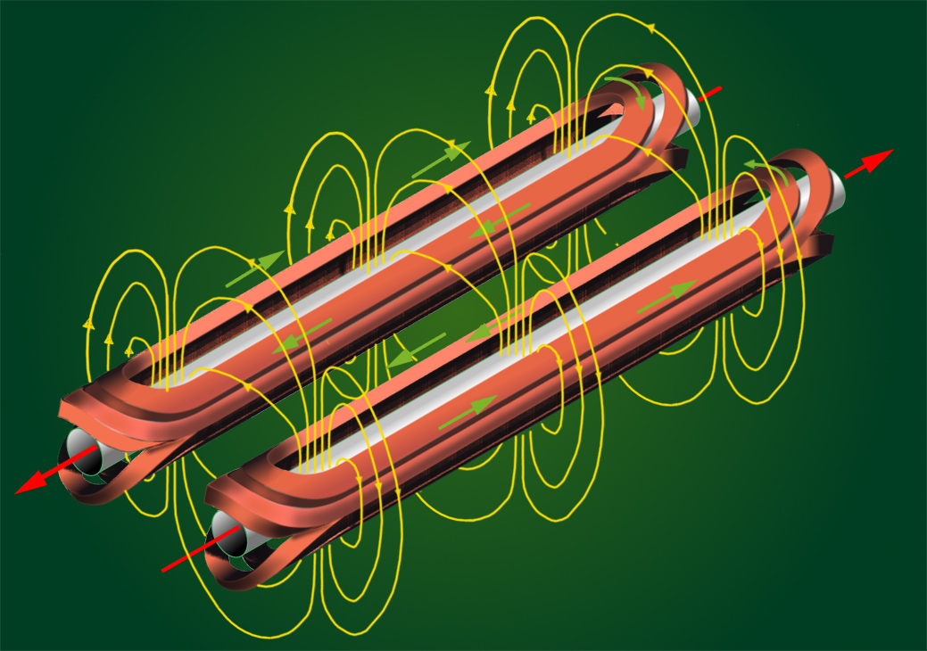
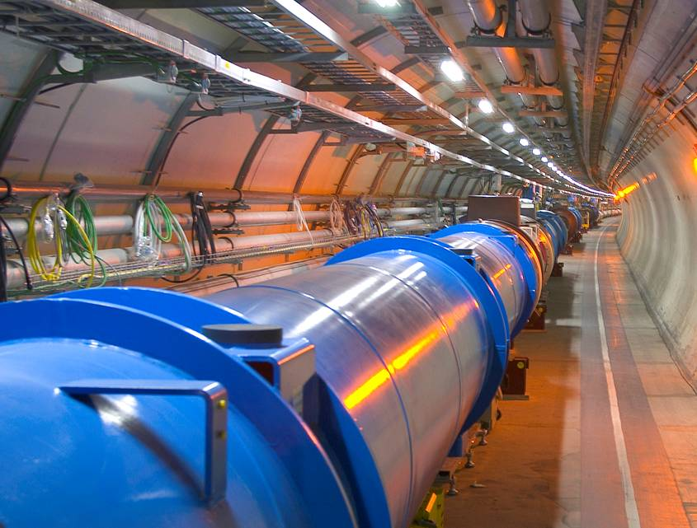
LHC dipoles
Helium @ 1.9 K
Horizontal force at 8,33 T (inner and outer layer)1,7 MN/m
Composition of the superconducting alloy Ni_Ti (47Wt% Ti)
Maximum current with NO resistence (1,9 K e 8,33 T) 17000 A
Number de strands per cable 36
Number de Ni-Ti filaments in each strand 6500
Bending radius 2803.95 m
Force on the cable: F = B * I0 * L
with
B = 8.33 T
I0 = 12000 Ampere
L = 15 m
F = 165 tons

Slide 23
HIGH FIELD MAGNETS
LHC upgrades
DLHC
Double energy
E_{cm} = 28 T
Dipoles
SLHC
Higher L
10³⁵
Low β quads

Slide 24
Luminosity frontiers
Intensity frontiers
Power frontiers
+ Energy frontiers
Dimension frontiers

Slide 25
Luminosity Frontiers in Leptons Factories
Superfactories
New colliding schemes for reducing beam-beam effects
(limiting beam currents and increasing beam dimensions)
Operating factories Crossing scheme
BEPC II - tau ‘classical’ scheme
VEPP200 -2 GeV round beam
DAFNE - PHI crab waist - > (SuperB)
KEKB - B crab cavity

Slide 26
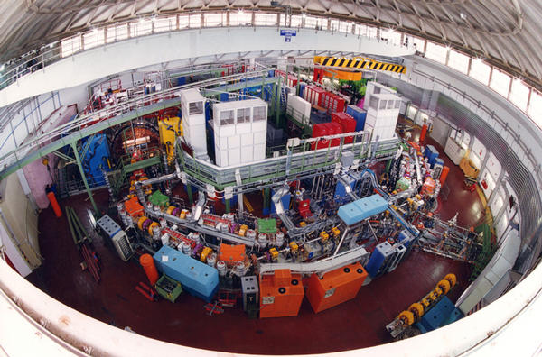
DAΦNE – LNF - FRASCATi

Slide 27
‘classical approach’ (as original DAFNE, KEKB, PEPII)
High currents in multibunch operation
High rep frequency
Crossing angle
Design L = 10³³
3.3×10³²cm⁻²s⁻¹
Short run period
BEPCII Peak Luminosity trend (2008-7-15 to 2009-5-19)

Slide 28
Luminosity: Two Options
High Current
Nano-Beam
Slightly smaller β_{y}*
6.5(LER)/5.9(HER)→ 3.0/6.0
Increase beam currents
1.8A(LER)/1.45A(HER) → 9.4A/4.1A
Increase ξ_{y}
0.1(LER)/0.06(HER) → 0.3 or more
Smaller β_{y}*
6.5(LER)/5.9(HER)→ 0.21/0.37
Slightly increase beam currents
1.8A(LER)/1.45A(HER) → 3.6A/2.1A
Close to original KEK design
Keep ξ_{y}
0.1(LER)/0.06(HER) → 0.09/0.09
Evolution of design in original Letter of Intent (LoI) for SuperKEKB (2004)
Proposed by P. Raimondi et al., along with Crab Waist, for use at Italian Super B Factory
Marica Biagini next talk
Notes:
28

Slide 29
High luminosity
linear collider
circular collider
High brightness
High average current
High charge per bunch (1 nC)
High charge per bunch
Low emittance (1 mmmrad)
Low emittance lattice prad
Short pulse (fs)
Short pulse (ps)
Photoinjector -> FEL injector
Synchrotron radiation source

Slide 30
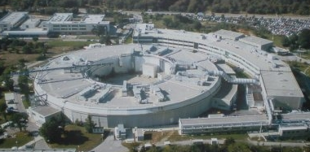
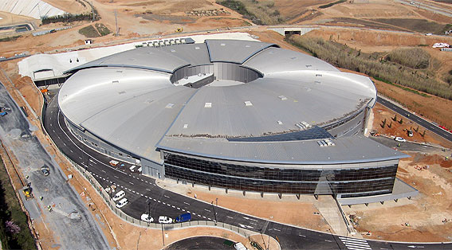
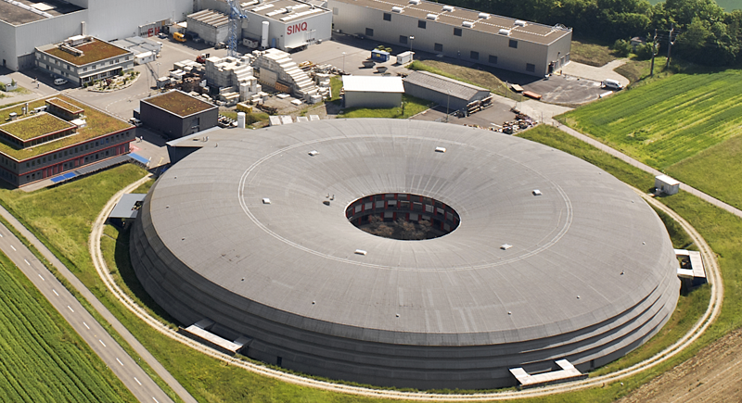
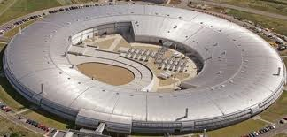
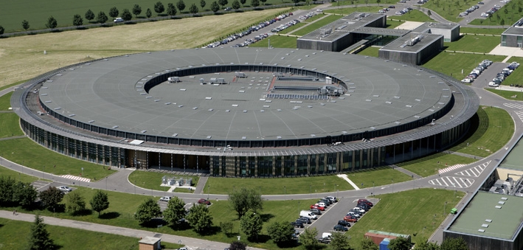
ELETTRA-ITALY
SYNCHROTRON RADIATION
SOURCES
ALBA- SPAIN
SLS - SWISS
DIAMOMD - UK
SOLEIL - FRANCE

Slide 31
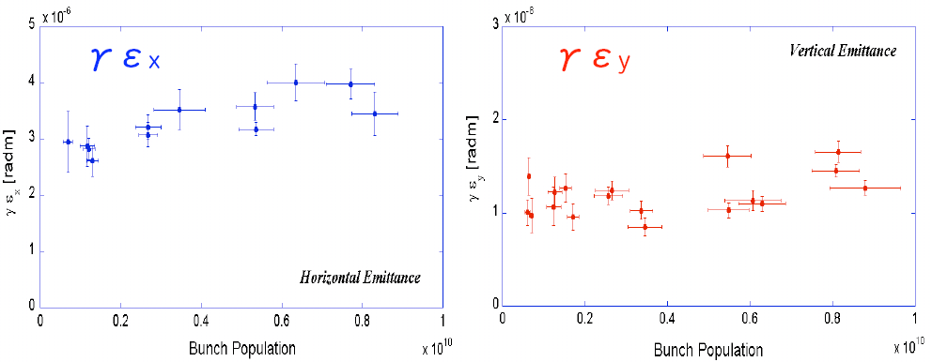
Low emittance in ATF
Best measurements of emittance in ATF DR:
  the ε_{y}=4pm is the best achieved value at low intensity and it becomes 1.5 times at the intensity of 1 x 10^10/bunch [Y.Honda et al., PRL 92 (2004) 054802]
Very recent preliminary vertical emittance:
  the ε_{y}=5pm (about 10% error) which was measured by Laser Wire in DR
  thus, the best conditions are reproducible.

Slide 32
HPPA – High Power Proton Accelerators
 | Beam Power | Average current | Energy | Major Users
Spallation Neutron Sources | 1-10 MW | 1 - 5 mA | 1-1.5 GeV | Condensed matter
Radioactive beams | P > 200kW N > 5 MW | 1 – 10 mA | >200 MeV > 1 GeV | Nuclear Phys Astrophys beta beams
Transmutation nuclear waste | 5 – 20 MW | 5 – 20 mA | 1 GeV | Energy product
Technological irradiation tools | 10 – 40 MW | 10–40 mA | 1 GeV | Solid state phys
Neutrino factories | 4 MW | 2 mA | 2 GeV | High ener phys Astrophys

Slide 33
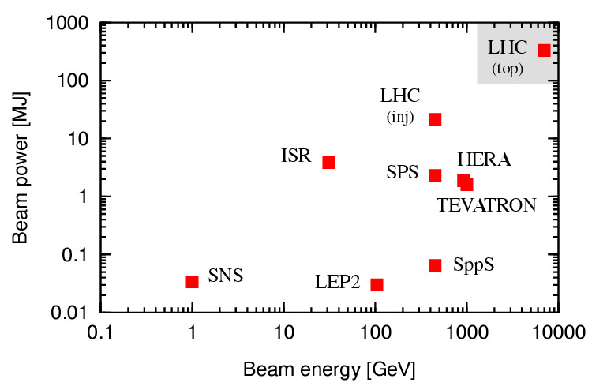
Challenges: Energy stored in the beam
x 200
Energy stored in the beam [MJ]
x 10000
Momentum [GeV/c]
courtesy R.Assmann
Energy density: even larger factor between LHC and other machines

Slide 36
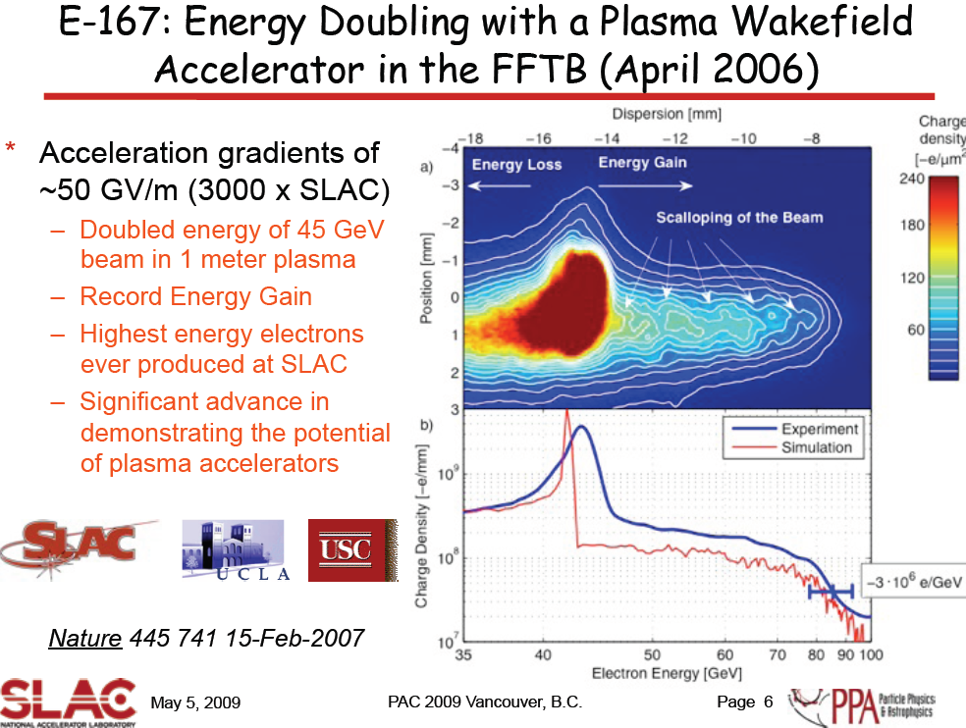

Slide 38
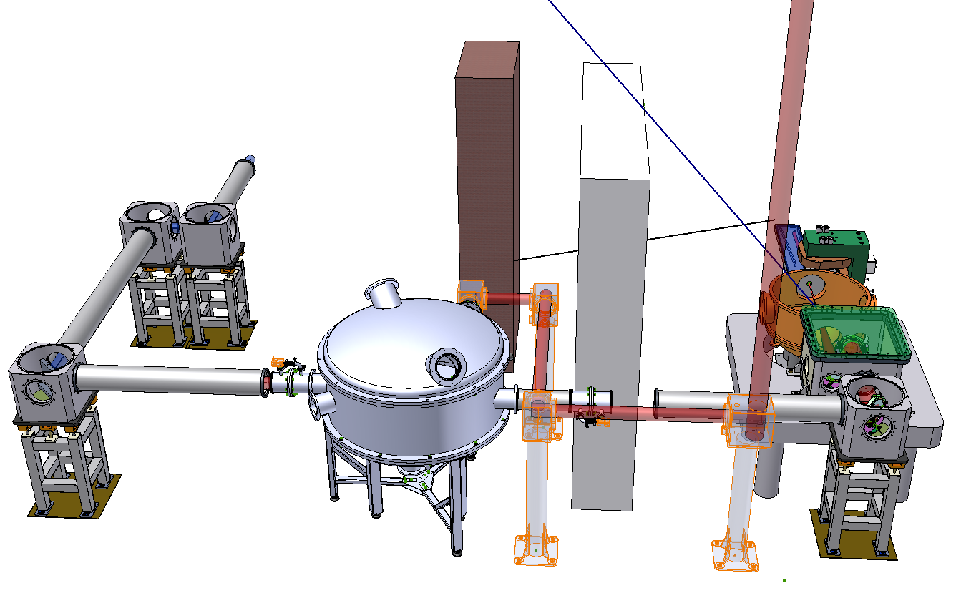


Frascati FLAME Target Area
Radiation protection walls
Main beam (>250 TW)
Vacuum transport line
Beam transport to sparc bunker
Interaction
vacuum
chamber
Compressor
vacuum chamber

Slide 39
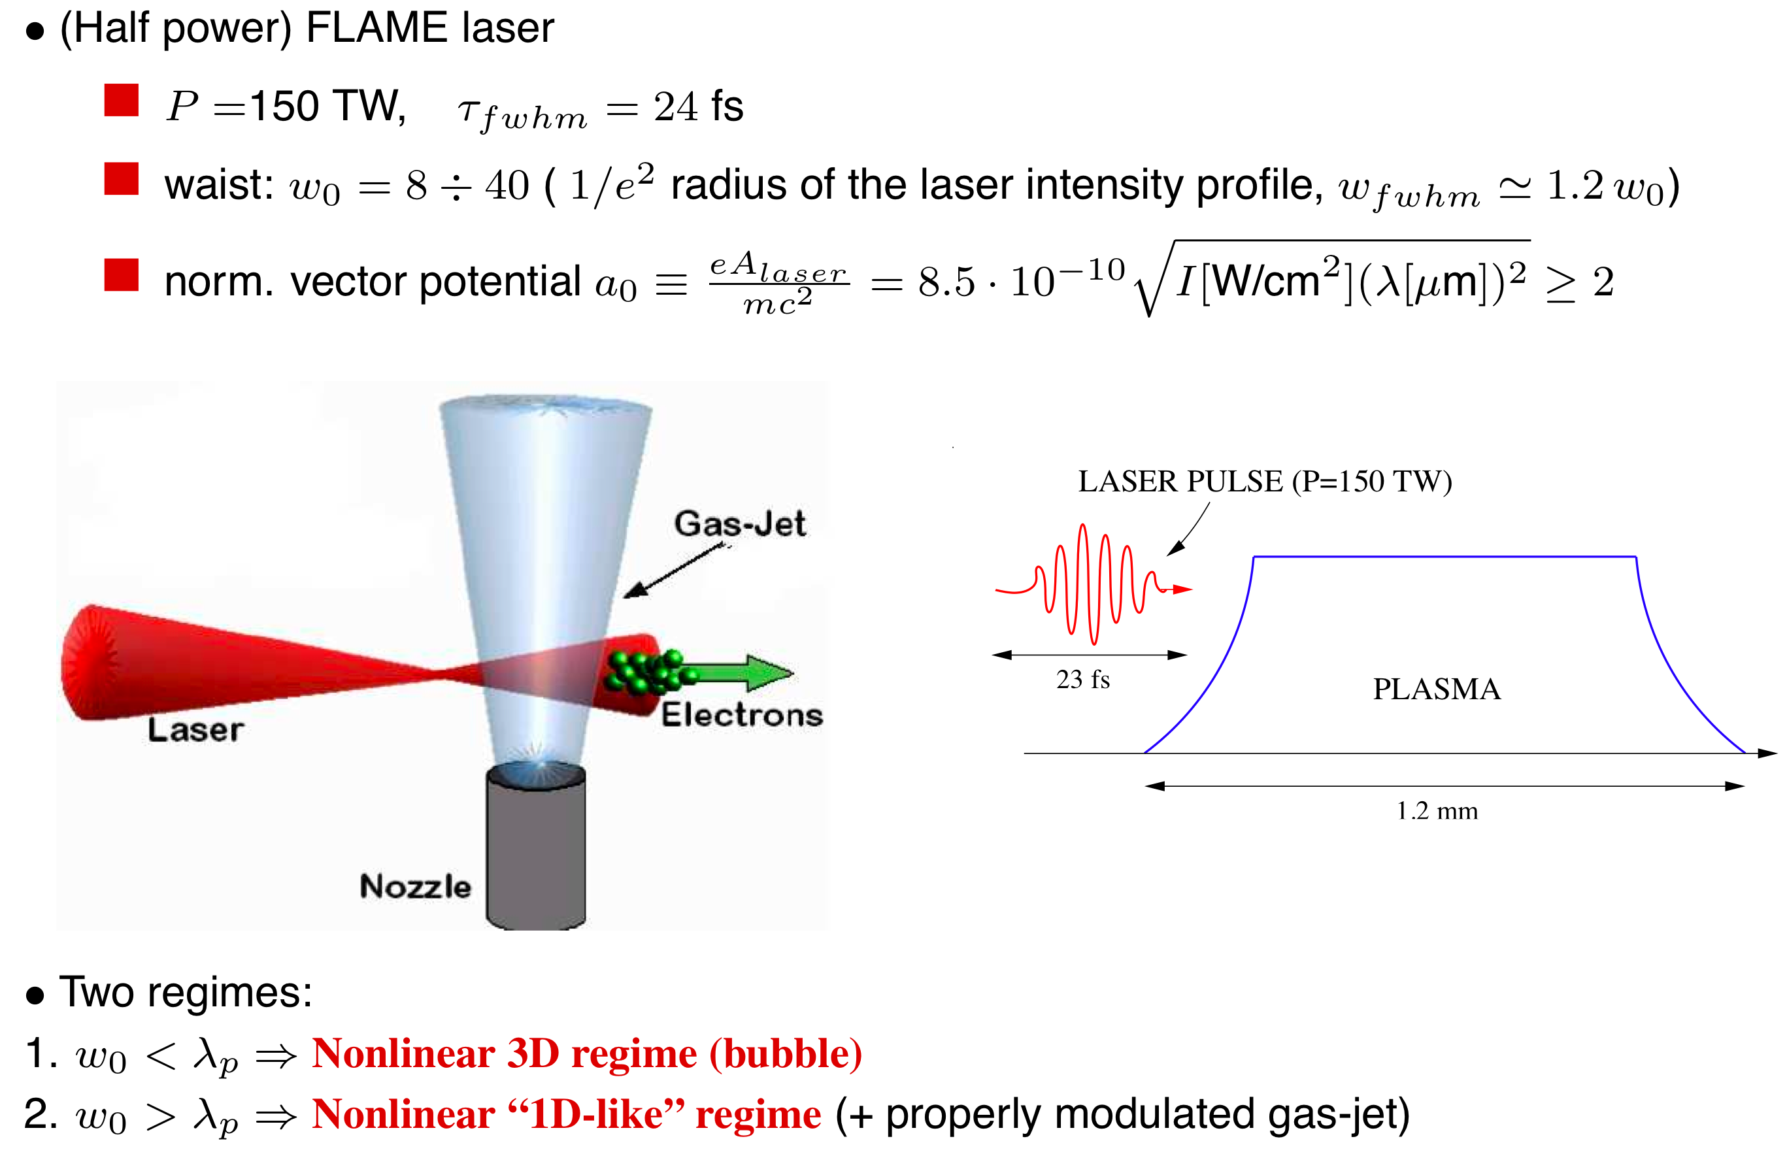
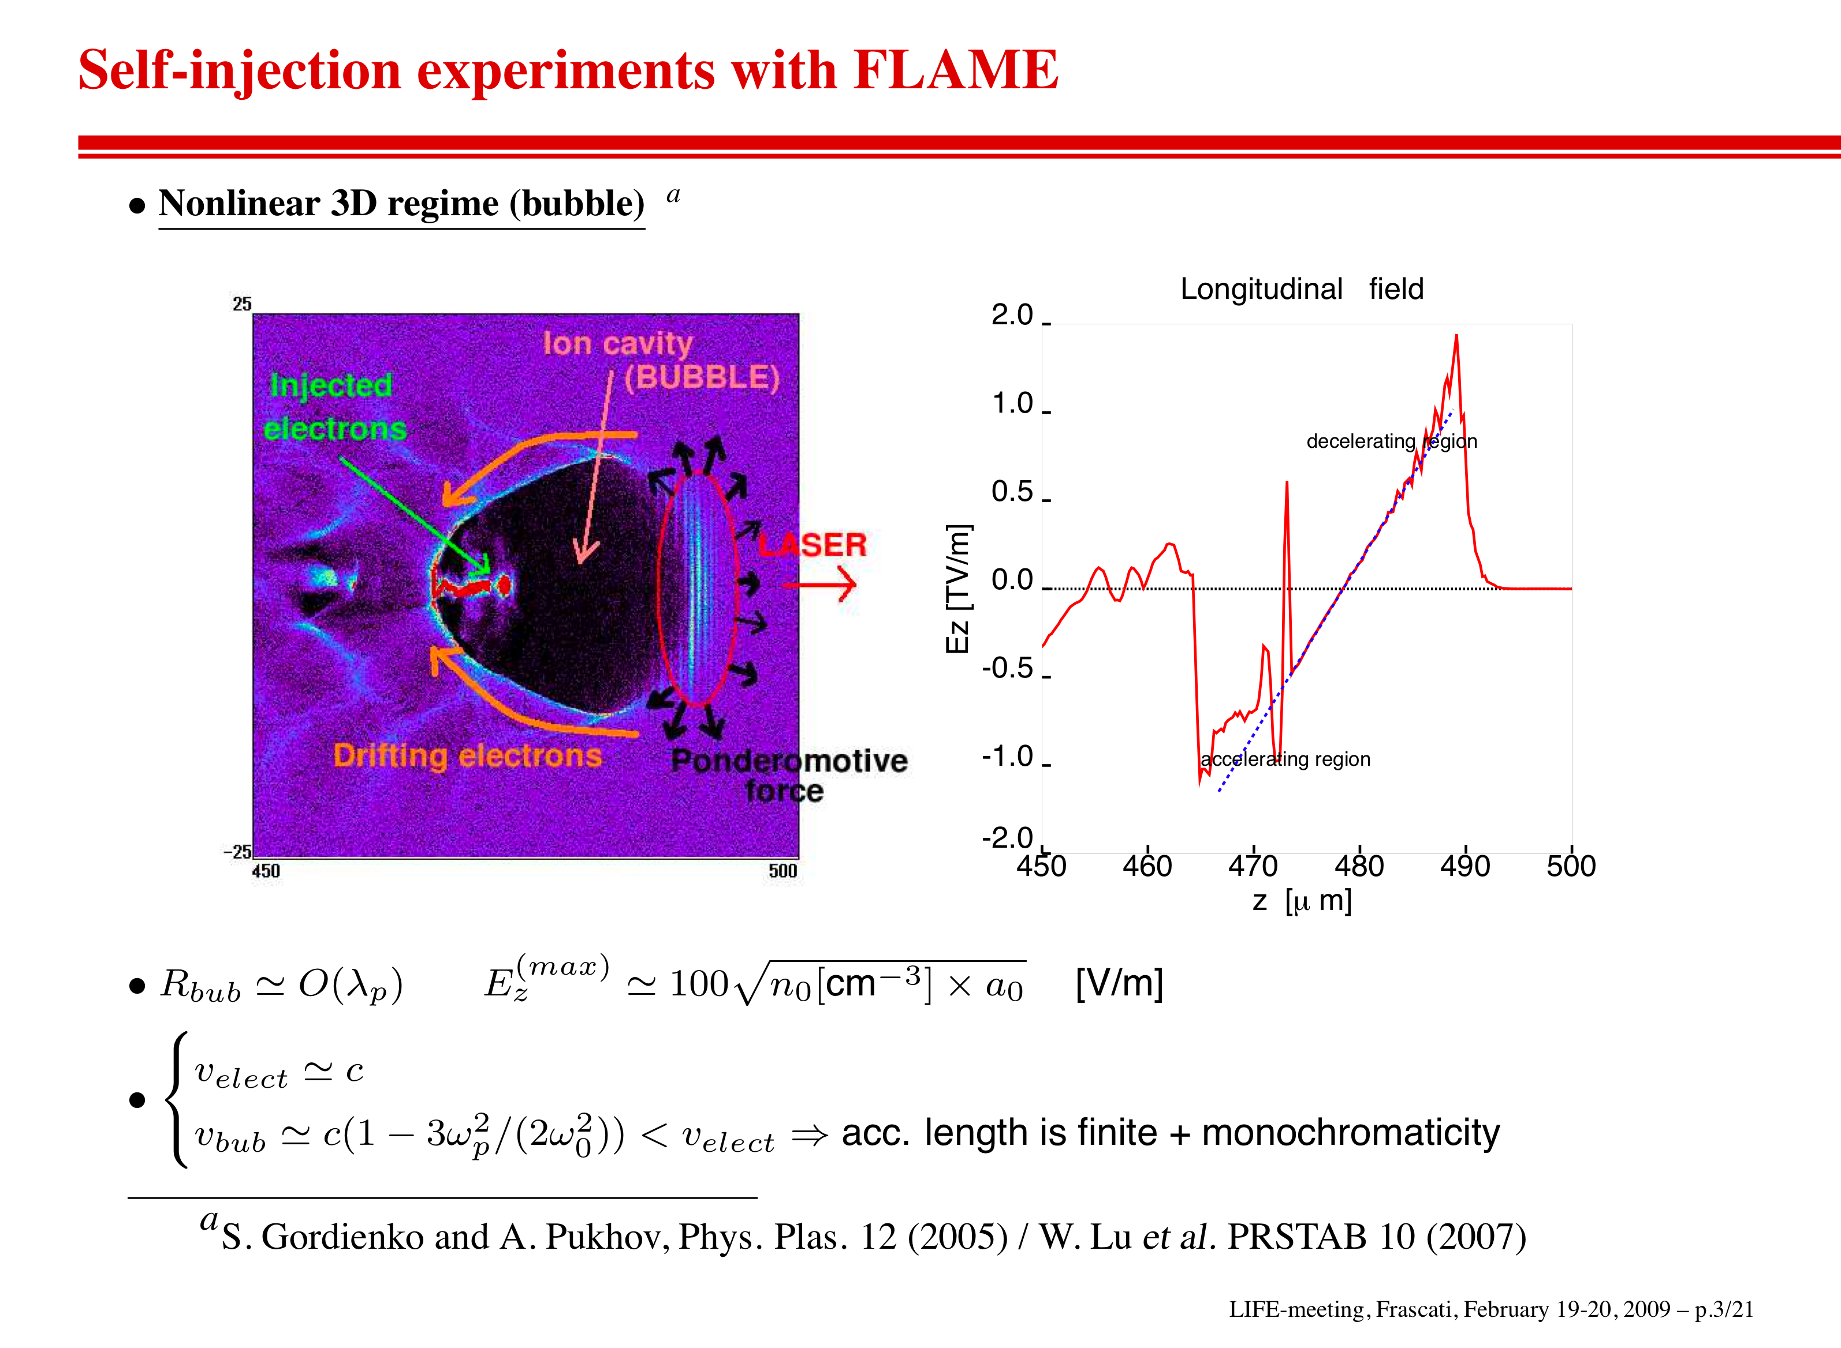
FLAME test experiment on Self-injection

Slide 40
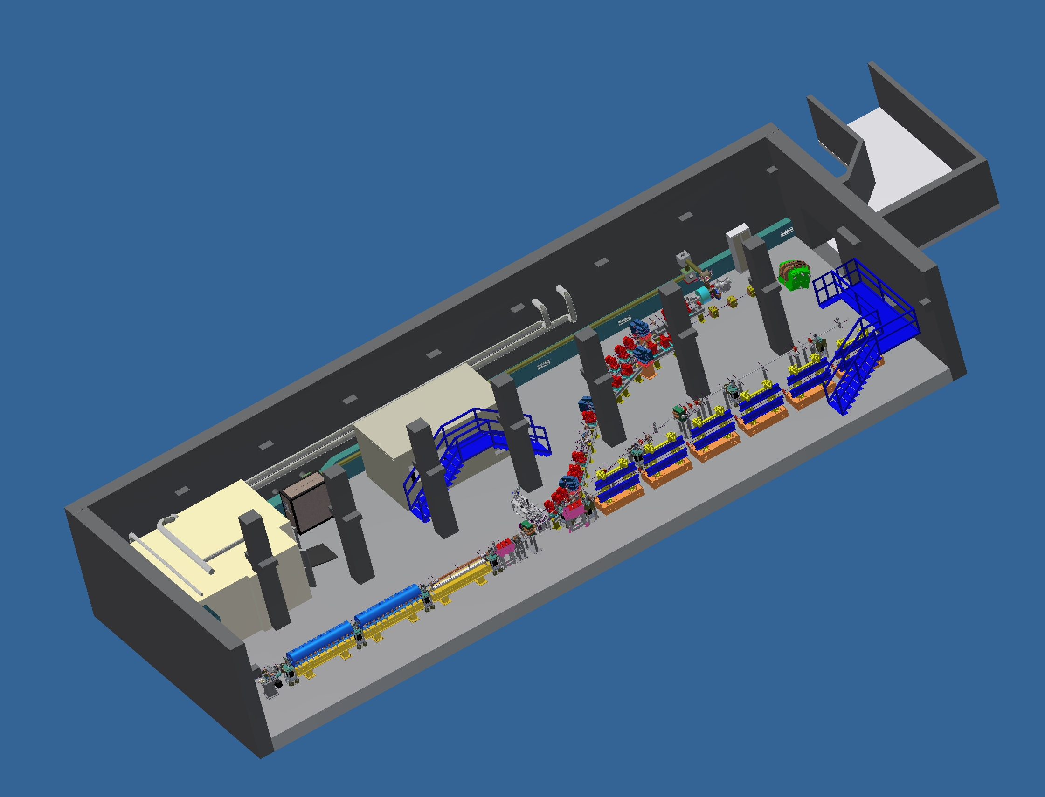
Near future SPARC Layout

Slide 41
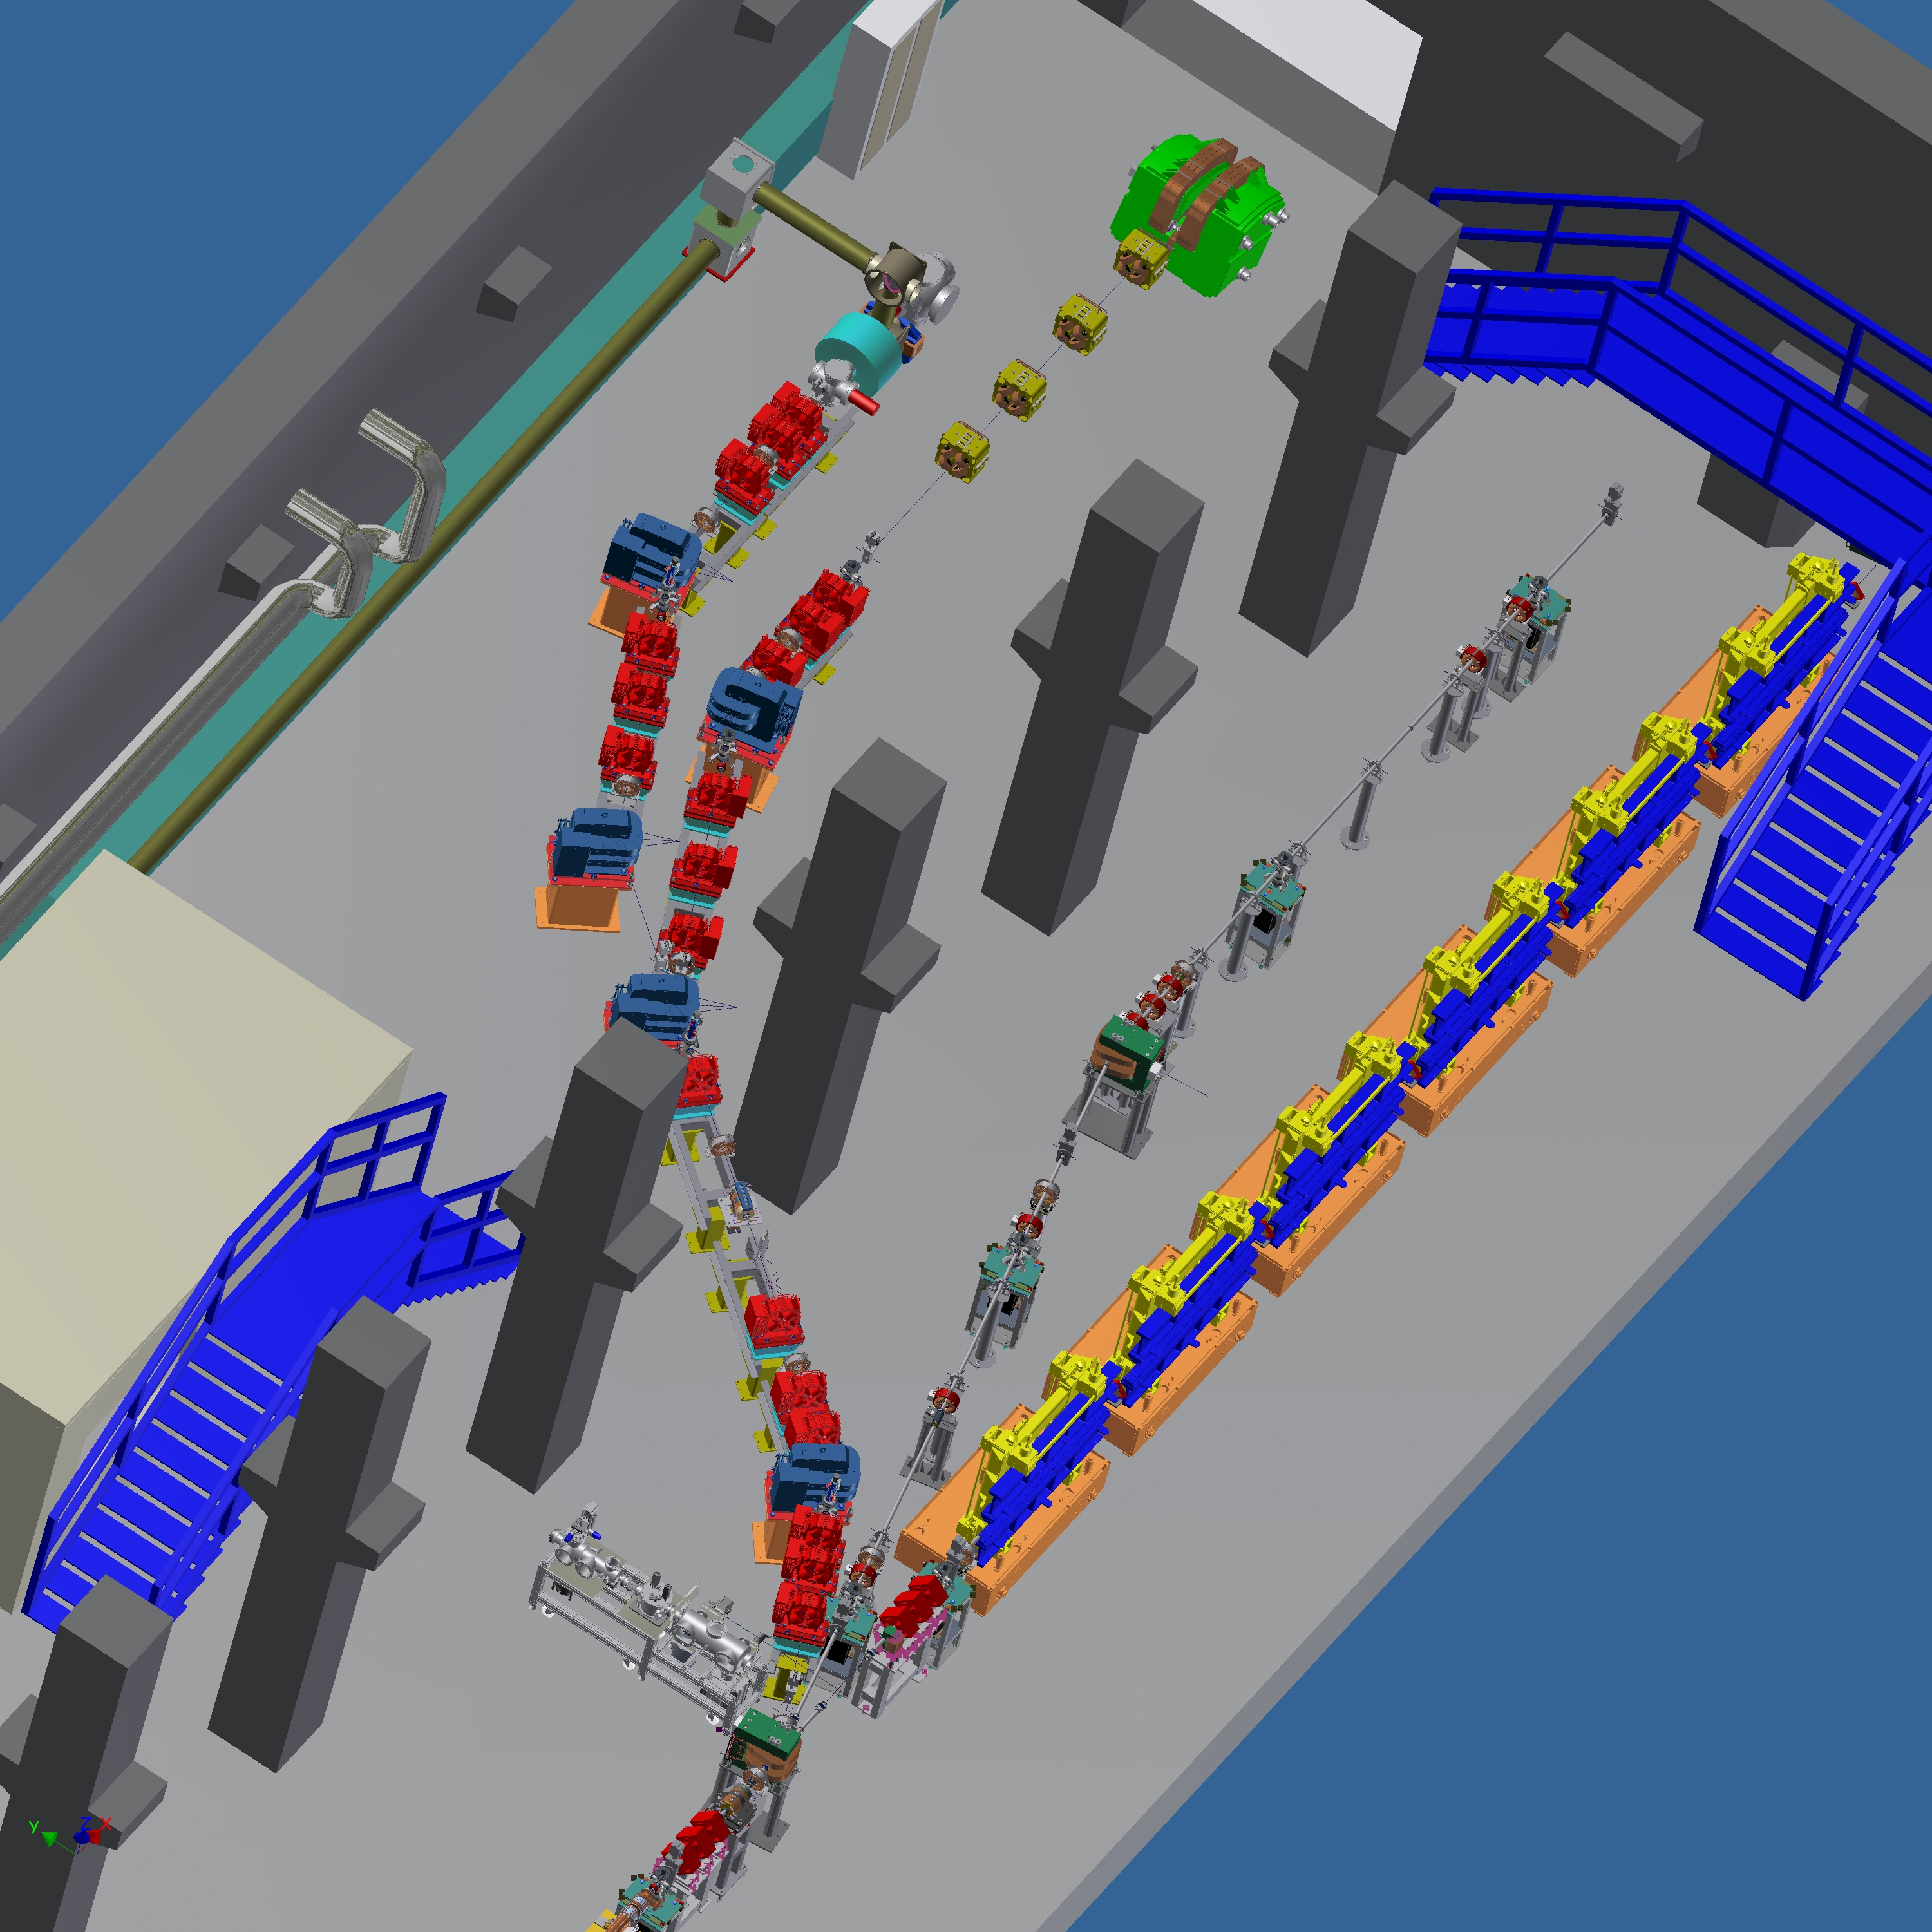
Linea Thomson
scattering
Linea THz
Linea Plasma
Acceleration
Linea FEL

Slide 42
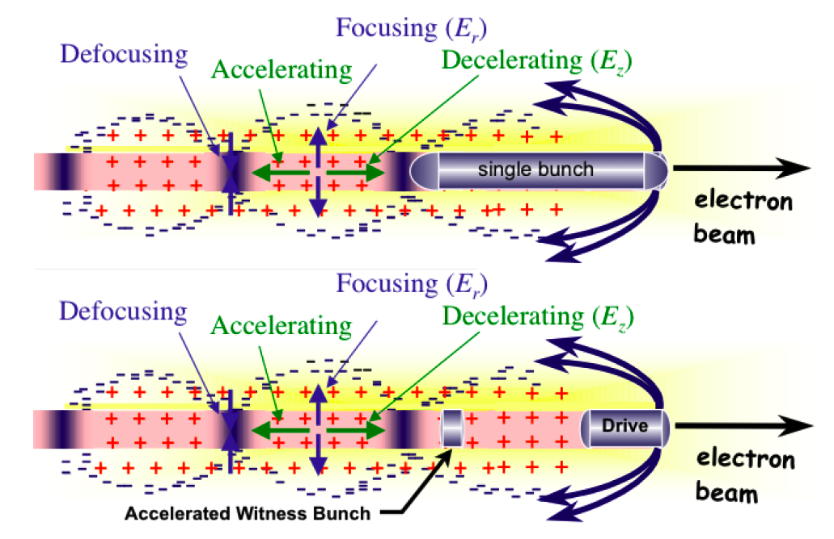
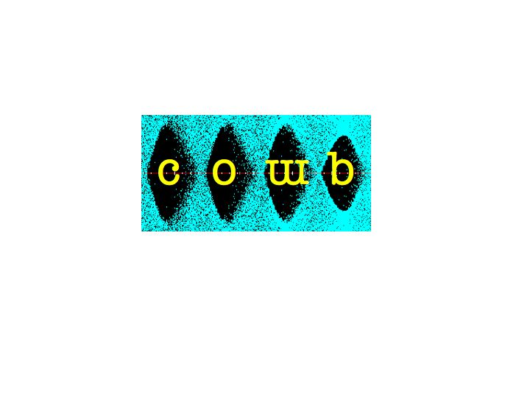
Using a high charge driving bunch to accelerate a low charge witness bunch
Resonant plasma Oscillations by Multiple electron Bunches
Weak blowout regime with resonant amplification of plasma wave by a train of high Brightness electron bunches produced by Laser Comb technique ==> 5 GV/m with a train of 3 bunches, 100 pC/bunch, 50 μm long, 20 μm spot size, in a plasma of density 10²² e⁻/m³ at λ_{p}=300 μm ?
Ramped bunch train configuration to enhance tranformer ratio?
High quality bunch preservation during acceleration and transport?
Strong blowout regime with pC/fs bunches ==> TV/m regime ?

Slide 43
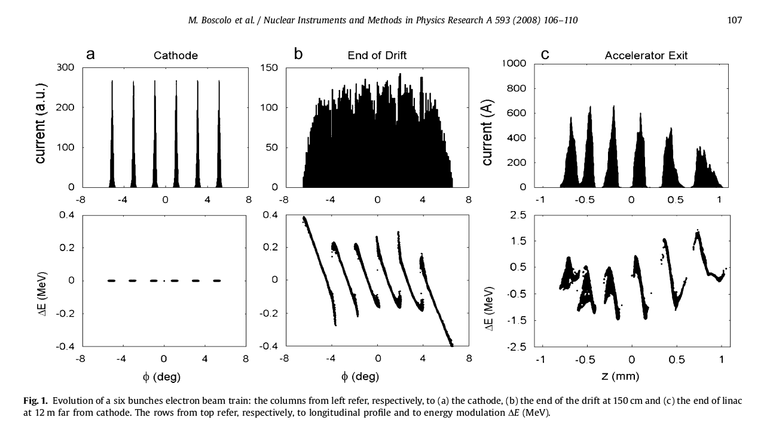
Laser Comb: beam echo generation of a train bunches
Notes:
43

Slide 44
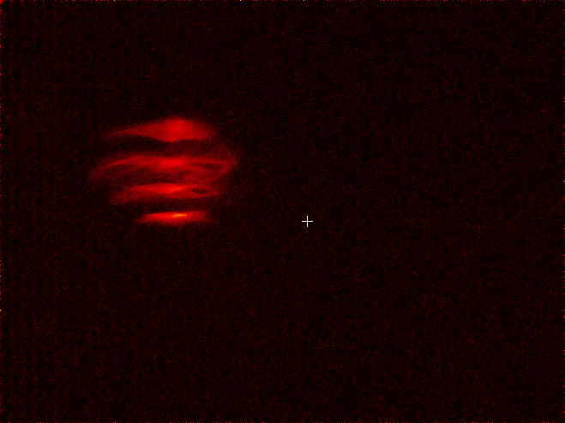



4-pulses-time-structure
4-levels-energy-spectrum
longitudinal phase space
time
vertical dim
time
orizontal dim
energy
energy
4 pulses in the same RF bucket
2 ps spacing / 300 fs FWHM

Slide 45
Schemi di accelerazione a plasma
Da sperimentare nei Laboratori di Frascati
Self-injection : laser di potenza (FLAME) su gas jet
Wakefield : multi impulsi di SPARC su gas jet
External injection : singoli impulsi di SPARC accelerati
dall’onda di plasma formata da laser FLAME

Slide 46

THZ radiation experiment

Slide 47






Expected
Measured
Interferogram
Spectrum

Slide 48
Acknowledgements and references
C.Biscari, M.Ferrario, V.A. Lebedev, J. Wenninger, K. Oide, C. Zhang, M. Bai, G.L.Sabbi, M.L. Hogan, M.S. Zisman, C. Prior, R.B Palmer, R.L. Geng, J. Galambos, M. Benedikt, S.G. Tantawi, I. Syratchev, E. Kallos, R. Corsini, S. Schreiber, S.F. Buffechoux, S. Banerjee, R. Tomas, A. Seryi, C. Montag, R. Milner, J.P. Koutchouk, A. Valishev, F. Zimmermann, S. Holmes, A.D. Bross, N.J. Walker, G.Geshonke, J.P. Delahaye, S. Bettoni, L. Evans, A. Blondel, M. Biagini, M. Zobov, I. Koop, G. Geshonke, V. Shiltsev, R. Milner

