Slide 1
Possible application of the SiTRD technique in the next generation collider experiments
M. Brigida, F. de Palma, C. Favuzzi, P. Fusco, F. Gargano, N. Giglietto, F. Giordano, F. Loparco, M. N. Mazziotta, C. Monte, S. Rainò and P. Spinelli
Università degli Studi di Bari and INFN Sezione di Bari

Slide 2
The SiTRD concept
Radiator
SSD
B field
TR X-ray
electron
γ
r
l
e

Slide 3
Principle of operation (1)
The radiating particle is separated from the TR X-rays by the magnetic field
Absorption of TR X-rays in the SSD will take place in a different region (“particle shadow”) from that in which the particle will leave its ionization energy deposit
The position of the “particle shadow” can be inferred starting from the particle track
The ionization energy deposit of the particle is of ∼120keV in a 4ooμm thick SSD
The ionizing particle will induce signals on one or more strips (“particle cluster”)
The size of the “particle cluster” will depend on the inclination of the track and on the charge sharing in the SSD
The TR X-ray energy spectrum is peaked at ∼10÷20keV and its tails may extend up to a few tens of keV
TR X-rays will induce signals on one or more strips (“X-ray cluster”) within the “particle shadow”
Since X-ray conversion is a point event, the typical size of an “X-ray cluster” is of a single strip
A low noise electronics is required for efficient X-ray detection
typical value of σ_{noise}∼ a few hundreds ENC

Slide 4
Principle of operation (2)
particle shadow
particle cluster
electron
r
t
l
A minimum separation of one strip is required between the “particle cluster” and the “particle shadow”
This condition sets the momentum upper limit for the identification of radiating particles

Slide 5
Beam test in 2006
A beam test on a reduced scale 2-module SiTRD prototype was carried out at the CERN-PS T9 facility in 2006
the beam test campaign, consisting of several tests, started in 2001
e/π beam with momenta up to 10GeV/c
MNP17 magnet ➔B field up to 1T
Length of each SiTRD module = 25cm
Radiator thickness = 5cm
S₃
S₁
SiTRD 1
SiTRD 2
M₇
S_{h}
S₀
M₁
M₂
M₃
M₄
M₅
M₆
C₁
C₂
Pb-glass
Radiators
S₂
Magnet

Slide 6
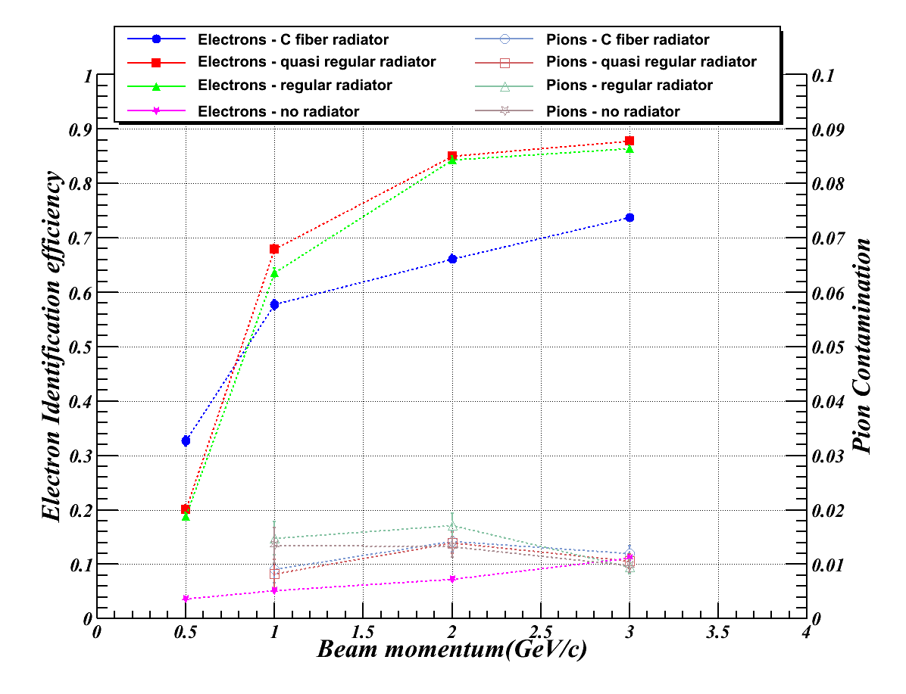
Beam test results (1)
Runs with pc/qB=3GV/T:
constant separation between the “particle cluster” and the “particle shadow” in the SSD
allow to study the dependence of the SiTRD performance on the TR yield
Efficiency = fraction of events with at least one “X-ray cluster” detected within the “particle shadow” in any SiTRD module
Energy threshold of “particle clusters” = 30keV
Energy threshold of “X-ray clusters” = 4.5keV

Slide 7
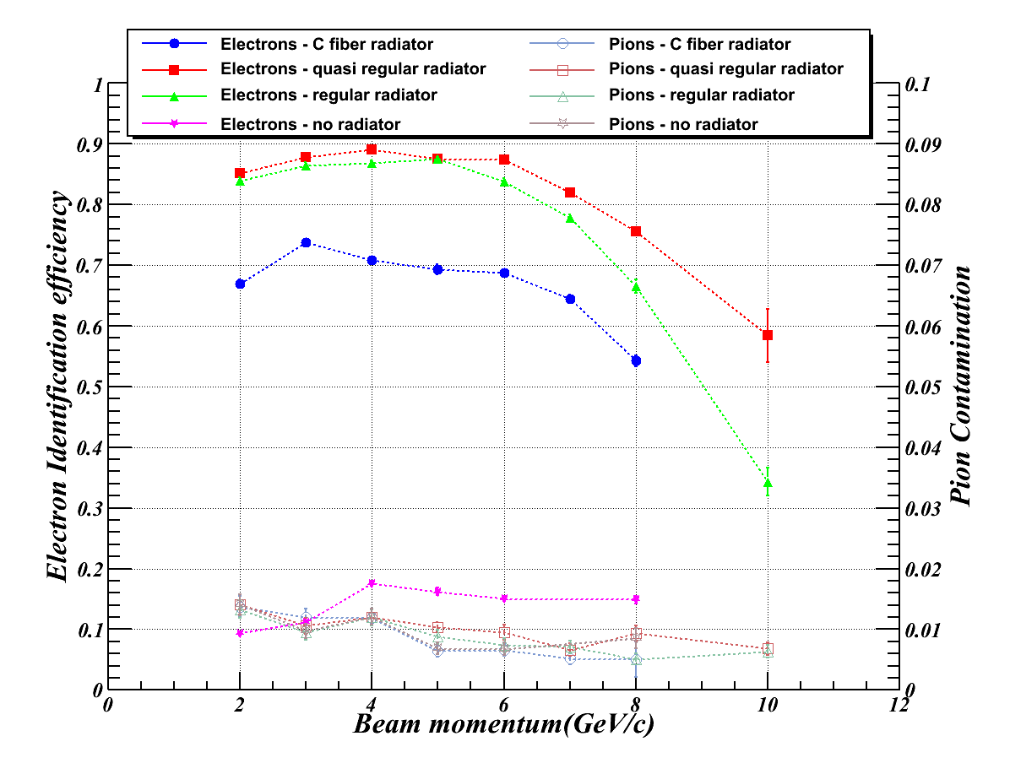
Beam test results (2)
Runs with B=1T
at low momenta the “particle shadow” is well separated from the “particle cluster” and the electron identification efficiency reaches its maximum
at p>5GeV/c the electron identification efficiency drops because some “X-ray clusters” can be merged into the “particle cluster”
the pion contamination is always of the order of 1% and slightly decreases with increasing momentum because the size of the “particle shadow” also decreases
Energy threshold of “particle clusters” = 30keV
Energy threshold of “X-ray clusters” = 4.5keV

Slide 8
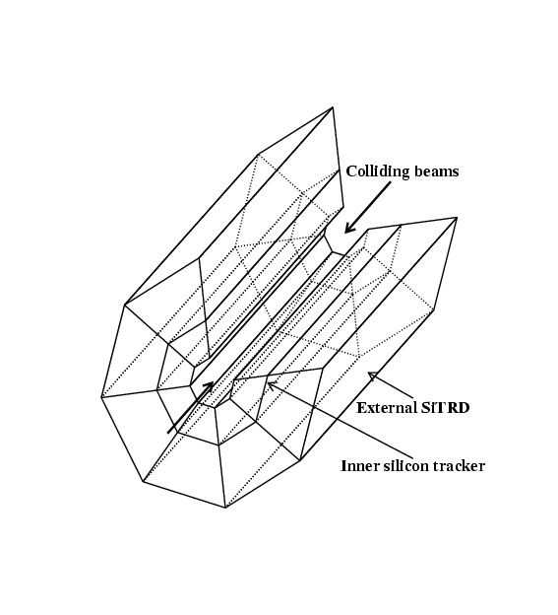
A SiTRD for SLHC
Detector: Inner silicon tracker + external SiTRD
Application: e/h discrimination
high magnetic field available
no limitations on the number of electronic channels
Momentum range up to ∼100GeV (limited by hadron TR)
Reduced material budget (in terms of X₀)

Slide 9
A SiTRD for the ATLAS upgrade
References:
R. L. Bates, “Upgrading the ATLAS barrel tracker for the super-LHC”, NIMA607 (2009), 24
M. Minano, “ATLAS strips upgrade”, Vertex2009
Geometry:
5 SSD planes available, at radial distances of 38cm, 49cm, 60cm, 75cm and 95cm ➔4 SiTRD modules with total lengths of 11cm, 11cm, 15cm and 20cm
Magnetic field: B=2T
Detectors:
SSDs with a thickness of 320μm and a strip pitch of 74.5μm
the strips of the 3 inner layers are 24mm long, those of the 2 outer layers are 96mm long

Slide 10
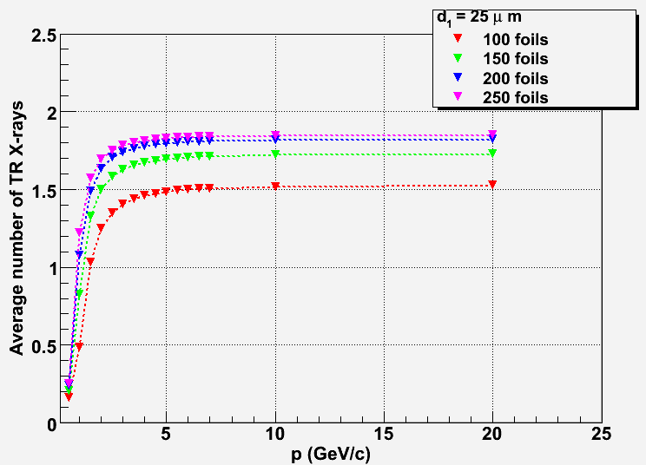
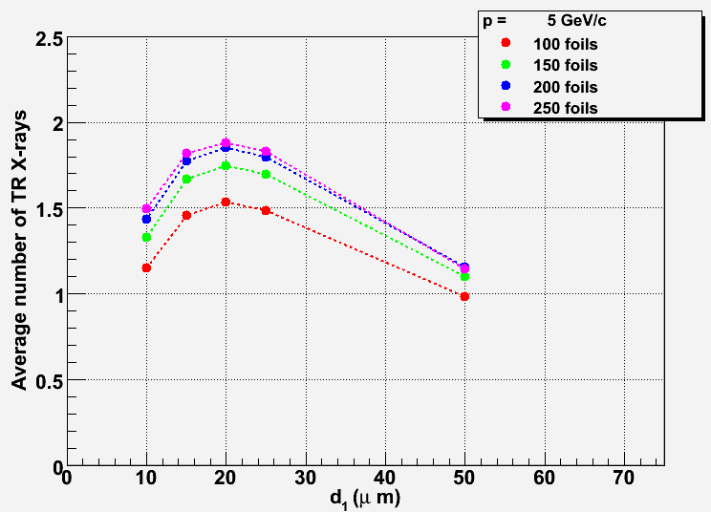
Choice of the radiator
We assumed that each SiTRD module hosts a 5cm thick regular radiator
We chose polyethylene as radiator material
The foil thickness d₁ and the number of foils have been chosen in order to maximize the TR X-ray yield while limiting the material budget
The calculation of the TR X-ray yield was performed taking into account absorption in the air and in a 320μm thick silicon detector
We chose a radiator consisting of 200 foils, each 25μm thick

Slide 11
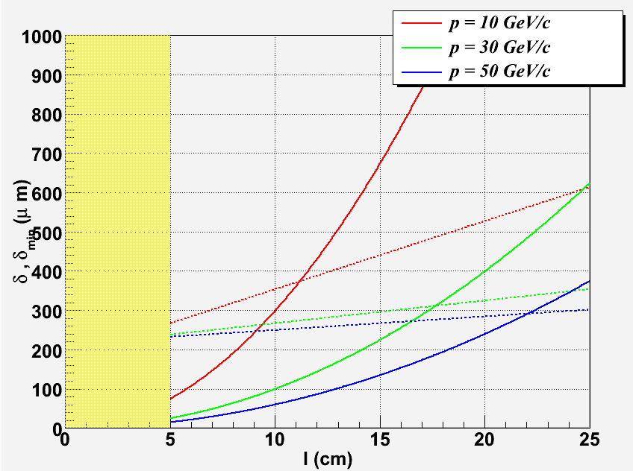
Expected performance
Continuous lines = average separation between the particle and the TR X-rays in the SSD
Dashed lines = minimum separation required to distinguish the “X-ray cluster” from the “particle cluster”
The calculations were performed considering particles at normal incidence
The 11cm modules are expected to discriminate electrons from hadrons up to 10GeV/c momentum
The 20cm long SiTRD is expected to discriminate electrons from hadrons with momenta larger than 30GeV/c

Slide 12
SiTRD Monte Carlo simulation
A Geant3 based code has been used that includes the simulation of the TR emission (M. N. Mazziotta, Comp. Phys. Comm. 132, 110)
In our Monte Carlo code we implemented a full simulation of the SSDs
The energy loss in Si is evaluated from the collision cross section σ(E) (H. Bichsel, Rev. Mod. Phys. 60, 663)
The mechanism of production of both primary and secondary e-h pairs in silicon, due either to the ionization energy loss or to the X-ray absorption, are simulated in a dedicated code (M. Brigida et al., NIMA533, 322)
Electric signals in SSDs are evaluated with a dedicated algorithm based on the Ramo’s theorem (NIMA533, 322)
The propagation of carriers in the SSDs is simulated neglecting the magnetic field
A simulation of the front-end electronics is also implemented, including noise generation
The whole simulation chain was validated taking advantage of the results of previous beam tests
We studied the SiTRD e/h identification performance simulating samples of electrons and pions with momenta up to 50GeV/c
we did not implement any simulation of any other background
we simulated only events with normal incidence on the SiTRD

Slide 13
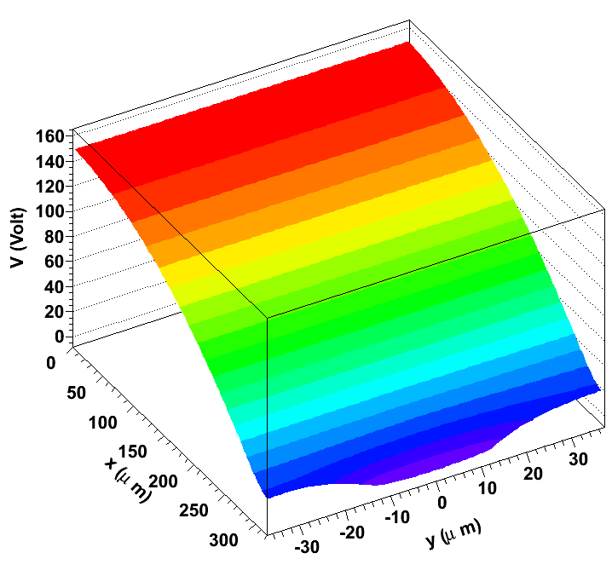
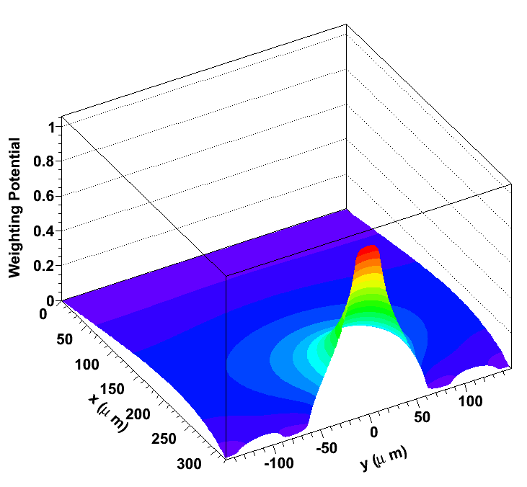
Electric potential and weighting potential maps in the SSDs
Electric potential in a single SSD cell
Weighting potential in a group of 5 SSD cells
The weighting potential describes the coupling between the electrodes and allows to simulate the charge sharing in the SSD

Slide 14
Front-end electronics simulation
Preamplifier
Shaper
Detector
We simulated a simple front-end electronics consisting of a preamplifier and a shaper
ENC = 200 electrons ➔ 0.7keV
peaking time = 50ns
gain = 13mV/fC

Slide 15
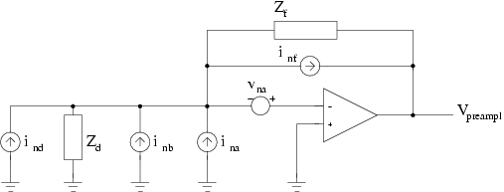
Noise simulation
The electronic noise is due to the detector and to the front-end
Thermal noise due to the feedback resistor:
i²_{nf}=4KT/R_{f}
Shot noise due to the leakage current:
i²_{nd}=2eI_{L}
Electronic noise due to the amplifier:
i²_{na}= 0
v²_{na} = 2.7KT/g_{m}
Thermal noise due to the bias resistor:
i²_{nb}=4KT/R_{b}

Slide 16
Display of a 5GeV/c electron event
Bending plane
Not-bending plane

Slide 17
Examples of signals in the SSDs
Strips composing a “particle cluster”
Strips composing a “X-ray cluster”

Slide 18
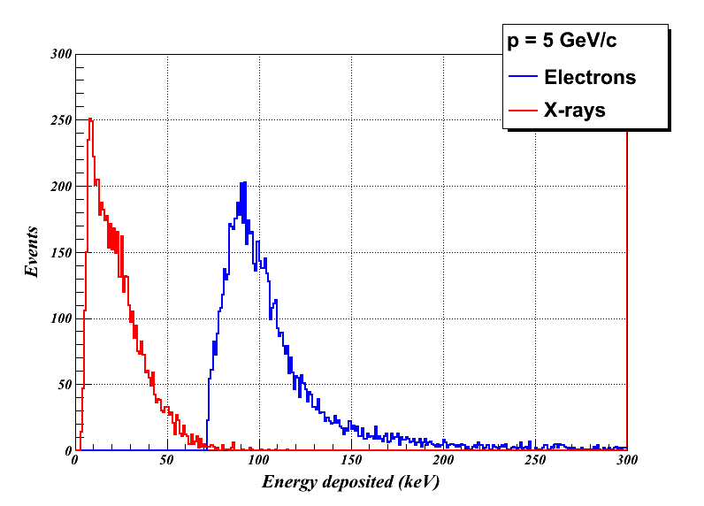
Energy deposition in the SSDs
Energy threshold for the “particle cluster”= 35keV (50σ_{noise})
Energy threshold for the “X-ray cluster”= 3.5keV (5σ_{noise})
An “X-ray cluster” may correspond to multiple TR photons

Slide 19
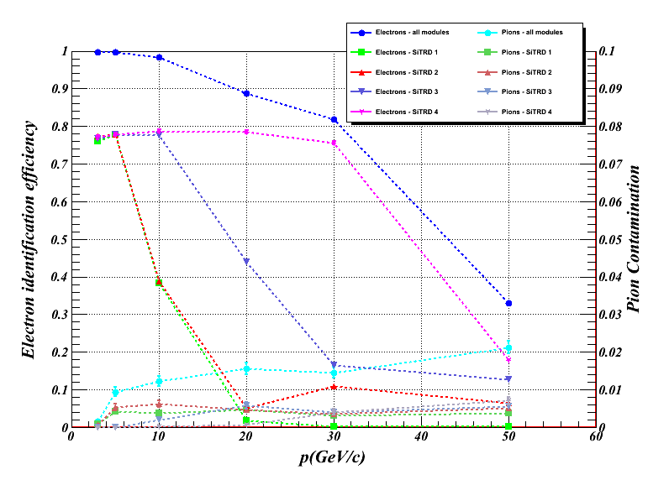
SiTRD performance (X-ray cluster counting mode)
The efficiency is defined as the fraction of events with at least an “X-ray cluster” in any SiTRD module
The energy threshold of X-rays is 3.5keV (5σ_{noise})

Slide 20
The likelihood analysis approach
Event selection:
a single “particle cluster” in each SSD
For each SiTRD module the following data are available:
number of “X-ray clusters”
energy associated to “X-ray clusters”
energy associated to “particle clusters”
For each kind of particle (electrons and pions), starting from the SiTRD information, it is possible to build a likelihood function
A given electron identification efficiency can be achieved setting a threshold on the logarithm of the likelihood ratio:

Slide 21
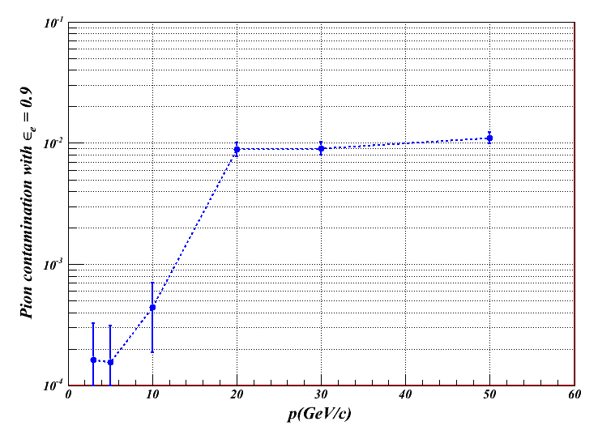
SiTRD performance (likelihood analysis approach)
The likelihood approach allows to obtain a pion contamination less than 1% while keeping a 90% electron identification efficiency in the whole momentum range up to 50GeV/c
These results have been obtained selecting a sample of events with a single “particle cluster” in each SSD module. A study of the tracking efficiency is beyond the scope of this work.

Slide 22
Conclusions
We have implemented the simulation of a 4-module SiTRD to be operated in a future experiment at SLHC
the geometry of a possible upgrade of the ATLAS experiment has been used as a starting point
when operated in X-ray cluster counting mode, the SiTRD allows optimal e-π discrimination in the momentum range up to 10GeV/c
for p≤10GeV/c the electron identification efficiency is close to 100% with a pion contamination ∼1%
at p>10GeV/c the electron identification efficiency decreases to 40% at 50GeV/c while the pion contamination is still ∼1%
if the likelihood analysis is implemented, the SiTRD allows 90% electron identification with pion contamination ∼1% in the momentum range up to 50GeV/c

Slide 23
References
M. Brigida et al., “Test beam results for a Silicon TRD (SiTRD) prototype”, NIMA522 (2004), 148
M. Brigida et al., “Perspectives on the performance of a multilayer Silicon TRD (SiTRD)”, NIMA522 (2004), 153
M. Brigida et al., “Investigation of the Transition Radiation produced by fast electrons crossing multifoil and fiber radiators”, NIMA550 (2005), 157
M. Brigida et al., “A Silicon Transition Radiation Detector for space and accelerator applications”, NIMA564 (2006), 115
M. Brigida et al., “The silicon transition radiation detector: performance and perspectives”, NIMA572 (2007), 440
M. Brigida et al., “Beam test results with a reduced scale Silicon Transition Radiation Detector prototype”, NIMA577 (2007), 519

