Slide 1


SuperB Accelerator Status
M. Biagini
for the SuperB Accelerator Team
SuperB Workshop LNF
LNF, Frascati, April 4-6, 2011

Slide 2
Present SuperB Accelerator Team
M. E. Biagini, S. Bini, R. Boni, M. Boscolo, B. Buonomo, S. Calabro’, T. Demma, E. Di Pasquale, A. Drago, M. Esposito, L. Foggetta, S. Guiducci, , S. Liuzzo, G. Mazzitelli, L. Pellegrino, M. A. Preger, P. Raimondi, R. Ricci, U. Rotundo, C. Sanelli, M. Serio, A. Stella, S. Tomassini, M. Zobov (LNF)
K. Bertsche, A. Brachman, Y. Cai, A. Chao, R. Chestnut, M. H. Donald, C. Field, A. Fisher, D. Kharakh, A. Krasnykh, K. Moffeit, Y. Nosochkov, A. Novokhatski, M. Pivi, C. Rivetta, J. T. Seeman, M. K. Sullivan, S. Weathersby, A. Weidemann, J. Weisend, U. Wienands, W. Wittmer, M. Woods, G. Yocky (SLAC)
A.Bogomiagkov, I. Koop, E. Levichev, S. Nikitin, I. Okunev, P. Piminov, S. Sinyatkin, D. Shatilov, P. Vobly(BINP)
F. Bosi, E. Paoloni (INFN & University of Pisa)
J. Bonis, R. Chehab, O. Dadoun, G. Le Meur, P. Lepercq, F. Letellier-Cohen, B. Mercier, F. Poirier, C. Prevost, C. Rimbault, F. Touze, A. Variola (LAL-Orsay)
B. Bolzon, L. Brunetti, A. Jeremie (LAPP-Annecy)
M. Baylac, O. Bourrion, J.M. De Conto, Y. Gomez, N. Monseu, D. Tourres, C. Vescovi (LPSC-Grenoble)
A. Chancé (CEA-Saclay)
D.P. Barber (DESY & Cockcroft Institute)
S. Bettoni (PSI)
P. Fabbricatore, R. Musenich, S. Farinon (INFN & University of Genova)
Yuan Zhang (IHEP, Beijing) NEW ENTRY
Hopefully soon: R.Bartolini, A. Seryi, A. Wolski et al… (John Adams & Cockcroft Institute)

Slide 3
SuperB Accelerator
SuperB Progress Reports -- Accelerator updated in January:
http://arxiv.org/abs/1009.6178v2
Site still under study
Layout will evolve following the site chosen & the new options (SR beamlines)
Collaboration is growing but manpower recruitment is needed as soon as possible
R&D on QD0 progressing very well
More R&D starting (RF, beam-beam, SR beamlines layout…)

Slide 4
Layout V12, 1.25 Km
LER SR
IP
60 mrad
LER SR
HER and LER arcs are parallel to each other in the H-plane while separated by 2.1 m.
Each ring has one inner and one outer arc.
Both inner and outer arcs provide the same bending angle but outer arc is made longer (increased drift space around the dipoles) in order to provide the same azimuth location as the inner arc
LER
arc
LER
arc
HER
arc
HER
arc
Rings
crossing
e-
e+
RF

Slide 5
Machine Parameters for 10³⁶ cm⁻² s⁻¹
The IP and ring parameters have been optimized based on several constraints to maintaining wall plug power, beam currents, bunch lengths, and RF requirements comparable to present B- Factories
Simplifying the IR design as much as possible. In particular, reduce the synchrotron radiation in the IR, reduce the HOM power and increase the beam stay-clear
Relaxing as much as possible the requirements on the beam demagnification at the IP. Improved chromatic correction in arc cells

Slide 6
Flexibility for parameters choice
The horizontal emittance can be decreased by about a factor 2 in both rings by changing the partition number (by changing the RF frequency [LER] or the orbit in the Arcs) and the natural ARC emittance by readjusting the lattice functions
The Final Focus system as a built-in capability of about a factor 2 in decreasing the IP beta functions
The RF system will be able to support higher beam currents (up to a factor x1.6) over the baseline, when all the available PEP-II RF units are installed

Slide 7
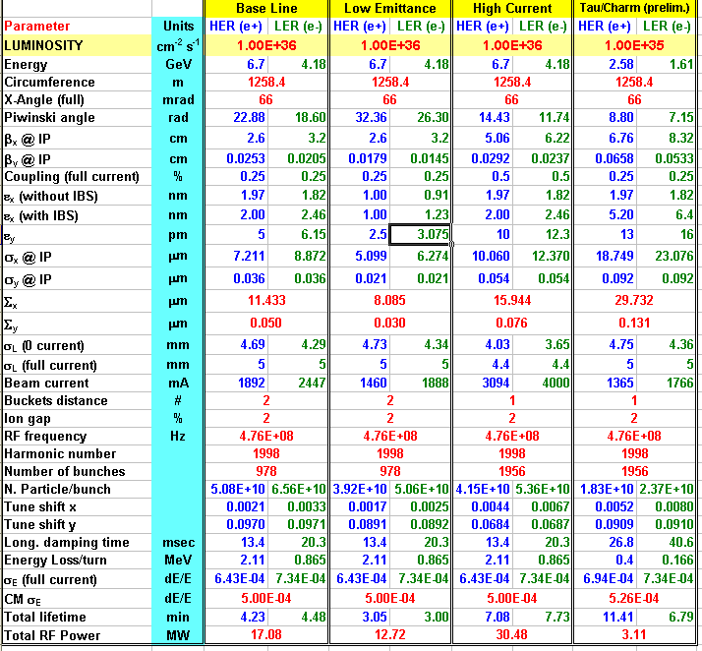
Parameters list
Tau/charm
threshold running
at 10³⁵
Baseline +
other 2 options:
Lower y-emittance
Higher currents
(twice bunches)
Baseline:
Higher emittance
due to IBS
Asymmetric beam
currents
RF power includes
SR and HOM

Slide 8
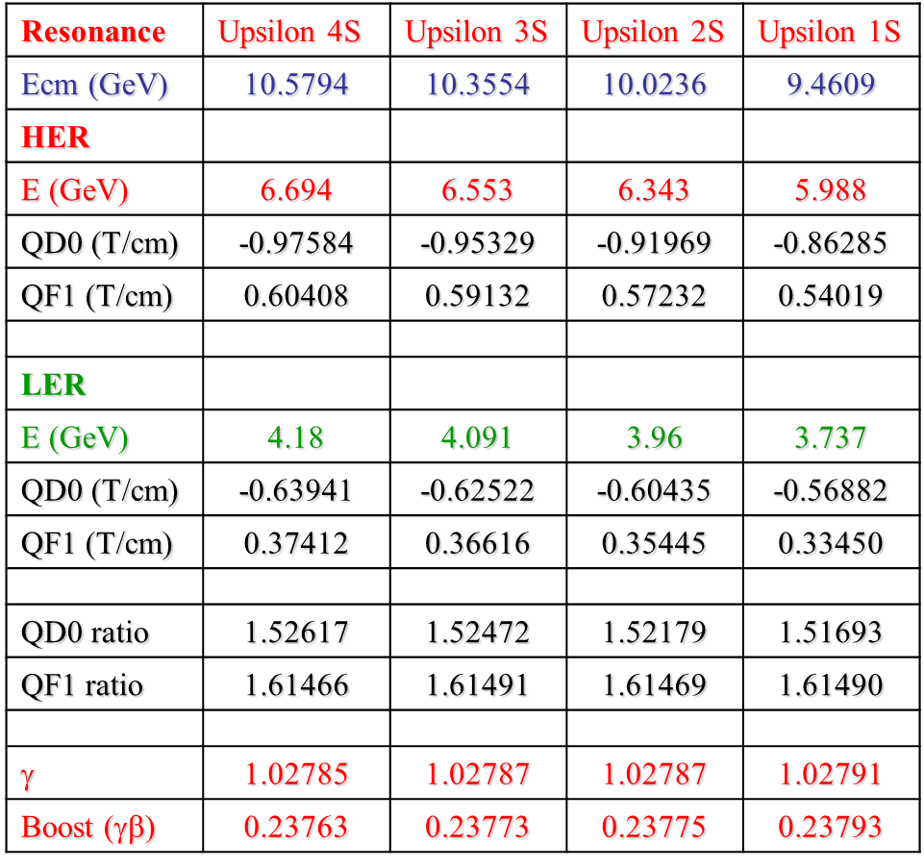
Energy scan
Sullivan
Change center of-mass energy while maintaining the same magnetic field strength ratio for QD0 and QF1
Can get to all of the Upsilon resonances Υ(1S)…Υ (5S)
Can scan the center-of-mass energy above the Υ(4S) without removing or changing any of the permanent magnets
Have to remove most if not all of the permanent magnets for Tau-charm energy region

Slide 9
Beam-beam
Shatilov
Beam-beam tune scan performed with latest beam parameters (V12) and latest beam beam code, improved to take into account crabbed beams
Comparison with previous parameters: lower bb tune shift increases tune operation area and achievable luminosity (10^36 in the large red area)
Needs to be run including lattice nonlinearities for beam beam tails and lifetime, as soon as the lattice is “reasonably” stable

Slide 10
Beam-beam tune scan
Shatilov
CDR, ξ_{y} = 0.17
CDR2, ξ_{y} = 0.097
L (red) = 1. ∙10³⁶

Slide 11
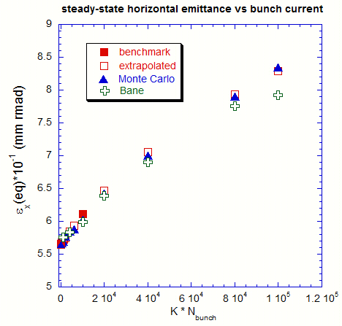
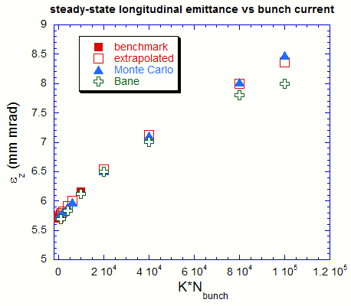
Intra Beam Scattering
Boscolo, Chao, Demma
3 methods used, all in good agreement:
  Bane (theoretical), allows for emittance growth rates estimate
  Chao (theoretical), allows for emittance time evolution estimate
  6D MonteCarlo → more accurate, all of above, will include non-gaussian tails, soon to be translated from Mathematica to Fortran for speed and precision reasons (collaboration with M. Pivi, SLAC)
ε_{x,z} vs bunch current

Slide 12
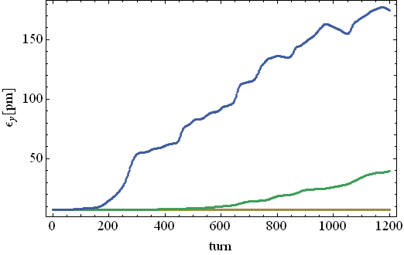
e-cloud instability
Demma, Pivi
Single bunch instability simulations for SuperB HER (V12 and V13) taking into account the effect of solenoids have been performed using CMAD (M. Pivi). They indicate a threshold density of ~10¹² e-/m³ (roughly 2 times previous estimates)
The obtained thresholds have to be compared with build-up simulations using updated parameters to determine safe regions of the parameter space (SEY, PEY)
Work is in progress to:
  Estimate the effect of radiation damping on long term emittance growth
  Estimate the fraction of synchrotron radiation absorbed by antechambers.
Vertical emittance growth induced by e-cloud
ρ=5x10¹¹
ρ=4x10¹¹
ρ=3x10¹¹

Slide 13
Build-up in Free Field Regions
Snapshot of the electron (x,y) distribution
Snapshot of the electron (x,y) distribution 50G solenoids on
Density at center of the beam pipe is larger then the average value.
Solenoids reduce to 0 the e-cloud density at center of beam pipe

Slide 14
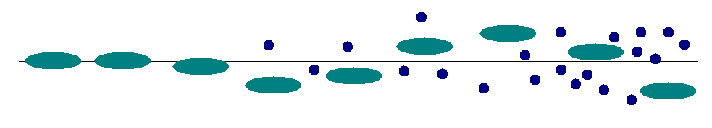
Fast Ion Instability
Demma
Residual gas in the vacuum chamber can be ionized by the single passage of a bunch train
The interaction of the electron beam with residual gas ions results in mutually driven transverse oscillations
Ions can be trapped by the beam potential or can be cleared out after the passage of the beam
Multi-train fill pattern with regular gaps is an efficient and simple way to cure FII
  Beam oscillations are suppressed by the feedback system for Lgap ≥ 40 ns, while considerable residual oscillation remains for Lgap ≤ 20 ns
Lgap=20ns
Lgap=180ns

Slide 15
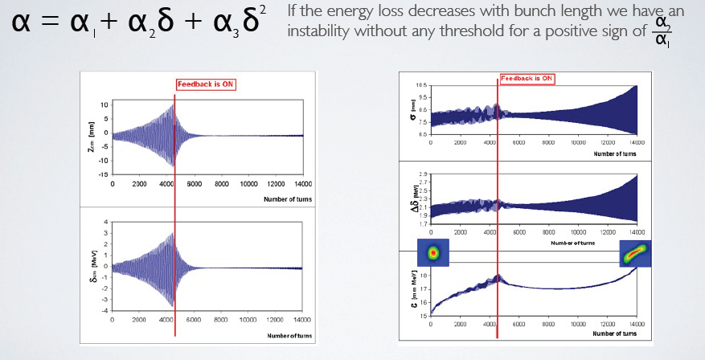
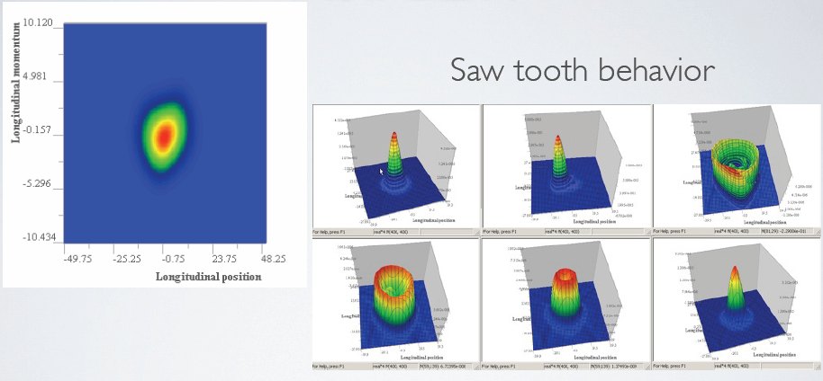
Second order momentum compaction studies
Novokhatski
Head-tail
instability

Slide 16
Low Emittance Tuning for LER
Liuzzo
LER ARC's tolerances evaluated using a Response Matrix technique that optimizes orbit, in order to recover the design values for Dispersion, Coupling and Beta-beating, and obtain the lowest possible vertical emittance
Different sets of correctors tested, may be reduced to 109.
Final Focus introduces
stringent restrictions on alignment of both FF and
ARCS (even for no errors in FF)

Slide 17
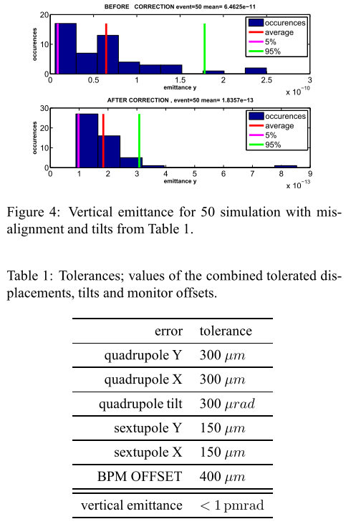
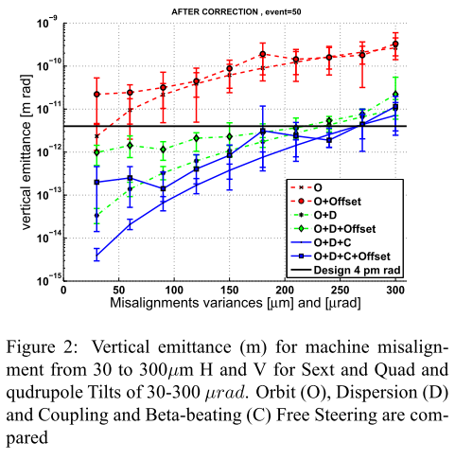
HER tolerances
Liuzzo

Slide 18
IR design
Sullivan
We have two designs that are flexible and have good:
  SR backgrounds
  Lattice functions
  Beam apertures
The two designs are:
  Vanadium Permendur for QD0 and QF1
  Parallel air-core dual quads for QD0 and QF1 (prototype in progress)
    Both designs include additional vanadium permendur Panofsky quads on the HER
These IR design demonstrates initial robustness
  Two separate QD0 designs work
  The direction of the beams can be either way with a weak preference for the incoming beams to be from the outside rings due to the location of the SR power on the cryostat beam pipe

Slide 19
QD0 Design: 2 possible choices
Vanadium Permendur
“Russian” Design
Air core “Italian” QD0, QF1 Design

Slide 20
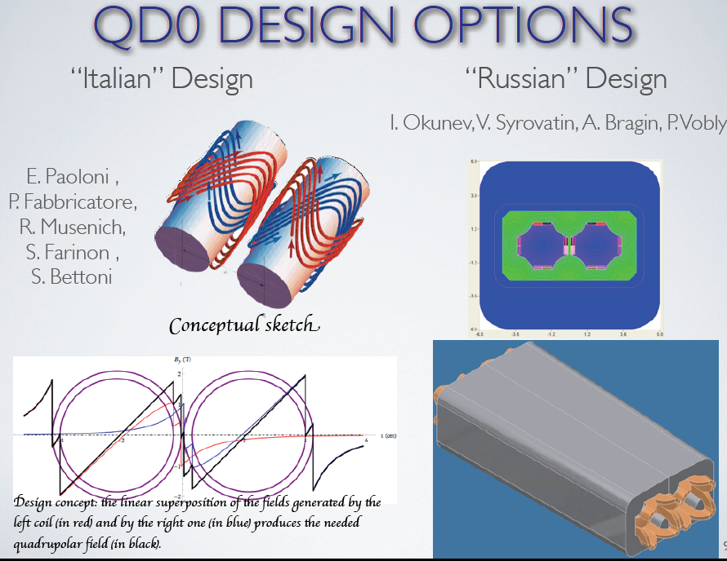
Air-core QD0 is a SC iron free septum double quad

Slide 21
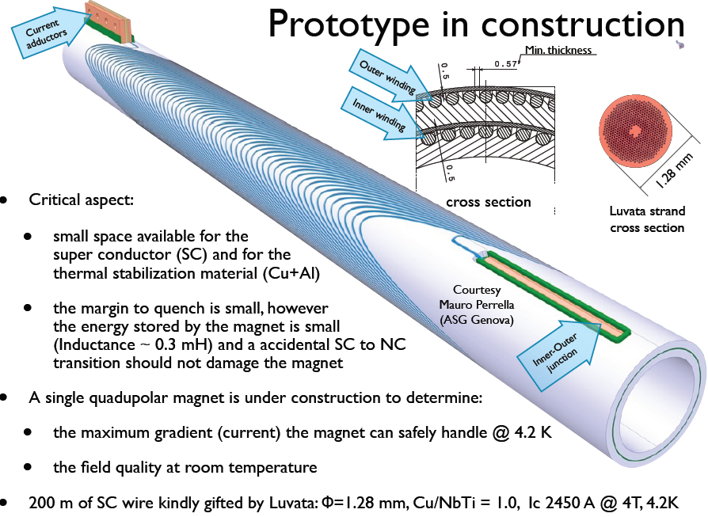
Field generated by 2
double helix windings
in a grooved Al support
Fabbricatore, Farinon, Musenich, Paoloni

Slide 22
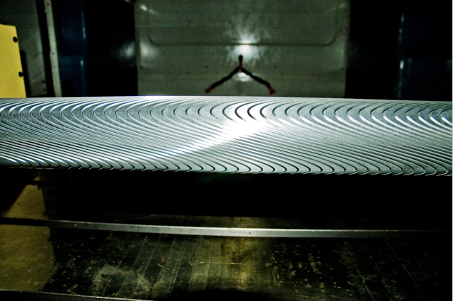
The actual grooved Al support
Ready before Summer for tests and field measurements at CERN

Slide 23
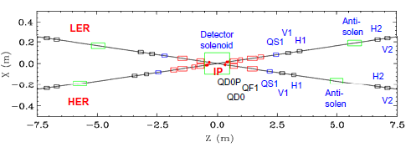
Coupling correction with detector solenoid ON
Scheme based on a hard edge solenoid field model. It includes bucking solenoids, an anti-solenoid, rotated IR permanent quadrupoles, skew quadrupole component in the SC quadrupoles, and a full set of skew quadrupoles and orbit correctors for complete compensation of linear coupling, orbit, dispersion and β function perturbation in each half-IR. Most of the correctors are rather weak
The same system can be used to correct the coupling effect when the solenoid is off, but the SC quadrupole coupling components and QD0P rotation remain. The latter can be adjusted for most local correction
Further studies are needed to evaluate the effect of solenoid on FF bandwidth and dynamic aperture. The non-linear solenoid effects need to be studied as well
Nosochkov
Other correctors are outside of this region

Slide 24
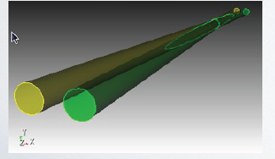
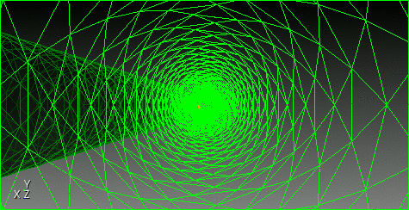
Beam’s eye view in a round chamber model
Weathersby
SLAC Advanced Computing Department parallel Finite Element Method electromagnetic time domain solver (t3p) as a tool for IR wakefield computation
Notes:
CUBIT animation.

Slide 25
RF Power

Slide 26
Wakefields
Need
Collimators
PEP-II ones are OK

Slide 27
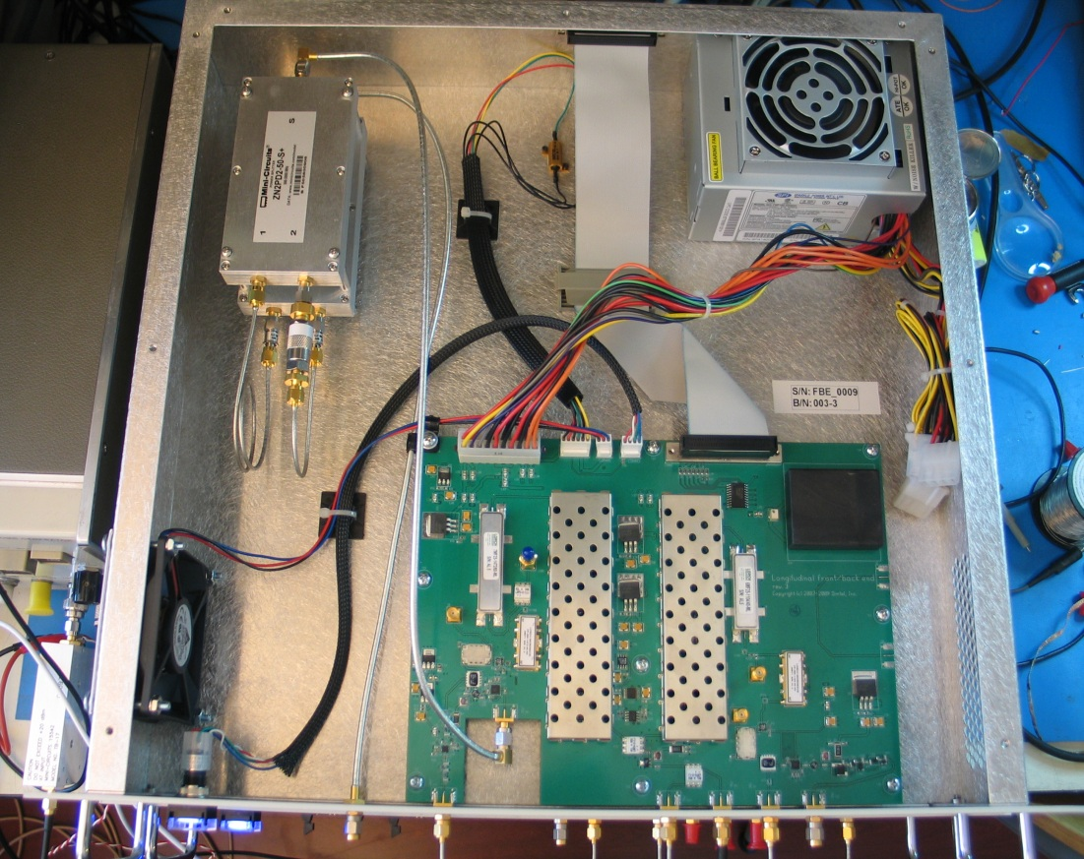
Bunch-by-bunch feedback upgrade
Drago
During last month all the 6 DAΦNE feedback have been upgraded
VFB – new 12 bit iGp systems with larger dynamic range and software compatibility with the previous version
LFB - completely new systems in place of the old systems designed in 1992-1996 in collaboration with SLAC/LBNL: fe/be analog unit connected to iGp-8 as processing unit
HFB: upgrade hw/sw of the iGp-8bit system already used
Epics server upgraded to the last version of LINUX
New front-end/back-end analog unit used in the longitudinal feedbacks

Slide 28
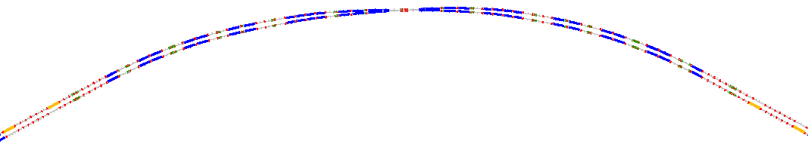
Polarization in SuperB
Barber, Monseu, Wienands, Wittmer
90° spin rotation about x axis
  90° about z followed by 90° about y
“flat” geometry => no vertical emittance growth
Solenoid scales with energy => LER more economical
Solenoids are split & decoupling optics added
LER
IP
HER
S.r. dipoles
(270° spin)
HER
LER
S.R. solenoids
(90° spin)

Slide 29
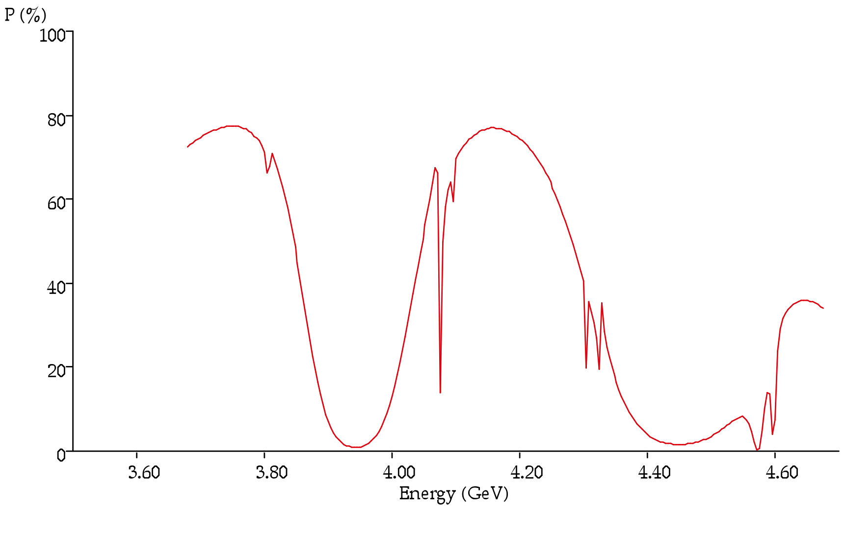
Polarization (P_{inj} = 90%)
Wienands
3.5 min
beam lifetime
E_{LER}

Slide 30
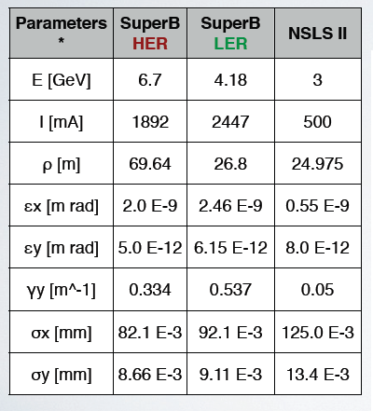
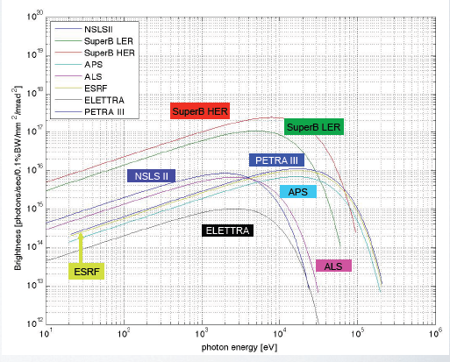
Synchrotron light options @ SuperB
Wittmer
Comparison of brightness and flux from bending magnets and undulators for different energies dedicated SL sources & SuperB HER and LER
Synchrotron light properties from dipoles are competitive
Assumed undulators characteristics as NSLS-II
Light properties from undulators still better than most LS, slightly worst than PEP-X (last generation project)
Brightness from bending magnets

Slide 31
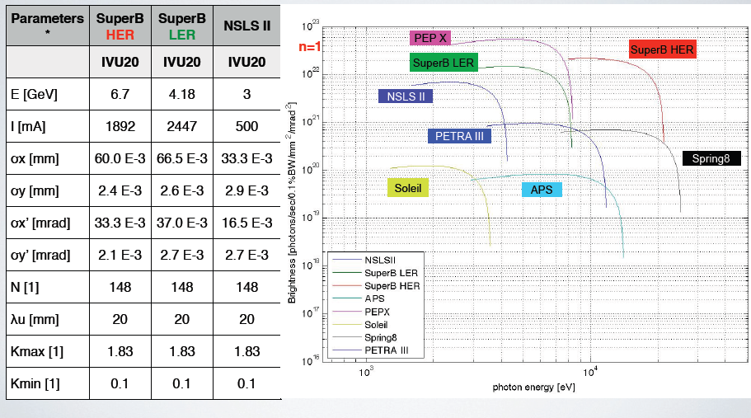
Brightness from undulators

Slide 32
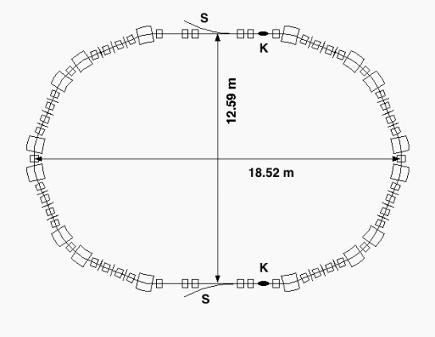
Injection System
Proposed scheme
positron linac
e+
1 GeV
CAPTURE
SECTION
PC
0.6 GeV
SHB
THERMIONIC
GUN
combiner
DC dipole
e+
e+
BUNCH
COMPRESSOR
5.7 GeV e+ 3.9 GeV e-
POL.
SLAC
GUN
Wien
filter
Mott
polarim
50 MeV
CAPTURE
SECTION
e-
SHB
0.25 GeV
Main Rings injection rate: 50 Hz
Damping Ring just for positrons
collimators
Parameter | Units | SLC
Electron charge per bunch | nC | 16
Bunches per pulse |  | 2
Pulse rep rate | Hz | 120
Cathode area | cm² | 3
Cathode bias | kV | -120
Bunch length | ns | 2
Gun to SHB1 drift | cm | 150
e_{n,rms,gun} (fm EGUN) | 10⁻⁶ m | 15
from A. Brachmann - SuperB Workshop
SLAC, October 2009
Round beam
Emittance @ 4.16 GeV = 1.8 nm
Required bunch charge for electrons ≈ 0.3 nC
… scrapers .. collimators needed
Boni, Chancé, Dadoun, Guiducci, Hermes,
Poirier, Preger, Seeman, Variola
R. Boni, XiV SuperB meeting, Frascati 29-09-2010
Notes:
32

Slide 33
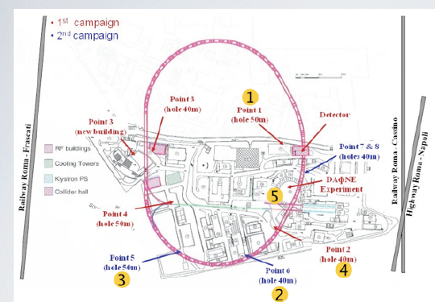
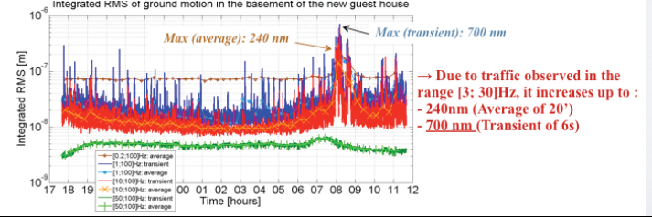
Ground motion at LNF
Bolzon, Brunetti, Jeremie,Tomassini
A second campaign of geological prospections has been done @ LNF (four additional holes)
A new campaign of ground motion measurements was carried out in October with the collaboration of the LAPP group

Slide 34
Vibrations budget
Bertsche
The small beam sizes at the IP pose stringent vibration requirements. Beam position at the IP is very sensitive to individual motion of IR components
However, the present IR design with shared elements in a common cryostat will cause coherent motion of these elements, greatly reducing the vibration sensitivity of the IR.
Cryostat vibration should be kept below 800 nm rms, and cryostat rotation less than 2 μm rms
Vibration of the remaining FF and arc quadrupoles should be kept to less than 200 nm rms
A fast luminosity feedback system should have a bandwidth of at least 100 Hz, achieving at least 10xvibration reduction at low frequencies
With these requirements the vibration budget can be met even during the noisiest part of the day, limiting vibration-induced luminosity loss to less than 1%

Slide 35
Layout, Site
The rings footprint is at the moment the same as presented at Elba. Injection and transfer lines are also unchanged
The insertion of synchrotron beamlines, with their impact on the layout and lattice is being studied
We are looking for a green field site in order to exploit at best the facility (SuperB and SL)
Several sites seems available, first pick at the moment is in Tor Vergata University campus and we are studying its compatibility with the requirements (Site Committee will visit April 18-19)
The layout will be adjusted as soon as the site is chosen to further optimize the system performances

Slide 36
Accelerator Team Organization
Frascati Lab will host the team in the initial phase (at least 2 years...)
Need to assemble a team:
  INFN Frascati
  INFN other Labs
  SLAC
  France
  BINP
  Poland
  UK
  More welcome!
Need to obtain (a lot of) engineering help

Slide 37
Synergies with state-of-the art international efforts
SuperB design has many characteristics in common with state-of-the-art colliders (LC, CLIC) and SL sources, to cite just a few:
  Alignment of magnets, and orbit and coupling correction with the precision needed to produce vertical emittances of just a few pico-meters on a routine basis
  Optimization of lattice design and tuning to ensure sufficient dynamic aperture for good injection efficiency (for both) and lifetime (particularly for SuperB LER), as well as control of emittances
  Feedbacks (IP and rings)
  Control of beam instabilities, including electron cloud, ion effects and CSR
  Reduction of magnet vibration to a minimum, to ensure beam orbit stability at the level of a few microns
All these issues are presently active areas of research and development, the similarity of the proposed operating regimes presents an opportunity for a well-coordinated program of activities that could yield much greater benefits than would be achieved by separate, independent research and development program

Slide 38
Conclusions
Accelerator design is converging with most aspects starting to look feasible
Lattice and parameters optimization is continuing, for better performances and more flexibility
More subtle beam dynamics issues are being studied (e.g. IBS, FII, emittance diffusion, beam-beam effects, feedbacks)
Components and lattice tolerances with corrections are being studied
Polarization is progressing: beam-beam depolarization, trying to simplify the polarized gun, spin measurements
Synchrotron Light beamlines option is being studied
CDR2 is ready
We are already actively collaborating with other Labs (CERN, PSI, Rutherford, Cornell,…) to solve common issues
We need to organize the effort for the project

