Slide 1
The Naples' testbed for the SuperB computing model: first tests
G. Russo, D. Del Prete, S. Pardi

Slide 2
The rationale
Following the Ferrara and Frascati meeting, we decided to setup a testbed for SuperB applications
The testbed is based on 12 servers (8 core, 32 GB, 8 disks), connected with a 2x10 GbE
A further server (48 core) under order
The tests will be based on:
RoCE, MPI, data access, dataset distribution, monitoring tools

Slide 3
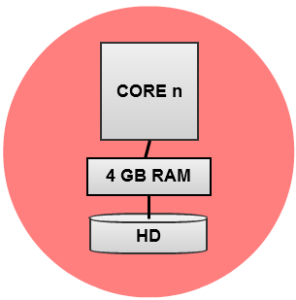
The configuration of each node
2x CPU 2,13GHz 4Core, 4,80GT/s + 4,80GT/s QPI
8x 4GB Dual Rank 1066MHz
8x HDD 500GB 7200rpm SATA Hot-Plug 3,5”
1 Gbps
10 Gbps
10 Gbps
1 Gbps
Twinax
UTP
. . . 8x one node (12 nodes in this test)
96 core (8x 12), 384 GB Ram (32x 12), 48 TB HD (4x 12)

Slide 4
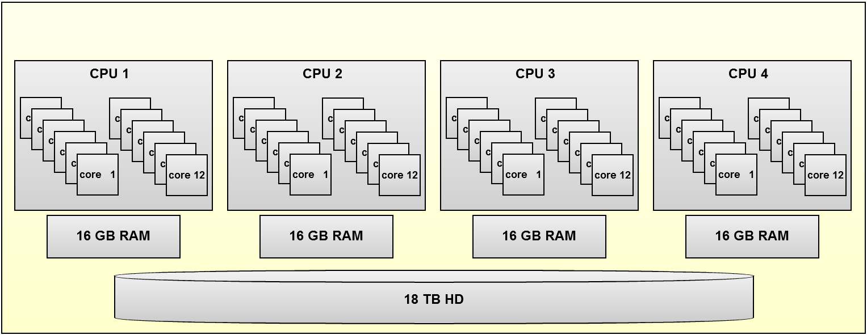
The configuration of the shared storage
Storage Server for the redundant and shared data
48 core (12x cpu), 64 GB Ram (16x cpu), 18 TB HD

Slide 5
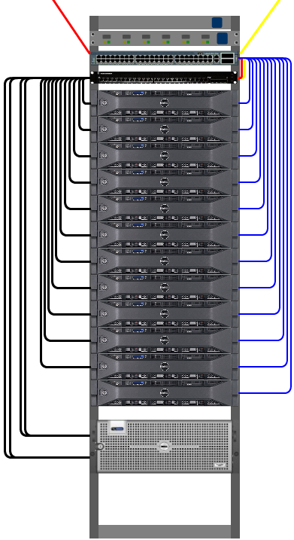
Optical fiber Lan2
10Gbps
Rack n
Optical fiber Lan1
10Gbps
Twinax 10Gbps connection
Gigabit Ethernet connection
Server 48 Core
64 GB di RAM
4x Twinax 10Gbps connection
Storage 18 TB

Slide 6
Computing Model
Rack 1
Rack n
10 GB Switch
10 GB Switch
WN1/DataNode
WN1/DataNode
2x CPU 2,13GHz 4Core
8x 4GB
8x HDD 500GB
WN2/DataNode
WN2/DataNode
2x 10 GB
2x 10 GB
WN12/DataNode
WN12/DataNode
Shared/Redundant data Server
4x 10 GB
4x 10 GB
Shared/Redundant data Server
4x CPU 12 Core
8x 8GB di RAM
Storage 6x 3TB
6

Slide 7
Computing Model
Network Optimization Parameters:
MTU 9000
# TCP buffer sizes
net.ipv4.tcp_rmem = 131072 1048576 2097152
net.ipv4.tcp_wmem = 131072 1048576 2097152
net.ipv4.tcp_mem = 131072 1048576 2097152
net.core.rmem_default = 1048576
net.core.wmem_default = 1048576
net.core.rmem_max = 2097152
net.core.wmem_max = 2097152
# SACK and timestamps - turn off
net.ipv4.tcp_dsack = 0
net.ipv4.tcp_sack = 0
net.ipv4.tcp_timestamps = 0
# Network backlog
net.core.netdev_max_backlog = 10000
Basic: perfomance tests
Test Latency : 0.025 ms
Test Iperf : 5.6 Gbits/s

Slide 8
DOUBLE FILE SYSTEM CONFIGURATION
CURRENT SETUP:
OS SL 5.5 with gLite 3.2 Middleare. The Nodes are ready to be include in the Atlas TIER2 and available for SuperB FastSim Program (to do in the next weeks)
IMPLEMENTATION OF THE HADOOP DISTRIBUTED FILE SYSTEM ON 8 NODE
IMPLEMENTATION OF GLUSTERFS DISTRIBUTED FILE SYSTEM ON 9 NODE
8

Slide 9
HDSF-HADOOP IMPLEMENTATION
HDSF Name Node
10 GIGABIT SW
1 NAME NODE
8 WORKER NODE / DATANODES that share
the local disk
All the DataNode mount
HDSF Posix Inferface through
Fuse module
HDFS FILE SYSTEM
WN1/DataNode
WN2/DataNode
WN../DataNode
WN8/DataNode
9

Slide 10
GLUSTER IMPLEMENTATION
GLUSTERFS IS A FILE CLUSTER FILE SYSTEM THAT WORK WITHOUT DATA-NODES. IT CAN WORK IN 3 DIFFERENT CONFIGURATION: DISTRIBUTED, STRIPED AND REPLICA. IT USES THE POSIX EXENSION TO GUARANTEE THE CONSISTENCY OF FS.
GLUSTER
10 GIGABIT SW
NO NAME NODE
9 WORKER NODE / DATANODES that share
the local disk
All the DataNode are client and server.
The Gluster FS is configured with replica 3
WN1/DataNode
WN2/DataNode
WN../DataNode
WN9/DataNode
10

Slide 11
First Benchmark
Perfomance test executed through a SuperB Analysis job provided by Alejandro Perez.
It executes a real analysis test on a set of simulated root files previously replicated in the gluster-fs volume.
The following tests show the bandwidth occupation during a set of different job execution setup

Slide 12
Network Occupation in a Single Node
Single Job max rate 59MB/s

Slide 13
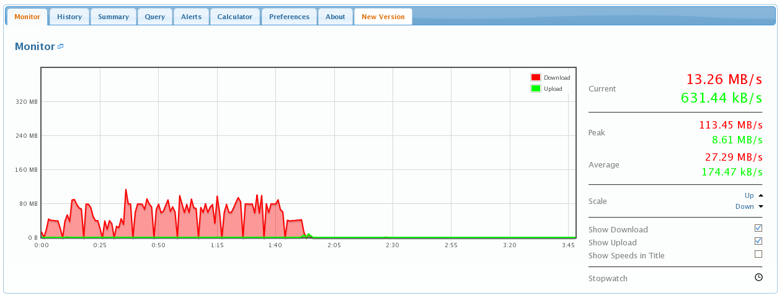
Network Occupation in a Single Node
2 Jobs max rate 113MB/s - 1 Gigabit nick cart is still enough but the CPU power is used at 25% - can code parallelization enhance this ratio?
113MB/s

Slide 14
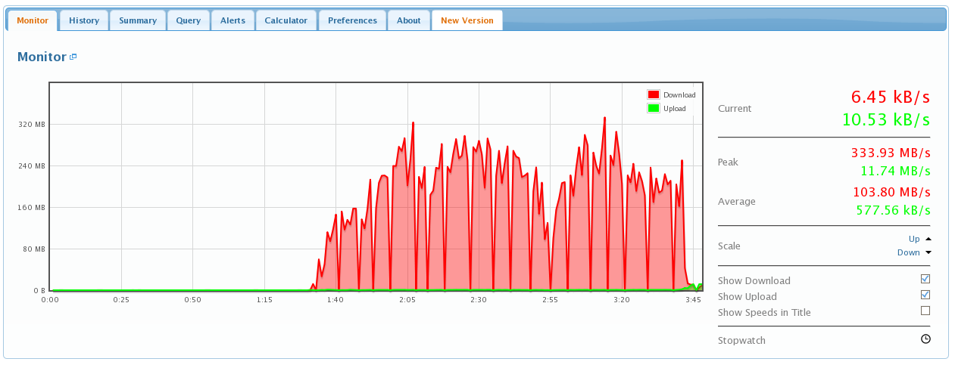
Network Occupation in a Single Node
8 Jobs (max box size) max rate 333MB/s
100% CPU Used but Network is at 30% more CPU can support from more 10Gbit/s Nic Cards
333MB/s

Slide 15
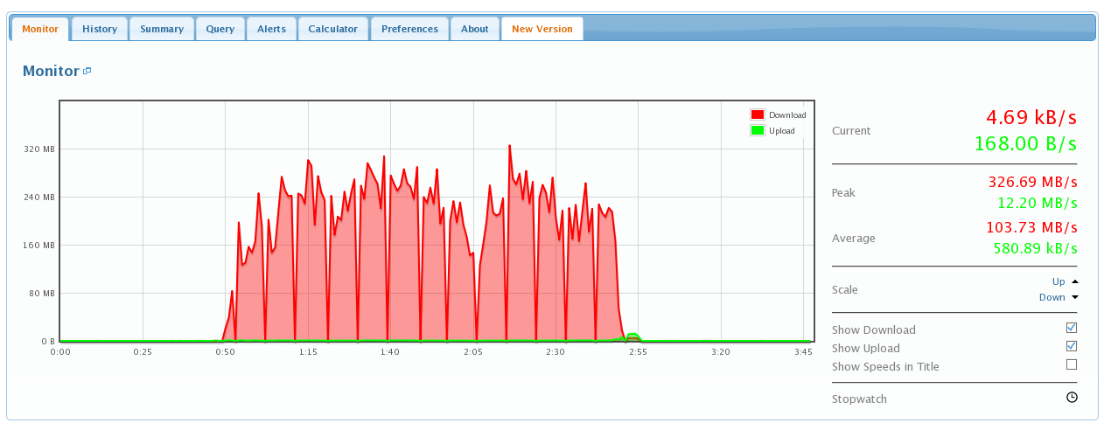
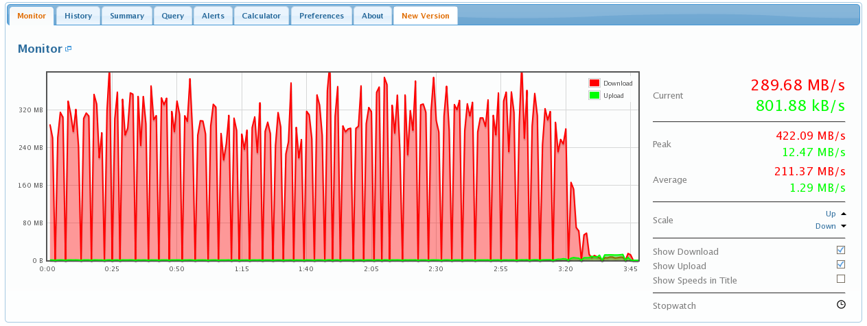
Network Occupation over the box core size
326MB/s
16 Job on a 8 CPU Node
Whithout multi threading
24 Job on a 8 CPU Node
Without multi threading
Max Rate 422 MB/s
Need to extimate the
GLUSTERFS Overhead
422MB/s

Slide 16
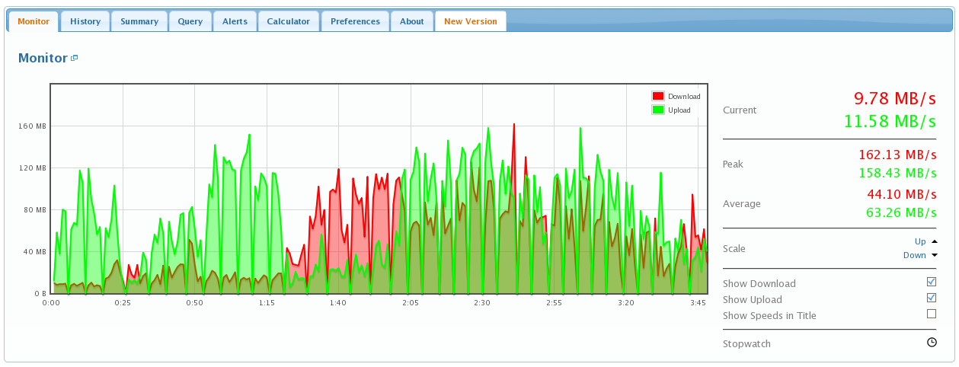
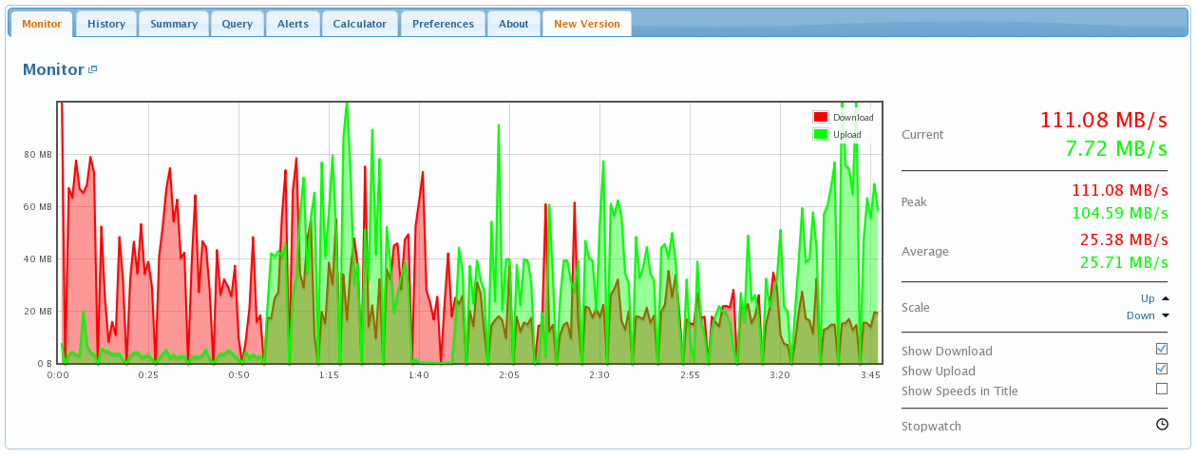
Network Occupation 8 job in each node
In this test we sent 8 analysis jobs for each 8 core server
We Compute an Aggregate
Network occupation of 10 Gbit/s In the Cluster

Slide 17
Analysis
The Network Trend during data analysis Jobs show that:
We have a set of SuperB Analysis that use 20-50MB/s
To support future multicore architecture (24/48) we must move to a 10-20Gbit/s Network (nics now offer two ports); cost of switch is dominant (if using more than 24 ports)
We have some option in the open source File System that can support 400MB/s (GLUSTER File System, Hadoop)
A correct configuration and tuning of 10Gbit/s Nic cards is needed
17

Slide 18
CONCLUSION
Preliminary tests on a full 10Gbit/s Farm show that the possibility to have data and computing in the same node is strictly correlate with the available network (for a 48Core two or four 10 Gbit/s nick card will be needed).
Interesting issue:
Comparison between different cluster file-system are interesting in terms of overhead, reliability and network usage and services offered.
Comparison with different setup or number of replica with the same FS.
Can Code Parallelization between core improve the ratio CPU used by Job vs Network requirement for data access?
18

