Slide 1
PId Front End Chip: PIF
V. Tocut,
LAL/IN2P3 Orsay
H. Lebbolo
LPNHE/IN2P3 Paris

Slide 2
Requirement reminder
Time measurement :
100ps resolution max
Considering 70ps TDC resolution
1MHz background rate max
50ns double pulse resolution min
Charge measurement :
dynamic range of 10
8 bits
run always

Slide 3
Charge Measurement
Charge measurements will improve the resolution

Slide 4
PIF: Babar like FE chip
 ‘Constant Fraction Discriminator’ like
*16
Charge
measurement
To ADC
IN
16
Low walk discriminator
To TDC

Slide 5
PIF: Babar like FE chip
+++
No walk correction if walk < 50ps (depending on PM dynamics)
Charge measurement to improve resolution
---
Need « Time + charge » data synchronization
2 different chips developed:
analog front end -> {PIF }: CFD like and charge measurement
 time measurement -> {SCATS}

Slide 6
PIF proposal
In00
Charge
Amplifier
Sample
& Hold
Mux
Charge output
(To ADC)
State
Machine
Synchronization
with
TDC data
Pseudo
CFD
To TDC

Slide 7
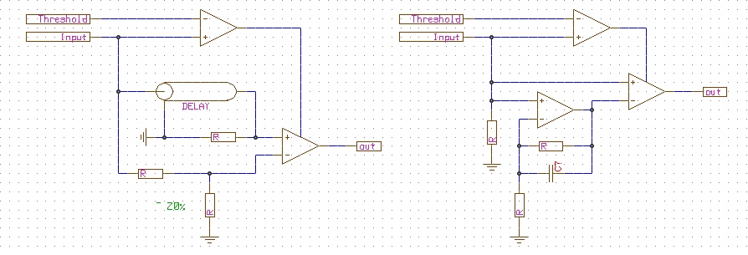
CFD on silicon
Fast comparator
➔
Fast comparator
Classical CFD
Proposed pseudo CFD
Delay + Fraction → Gain + Integrators

Slide 8
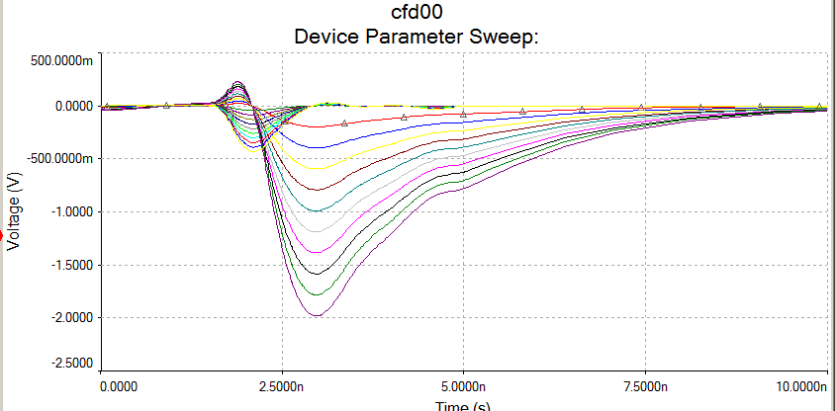
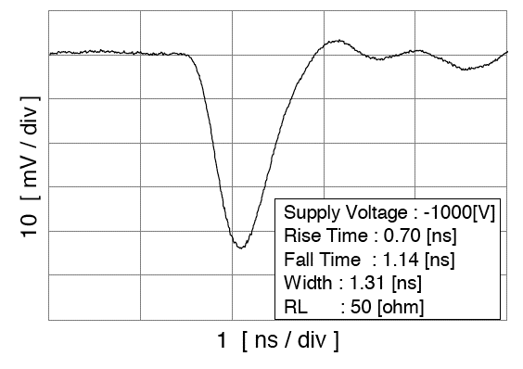
Spice Simulations

Slide 9
CFD Implementation
Threshold
DAC
Reset
PM
Fast
Comparator
Amplifier
LVDS
D flip flop
outp
D
Delay / Filter
Fast
Comparator
C
outn
Amplifier
Charge
Amplifier
To ADC

Slide 10
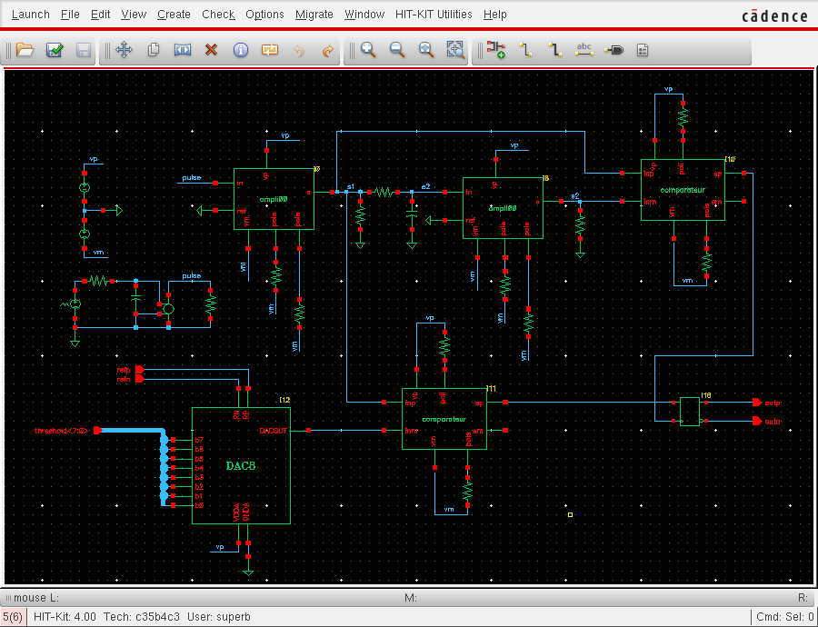
Simulations with AMS CMOS 0.35µ

Slide 11
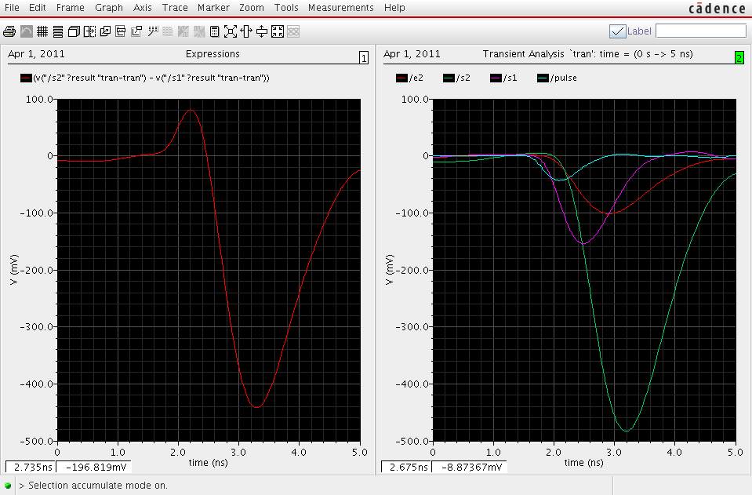
Simulations with AMS CMOS 0.35µ
Difference between amplified signal and
delayed amplified signal

Slide 12
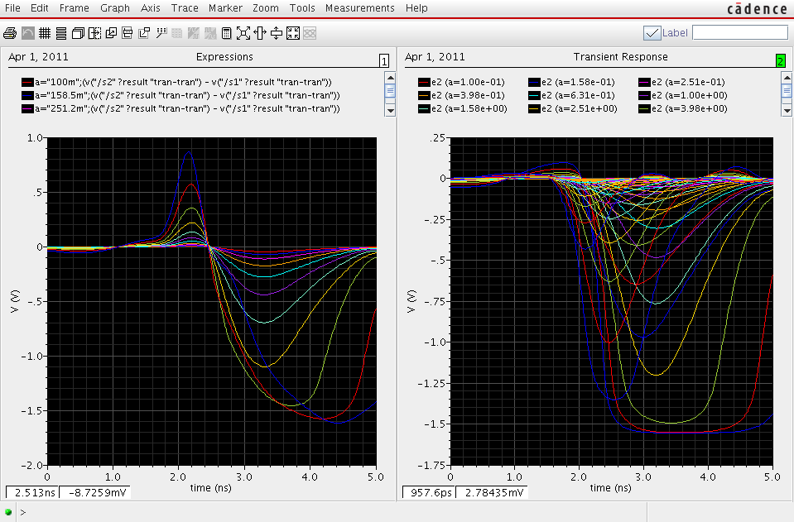
Parametric simulation : amplitude from 1 to 100
70ps walk
Resolution:
70ps for a dynamic of 100
100ps total resolution

Slide 13
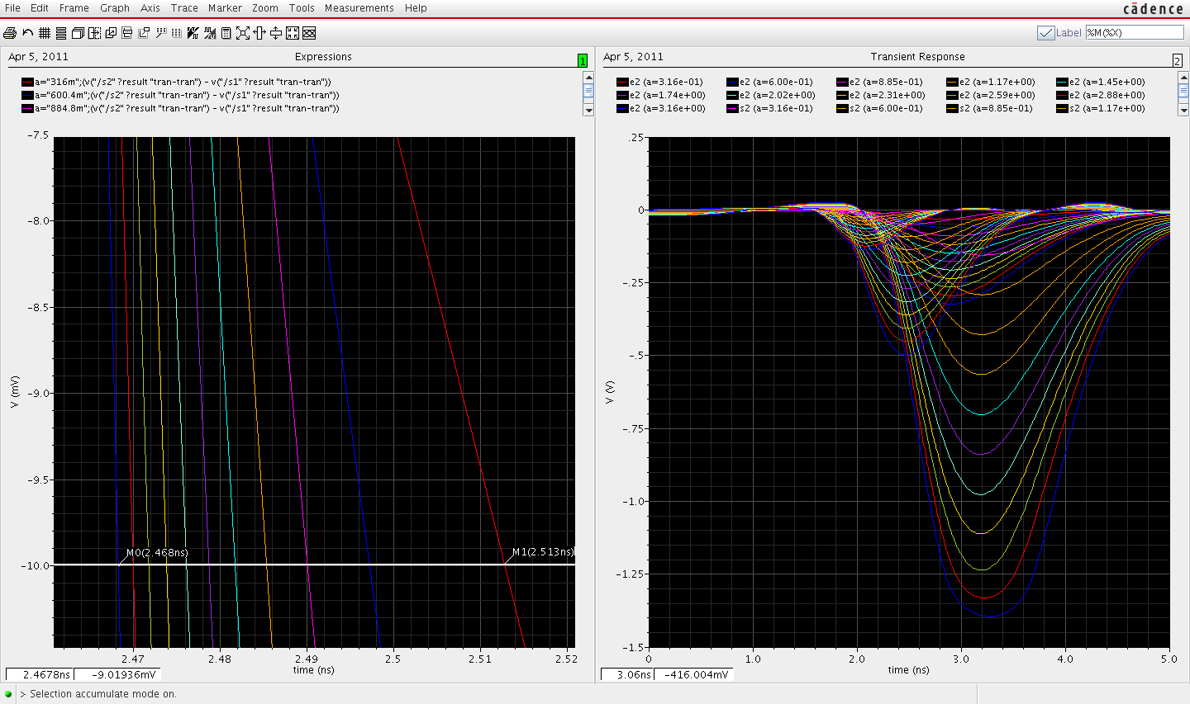
Parametric simulation : amplitude from 1 to 10
45ps walk
Resolution:
50ps for a dynamic of 100
86ps total resolution

Slide 14
Milestones
PIF the Chip :
Design & Simulations with CMOS AMS 0.35µ
Submission by the end of 2011

Slide 15
CRT Test Bench FE
V. Tocut,
LAL/IN2P3 Orsay
H. Lebbolo
LPNHE/IN2P3 Paris

Slide 16
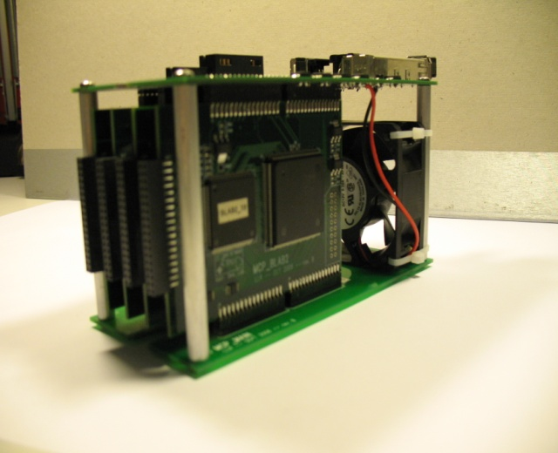
CRT Test Bench
Up to 16 channels on Discri mezzanine
Several architecture could be implemented:
Classical CFD and Charge Amp Channel
Simple discri and Charge Amp Channel
PIF-like CFD and Charge Amp Channel

Slide 17
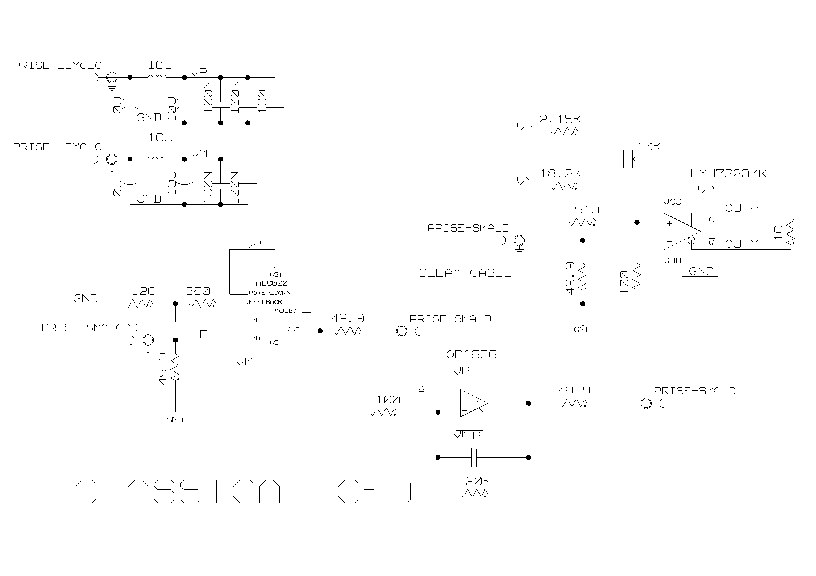
Classical CFD and Charge Amp Channel

Slide 18
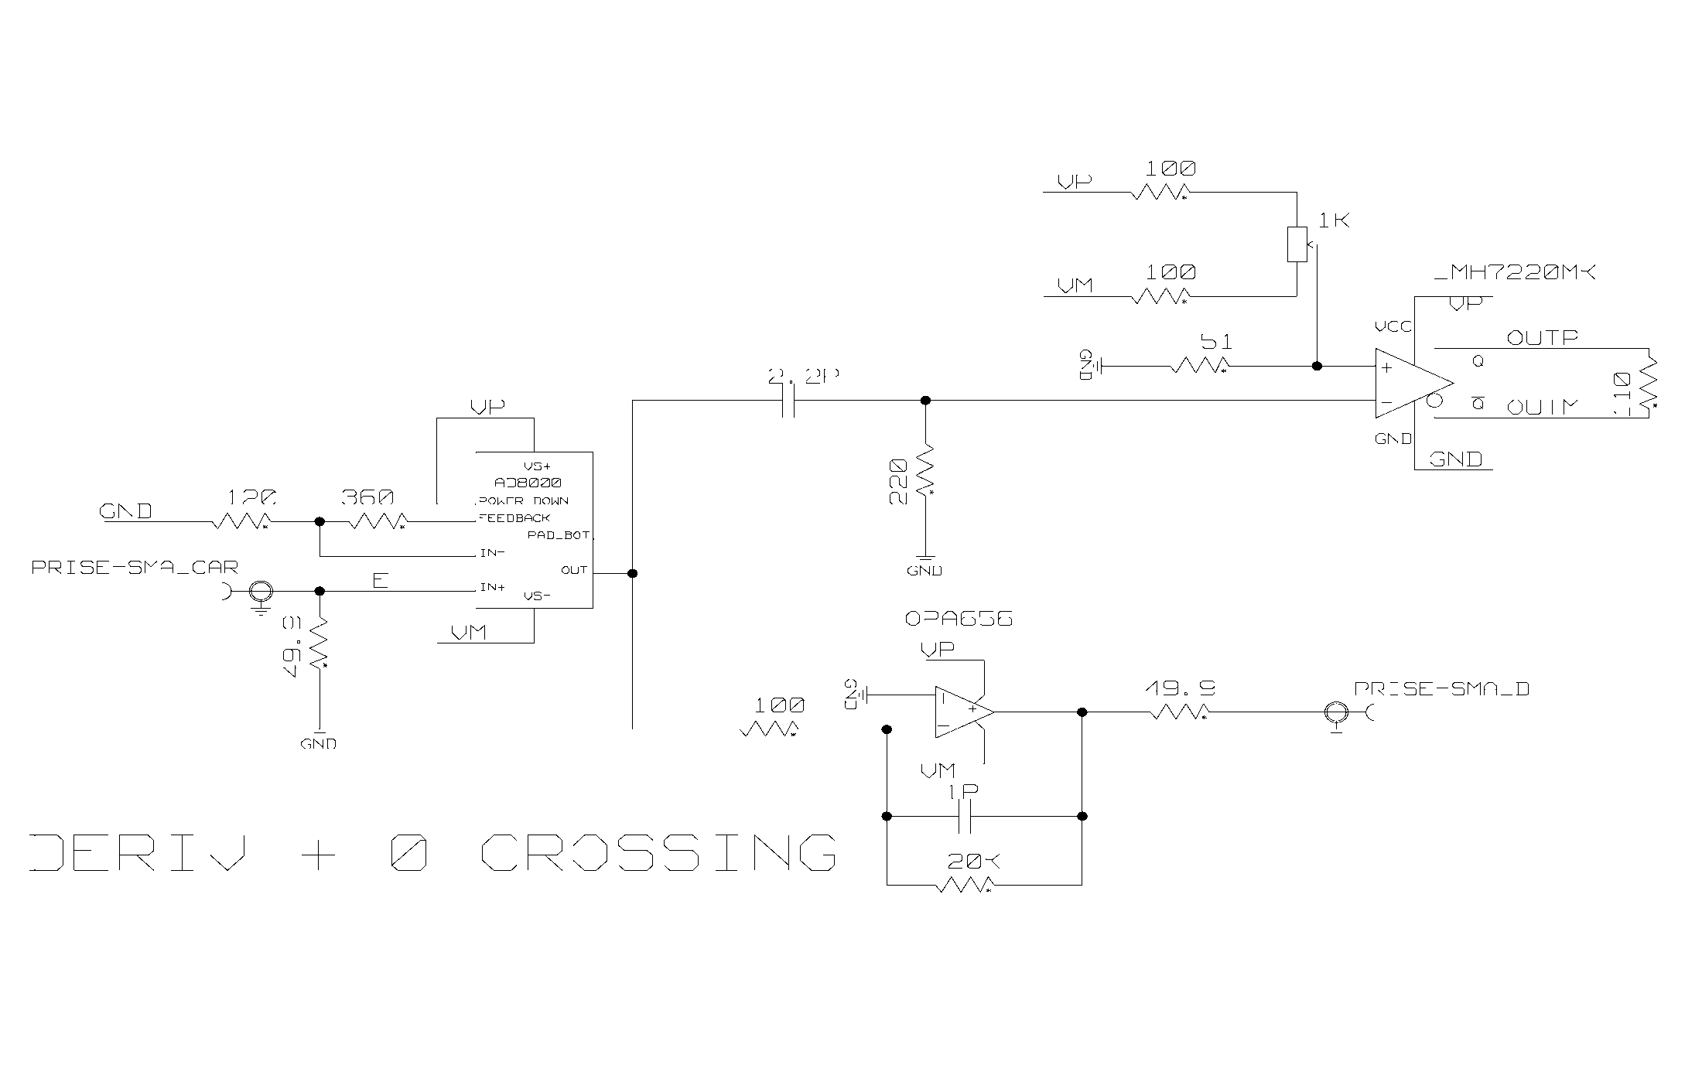
Simple discri and Charge Amp Channel

Slide 19
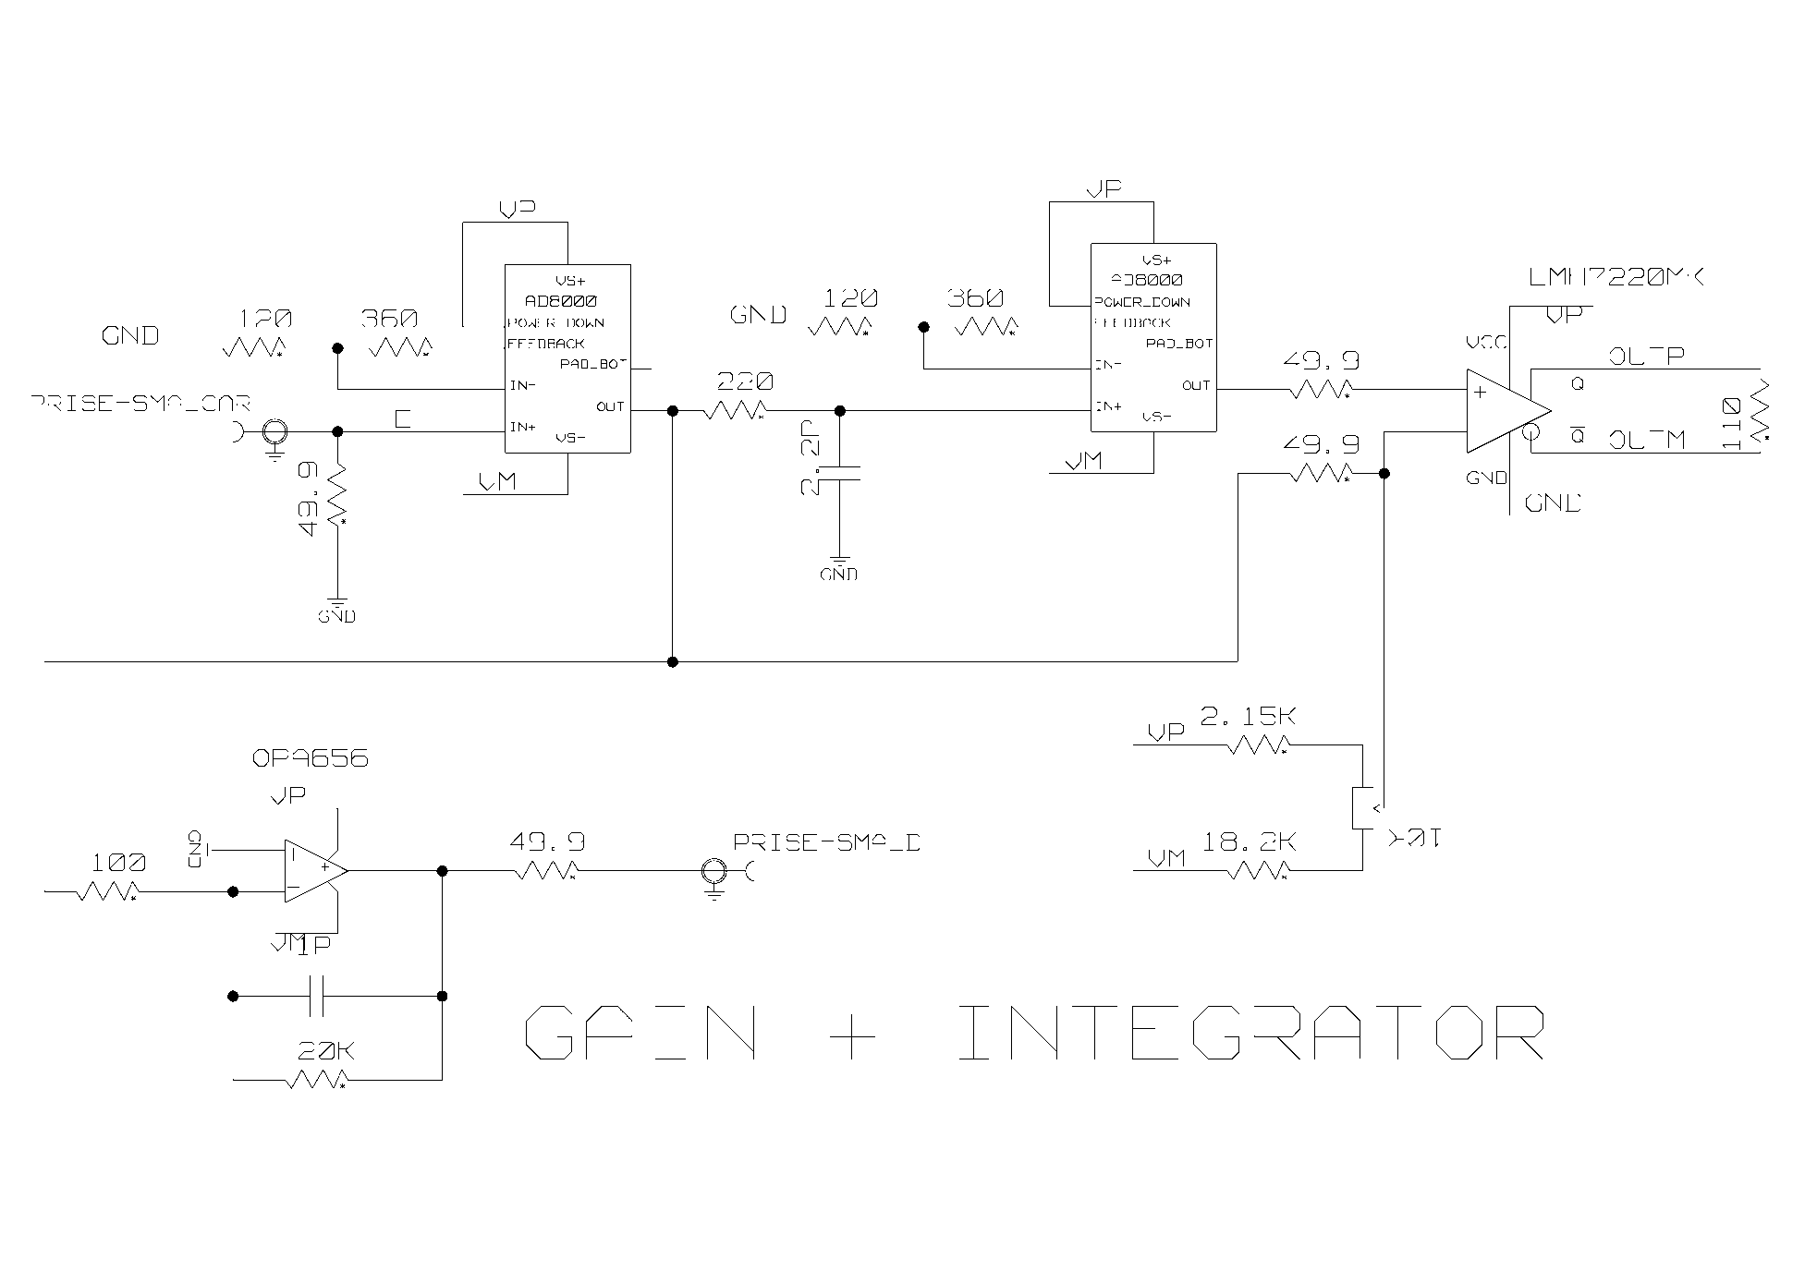
PIF-like CFD and Charge Amp Channel

