Slide 1
COMPASS experience with
HAMAMATSU MAPMTs
S. Dalla Torre

Slide 2
references
P. Abbon et al., NIMA 587 (2008) 371-387
P. Abbon et al., NIMA 616 (2010) 21-37
[ P. Abbon et al., NIMA 631 (2011) 26-39 ]
Collaborators to the COMPASS RICH upgrade project from :
Alessandria, Bonn, Erlangen, Freiburg, Liberec, LIP, Mainz, Munich,
Prague, Saclay, Torino, Trieste
underlined: specific contribution to MAPMT sector
in colour: project leaders & characterisation

Slide 3
OUTLINE
Introduction
MAPMTs : characterization – main chapter
MAPMTs : quality control – only a flavour
MAPMTs : yields and robustness

Slide 4
OUTLINE
Introduction
MAPMTs : characterization – main chapter
MAPMTs : quality control – only a flavour
MAPMTs : yields and robustness

Slide 5
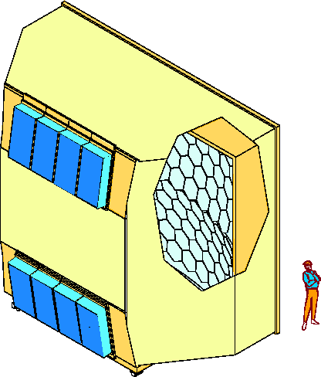
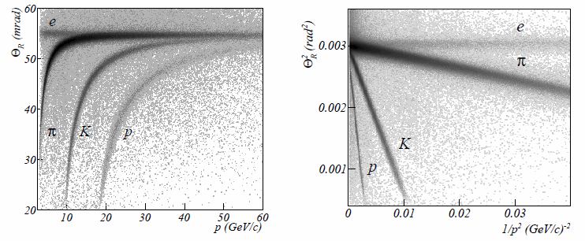
COMPASS RICH-1
3 m
large gaseous RICH
two kind of photon detectors
detector designed in 1996
in operation since 2002
upgraded in 2006 (MAPMTs)
6 m
Al vessel
MWPC’s + CsI
hadron PID from 3 to 60 GeV/c
acceptance: H: 500 mrad V: 400 mrad
trigger rates up to 20 KHz, beam rates up to 4∙10⁷ Hz
UV mirror
wall
5 m
PMT’s
radiator:
C₄F₁₀
radiator gas: C₄F₁₀
beam pipe

Slide 6
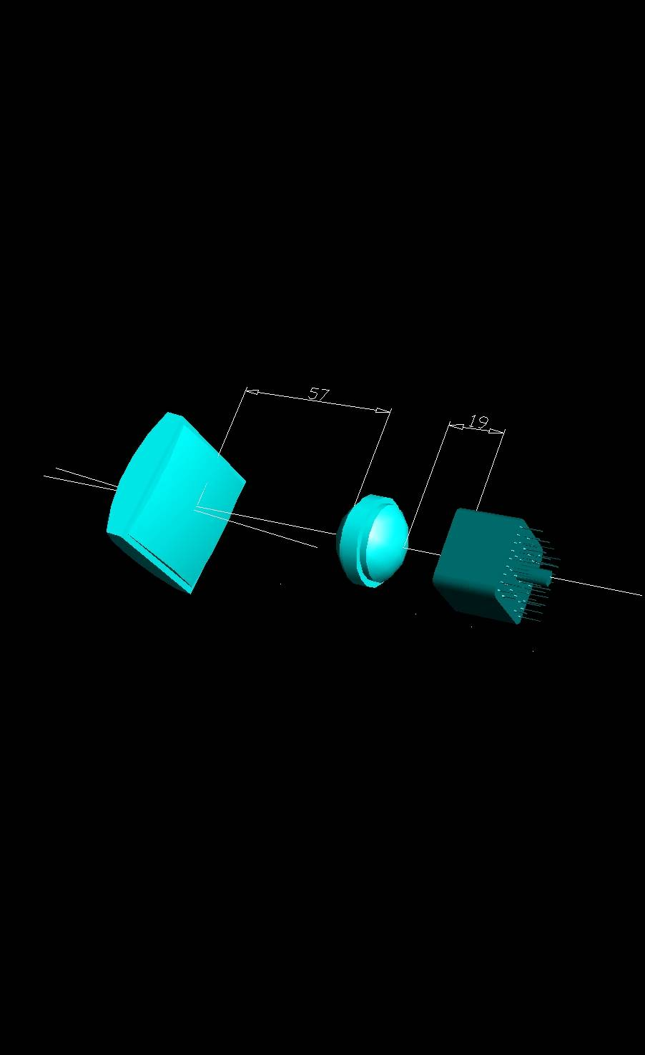
UPGRADE WITH MAPMT
PRINCIPLE
field lens
concentrator
photons
MAPMT
Surface ratio: ~ 7

Slide 7
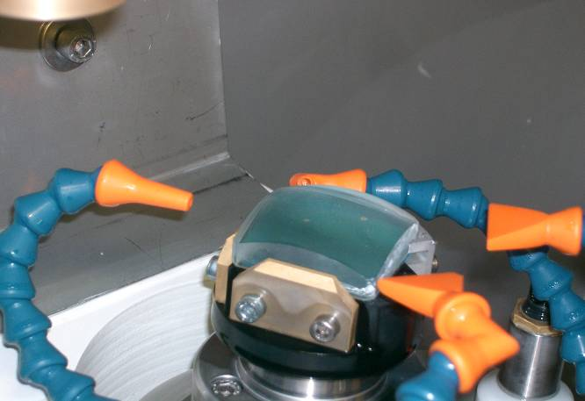
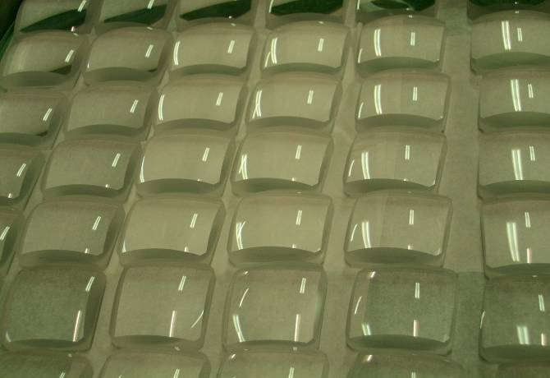
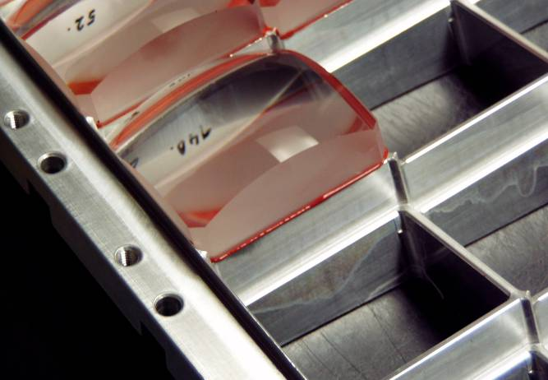
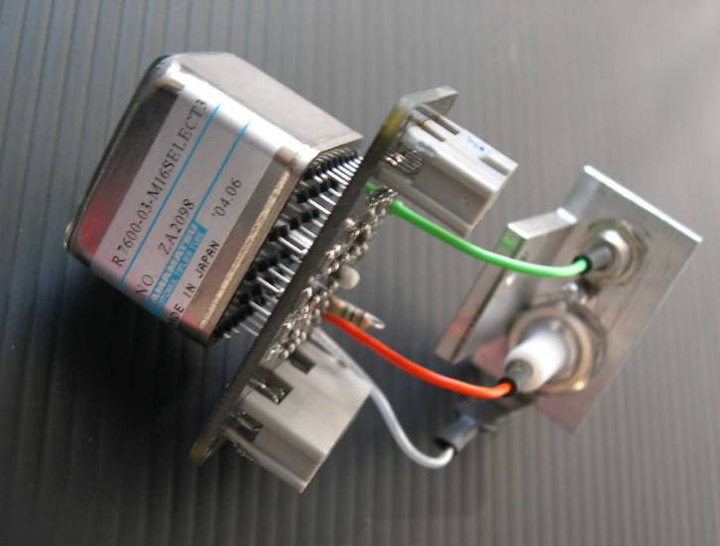
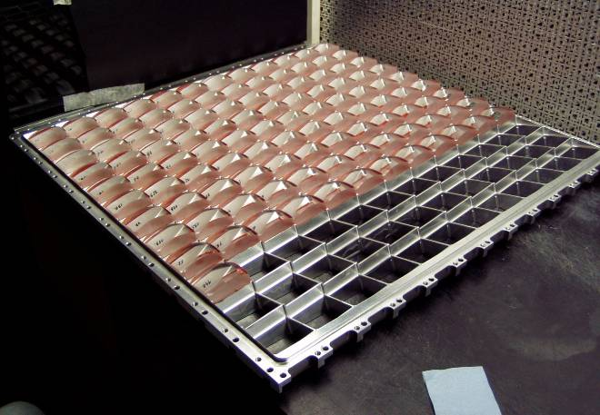
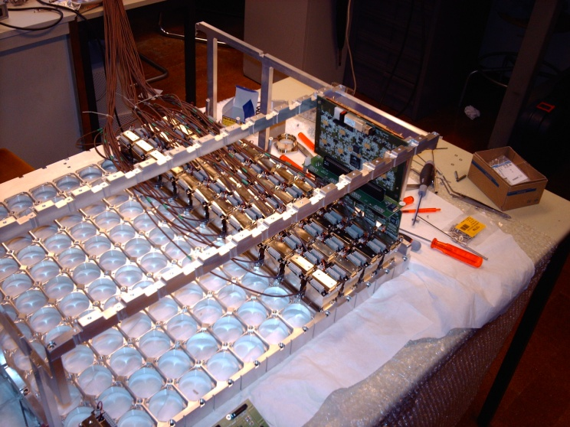
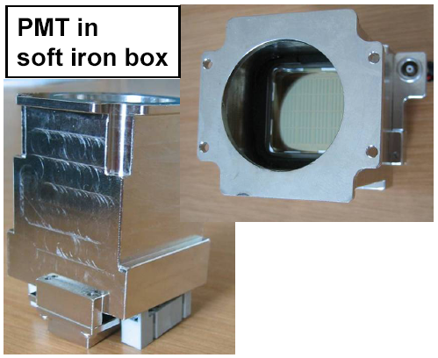
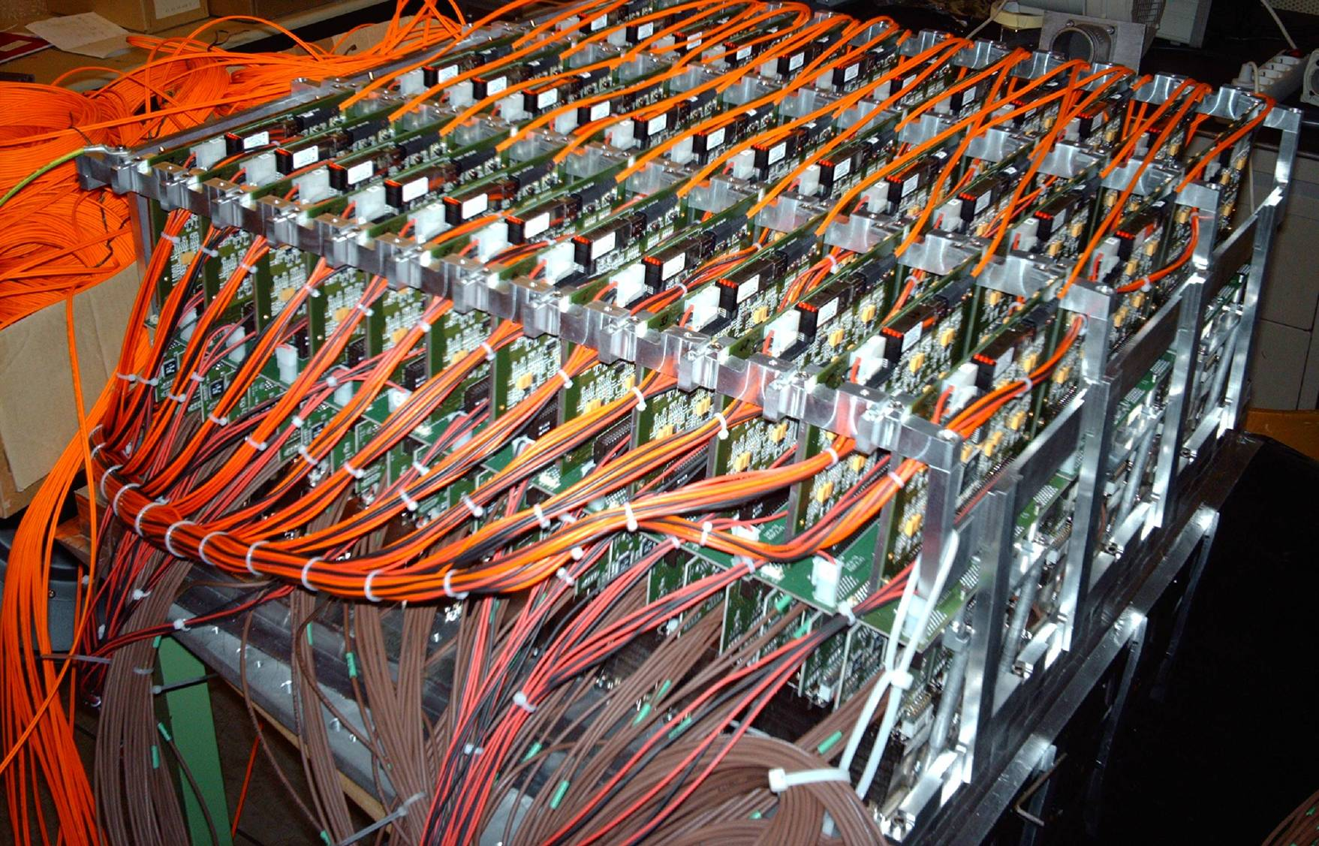
UPGRADE WITH MAPMT
IMPLEMENTATION
home made voltage divider
shielding against
B ≤ 200 G

Slide 8
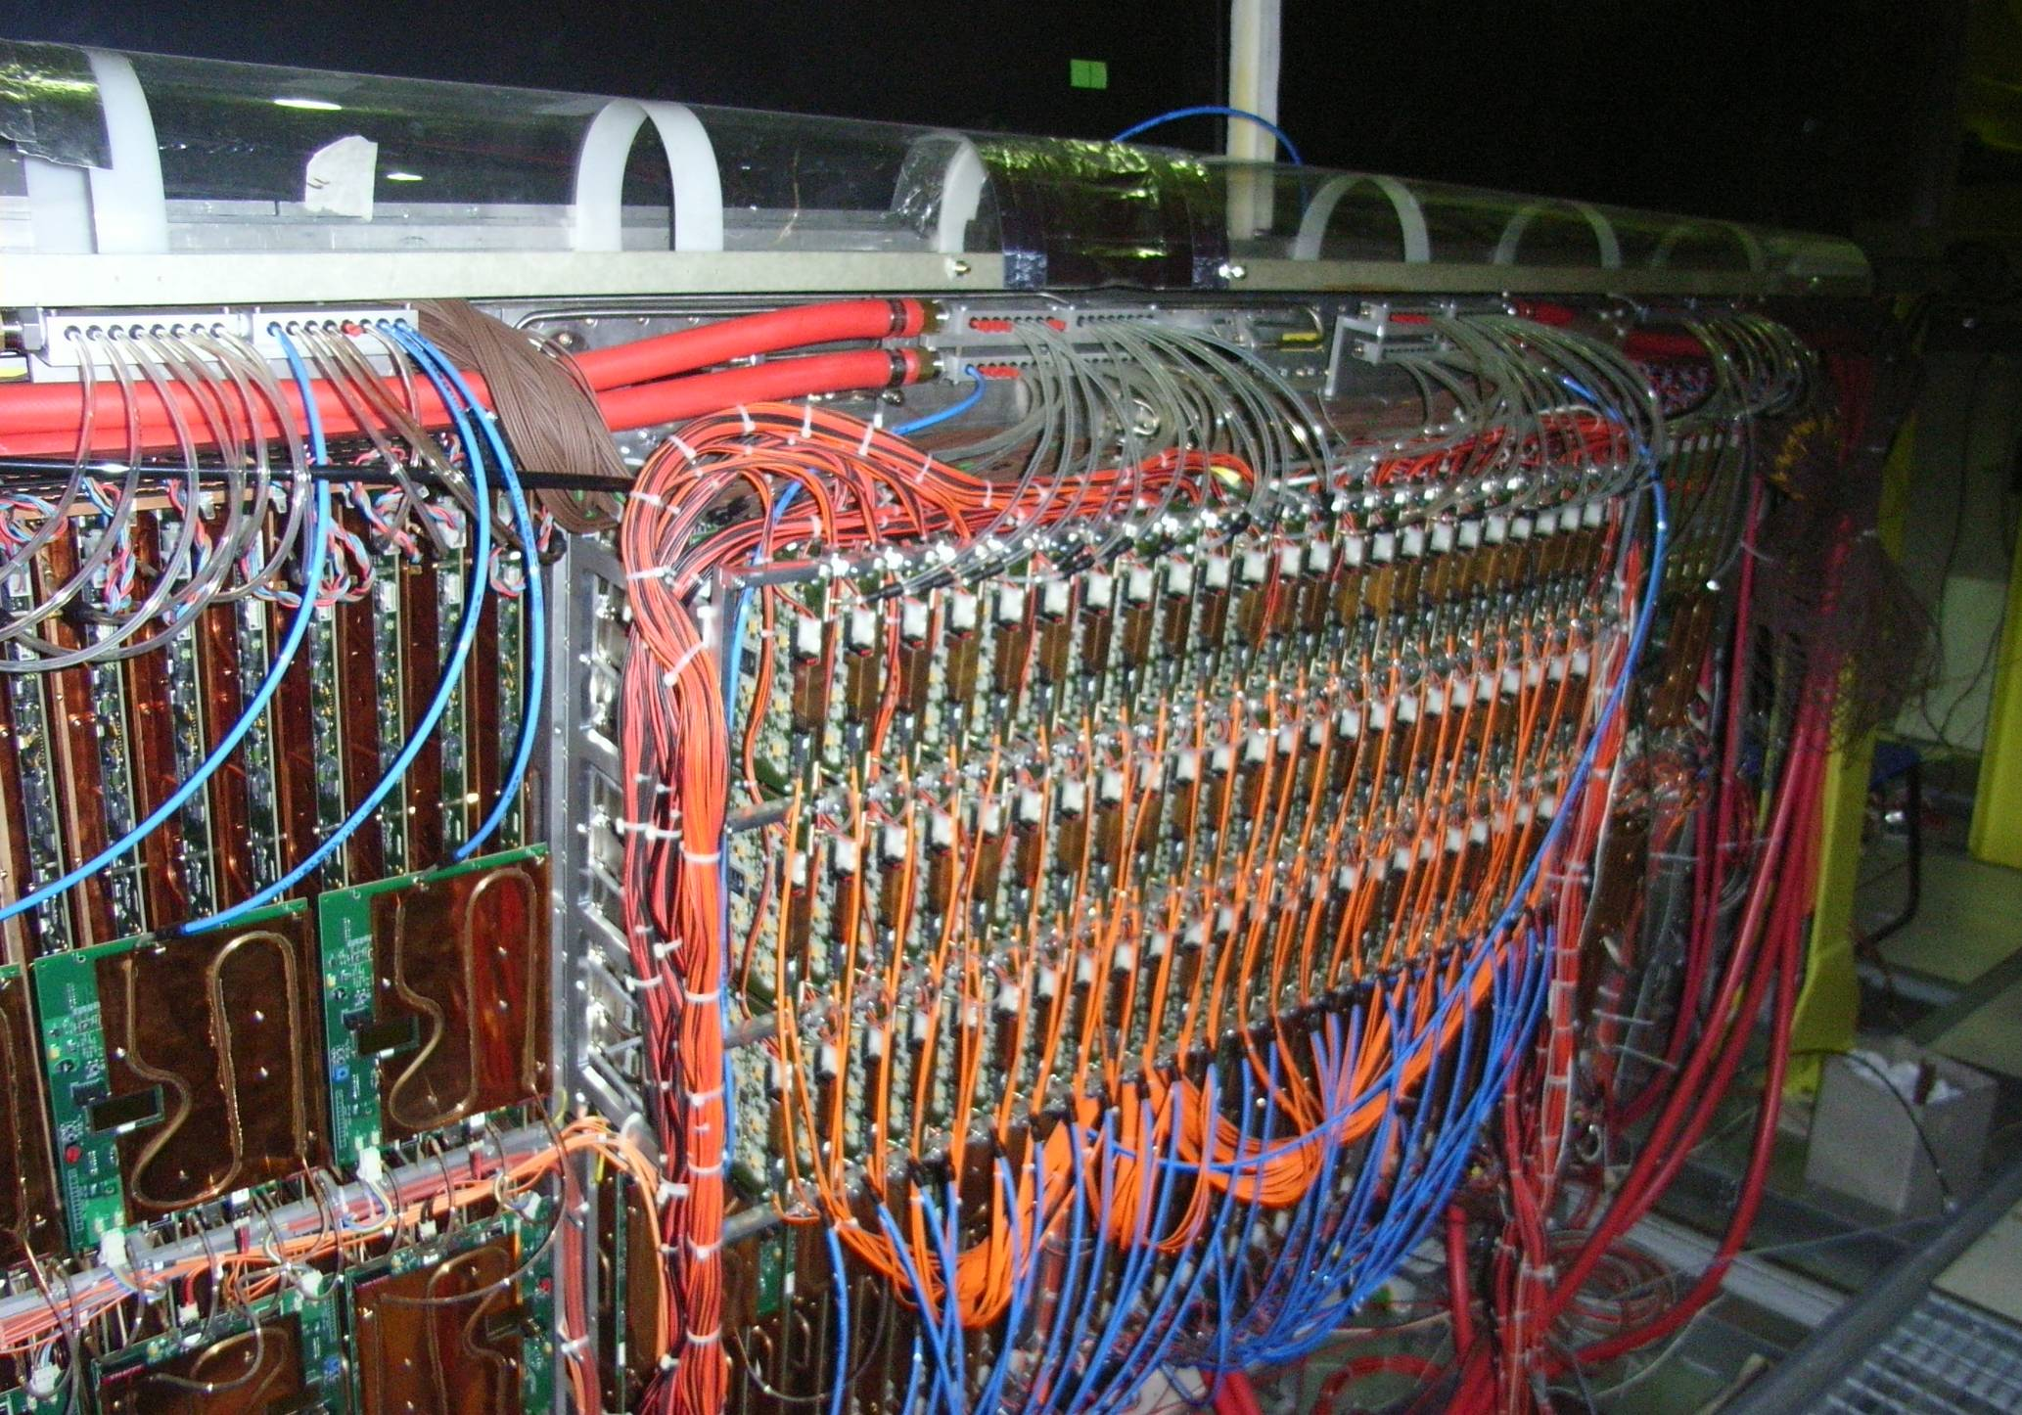
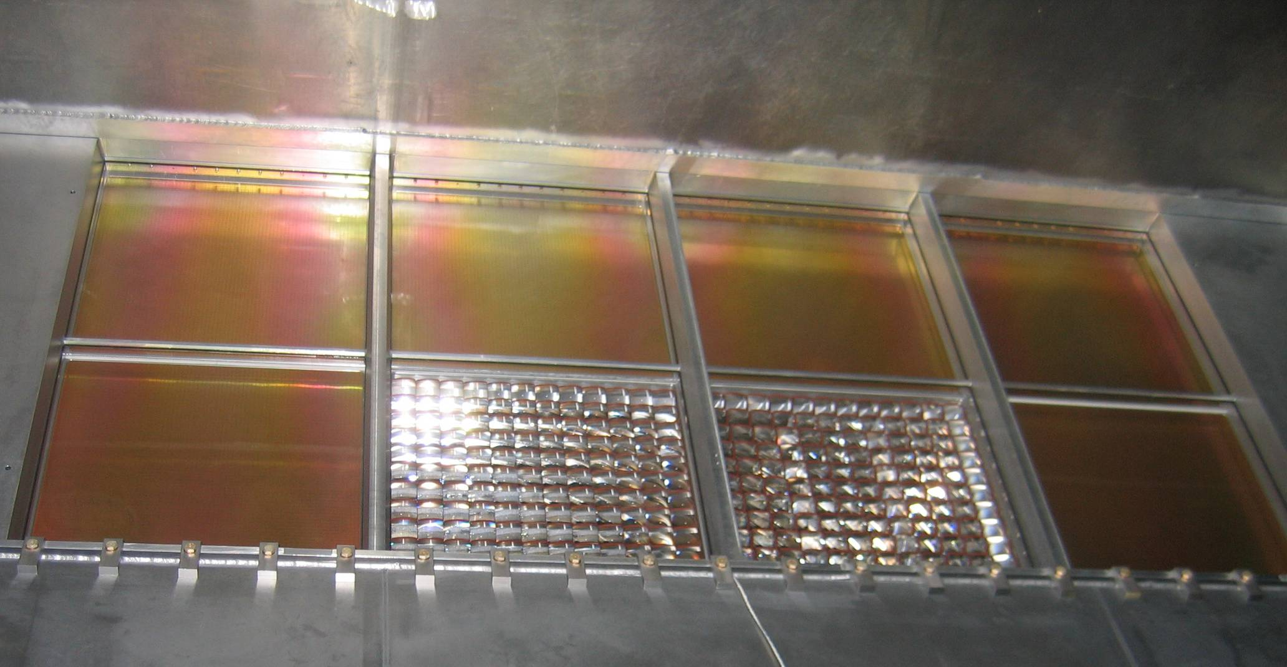
UPGRADE WITH MAPMT
outside the RICH vessel
DETECTOR
ASSEMBLED
inside the RICH vessel

Slide 9
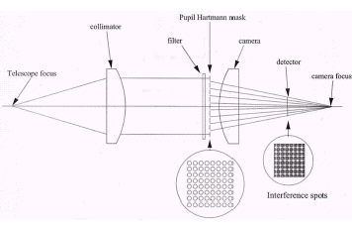
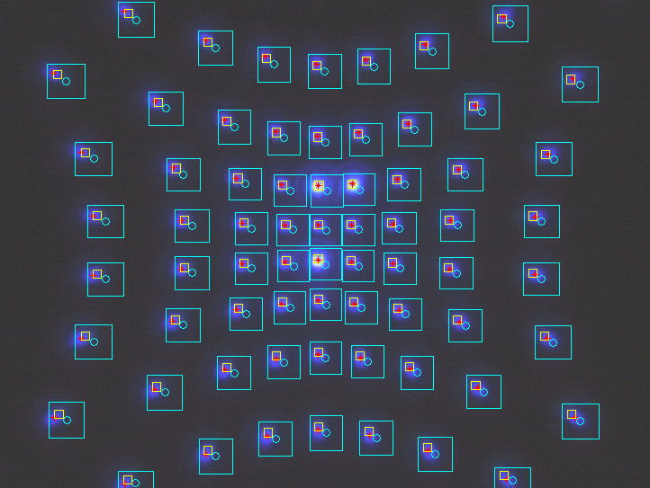
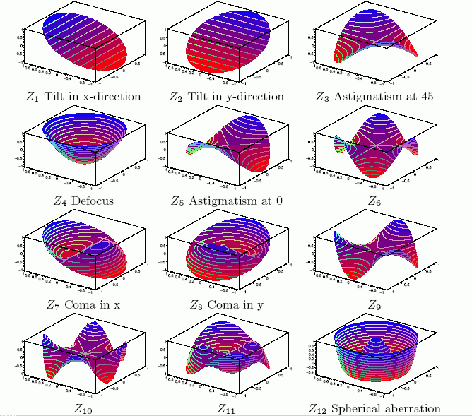
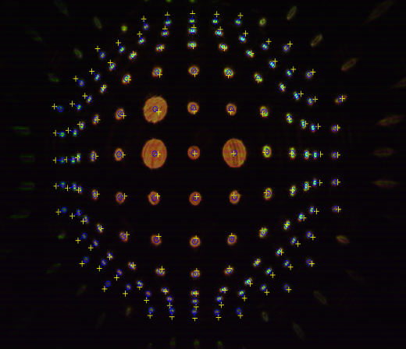
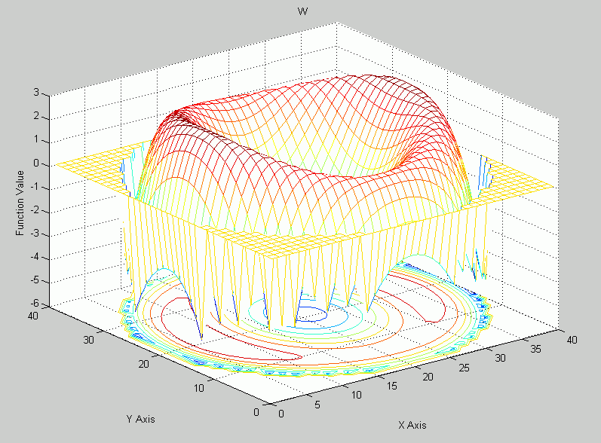
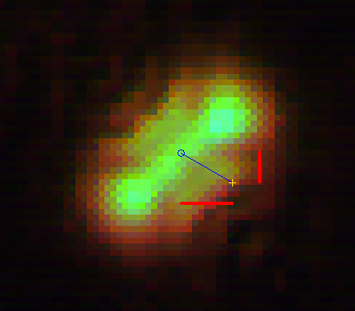
AN INTERESTING ASPECT
OPTICS QC: THE HARTMANN METHOD
optical system
under test
image centroide
Theoretical
reference
for parallel light
He-Na laser
632 nm
Lens focus
2. the images
1. the principle
Detected
Image
(CCD camera)
tolerance
(= center points +/- 0.1 mm)
Hartmann plate
Deviations from
ideal surface
3. the analysis
Zernike
polynomials

Slide 10
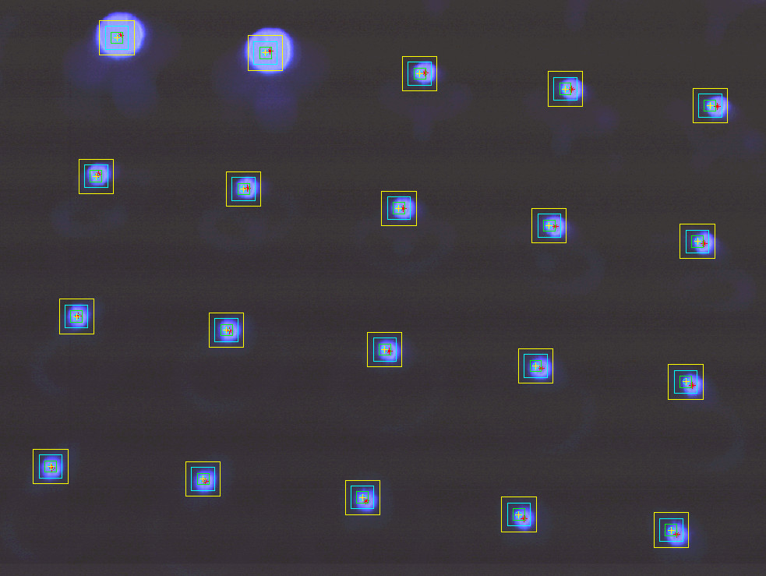
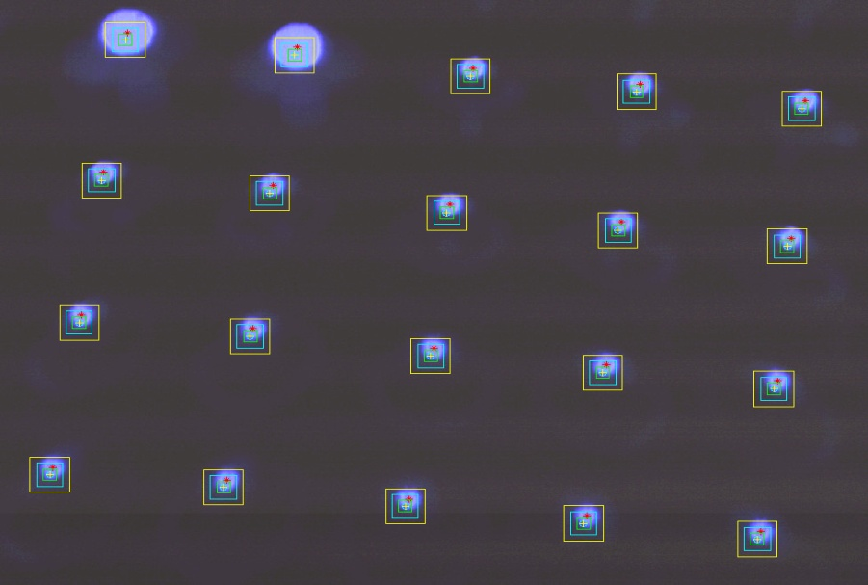
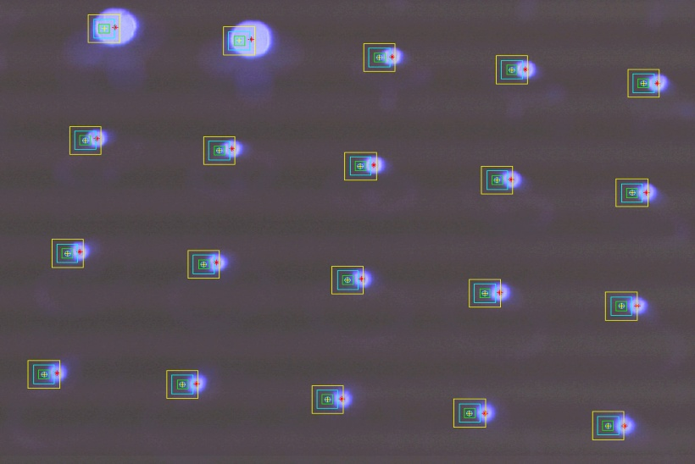
OPTICS QC: THE RESULTS
A
B
C
576 TELESCOPES:
A) ~70% within 50 µm tolerance
B) ~20% within 100 µm tolerance
C) ~10% within 150 µm tolerances

Slide 11
OUTLINE
Introduction
MAPMTs : characterization – main chapter
MAPMTs : quality control – only a flavour
MAPMTs : yields and robustness

Slide 12
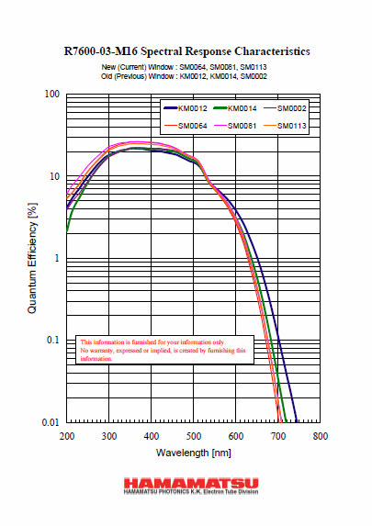
WHICH MAPMT ?
R7600-03-M16 by Hamamatsu
16 anode channels
bi-alkali photo-cathode
UV extended glass window
Photo-cathode surface 18:1 18:1mm2
Multiplicative chain 12 dynodes
Gain 3.5 10⁶ (typical)
> 1 10⁶ at 800V
Anode DC per channel 0.8 nA (typical)
< 2 nA
Total DC 12 nA (typical),
60 nA (maximum)
Anode signal rise time 0.83 ns (typical)
Signal transit time 10.9 ns (typical)
Uniformity between anodes 1:2.5 (typical)
1:3 (maximum)
QE at 420nm >20%
QE at 250nm >5%

Slide 13
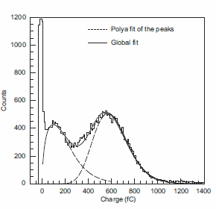
12 vs 11 dynodes 1/2
Typical mean gains (900 V)
First peak : 8 x 10⁵
Second peak: 4 x 10⁶
Population of the first peak:
30%-40%
contributions to the first peak:
Photoelectrons skipping the
first dynode
Conversions on the first dynode
Single photon mode, single anode
900 V
BOTH PEAKS
GOOD FOR US !
Already observed:
I. Chirikov-Zorin et al., NIMA 456 (2001) 310; I. Chirikov-Zorin et al., NIMA 461 (2001) 587.

Slide 14
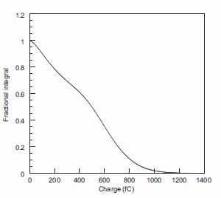
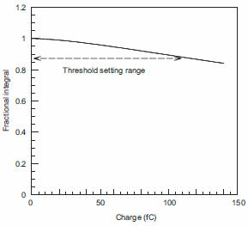
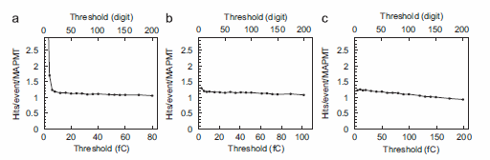
12 vs 11 dynodes 2/2
Crucial: the possibility to apply electronics thresholds low enough
to guarantee good single pe detection efficiency
Fractional integral
zoom

Slide 15
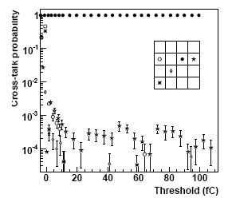
CROSS-TALK
reference anode
cross-talk rate
10 fC threshold
cross-talk rate < 0.1 %
WORNING:
the cross-talk rate dramatically
depends on the coupling
between anodes and FE

Slide 16
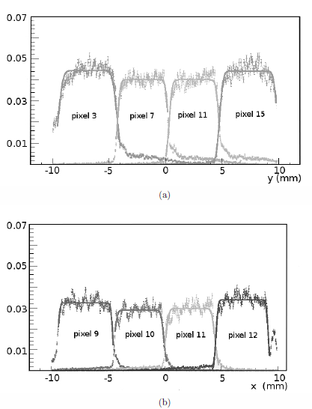
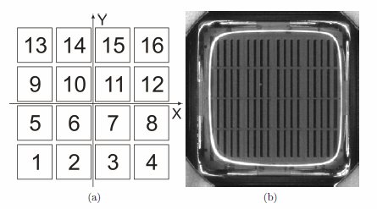
EFFECTIVE PIXEL SIZE
Scanning with a light source
with a dimension of 0.1 mm r.m.s.

Slide 17
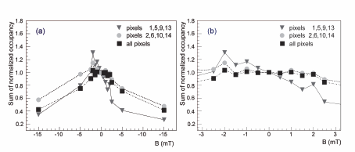
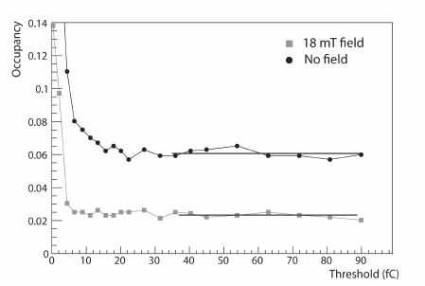
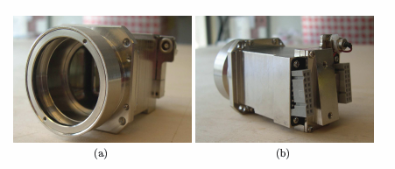
MAPMT in moderate B
pe detection efficiency in B field
External
column
Internal
column
All pixels
zoom
for each pixel
Shielding: B < 1 mT @MAPMT
B = 0
B = 18 mT

Slide 18
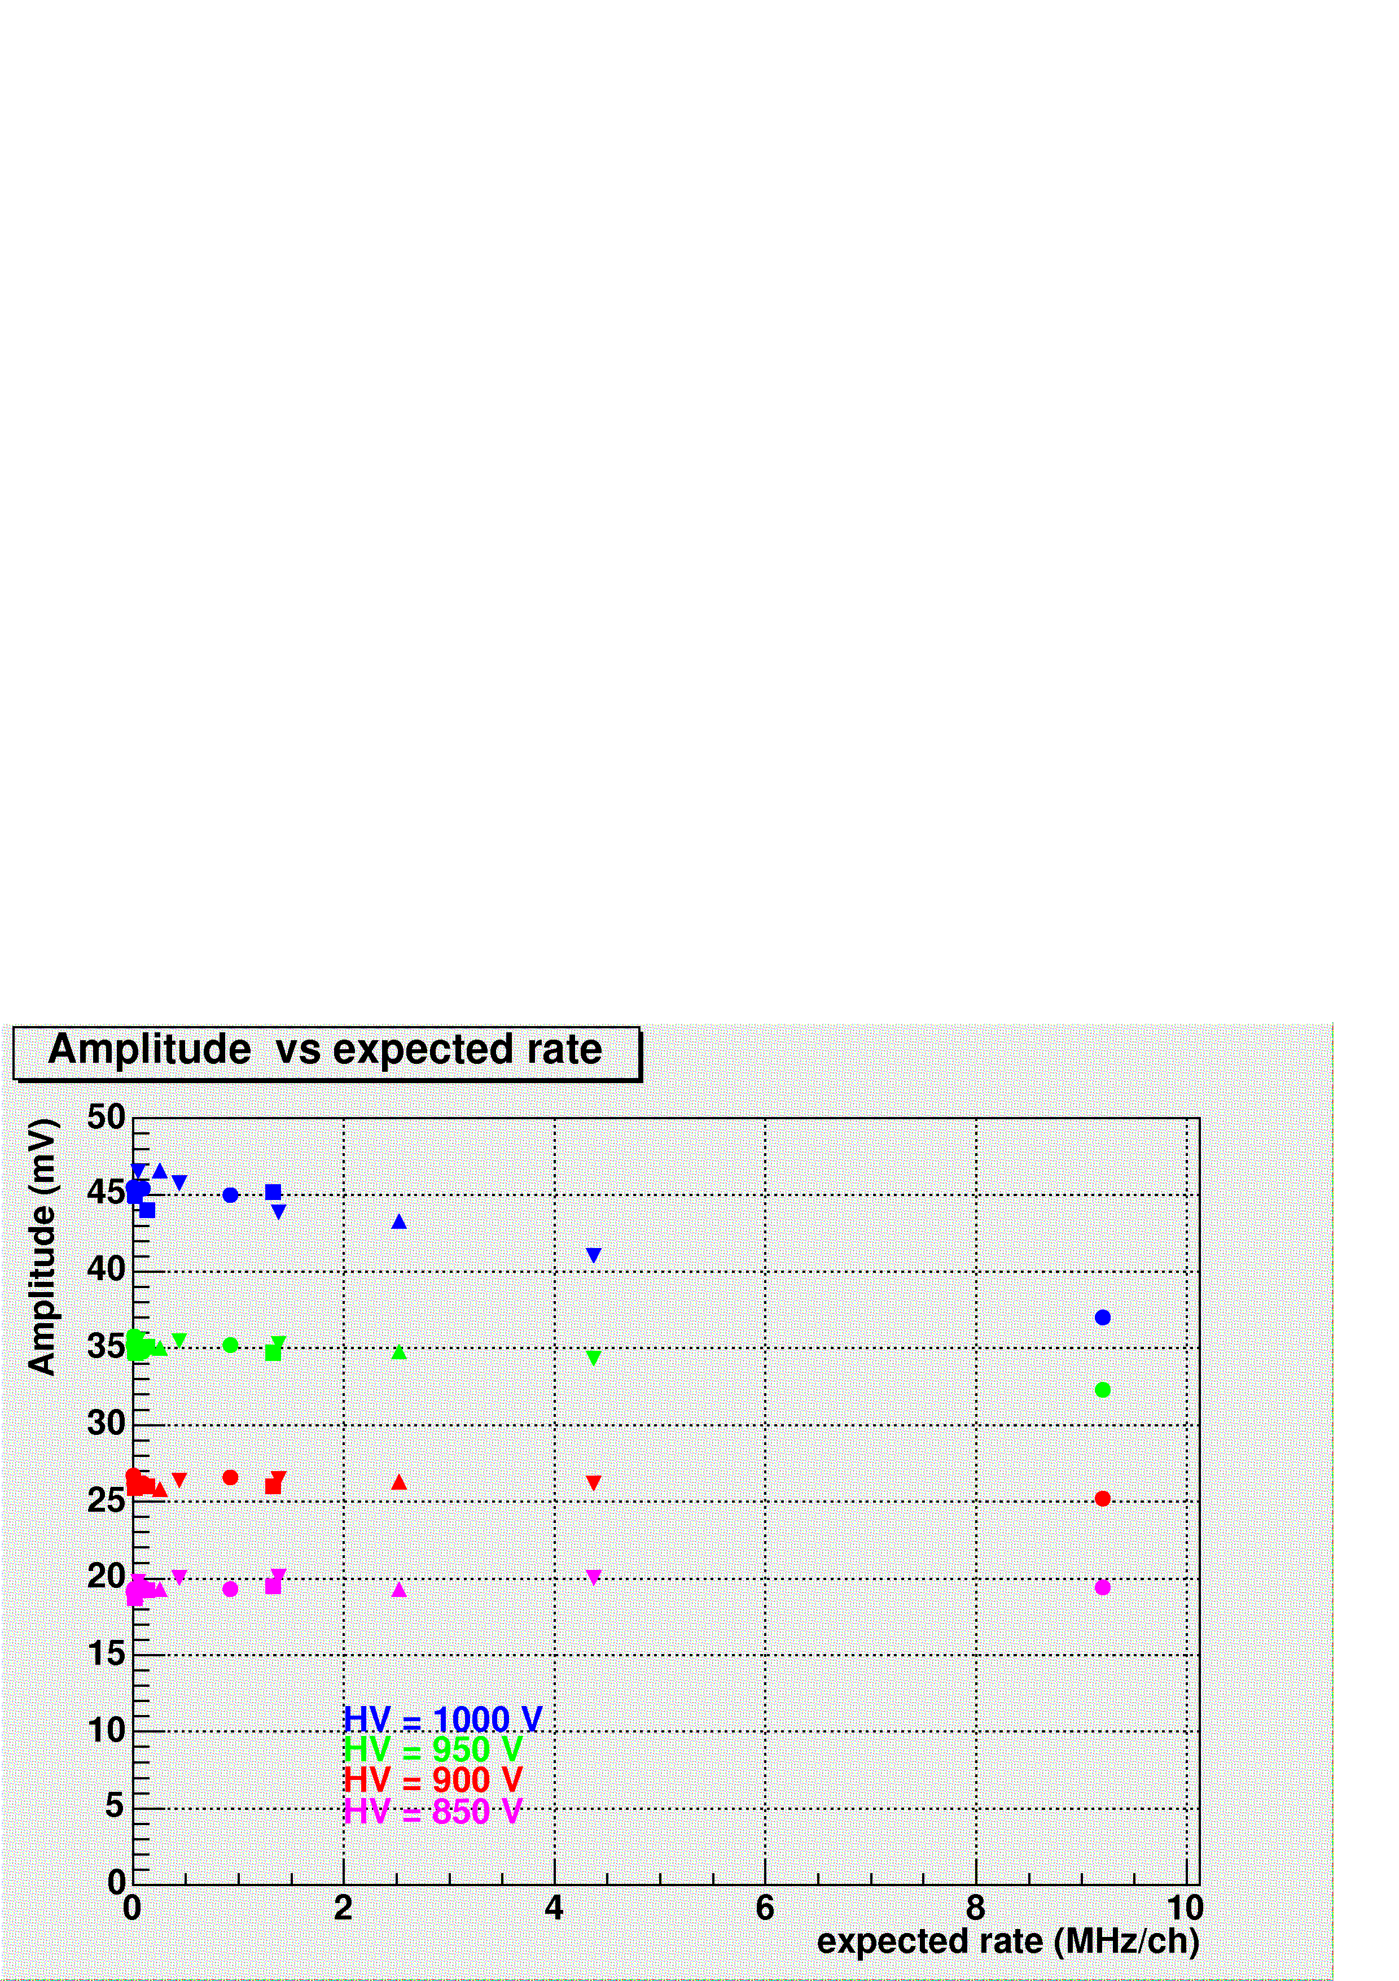
RATE CAPABILITY
mean signal amplitude versus rate/pixel, standard voltage divider scheme
pulsed light source synchronous to the trigger + random background from a lamp
IMPORTANT: MIP flux, if non negligible, can modify this picture
measured for single photoelectron
HV range in operation

Slide 19
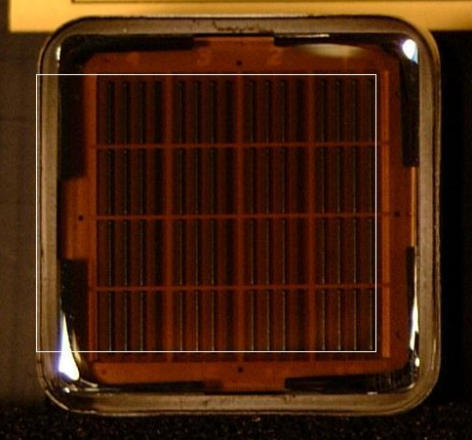
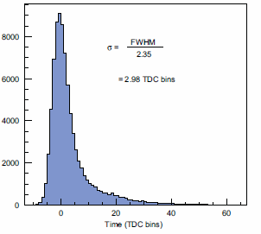
TIME RESPONSE
The tail in the time distribution
is due to photons impinging
at the edges
Folded with the time resolution
of the read-out chain ( 75 ps )
at pixel centre
0.5 mm from pixel centre
= 320 ps
0.5 mm from pixel border
at pixel border
a
0 1 2 3 4 5 6 t (ns)

Slide 20
OUTLINE
Introduction
MAPMTs : characterization – main chapter
MAPMTs : quality control – only a flavour
MAPMTs : yields and robustness

Slide 21
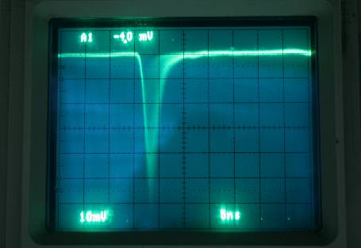

QUALITY CONTROL
PROTOCOL – 2 h / MAPMT
(largely automatized)
Visual Inspection (Pixel grid)
Noise rates and dark current
Scope Image stored
Signal shape, uniformity, gain
  Amplitude distribution @ several Voltages
Quantum efficiency
  measurement with blue LED and UV LED
Individual ADC
spectra for each
channel, voltage,
wavelenght
measured @ 360 nm
gain vs HV for each
MAPMT anode

Slide 22
OUTLINE
Introduction
MAPMTs : characterization – main chapter
MAPMTs : quality control – only a flavour
MAPMTs : yields and robustness

Slide 23
YIELDS & ROBUSTNESS
tested: 642 MAPMTs, i.e > 10 k anode channels
rejected:
  1 MAPMT dead
  1 MAPMT a few degree misalignment of the metallic dynode set
  20 MAPMTs too high dark current for 1 or 2 anodes
  (dark I < 2 nA/ch after ½ h in dark environment)
  rejection rate: ~ 2.5 %
after 5 years, running ~ 6 months/year
1 MAPMT dead over 576 in operation → less than 1‰ / y

Slide 24
THANK YOU

