Slide 1


Detector Status
F.Forti, INFN and University, Pisa

Slide 2
Overview
Detector design is fairly advanced
  Progress report: arxiv.org/abs/1007.4241
R&D continuing in several areas
Organization is in place and working well
We are moving towards the Technical Design Report
… but …
Significantly more physicists and engineers are needed
  to finalize the design
  to build and operate the detector
  to do physics

Slide 3
Detector Organization
Detector Coordinators – B.Ratcliff, F. Forti
Technical Coordinator – W.Wisnieswki
SVT – G. Rizzo
DCH – G. Finocchiaro, M.Roney
PID – N.Arnaud, J.Va’vra
EMC – F.Porter, C.Cecchi
IFR – R.Calabrese
Magnet – W.Wisniewski
Electronics, Trigger, DAQ – D. Breton, U. Marconi
Online/DAQ – S.Luitz
Offline SW –
  Simulation coordinator – D.Brown
  Fast simulation – M. Rama
  Full Simulation – F. Bianchi
Rad monitor –
Lumi monitor –
Polarimeter –
Background simulation – M.Boscolo, E.Paoloni
Machine Detector Interface –
Detector Geometry Working Group
Chairs M.Rama, A.Stocchi
Forward Task Force
Chair H.Jawahery
Backward Task Force
Chair W. Wisniewski
To be created:
Mechanical integration team
Central electronics team

Slide 4
Institutions
System | Institutions
SVT | Bologna, Milano, Pavia, Pisa, Rome3, Torino, Trieste, Trento, LBNL, Queen Mary, RAL
DCH | LNF, McGill, Montreal, TRIUMF, UBC, Victoria
PID | SLAC, BINP , Hawaii, Cincinnati, Bari, Padova, Maryland, LAL, LPNHE
EMC | Bergen, Caltech, Edinburgh, McGill, Perugia, Rome1
IFR | Ferrara, Padova
ETD | SLAC, Caltech, Napoli, Bologna, LAL, Padova, Roma3
Computing | Padova, Ferrara, Torino, Bologna, Rome2, Pisa, Perugia, LNF, LBNL, Napoli, SLAC
Magnet/ Integration | SLAC, LNF, Pisa
Backgrounds | Pisa, LNF
TBD | (Valencia, Barcelona, Annecy, Strasbourg, Tel Aviv, Ohio State, Liverpool, Kiev, Krakow,...)

Slide 5
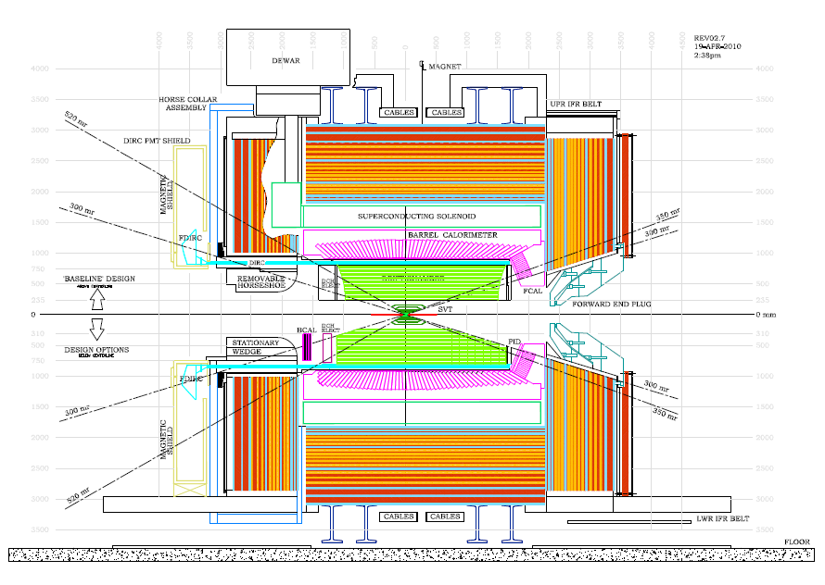
Detector Design (with options)
Backward Task Force
Forward Task Force

Slide 6
Detector Design Issues
System | Baseline | Issues (technical OR manpower; R&D)
MDI | Initial IR designed | Magnetic elements and radiation masks. Design of tungsten shields. Background simulations: global map, detector occupancy
SVT | 6-layer silicon | Technology for Layer 0: striplets or pixels. Thin pixels R&D. Readout chip for strips. Mechanical design.
DCH | Stereo-axial He-based | Dimensions (inner radius, length). Mechanical structure Cluster counting option.
EMC | Barrel: CsI(Tl) Forw: LYSO | Electronics and trigger. Mechanical structure Forward EMC technology: LYSO / LYSO+CsI(Tl); Pure CsI. Backward EMC: cost/benefit analysis
PID | DIRC w/ FBLOCK | FBLOCK design. Photon detection. Mechanical structure Forward PID: cost/benefit analysis. Different technologies.
IFR | Scintillator+ fibers | 8 vs 9 layers. SiPM radiation damage and location. Extra 10cm iron. Mechanical design and yoke reuse.
ETD | Synchronous const. latency | Fast link rad hardness. L1Trigger (jitter and rate). ROM design. Link to computing for HLT.

Slide 7
TDR process and timeline
The Technical Design Report is an essential step to get funding and get the detector built.
Conflicting requirements
  Essential to enlarge the collaboration, define institutional responsibilites and find resources for designing and building the detector
  Essential that collaboration members, institutions and countries take ownership of the design and fabrication
  Essential to move forward rapidly to finalizing the design and writing the TDR
Timeline has to be adjusted to these requirements
  Can be different for different systems

Slide 8
MDI
Eugenio Paoloni

Slide 9

Bkg simulation: progresses since Caltech
DCH bkg. rate dependence on max G4 step length
  The Geant4 default approximation made for slow particles traveling in low density material overestimates the multiple Coulomb scattering effect
  Low pt electrons caged in a single DCH cell by the magnetic field erroneously scattered over several cells giving rise to severe overestimates of the bkg. rate (R.Cenci).
Correlation studies of loss position at the beam pipe and rate observed in the DCH, very useful for shield optimizations
(D. Lindemann)
Beam line + detector hall model (A.Perez)
First look at the radiation map of the detector hall (R.Cenci)
First look at the pair production rate on L0 in the 2 machine options (high/low boost @ charm threshold)
Backward EMC scoring (S.Germani), fTOF (L.Burmistrov + R.Cenci)
Bruno Optical photon simulation (A. Di Simone + D. Roberts)
Please join the tomorrow afternoon Bkg parallel for further details

Slide 10
DCH Background studies
The source of DCH backgrounds are mainly
concentrated in +/- 20 cm from IP (Dana)
The default Geant4 setting overestimate the moultiple Coulomb scattering (Riccardo)

Slide 11
Focus of the meeting
Definition a Quality Assurance policy for the next productions
  Subsystem + machine reference plots
  Definition of a before production “takeoff” checklist & sign off procedure
Definition of a set of reference plot for background studies
  Definition of a right after production “landing” checklist to validate the production output
Write down the shopping list for the simulation of the poorly simulated/still not simulated background sources

Slide 12
SVT
Giuliana Rizzo

Slide 13
SVT
20 cm
old beam pipe
new beam pipe
Layer0
30 cm
40 cm
SVT Baseline for TDR
  Striplets in Layer0 @ R~1.5 cm
  5 layers of silicon strip modules (extended coverage w.r.t BaBar)
Upgrade Layer0 to thin pixel for full luminosity run
  more robust against background occupancy
Since Caltech (approval!) more focused activities on the design of the SVT baseline option with regular biweekly SVT-TDR meetings
Some progress also on pixel R&D
  Slower than expected due to very long delays in delivery of first Vertical Integration (3D) MAPS → some results available from 2D wafers.
  Preparation of new submissions for 3D pixels and INMAPS process.
Testbeam in preparation for Sept. 2011

Slide 14
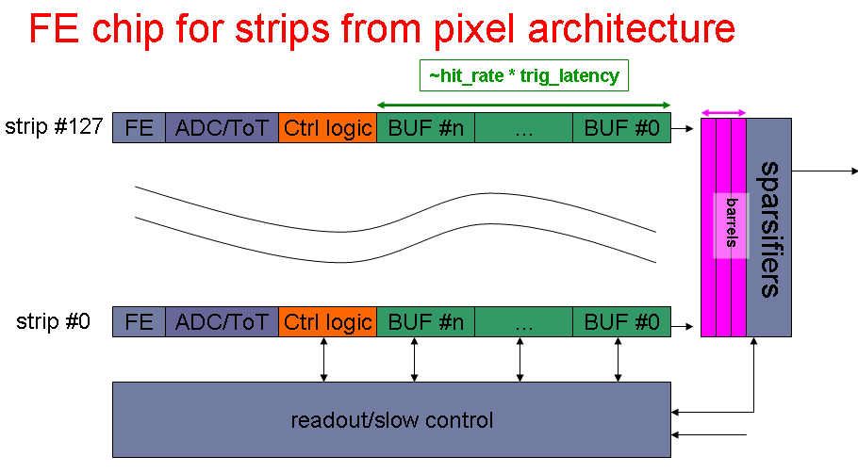
Main progress on SVT baseline (I)
Requirement definitions for strip/striplets FE readout chips:
  Very different among layers: striplets: ~2 MHit/strip → 25 ns shaping time & fast readout , Layer4-5 strip: long modules → 1 μs shaping
  Existent FE chips do not match and we need to develop new chip(s)
  Analog channels could be designed by Pavia group
  Just started to evaluate if readout architecture we developed for pixel could be used for strip and striplets FE chips. Probably yes but need more thinking/simulation. Manpower is an issue.
The readout sees the 128 strips with N buffers each (to store hits during trigger latency) as a pixel matrix with 128xN pixels

Slide 15
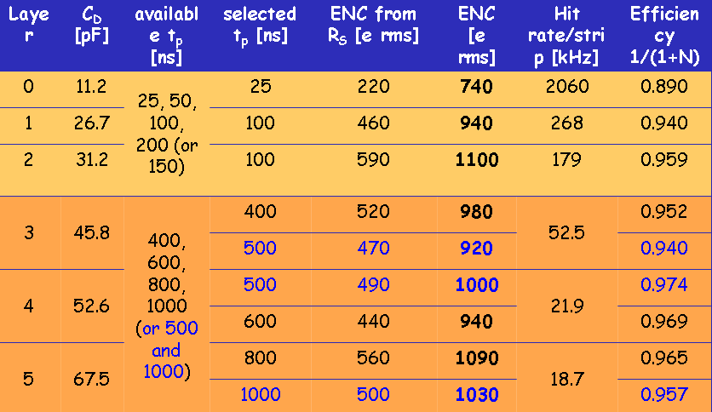
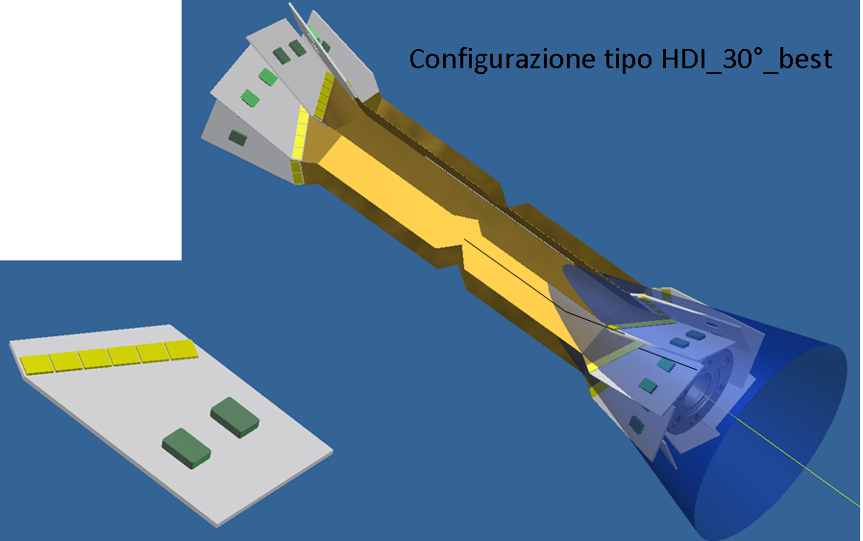
Main progress on SVT baseline (II)
First estimate of noise performance for strip readout channel
    realistic inputs for C, Rs, shaping time have been evaluated
More realistic design of Layer0
striplets module:
  Mechanical constraints quite tough
  HDI design challenging
    small, 6 chips, many output lines/chip
  FE chip development needed
Important to (re-)evaluate real cost/benefit of having striplets vs hybrid pixel installed at T₀.

Slide 16
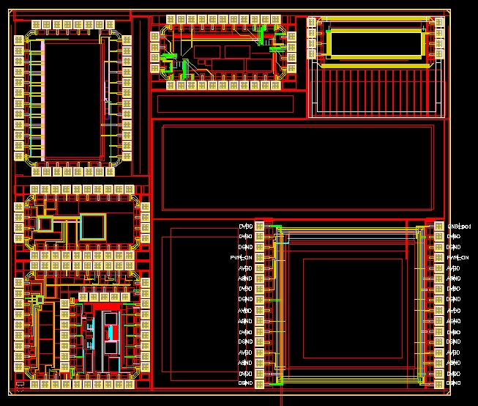
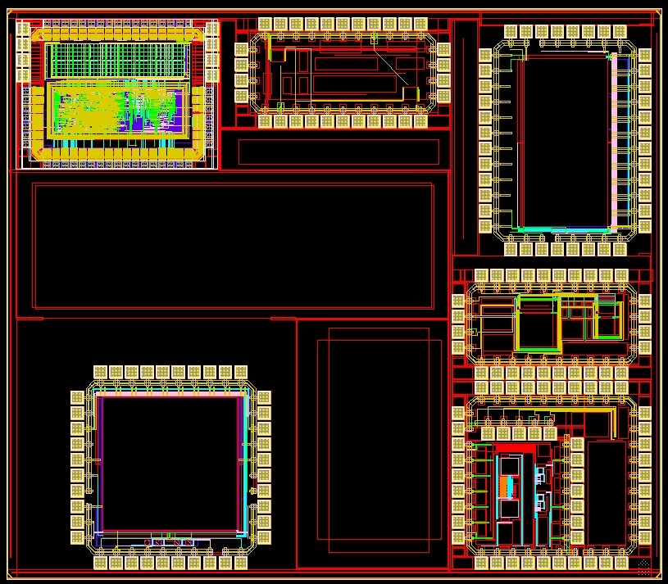
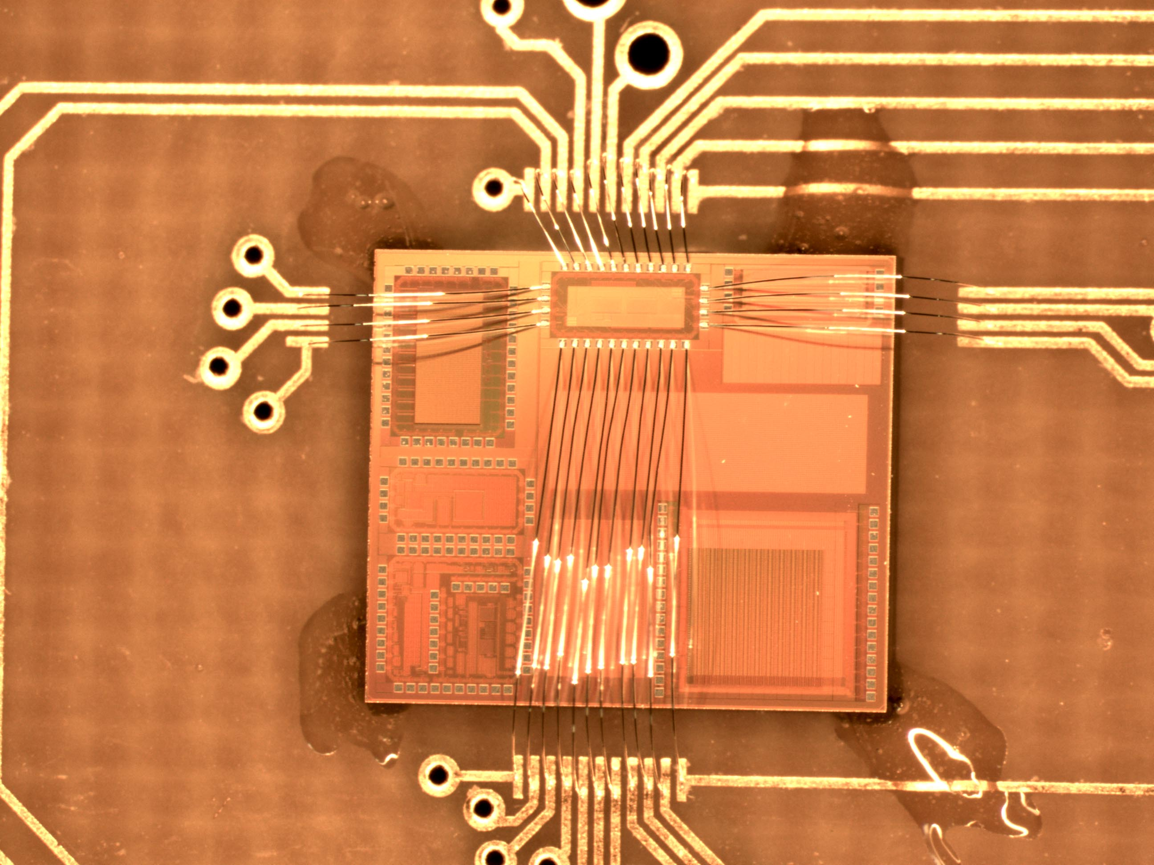
First results on MAPS from Chartered/Tezzaron process
Sensor + analog tier
Digital tier
2D MAPS now available with the same CMOS process used for vertical integration of 3D MAPS
  Now in test sensor+analog tier only!
  First important results for the characterization of the process
Still waiting for 3D wafers
Preliminary
Noise ~ 4mV
  → ENC ~ 50 e-
Calibration with Fe55
  Gain ~ 500 mV/fC from 5.9 keV peek.
First estimate of MIP signal from test with Sr90 ~ 800 e-

Slide 17
DCH
Giuseppe Finocchiaro and Mike Roney

Slide 18
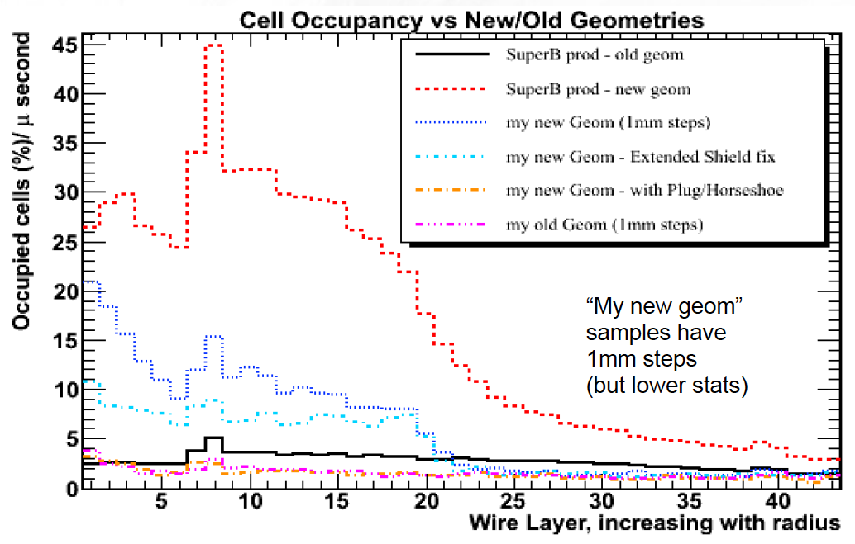
Backgrounds
Problem of very high DCH background rates in recent Bruno productions
now solved!
  End plug +“horseshoe” included in the simulation, extended Tungsten shield
Issues which still need to be addressed
  Safety factor? Validation e.g. with KLOE background data?
  Touschek contribution to be inserted in Bruno
From here
To here

Slide 19
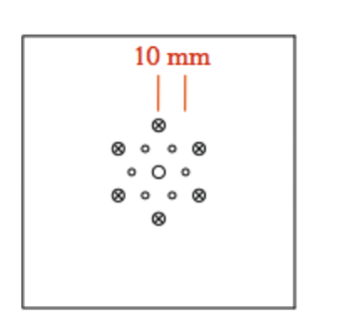
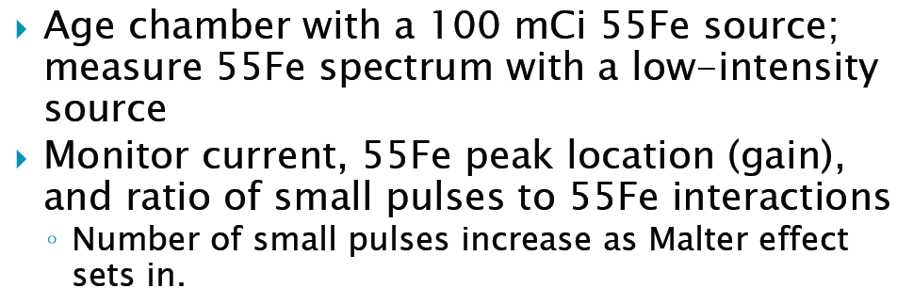
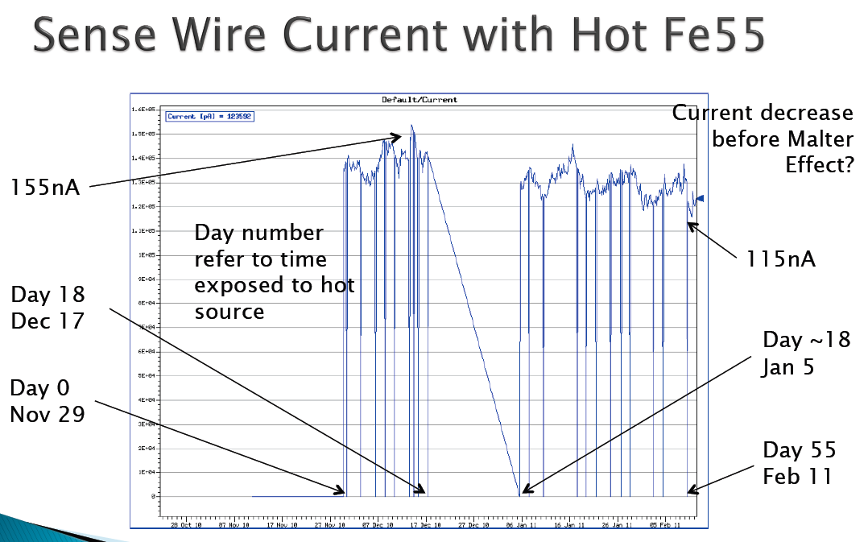
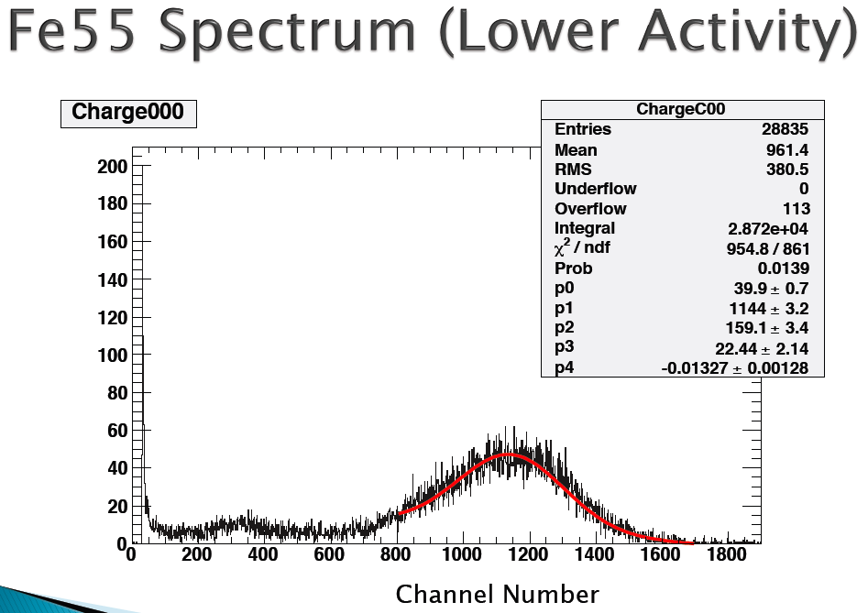
Aging studies

Slide 20
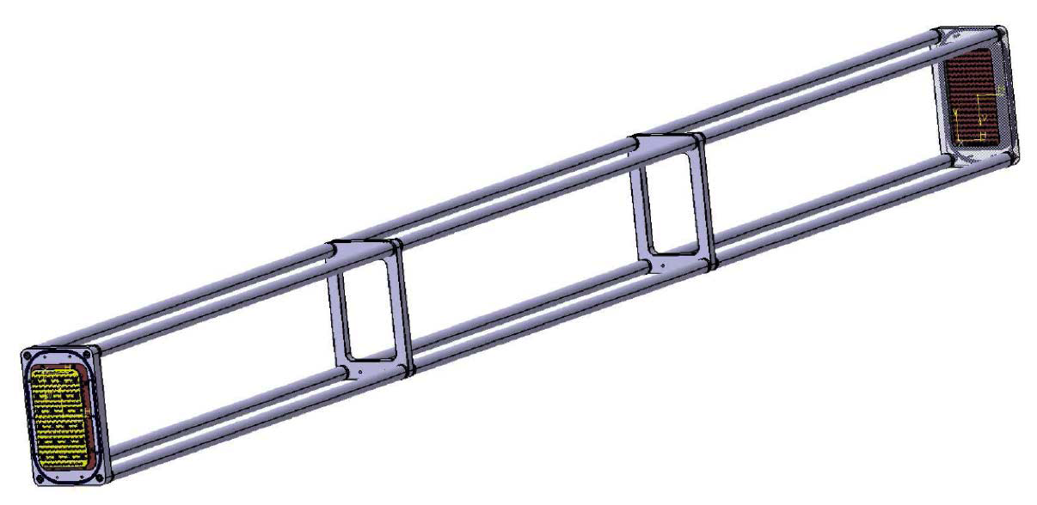
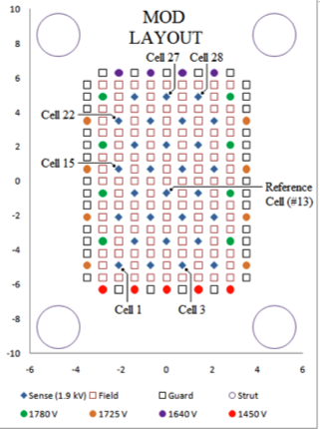
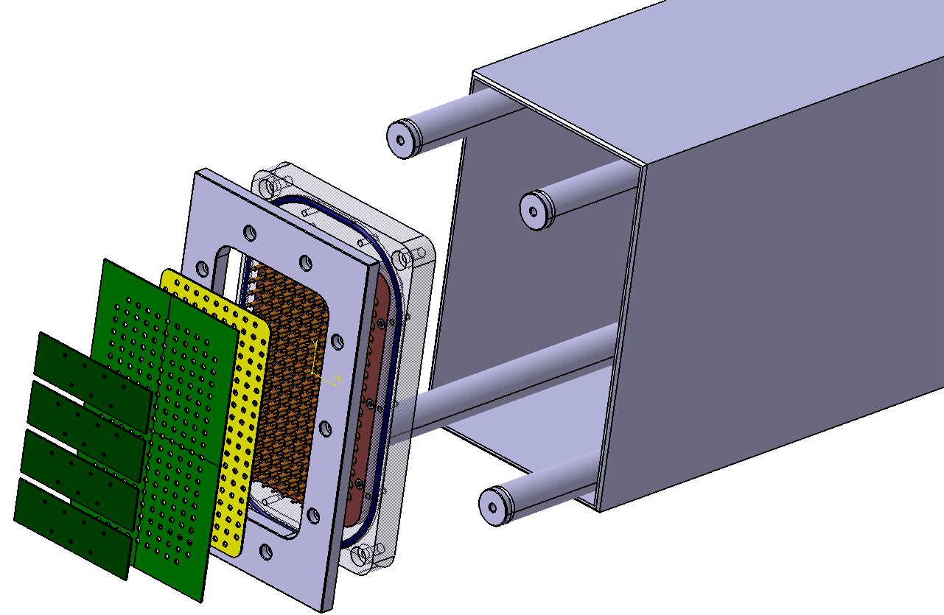
Prototype 2
Building 2.5m long prototype with 28 sense wires arranged in 8 layers
  study DCH response from single clusters in a realistic environment, and serve as a test bench for the final FEE

Slide 21
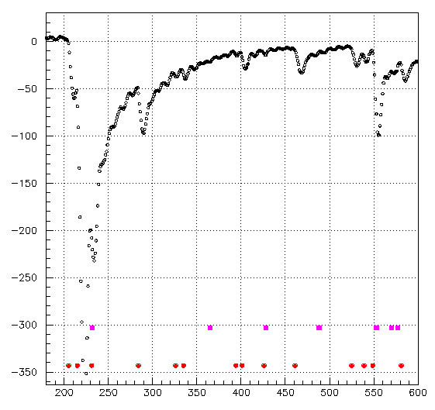
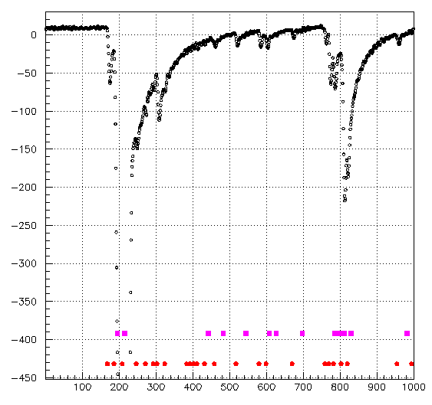
Cluster Counting in square drift tube
Continuing studies of cluster counting in 30mm square drift tubes
Time of clusters from full waveform analysis
Time of clusters from “analog derivative” method (delayed by ~50ns)

Slide 22
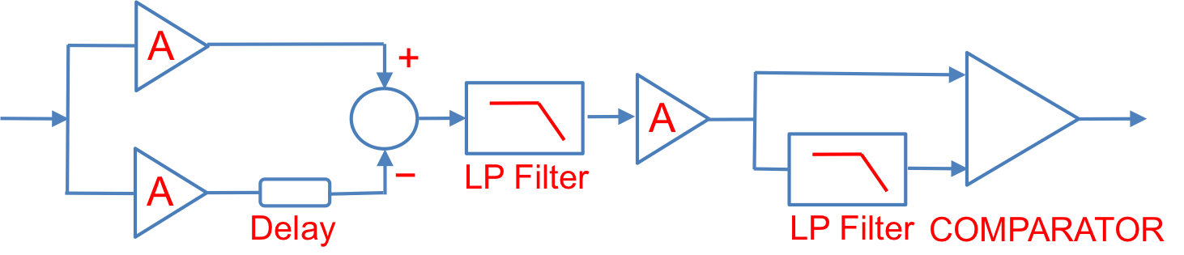
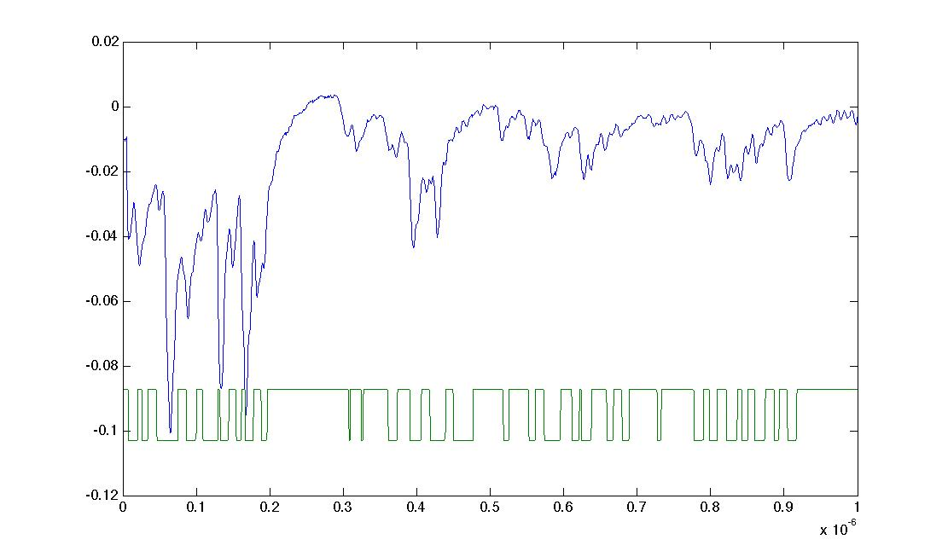
Improved Cluster Counting circuit
Studies to verify Cluster Counting capability with analogic derivative circuit are going on.
The method will be extensively tested on the 28 channel DCH prototype.

Slide 23
PID
Nicolas Arnaud and Jerry Va’vra

Slide 24
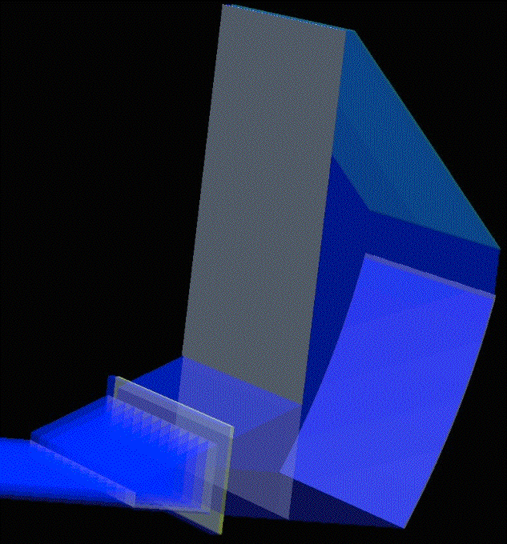
Barrel PID
• FBLOCK & New Wedge [SLAC]
▪ Cosmo Co. has started to process of machining & polishing of the optical pieces.
▪ New Wedge is expected to be finished by May.
▪ FBLOCK is expected to be finished by June.
▪ We are ~2 months late compared to original plans. More clear picture by Elba.
• FDIRC optical coupling studies [SLAC]
▪ Developed a procedure to make a large optical couplings.
▪ Measured transmission of all glue candidates.
▪ Measuring yelowing under a large dose of photons and
radiation damage effects.
▪ This part seems to be under control and within the
original schedule.
• FDIRC Mechanics [Padova + Bari + SLAC]
▪ Dummy FBLOCK & New Wedge is being produced (Bari).
▪ Detailed mechanical drawings almost ready to start cutting metal (Padova, Bari).
▪ Detector holder concept defined. It will be produced at SLAC.
▪ Method to generate the laser calibration defined (SLAC, Maryland, Padova).
▪ We hope to freeze mechanical drawings by the end of this meeting and start cutting.
▪ We are ~2 months late compared to original plans.

Slide 25
Barrel PID
• H-8500 Detectors [SLAC + Hawaii + Maryland + Bari]
▪ SLAC scanning setup re-started. It uses old LeCroy Disc/TDC electronics presently.
▪ It is going to be used to qualify 14 H-8500 detectors for CRT tests.
▪ The scanning setup will be upgraded later on for the BLAB3 electronics.
▪ Similar scanning setups are being prepared in Maryland and Bari.
▪ Should be able to finish the detector qualification by summer.
Electronics [Hawaii + LAL-Orsay + LPNHE-Paris]
▪ Will start the prototype with BLAB3 electronics. Gary has promissed 7 double-units.
▪ LAL-Orsay electronics will be available in 2012:
- Front-end chip and SCAT (100 ps TDC) status: work has started and they applied for
a 450 kEuros grant to fund the development of the boards -- decision to be known by
the Elba meeting probably
• Definition of tasks/schedule
▪ Detailed schedule for building of the FDIRC prototype exists.
▪ Search for participating institutions to take full responsibility continues.
• New collaborators
▪ Continue to work on this issue.

Slide 26
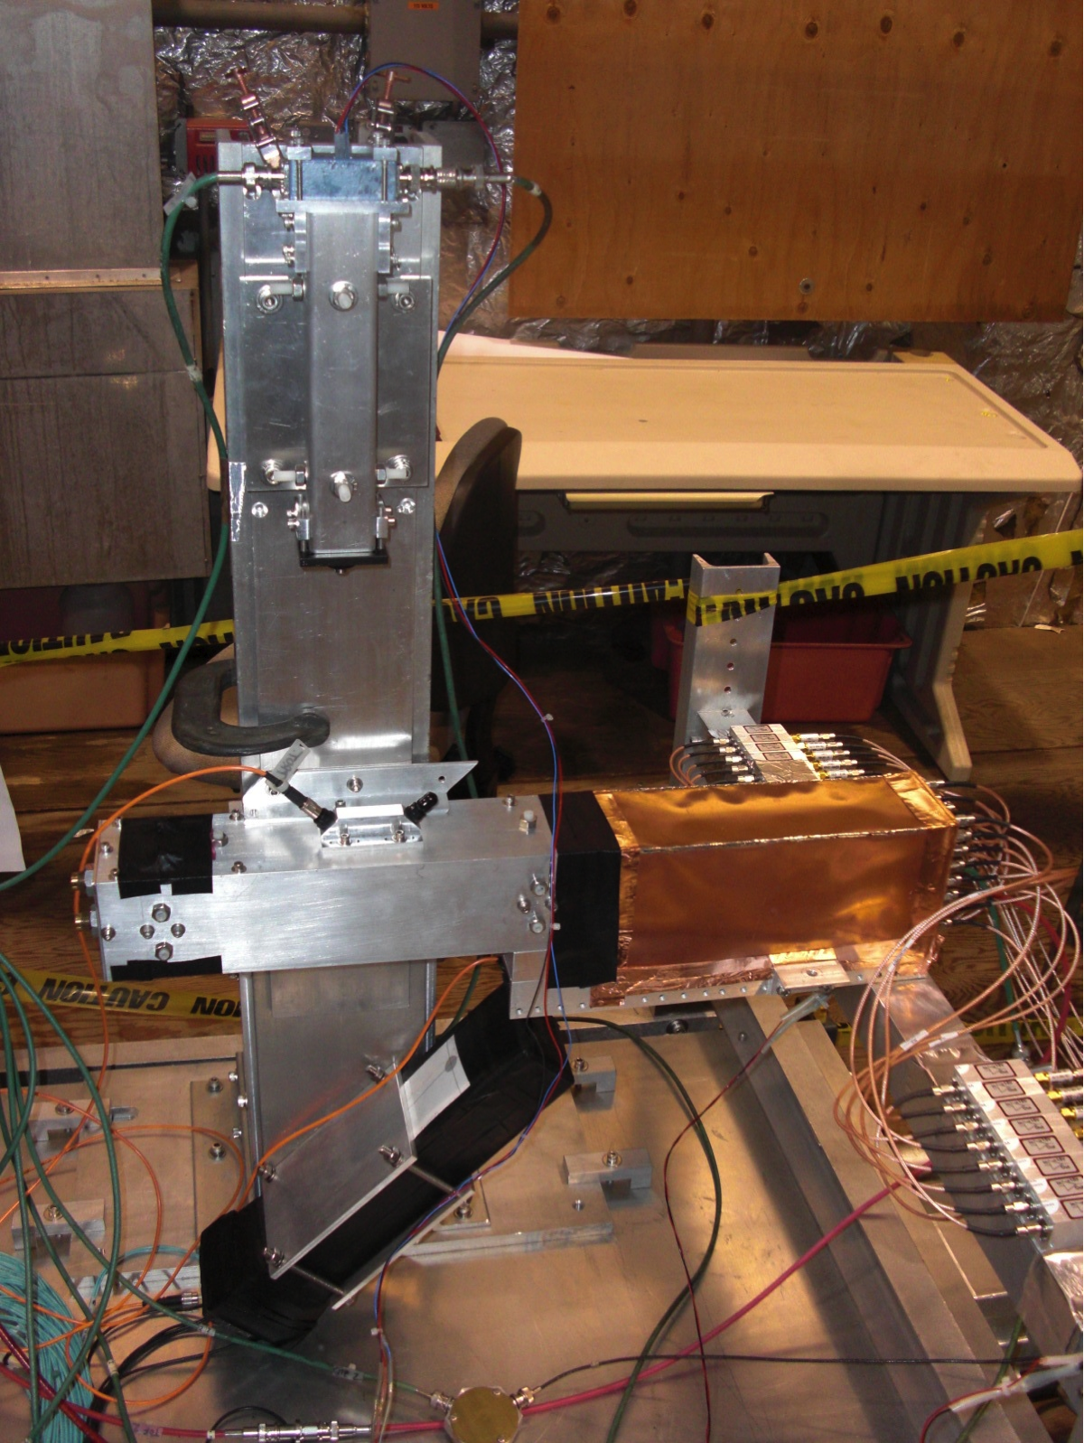
Forward PID
• FARICH [Novosibirsk]
▪ Test beam in progress.
• DIRC-like TOF (FTOF) [LAL-Orsay + SLAC]
▪ Large data sample collected in CRT telescope.
▪ Leonid will present results of his analysis in this meeting
▪ Detailed MC simulation has been developed to
understand the CRT data
• A simple pixilated TOF using a LYSO crystal + G-APD [SLAC]
▪ CRT tests yielded a poor timing resolution with a full size LYSO crystal (σ~220ps).
▪ There will be one more CRT test at SLAC, but it seem unlikely that one can
achieve σ~100ps.

Slide 27
EMC
Claudia Cecchi and Frank Porter

Slide 28
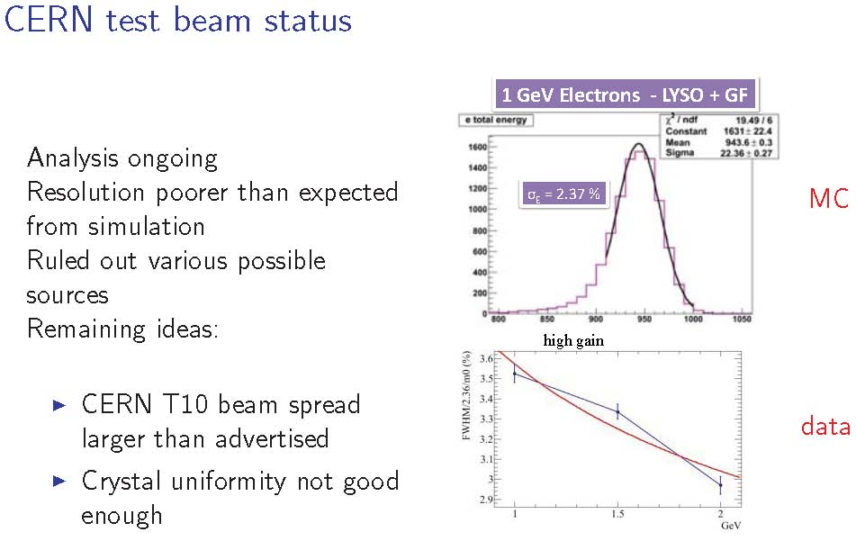

Slide 29
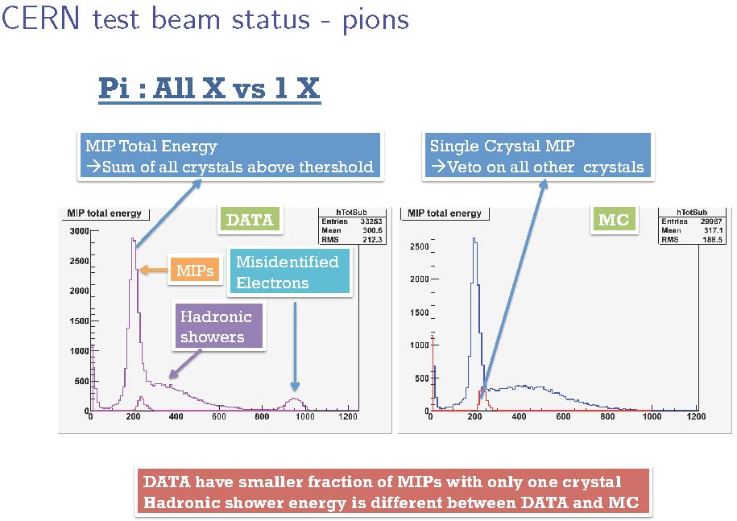

Slide 30
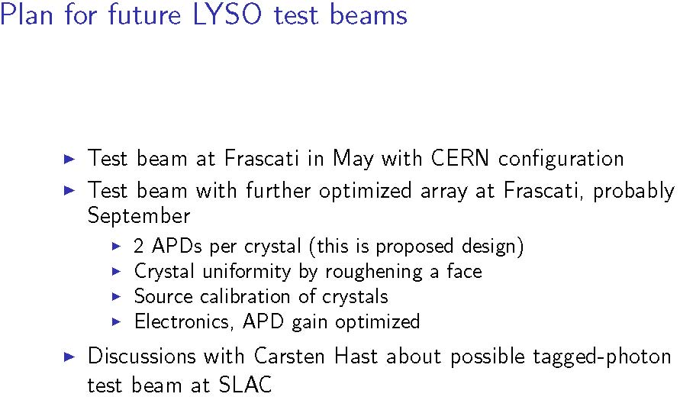

Slide 31
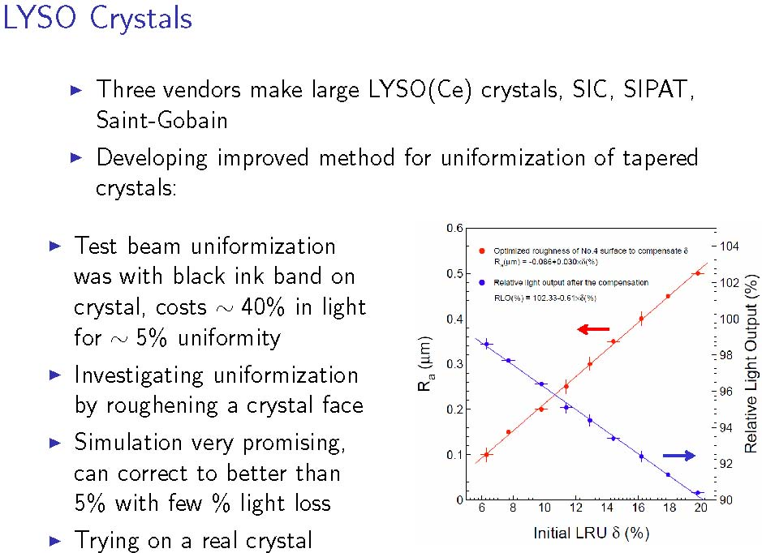

Slide 32
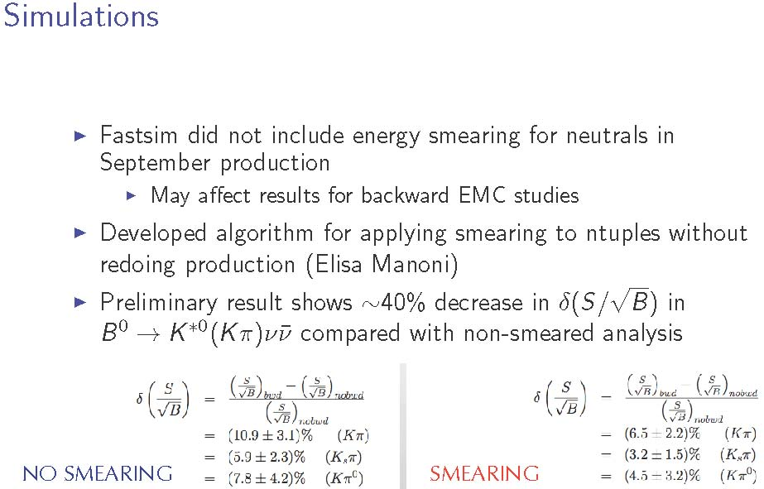

Slide 33
IFR
Roberto Calabrese

Slide 34
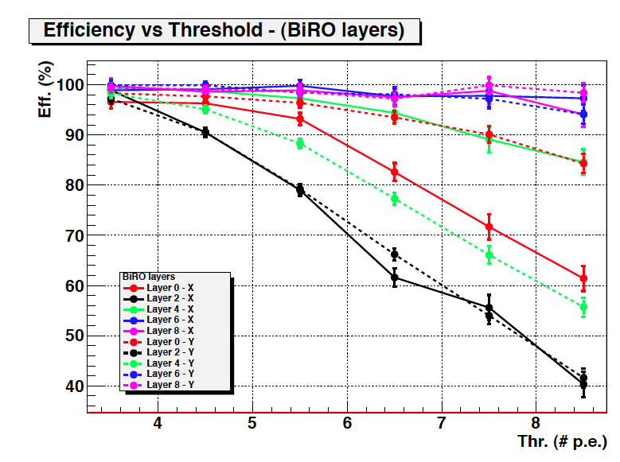
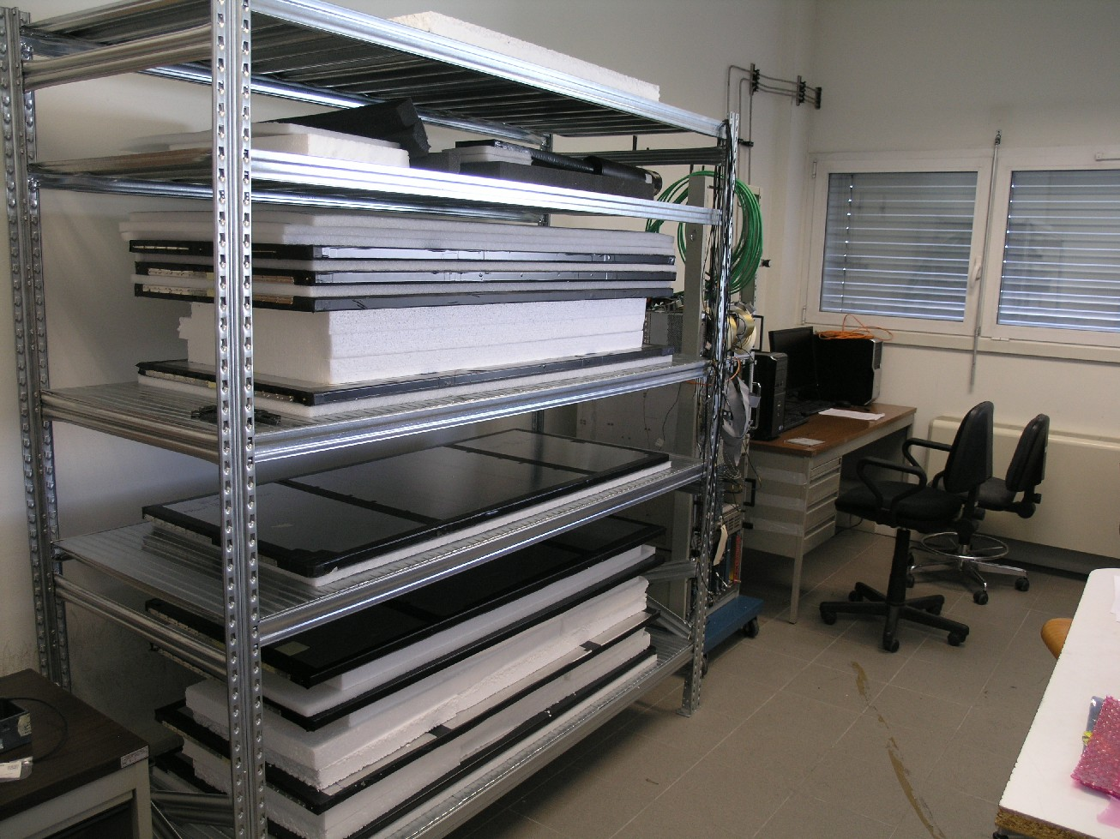
Advancements since Caltech:
Prototype tested (1-7 Dec 2010) at the Fermilab Test Beam Facility (Meson Area)
9 layer configuration tested with different readout schemes (5 BiRO layers and 4 TDC layers)
Beam Test Data analysis ongoing
Prototype shipped back and reassembled in Ferrara (no Iron) to continue the test with cosmics
New Beam Test foreseen next summer

Slide 35
Goals for this meeting:
Review advancements and achievements in all the development areas
Particular focus on beam tests: analysis of the December data and preparation for the new summer beam test
Analyze the TDR preparation process and prioritize the short and medium term activities

Slide 36
Toward the TDR
test prototype with cosmics
first beam test @ FNAL
analyze/review test results
new beam test @ FNAL
analyze/review new test results
write TDR
done
October 2010
done
December 2010
Spring 2011
Ongoing
Summer 2011
Fall 2011
Winter 2011

Slide 37
ETD/Online
Dominique Breton, Umberto Marconi, Steffen Luitz

Slide 38
ETD (1)
Since Caltech, we had a two-day ETD workshop at CERN end of February
  All groups were represented => discussions were very effective
  Good progress was done on putting numbers in dataflow and refining the trigger strategy on the front-end
  Guidelines for next milestones were defined
  Trigger studies really got started
We will have 3 sessions during this workshop:
  one concerning front-end electronics
  one concerning common items
  one dedicated to hardware trigger
During the two last sessions, we would like to discuss the following points:
Clock and control links:
  Irradiation of the event data SERDES chipset was performed => results will be presented by Raffaele
  We have to define plans to start qualifying components of the optical layer
  The use of mezzanines vs firmware blocks has to be discussed again for the FCTS and ROM sides

Slide 39
ETD (2)
ROM: new steps were made in understanding the solution to be described in the TDR.
  We have to refine the ratio price/performance/flexibility of the different solutions.
  A few presentations on these subjects will take place this week.
Common Front-End Electronics: first simulations of the front-end derandomizer in order to be able to estimate its adequate depth will be presented
Trigger:
  Separate front-end parameters for trigger and event readout (e.g. in the EMC, different shaping times for trigger and event readout) were studied
    => What is the achievable time precision for the trigger primitives?
  New solutions were presented to extract the trigger primitives from the front-end
    We would like to standardize the philosophy of the primitives between DCH and EMC
    EMC primitives could be transmitted on LVDS copper pairs (DCH?)
  All these subjects will be analysed in view of the TDR writing.

Slide 40
Agenda

Slide 42
Workshop focus
Review ongoing R&D and detector design
  Increase mechanical integration effort
Focus on issues to be resolved for TDR
  Forward and backward geometry – tentative plan to take a decision in Elba.
  Many more issues in the subsystems
Advance understanding of backgrounds
  Dominate detector design in many areas
Recruit new collaborators
  Prepare for the First SuperB Collaboration Meeting in Elba

Slide 43
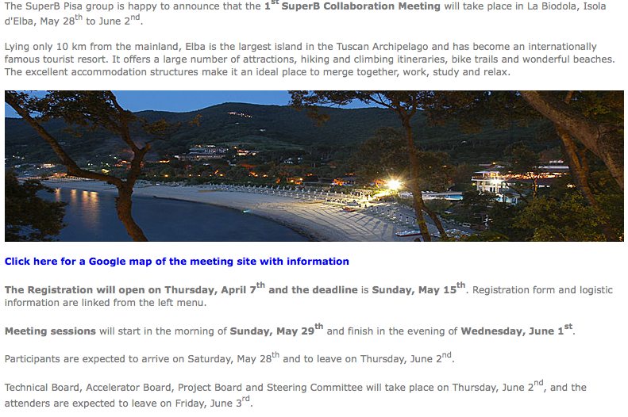
http://agenda.infn.it/conferenceDisplay.py?confId=3352

Slide 44
Backup

Slide 45
SVT - Next R&D on pixel for Layer0
Improvements in MAPS performance being pursued with:
  INMAPS CMOS process with quadruple well + high resistivity substrate: higher charge collection efficiency & rad hardness → design of first prototypes ongoing
  3D MAPS with 2 CMOS tiers interconnected:: higher cce efficiency, more complex in-pixel logic, reduce cross-talk → first chips under test, testbeam in Sep. 2011
Improved readout architecture developed for pixel with Vertical Integration
  TimeStamp is latched in each pixel when fired & readout is time ordered.
    Timestamp granularity 100 ns
  Readout could work in data push mode & triggered mode
    VHDL results for 100MHz/cm2 hit rate: Effi_triggered=98.2%, Effi_data_push=99.9%
  New submission of large 3D MAPS and FE chip for Hybrid pixel (2-tiers), with the improved readout architecture, in preparation for mid 2011
Vertical interconnection of FE chip (2-tiers) with high resistivity pixel matrix (best technology under investigation) will give the best performance: high S/N and radiation hardness, low power and material budget

