Slide 1



The Project Update
Marcello A. Giorgi
Università di Pisa & INFN Pisa
April 5, 2011
Notes:
1
1

Slide 2
Outline
This workshop devoted to Physics Detector Computing
Where we are with the approval process.
Detector requirements for full exploitation of the collider potential.
Site requirements and evaluation process

Slide 3
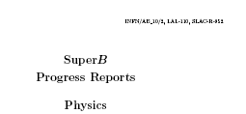
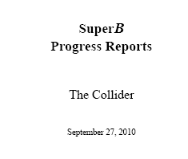

In Preparation of TDR
Since September 2010 the three SuperB Progress Reports have been published, it was an important step forward to the completion of the TDR , in time during 2011.
Machine parameters are fixed including the tunnel length , a Physics update after the 2008 Valencia document, the Detector is almost frozen.
arXiv:1008.1541v1
arXiv:1007.4241
arXiv:1009.6178v1

Slide 4
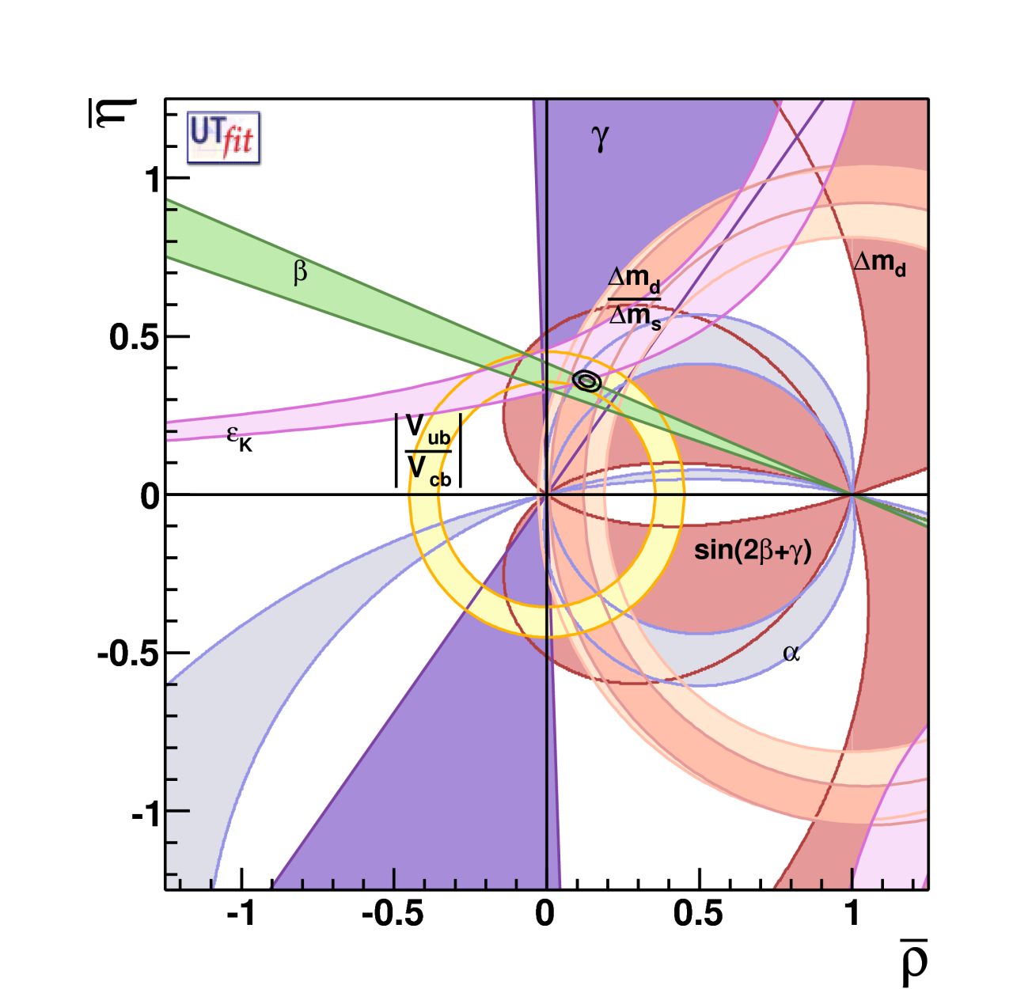
Fit on Unitarity Triangle
Coherent picture of FCNC and CPV processes in SM
Consistence on an
over constrained fit
of the CKM parameters
Discovery : absence of
New Particles up to the
~2×Electroweak Scale !
ρ = 0.132 ± 0.020
η = 0.358 ± 0.012
With a precision of
σ(ρ) ∼15% and σ(η) ~4% !
CKM matrix is the dominant source of flavour mixing and CP violation

Slide 5
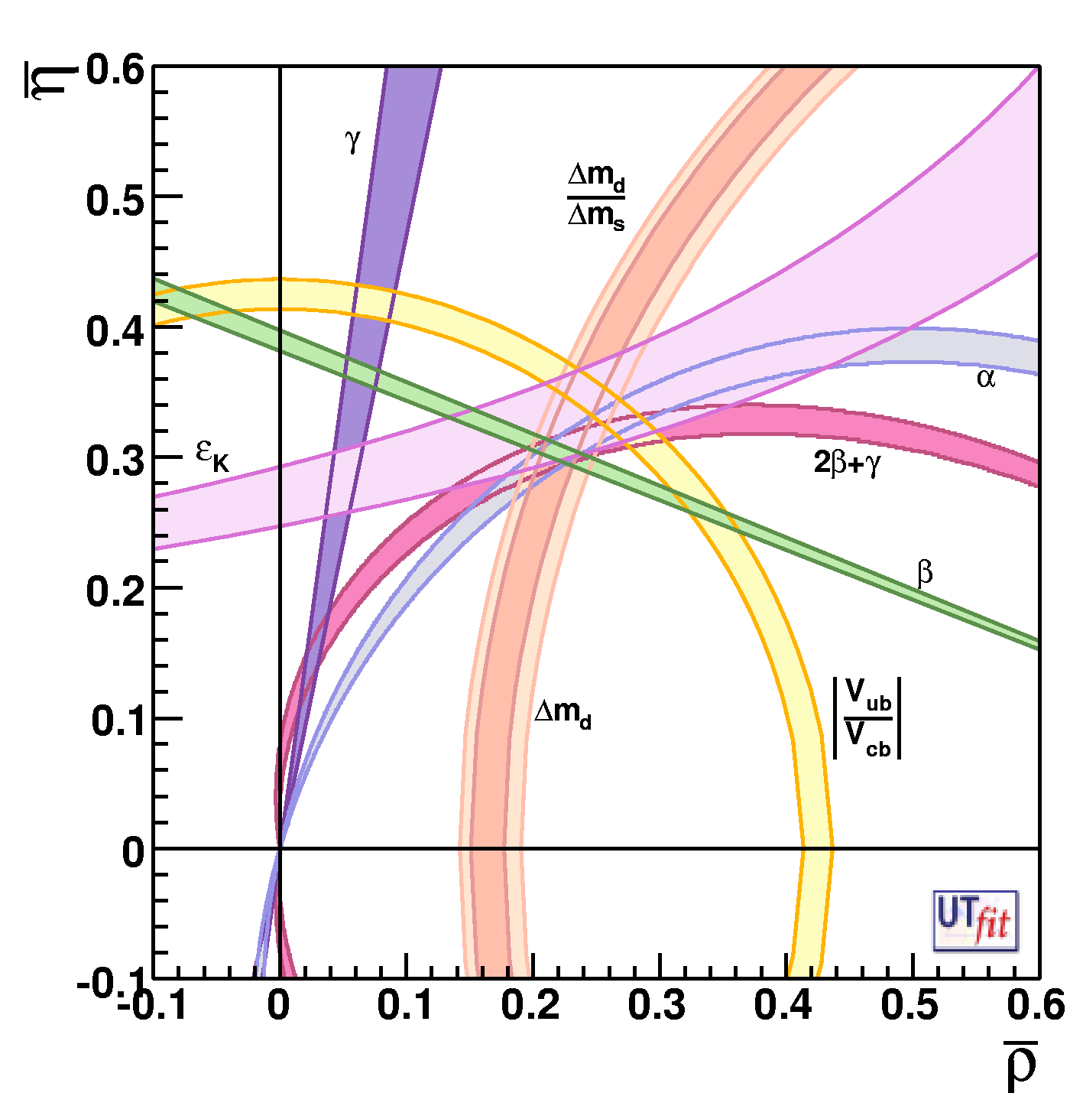
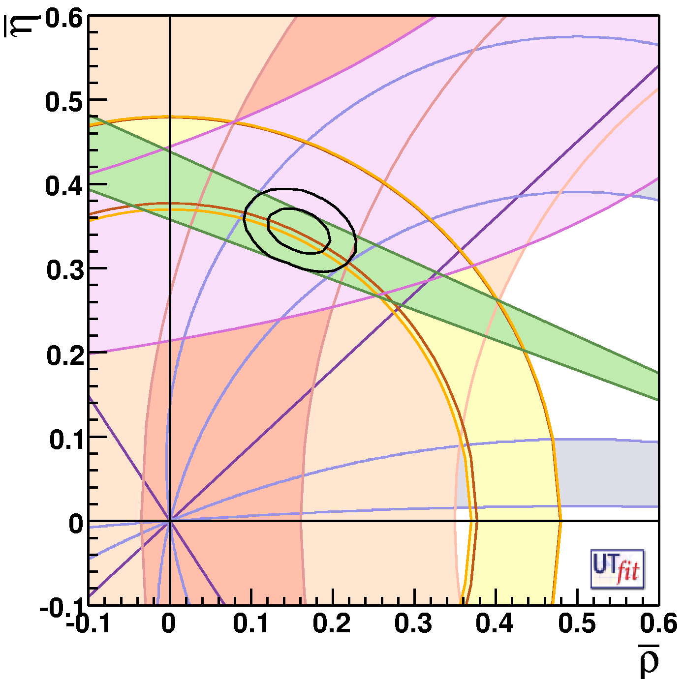
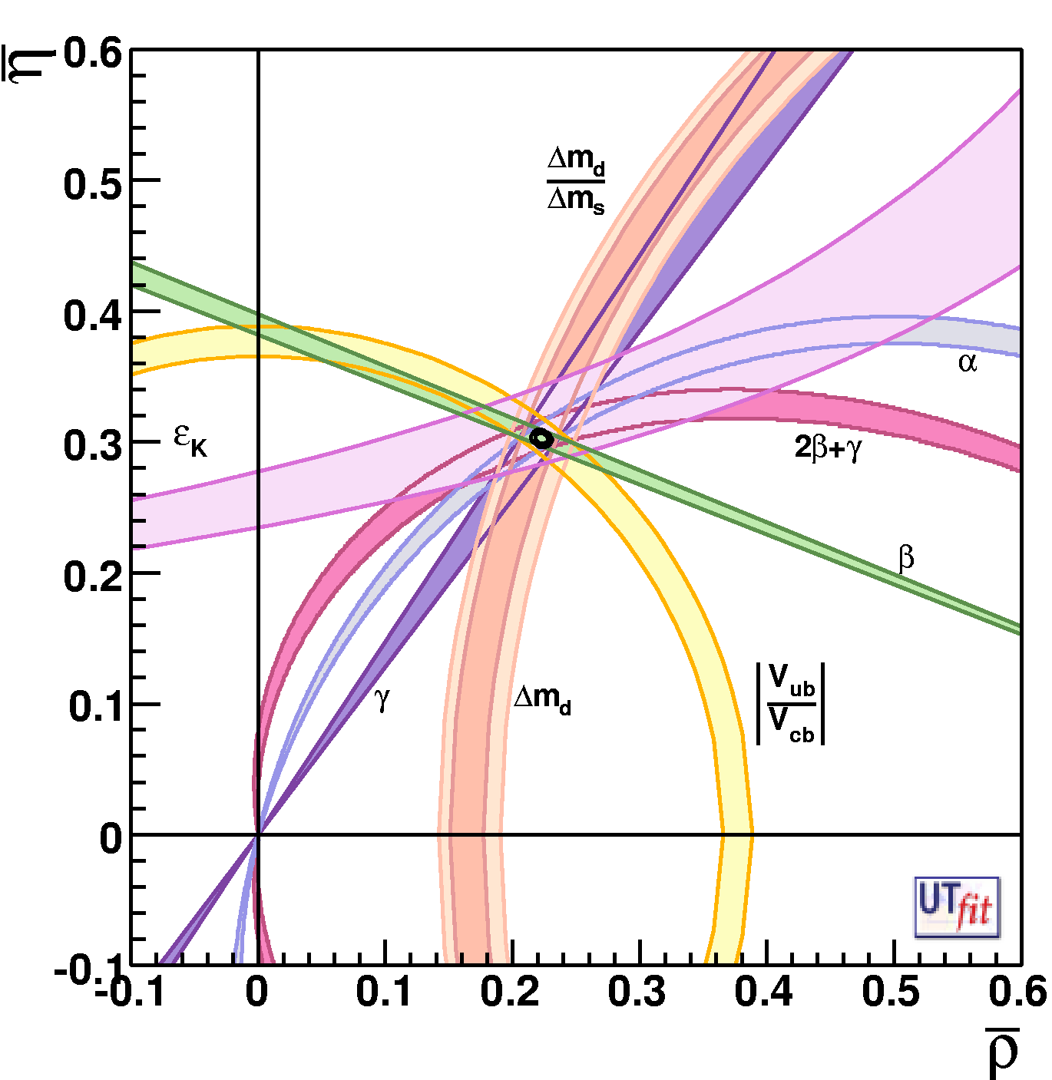
From A.Stocchi
Determination of CKM parameters and New Physics
Today
Future (SuperB) + Lattice improvements
This situation will be different @2015 thanks to LHCb
players are :
γ,α,β..,V_{ub}
and Lattice !
ρ = 0.163 ± 0.028
η = 0.344± 0.016
ρ = ± 0.0028
η = ± 0.0024
Improving CKM is
crucial to look for NP
Important also in K physics :
K→ π ν ν , CKM errors dominated
the error budget

Slide 6
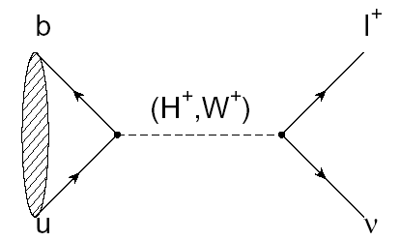
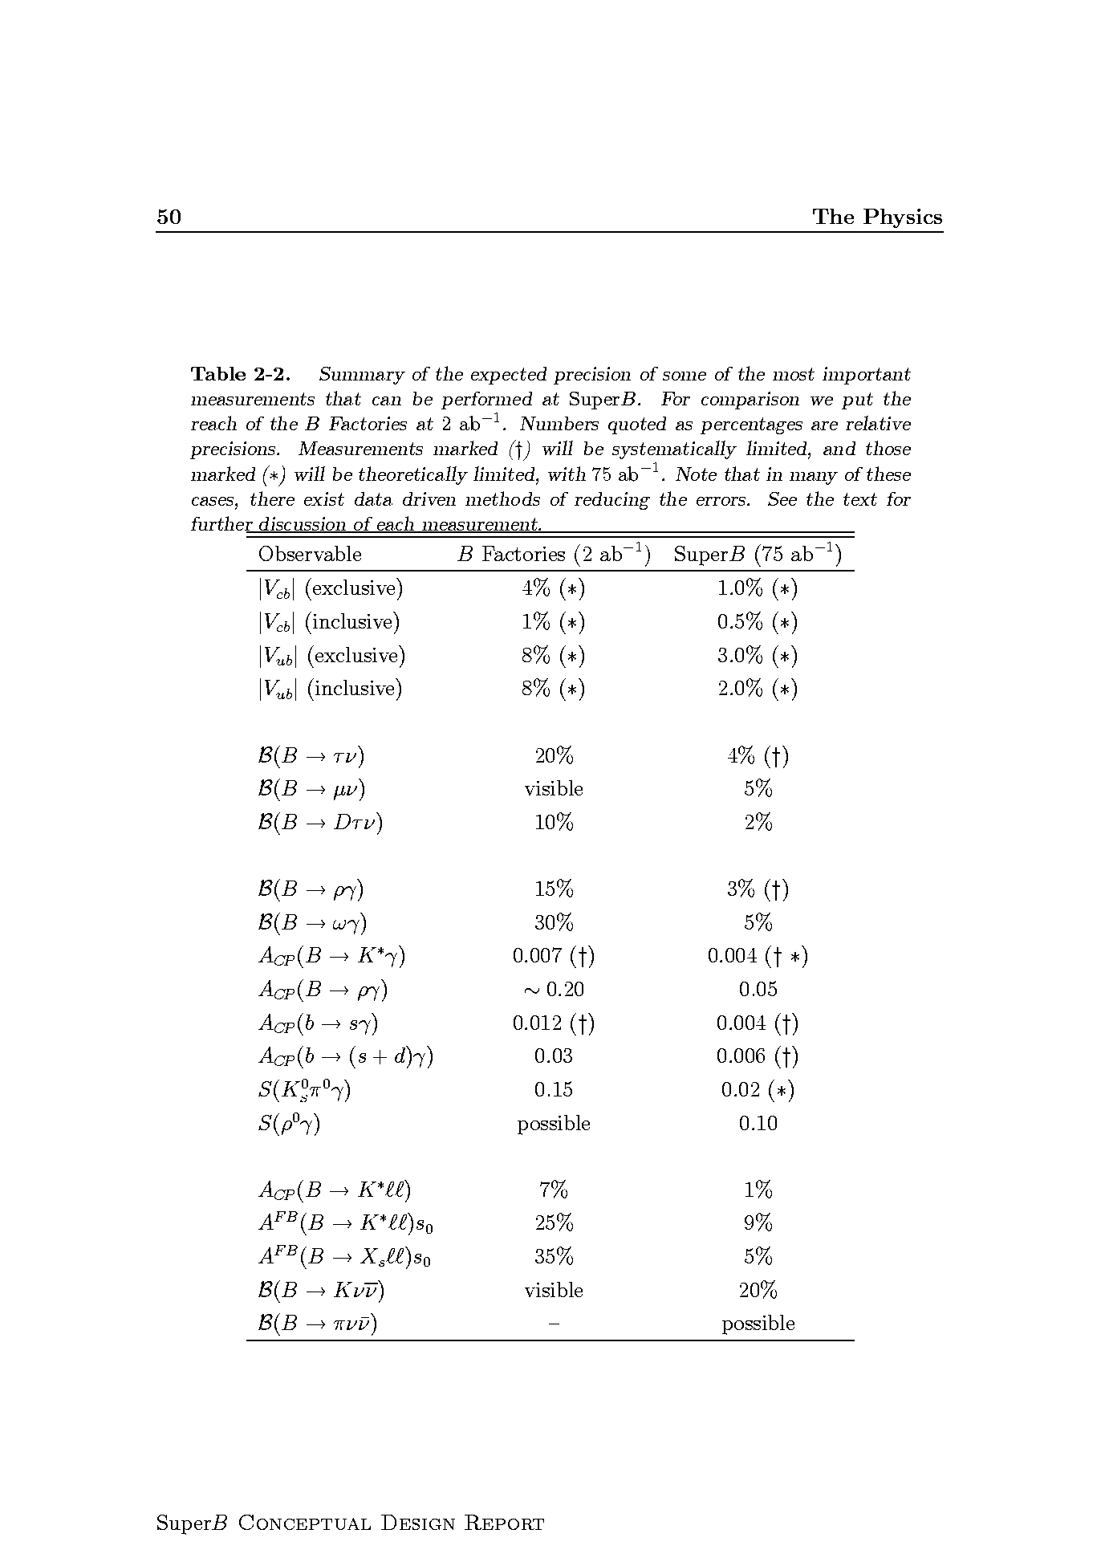
From A.Stocchi
Leptonic decay B → l ν
SuperB
SuperB -75ab⁻¹
M_{H}~1.2-2.5 TeV
for tanβ~30-60
2HDM-II
MSSM
75ab⁻¹
2ab⁻¹
LEP m_{H}>79.3 GeV
SuperB
ATLAS 30fb⁻¹
SuperB excludes
SuperB excludes
ATLAS 30fb⁻¹
B-factories exclude
B-factories exclude
ATLAS 30fb⁻¹

Slide 7
SuperB is designed with 80% longitudinal polarization for e⁻.
  Polarization allows:
  Precision Measurement in ElectroWeak sector
  EDM and g-2 in τ .
  BKG reduction for LFV in τ .
Polarized beams provide measurements of sin²θw(eff) with comparable precision to SLD but at much lower energies.
Polarization allows for NC Z-bb coupling measurement with better precision and different systematic w.r.t. LEP measurement of A_{FB}^{b} .

Slide 8
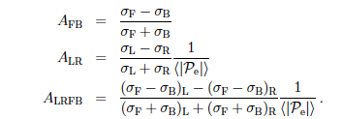


Differential Cross sections in e⁺e⁻→f⁺f⁻
Asymmetries at Z-pole for measured σ
Diagrams | σ (nb) | A_{FB} | A_{LR} (Pol = 100%)
|Z+γ|² | 1.01 | 0.0028 | -0.00051
|Z|²+|γ|² No interference | 1.01 | 0.0088 | -0.00002
Interference term is ~gA^{e}gV^{f}
at LEP: 15M hadronic Z decays, unpolarized
at SLC: 0.5M hadronic Z decays, polarized e⁻
at SuperB: Z-term ~30M, polarized e⁻
Expected stat. error: σ(ALR) = 4.6 x 10⁻⁶
relative stat. error 1.1% (80% polarization).
Systematics <0.5% on polarization needed
σ(sin²θeff)=1.8 x 10⁻⁴
cfr SLC σ(sin²θeff)=2.6 x 10⁻⁴

Slide 9
Electroweak measurement @ SuperB
POLARIZATION NEEDED
M.Roney et al.
The L-R luminosity asymmetry has to be very well controlled.Possibly done using monitoring
using Bhabhas
  Polarization should be measured better than .05%
  luminosity dependent polarization affects systematic uncertainties
0.5% polarization syst.
0.3% stat. error
→ 0.0021

Slide 10





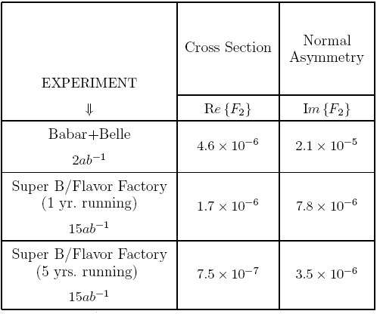
g-2 Reach (Valencia Report 2008)
Δaμ is not in good agreement with SM
Measuring differential cross section of tau production would lead to measurement of the real part of tau form factor.
We began considering 1-3 prong
whose experimental selection is cleaner
Need to tag the sample:
Lepton tag: higher purity & higher diluition (at least 3
neutrinos)
Hadronic tag: lower purity & lower diluition (2 neutrinos)
Systematics come mainly from tracking
Should be able to measure the
real part (0.75-1.7)x10⁻⁶
75ab⁻¹

Slide 11
τ→μγ :Bkg extrapolation (using BaBar analysis)
BaBar expects 5.1 events in the 2σ signal region
1.7 from lepton tags
1.4 from 3 hadron tags
2.0 from π+ρ tags
96% comes from real τ decays (86% from μννγ)
Bkg extrapolated to SuperB gives
300 events in the signal box.
It can be reduced thanks to:
Improved resolutions
Improved EMC coverage
~250 events expected
Background from taus is considered irreducible
Need to reduce backgrounds to an acceptable level to scale better than √L

Slide 12
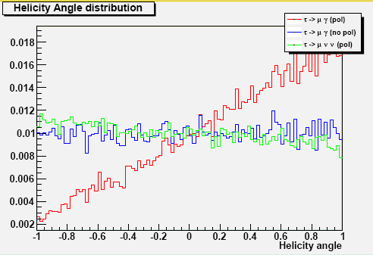

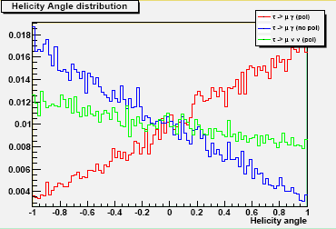
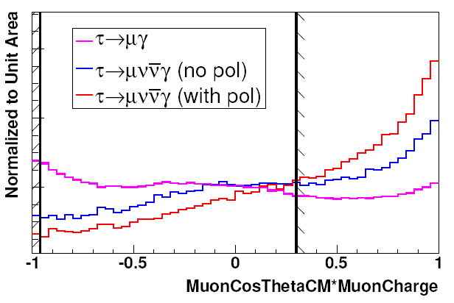
τ→μγ with Polarization
Using Polarization a more viable option is exploit hadron tags: only one ν in the event ⇒ fixed helicity
Signal helicity angle was studied for signal (both Polarized and Unpolarized) and backgrounds.
π-tag
ρ-tag
μ-tag

Slide 13
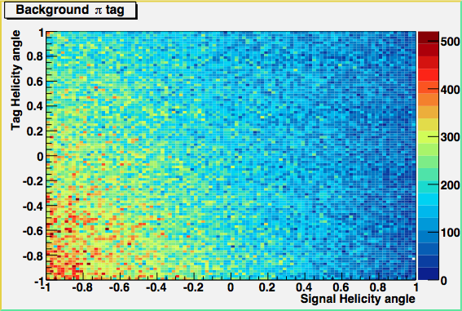
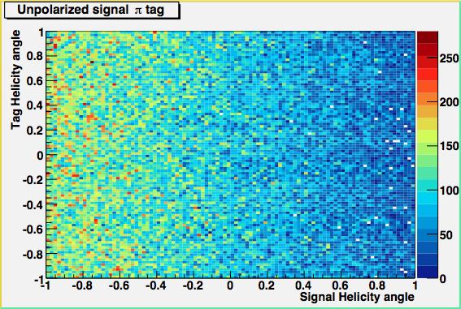
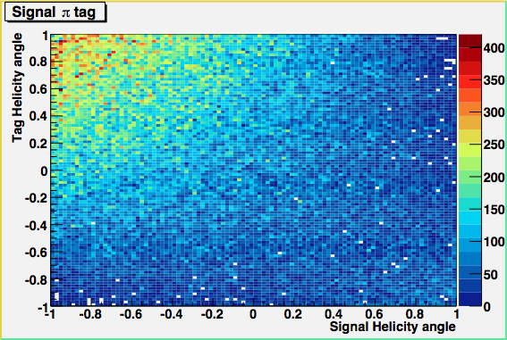

A simple analysis
Trapezoidal Cuts
eff. on signal:
41.6%π 49.4%ρ
bkg retained
11.5%π 9.8%ρ
Using polarization we obtain an improvement equivalent to a 2.6 increase in integrated Luminosity albeit using only 25% BF

Slide 14


Polarization Effects
Using Polarization background drops to O(15) events: UL scaling better than √L
Using a bayesian approach we may estimate an UL given the expected bkg
UL 3.9x10⁻⁹ using only ρ tag
BaBar Expected UL 8x10⁻⁸
scaling with √L (factor 12)
BaBar scaled Expected UL 6.4x10⁻⁹
Using polarization we obtain an improvement equivalent to a 2.6 increase in integrated Luminosity
albeit using only 25% BF
Further improvement adding all tags, but with some dilution.

Slide 15
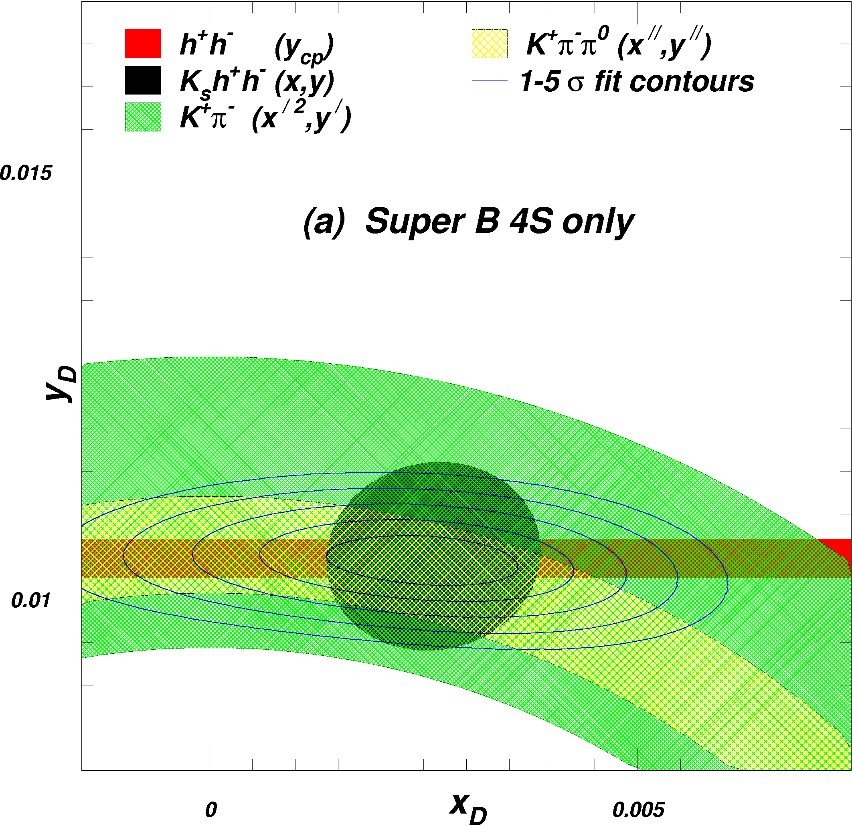
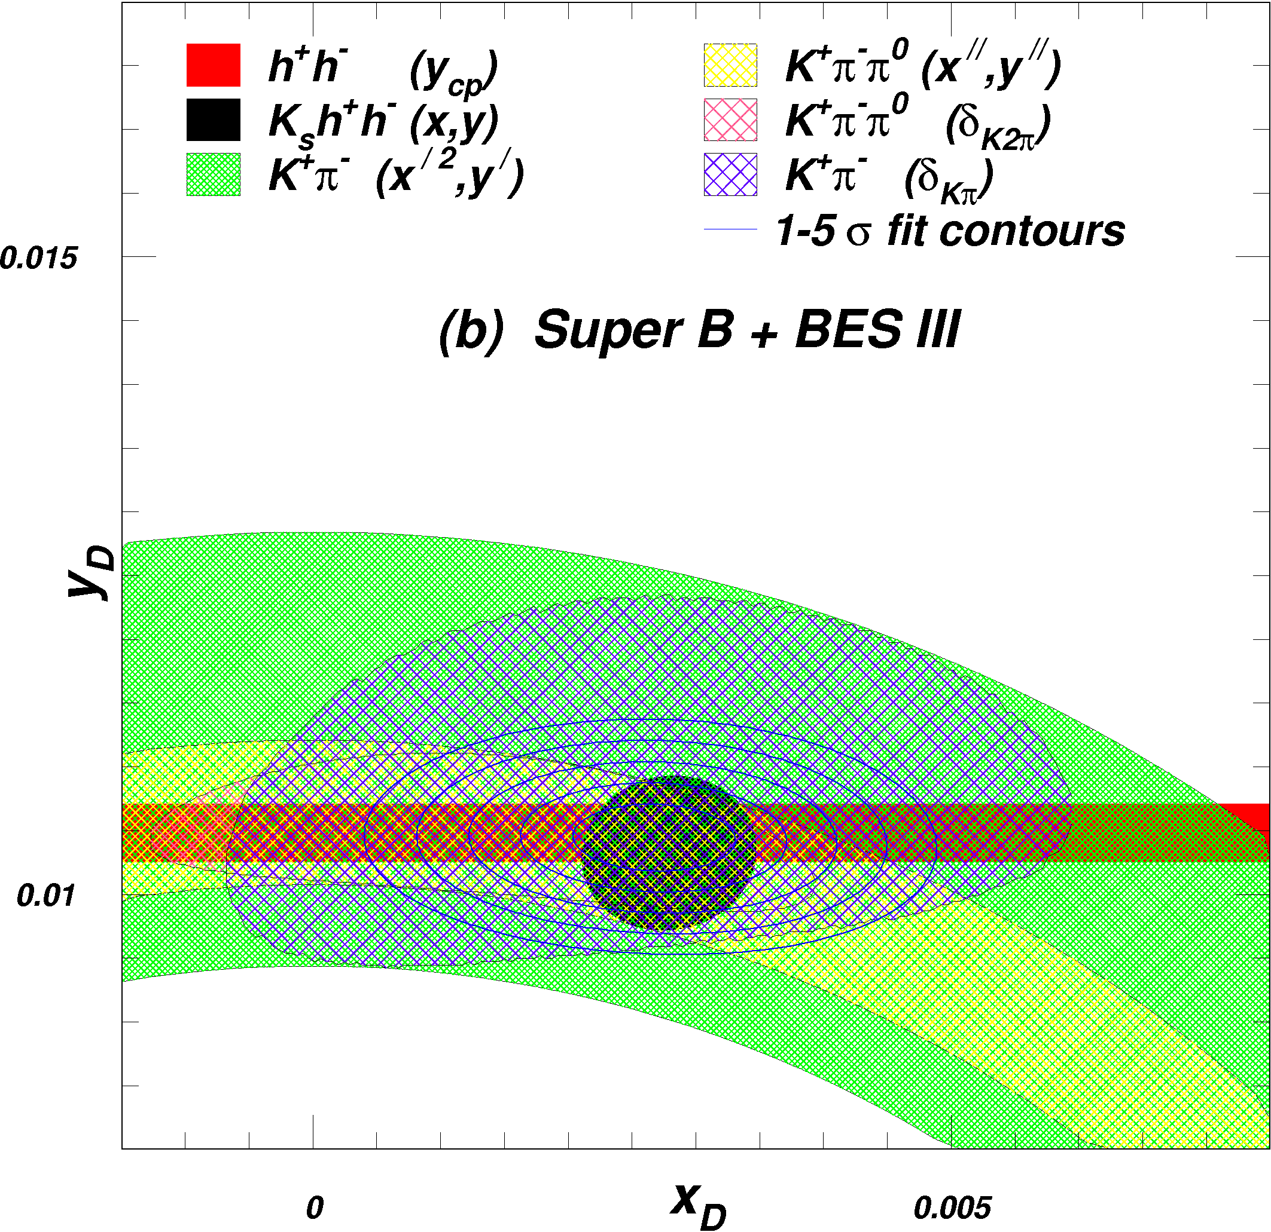
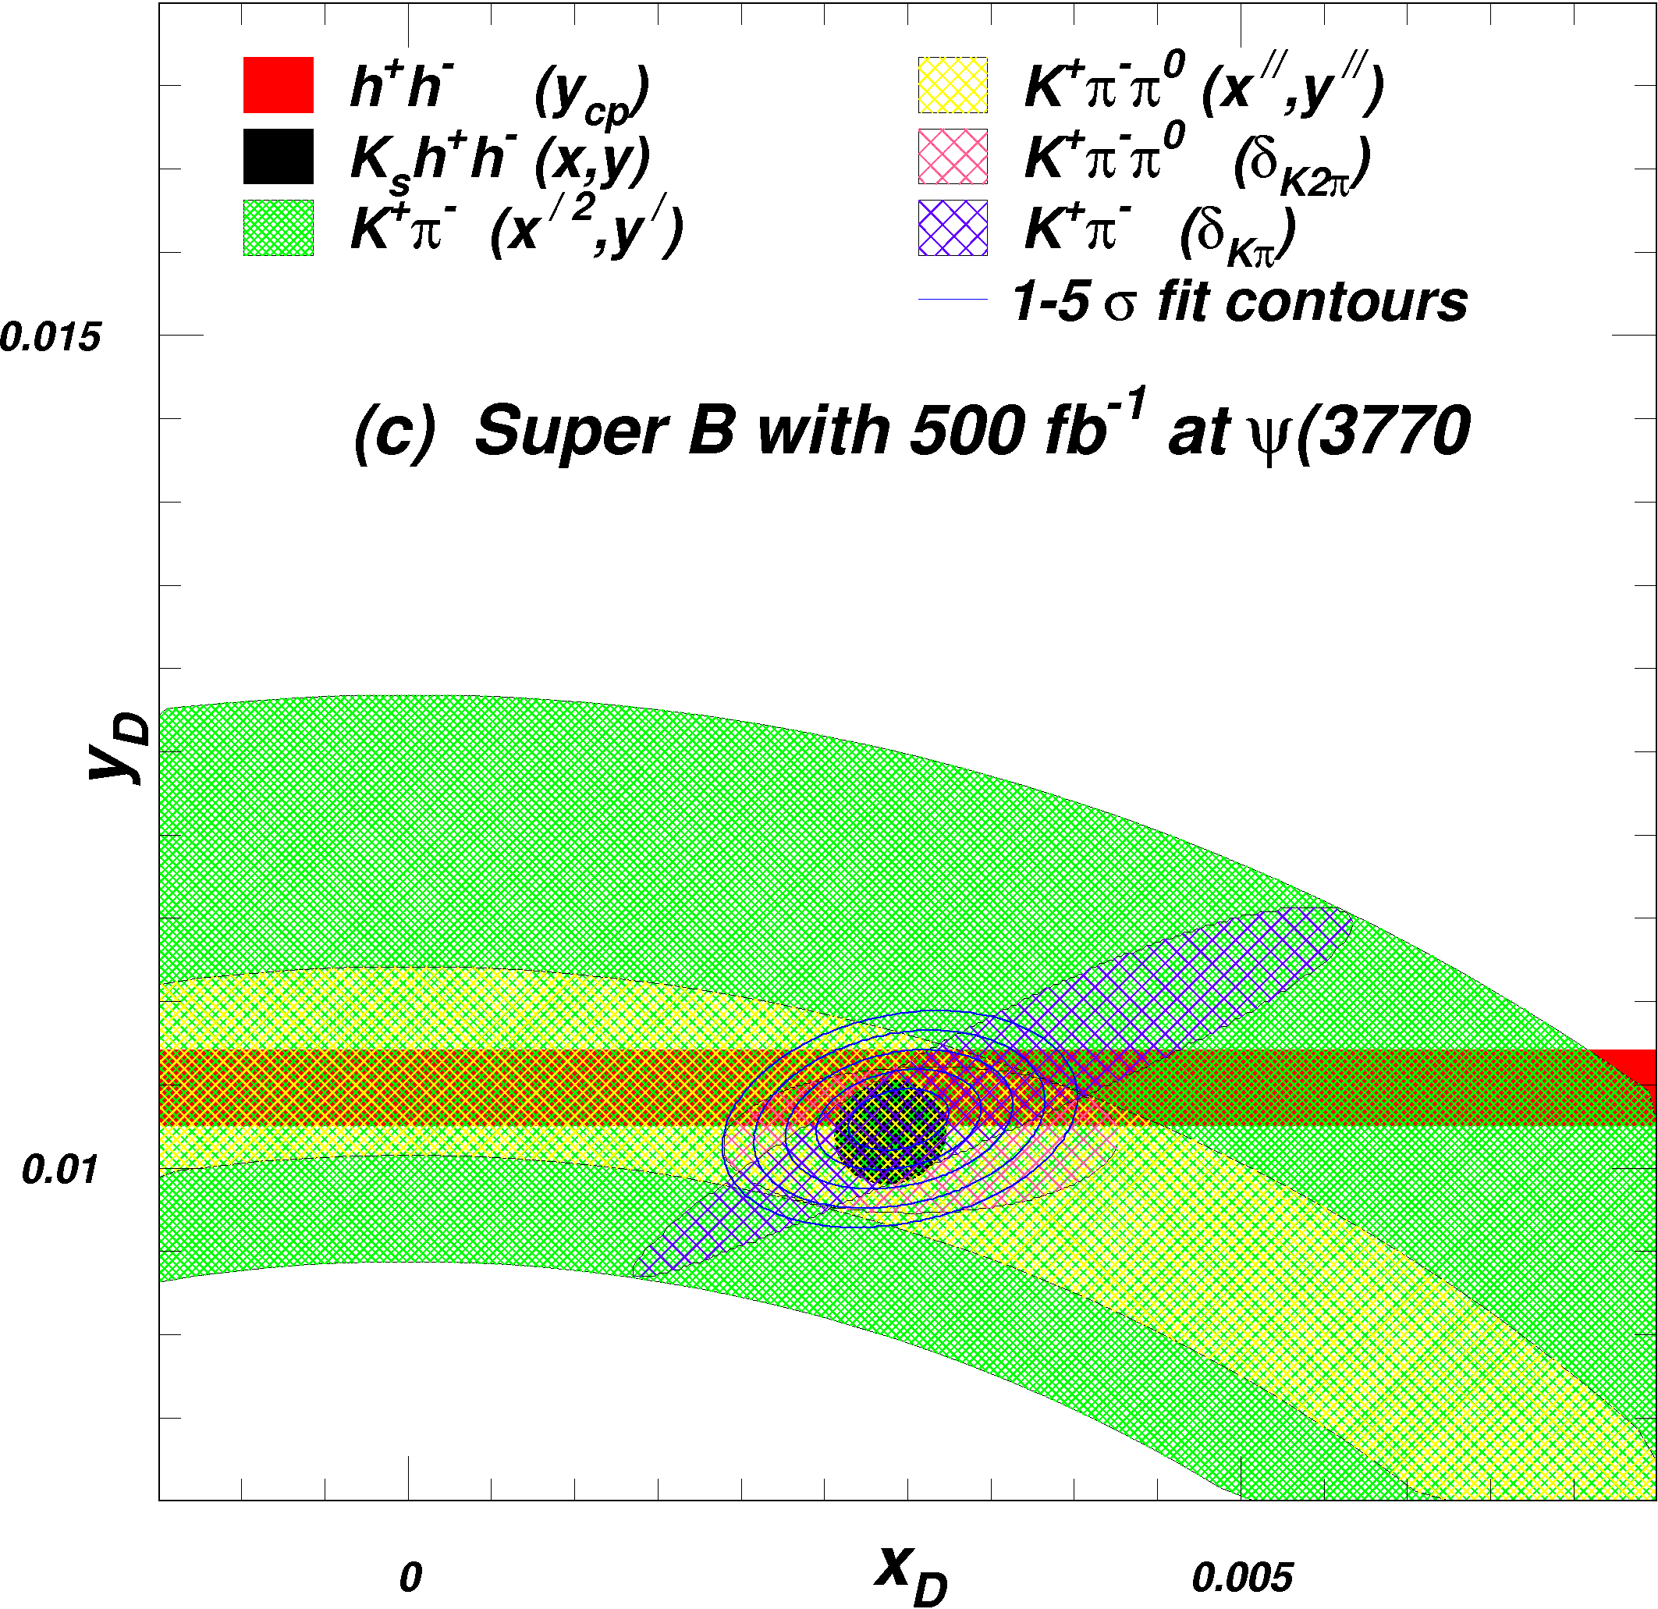
B. Meadow et al.
Interest of running @ threshold
500 fb-1 at ψ(3770)
Decays of ψ(3770) → D⁰D⁰ produce coherent (C=-1) pairs of D⁰’s. Quantum
correlations in their subsequent decays allow measurements of strong phases
  Required for improved measurement of CKM γ
  Also required for D⁰ mixing studies
Dalitz plot model uncertainty shrinks
Information on overall strong phase is added
Uncertainty in x_{D} improves more than that of y_{D}

Slide 16
From A.Stocchi
Some Golden Modes
No result
Moderate
Precise
Very Precise
Observable | Babar/ Belle | LHCb (10fb⁻¹) | SLHCb (100fb⁻¹) | SuperB (75ab⁻¹) | Some Comment | Theo
γ
V_{ub}/V_{cb} |  |  |  |  | Excl. needs Lattice & Inclusive @ 2% ?
β |  |  |  |  | Theo. error to be controlled on data (ex: J/ψπ⁰)
S(J/ψφ) |  |  |  |  | At 1º theo error controlled with data ?
B→ τ ν, μν |  |  |  |  | Very precise if detector is improved
S-Penguins |  |  |  |  | SLHCb (very) precise for B→φK, Bs→φφ Not possible for Ksπ^{0,}ksksks,ηks, ωKs..
A_{CP}(B→ X_{s}γ) |  |  |  |  | Control syst. Is an issue
Br (B→ X_{s}γ) |  |  |  |  | Syst. Controlled with data ?
Br (B→ X_{s} l l) Angular var.
Br(B→K*l l ), Angular var. |  |  |  |  | Could theory control @20%? Angular analysis are clean ? →
Br (B→ K^{(*)}ν ν) |  |  |  |  | Stat. limited. With more stat. angular analyses also possible
Br (B→K_{s}π⁰γ)
Br(B_{s}→φγ) |  |  |  |  | As precise as Br →K_{s}π⁰γ) ?
Br (B_{s}→μμ)
τ◊μγ |  |  |  |  | profit of polarized beams
CPV charm |  |  |  |  | CPV in SM negligible. So clean NP probe
THEORY
Moderately
Clean
Clean
Need Lattice
Clean

Slide 17
Comparison Physics task Force
A task force has been set up to compare the physics reach of SuperB with the other Flavor Experiments:
LHCb, SuperBelle, Na62, MEG, Mu2e.
Super B is a SuperFlavor Factory and it is complementary to the other Flavor Experiments, all together they can prove New Physics beyond Standard Model.
Group leaded by :
Bevan, M.Ciuchini, A .Stocchi, B.Meadows, J.Walsh.
REPORT is expected by end May in the meeting of Elba.

Slide 18
REQUIREMENTS FROM PHYSICS
Parameter | Requirement | Comment
Luminosity (top-up mode) | 10³⁶ cm⁻²s⁻¹ @ Υ(4S) | Baseline/Flexibility with headroom at 4. 10³⁶ cm⁻²s⁻¹
Integrated luminosity | 75 ab⁻¹ | Based on a “New Snowmass Year” of 1.5 x 10⁷ seconds (PEP-II & KEKB experience-based)
CM energy range | threshold to Υ (5S) | For Charm special runs (still asymmetric……)
Minimum boost | βγ ≈0.237 ~(4.18x6.7GeV) | 1 cm beam pipe radius. First measured point at 1.5 cm
e⁻ Polarization | ≥80% | Enables τ CP and T violation studies, measurement of τ g-2 and improves sensitivity to lepton flavor-violating decays. Detailed simulation, needed to ascertain a more precise requirement, are in progress.

Slide 19
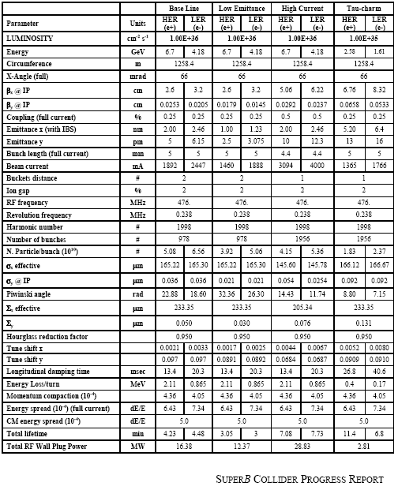
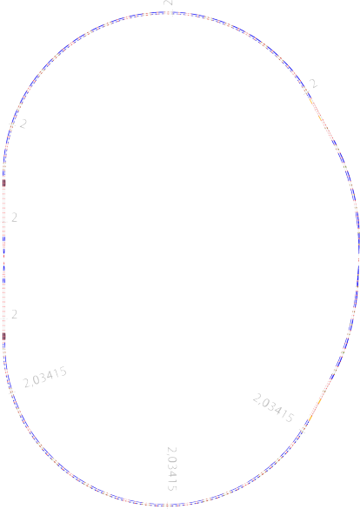









Collider Parameters are “stable”
LER
arc
HER
arc
HER Energy:
6.7 GeV
RF
FF
Polarization
80% for e⁻
l *~ 0.5m
I.P.
LER Energy:
4.2 GeV
e+
FF
e-
LER
arc
HER
arc

Slide 20
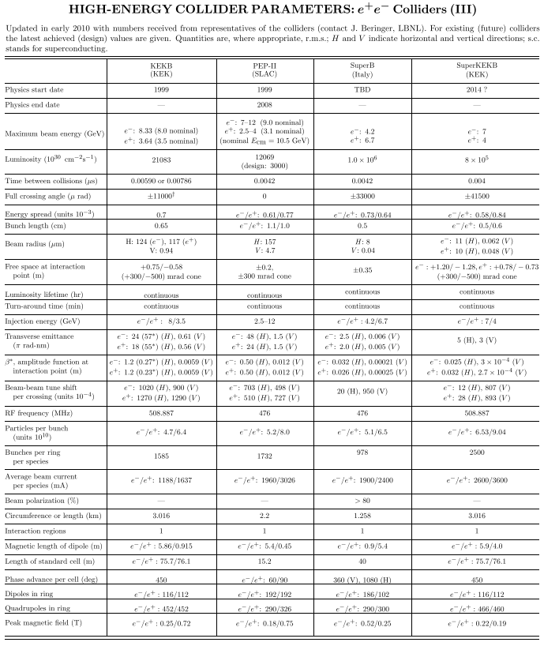
New PDG table for SuperB

Slide 21
SuperB IR Layout
M. Sullivan

Slide 22
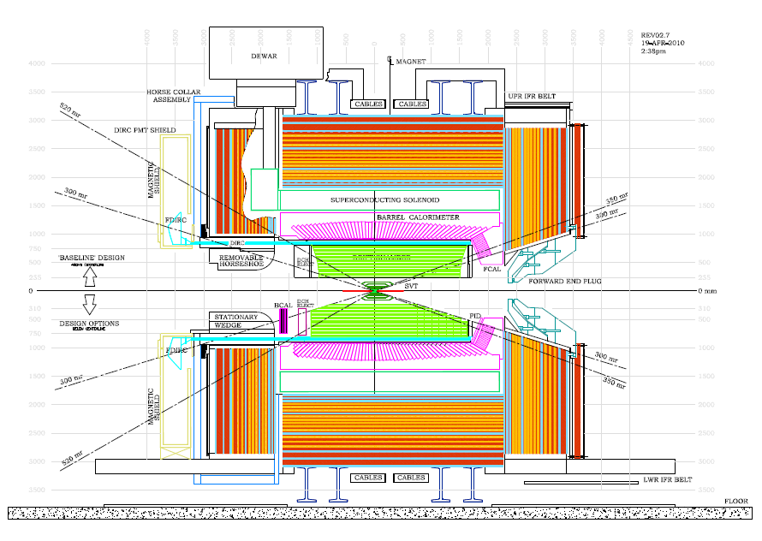
SuperB Detector (with options)

Slide 23
Open Issues
SVT Layer0
Forward EMC
Forward PID (if any)
Backward Calorimeter

Slide 24
Open issues in detector
In addition to what discussed so far there are several open issues:
The vertical size of bunches is O(40 nm) peak luminosity is strongly dependent on alignment and feedback a precise control of luminosity is needed in almost real time. A luminosity monitor rad hard , fast and precise is needed.
A precision determination of beam polarization is required for measuring asymmetries to extract SM parameters better than at LEP and SLD. A detector giving the polarization with a precision better than 0.5% is needed.

Slide 25
Expect from TDR
TDR has to be the document before construction.
It should contain the engineering of subdetectors
It should contain institutional responsibilities
It should contain human resources description and financial coverage.
Freezing on all systems within 2011 and forcing on a premature closing to new entries and contibutions from new institutions and regions would be a sort of suicide.
However……

Slide 26
Expect from TDR
TDR has to be the document before construction.
It should contain the engineering of subdetectors
It should contain institutional responsibilities
It should contain human resources description and financial coverage.
Freezing on all systems within 2011 and forcing on a premature closing to new entries and contibutions from new institutions and regions would be a sort of suicide.
However……

Slide 27
Must be Flexible an Wise
Systems “mature”, funded and supported by strong teams should move soon to construction Phase.
Other systems can wait just the minimum needed….
No premature descoping.
A review system internal to SuperB in place soon for continuous monitoring.
An external Review Committee also needed by the end of this year.

Slide 28
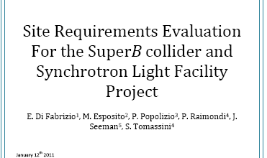
Toward fixing the site requirements.
An ad hoc committee has been set up to prepare the document on requirements for the site choice , preliminary to the infrastructure design.
Requirements and design will be reviewed by an International Review Committee

Slide 29
Site identification is in Progress
The International SuperB Site Committee led by J.Osborne will be in Frascati 8 and 19 April 2011 to discuss the site requirements and possibly to visit one site candidate in Tor Vergata.

Slide 30
About the approval of SuperB

Slide 31
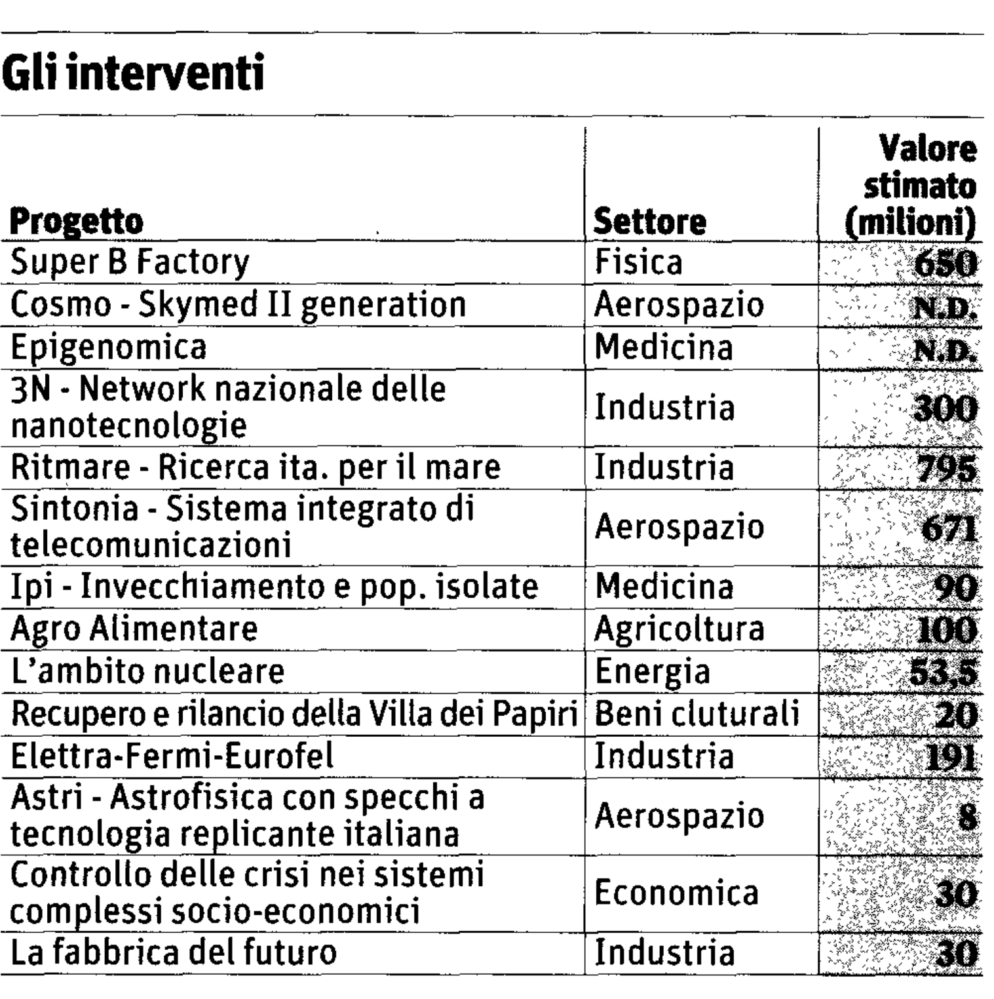
Progetti Bandiera
Flagship Projects

Slide 32
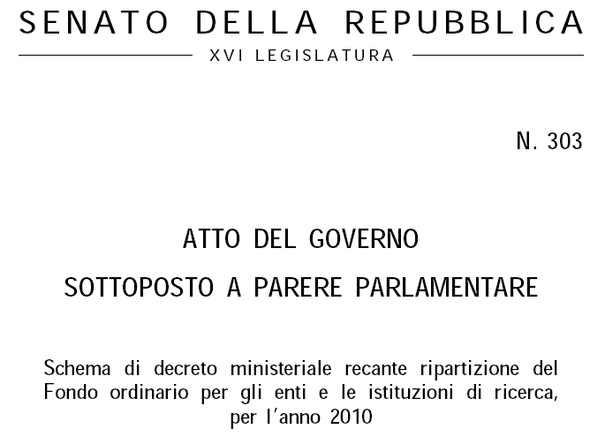

Extracts from official documents of Italian Government and Italian Parliament
Ministerial act sent to parliament on DEC 3 , 2010

Slide 33
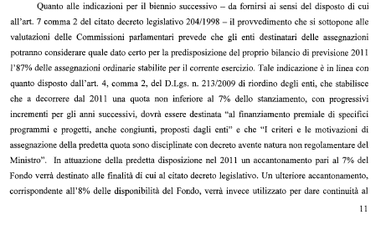

Out of the original 12 Flagship Projects “Progetto Bandiera” as presented by Minister Gelmini at the end of M and reported on the italian media, now only 6 are funded.
The act says that 8% of the Full Budget of the Research agencies will be used from now on to ensure the full funding of the multiyear Progetti Bandiera.
SuperB is the only one quoted as multiyear..
The Minister Act was finally approved by the Senate and Chamber on Dec 14 and 15, 2010

Slide 34
Last week the CIPE (Inter Ministry Committee) has decided the approval of the National Research Plan, containing the funding of SuperB

Slide 35
From now ….. Plan for future
INFN
Choose the site asap! (the preferred site is Tor Vergata close to LNF)
Organize for the completion of TDR
Prepare the transition from TDR Phase to Construction
Start the recruitment for the construction mainly Accelerator Physicists and Engineers
Prepare for spending a reasonable fraction of the initial contribution in 2011

Slide 36
Move forward
Meanwhile progress with IIT (as user of the photon lines) for its co-funding of SuperB.
Prepare to submit to EU set up of SuperB ERIC. A draft of governance is ready and under examination.

Slide 37
Cover Page of the Governance Draft
SuperB ERIC Statute
12 October 2010-Draft
DRAFT
Statute of the European Research Infrastructure Consortium SuperB
(SuperB “N. Cabibbo” ERIC)

Slide 38
Moving to next phase
1st General Meeting
Site decision
Management structure and team for Machine construction
Initiate the collaboration for Detector Construction
Physics document on comparison?
Validation of Machine Footprint by a possible MAC/MiniMAC next July 2011
La Biodola Isola d’Elba
May 28-June 1 + Appendix June 2 and 3

Slide 39
END

