Slide 1
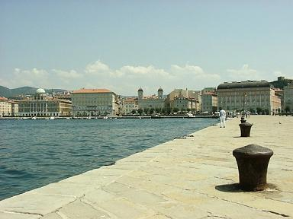


Update on Trieste Activities
Lorenzo Vitale
University & INFN Trieste
on behalf of Trieste SuperB Group
Luciano Bosisio, Pietro Cristaudo, Livio Lanceri, Irina Rashevskaya, Carlo Stella

Slide 2
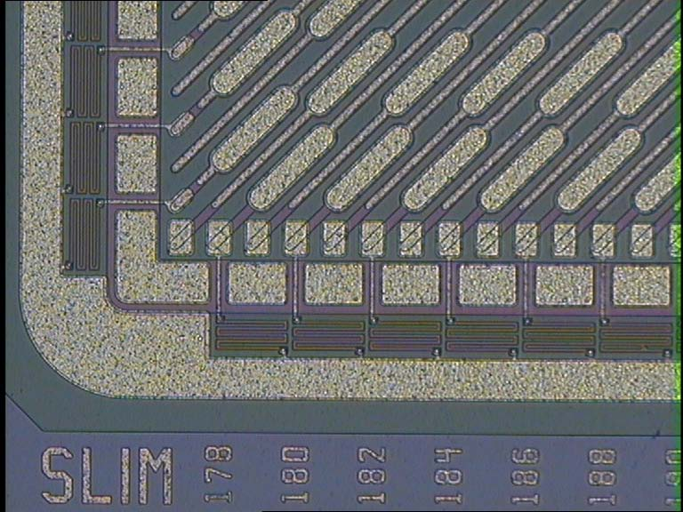
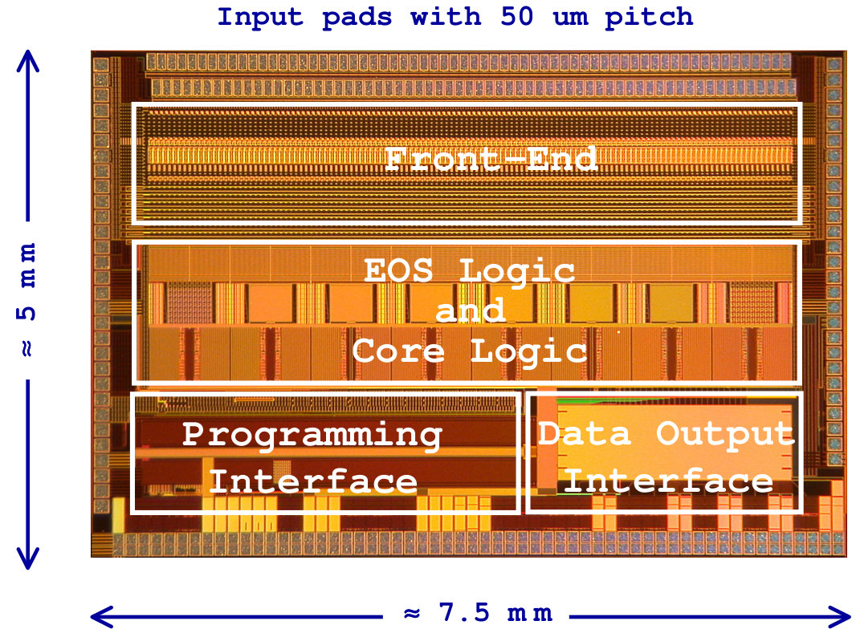
Summary
Group is involved in strip(lets) detectors and in DAQ with FSSR2 (still used for beam tests)
Ongoing activities :
Sensors and Fanout specifications for the TDR
Beam Test in Sept. (Spare telescope modules construction and striplets run)
dE/dx in SVT Studies with Bruno
Irradiation tests

Slide 3
Sensors and Fanout for TDR
L.B. has had a preliminary contact with Hamamatsu, Micron, FBK-irst, Sintef, CiS, (E2V) for the procurement of double sided silicon strip sensors for the 6 layers of SVT. News from our last meeting: it seams feasible to increase the metalization thickness to reduce R_{series}
For the fanouts of layers 1-5 we are considering CERN and also possible alternatives (e.g. two Italian companies TVR and Cistelaier)

Slide 4
Activities
  Measurement of the parameters of the striplets sensor, and possibly an estimate of the radiation effects
  L1-5 Definition of the sensor charateristics (dimentions , strip pitch, bias resistors, …). (Layout → 2012)
  L1-5 Estimate of the modules capacity and series resistance.
  Beam Test …

Slide 5
Spare telescope modules and beam test (Sept. 2011)
We are building other 4 telescope modules with a FSSR2 in order to a have a 3+3 telescope configuration; 5 were already available and used in 2008-2009 beam tests in a 2+2 configuration.
A striplets module was also tested in 2008, and it can be tested again at higher angles and lower thresholds.

Slide 6
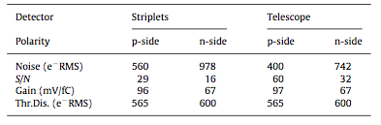
Striplets results in 2008
125ns shaping time.
Expected noise 320e-
for C=4pF Tele (≈Striplets)

Slide 7
Eff./Reso. for the Striplets
ϑ in degrees | p-side Eff within 80μm* (80/cosϑ) | n-side Eff within 80μm (80/cosϑ) | p-side Spatial Resolution | n-side Spatial Resolution
0 | 98.2 | 98.3 | 13.6 | 14.1
5 | 97.2 | 97.9 | 12.9 | 13.2
10 | 97.7 | 97.8 | 11.5 | 12.3
20 | 97.8 | 97.9 | 7.8 | 9.8
30 | 98.0 (98.0) | 98.2 (98.2) | 9.0 | 10.4
45 | 98.0 (98.3) | 96.7 (97.1) | 15.7 | 17.8
60 | 95.5 (98.0) | 90.5 (97.2) | To be defined | To be defined
70 | 78.9 (98.9) | 78.8 (98.7) | To be defined | To be defined
At 45° start
deteriorating
*≈ 5 s.d. of residual distribution

Slide 8
dE/dx in SVT
Carlo Stella (diploma student) is studying dE/dx in the 6 double layers of SVT
Study was driven by FSSR2 (that provides a 3-bit ADC information for each recorded hit)
We started looking at full simulated events BRUNO (with 200 μm cylindrical Layer0)
  e+e-e+e- (pairs) 160k events
  Single particle (momentum distributions as inclusive soft π’s from ϒ(4s) and cc) 50k

Slide 9
dE/dx in full simulated data
“Digitized” dE: the strips have
  Striplets pitch in Layer0 and the BaBar pitch in L1-5
  share released energy: a flash ADC scheme a la FSSR2 with linear and logarithmic thresholds:
We are trying to understand several things:
  What resolution can be achieved with 3 bits
  How FSSR2 thresholds need to be set
  What is the optimal number of adc bits (3-4 bits)
 | 1 | 2 | 3 | 4 | 5 | 6 | 7 | 8
Linear | 0.20 | 0.35 | 0.50 | 0.65 | 0.80 | 0.95 | 1.10 | 1.25
Log | 0.20 | 1.23 | 1.74 | 2.47 | 3.50 | 4.96 | 7.04 | 10

Slide 10
Strip multiplicity e± from pairs after a 1st threshold cut on 20% Mip
L0 +45∘
<n>=5.2
L0 -45∘
<n>=5.3
L1 Z
<n>=3.8
L1 Phi
<n>=7.3
L2 Z
<n>=3.7
L2 Phi
<n>=7.1

Slide 11
Average strip multiplicity for e± from pairs (soft π’s )
Layer | RO PitchZ (or +45∘) μm | <n>_Z | RO PitchPhi (or -45∘) μm | <n>_Phi
0 | 50 | 5.2 (4.1) | 50 | 5.3 (4.0)
1 | 100 | 3.8 (4.2) | 50 | 7.3 (2.8)
2 | 100 | 3.7 (4.1) | 55 | 7.1 (2.6)
3 | 100 | 3.9 (4.0) | 55 | 8.2 (2.5)
4 | 210 | 1.6 (2.0) | 100 | 3.9 (1.9)
5 | 210 | 1.9 (2.1) | 100 | 3.1 (2.4)

Slide 12
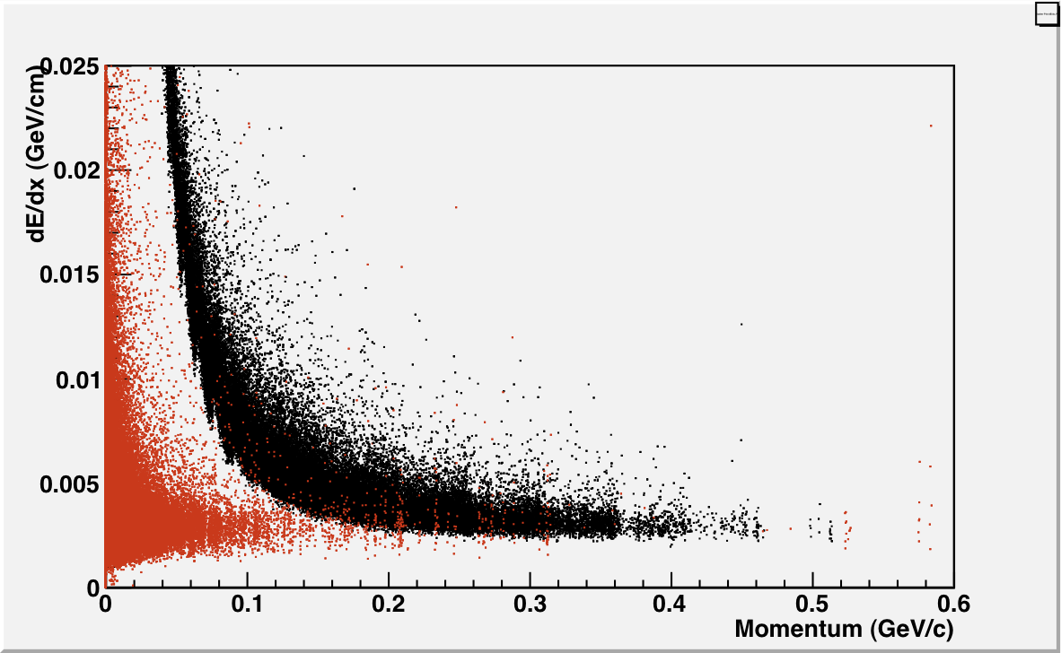
Initial dE/dx info from BRUNO
Inclusive soft π’s
e+e-e+e- (larger sample)

Slide 13
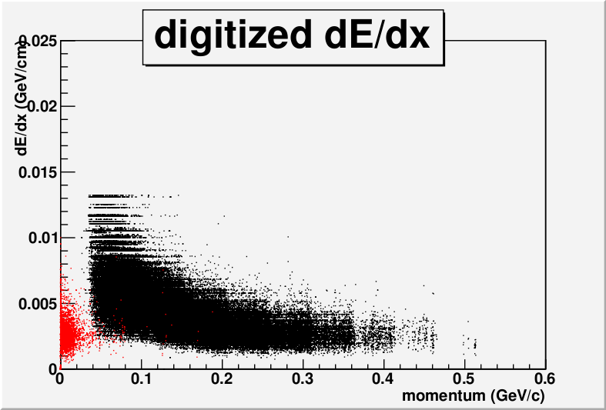
“Digitized” dE/dx for Phi strips
8 linear Thresholds 0.2Mip-1.25Mip

Slide 14
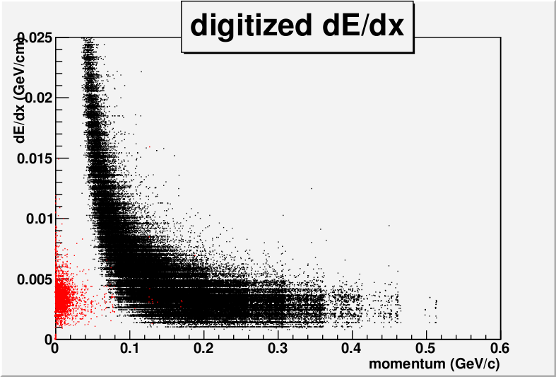
“Digitized” dE/dx Phi strips
8 log Thresholds 0.2Mip-10Mip

Slide 15
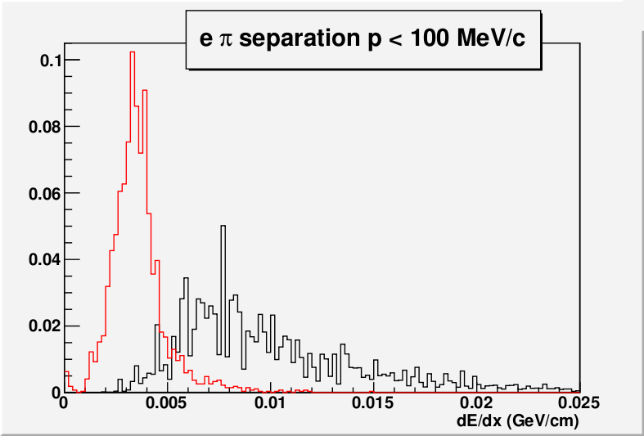
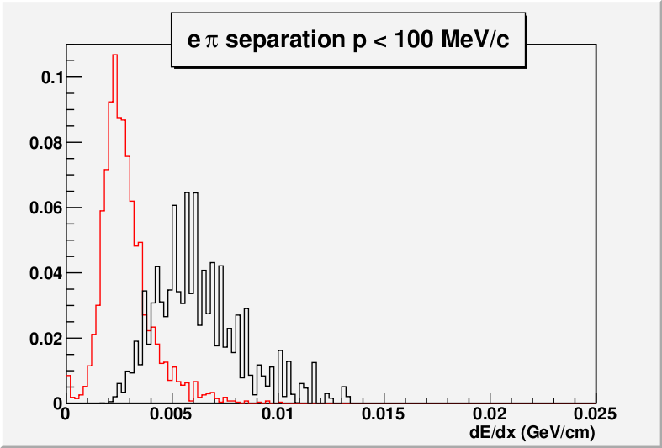
e-π separation after digitized dE/dx

Slide 16
dE/dx in SVT
Landau fits in different momentum intervals are in backup slides
Some technical problems for e± larger sample
For Z strips there is a bias when 1 strip only is fired
For Striplets similar results (but same results for ±45∘)
Need to make more cross checks
No room in this presentation for all details
(Carlo can make a longer presentation in SVT meeting)

Slide 17
Summary dE/dx in SVT
Tools are useful and promising.
Work still in progress:
  Quantify the e-π separation within different options (tracks vs clusters only, 3-4 bits)
  Compute rates and normalizations
  Input welcome

Slide 18
Backup Slides

Slide 19
SuperB SVT
Silicon Sensor Suppliers
Issue separated tenders for Layer 0 and for Layers 1-5
different thickness (and wafer size?)
==> some suppliers could fabricate only one of the two
Mail enquiring for interest sent to:
Micron
Sintef
CiS (Erfurt, D)
Hamamatsu
Time frame for market survey: early 2012

Slide 20
Silicon Sensor Suppliers
Description sent to the potentially interested suppliers:
Preliminary description of the Silicon Microstrip Sensors for the Silicon Vertex Tracker at the Super-B-Factory
Inner Layer (LY0):
- Double Sided Microstrip Sensors
- 200 µm thick
- Size ~ 102 mm X 20 mm (--> does not fit on a 100 mm wafer)
- AC-coupled, with polysilicon resistors (R ~ 1 Mohm)
- 50 µm strip pitch on both sides
- ~ 25 good sensors needed
Outer Layers (LY1-5):
- Double Sided Microstrip Sensors
- 300 µm thick
- 6 different models, differing in size and strip pitch (including one with trapezoidal
shape); they all can fit on a 100 mm wafer
- AC-coupled, with polysilicon resistors (R ~ 5-10 Mohm, depending on model)
- 50-150 µm strip pitch
- ~ 600 good sensors needed

Slide 21
Answers received so far
Micron
  Very much interested, can make both types
CiS
  LY1-5 OK, for LY0 maybe in one year
Hamamatsu
  Answer received from Japan headquarters:
    They work on 150 mm wafers only
    Minimum thickness 320 µm (acceptable for LY1-5 ?)
Sintef
  Responsible person was absent; I will meet him this week in Trento
  From their published realizations, I think they can make both types; we must see if they are interested

Slide 22
What about FBK-irst?
They have the technical capability for LY 1-5
They are not in a position to supply LY0 sensors
  200 µm 2-sided processing OK
  BUT
  Wafer size presently limited to 100 mm
  Fab line upgrade to 150 mm under discussion, but not feasible soon enough to participate in this supply
I will be in Trento this week, will talk to them

Slide 23
A second possible supplier in UK?
Mail from A. Bevan: E2V (http://www.e2v.com), known for CCDs and CMOS image sensors, could be interested in supplying strip detectors (??).
He will investigate….
The step does not look a simple one: strip detectors (not to mention double-sided ones) have different processing requirements from CCDs and CMOS image sensors…

Slide 24
Some Final Fanout parameters from BaBar
Biblio: TDR, BaBar Notes 376 (Fanout specs), 307 (Assembly), 312 (Final Geom), 273 (Numbering Conventions), 306, 392, BaBar detector.
50 μm thick Upilex substrate
4.5 μm Cu layer deposited on 150 nm layer of adhesive Cr
<1 μm Au layer on another 150 nm layer of Cr
Average rad. length 0.03%X₀
R=1.6 Ω/cm R_{IS}>2MΩ
C_{IS}=0.52pF/cm

Slide 25
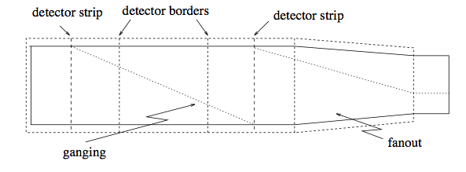
Some Fanout parameters from BaBar (cont.)
28 different designs to accommodate all layer specs: 01 02 03 4A 4B 5A 5B; Forw Backw; Z Phi.
Total 208 fanouts for the 6 6 6 16 18 modules
Minimum pitch 41 μm (on wafer type VI Wedge)
Line width depends on strip pitch, 30(70) μm on 100(210) μm strip pitch, reducing to 20 μm on electronics side (min. 8 μm)
2x Ganging on Layers Z 4 & 5 (from 55% to 98.9 %)

Slide 26
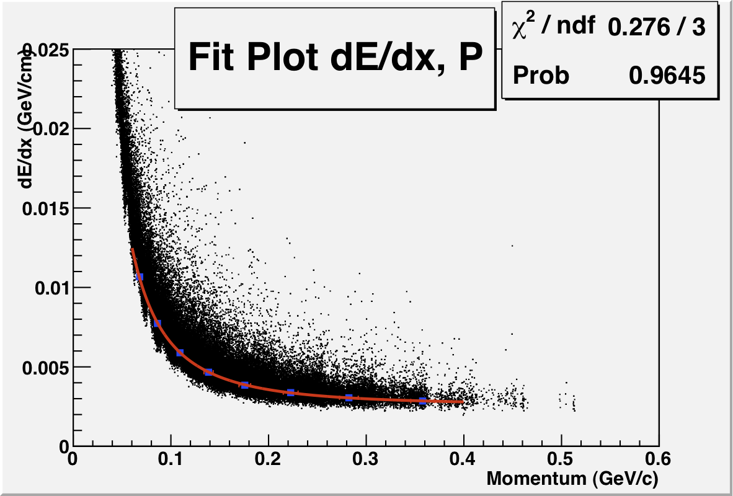
Fit of initial dE/dx info for π

Slide 27
dE/dx π in 8 p slices (60-400MeV/c)

Slide 28
“Digitized” dE/dx for Phi strips
8 linear Thresholds 0.2Mip-1.25Mip

Slide 29
“Digitized” dE/dx Phi strips
8 log. Thr 0.2Mip-10Mip

