Slide 1
Update on the Bus, the HDI and peripheral electronics
SuperB Workshop: SVT Meeting
M. Citterio
on behalf of INFN Milano and University of Milan

Slide 2
Index
3-Chip Bus Design Status
  Summary of the modifications suggested by CERN
    Description of the changes
    Layout and simulation results
  BUS construction phases
    Goals to be achieved in 2-nd production
HDI Status
  Thick Film Babar HDI: lesson learned
  Next steps

Slide 3
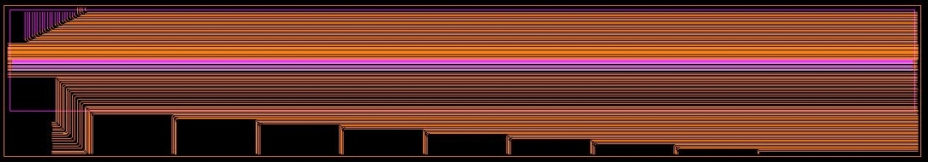
1-st prototypes results
Pixel Bus Prototype measurements:
Thermal test on the BUS did not show problems up to 85-90 Centigrade (repetitive cycles)
A typical impedance of ~ 60 Ohm confirmed (extraction of info from “real layout” was important)
→ Crosstalk higher than simulated ~ 5 % (agreement better than before, but understanding of layout, did not resolve completely the issue !!)
→ Measurements performed on various samples with same results
  frequency response:
    signal transferrred with no “digital errors” up to 200 MHz, on individual lines (pattern ex. 0000100)
    if a random digital pattern is sent through 8 adjacent lines, than max frequency decreases at ~ 160 MHz (line lenght ~ 10 cm)
    driver and receiver are implemented into FPGA

Slide 4
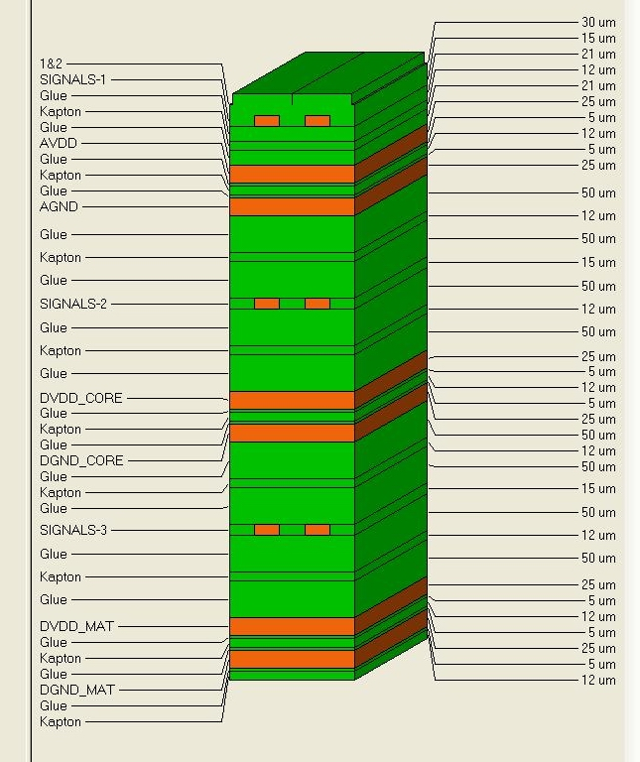
February 2011 Status
Pixel Bus second generation:
Layout details agreed
Production: it could have started week 7
→ Evaluation of process → made on first “sandwich” (mid March) to verify process parameters
→ Production conclusion estimate → 8-10 week later
Cern suggestions:
  Review the signal layers: concern about 15 um Al layer and 75 um lines
  Cern will prefer a BUS with decreased thickness
  Cern suggested to adopt Cu (3 um thick, 50 um wide)
  We could have two signal layers
  Two CHIP lines will be shared on a same layer
  Simulation are indicating small attenuation BUT larger crosstalk even if we are using only STRIPLINES

Slide 5
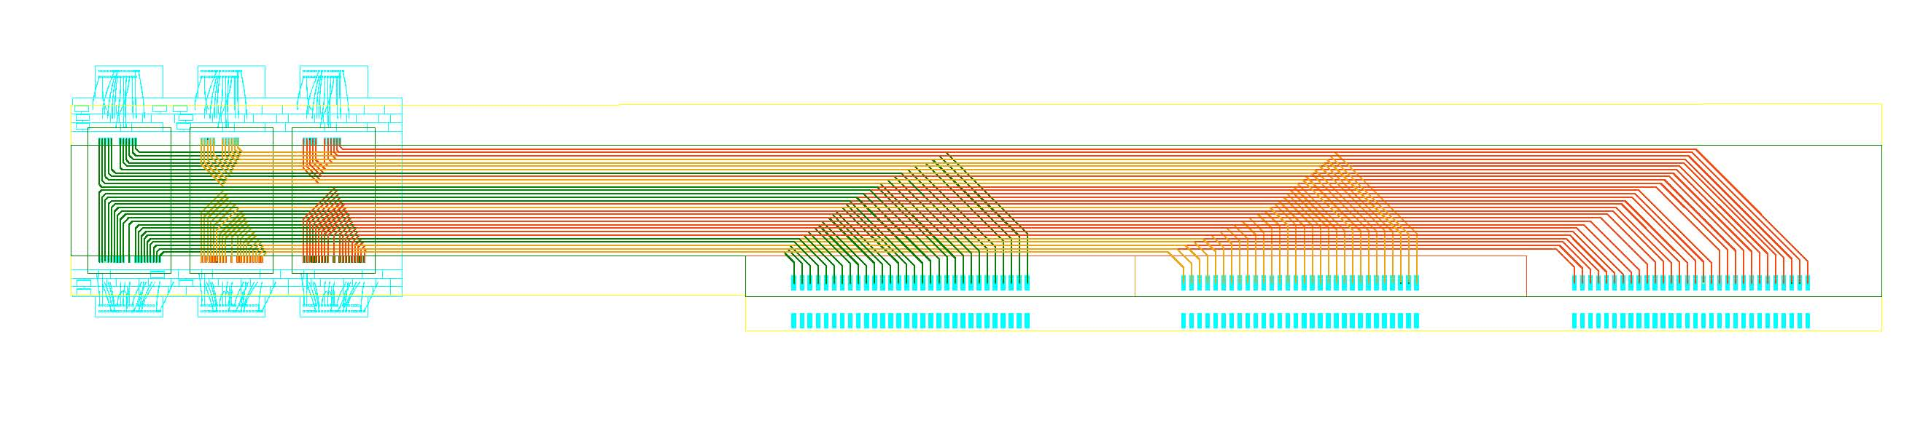
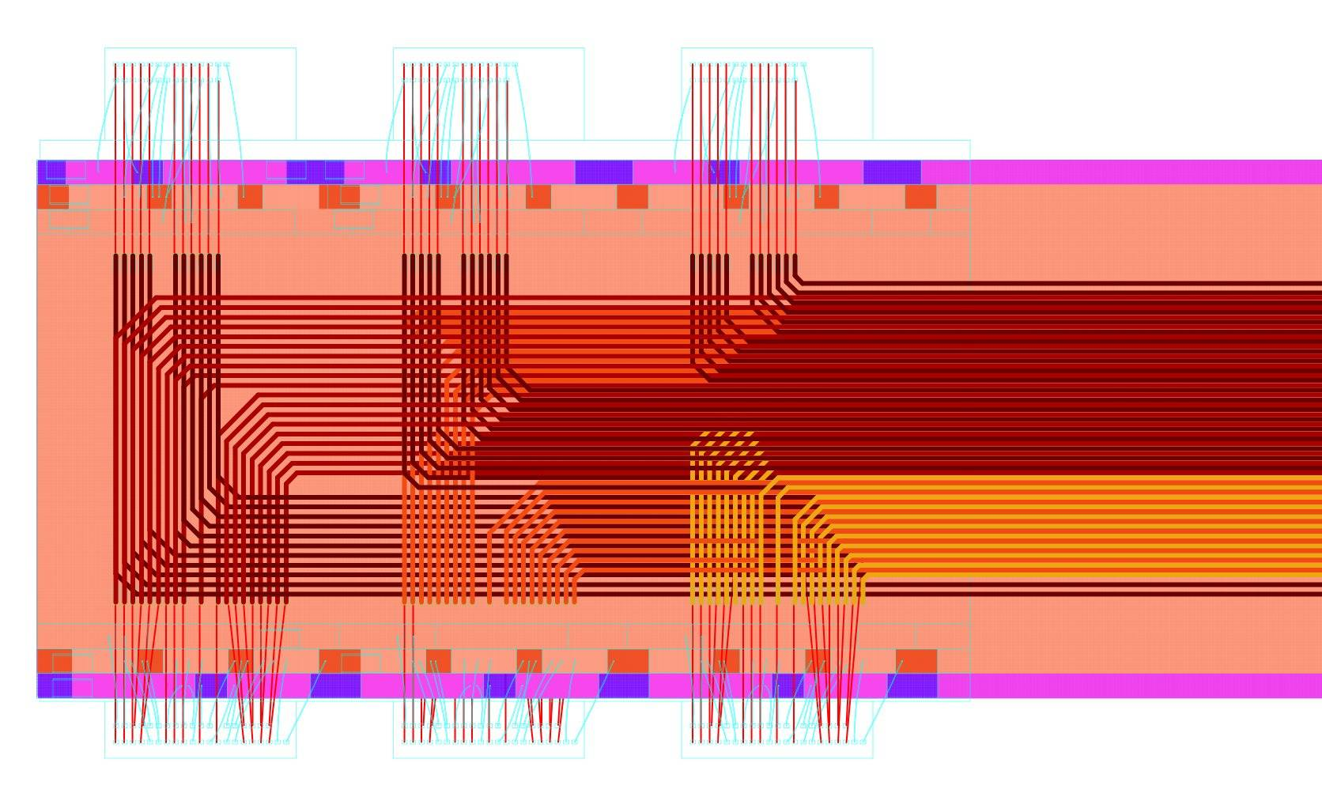
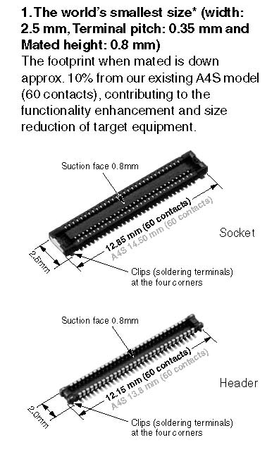
Signal layers before optimization
Panasonics high density connectors
Layers were properly stacked … cut-outs per each layer were optimized to preserve “bonding topology”
5

Slide 6
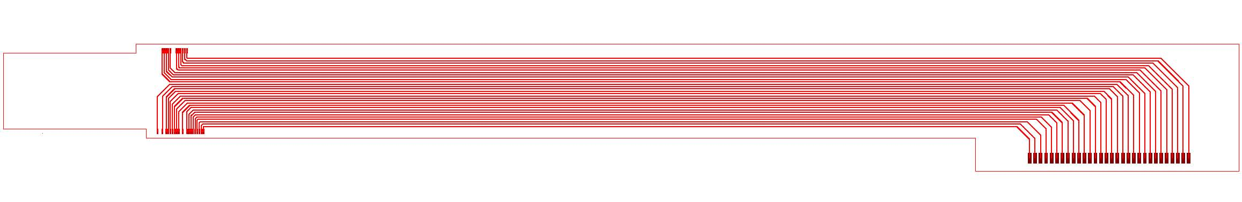
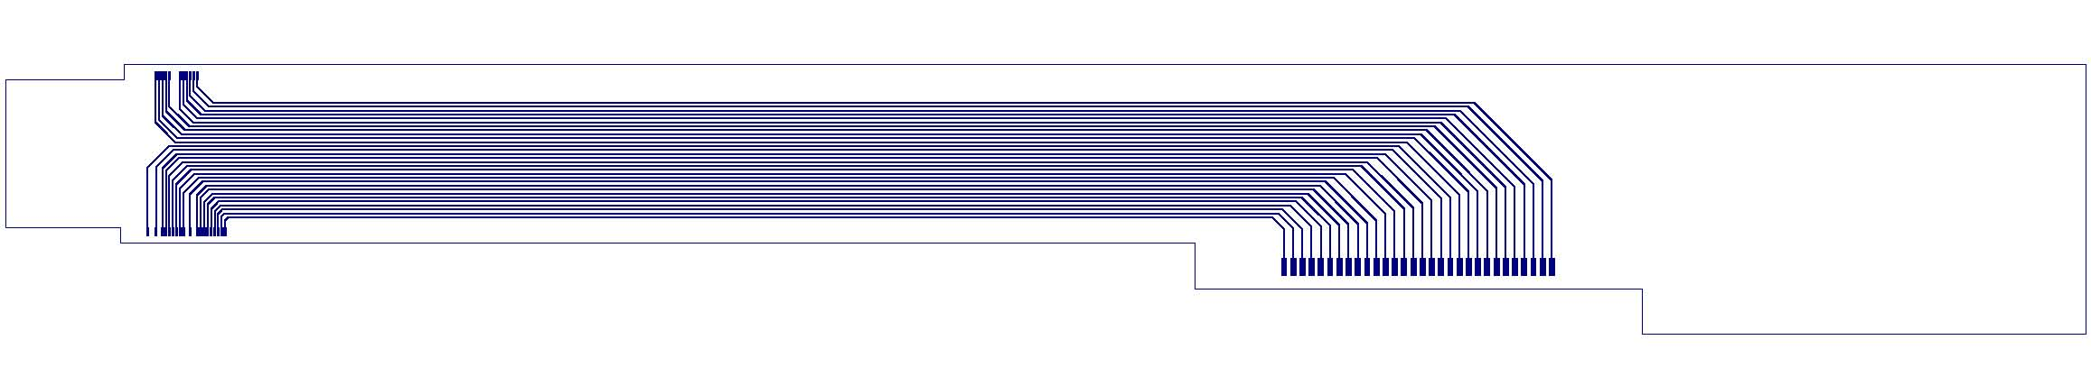
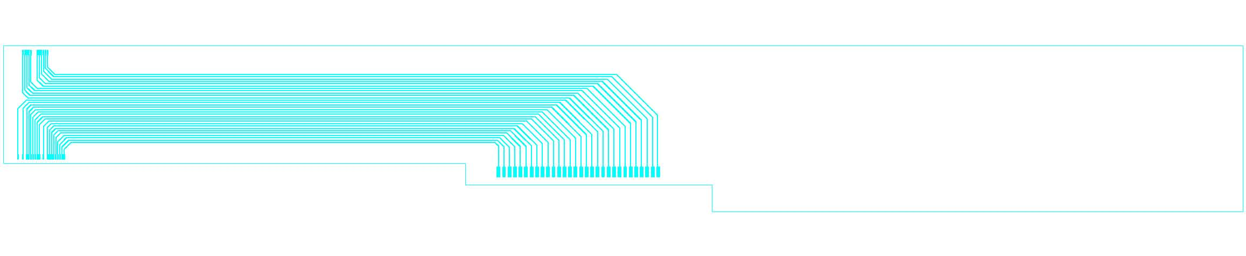
Layers for the 3-chip assembly
Top Layer : microstrip
Inner Layer 1: stripline
Inner Layer 2: stripline
Panasonics high density connectors
6

Slide 7
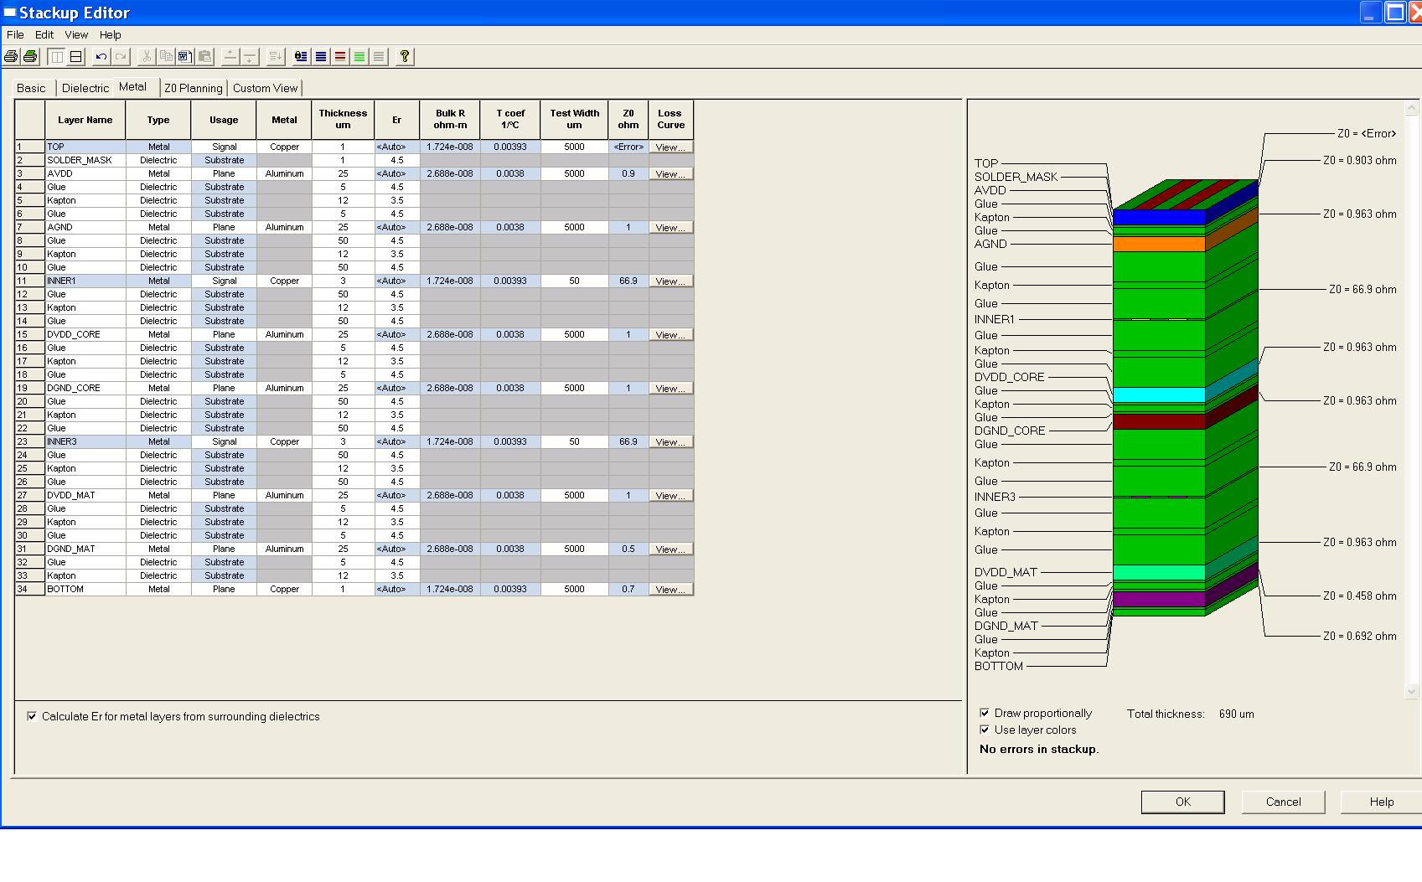
2 Signal Layer BUS
No real layers inserted only for simulation
Z ~ 70 Ohm

Slide 8
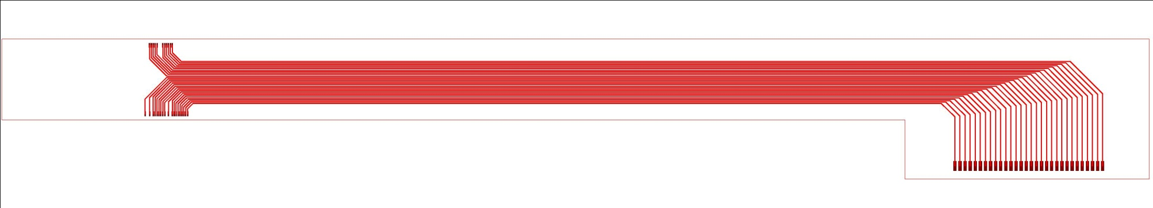
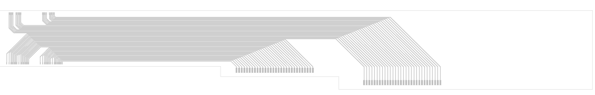

Signal/Power NEW layout
Two IC signals will share the same plane
Simplified plane-cuts
Panasonics high density connectors

Slide 9
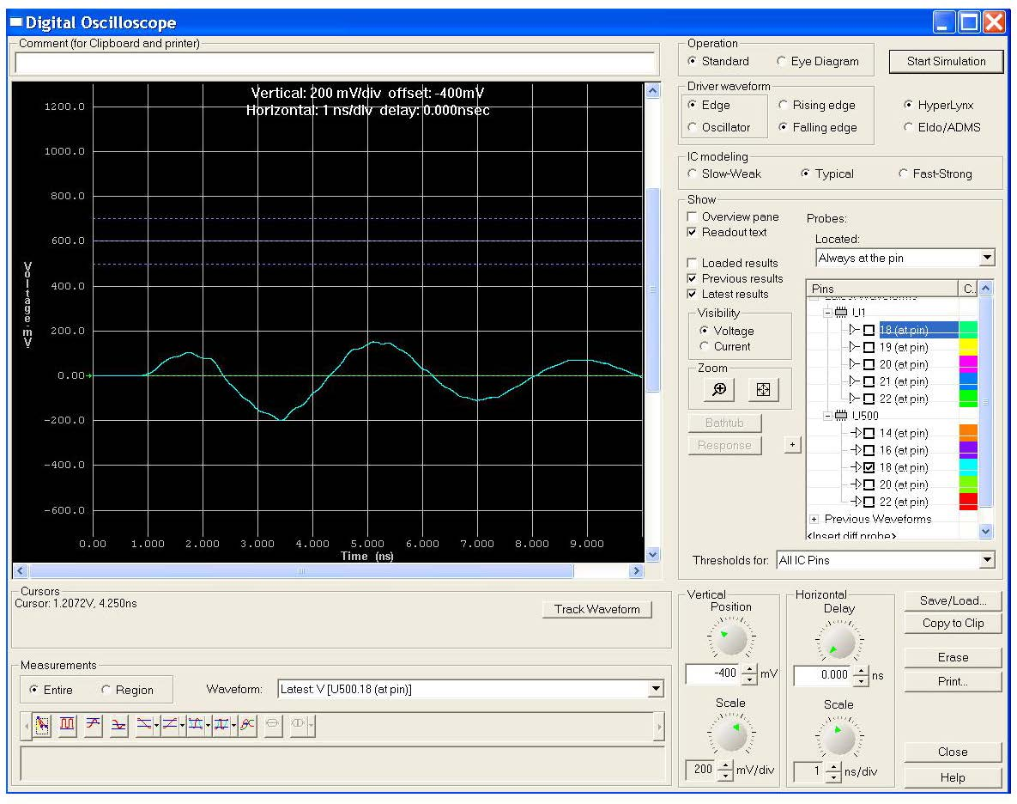
Crosstalk issues
Simulation performed
on a 1101 pattern (three aggressors and one victim, the “0” line)
The results refer to the longest stripline
Goal was to keep the crosstalk signal below +/- 200 mV
The maximum frequency is ~ 130 MHz
There is no optimal termination at the receiving end.
Driver and receiver are implemented using the IBIS models provided by Xilinx
BUS bandwidth is decreased by ~ 15 %
It is the worst case ?

Slide 10
Next Steps …..
  Ready to delivery the 2-layer layout to CERN
  The latest layout is following CERN guidelines
    Some information exchange during layout finalization
    No negative feedback received so far
  Verification of properties to be done during production on the bottom signal layer (Stripline)
  If measurement not satisfactory → Stop of the production
  Goal is to have bus back my end of June
  Bus production will give us info on the detector fanout, too

Slide 11
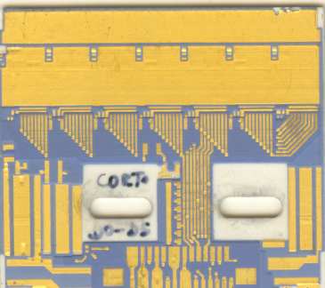
Babar HDI … lesson learned
The HDI must allow all the functionalities of the readout chips:
Analog and digital powers. Three different power supplies, +5V (AVDD)
and +2V (AVDD2) analog and +5V (DVDD) digital.
2. Two different current return, one for the digital current (DGND) and
one for the analog current (AGND)
3. Each power line must be locally filtered
4. Two redundant sets of differential clock and command lines must be
bussed to all the chips and terminated so as to match with the characteristic
impedance of the tail
5. Redundant differential data lines must be connected to the first and
last chips on each side of the HDI.
6. The detector bias voltage (VDET) must be capacitively coupled to the
AVDD2 line (representing the analog reference voltage of the readout
IC front-end)
7. The two readout section (phi and z) of the HDI must be capacitively
coupled.
8. Each HDI must host and provide connections to one resistive temperature
monitor.
9. Each HDI must provide connections for remote sensing lines for alI the
three IC voltages.
30 pins BERG high
density connector to kapton tail (power and signals)

Slide 12
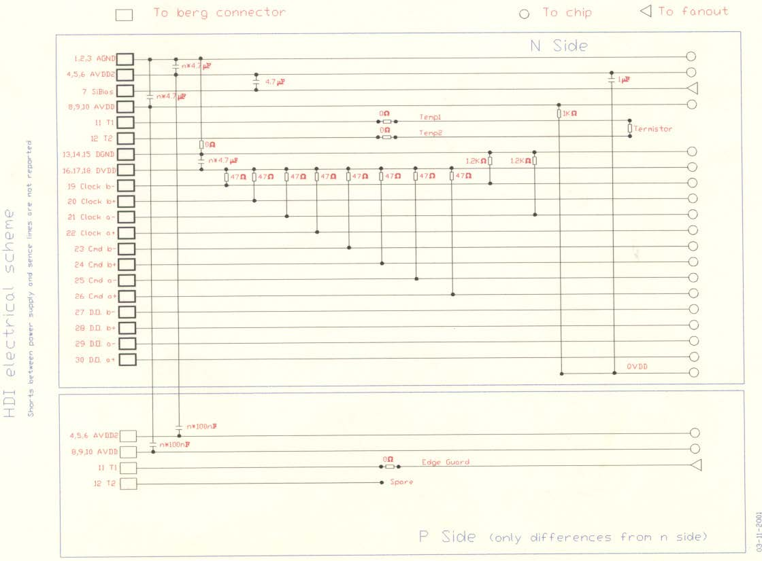
Thick Film Hybrid
The hybrid is realized with a single piece of AlN
Detector fan-out are soldered on the hybrid edge
and chips inputs are wire bonded to the fan-out.
Four or more layers (depending on the
specific electric layout) on each side will allow electrical connections between the detector and chips from one side and the chips and the transition cards and power supplies on the other side.
Each layer has a thickness of 65 um
(15 um conductor and 50 um dielectric)
Traces are 15 um thick, 250 um wide
Traces pitch is 400 um and pads dimensions
are 250 x 400 um'2.
Minimum distance between two vias is 400 um

Slide 13
Screen printing process
Conductive and vias masks are realized from the design of the conductive
layers and vias . Dielectric masks are deduced from via masks.
The conductive layer is 10 um thick.
For a good isolation of two conductive layers the dielectric layer must have a minimum thickness of 45-50 um.
This is realized with three different dielectric depositions ( printing
and thermal process ) and two via filling:
• Deposition of a conductive layer ( 10 um thick)
• First dielectric deposition ( 15 um thick)
• First via filling
• Second dielectric deposition ( 15 um thick)
• Last dielectric deposition ( 15 um thick)
• Second via filling
• Deposition of another conductive layer

Slide 14
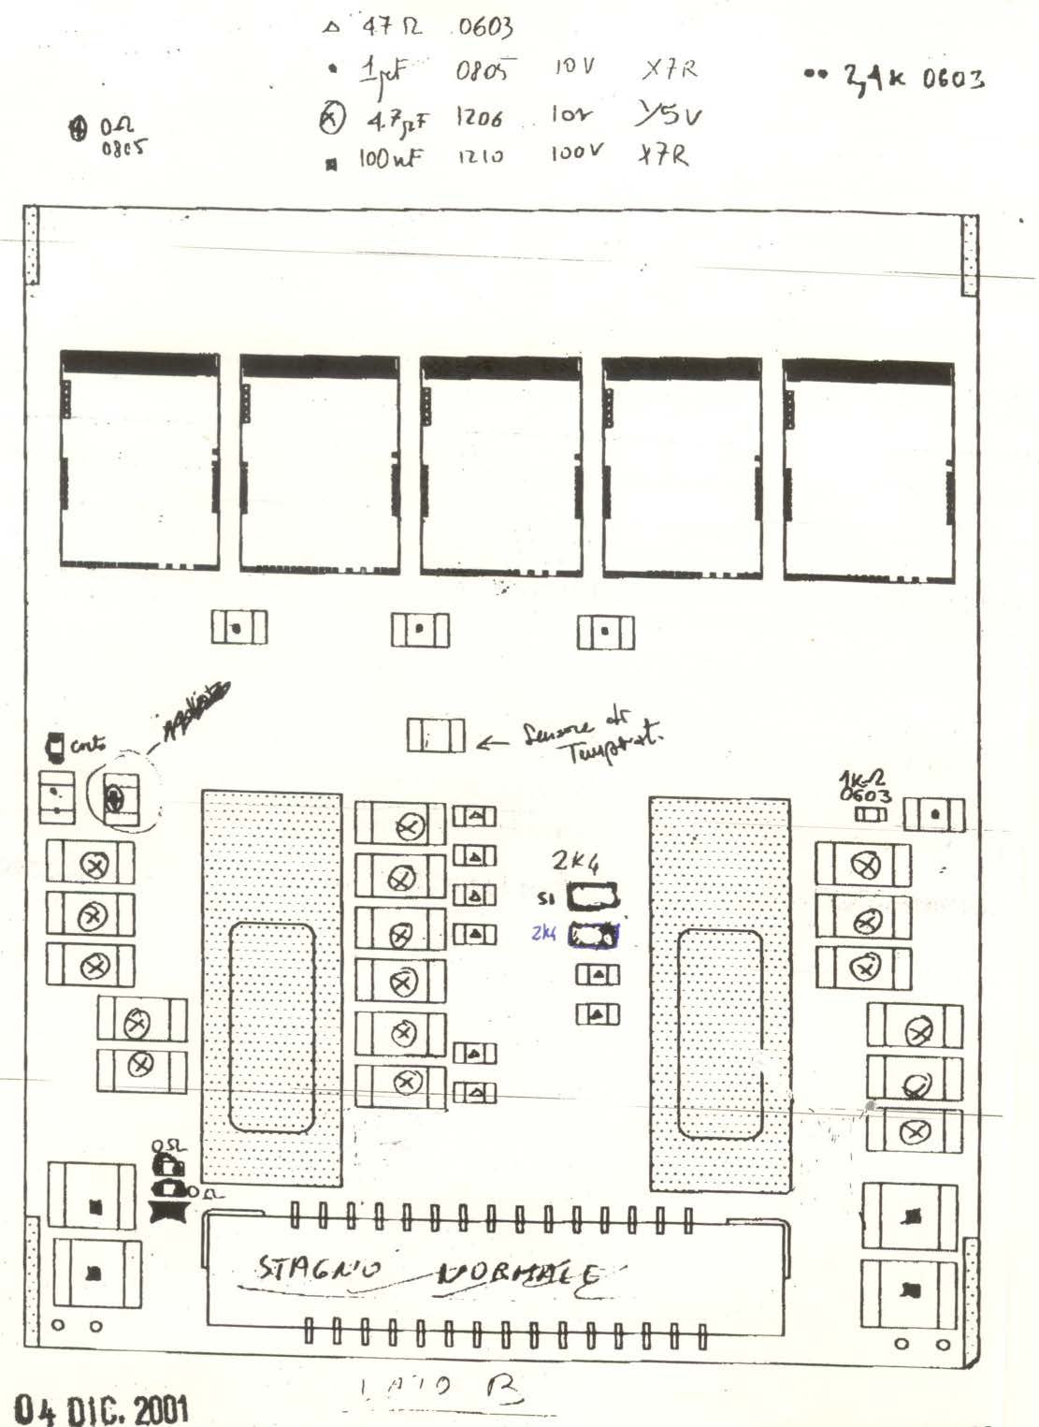
Component placing
Passive components (capacitor and resistors)
Criteria:
Separation of components conneted to the analogue and digital part:
most of the components “linked “ to the analogue part are mostly placed close to the border of the HDI.
the other components are placed in between the mechanical supports
Moreover the conductive layers (C1 to 5)
Layer C1 : clock and control lines (few lines)
Layer C2: contains all components. Most lines are for soldering components. Power sense lines are on this layer
Layer C3, C4 and C5: mostly contain the power planes

Slide 15
New HDI layout
The New HDI needs to accomodate not only the FE Ics, the passive components but also some ”additional” rad-hard ICs (data organizer, buffers, and serializer)
.... Unfortunately we still have only a cartoon ...
Questions have been formulated: assuming 150 KHz LV1 trigger (6.7 us) → 6 lines/chip in L0 assuming 100 MHz clock!
How many lines is reasonable to assume for a realistic HDI design?
  6 chips/HDI, small HDI (see Bosi design)
  Differential lines?

Slide 16
Progress is slow
  Mainly focused on designing ASIC building blocks
    to learn technology → Silicon on Sapphire, same technology used in the DALLAS 16:1 Serializer (LOC chip)
    simple builiding blocks on which we would like to start implementing radiation hardening by design
  Goal: ~ 20 um Buffer, data transfer can bew reduced to ~ 2 Gbps
    Existing LOC2 could not operate error free to reduced data transfer → collaboration with SMU Dallas fo a slow and ”low power” version of the serializer
    Implement a redundandancy scheme in the next generation LOC
    Evaluation of other serializers: intensified contacts with the CERN GBT project ... Any suggestion is welcome !

Slide 17
Peripheral Electronics
No activities on the designing side.
We have acquired some components
micro power cables, we have started a discussion with an industrial partner for siltem isolated quad twist multi strands AWG32 wires.
→ concern is how to connect thin wires to the HDI and transition card (we had similar problems with tail termination)
we are expecting the ”custom” set up we ordered to an outside firm.
→ the set up will not be ready before summer
Short term plans:
- initiate preliminary layout of the transition card and of the tail
- start to look at the fanout (multilayer design) as soon we have BUS samples

