Slide 1
Electronics Trigger and DAQ CERN meeting summary.

Slide 2
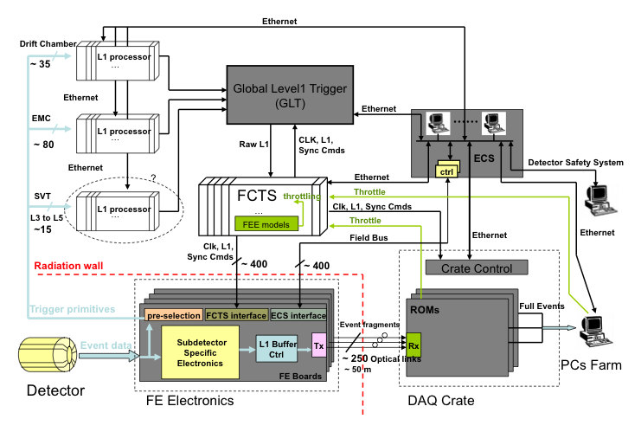
Architecture
Synchronous, Pipelined, Fixed-Latency

Slide 3
Optical Link
Studies of the optical data links to be used for commands and clock distribution are well advanced. It has been demonstrated that these links can be built using serializer/deserializers, which provide deterministic link latency.
Preliminary results concerning irradiation effects are very encouraging. Ser/des needs to be further qualified. Data link properties are still under studies as well.

Slide 4
Trigger
The requirement of having the dead time at 1% level at 150 kHz trigger rate implies a minimum command spacing of about 70ns.
The sampling rate of the detectors used for triggering is 7 MHz, with a corresponding sampling period of 140 ns.
Interpolation needed.
It would significantly help to bring down the L1 accept rate, especially in view of the potential increase in luminosity.
Bhabha scattering 50 kHz;
Machine related background 25 kHz;
Physics and background 25 kHz.
We have foreseen a 50 % contingency here.
Detector readout windows as small as 100 ns (to be verified) will be used by some sub-detectors (SVT, PID, IFR). It sets a limit on the maximum trigger timing resolution to be better than 50 ns (SVT). Wider sub-detector readout windows may be needed in case to cope with the best achievable trigger timing resolution.
L1 processing clock will be set to 56MHz.
Evaluate what's achievable as L1 time precision. Define what are the maximum affordable sub-detector readout window sizes. How to reduce machine backgrounds and backgrounds from Bhabha scattering?

Slide 5
FEE
We estimated the number of optical data links connecting the FEE to the ROM amounts to 325.
data links operate at 1.8 Gb/s rate.
The event size at the FEE stage is estimated to be of the order of 500 kB (to be checked).
To be studied: optical link occupancies (%), de-randomizer and transmission output stage, throttling mechanisms.

Slide 6
ROM
Two solutions are foreseen to implement the required ROM functionalities: FPGA/GBit-NIC and PC/CPU based ones.
ROMs based on custom electronics (FPGA/GBit-NIC) would simply act as a bridge/interface between the FEE and the HLT farm, just performing event formatting with minimal data handling.
The overall data flux of 500 kB * 150 kHz is assumed to not be an issue for a core network switch connecting the ROMs to the HLT farm; data handling would be postponed to the HLT farm (about the HLT single event processing time see below).
PC/CPU implementation requires each PC to be equipped with an optical/PCIe bus interface to get data stored in the PC RAM.
This approach provides max flexibility in both FE data processing and transmission.

Slide 7
FCTS and ECS
The FCTS architecture is well understood. Clock and commands are distributed throughout the detector components using pluggable FCTS receiver modules.
ROM requires FTCS mezzanine boards to get packets destination addresses and complete event information field.
ECS configuration and control of the FE boards is performed by means of SPECS boards and the available protocols at 10 MB/s.
Far from the detector ECS can be provided with Ethernet connections.

Slide 8
Event Builder
Static, round robin, push mechanism relying on unreliable protocol (UDP) is the easiest to be implemented. For such a scheme, DCB/Converged Ethernet could provide a reliable layer 2 transport, effectively turning UDP in a reliable on-the wire protocol.
Alternative protocols could include RDMA over a reliable layer 2 transport (such as DCB/Converged Ethernet).
Slow feedback mechanisms of the PC farm to the system can go through ECS. Do we need FCTS feedbacks instead?

Slide 9
HLT
HLT processing time of the order of 10 ms/event at 150 kHz can be managed by means of 1500 CPU cores, which corresponds to order of 100 boxes.
The HLT farm shall be rather small therefore.
We know that 1÷ 2 ms on 2.2GHZ AMD Opteron (~2006) was the measured latency of the BaBar L3 algorithm in average.6

