Slide 1
Forward PID
DIRC like TOF detector

Slide 2
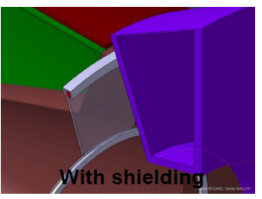
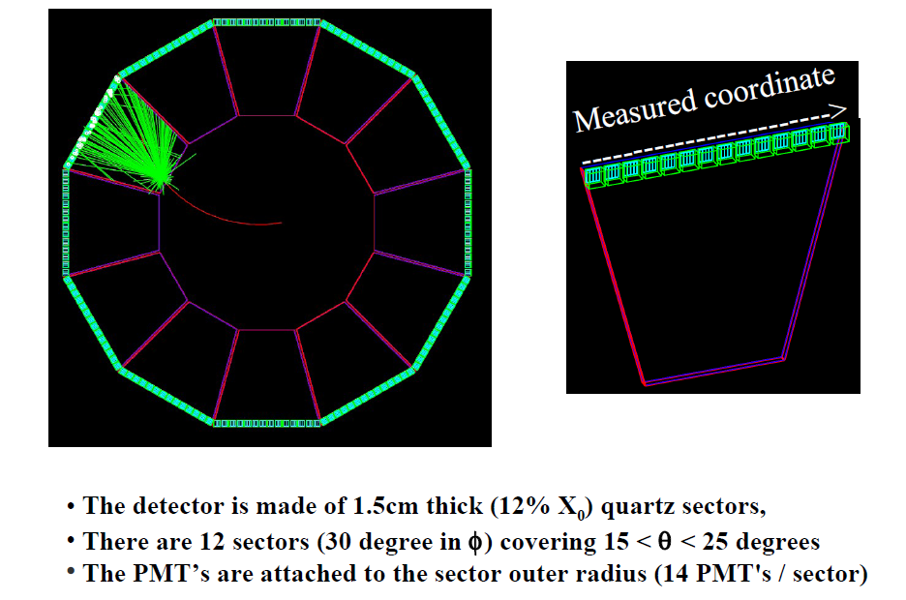
SuperB setup for FTOF
Close to the DCH and with 12 sector granularity

Slide 6
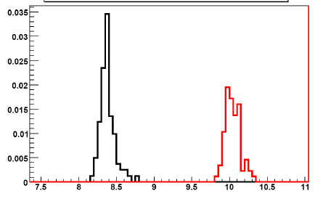
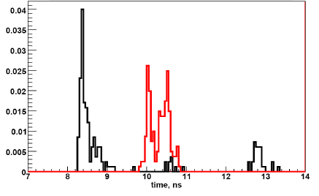

Slide 7
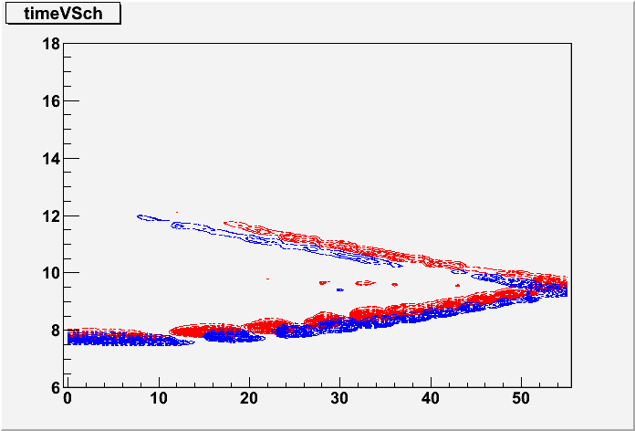
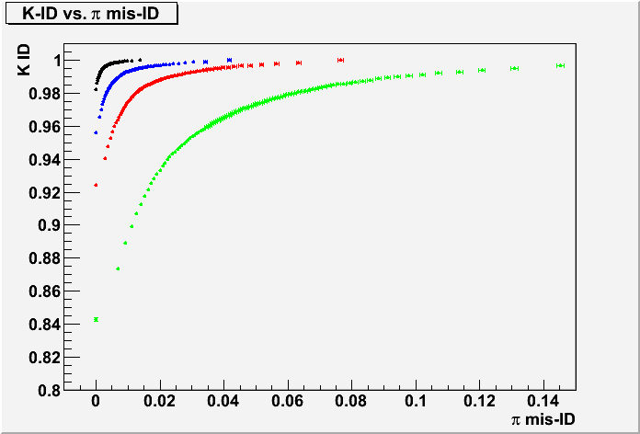
Could we work with complicated configurations in presence of background ?
Arrival time vs. channel number
Preliminary answer
Zone in which the bkg photons
are randomly generated
p = 2 GeV/c
θ = 20 degrees
φ = 0 degrees
Kaon map, 10 photons/track
Pion map, 13 photons/track
Preliminary studies (Annecy) shown that
we expect ~1 event of background in FPID
Number of bkg photons
• 0
• 5
• 10
• 20
It seems that the PID starts to
really suffer if background is ~20events
In terms of k/π separation
* 0 bkg -> 5.4 * 5 bkg -> 4.8 * 10 bkg -> 4.3 * 20 bkg -> 3.6

Slide 8
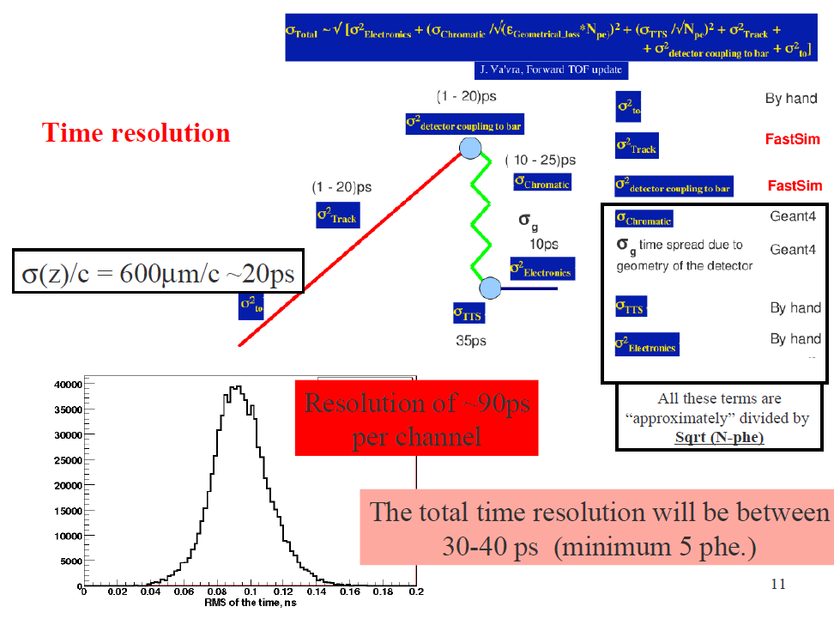
+
+
O σ_{T0} O σ_{Track} O σ_{dcb}
+
This term should be divided
approximately by sqrt(Nphe)
σ(det) ~ 50 ps
10ps

Slide 9
Test at the SLAC Telescope
Prototype of the DIRC-like TOF detector
Proof of principle
We want to the test the system : detector + PMs + electronics
We want to extract the overall single photoelectron time resolution
Of course in this case the σ(det) will be different than in the SuperB
detector and depends on the geometry of the experiment

Slide 14
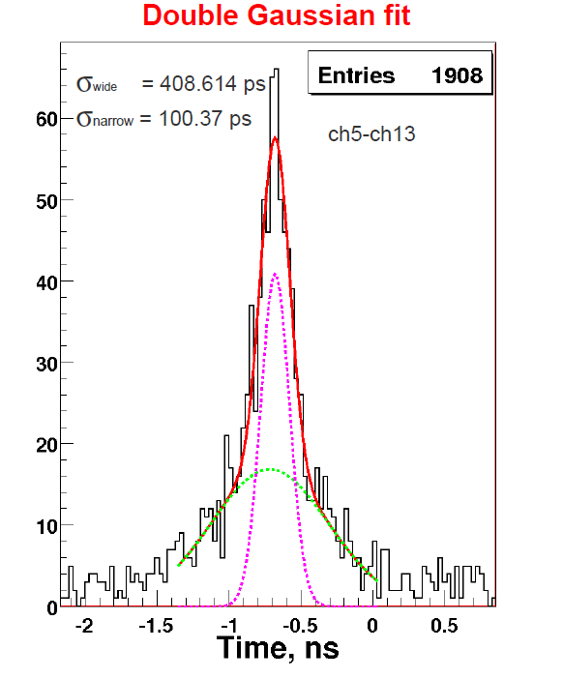
Time resolution considering all muons entering into the detector
Example for time difference
expected In the simulation
between two channels
408 ps
100 ps
The resolution is
100/sqrt(2) ps ~ 75 ps
The expected resolution is
rather the same when you look
at different couple of channels
The expected resolution is
not changing significantly
when considering muons in
a given portion of the detector

Slide 15
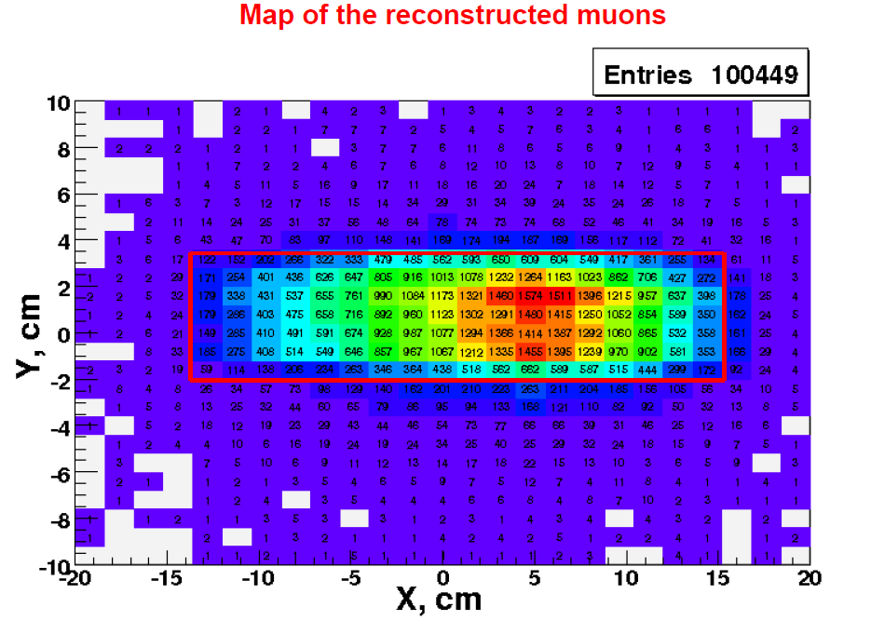
Look at DATA

Slide 16
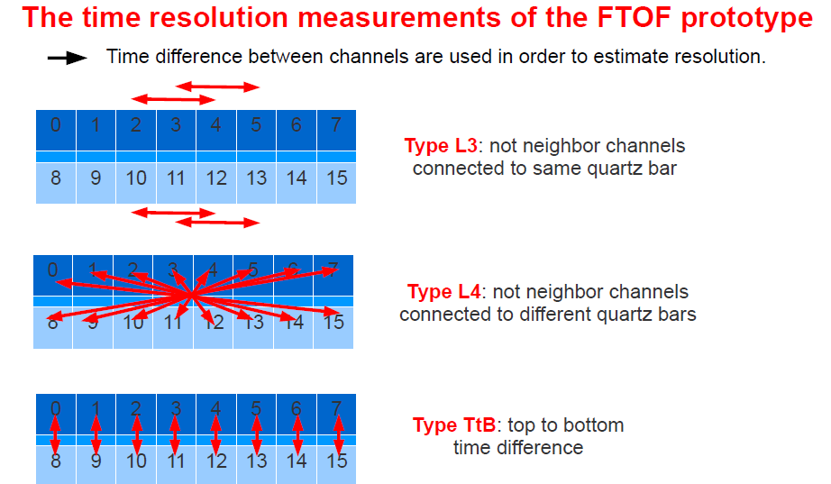

Slide 17
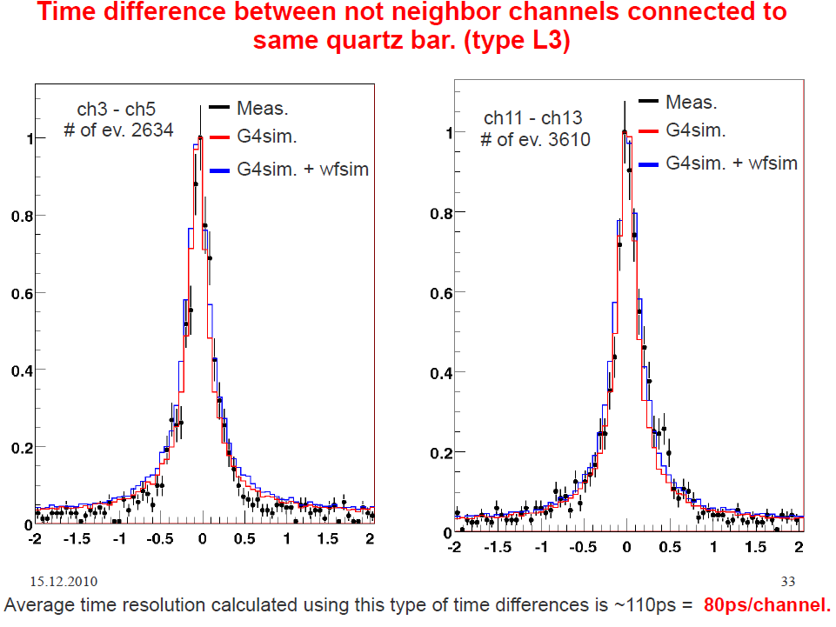

Slide 18
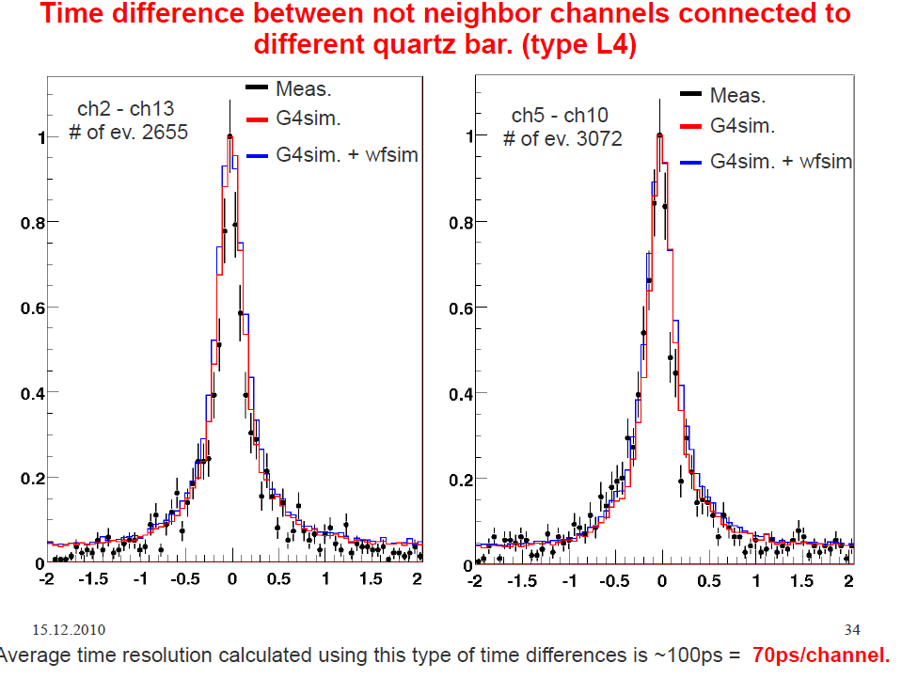

Slide 19
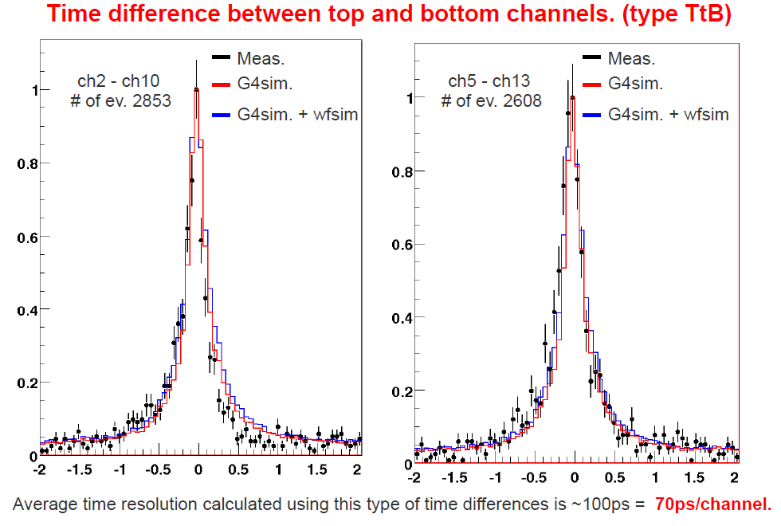

Slide 20
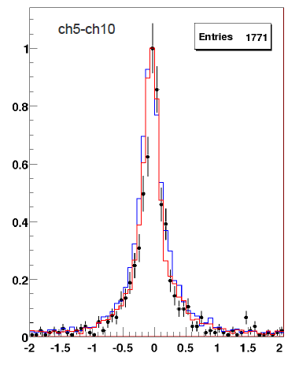
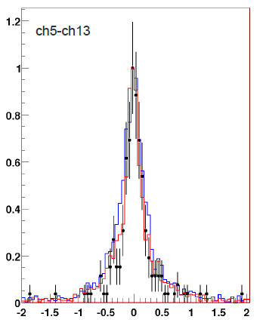
No Kinematical cuts
With some Kinematical cuts
Fraction of first
photoelectron
increased
Similar resolution
but tails reduced

Slide 21
Conclusions
We have a SuperB TOF set up which guarantee a
time resolution of about 30-40ps
→ All the solid angle of SuperB will be covered with the same PID quality as with DIRC
SuperB
The background seems not to spoil the PID using TOF technique (work in progress)
Proof of principle
This technology (detector + PM + electronic) has been tested in the SLAC CRT
convincing results from DATA in
agreement with simulation.
Total time resolution/photoelectron :
CRT-TESTS
~75ps

