Slide 1
SuperB EMC TB:
Time Resolution
06/04/2011
Stefano Germani & Matteo Cardinali
Università di Perugia
INFN Sez. Perugia

Slide 2
Summary
Development of an algorithm to measure TIME RESOLUTION from EMC data
Test the capability of the system, using Cern Teast Beam data
Data Analysis
Outlooks
Conclusions
2

Slide 3
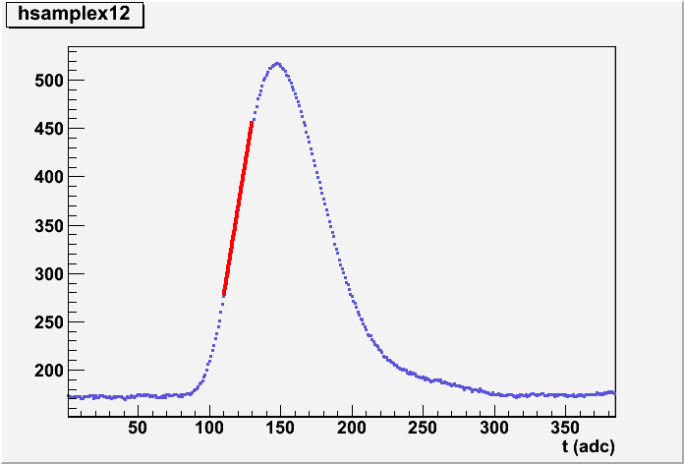
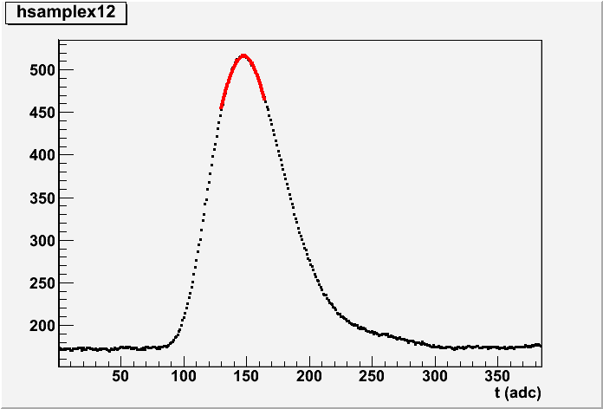
Arrival time of the signal
Linear Fit
Peak Fit
Linear Fit: time from the extrapolation to the baseline using a linear fit (pol 1)
Peak Fit: time from the mean value of signal gaussian fit
Time measure
3

Slide 4
Relative Time
Needs of a reference time t₀ :
external clock
time of one of the 25 crystal
Delta_t
t_{XX}
t₀(=t₁₂)
Drawing histograms of time difference Delta_t = t_{XX}-t₀ (with data from one or a lot of
runs) we should find a gaussian distribution where time resolution is
4

Slide 5
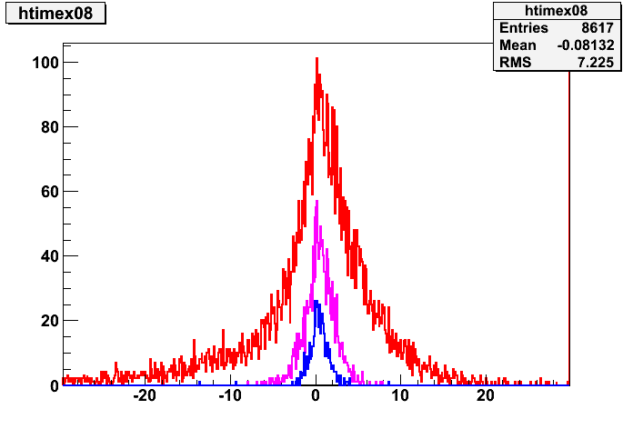
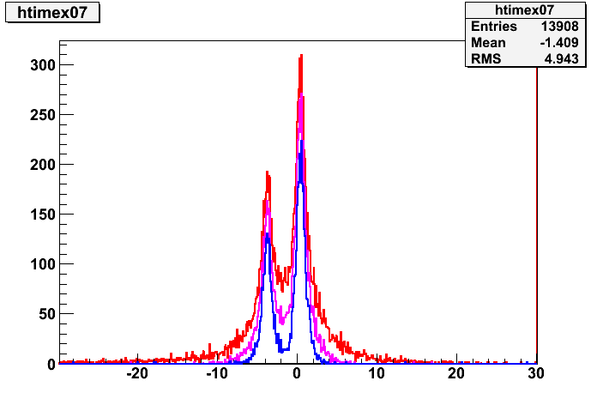
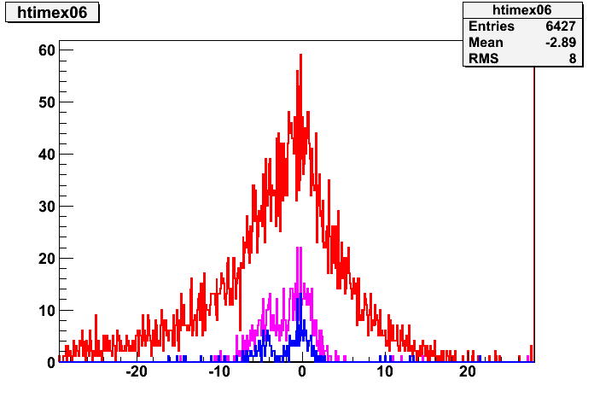
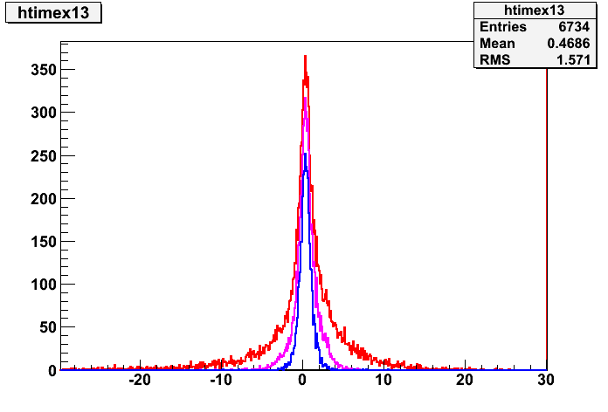
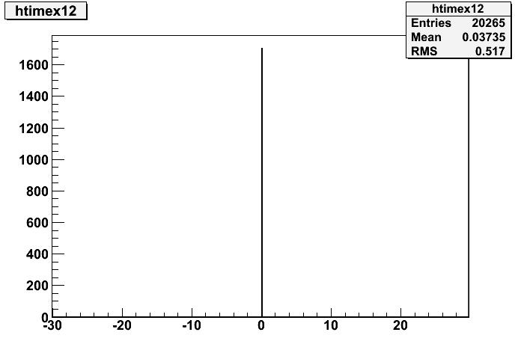
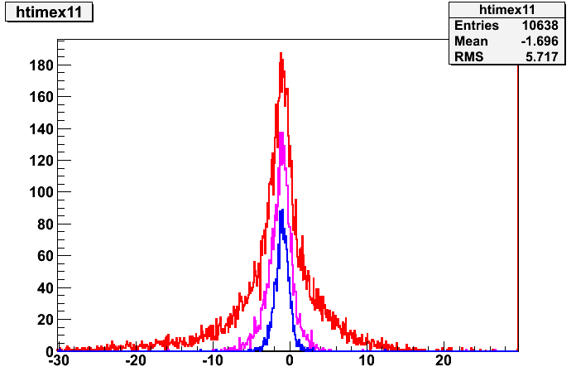
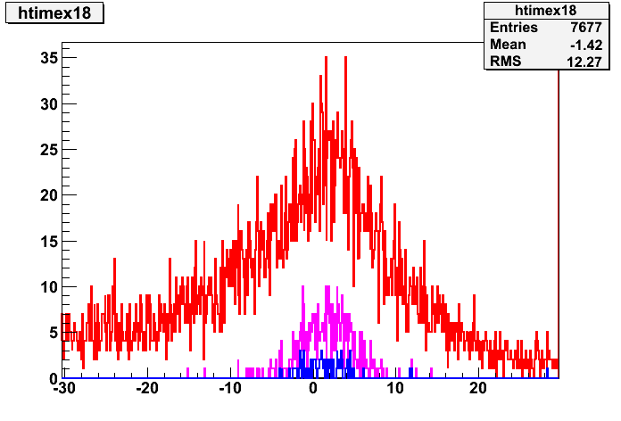
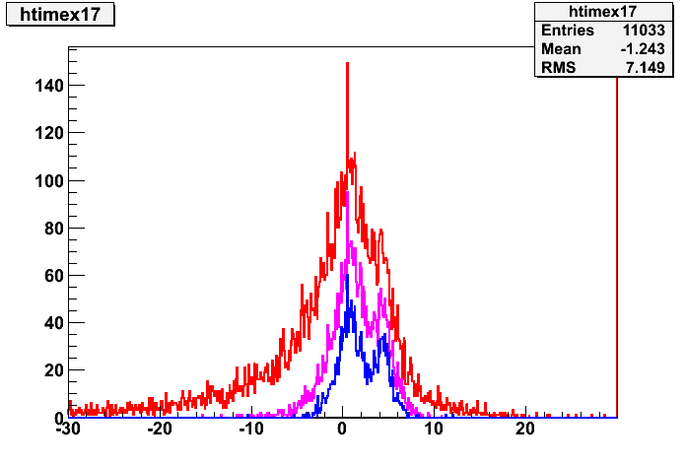
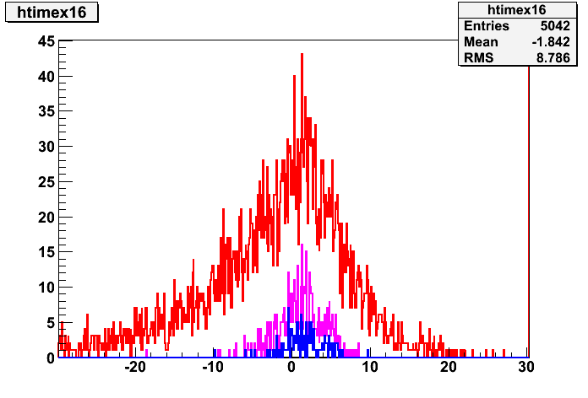
Linear Fit: Run350 (20264 events) t₀=t_{xtal12}
Threshold
10 ADC
50 ADC
100 ADC
8
7
6
12
11
13
18
17
16
5

Slide 6
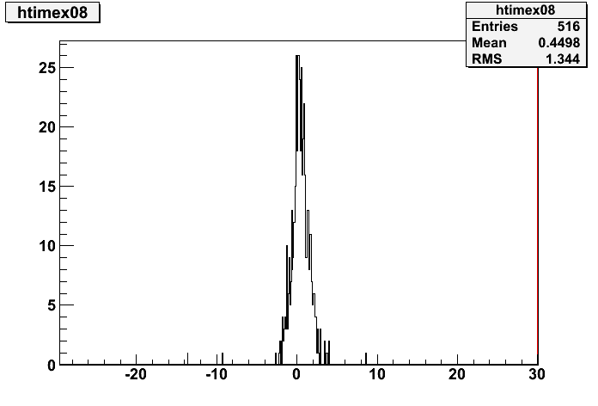
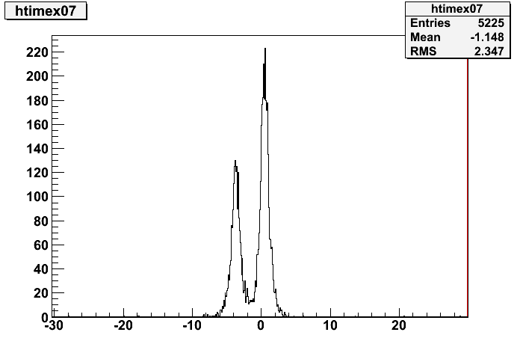
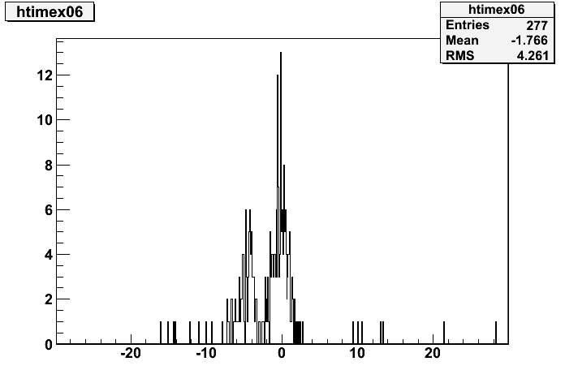
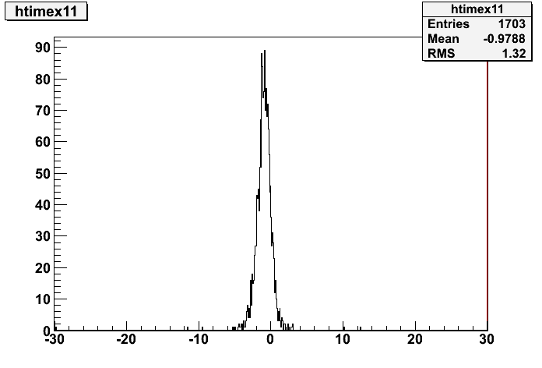
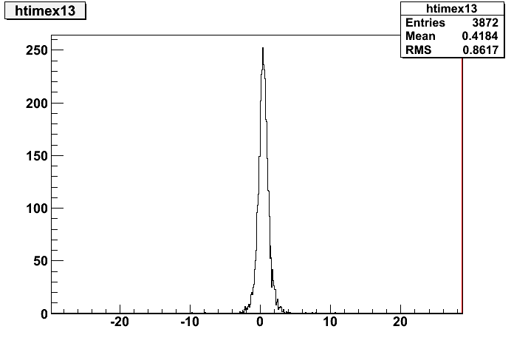
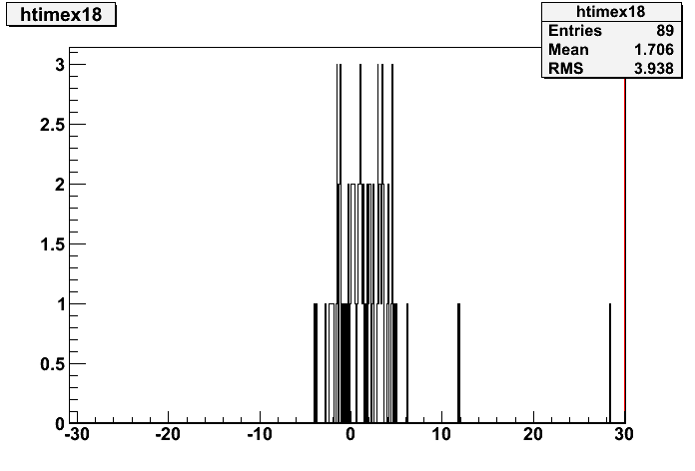
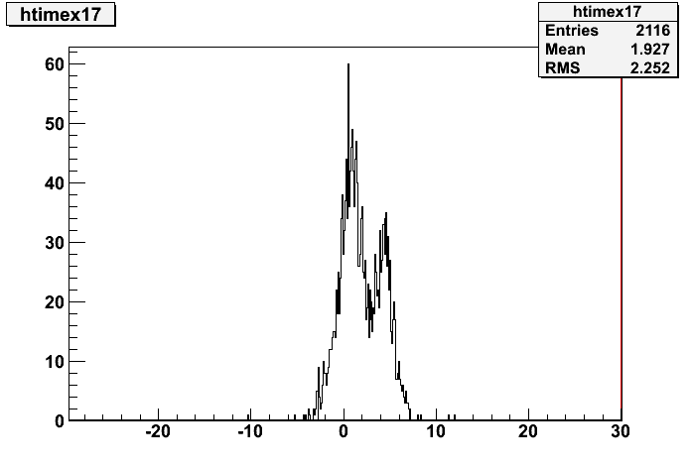
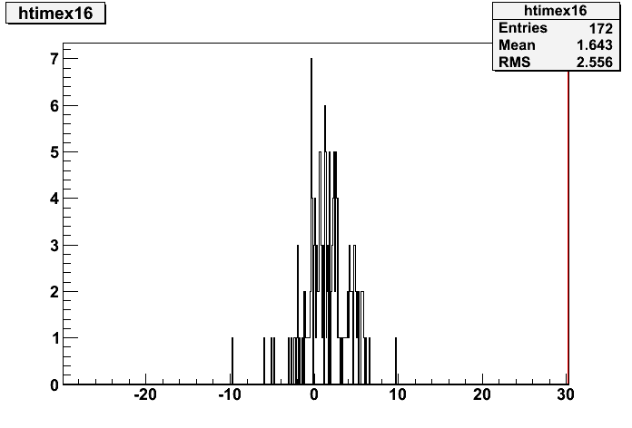
Linear Fit: Run350 (20264 events) t₀=t_{xtal12}
8
7
6
13
11
12
18
17
16
6

Slide 7
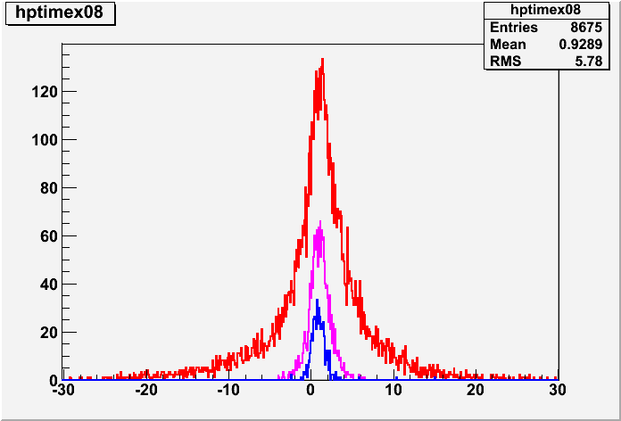
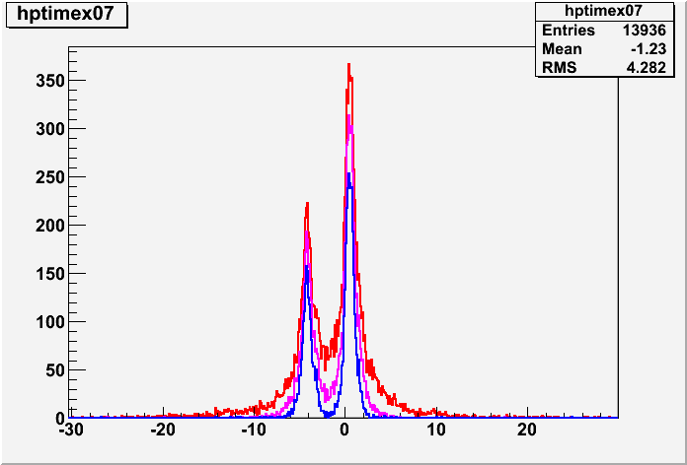
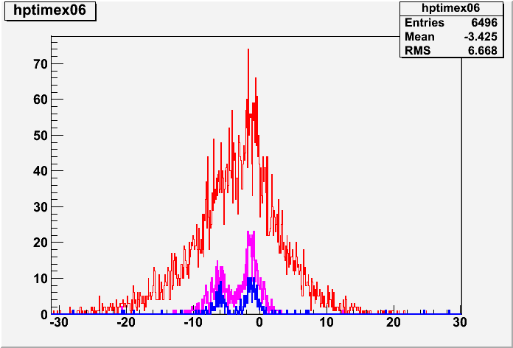
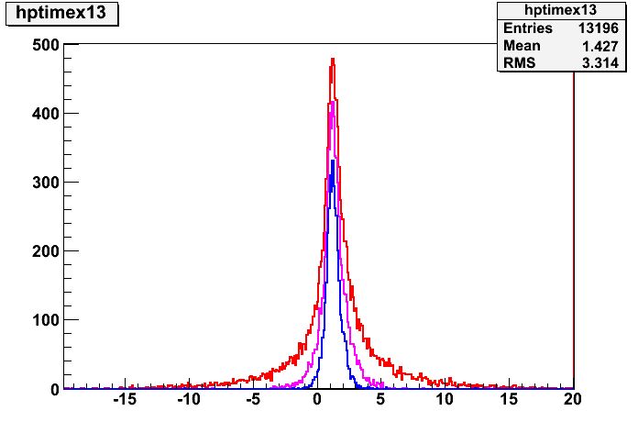
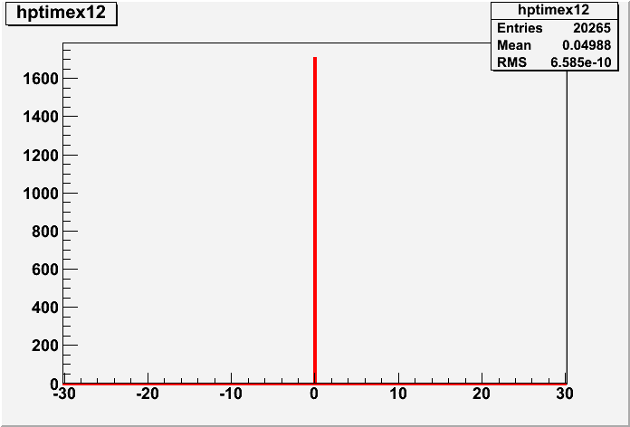
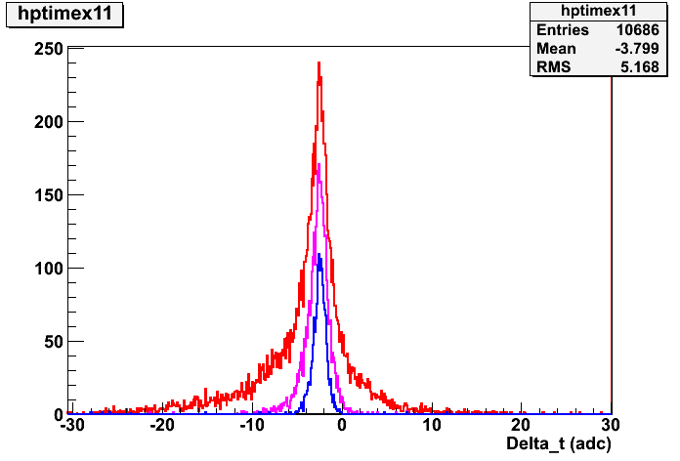
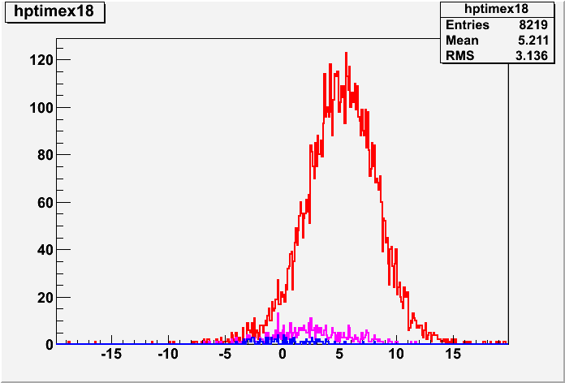
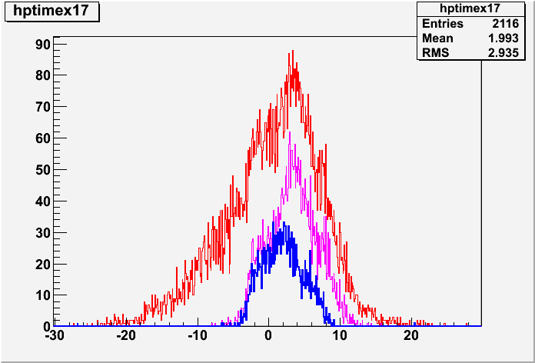
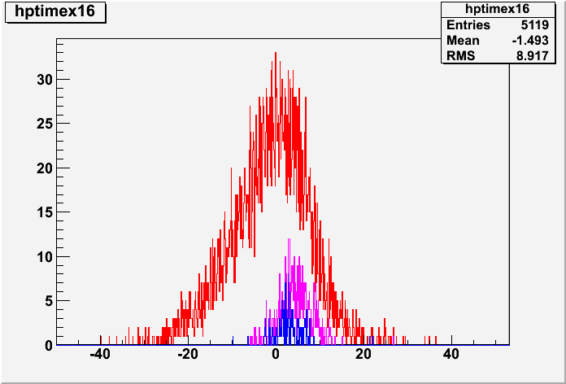
Peak Fit: Run350 (20264 events) t₀=t_{xtal12}
Threshold
10 ADC
50 ADC
100 ADC
8
7
6
12
11
13
18
17
16
7

Slide 8
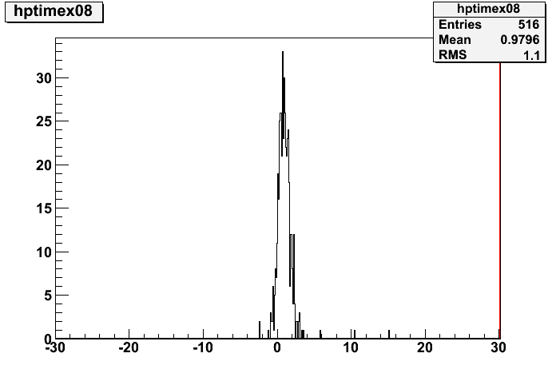
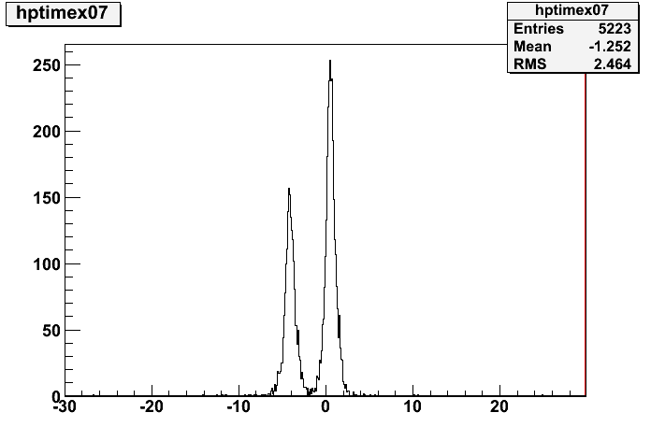
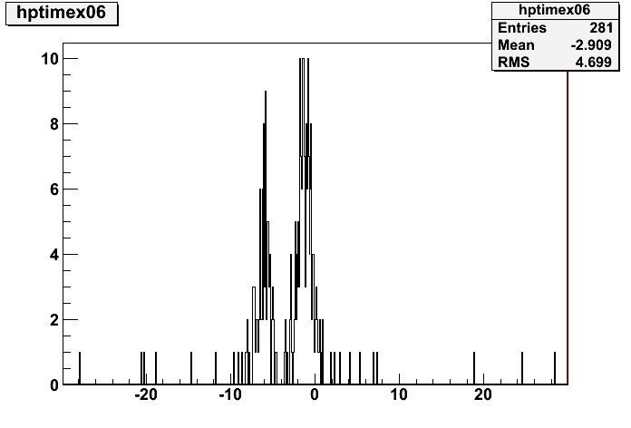
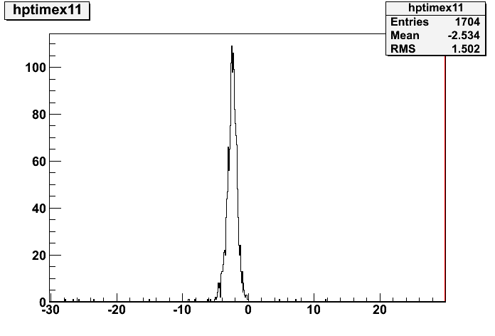
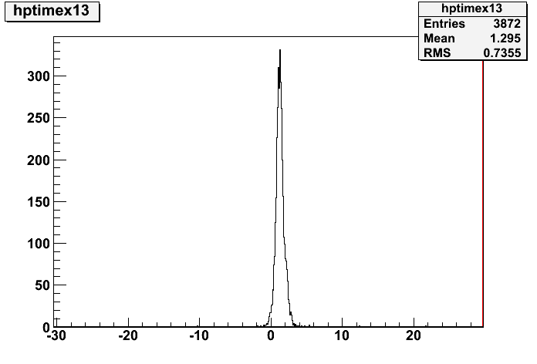
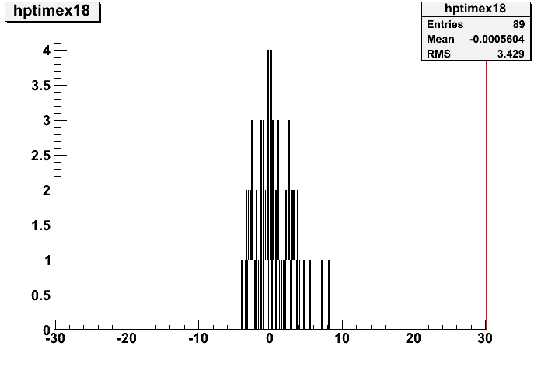
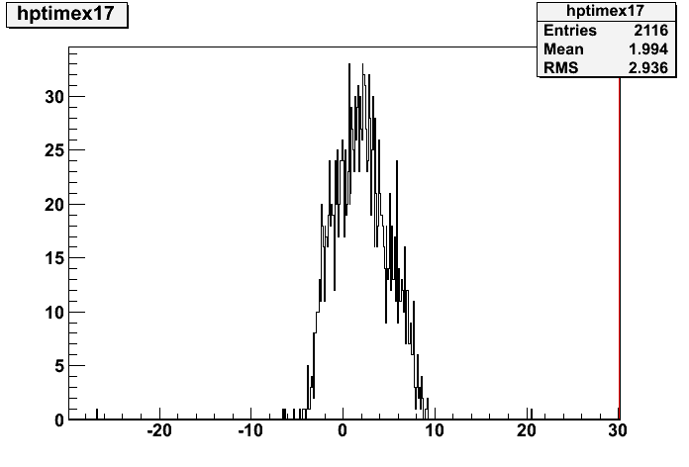
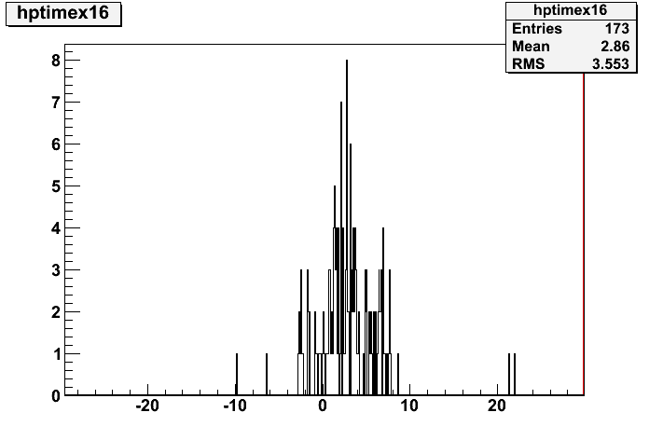
Peak Fit: Run350 (20264 events) t₀=t_{xtal12}
8
7
6
13
11
12
18
17
16
8

Slide 9
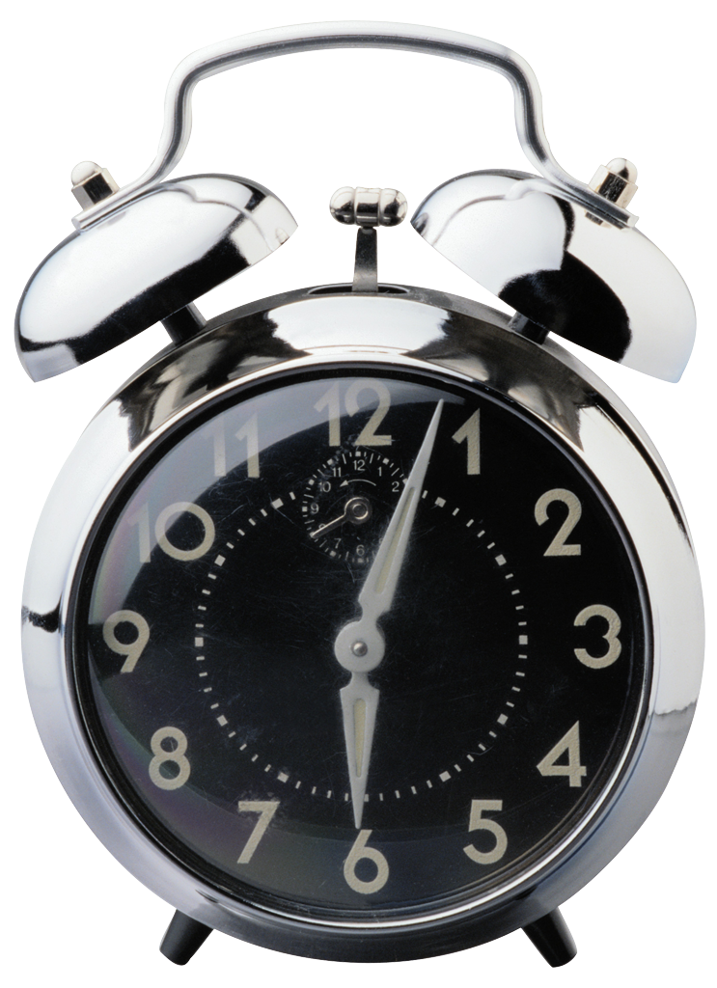
Trigger Problem
ADC 0
ADC 1
ADC 2
ADC 3
4 | 3 | 2 | 1 | 0
9 | 8 | 7 | 6 | 5
14 | 13 | 12 | 11 | 10
19 | 18 | 17 | 16 | 15
24 | 23 | 22 | 21 | 20
9

Slide 10
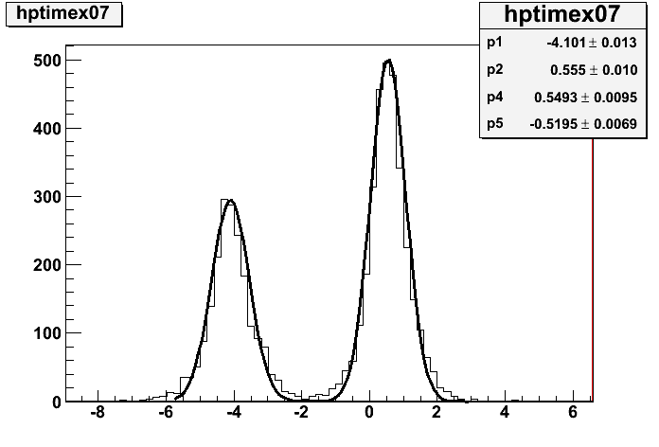
Trigger Problem 2
distance between peaks about
4 adc sample
1 adc sample = 4 ns
4x4 = 16 ns
62.5MHz
250MHz
250MHz
250MHz
250MHz
Cern TB
Master 1720
ADC 0
ADC 1
ADC 2
ADC 3
16ns
4 phase locked loop
When ADC X lost phase, there is a 16 ns shift, which could be positive or negative
JITTER PROBLEM!
10

Slide 11
"All-Runs check"
8 | 7 | 6
13 | 12 | 11
18 | 17 | 16
Let's focus on crystal 12 centred runs ( 1, 1.5, 2, 3 GeV) and plot:
t_{XX} vs # events
t_{XX}-t₁₂ vs # events
Investigated Runs: 350,351,361,362,369,370,371,390,391,407,408,409,410,411,412,413,414,415,419,420,421,422,429,430,431,432,435,437,438,439,440,441
11

Slide 12
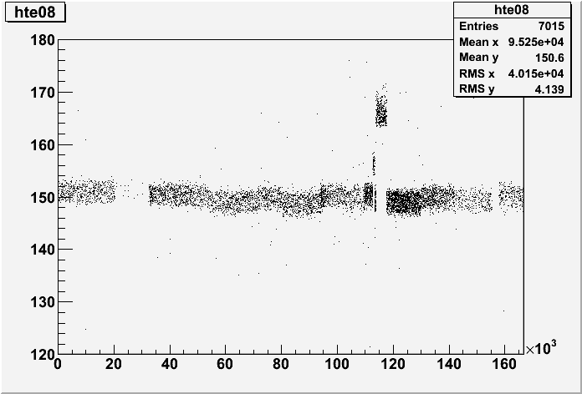
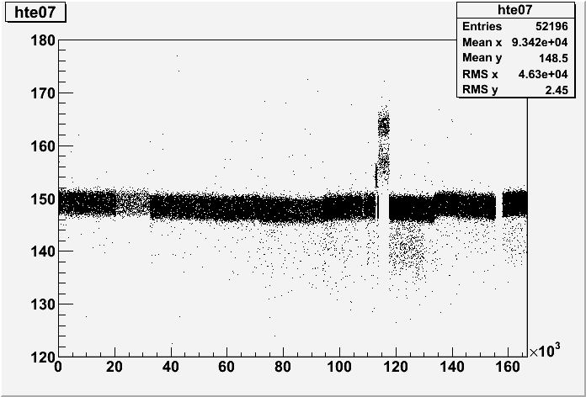
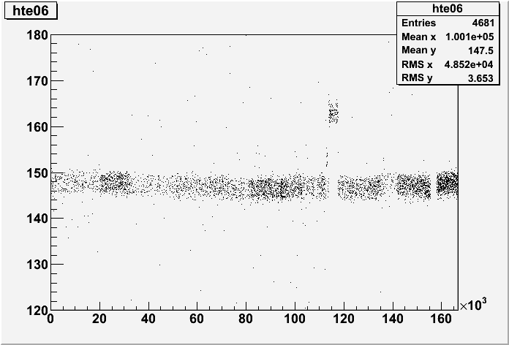
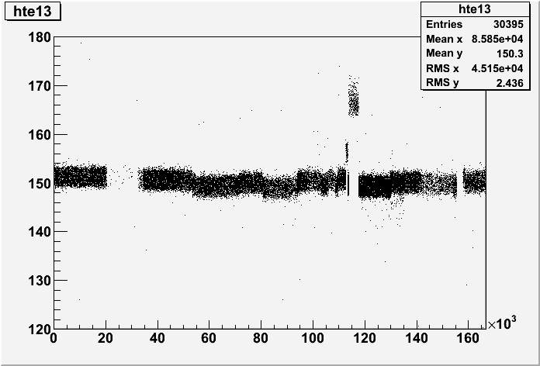
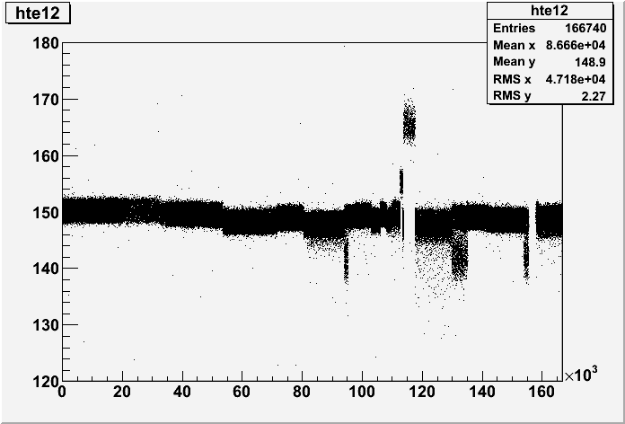
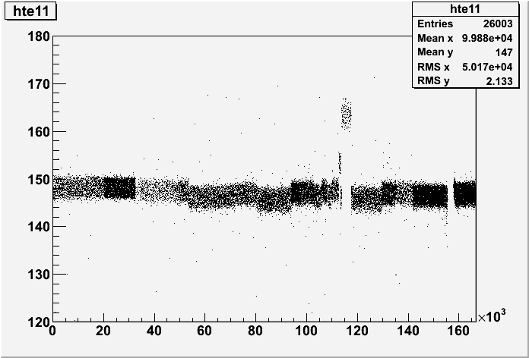
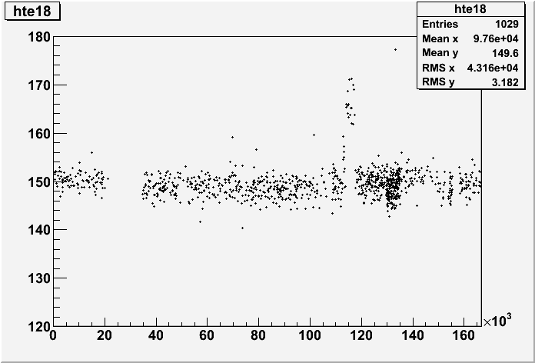
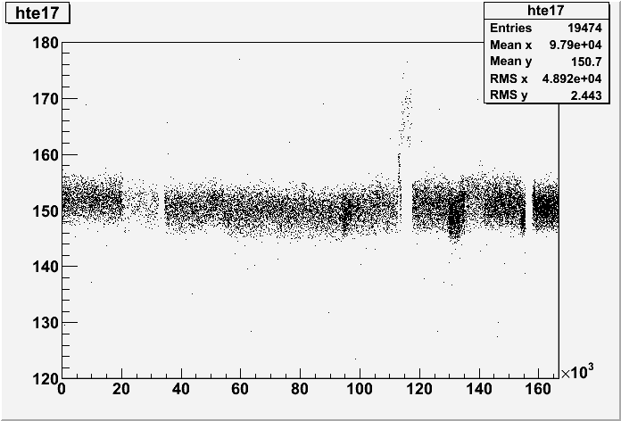
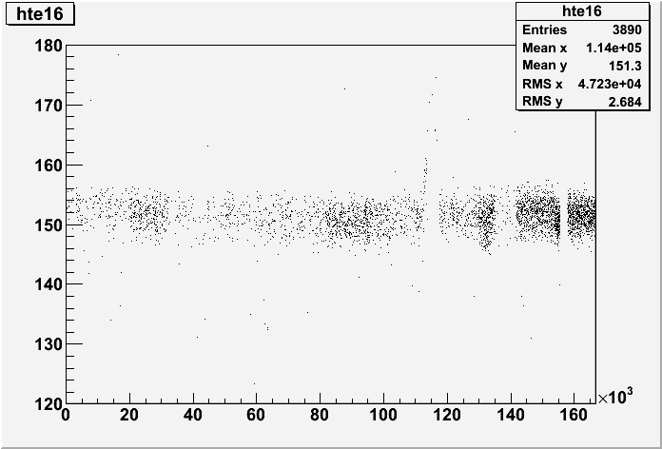
All Runs on Crystal 12: t_{XX} vs events
12

Slide 13
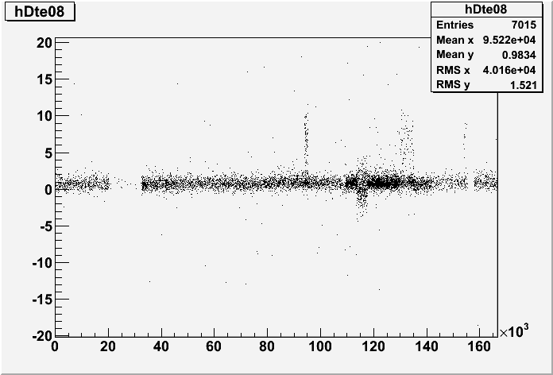
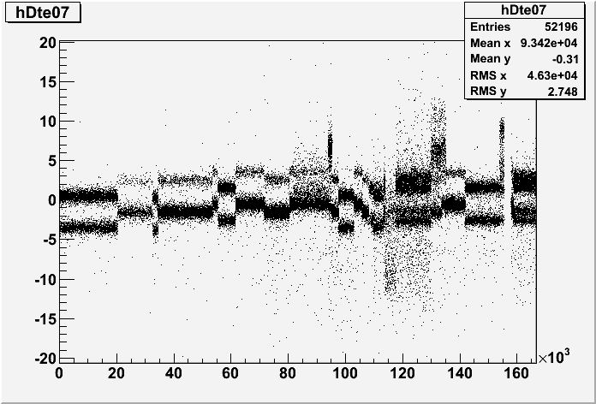
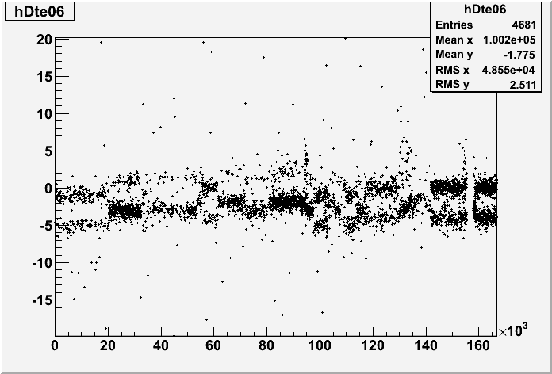
All Runs on Crystal 12: t_{XX}-t₁₂ vs events
13

Slide 14
ProfileX ( t_XX vs events )
xtal12
xtal13
run limits
14

Slide 15
"All runs" 166400 events (step =500)
t₁₂ from gaussian fit
15

Slide 16
Delta_t vs Amplitude
Testing amplitude dependence from Delta_t
XTAL 07
XTAL 13
16

Slide 17
Delta_t vs Amplitude
Problems with ADC n.2
17

Slide 18
List of problems
Asynchrony between ADC modules (Jitter-16ns)
Asynchrony between ADC channels
Degradation of signal in ADC 2
Possible solution (test setup at INFN laboratory, Roma1)
Reproduce problems
Offline correction algorithm?
Try to solve with Fan In Out
ADC 0
ADC 1
Pulser
Fan in/out
ADC 2
ADC 3
18

Slide 19
Time Resolution
Considering only crystal in the same ADC unit, however it's possible to extimate the time resolution of the system.
σ= (1.82± 0.06 ) ns
RUN 350 centered on crystal 12
Delta_t = t₀₈-t₁₂
RUN 357 centered on crystal 7
Delta_t = t₀₇-t₁₂
σ= ( 1.92 ± 0.07 ) ns
19

Slide 20
Conclusions
Need of an experimental test of the trigger system (fan in/out configuration)
Try to investigate a possible offline solution to synchronize the times
Time Resolution is about 2 ns but it needs to be fixed for the whole system
20

