Slide 1
Trigger consideration
A. Budano (INFN Roma 3)
Involved Group (INFN-LNF, INFN-NA, INFN-PG,INFN-Roma, INFN-Roma3)

Slide 2
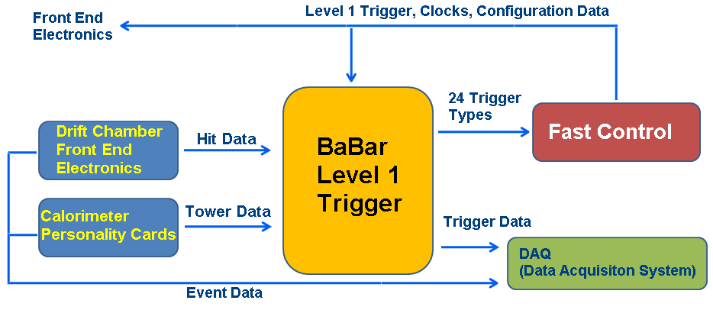
BaBar: Trigger Layout
J. C. Andress et Al., “BaBar Calorimeter Level 1 Trigger Design” , BaBar Note (1998)

Slide 3
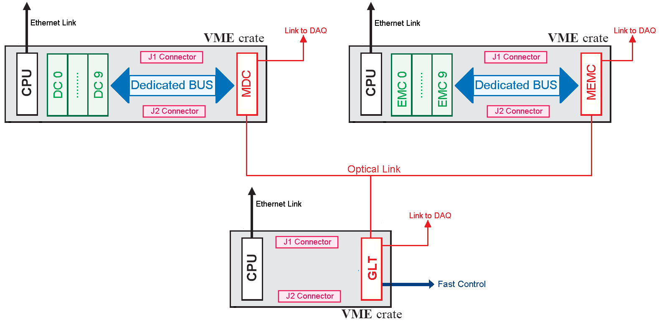
A possible sketch of trigger system in SuperB
EMC Electronics
DC Electronics

Slide 4
Latency
Latency in BaBar :
  DC event processing about 6 μs +
  GLT event processing 3 μs +
  trigger data movement 3,8 μs
  Total: 12.8 μs
How to reach about 6 μs ?
Latency of the system is dominated by DC processing. It depends on how fast data processing is.
We should be able to be faster with new FPGAs.
Let’s have a look at EMC.

Slide 5
Forward Lyso signal
The Lyso has been read out by a PMT (signal lasts 150 ns)
we should not have problems here

Slide 6
The calorimeter trigger signal processing in the barrel
J. C. Andress et Al., “Babar Calorimeter Level 1 Trigger Design” , BaBar Note (1998)
The sum of 24 contiguous crystals defines a tower

Slide 7
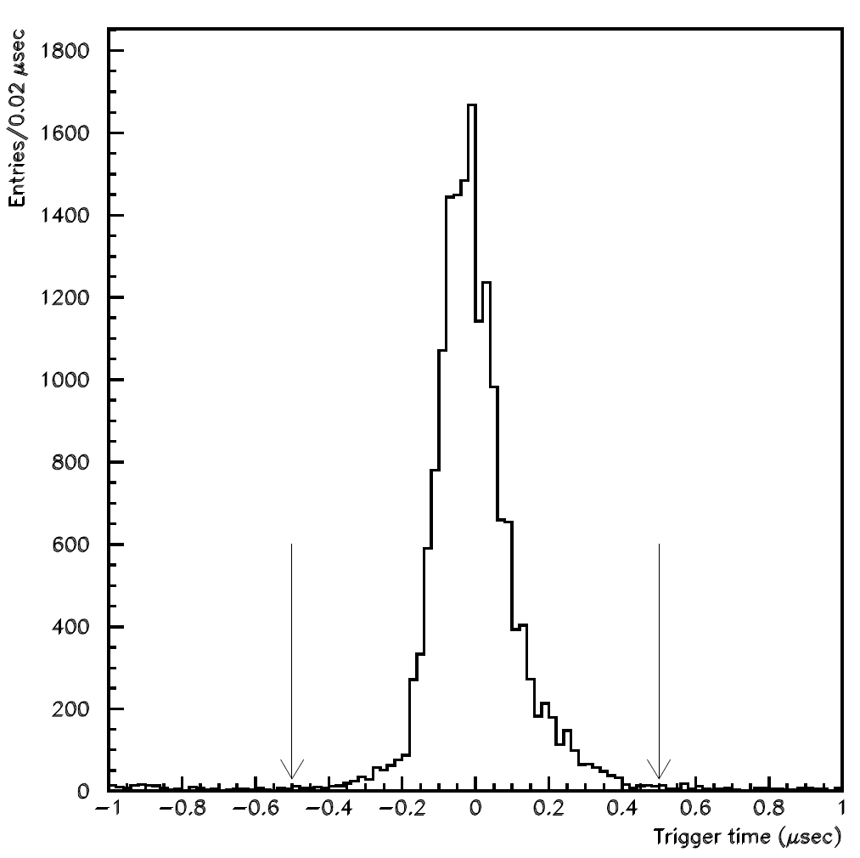
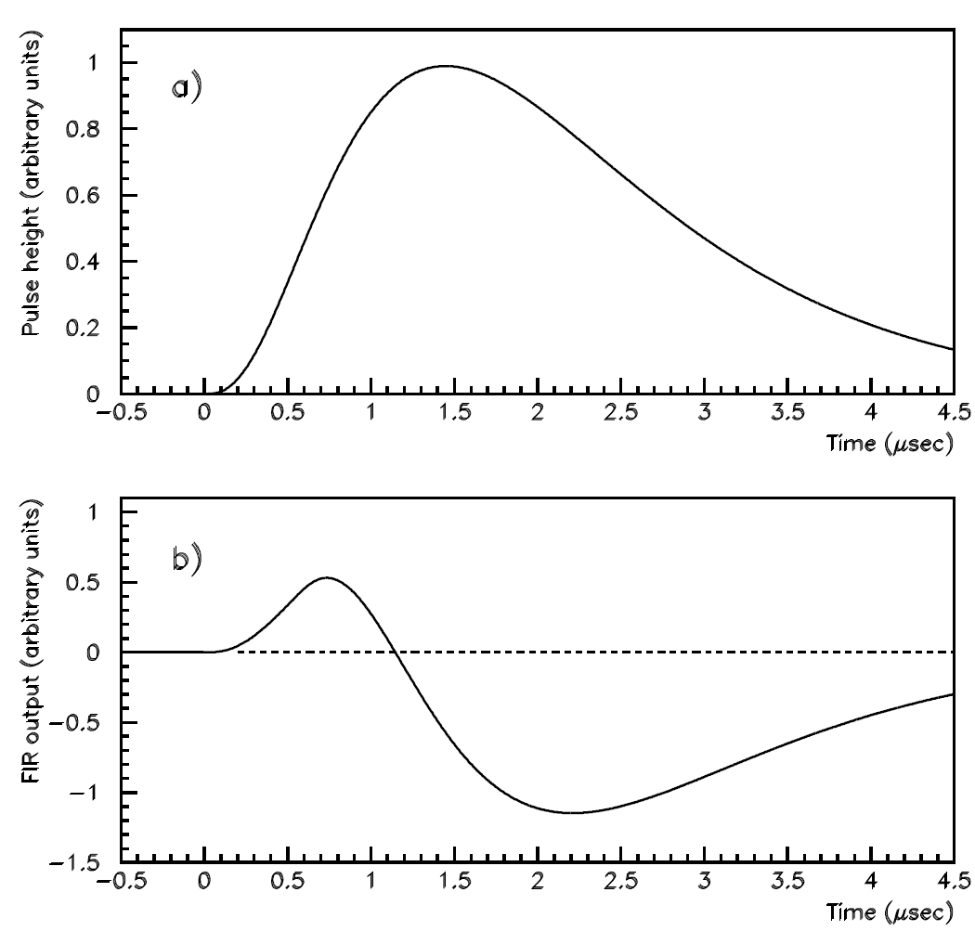
Barrel CsI (Tl doped)
P. D. Dauncey et Al., “Design and performance of the level 1 calorimeter trigger for the BABAR detector” (2001)
3 thresholds applied to the signal of the tower.
The plot shows the difference between the EMC trigger time and the DC trigger time.
μ+μ- events used to select good resolution in DC.
A FIR Filter with 8 parameters was applied to the signal. Its zero crossing occurred
at roughly a fixed time distance from the start of the signal, it was used to gate
the threshold information. Due to this mechanism the time resolution was about 100 ns.

Slide 8
Trigger Time jitter
The original BaBar trigger time resolution would be about 100 ns.
Can we improve it?
100 ns good for BaBar running@2.2 μs dead time.
We should aim at 30 ns since SuperB dead time is estimated to be 70 ns.
P. D. Dauncey et Al., “Design and performance of the level 1 calorimeter trigger for the BABAR detector” (2001)

Slide 9
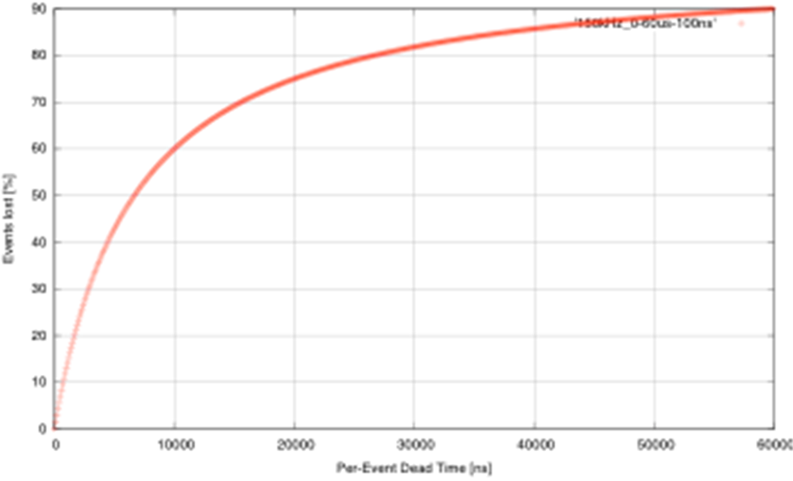
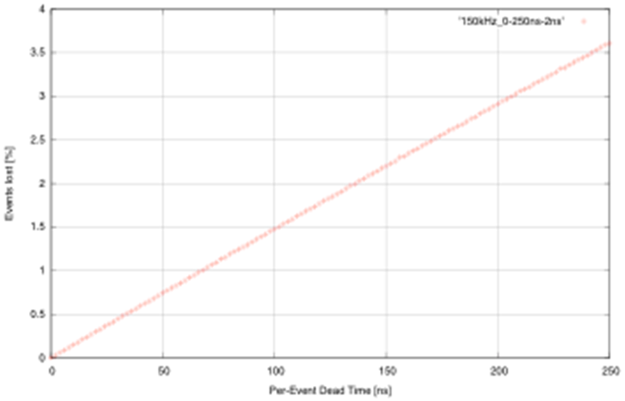
Let’s remember the specs
Baseline:
re-implement BaBar L1 trigger with some improvements
  Shorter latency (~ 6 μs instead of 12 μs )
  Higher sampling frequencies (DCH and EMC)
  2-d map for calorimeter
Challenge
To keep the event loss due to dead time below 1% => a maximum of ~70ns “per-event dead time” is allowed in trigger and FCTS (Fast Control and Timing System)
150kHz
Exponential Inter-arrival time pdf.
From Luitz presentation 2010

Slide 10
Latency in the EMC Barrel
ADC conversion time.
Depends on
Shaping, can
it be changed?
J. C. Andress et Al., “Babar Calorimeter Level 1 Trigger Design” , BaBar Note (1998)
Can we improve latency here?

Slide 11
Throughput of the EMC System
6580 EMC barrel channel
4440 Forward EMC number of channels
3.7 MHz sampling frequency
16 bit Energy deposit
Total 82 Gbytes/s
Trigger gets sum in tower made of 24 crystal throughput 3.5 Gbytes/s
1 Gb link profile → 30 to 40 links.

Slide 12
Throughput of the DC System
7104 wires
3.7 MHz sampling frequency
1 bit (over threshold yes/no)
Total 3.2 Gbytes/s
1 Gb link profile → 30 to 40 links.

Slide 13
Considerations on links
From NA Group experiments : only 1 Gbit/s has been proven to be radiation hard.
So if we really need a radiation hard link and we increase sampling frequency by a factor say 4, then we’ll correspondingly increase the number of links from about 40 to 160 per detector.
If we could house the radiation sensitive hardware in a shielded zone we could profit of faster links and reduce number of links thus simplifying the problem. Does such a place exist?

Slide 14
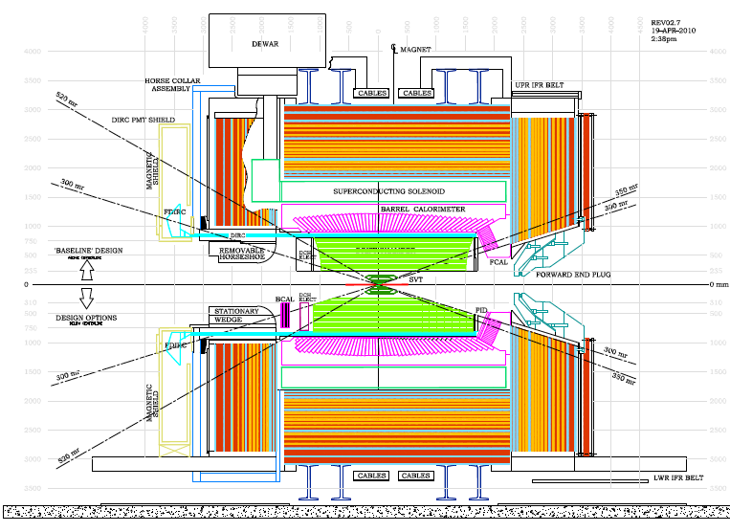
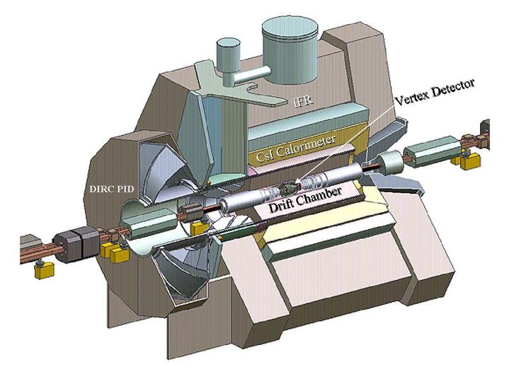
It could exist …
Inside the detector
Outside the detector

Slide 15
Further Considerations
As far as the DC trigger is concerned we can increase the sampling frequency. As a benefit we would also improve the zed resolution (good to remove background).
Signal are really fast in the EMC forward and there should not be any real problem in getting a better time resolution there
(1-2 ns detector time resolution reached at test beam).
But …
Situation is much less clear in the barrel where a long shaping time is used and a FIR was necessary to do the job.
Maybe we need several tests and some test beam data to
really understand this problem.

Slide 16
Conclusions
Link’s number is a rather huge number if we have to use the 1 Gbit/s profile. A faster profile seems necessary.
Trigger time jitter and latency could be turn out to be dominated by the Barrel EMC electronics.
We have to change something in order to do better.

