Slide 1
ROM Project Status update
U. Marconi, INFN Bologna
with
Marco Bellato, Damiano Bortolatti, Ignazio Lax

Slide 2
Parameters
The estimated event size at the FE is 500 kB.
The reference value for the trigger rate is 150 kHz.
Number of FEE 2Gb/s data links : 325
We set the aggregate ROM input rate to 10 Gb/s.
With these assumptions the number of ROMs needed to manage the data flux is of the order of: (8. × 500. ×10³ ) × (150. × 10³)/(10. × 10⁹) = 60 boards
Each ROM will handle ∼10 kB of fragment size at 150 kHz.
To cope with higher rates? Increase the number of ROMs accordingly: 300 kHz → 120 ROMs.

Slide 3
Implementation
Solution based on FPGA and PC/CPUs appears to be more versatile than the one based on stand alone custom board.
The required functionality implemented by means of high level languages.
Transmission protocol to the HLT farm is no more a constraint.
The trigger rate of 150 kHz constraints the available processing time per CPU to N_{CPU} / 150. ms N_{CPU} being the number of CPU cores per PC box.
A processing time of the order of 1 ms per CPU would require order of 100 CPU cores per box.

Slide 4
Implementation(II) – Block Diagram
Power Management
SFP RTX
FCTS I/F
SNAP12 RX
Front-Ends
FPGA – Virtex 6/7
PCIexpress 4x
Dual port RAM
Clock Management

Slide 5
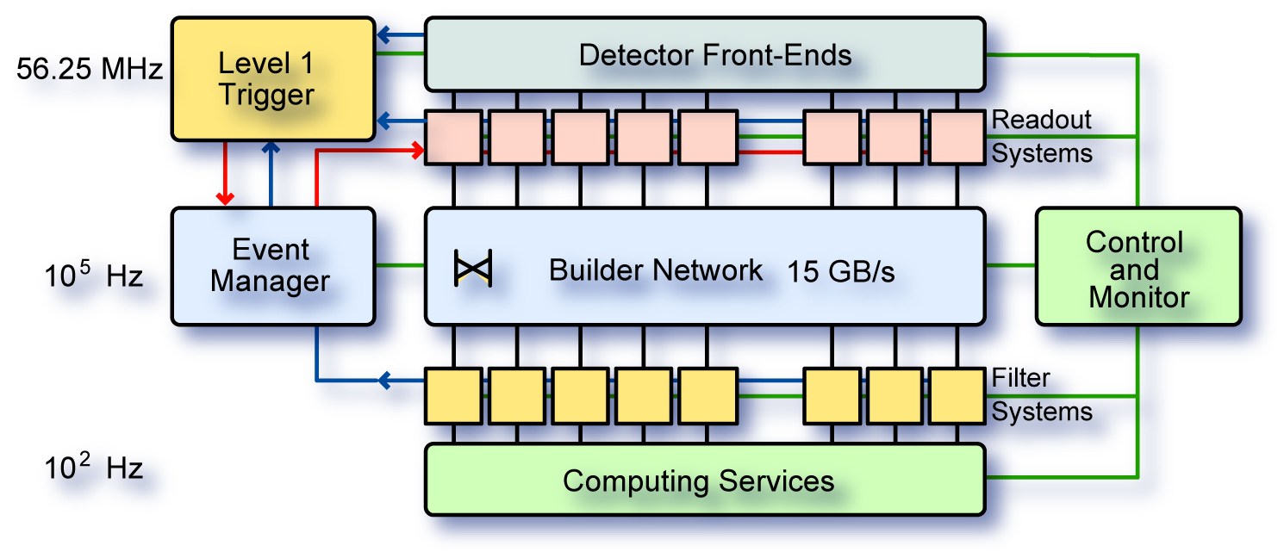
ROM PCIe Architecture
HLT can be performed on the same farm used to implement the ROMs:
The event builder farm can fit the ROMs as plug-in cards
Exploit existing hardware and reduce costs.
+ filter farm

Slide 6
Architecture
FE
FE
optical link
optical link
Event building
and HLT
Server
Server
ROM
ROM
Switch
Each server gets data from the FEE through the ROM interface and distribute event fragments
to the other PC servers, to perform the event building and the HLT event selection.

Slide 7
Test setup
Evaluation
board

Slide 9
FPGA logic
PCIe
Core
Rx engine
Register
Tx engine
64
FIFO: 512 × 64 bits
8 lanes @ 2.5 Gb/s
16 Gb/s
DMA
FIFO
64
DMA Buffer
250 MHz, 64 bits
16 Gb/s
Pattern
Generator
full

Slide 10
8 lanes at 2.5 Gb/s
in total 20 Gb/s,
the coding 8b/10b reduces the available
bandwidth to16 Gb/s

Slide 11
Estimated dead time: 10%,
Effective transmission rate: 0.9 × 16 = 14.5 Gb/s

