Slide 1
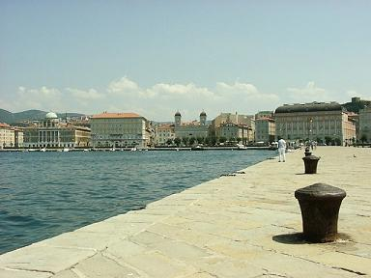


Update on Trieste Activities
Lorenzo Vitale
University & INFN Trieste
on behalf of Trieste SuperB Group
Luciano Bosisio, Pietro Cristaudo, Livio Lanceri, Irina Rashevskaya, Carlo Stella

Slide 2
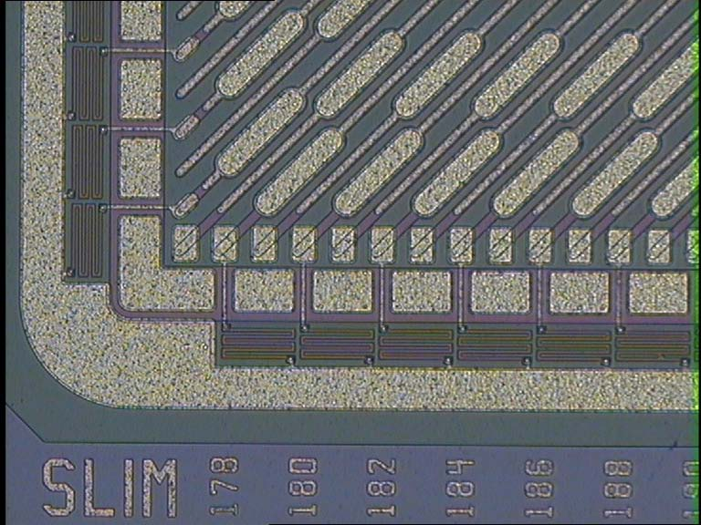
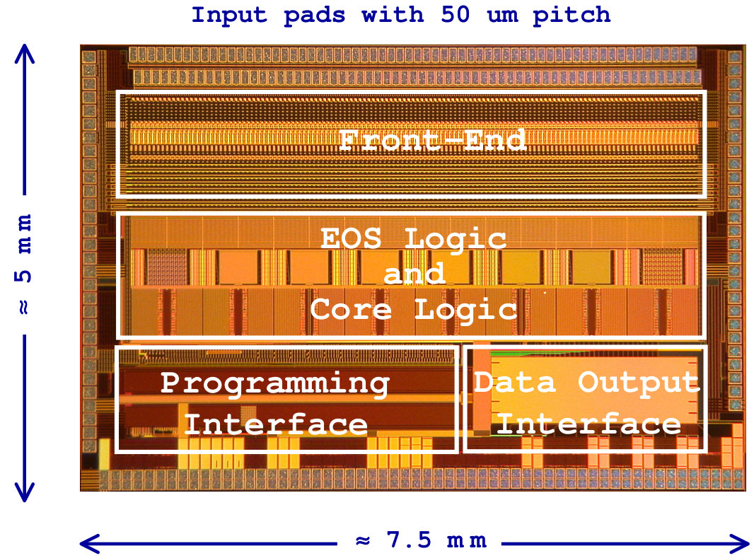
Outline
Ongoing activities:
Strip multiplicity and dE/dx in SVT Studies with Bruno
Sensors and Fanout specifications for the TDR
  Measurements of Striplet capacitance
Construction of 5 new telescope modules
Striplets run at Beam Test in Sept. (FSSR2 RO)
Irradiation tests on MAPS with neutrons
Interest of Insubria group to collaborate

Slide 3
Strip multiplicity and dE/dx in SVT
Carlo Stella (graduated on Friday) has been studying strip multiplicity and dE/dx in the 6 double layers of SVT
Study was driven by FSSR2 (that provides a 3-bit ADC information for each recorded hit), but then concentrated more on Strip multiplicity, rates, occup.
We are using full simulated events BRUNO
    with old Geometry (200 μm cylindrical Layer0)
    e+e-e+e- (pairs) 160k events
    Single particle (momentum distributions as inclusive soft π’s from ϒ(4s) and cc) 50k events
  with new Geometry May 2011 production by Riccardo (consistent results wrt old, work in progress)

Slide 4
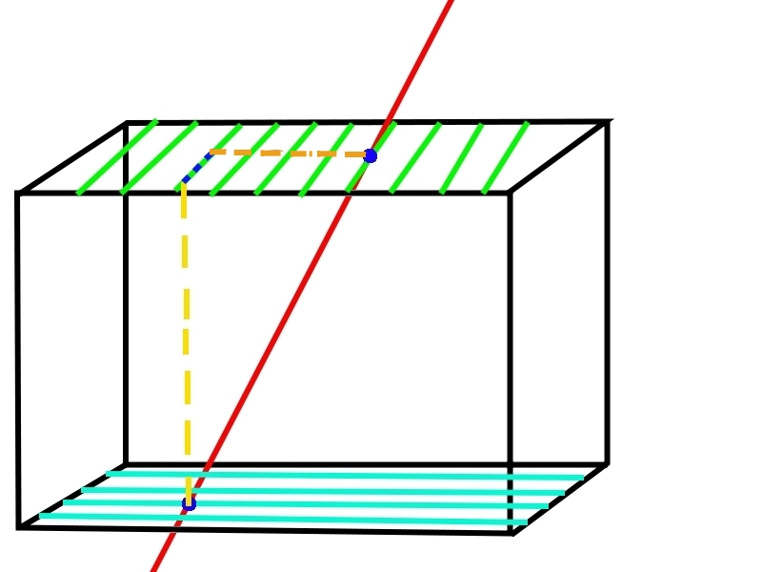
Digitization procedure
Require particle identity (abs(SVTHits.pdg)==11 pairs, 211 π)
Use entrance and exit point to define path Δx in wafer and project it onto Z and RΦ
Use released energy ΔE in active silicon
Share the energy among the “Digitized” strips dE_{i}
First & last strip has random
flat dE_{i}, the others the same
Smear dE_{i} with gaussian
Apply two sets of thresholds
on dE_{i} (=each strip):
2880 e- 0.18(0.12)MIP-L0(L1-5)
4800 e- 0.30(0.20)MIP-L0(L1-5)

Slide 5
Average strip multiplicity per Cluster for e± from pairs OLD vs. (NEW)
No threshold cut
Layer | RO PitchZ (or +45∘) μm | <n>_Z | RO PitchPhi (or -45∘) μm | <n>_Phi
0 | 50 | 5.1 (X.X) | 50 | 5.2 (X.X)
1 | 100 | 4.0 (4.0) | 50 | 6.7 (6.7)
2 | 100 | 3.8 (3.8) | 55 | 6.6 (6.4)
3 | 100 | 3.9 (3.6) | 55 | 6.5 (5.9)
4 | 210 | 1.8 (1.9) | 100 | 3.7 (3.6)
5 | 210 | 2.0 (1.9) | 100 | 2.6 (3.2)

Slide 6
Average strip multiplicity for e± from pairs per Cluster vs. (per QED Event)
OLD files - No threshold cut
Layer | RO PitchZ (or +45∘) μm | <n>_Z | RO PitchPhi (or -45∘) μm | <n>_Phi
0 | 50 | 5.1 (18.7) | 50 | 5.2 (19.1)
1 | 100 | 4.0 (13.3) | 50 | 6.7 (19.7)
2 | 100 | 3.8 (11.5) | 55 | 6.6 (16.6)
3 | 100 | 3.9 (9.4) | 55 | 6.5 (13)
4 | 210 | 1.8 (4) | 100 | 3.7 (8)
5 | 210 | 2.0 (5) | 100 | 2.6 (9)

Slide 7
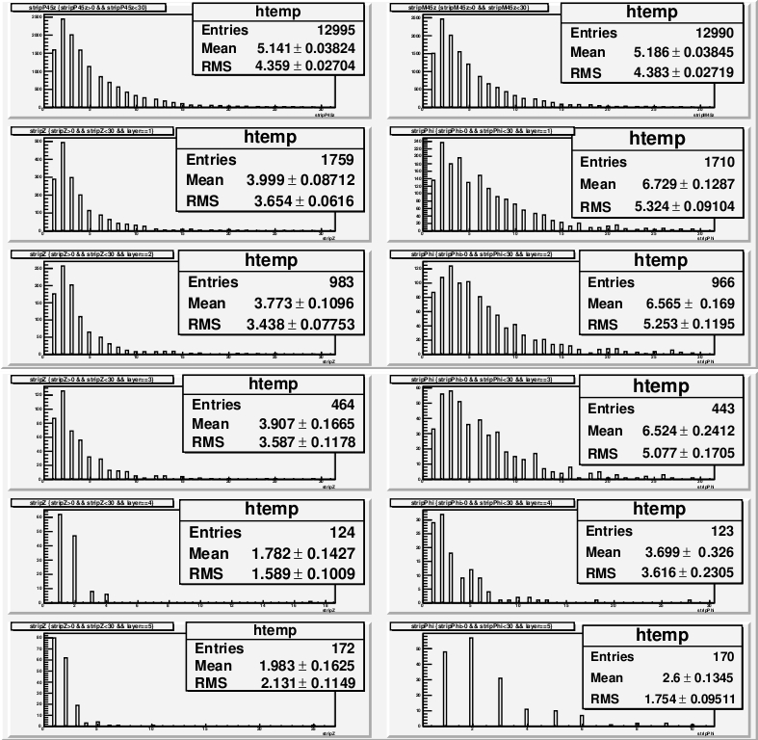
Strip Multiplicity S0 = 0 e-
QED pairs

Slide 8
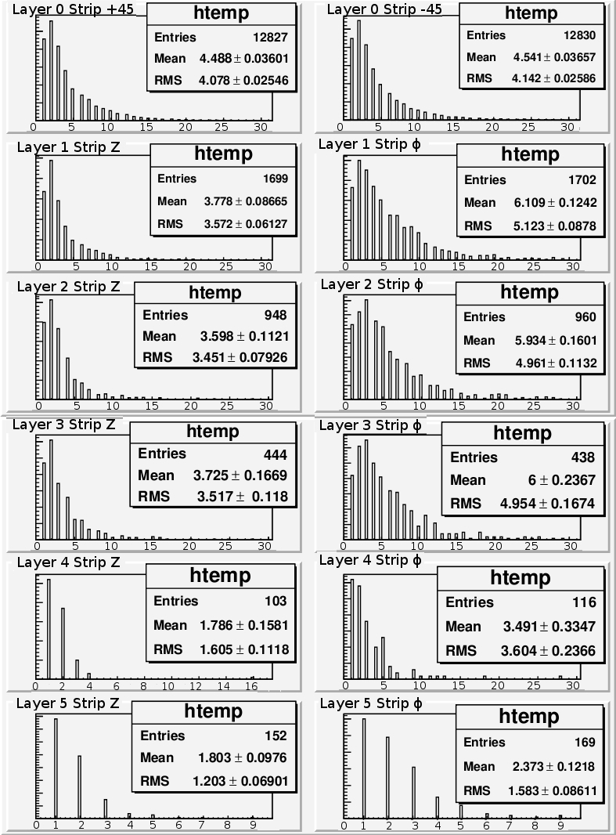
Strip Multiplicity S0 = 2880 e-
QED pairs

Slide 9
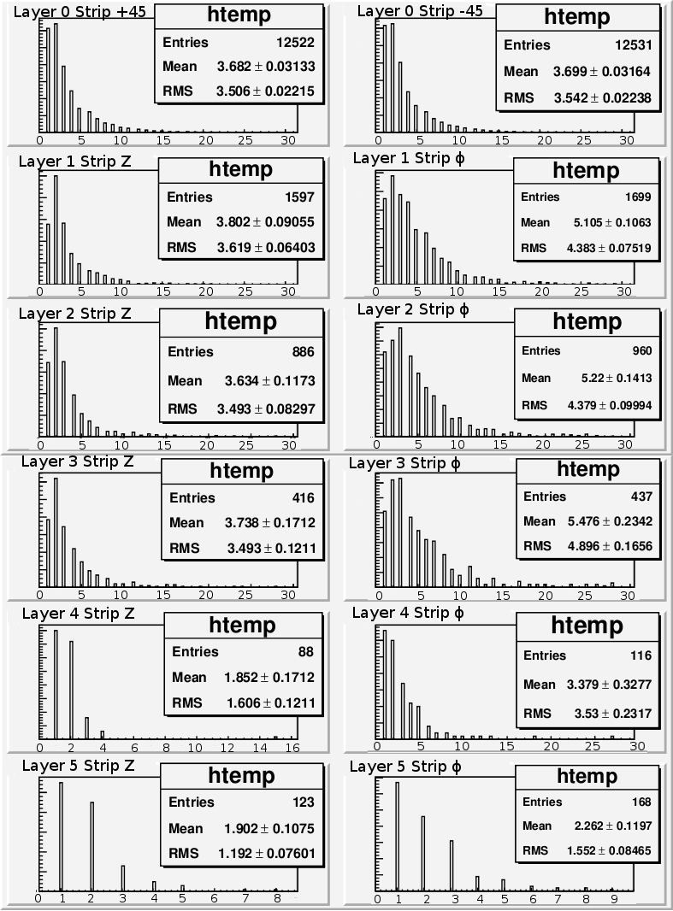
Strip Multiplicity S0 = 4800 e-
QED pairs

Slide 10
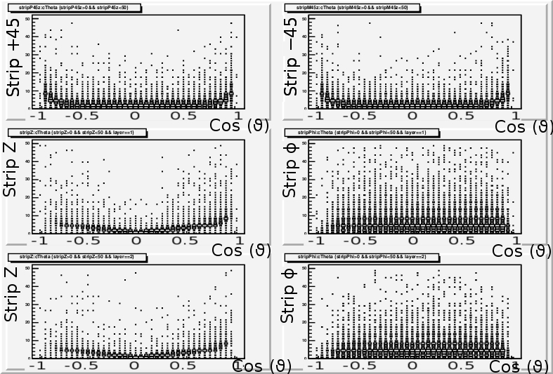
L0-1-2 Strip multiplicity vs cos(𝜗_{cluster})

Slide 11
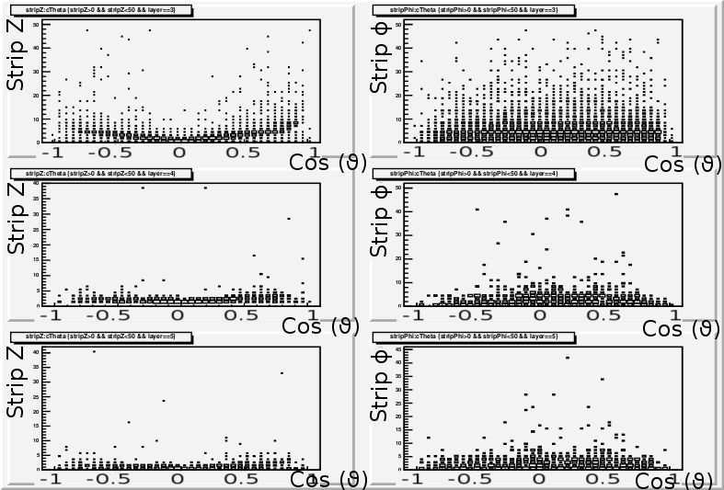
L3-4-5 Strip multiplicity vs cos(𝜗_{cluster})

Slide 12
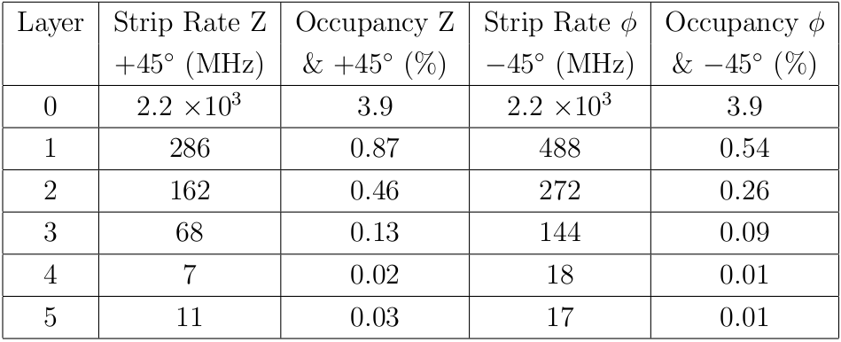
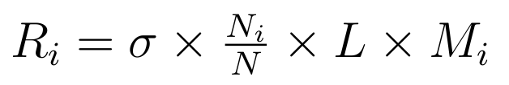
As an example we computed
Strip Rate & Occupancy in Δt = 100 ns
QED Pairs (S0 = 4800 e- )

Slide 13
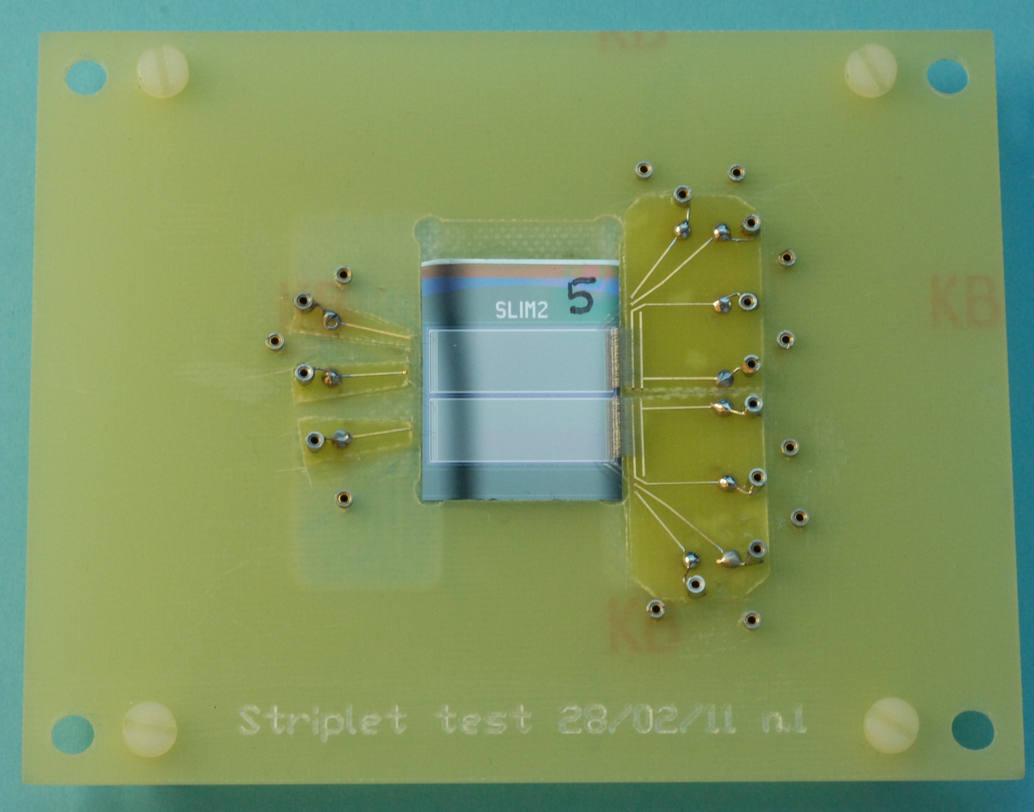
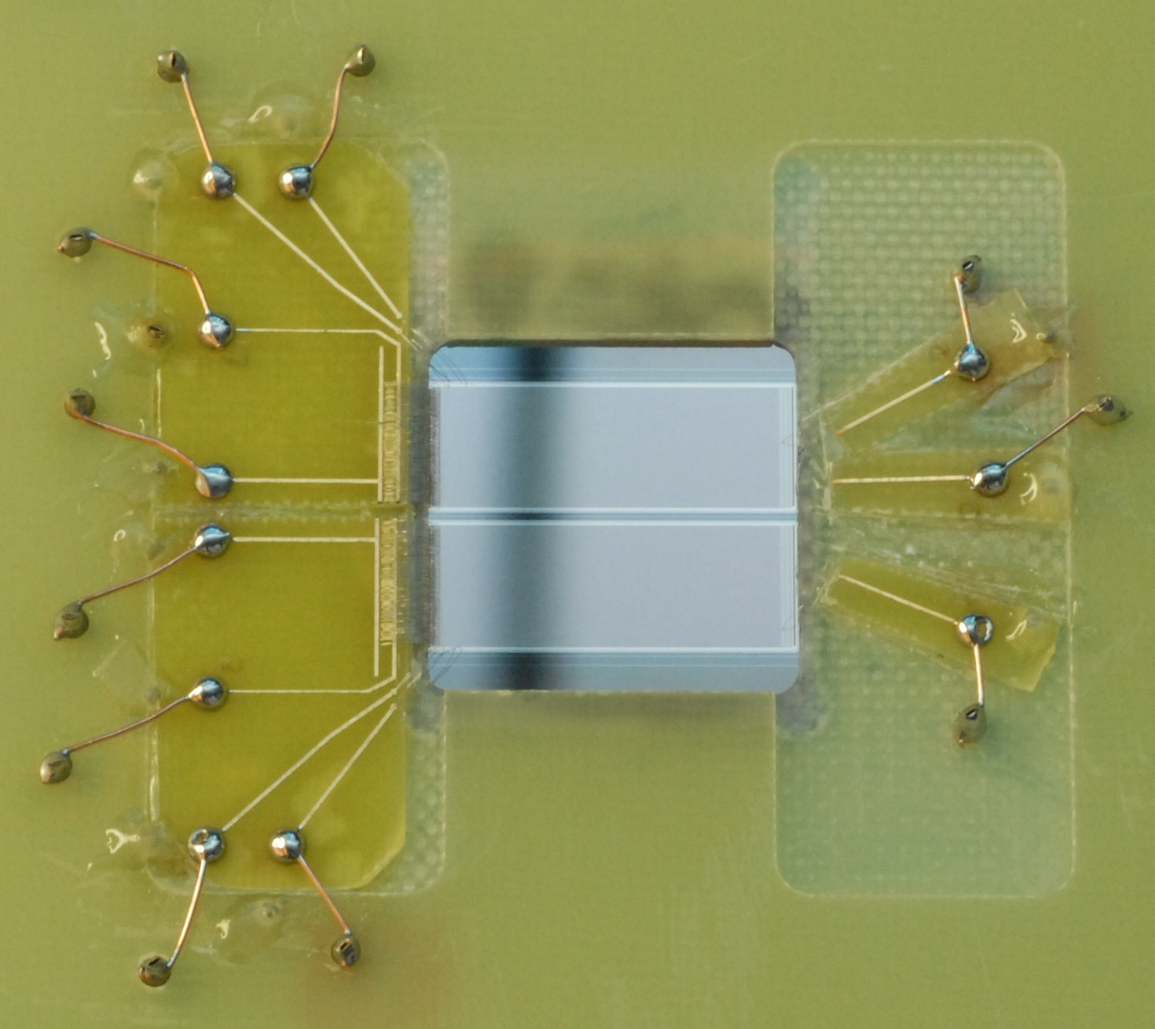
  Measurements of striplet capacitance
A striplet test structure has been assembled and bonded to a PCB in order to measure:
strip capacitance (interstrip, backside and total)
noise contributions from the sensor
P-side view
A few strips individually bonded, having different layouts on p-side (with/without field plate or intermediate floating strip)
All other strips bonded together
N-side view
(detail)

Slide 14
  Measurements of striplet capacitance
Many measurements made, vs. bias voltage and frequency.
Analysis of results is under way.
One example for a p-side strip shown here.
No significant differences observed between various configurations (field plate, floating strips).
Total capacitance is smaller that that conservatively estimated at the time of the 2008 beam test (4 pF)

Slide 15
Telescope modules and beam test (Sept. 2011)
We are building 5 new telescope modules with FSSR2 readout, in order to a have a 3+3 telescope configuration; 5 were already available and used in 2008-2009 beam tests in a 2+2 configuration.
The striplet module tested in 2008 will be tested again at larger incidence angles and with lower thresholds.

Slide 16
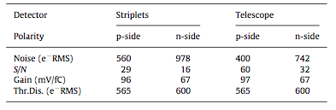
Striplets results in 2008
125ns shaping time.
Expected noise 320e-
for C=4pF Tele (≈Striplets)

Slide 17
Eff./Reso. for the Striplets
ϑ in degrees | p-side Eff within 80μm* (80/cosϑ) | n-side Eff within 80μm (80/cosϑ) | p-side Spatial Resolution | n-side Spatial Resolution
0 | 98.2 | 98.3 | 13.6 | 14.1
5 | 97.2 | 97.9 | 12.9 | 13.2
10 | 97.7 | 97.8 | 11.5 | 12.3
20 | 97.8 | 97.9 | 7.8 | 9.8
30 | 98.0 (98.0) | 98.2 (98.2) | 9.0 | 10.4
45 | 98.0 (98.3) | 96.7 (97.1) | 15.7 | 17.8
60 | 95.5 (98.0) | 90.5 (97.2) | To be defined | To be defined
70 | 78.9 (98.9) | 78.8 (98.7) | To be defined | To be defined
At 45° start
deteriorating
*≈ 5 s.d. of residual distribution

Slide 18
Interest of Insubria group to collaborate in SVT
The group of Michela Prest has expressed interest in collaborating with us starting from 2012 with Michela, Erik Vallazza, 2 post docs and 1 PhD student.

Slide 19
Conclusions
Several activities are progressing:
Strip multiplicity and dE/dx in SVT Studies with Bruno
Sensors and Fanout specifications for the TDR
  Measurements of Striplet capacitance
Construction of 5 new telescope modules
Striplets run at Beam Test in Sept. (FSSR2 RO)
Irradiation tests on MAPS with neutrons
Interest of Insubria group to collaborate

Slide 20
Backup Slides

Slide 21
Cluster rates for e± from pairs
OLD files vs. (NEW) and vs. Ric
Sorry, Work in progress
Layer | Cluster Rate kHz/cm2 | Cluster Rate Riccardo kHz/cm2
0 | 7.5(X.X)x10³ | 6.4x10³
1 | 216(X.X) | 220
2 | 88(X.X) | 120
3 | 19(X.X) | 38
4 | 2.3*(X.X) | 5.8
5 | 2.1*(X.X) | 3.4

