Slide 1


The Goals
Marcello A. Giorgi
Università di Pisa & INFN Pisa
La Biodola May 30, 2011
XVII SuperB Workshop and Kick off Meeting

Slide 2
SuperB is a Super Flavor Factory
High statistics production of
, , pairs.
Follow the high intensity route
to New Physics , look at signals
through high precision
measurements in Flavor/

Slide 3
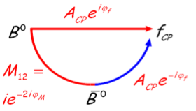
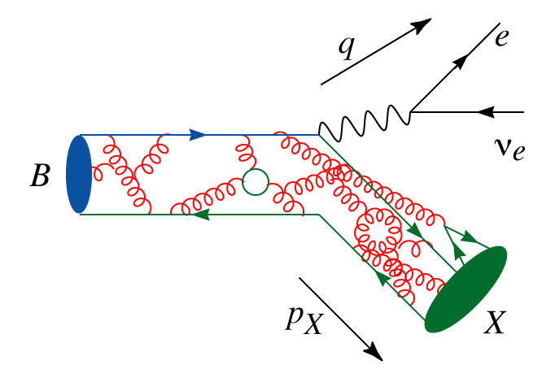
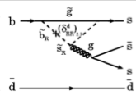

Toward New Physics
Explore the origin of CP violation
  Key element for understanding the matter content of our present universe
  Established in the B meson in 2001
  Direct CPV established in B mesons in 2004
Precisely measure parameters of the standard model
  For example the elements of the CKM quark mixing matrix
  Disentangle the complicated interplay between weak processes and strong interaction effects
Search for the effects of physics beyond the standard model in loop diagrams
  Potentially large effects on rates of rare decays, time dependent asymmetries, lepton flavour violation, …
  Sensitive even to large New Physics scale, as well as to phases and size of NP coupling constants
Statistic

Slide 4
Physics programme in a nutshell
Versatile flavour physics experiment
  Probe new physics observables in wide range of decays.
    Pattern of deviation from Standard Model can be used to identify structure of new physics.
    Clean experimental environment means clean signals in many modes.
    Polarized e⁻ beam benefit for τ LFV searches.
  Best capability for precision CKM constraints of any existing/proposed experiment.
    Measure angles and sides of the Unitarity triangle
    Measure other CKM matrix elements at threshold and using τ data.

Slide 5
B_{u,d} physics: Rare Processes and
Precision Measurements
Goal: Reveal presence of New Physics (NP) using two-pronged attack:
  Search for Rare Processes: NP contributions can be as large as Standard Model ones
    Large sensitivity to NP
    Ability to distinguish among NP models
  Make Precision Measurements of many quantities: over constrain the Standard Model predictions
    NP will often lead to discrepancies in global analyses of measured processes
will build on experience of current B-factories.

Slide 6
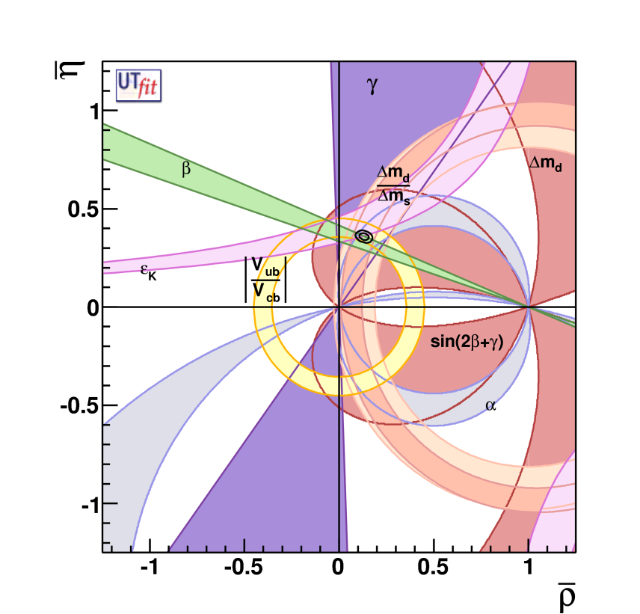
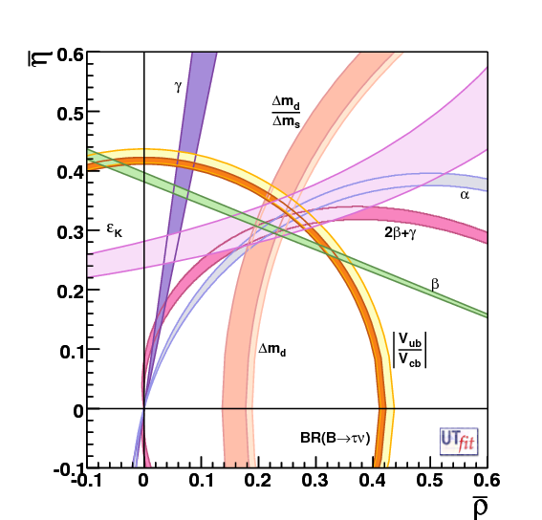
CKM constraints
Today:
measures the sides and angles of the Unitarity Triangle (UT)
Many measurements constrain the sides and angles of the UT: the SM predicts that all measurements “intersect” at apex of the triangle
When NP is present, the measurements do not yield a unique apex, but you need the high precision of a Super Flavour Factory.
SuperB: The "dream" scenario with 75ab⁻¹

Slide 7
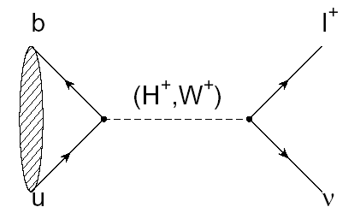

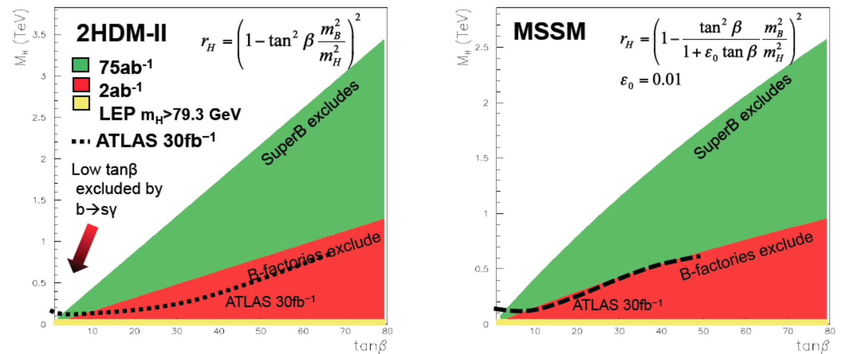
B_{u,d} physics: Rare Decays
Example:
  Rate modified by presence of H⁺
SM particle
NP particle

Slide 8

Charm@ : goals
Run at ϒ(4S):
βγ=0.238
Large improvement in D⁰ mixing and CPV: factor 12 improvement in statistical error wrt BaBar (0.5 ab⁻¹);
time-dependent measurements will benefit also of an improved (2x) D⁰ proper-time resolution.
[≈1KHz of ]
Unique feature of SuperB
Run at ψ(3770):
βγ up to 0.9
coherent production with 100x BESIII data and CM boost up to βγ=0.9;
almost zero background environment;
possibility of time-dependent measurements exploiting quantum coherence.

Slide 9
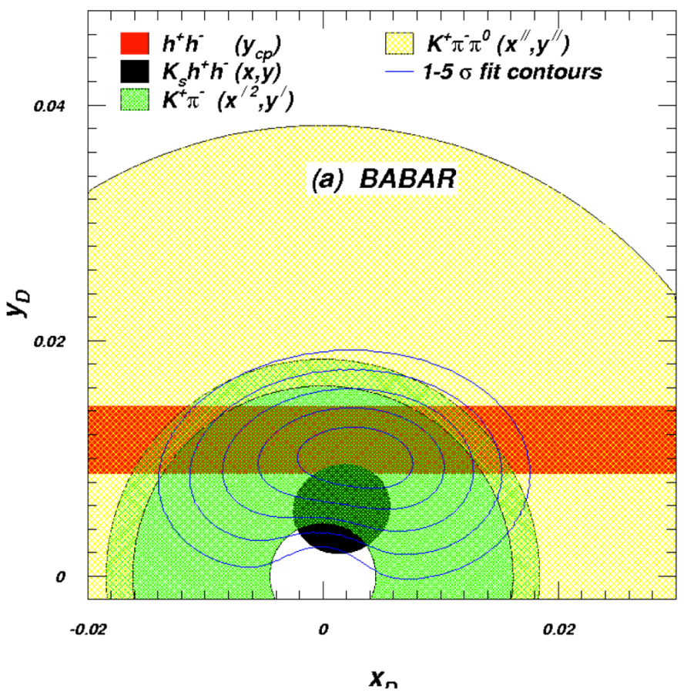
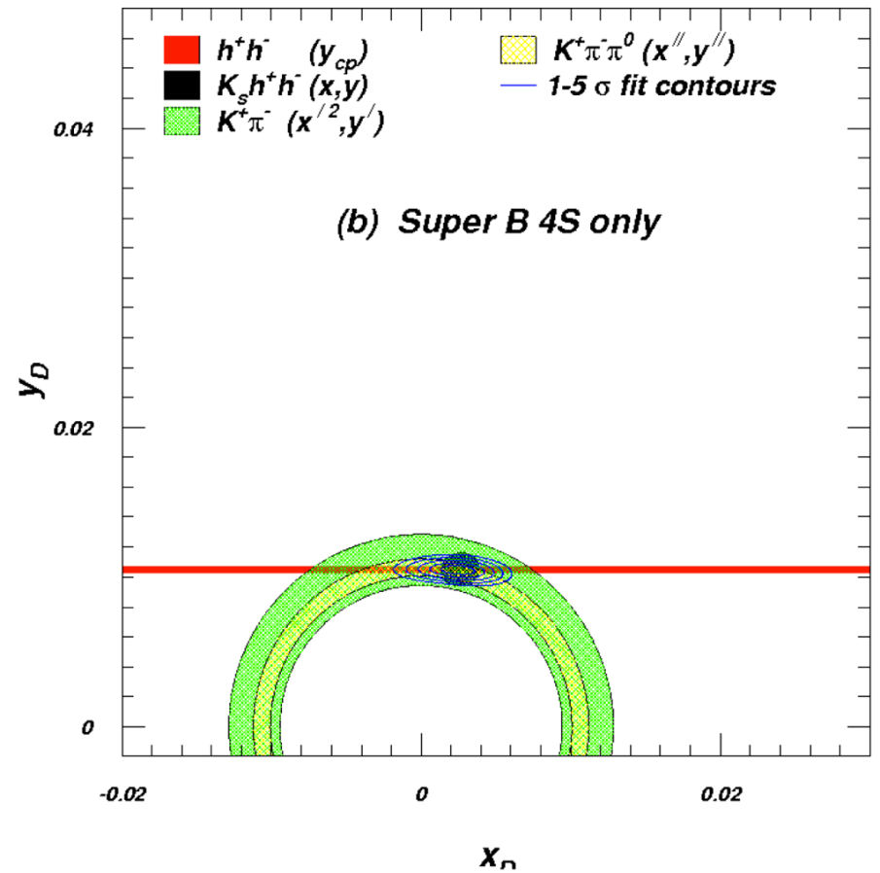
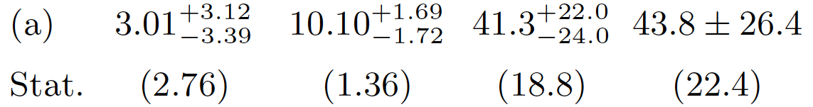
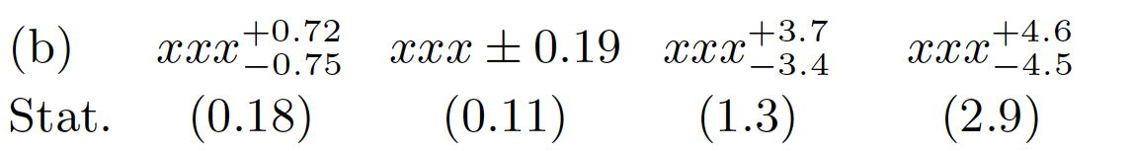
Sensitivity projections with 75 ab⁻¹ at ϒ(4S)
Uncertainties shrink:
x_{D}→ x_{D/4}; y_{D}→ y_{D/}10
Precision in x_{D} is limited by Dalitz plot model.
9

Slide 10
Charm at DD threshold
Almost zero background analyses: search for rare/forbidden decays, precise measurement of relative D⁰-D⁰ strong phases, search for CPV in wrong sign (WS) semileptonic (SL) D⁰ decay modes.
Unique possibilities of time-dependent measurements at DD threshold currently under study:
  coherent production allows time-dependent measurements also withCP-tagged events;
  CP, T, CPT conservation tests similar to those in K⁰-K⁰ and B⁰-B⁰ systems;
  measure of the unitarity triangle in the Charm sector.
CP-odd
V_{ud}*V_{cd}
V_{ub}*V_{cb}
CP-even
V_{us}*V_{cs}

Slide 11
Time dependent measurements at the
Ψ(3770) (same as for Y(4s))
π⁺
π⁻
D tag
π⁻
K⁰_{S}
π⁺
π⁻
z
Ψ(3770)
D
βγ up to 0.9
Δz
π⁺
Δt ≅ Δz/γβc
Reconstruct the decay vertex of
the two D mesons
2. Compute the proper time difference Δt
minimum boost needed to achieve
the required Δt resolution

Slide 12
Experimental considerations of running at DD threshold with boost
Pro:
  Very clean environment, backgroud extremely low;
  Quantum coherence: mixing and CP, T, CPT analyses;
  Access to D⁰-D⁰ relative phases and possibilities of time-dependent Dalitz plot analyses with a model independent approach;
  Systematic errors reduction due to background and Dalitz model uncertainties;
Cons:
  Time-dependent measurement require larger CM boost compared to the B⁰-B⁰ case to achieve adequate time resolution;
  reconstruction efficiency decreases with large CM boost. Need to optimize the boost value.

Slide 13
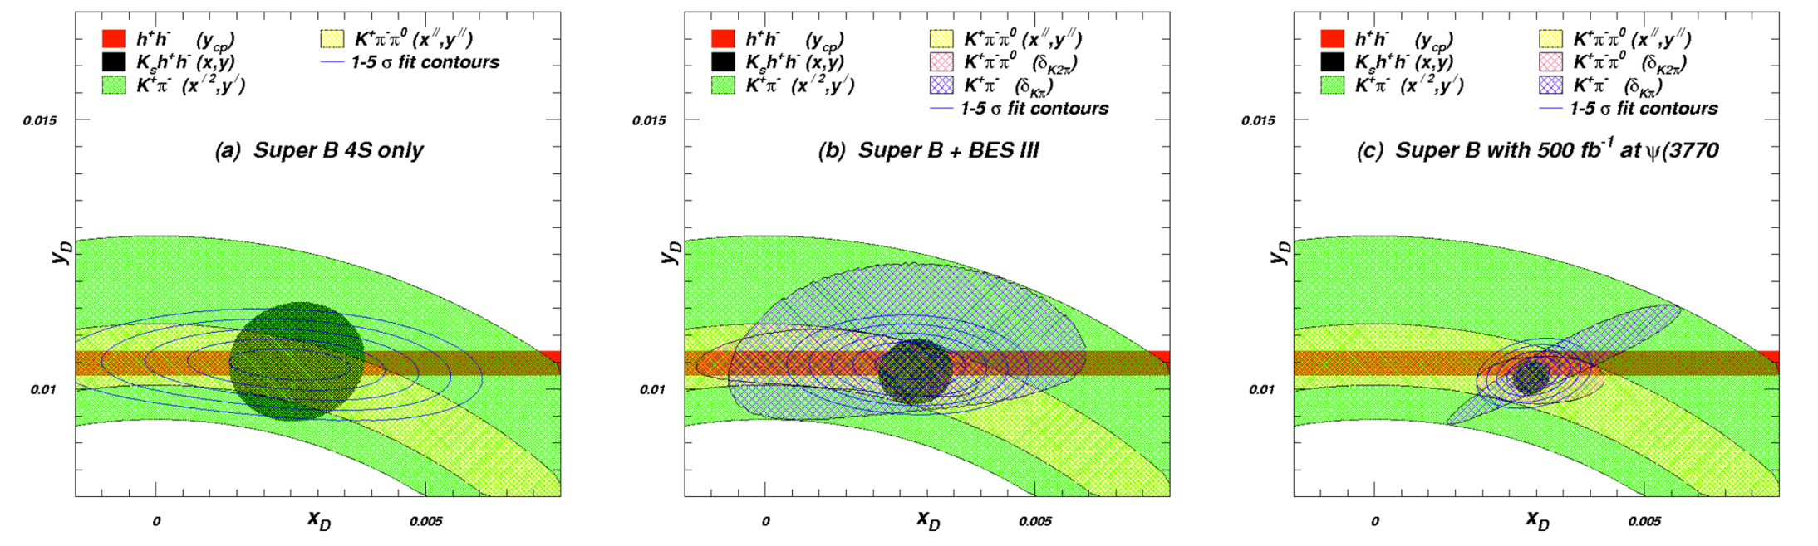



Two improvements in mixing precision come from threshold data:
CAVEAT: NO TIME-DEPENDENT STUDIES INCLUDED YET
Dalitz plot model uncertainty shrinks
Information on overall strong phase is added
13

Slide 14
Measurements with Polarization

Slide 15
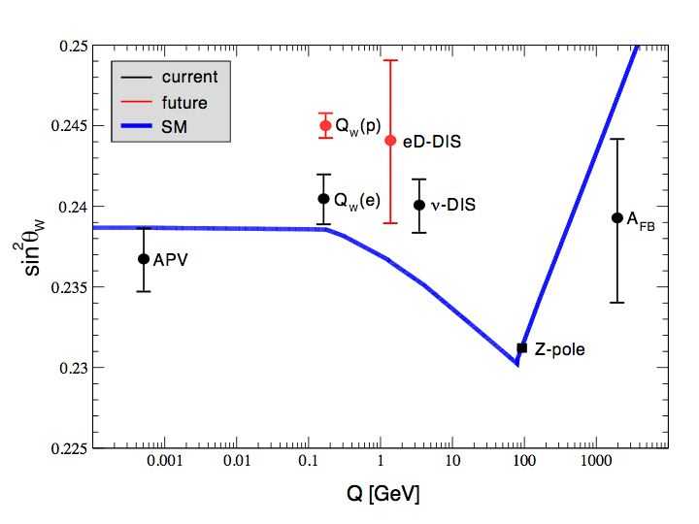
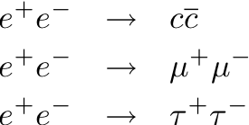
Precision Electroweak
sin²θ_{W} can be measured with polarised e⁻ beam
  √s=ϒ(4S) is theoretically clean, c.f. b-fragmentation at Z pole
Measure LR asymmetry in
at the ϒ(4S) to same precision as LEP/SLC at the Z-pole.
Can also perform crosscheck at ψ(3770).
SuperB

Slide 16
Is this measurement also possible with Charm?
@ Y(4S) . But hadronization correction.
Operate at a ccbar vector resonance above open charm threshold Ψ(3770), use the same analysis method as for b.
Polarization at low energies with high luminosity is needed
That is included in the SuperB design

Slide 17
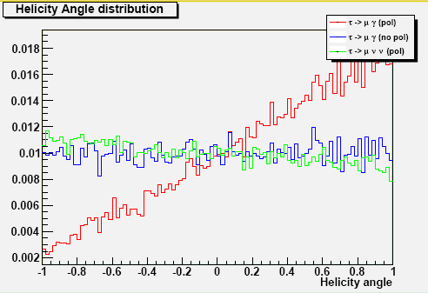

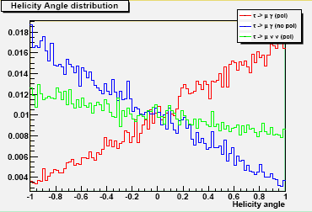
Polarization: a tool to handle and reduce Background

Slide 18
τ→μγ :Bkg extrapolation (using BaBar analysis)
BaBar expects 5.1 events in the 2σ signal region
1.7 from lepton tags
1.4 from 3 hadron tags
2.0 from π+ρ tags
96% comes from real τ decays (86% from μννγ)
Bkg extrapolated to SuperB gives
300 events in the signal box.
It can be reduced thanks to:
Improved resolutions
Improved EMC coverage
~250 events expected
Background from taus is considered irreducible
Need to reduce backgrounds to an acceptable level to scale better than √L

Slide 19
Notes:
DA RECUPERARE

Slide 20
Notes:
NOTA: DA RECUPERARE CON RISOLUZIONE MIGLIORE

Slide 21
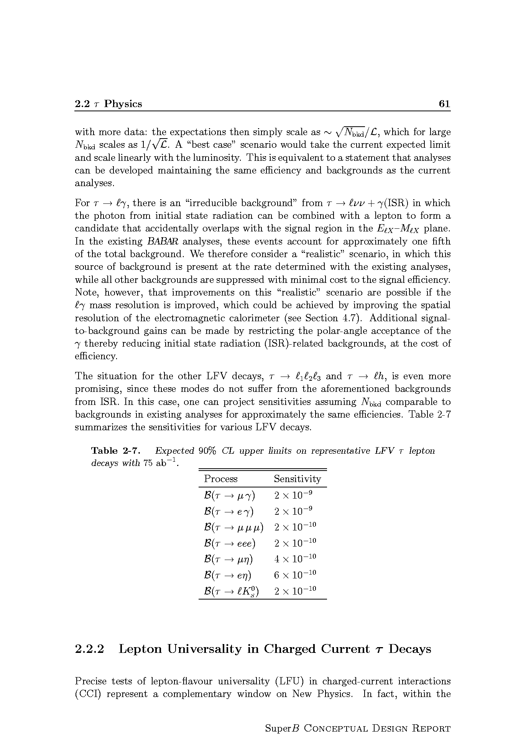
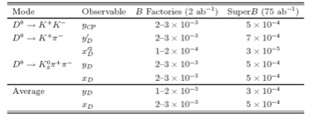
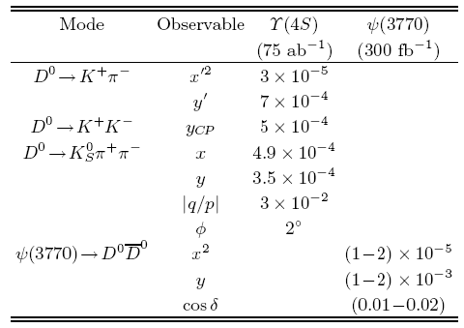
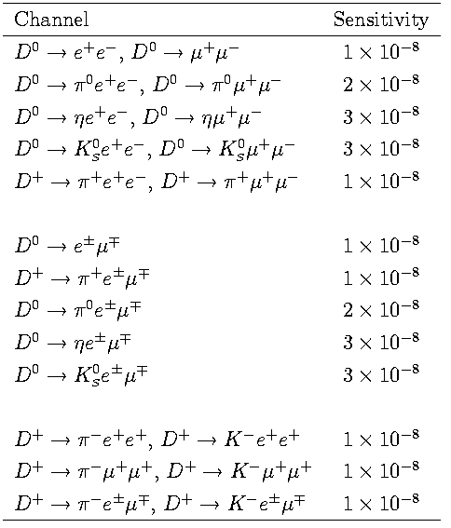
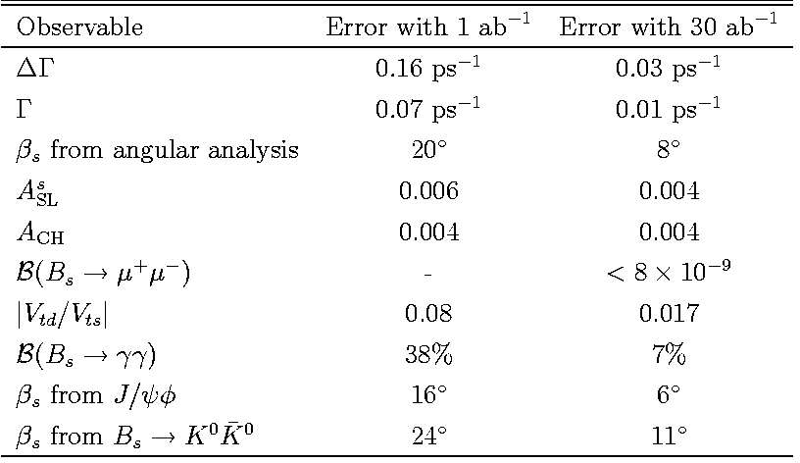
τ physics (polarized beams)
Charm at Y(4S) and threshold
To be evaluated
at LHCb
B_{s} at Y(5S)
Bs : Definitively better at LHCb

Slide 22
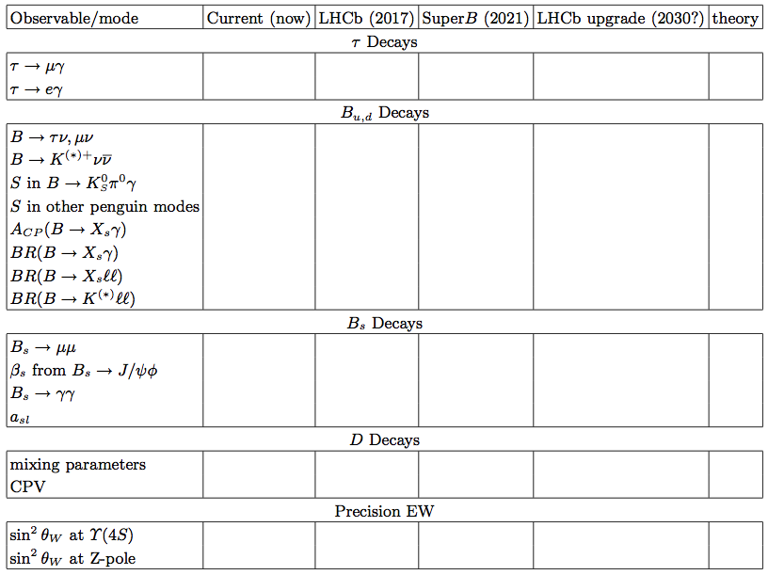
Many unique quality measurements
Experiment: No Result Moderate Precision Precise Very Precise
Theory: Moderately clean Clean Need lattice Clean
Benefit from polarised e⁻ beam
very precise with improved detector
Statistically limited: Ang. analysis with >75ab⁻¹
Right handed currents
SuperB measures many more modes
systematic error is main challenge
control systematic error with data
SuperB measures e mode well, LHCb does μ
Clean NP search
Theoretically clean
b fragmentation limits interpretation

Slide 23
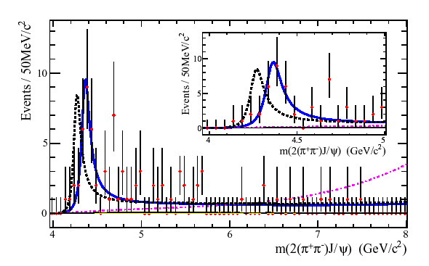
Exotic hadronic spectroscopy
Hints of a new type of particles with more than 3 quarks
c
q
c
q
B-Factories produced a lot of results but …

Slide 24
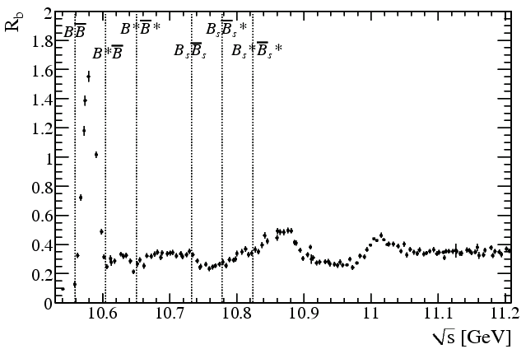
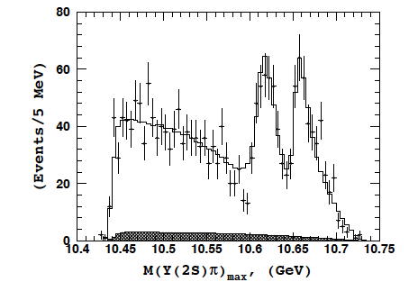
Exotic hadrons @ SuperB
Much larger statistics @Y(4S) needed
High luminosity energy scan needed:
  produce resonances directly (E~4-4.5 GeV)
  Exploit recent evidence of exotic states produced at Y(5S)
Υ(4S)
Expected tetraquarks
Υ(5S)
Υ(6S)
Y(5S)→Zbp→

Slide 25
and Panda :Hadron Spectroscopy e⁺e⁻ vs ‾pp
e⁺e⁻ collisions
direct formation
two-photon production
initial state radiation (ISR)
B meson decay
+ low hadronic background
+ high discovery potential
- direct formation limited to vector states
- limited mass and width resolution for
non vector states
- high hadronic background
+ high discovery potential
+ direct formation for all (non-exotic) states
+ excellent mass and width resolution
for all states
‾pp annihiliation

Slide 26
REQUIREMENTS FROM PHYSICS
Parameter | Requirement | Comment
Luminosity (top-up mode) | 10³⁶ cm⁻²s⁻¹ @ Υ(4S) | Baseline/Flexibility with headroom at 4. 10³⁶ cm⁻²s⁻¹
Integrated luminosity | 75 ab⁻¹ | Based on a “New Snowmass Year” of 1.5 x 10⁷ seconds (PEP-II & KEKB experience-based)
CM energy range | threshold to Υ (5S) | For Charm special runs (still asymmetric……)
Minimum boost | βγ ≈0.237 ~(4.18x6.7GeV) | 1 cm beam pipe radius. First measured point at 1.5 cm
e⁻ Polarization Boost up to 0.9 in runs at low energy under evaluation for charm physics | ≥80% | Enables τ CP and T violation studies, measurement of τ g-2 and improves sensitivity to lepton flavor-violating decays. Detailed simulation, needed to ascertain a more precise requirement, are in progress.

Slide 27
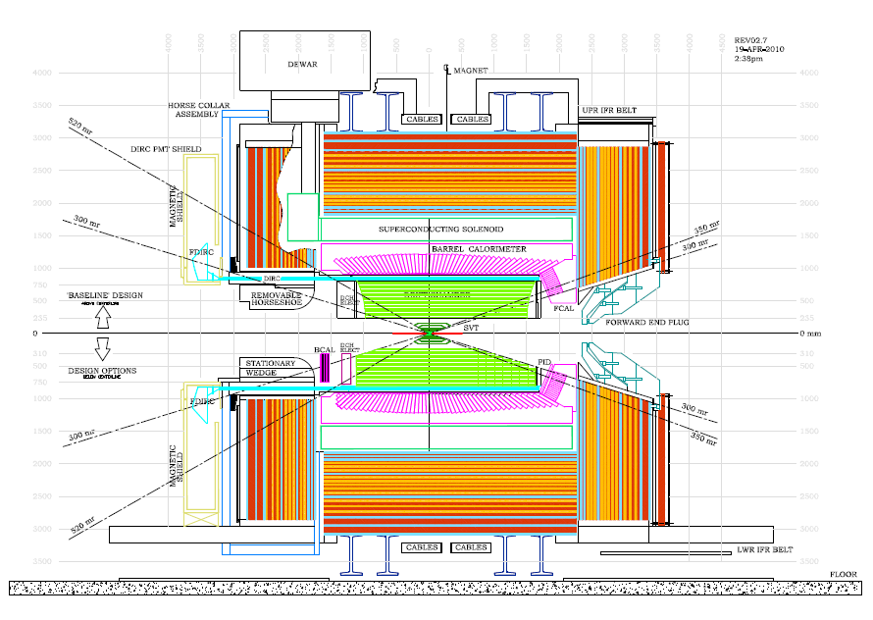
SuperB Detector (with options)

Slide 28
END

Slide 29

SuperB Luminosity model
75 ab⁻¹

Slide 30





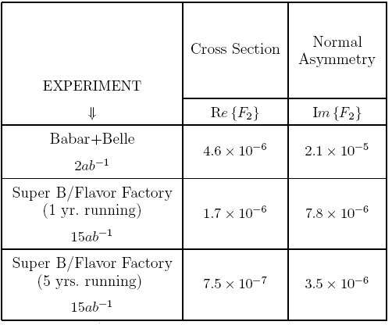
g-2 Reach (Valencia Report 2008)
Δaμ is not in good agreement with SM
Measuring differential cross section of tau production would lead to measurement of the real part of tau form factor.
We began considering 1-3 prong
whose experimental selection is cleaner
Need to tag the sample:
Lepton tag: higher purity & higher diluition (at least 3
neutrinos)
Hadronic tag: lower purity & lower diluition (2 neutrinos)
Systematics come mainly from tracking
Should be able to measure the
real part (0.75-1.7)x10⁻⁶
75ab⁻¹

Slide 31

Questions
Are SuperKEKB and SuperB discovery machines in the LHC era ?
Why is a luminosity > 10³⁶ required ?
Why LHCb is not enough for flavor studies ?
Is it important running at the charm/tau threshold ?
How important to have polarization ?

Slide 32
Future Super B Factories
 | SuperB | Super KEKB
Peak Luminosity | >10³⁶ | 0.8 x 10³⁶
Integrated Luminosity | 75 ab⁻¹ | 50 ab⁻¹
Site | Green Field | KEKB Laboratory
Collisions | mid 2016 | 2015
Polarization | 80% electron beam | No
Low energy running | 10³⁵ @ charm threshold | No
Approval status | Approved | Approved

Slide 33
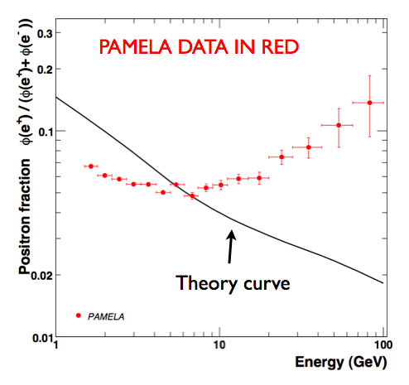
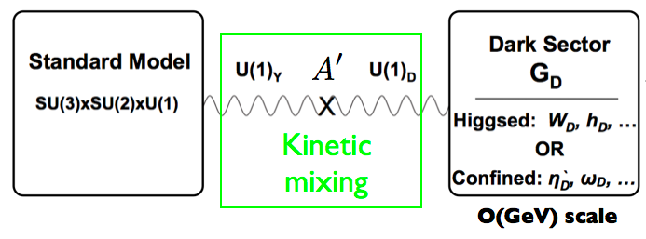
Search for Dark Forces
Results from Pamela/Fermi: excess of positrons of astrophysical origin
Due to particles decaying into e⁺e⁻ with m<2m_{p}?
“Dark” gauge sector

Slide 34
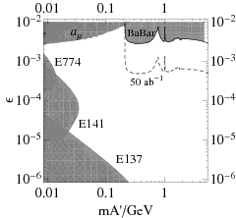
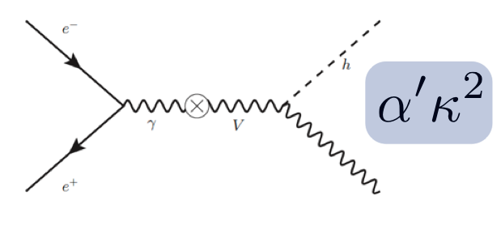
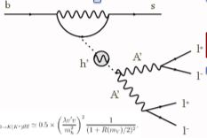
SuperB Sensitivity to dark forces
Discovery modes:
Direct production
B decays
SuperB

