Slide 1
The air core magnets of IR: characteristics and criticity
List of the magnets
Structure of the quadrupoles
Margins
R&D needs (the model)
Quench issues
Lay-out of the anti solenoids
Open problems
Next steps

Slide 2
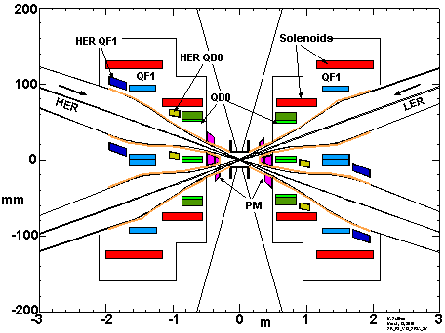
The IR magnets (Mike Sullivan December 2010)

Slide 3
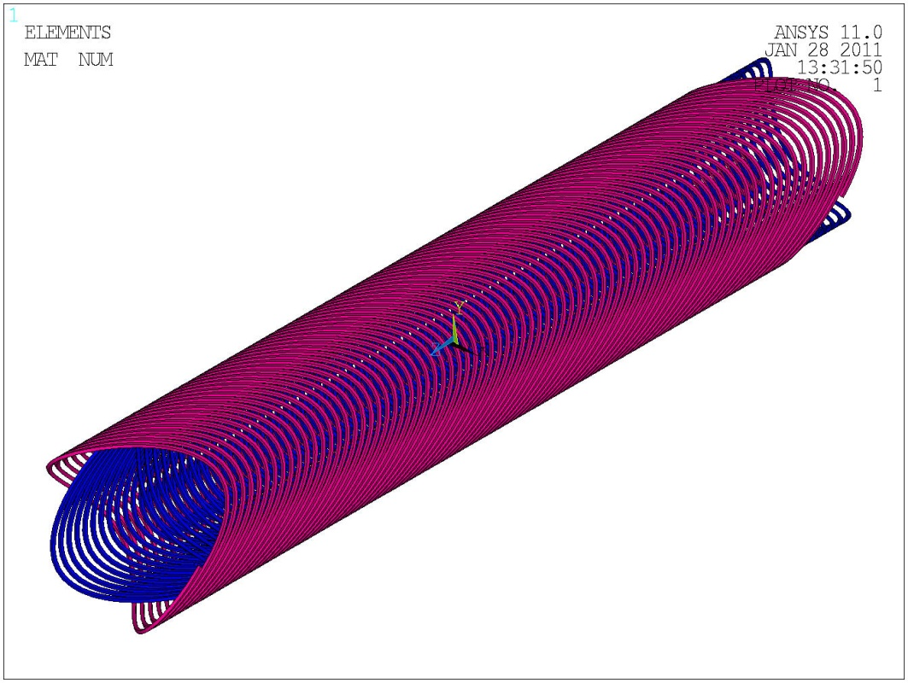
Basic layout: double helix
The quadrupoles are done according the double helix principle. This lay-out allows to modulate the winding introducing suitable multipole corrections. The overall structure is compact and the effect of coil ends on field quality is minimal (wrt more conventional designs)

Slide 4
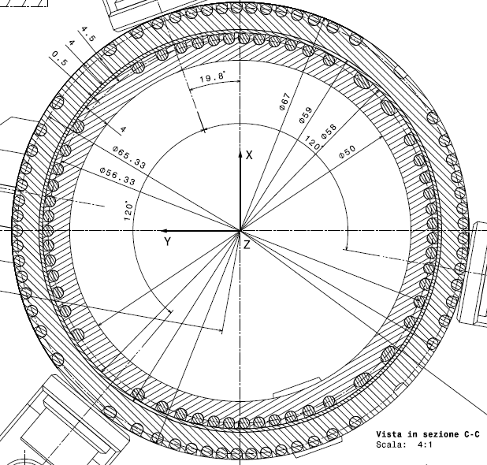
Cross section of a (pure) quadrupole

Slide 5
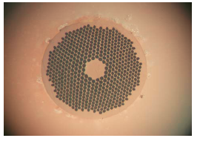

The superconducting wire
Preliminarly the sc wire chosen for these coils if a NbTi multifilamentary wire already involved in CMS conductor. The diameter is 1.28 mm; the Cu/SC ratio is 1.1

Slide 6
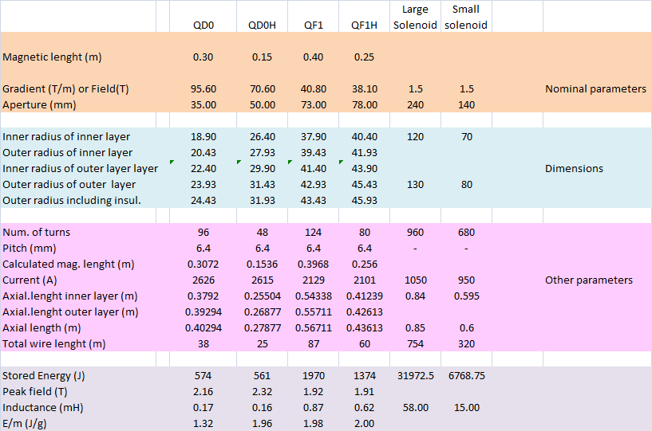
Main characteristics of all magnets

Slide 7
Temperature margin and engineering current density for QD0
At I=2626 A (I/Ic= 64%) Grad=95.6 T/m ) →
DT marg=1.5 K ; Peak Field 2.2 T (Tc= 8.35 K; Tg=5.7
(Not too much!! we will need a conductor slightly larger and currying more current)
In the wire J= 2051 A/mm²
A value incredibly high (in LHC dipole J~400 A/mm² )
Protection is critical
→ Development of a model

Slide 8
Quench issues
Simple quench simulations (QF1) indicate potential problems. Local temperature increase is high because the quenched zone is small (about 10 m for a bilateral propagation).

Slide 9
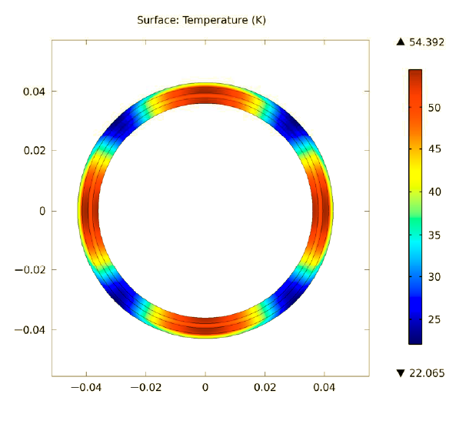
Mitigation
In facts quench scenario is better because:
As current decay, the eddy current induced in the mandrel will heat up the coil (quench back) better distributing the temperature increase; induced currents also dissipates energy in the mandrel reducing the amount of energy dissipated in the winding.
ac losses in the sc wire help in quenching larger regions.
→ A test of the model is crucial for understanding these issues.

Slide 10
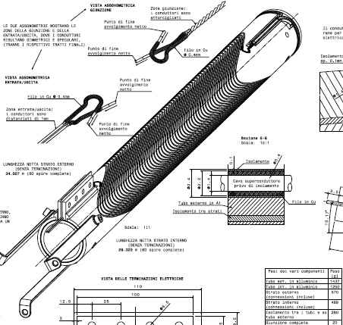
The model
With 60 turns this coil generates a gradient of 50 T/m at 2600 A
The stored energy is 1.1 kJ (2 times QD0). The current density is the same of QD0

Slide 11
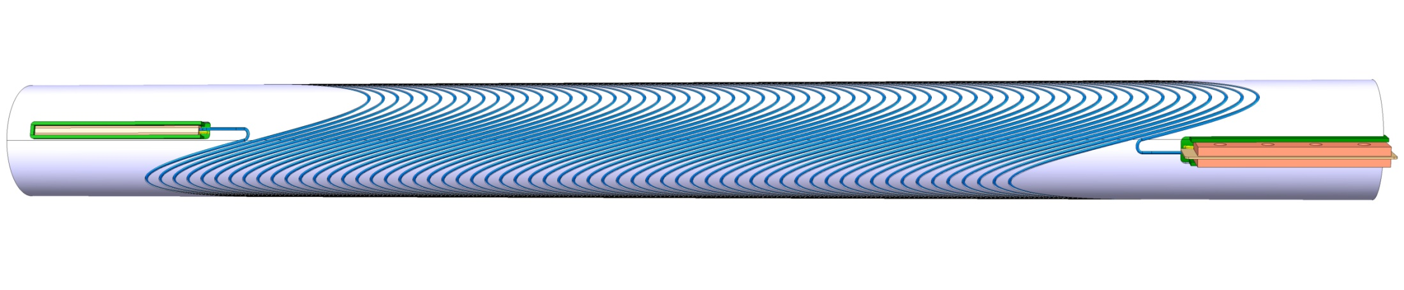
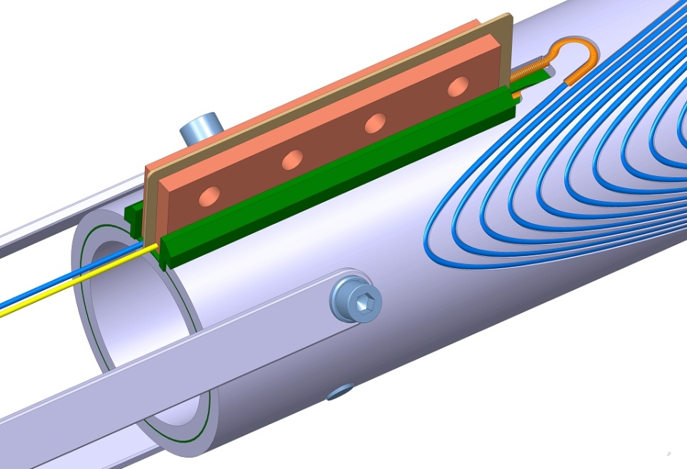
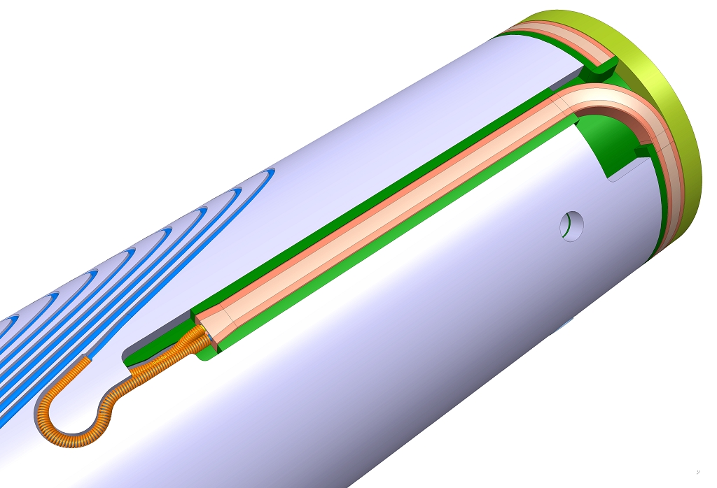
The model is under construction at ASG Superconductors

Slide 12
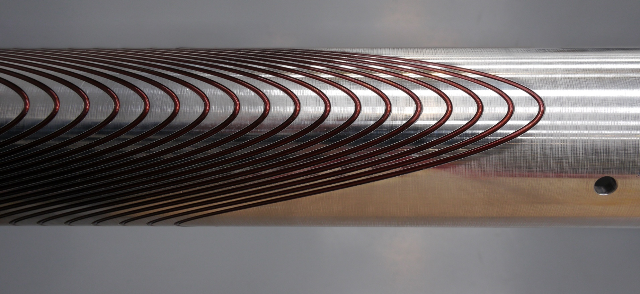
Winding tests
Winding tests performed at ASG Superconcoductors (Ge) with dummy cylinder (INFN Pisa) and dummy wire

Slide 13

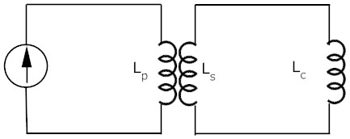
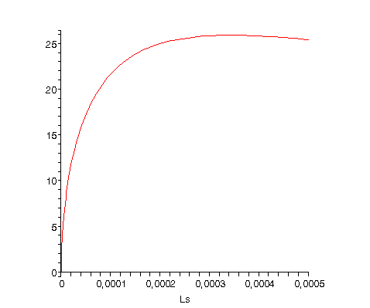
Limiting quench problems
We will use a transformer system for charging the model so to limit the energy which in case of in case of quench can be dissipated as heat (1150 J)
As primary we use a large magnet we have in lab L_{p}=6H ; L_{c}= 340 μH
The ideal current transformer ratio is for Ls=Lc, but the energy would double. Using a reduced secondary inductance L_{s}=85 mH the current transformer ratio is still acceptable. In order to fast dump the current and extract energy from the coil, a heater is placed in the secondary winding.

Slide 14
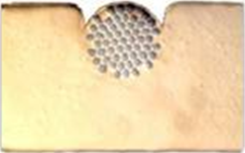
The conductor for the antisolenoids
The same wire involved in the quadrupoles is embedded into a copper block (wire in channel) with dimensions 3.5 mm x 2.4 mm
Peak Field 1.73 T
(Tc= 8.54K; Tg=7.65 K).
The temperature margin is 3.4 K. That’s fine!

Slide 15
Shield of the main solenoid field
The backward and forward solenoids shall be different.
High axial force on backward solenoids (40 kN)

Slide 16
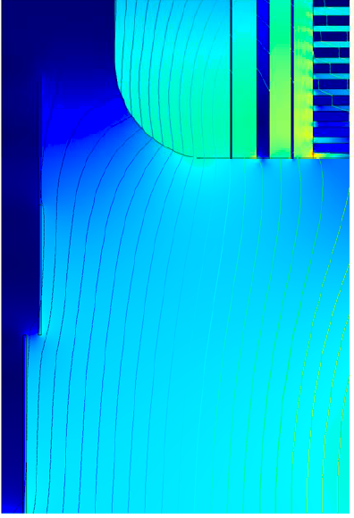

Slide 17
Magnetic field profile along the axis
Backward
Forward

Slide 18
Open problems
Determine the maximum current density allowing safe operation of the sc coils. Wait for the test on the model.
The axial length of real coils is higher than the magnetic length. The allowed axial space should be reviewed.
The allowed radial space looks quite small. At a first sight it is not easy to accomodate the antisolenoids with their supporting system inside the cryostat. This point needs a specific study which is also related to the cooling system of the cold mass (Bi-phasic or superfluid LHe bath, cooling tubes, conduction, ..)

Slide 19
Next steps
Construction of the model (July 2011) and cryogenic tests (Sept-October 2011)
Design construction and test of two prototypes of real magnets (QD0 or QF1) with two different technologies (NbTi and Nb₃Sn)
Preliminary design of the whole IR magnets cold mass, crostat and proximity cryogenics and services (We will have a chimney with cooling pipes and current leads connecting the cryostat with a proximity cryogenics including the sc transformers)

