Slide 1
Injection System Update
S. Guiducci (LNF)
XVII SuperB Workshop
La Biodola, Isola d'Elba, May 29th

Slide 2
Relevant parameters of SuperB
Main Rings for injection
 | e⁻ | e⁺
Energy (GeV) | 4.18 | 6.70
Number of bunches | 978 | 978
Particles/bunch | 6.6x10¹⁰ | 5.1x10¹⁰
Charge/bunch (nC) | 10.6 | 8.2
Horizontal emittance (nm) | 2.5 | 2.0
Vertical emittance (pm) | 6.2 | 5.0
Relative energy spread | 7.3x10⁻⁴ | 6.4x10⁻⁴
Lifetime (s) | 269 | 254
Polarization | ≈80% | 0

Slide 3
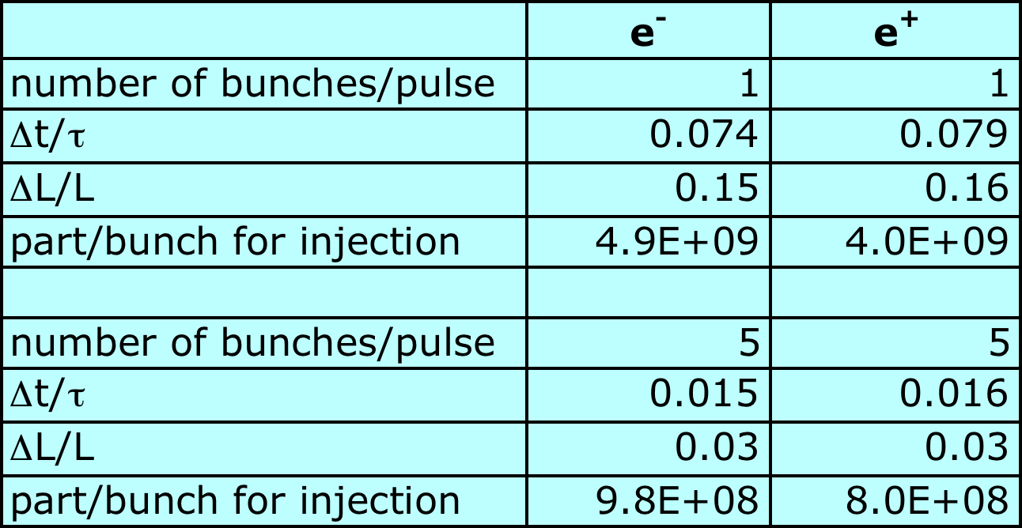
Charge per bunch required at injection
Assuming 50 Hz continuous injection in a single bunch,
each one of the ≈1000 bunches will be refilled after 20 s,
with a current loss ΔN/N ~ Δt/t
and a luminosity loss ΔL/L ~ 2ΔN/N
If we inject in the main ring a few bunches per pulse, for example 5, we can keep the peak luminosity nearly constant and reduce the injected charge per bunch

Slide 4
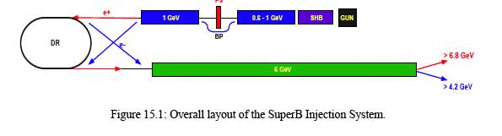
Injection System – New CDR
S band linac at 50 Hz
Injection in each ring at 25 Hz
SLAC Polarized electron gun
Spin rotator in a special section downstream of the gun
Conversion e-/e+ at low energy 0.6 GeV
  a newly designed capture section (L band) to produce a yield of more than 10%
Both beams are stored in the Damping Ring (DR) in turn
New Conceptual Design Report (Dec. 2010) on:
http://arxiv.org/abs/1009.6178

Slide 5
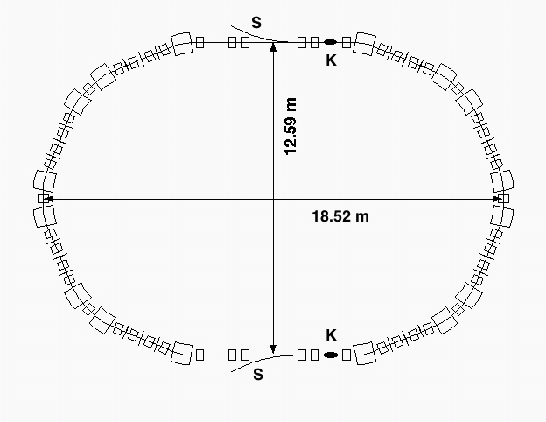
New Proposal for the Injection System
0.6 GeV
1 GeV
PC
SHB
THERM
GUN
BC
5.7 / 4 GeV
POL
GUN
SHB
0.2 GeV
Only the e⁺ beam is stored in the DR
S band linac at 100 Hz
Injection in each ring at 50 Hz
2 electron guns
  a “high current” gun for positron production
  a “low emittance” polarized gun for electron injection
Additional 200 MeV linac for e⁻
Reduced transfer lines and kickers for DR injection/extraction
Conversion e⁻/e⁺ at low energy 0.6 GeV as in CDR2

Slide 6
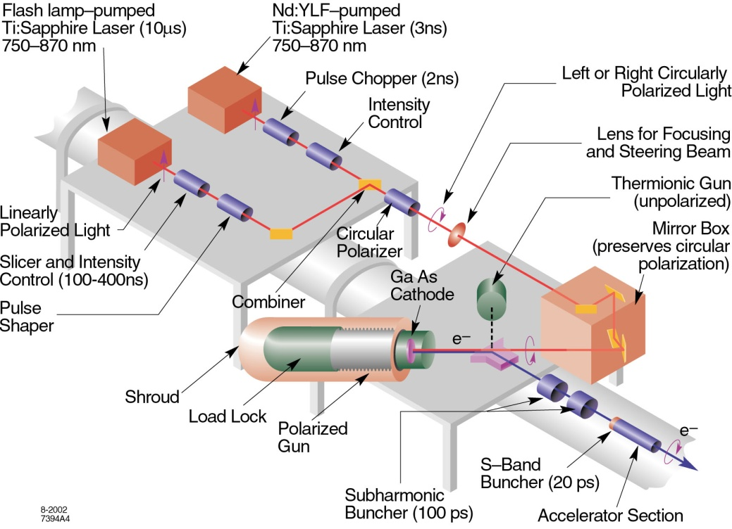
SLAC Polarized Gun
Parameter | SLC gun
Electron charge per bunch | 16 nC
Bunches per pulse | 2
Pulse rep rate | 120 Hz
Cathode area | 3 cm²
Cathode bias | -120 kV
Bunch length | 2 ns
Gun to SHB1 drift | 150 cm
e_{n,rms,gun} (fm EGUN) | 15•10⁻⁶ m
It’s important to define the characteristics of the 2 guns:
  “high current” gun for positron production
  “low emittance” polarized gun for electron injection
And to study the electron injection from the gun to the LER to understand the feasibility of direct injection, without DR
courtesy A. Brachmann
SuperB

Slide 7
Sub-Harmonic Buncher
PC
0.6 GeV
SHB
THERM
GUN
1 GeV
SHB
e
BC
5.7 - 4 GeV
POL
GUN
SHB
SHB
0.2 GeV
~ 5÷10 mt.
IHEP results: bunch length = 10 psec
transp. efficiency ≈ 90%
R. Boni

Slide 8
S-band Low Energy Linacs
PC
0.6 GeV
SHB
THERM
GUN
1 GeV
SHB
e
BC
5.7 - 4 GeV
POL
GUN
SHB
SHB
0.2 GeV
F = 2856 MHz
Eacc ~ 22÷23 MV/m
Klystron
50 MW
SLED
45 MW
205 ÷ 210 MeV
L ~ 30 mt.
L ~ 10 mt.
R. Boni

Slide 9
L-band Linac
1 GeV
PC
0.6 GeV
SHB
THERM
GUN
1 GeV
e
BC
5.7 - 4 GeV
POL
GUN
SHB
0.2 GeV
Eacc ~ 12÷13 MV/m
n. of klystrons: 20
Klystron
40 MW
PC
S-band
50 MeV
L ~ 100 mt.
R. Boni

Slide 10
L-band Linac
L-band, room temperature linacs are unusual in the field of particle accelerators
One is in operation at the University of Osaka. Another one is foreseen for the SuperKEK-B
Both are based upon the use of
■ 30 ÷ 40 MW Klystrons and
■ SW, 2 mt copper sections, with average gradient of 12÷13 MV/m.
This is the “state of the art” of L-band warm linacs.
At present we do not have a cost estimate
R. Boni

Slide 11
High Energy Linac
F = 2856 MHz
… S-band solution
Eacc ~ 25 MV/m
n. of klystrons: 40
n. of sections: 80
1 GeV
PC
0.6 GeV
SHB
THERM
GUN
1 GeV
e
BC
e+ 5.7 GeV e- 4.2 GeV
5.7 - 4 GeV
POL
GUN
SHB
0.2 GeV
KLY
60MW
60MW
~ 150 MeV
~ 270 mt

Slide 12
High Energy Linac
F = 5712 MHz
… C-band solution
Eacc ~ 40 MV/m
n. of klystrons: 50
1 GeV
PC
0.6 GeV
SHB
THERM
GUN
n. of sections: 100
1 GeV
e
BC
e+ 5.7 GeV e- 4.2 GeV
5.7 - 4 GeV
POL
GUN
SHB
0.2 GeV
C-band KLY
50MW
~ 70MW
~ 120 MeV
~ 170 mt

Slide 13
Injector Complex
S-band
315 m
215 m
C-band
Bunch compressor and beam transport in a C-band linac need study

Slide 14
The “french” proposal for low energy positron production
Freddy Poirier, R. Chehab, O. Dadoun, P.Lepercq, A. Variola SuperB Workshop, Annecy, March 2010
At the SuperB Workshop in Annecy (March 2010) the LAL group proposed a high efficiency conversion system, consisting of an adiabatic capture system after the conversion target.
In this proposal, e+/e- conversion takes place at 600 MeV
Alessandro Variola will present the positron production system soon after

Slide 15


Recap
Freddy Poirier
4 Scenarios under investigation
25MV/m for acceleration
Scenario | 1 | 2 | 3 | 4
RF (MHz) – strategy | 2856 - acc | 2856 – dec (S-band) | 1428 – dec (L-band) | 3000 dec + 1428 - acc
Mean Energy (MeV) | 302 | 287 | 295 | 333
E_{rms} (MeV) | 21.4 | 32.3 (12) | 16.83 (9.09) | 5.2 (3.2)
Z_{rms} (mm) | 2.7 | 6.4 | 8.89 | 3.5
X_{rms} (mm) | 3.8 | 4.4 | 8.0 | 8.1
X’_{rms} (mrad) | 1.02 | 1.11 | 1.69 | 1.4
E_{x} =X’X (mm.mrad) | 3.8 | 4.6 | 13.0 | 11.4
Total Yield (%) | 2.8 | 7.53 | 32.3 | 31.9
Yield ±10MeV (%) | 1.3 | 3.9 | 19.6 | 29.3
With a positron injection of 10 nC and a yield of 3.9%, we will have 2.43 10⁹ positrons at 300 MeV ±10MeV (scenario 2 – 2.8 GHz)
These values are a good indication of how well the scenarios work but need we to bring these to 1 GeV (DR energy)

Slide 16
Damping Ring
A damping ring at 1 GeV is used to reduce the positron beam injected emittance
M. Preger

Slide 17
Damping ring parameter list
Energy (GeV) | 1
Circumference (m) | 51.1
Equilibrium horizontal emittance (nm) | 23
Equilibrium vertical emittance, k=.01 (nm) | 0.2
betatron damping time (ms) | 7.3
Equilibrium energy spread | 6.2 10⁻⁴
Momentum compaction | 5.7 10⁻³
RF frequency | 475
RF voltage (MV) | 0.5
Bunch length (low current, mm) | 4.8

Slide 18
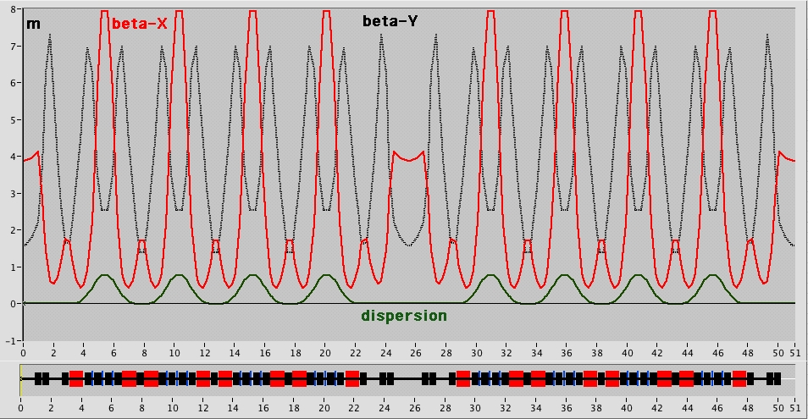
DR Optical Functions

Slide 19
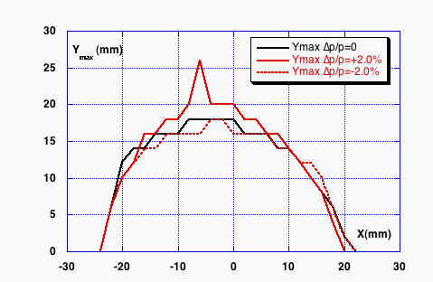
DR Dynamic Aperture
β_{x}= 3.9 m
β_{y}= 1.6 m
A_{x} = x_{max}²/β_{x}= 1 10⁻⁴ m
A_{y} = y_{max}²/β_{y}= 1.6 10⁻⁴ m

Slide 20
DR Injection Acceptance
DR Energy 1 GeV
Beam stay clear 25 mm radius
Injection on axis
Max oscillation amplitude (betatron +synchrotron) of the injected beam (with safety margin for orbit and energy errors) x_{max} = 15 mm
RF Energy acceptance @0.5MV is ΔE/E = 2.5 10⁻²
Acceptance including 99% of the positrons
A_{x} = x_{max}²/β_{x}= 1 10⁻⁵ m
ΔE/E = 1.5 10⁻²
We can define an equivalent rms emittance assuming x_{max} = 15mm = 3 σ_{x} :
β_{x}^{max} = 8 m
η_{x}^{max} = 0.8 m
ε_{x} = 1.1 10⁻⁶ m
σ_{p} = 5 10⁻³

Slide 21
The beam emittance at DR extraction is given by:
With:
_{i}^{DR} injected emittance in DR @ 1GeV
t storage time
⧫ betatron damping time
₀ equilibrium emittance
_{i}^{HER} injected emittance in HER @ 6.7 GeV
_{i}^{HER} = ^{DR} *1/6.7

Slide 22
Positron beam emittance evolution
_{i}^{HER} = ^{DR} *1/6.7
 | X-plane | Y-plane K=.01 | Y-plane K=.01
_{I} (m) | 1.1 10⁻⁶ | 1.1 10⁻⁶ | 1.1 10⁻⁶
t (ms) | 20 | 20 | 40
t (ms) | 7.3 | 7.3 | 7.3
₀ (nm) | 23 | 0.23 | 0.23
^{DR} (nm) | 27.5 | 4.8 | 0.25
_{i}^{HER} (nm) | 4.1 | 0.72 | 0.04

Slide 23
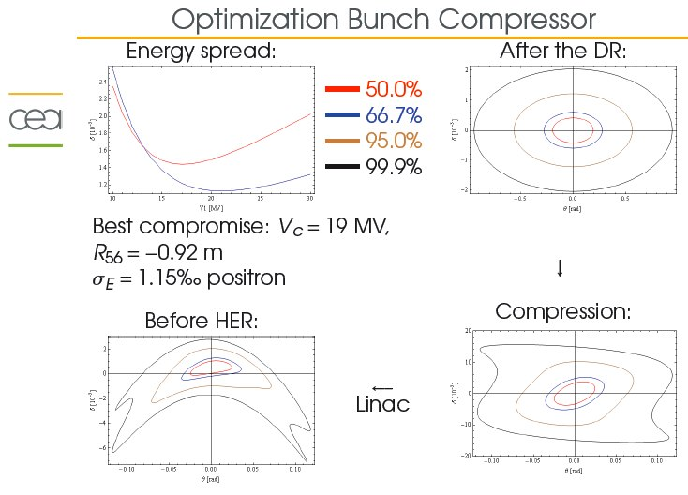
Bunch compressor and transfer lines
A. chance’
A. Chancé

Slide 24
Transfer lines between Linac and damping ring
X
No kickers and septa,
half-sine-wave kickers
in the damping ring
X
A. Chancé

Slide 25
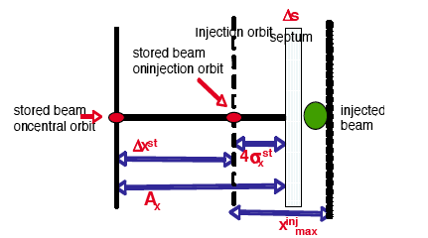
Injection into Main rings
We accept ±3σ_{x}^{i} of the injected beam
2different configurations are considered
zero dispersion at injection point D_{x}^{st} = D_{x}^{inj} = 0
non zero dispersion Dxst = Dxinj 1 0 and an energy offset d of the injected beam

Slide 26
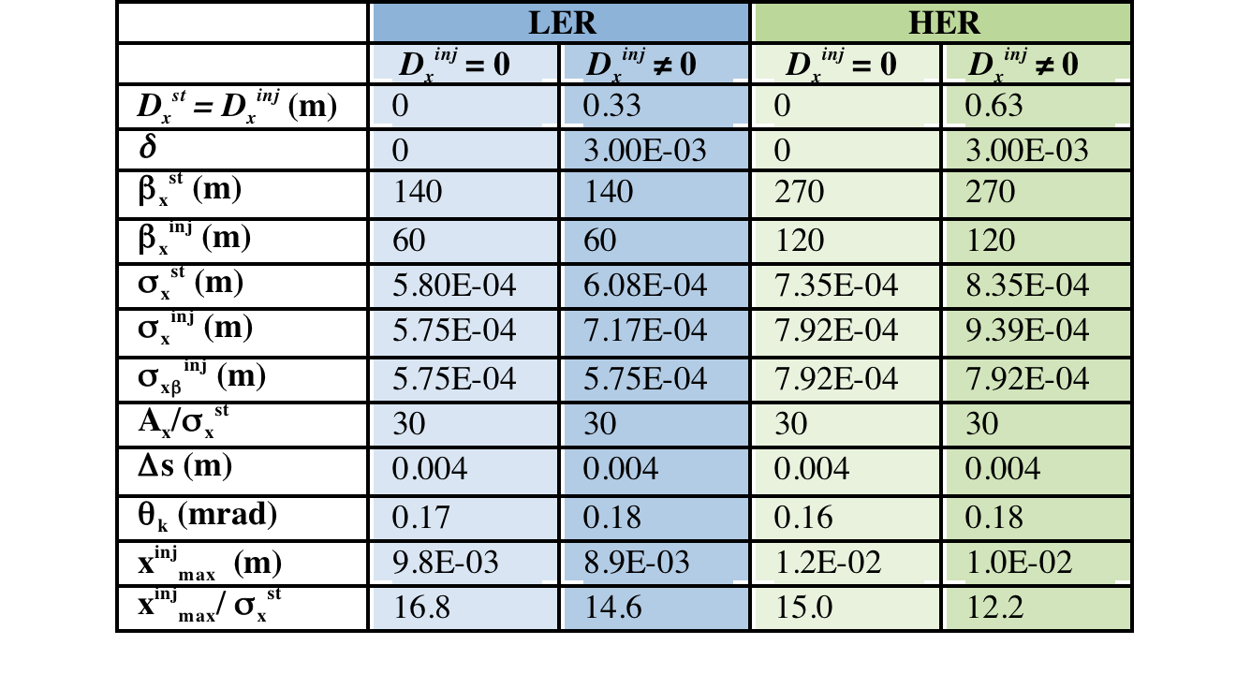
Parameters for injection in LER and HER
The configuration with non-zero dispersion is preferred since it allows smaller betatron oscillations of the injected beams (15 σ_{x} for LER and 12 σ_{x} for HER)

Slide 27
Comments on injection in LER and HER
 | LER | HER
Injected beam emittance ε_{x}^{i} | 5.50E-09 | 5.22E-09
Injected beam energy spread σ_{p}^{i} | 1.30E-03 | 8.00E-04
The requirements on the vertical injected beam emittance have not considered yet.
Neglecting beam-beam effects, since the beam is injected on axis, the only request on the vertical injected beam emittance is to be smaller than the beam stay clear of the rings.
An issue that has to be studied is the effect that the beam aspect ratio could have on injection efficiency and detector background.
A simulation tracking the distribution of injected particles through the ring, taking into account the effect of the beam-beam kick and the machine errors and nonlinearities, is needed to set the tolerances on the injection parameters

