Slide 1
Elba Report on SuperB Site Review Committee (SBSC) Meeting Frascati 18-19th April 2011
John Seeman (SLAC) for SBSC
May 30, 2011

Slide 2
SBSC members
John Osborne (Chairman) john.andrew.osborne@cern.ch
CERN Civil Engineer, mostly underground experience, LHC, CLIC, ILC
Philippe Eymard philippe.eymard@synchrotron-soleil.fr
Building group, tunnels
Wilhelm Bialowons wilhelm.bialowons@desy.de
Physicist and technical, vibration measurements, ILC
Alfredo Fulgenzi alfredo.fulgenzi@lngs.infn.it
Electrical engineer, at LNGS since 1987, LV & HV
Gaetano Schillaci schillaci@lns.infn.it
Mechanical and civil construction, 15 years at INS
Franco Gerardi franco.gerardi@cnao.it
Nuclear Engineer. PM, foundations and structures
John Seeman Seeman@slac.Stanford.edu
SLAC PEP2, member of Super B team

Slide 3
SBSC initial mandate
SuperB - Site Advisory Committee (SBSC)
Kick Off Meeting 17 February 2011
Mandate :
The initial task of the Site Advisory Committee (SBSC) is to review the document “Site Requirements Evaluation for the SuperB collider and Synchrotron Light Facility Project” , dated 12 January 2011.
Once reviewed, this committee will give recommendations on what site criteria should be analyzed to assist in the site selection process. Where possible, this committee will recommend parameters against each criterion.
The mandate for any subsequent phases will be defined after the completion of Phase one.

Slide 4
All SBSC documents will be uploaded on Indico site
http://agenda.infn.it/categoryDisplay.py?categId=53

Slide 5
SBSC comments on “Siting Document”
The committee was very impressed with the quality of the ‘Siting Document’
SBSC had two EVO meetings to review the Site Requirements document
SBSC comments formally submitted to SuperB via M. Giorgi on 9th March 2011
Feedback document from SuperB received 18th April.
During the visit discussions were held with the following SuperB experts :
M. Giorgi, C.Sanelli, S.Tomassini, P.Raimondi,
LAPP vibration specialist (L. Brunetti).
Notes:
Very well prepared,comprehensive document, including the difficult task of recommending limits against the list of criteria.

Slide 6
TECHNICAL REPORT ON SUPER B SITE COMMITTEE REVIEW MEETING HELD AT FRASCATI 18/19TH APRIL 2011
Report: May 10, 2011
Meetings took place on the 18th and 19th April 2011, between the SBSC and SuperB experts at the INFN-LNF Frascati Site. The main purpose of the meeting was to review the “SuperB Site Requirements Evaluation” document and to plan future work for the SBSC.
This report summarises the findings of the SBSC on this “Site Requirements” document and on the possibility of constructing this new facilities on either the INFN-LNF Frascati Site or nearby at the TOR VERGATA Site.

Slide 7
Initial recommendations (1)
General Issues (Construction, environmental..)
The committee learnt that the focus now is to understand if the TOR VERGATA site matches the project requirements. On the TOR VERGATA site, there exists a 10m thick layer of deposits. The opinion of the committee is that it is most likely that this layer will have to be removed to found the new machine on ‘virgin’ ground. This will certainly have a cost impact on the project.
Obviously, detailed site investigation boreholes are urgently required in order to proceed with the study. If permission for drillings is difficult, perhaps some simple trial pits could be excavated in the virgin ground areas e.g. in the old dry river bed area ?
The committee recommends that the approval procedures (and time) needed for formal Project Approval by the authorities for the TOR VERGATA site is verified and compared against the Frascati site.
For example, is an environmental impact study not required (e.g. radiation levels, acceptable volume of the surface buildings, noise during construction) ?

Slide 8
Initial recommendations (2)
General Issues (Construction, environmental..)
As between the two foreseen sites the construction methods cannot be equivalent (tunnel boring machine for FRASCATI and cut-&-cover for TOR VERGATA, a comparison in the overall time schedule should be prepared for the evaluations of the sites.
The technical requirements for the SuperB project are severe and very specific. All the requirements (thermal and stability) are not in the common practices of engineering companies and of construction companies. Furthermore, these requirements cannot be handed over without having the SUPERB process working.
The committee recommends that the design and construction phases of the project are somehow de-coupled (i.e. not the same company)
A detailed schedule should be developed highlighting the critical milestones e.g. deposit removal, checking of vibration levels, compare construction methods (TBM or cut & cover)
Does a Master Plan exist for the region, and if so has it been checked that no future developments are in contradiction with this project proposal ?
An updated seismic map should be checked for TOR VERGATA ?
Existence of potential archaeological remains should be double checked ?

Slide 9
Initial recommendations (3)
Cooling & Ventilation
The committee learnt that ground water wells are not available and only available supply is from the city drinking water. As such, wet cooling is excluded. A dry cooling scheme needs to be further investigated including discussions with local authorities for supply and discharge water.
The ventilation concept for the tunnel would be of interest to the committee e.g. temperature stability
It doesn’t appear that Cooling and Ventilation issues are a ‘show stopper’ and could impact on the site selection

Slide 10
Initial recommendations (4)
Electricity
The committee learnt that it is believed power stability/ quality of the electrical network is adequate for both the Frascati and TOR VERGATA sites
The only advantage of using the Frascati site would be that you could re-utilise some existing infrastructure, e.g. a primary station
The link to the grid for both sites needs to be better understood and costed (i.e. new lines/stations at TOR VERGATA v upgrade of Frascati Site)
Choosing the TOR VERGATA site, it is necessary to build a new HV station and the line links.

Slide 11
Initial recommendations (5)
Ground Stability / Vibration
Long term and short term settlement/vibration constraints in section 4 of the report seem severe for the TOR VERGATA and Frascati Site e.g. 0.1µm peak to peak
The committee suggests that longer term vibration measurements should be made e.g. in the basement of a nearby building ?
Construction of new Metro link could potentially be a noise source
Ground stability / vibration is a potential ‘show stopper’ for the site and as such, these investigations should have top priority
Notes:
Close to highway

Slide 12
Vibration
SBSC recommends to the project the definition of the limits in the following way:
The total transverse beam oscillation induced by random quadrupole oscillation should not exceed 10 % of the corresponding beam sizes.
The ambient noise (i.e. the Root Mean Square value above 1 Hz) measured over a longer period (several weeks) with a wide band instrument (e.g. seismic sensor) should be well below the vibration limit (budget) over most of the time (less than 50 % over 90 % of the time).
Vibration measurements have a high priority for the site selection process. For flat beams, as it is the case for SuperB, the measurement of the vertical vibration is sufficient.
The design of magnet support and girders must avoid resonances below 50 Hz and the additional floor motion must also well bellow the machine limit as defined above.

Slide 13
Tunnel boring
It should be note that at CERN, in Molasse rock (fairly similar to the Pozzolane Rock), the average advancement rate for a 4.5m diameter tunnel for LHC was approximately 30 linear metres per week using a roadheader.
The roadheader also provides much more flexibility than a TBM, ie the number of machines can be adapted to suit program needs.
1200m/30 m/wk = 40 weeks

Slide 14
Next Steps for SBSC ?
Report was issued in early May
The SBSC mandate could be extended to check the site evaluation made by the SuperB team for the candidate site/sites

Slide 15
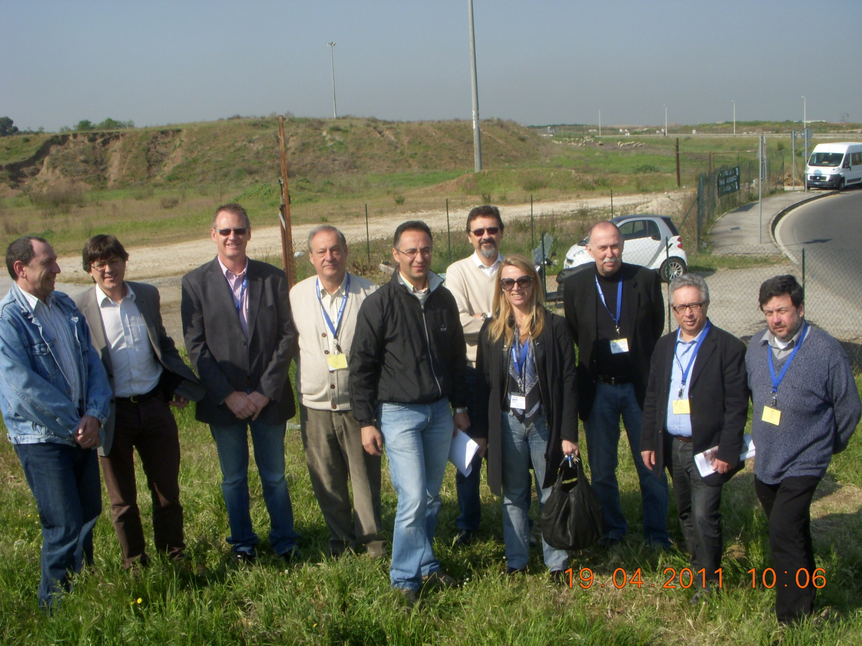
The SBSC thanks INFN LNF for its hospitality!

