Slide 1
Digitally Enhanced Interferometry
Daniel Shaddock
Centre for Gravitational Physics
Australian National University
Canberra, Australia
ANU:
Andrew Sutton
Danielle Wuchenich
Timothy Lam, Jong Chow
Malcolm King
Silvie Ngo, John Miller
David Rabeling (now at Nikhef)
JPL:
Brent Ware
Glenn de Vine
Robert Spero
Kirk McKenzie
Oliver Lay
Serge Dubovitsky
AEI
Oliver Gerberding
Roland Fleddermann

Slide 2
Overview
Introduction to Digital Interferometry (DI)
DI Measurement capabilities
  Picometre cavity readout
  Multiplexed measurements
  Wave-front sensing
  GRACE FO testing
  High-speed modulation
  Optical phased-array
  Quadrature phase-shift keying DI

Slide 3
Motivation
Optical interferometry has the potential for incredible sensitivity
Achieving this performance outside the lab is a significant challenge.
  Low frequency optical and electronic noise
      heterodyne interferometry
  Spurious interference from scattered light or electronic cross-talk e.g. M. Tröbs LISA Pathfinder talk.
      hunt down scattered light and remove it
  Monitoring displacement of N components requires up to 2N measurements.
      bulky optical systems.
Develop a metrology technique that is immune-by-design to these problems. Originally motivated by challenges in LISA.
Digital Interferometry combines the ultra high sensitivity of optical metrology with the robustness of digital modulation and signal processing.
D.A. Shaddock, Digitally Enhanced Heterodyne Interferometer, Optics Letters 32 2007.

Slide 4
Digital Interferometry
Digital Interferometry (DI) uses Pseudo Random Noise (PRN) codes phase modulated onto the light.
Allows interferometric signals to be isolated based on their delay.
Consequences:
Improved performance - eliminates contamination by spurious interference.
Multiplexing - multiple optical components to be measured with single optical head.
Miniaturisation - drastic reduction in the size and complexity of optical head. Push complexity from optical hardware into signal processing (scalable, deterministic).

Slide 5
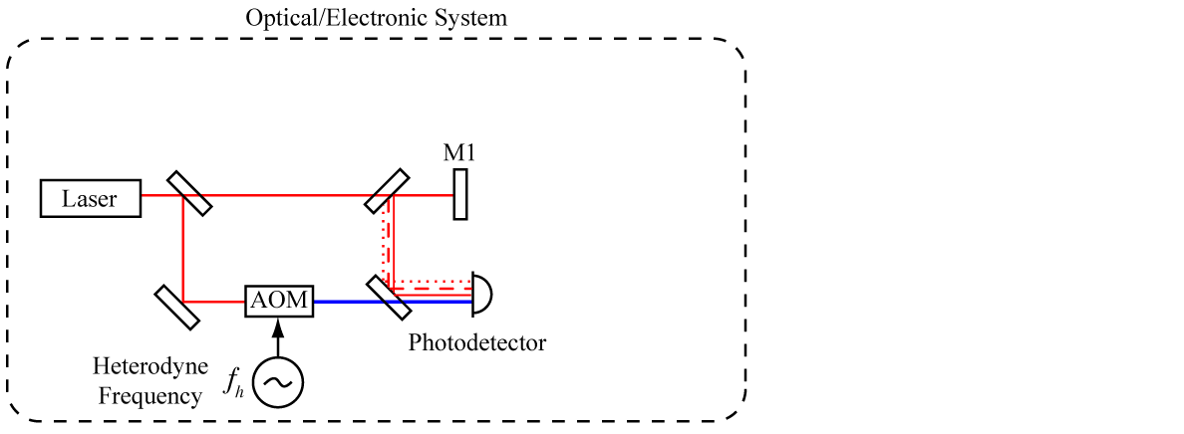
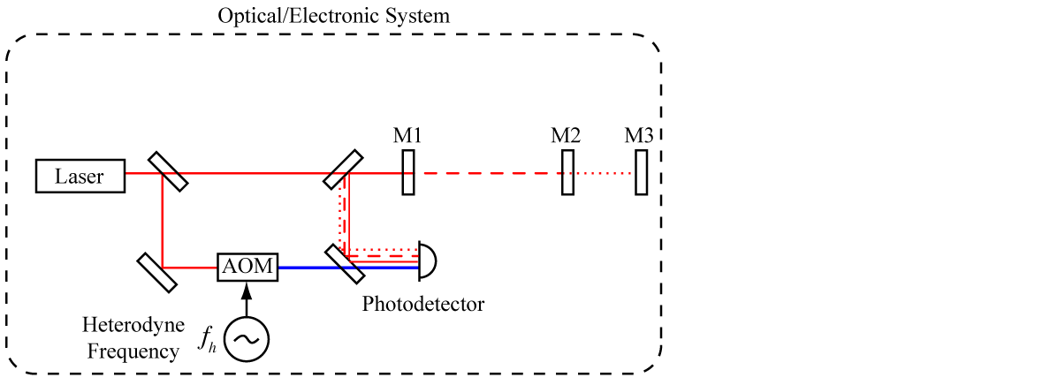


Heterodyne Interferometry
Detected
signal

Slide 6
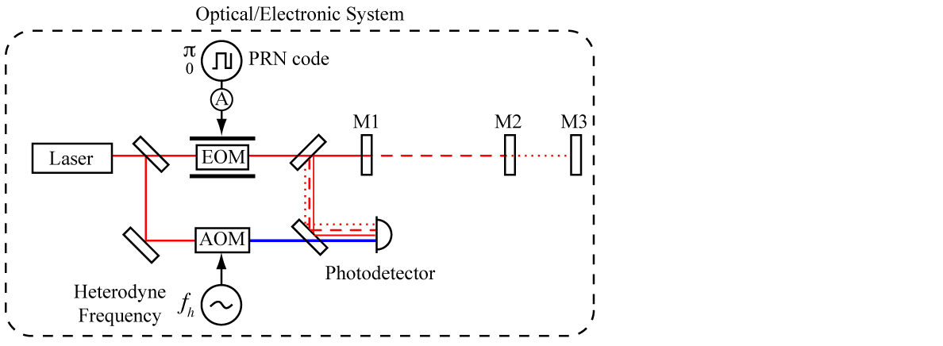
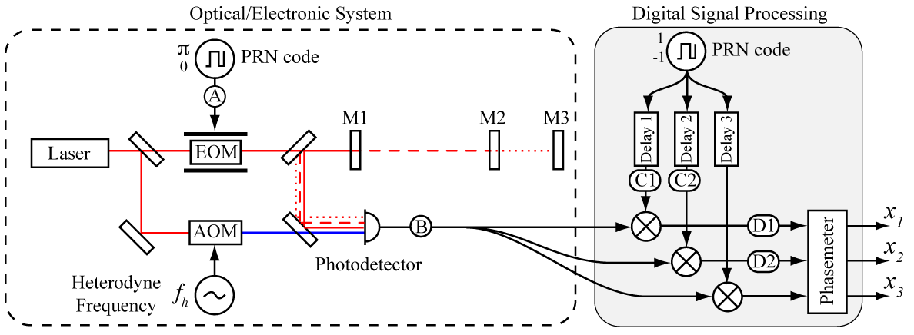
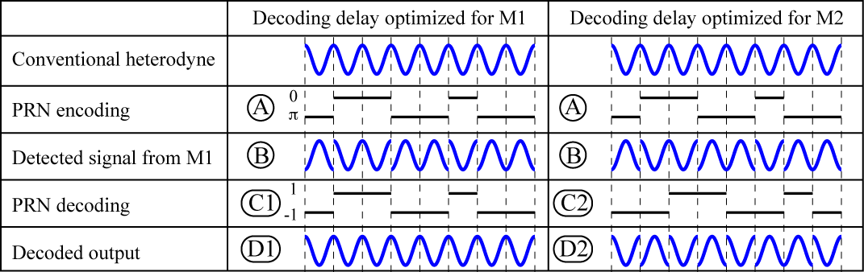
DI Measurement Concept

Slide 7
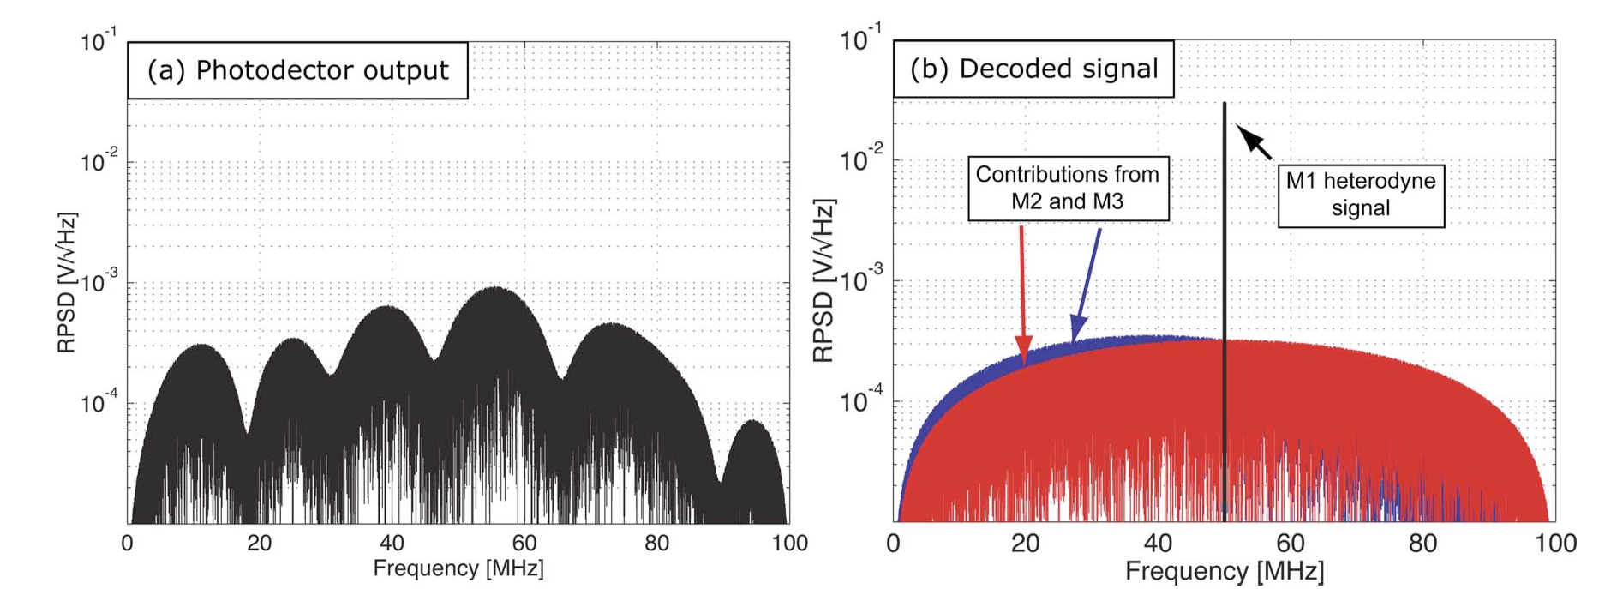
DI Measurement Concept

Slide 8
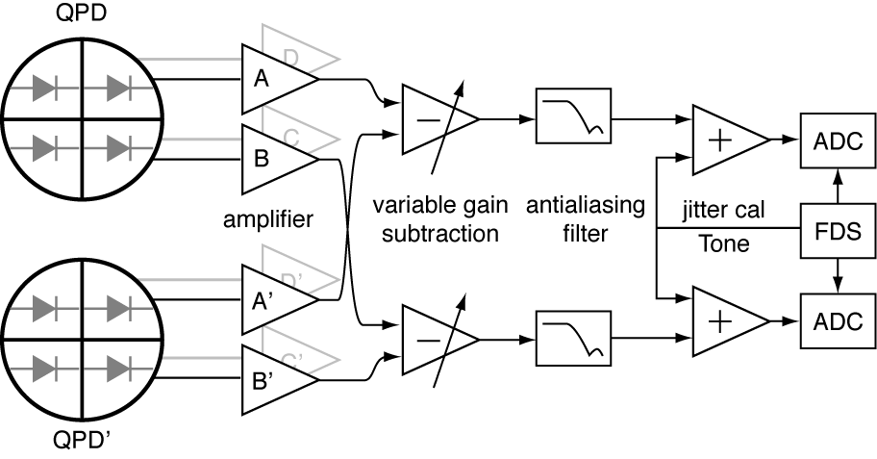
Common mode suppression
In LISA changing phase delays of analog measurement chain are ~10 times larger than allowed.
ADC sampling time jitter
Photodetector phase shift
Thermally driven cable phase delays
Requires a complex calibration system to remove.
Doubles phasemeter channels
Calibrated in post-processing
With DI, common measurement chain gives large common mode suppression of other common error sources.

Slide 9
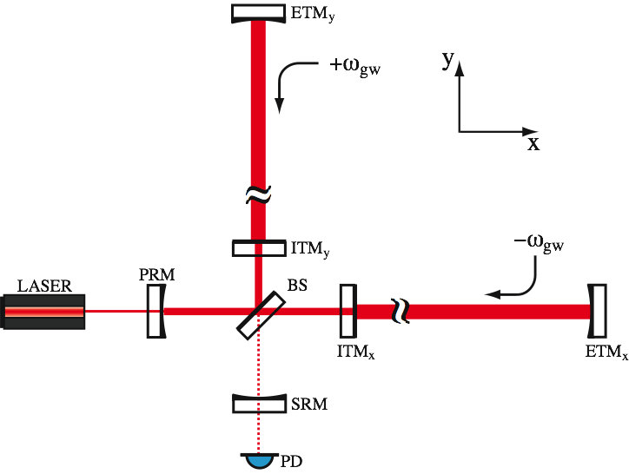
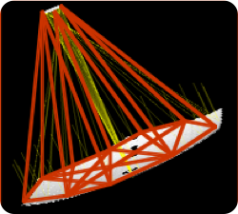
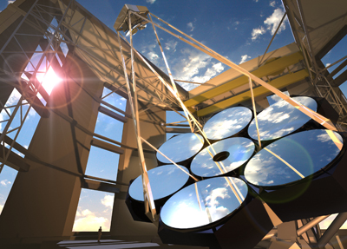
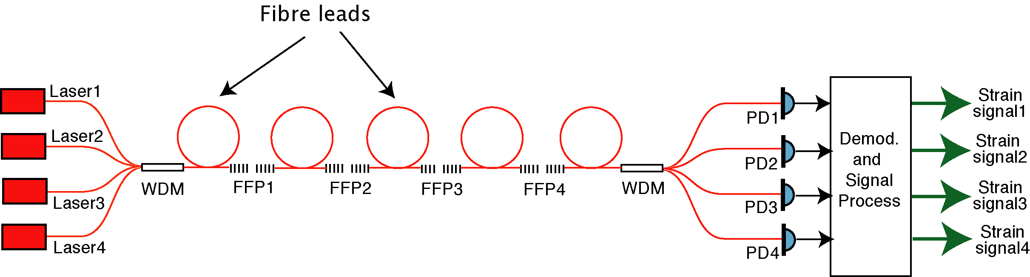
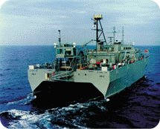
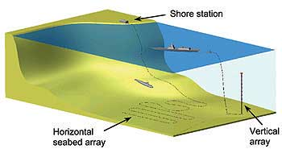
Applications
Interferometer Lock Acquisition
Giant Telescope Control
Fibre sensors
Giant Magellan Telescope

Slide 10
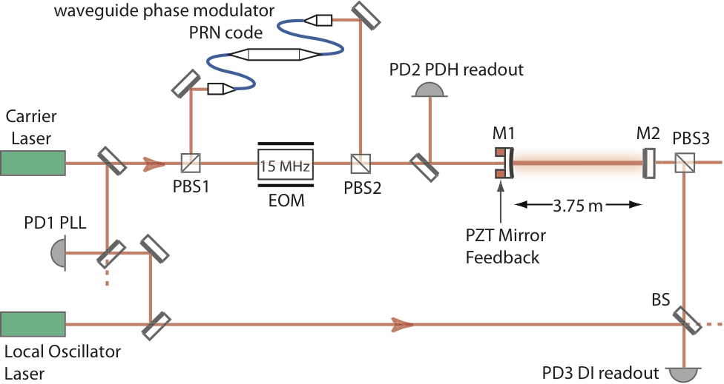
Experimental Test: PDH comparison
Compare concurrent measurements of a cavity displacement made using DI and PDH read outs.
Cavity length determined from two DI measurements.
Phase of single pass field.
Phase of first round-trip field.
Fields are selected by matching the PRN decoding delay to the optical delay.

Slide 11
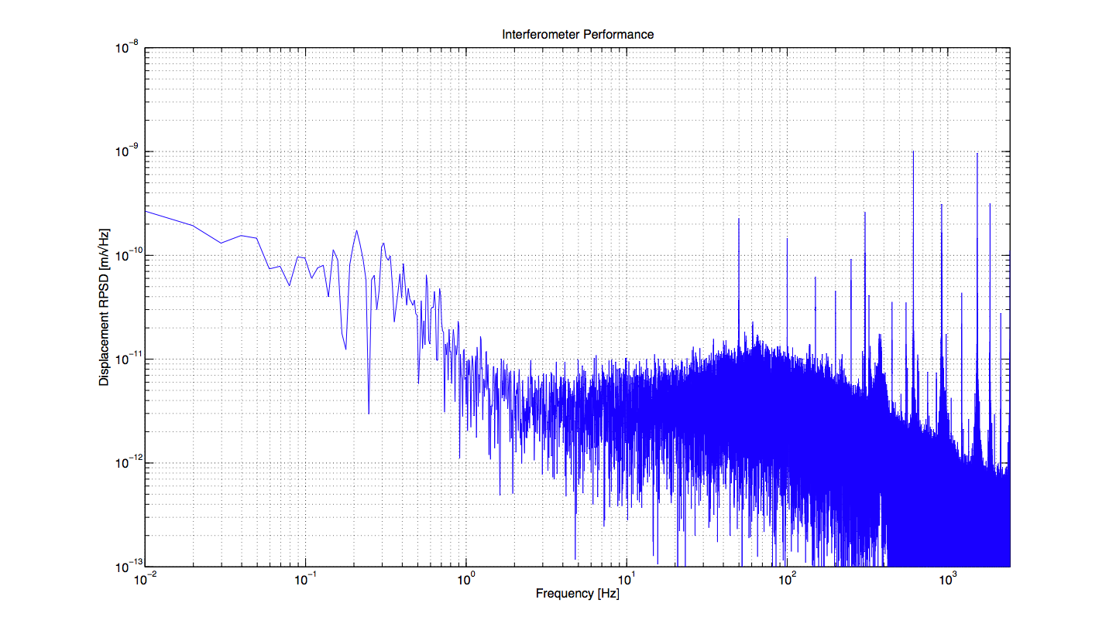
Displacement sensitivity
Locked 3.75 m long cavity to laser and then readout the cavity length using DI.
  Difference of 2 measurements gives an upper limit on the displacement sensitivity of Digital Interferometry.
1 nm/√Hz
10 pm/√Hz
0.01
0.1
1
10
100
1000
Frequency [Hz]
Notes:
Noise hump around 80 Hz is due to (the analog electronics of) the PDH system.

Slide 12
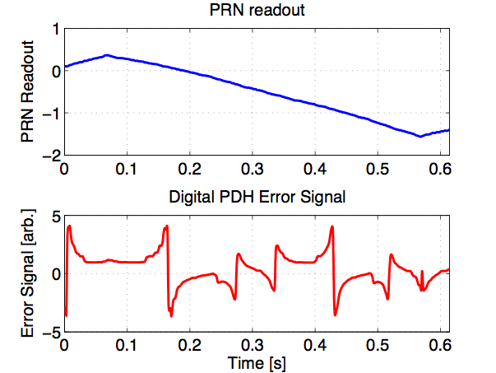
PDH comparison
Compare concurrent measurement of a cavity displacement made using Digital Interferometry with PDH locking.
Scanning cavity PZT with sawtooth signal over more than 1 FSR.
PRN gives full range readout.
PRN and PDH techniques agree to 0.6%.
1 cycle
1 FSR
Notes:
This slide deals mainly with calibration of scale factor.

Slide 13
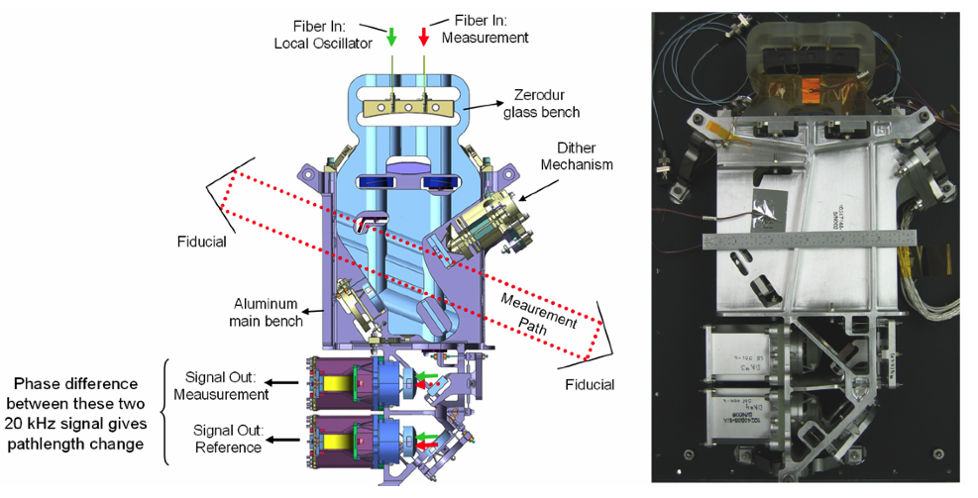
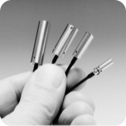
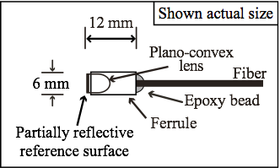
Miniaturisation
fibre tip is the reference surface
fibre coupled injection and detection
photodetection and electronics can be remotely situated

Slide 14
Multiplexing tests
Multiplexed fiber sensor arrays used for oil and gas exploration, defence.
Current approaches use Bragg-grating cavities, PDH readout,
  - 1 laser per “channel” combined with WDM techniques.
With DI we can use 1 laser and simple PC fiber connectors.
Notes:
Heterodyne digital interferometry setup for monitoring length changes of $L_1$, $L_2$, and $L_3$ by tracking reflections from $R_1$, $R_2$, $R_3$, and $R_4$.
to characterize our system, signals injected via PZTs into fibre
in L1: 1 Hz square wave
in L2: 3 Hz triangle wave
in L3: 5 Hz sine wave

Slide 15
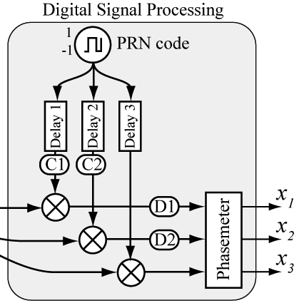
Multiplexing time domain
Difference adjacent signals to get length changes:
R2 - R1 gives L1
R3 - R2 gives L2
R4 - R3 gives L3
Notes:
time domain
real-time readout of displacement of each length
clear recovery of injected signals

Slide 16
Multiplexing: Cross-talk
L2 to L1 cross-talk: < 1e-4
L2 to L3 cross-talk: ~ 2.5e-3
Correlated spectra suggestive of low frequency noise.
Notes:
time domain
real-time readout of displacement of each length
clear recovery of injected signals

Slide 17
Frequency noise immunity
Independent length measurements allow frequency noise subtraction.
  Works even if lengths are different.
Frequency modulation at 5 Hz
Displacement signal at 500 mHz
Frequency noise suppressed
Displacement signal not suppressed
Notes:
-measurement of L2 before & after the subtraction of laser frequency noise (use L1 as “reference” length)
-red: ∂L2 before subtraction, - black: ∂L2 - L2/L1(∂L1)
-modulated the laser’s frequency by 500kHz at 5 Hz to quantify the amount of frequency noise suppression achieved
-this frequency modulation signal is suppressed by a factor of 40 (33dB)
-to operate in ‘frequency free’ mode, you must sacrifice one of your lengths to act as a frequency noise reference
-note any other noise affecting this reference length will couple into the subtraction-thus best to use longest length as the reference length and in a quiet environment
-at low freq we’re prob limited by thermal effects that could be improved with isolation or going into vacuum
-so we can have a system with unequal lengths to be operated in ‘open loop’ without feedback to the laser’s frequency while maintaining immunity to frequency noise

Slide 18
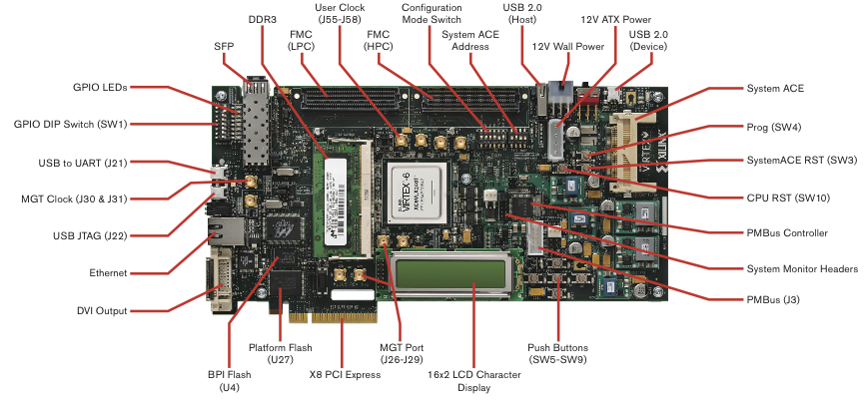
High-speed PRN
The minimum separation of resolvable components is related to the PRN “chipping” frequency.
L_{min} = λ_{PRN}/2 = c/(2f_{PRN})
We were restricted to frequencies < 80 MHz due to limitations of the FPGA technology (LISA-type breadboard hardware), L_{min} ~ 2 m.
New development platform will allow L_{min} ~ 0.1 m.
Xilinx Virtex 6 FPGA with > 1 GHz sampling rate

Slide 19
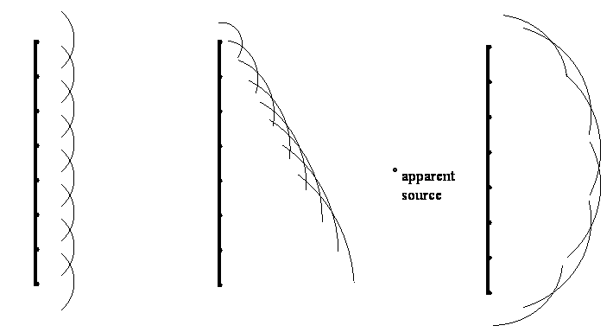
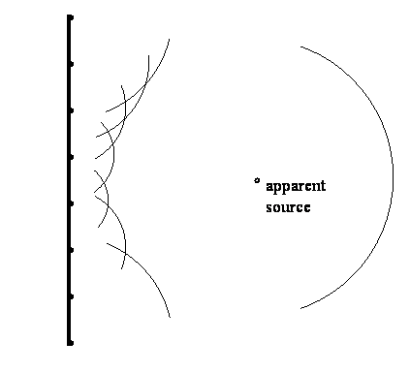
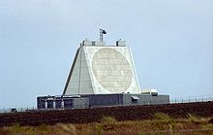
Optical Phased-Arrays
Beam steering, beam forming, ultra-high power, laser redundancy
e.g. defocus for LISA acquisition, adaptive optics for mode shaping.
Many emitters with variable phase differences.
Microwave/RF phased-arrays are a mature technology.
For an optical system, shorter wavelength requires readout and feedback control of the emitter phases.

Slide 20
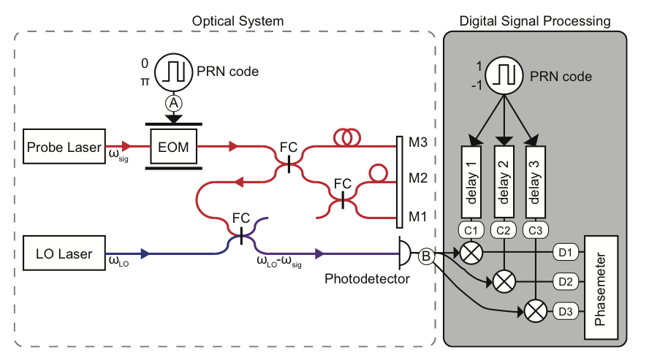
OPA demo Stage 1
First demonstration: 3 element 1D array
DI Milestone: 1st feedback control using DI. Previously only monitoring.

Slide 21
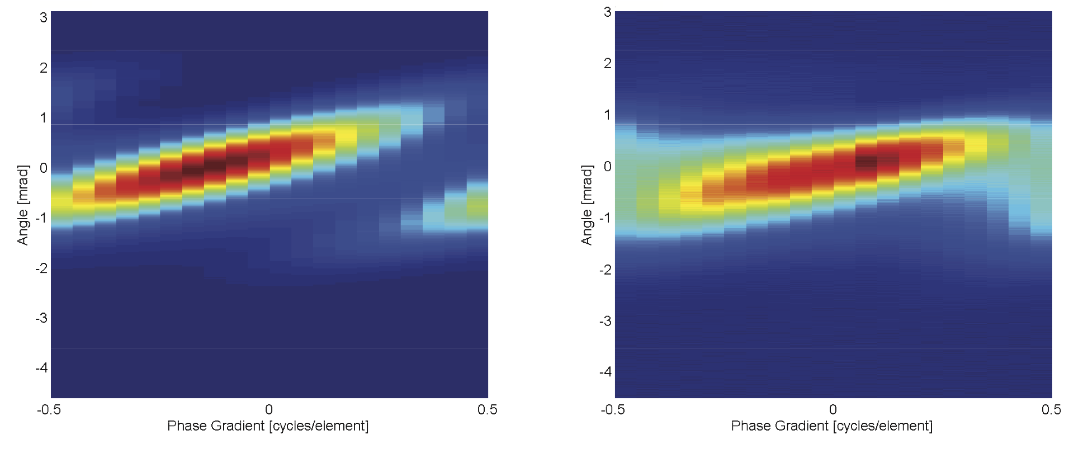
OPA Parameters
Theoretical prediction
Measured

Slide 22
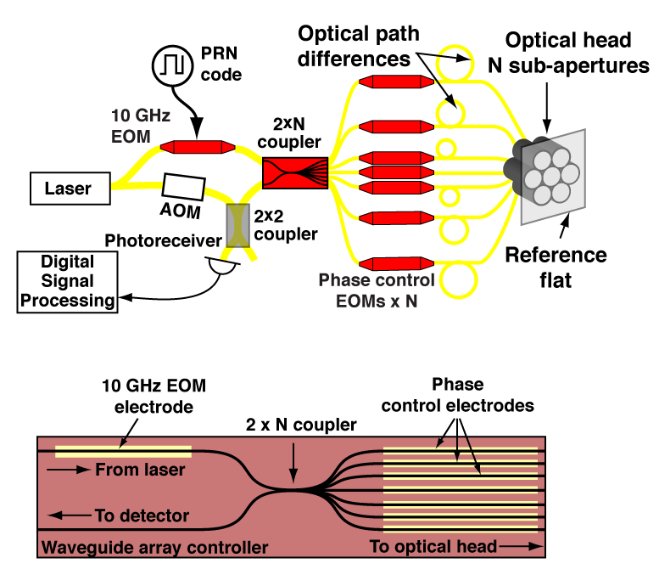
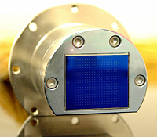

Optical Phased Array Stage 2
Optical phased-array head
~50 emitters possible in a single waveguide
Waveguide modulator and routing

Slide 23
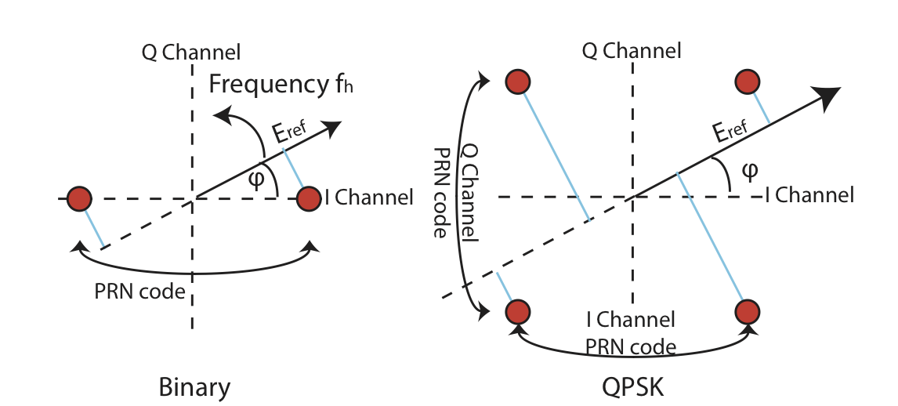
QPSK. The future of DI?
In heterodyne interferometry, LO frequency offset gives constantly changing measurement quadrature (sweep between phase and amplitude quadratures 20 million times/per second).
Alternatively, we could switch between the two quadratures by adding a π/2 phase shift with the PRN modulator.
Now have 4 different PRN modulation levels rather than 2

Slide 24
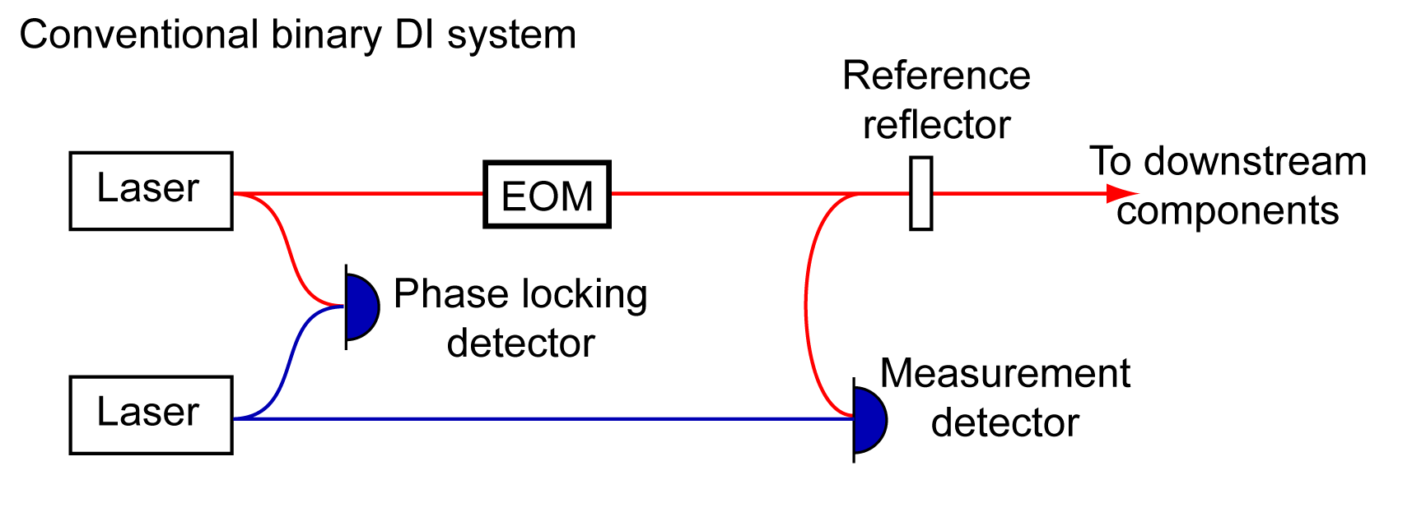
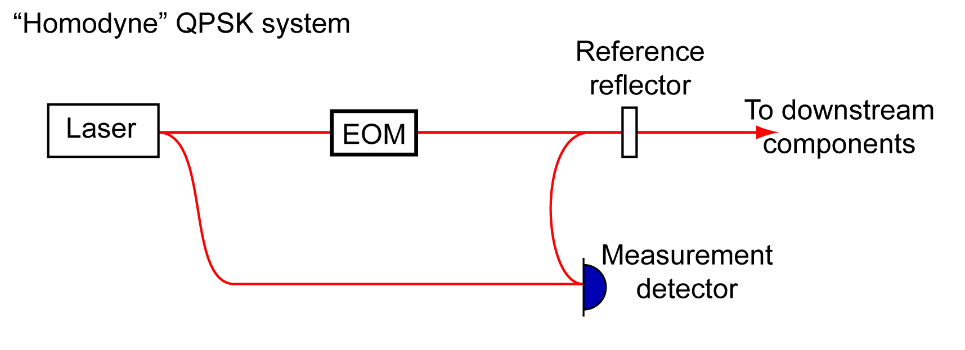
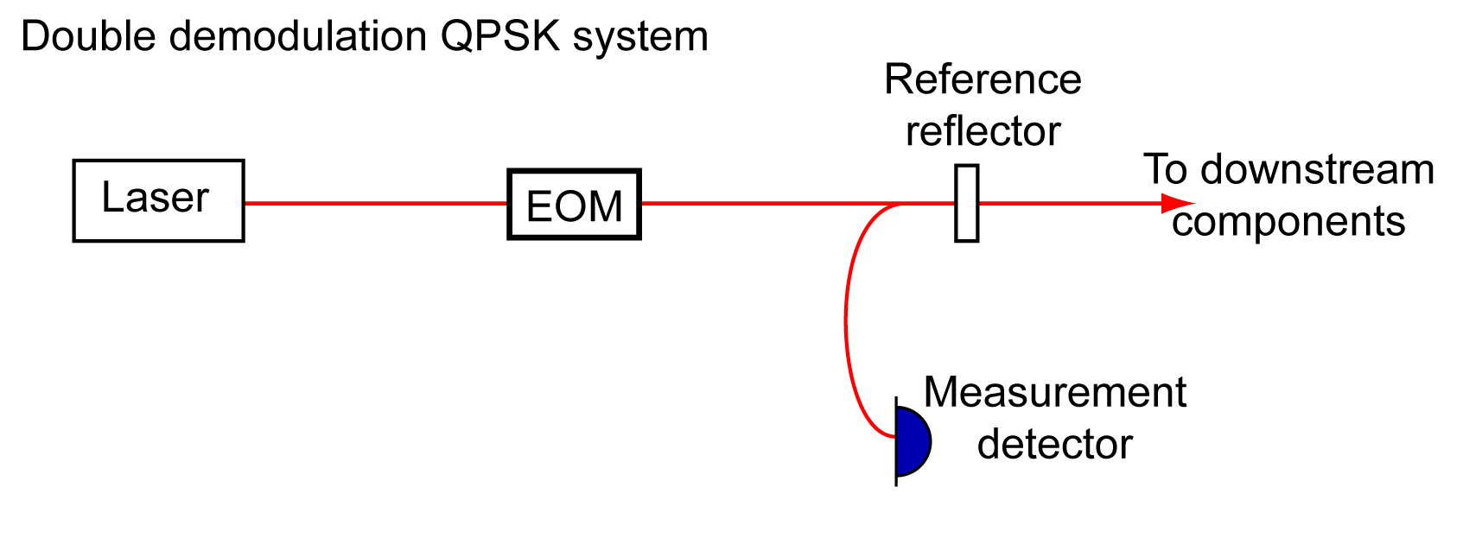
QPSK benefits
QPSK provides further hardware simplifications.
Potentially improved performance (due to lack of second harmonic in the demodulation/decoding process).

Slide 25
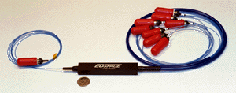
Back to LISA
How could DI be best used in LISA?
LISA philosophy: build with picometre passive stability. Impacts optical bench design, telescope design, thermal stability.
With DI, optical bench could be implemented on a waveguide.
Measure sensitive path lengths and subtract in post-processing.

Slide 26
Summary
Digital Interferometry combines the ultra high sensitivity of optical metrology with the robustness of digital modulation and signal processing.
Transfers optical hardware complexity to digital signal processing
Presented multiplexing measurements made with a single optical head.
Demonstrated 3 pm/√Hz displacement sensitivity with 30 nW of signal power.
Future Prospects
Lots of experiments underway.
Range gate reduced to ~0.1m.
New QPSK version looks very promising.

